Slide 1

Automation for QCA Prerequisites
Module 5: Selenium

Slide 2
Module 5 Objectives
At the end of this module, participants will be able to understand:
Selenium Introduction
Discussion on Selenium Suite
Why WebDriver?
Architecture of WebDriver
Configuring Selenium 2.0 with Eclipse
Working with Selenium 2.0 or WebDriver

Slide 3

Course Map / Module Map
Module 9
Module 8
Module 7
Module 6
Selenium
Module 4
Module 5 Map
Selenium Introduction
Discussion of Selenium Suite
Why WebDriver
Architecture of WebDriver
Configuring Selenium 2.0 with Eclipse
Working with Selenium 2.0 or WebDriver
Hands on Activity
Module 3
Module 2
Module 1

Slide 4
Module 5 - Design Outline
Selenium Introduction
Discussion on Selenium Suite
Why WebDriver?
Configuring Selenium 2.0 with Eclipse
Hands on Activity
Working with Selenium 2.0 / WebDriver
Architecture of WebDriver

Slide 5
Module 5 - Design Outline
Selenium Introduction
Discussion on Selenium Suite
Why WebDriver?
Configuring Selenium 2.0 with Eclipse
Hands on Activity
Working with Selenium 2.0 / WebDriver
Architecture of WebDriver

Slide 6
Selenium Introduction
Selenium is an open-source automation tool.
Selenium is used to automate web applications.
Selenium runs in many browsers like Firefox, Chrome, Opera and IE.
It is platform independent.
Selenium can be controlled by many programming languages like JAVA, C#, Python, Ruby and JavaScript.
Selenium supports different testing frameworks like JUnit and TestNG for Java, NUnit for C#, unittest for Python, Rspec for Ruby.

Slide 7
Module 5 - Design Outline
Selenium Introduction
Discussion on Selenium Suite
Why WebDriver?
Configuring Selenium 2.0 with Eclipse
Hands on Activity
Working with Selenium 2.0 / WebDriver
Architecture of WebDriver

Slide 8
Discussion on Selenium Suite (1 of 3)
Selenium Suite
Selenium IDE
Selenium RC
WebDriver
Selenium Grid
Selenium 2
Merged
Notes:
Selenium Suite has four selenium tools .
Selenium IDE
Selenium RC or Selenium1
Selenium web driver or Selenium 2
Selenium Grid

Slide 9
Discussion on Selenium Suite (2 of 3)
.
Selenium Core
Developed by Jason Huggins in 2004.
It was named as the “JavaScriptTestRunner” and was avaialbe as open source but later rename to Selenium Core.
It is a JavaScript program that would automatically control the browser’s actions.
Selenium IDE
Shinya Kasatani from Japan created Selenium IDE.
It is a Firefox extension that can automate the browser through a record-and-playback mechanism.
Selenium RC
Selenium Remote Control or Selenium 1 is a client/server system that allows tester to control web browsers locally or remotely, using any supported programming language and testing framework.

Slide 10
Discussion on Selenium Suite (3 of 3)
Selenium RC supports complex architecture.
WebDriver
In 2006 Simon Stewart created the WebDriver.
WebDriver is a tool for testing web applications across different browsers using different programming languages
In 2008, Selenium Team merged WebDriver and Selenium RC to form a more powerful tool called Selenium 2.
Selenium Grid
Selenium Grid was developed by Patrick Light body.
Selenium Grid supports concurrent execution of test case, and reduces the execution time.

Slide 11
Module 5 - Design Outline
Selenium Introduction
Discussion on Selenium Suite
Why WebDriver?
Configuring Selenium 2.0 with Eclipse
Hands on Activity
Working with Selenium 2.0 / WebDriver
Architecture of WebDriver

Slide 12
Why WebDriver?
WebDriver is a tool for testing web applications across different browsers using different programming languages.
WebDriver allows us to use a programming language of our choice in designing the tests.
WebDriver is faster than Selenium RC because of its simpler architecture.
WebDriver directly talks to the browser while Selenium RC needs the help of the RC Server in order to do so.
WebDriver’s API is more concise than Selenium RC’s.
WebDriver can support HtmlUnit while Selenium RC cannot.

Slide 13
Module 5 - Design Outline
Selenium Introduction
Discussion on Selenium Suite
Why WebDriver?
Configuring Selenium 2.0 with Eclipse
Hands on Activity
Working with Selenium 2.0 / WebDriver
Architecture of WebDriver

Slide 14
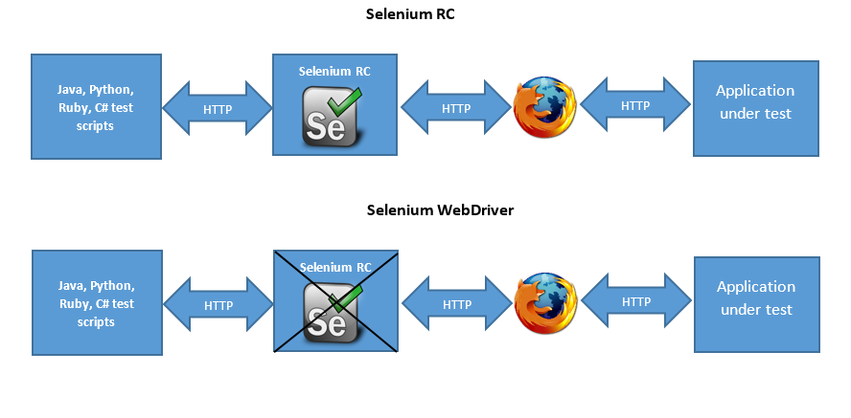
Architecture of WebDriver
Notes:
Selenium 2 is the combination of Selenium RC and Selenium web driver.
Selenium RC interacts with browser only through intermediate server. Due to this, the architecture of RC is very complex.
To overcome this complexities, Selenium web driver was designed which interacts with browser natively, without using the support of selenium server.
Web driver has driver for each browser to drive the automation testing.
The web driver API are completely object oriented which makes the interaction much simpler with different bowsers.

Slide 15
Module 5 - Design Outline
Selenium Introduction
Discussion on Selenium Suite
Why WebDriver?
Configuring Selenium 2.0 with Eclipse
Hands on Activity
Working with Selenium 2.0 / WebDriver
Architecture of WebDriver

Slide 16
******** Configuring Selenium 2.0 with Eclipse (1 of 5)
Selenium installation is setting up a project in development IDE, so that we can write programs using Selenium API’s. This depends on the programming language and development environment.
Follow the below steps to develop Selenium-WebDriver Java scripts:
Step1: Install Java
Download and install the Java Software Development Kit (JDK 1.6 or later) .
The JDK version comes bundled with Java Runtime Environment (JRE)
URL : http://www.oracle.com/technetwork/java/javase/downloads/jdk8-downloads-2133151.html

Slide 17
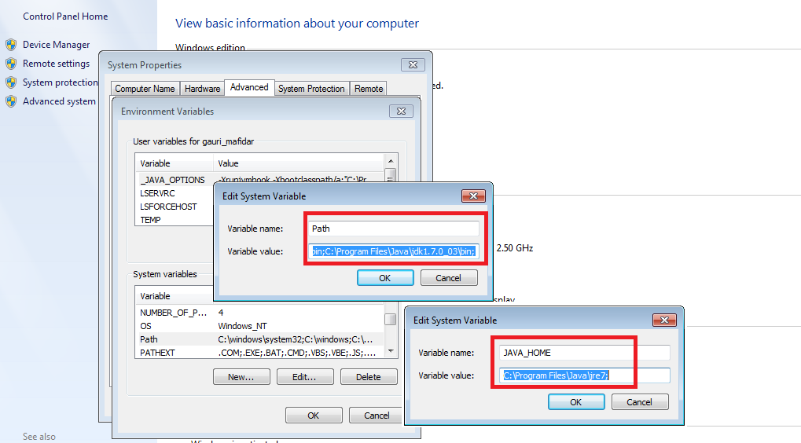
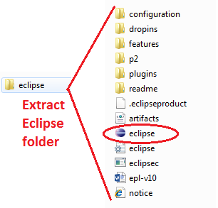
Configuring Selenium 2.0 with Eclipse (2 of 5)
Step 2: Set the Path and JAVA_HOME environment variables.
Step 3: Download Eclipse IDE for Java. Simply extract the zip file. The extracted folder contents are as shown below. Double click in the eclipse icon to start eclipse IDE.

Slide 18
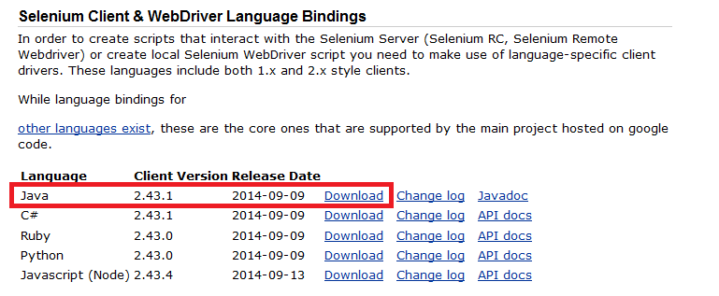

Configuring Selenium 2.0 with Eclipse (3 of 5)
Step 4: Download the Selenium Java Client Driver from the following location www.seleniumhq.org/download (Here we will download the Selenium Java Client Driver.) .
Client drivers for different languages are available, but we need to choose the one for Java. This download comes as a ZIP file. Extract the contents of this ZIP file. The extracted directory contains all the JAR files that we would later import in Eclipse.

Slide 19
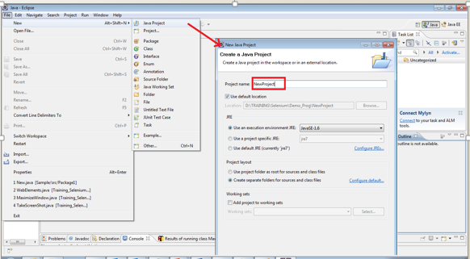
Configuring Selenium 2.0 with Eclipse (4 of 5)
Create a new Java project in Eclipse

Slide 20
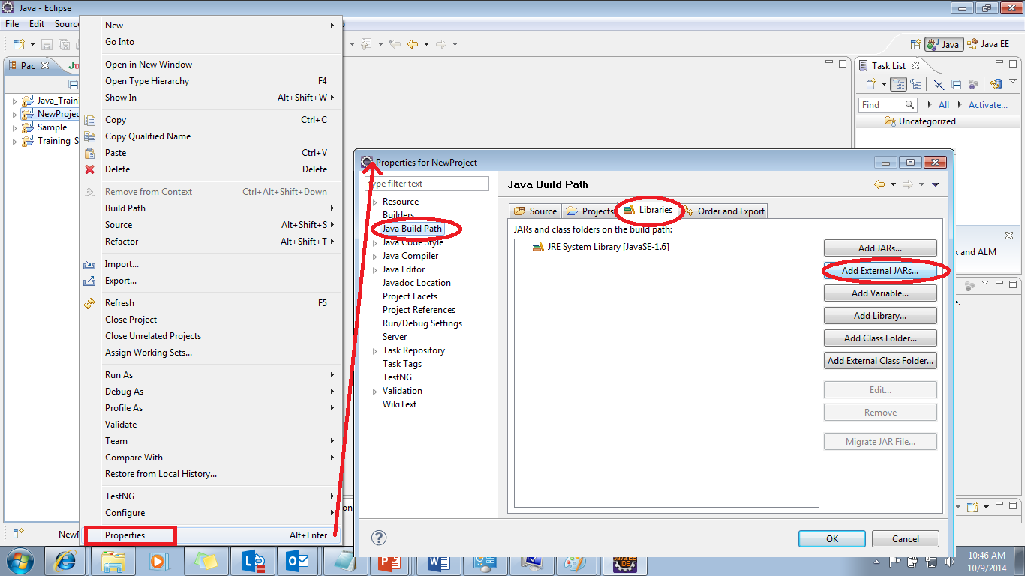
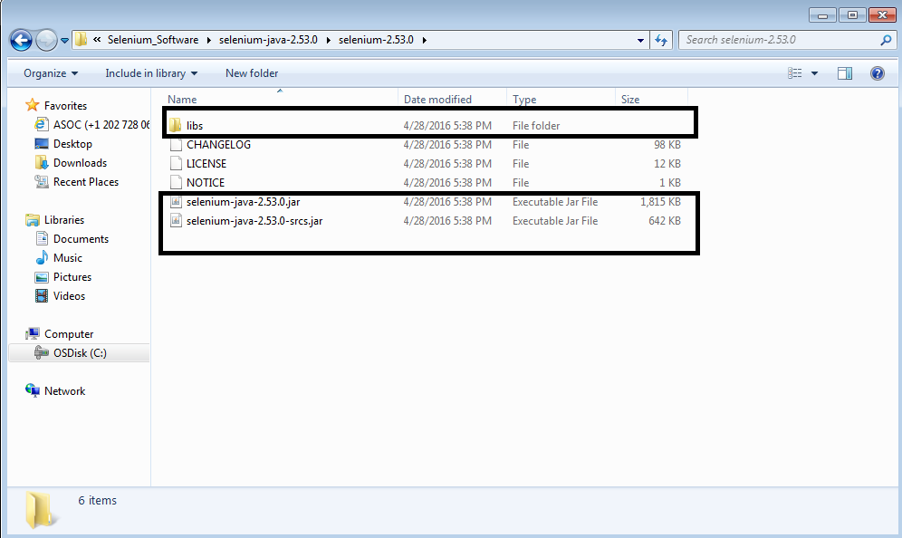
Configuring Selenium 2.0 with Eclipse (5 of 5)
Configure the downloaded Selenium jar files with the project. Right click the project→ Properties →Java build path →Libraries →Add External JARs

Slide 21
Module 5 - Design Outline
Selenium Introduction
Discussion on Selenium Suite
Why WebDriver?
Configuring Selenium 2.0 with Eclipse
Hands on Activity
Working with Selenium 2.0 / WebDriver
Architecture of WebDriver

Slide 22
Working with Selenium 2.0 / WebDriver (1 of 9)
WebDriver API
WebDriver
[Interface]
Internet Explorer
Driver
[Class]
ChromeDriver
[Class]
FirefoxDriver
[Class]
HtmlUnit
Driver
[Class]
Notes:
Selenium web driver API is completely object oriented and makes interaction with different bowsers.
It has a Web driver Interface which is implemented in FirefoxDriver class, InternetExplorer class, Chrome Driver class, etc.
Using the Web driver Interface , a driver instance is created for FirefoxDriver class, InternetExplorer class, Chrome Driver class, etc.
The web driver instance is used to drive the automation testing for that corresponding browsers.

Slide 23
Working with Selenium 2.0 / WebDriver (2 of 9)
Selenium Web driver API commands makes user flexible to do automation testing for web applications.
It provides a friendly API which is easy to explore and make your test simple to read and maintain.
By adding Selenium jar to Eclipse project, selenium web driver acts as normal library function.
Web driver is entirely independent , it does not require any additional processes like starting the server in Selenium RC.

Slide 24
Working with Selenium 2.0 / WebDriver (5 of 9)
Create Java Project :
In Eclipse, File->Java project-> Enter Project Name: Selenium_Module
Click “Finish” button
Click "Yes“ button

Slide 25
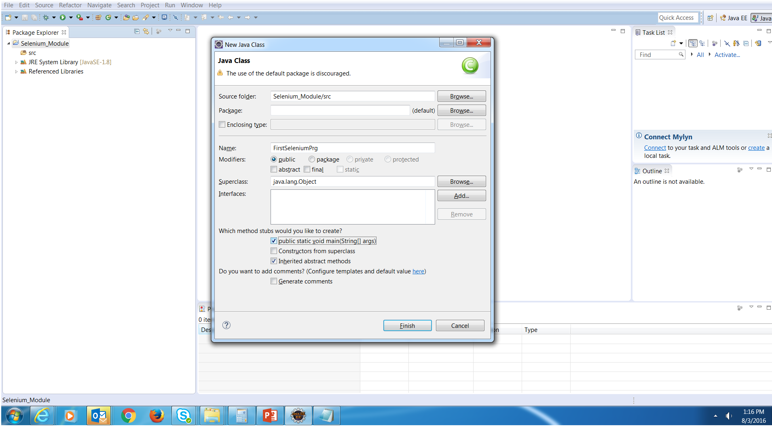
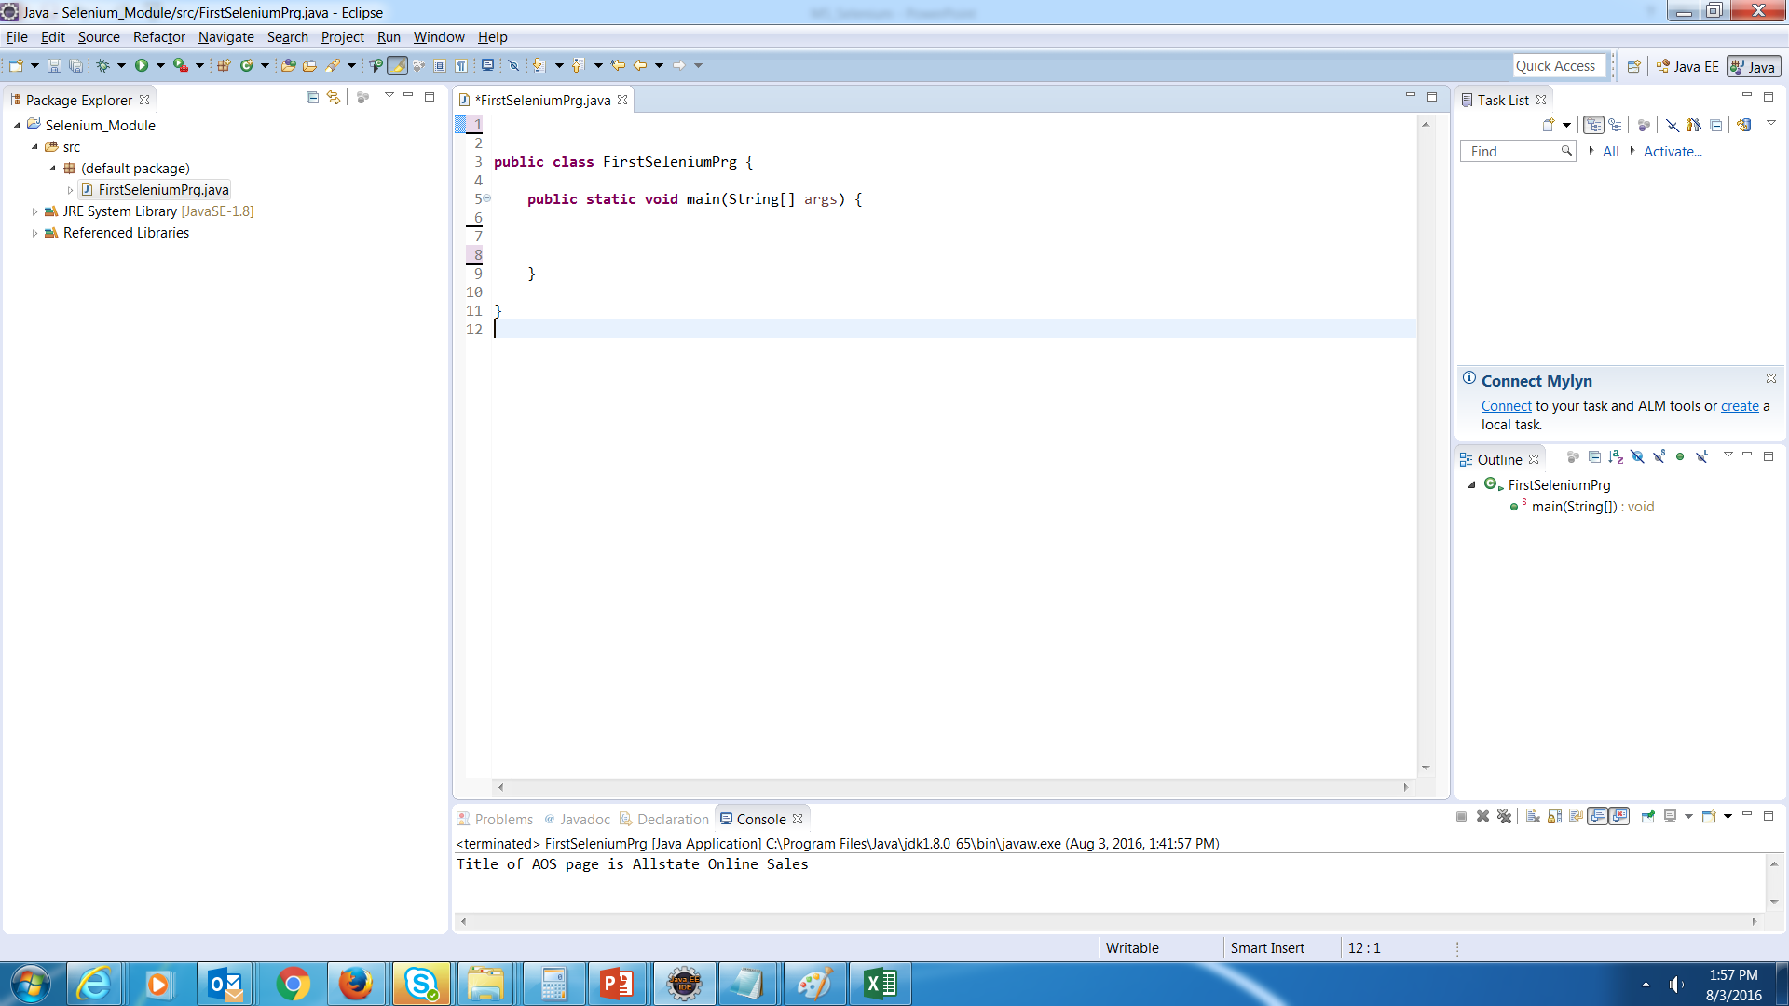
Working with Selenium 2.0 / WebDriver (6 of 9)
Steps Create Java Class:
In Eclipse, Select the "Selenium_Module" folder and right click
Select New->Class
Enter Class Name: FirstSeleniumPrg
Select "public static void main(String[] args)" check box
Click on “Finish” button

Slide 26
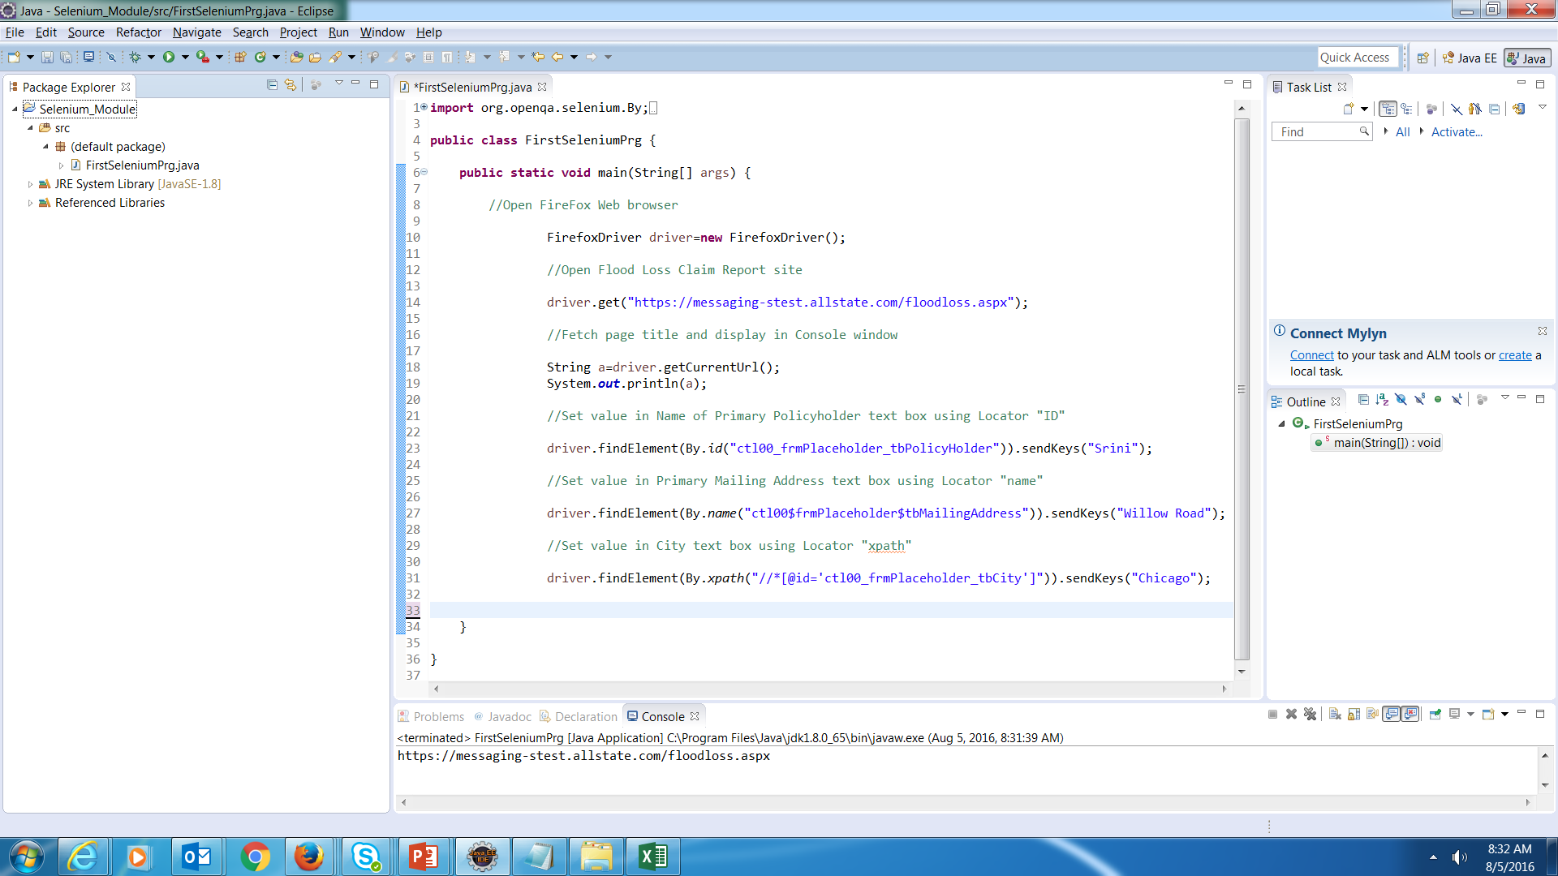
Working with Selenium 2.0 / WebDriver (7 of 9)
Notes:
import org.openqa.selenium.By;
import org.openqa.selenium.firefox.FirefoxDriver;
public class FirstSeleniumPrg {
public static void main(String[] args) {
//Open FireFox Web browser
FirefoxDriver driver=new FirefoxDriver();
//Open Allstate online Sales (AOS) site using get() method
driver.get("https://purchase-stest.allstate.com/onlinesalesweb/app/auto/");
//Fetch page title and display in Console window
String title=driver.getTitle();
System.out.println( "Title of AOS page is " + title);
//Set value in First Name text box using Locator "ID"
driver.findElement(By.id("first_name")).sendKeys("Srini");
//Set value in Last Name text box using Locator "name"
driver.findElement(By.name("lastName")).sendKeys("Muvva");
//Set value in Last Name text box using Locator "xpath"
driver.findElement(By.xpath("//*[@id='mailing_address']")).sendKeys(" Willow Road");
}
}

Slide 27
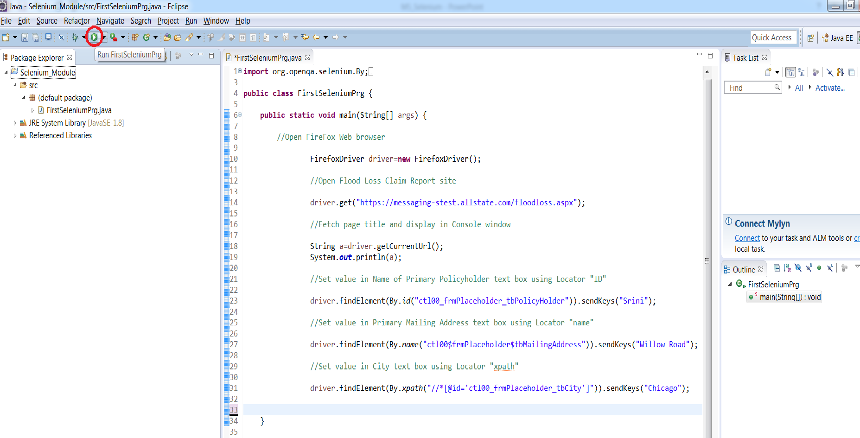
Working with Selenium 2.0 / WebDriver (8 of 9)
Steps to execute Selenium Program
Select “FirstSeleniumPrg” class and Click on Run icon

Slide 28
Working with Selenium 2.0 / WebDriver (3 of 9)
Below are the basic Selenium web driver API commands
Commands | Description
get() | It is used to launch new browser instance and open the URL passed as parameter to the command. It is similar as open command in IDE
getTitle() | It is used to fetch the title of current web page. No parameter is required
Sendkeys() | It is used to send one or more keystrokes to the active window same as typed in keyboard. It accepts string as parameter
Close() | It closes the current browser window focused by web driver
Quit() | It closes entire browser window and web driver will completely get shutdown.
Window.maximize() | It is used to maximize the browser window

Slide 29
Working with Selenium 2.0 / WebDriver (4 of 9)
Web Elements are located by different locators as shown below
Locators | Description | Example
By ID | Find element by value of its “id” attribute | driver.findElement(By.id("someId"))
By Name | Find element by value of its “name” attribute | driver.findElement(By.name("somename”))
By Class | Find element by value of its “class” attribute | driver.findElement(By.cssSelector(“classname”))
By link | Find element by value of its “link” attribute | driver.findElement(By.linkText(“linkname”))
By Xpath | Find element by its xpath | driver.findElement(By.xpath(“xpath”))

Slide 30
Module 5 - Design Outline
Selenium Introduction
Discussion on Selenium Suite
Why WebDriver?
Configuring Selenium 2.0 with Eclipse
Hands on Activity
Working with Selenium 2.0 / WebDriver
Architecture of WebDriver

Slide 31

Activity 1
Environment or File: M5_Selenium_Activity_PG_v1
Steps:
Open the Participants Guide given as word document.
Read the given activity details.
Complete the activities
Submit to faculty
Activity

Slide 32
Summary
At the end of this module, participants are able to understand:
Introduction to Selenium
Discussion on Selenium Suite
Why WebDriver?
Architecture of WebDriver
How to configure Selenium 2.0 with Eclipse
How to work with Selenium 2.0 or WebDriver

Slide 33


