Slide 1
ChIP-seq analysis – D. Puthier
Adapted from “Aviesan Bioinformatic School” (M. Defrance, C. Herrmann, S. Le Gras, J. van Helden, D. Puthier, M. Thomas.Chollier)

Slide 2
About transcriptional regulation and epigenetics

Slide 3
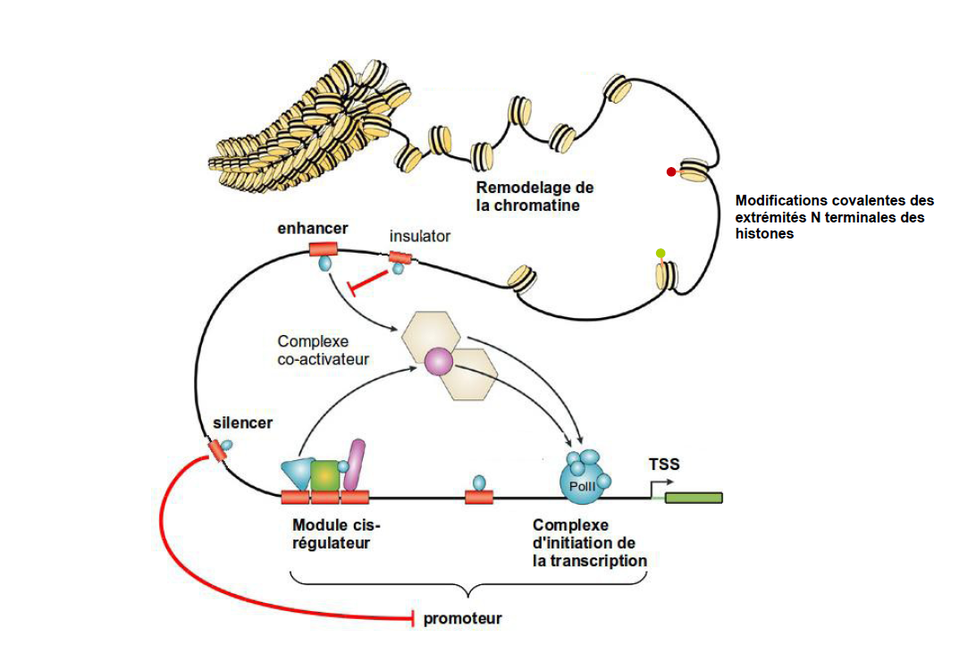
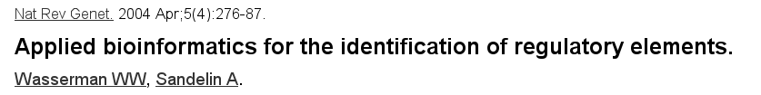
A model of transcriptional regulation

Slide 4
Chromatin constraints
Each diploid cell contains about 2 meters of DNA
  High level of compaction required
  Accessibility required
    Replication
    Transcription
    DNA repair
Specific machinery required

Slide 5
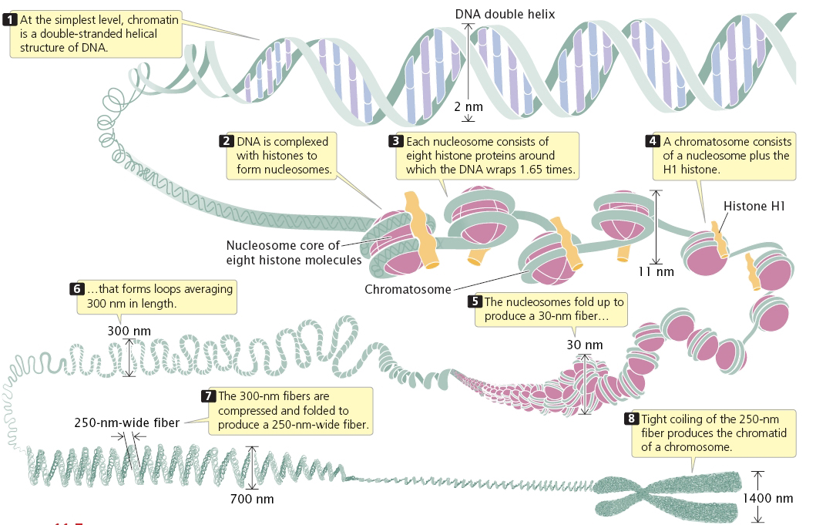
Chromatin has highly complex structure with several levels of organization
2005. Genetics: A Conceptual Approach, 2nd ed.
Notes:
H2A, H2B, H3,H4 x2

Slide 6
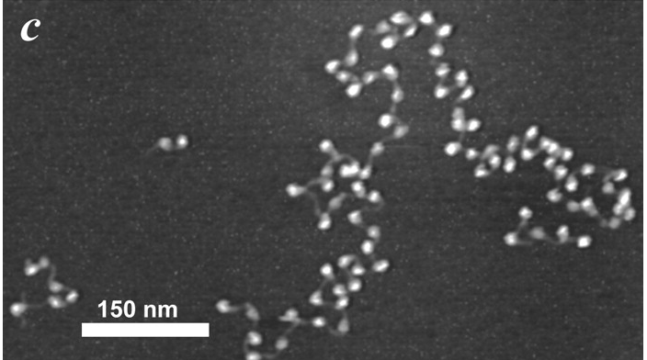

Beads on a string
Figure 4: Chromatin fibers purified from chicken erythrocytes. Each nucleosome (~12-15 nm) is well resolved, along with the linker DNA between the nucleosomes. Given the resolution, other components, if present, such as a transcribing RNA polymerase or transcription factor complexes, should be resolvable

Slide 7
Histones and nucleosomes
Histones
  Small proteins (11-22 kDa)
  Highly conserved
  Basic (Arginine et Lysine)
  N-terminal tails subject to post translational modification
Nucleosome
  Octamers of histone
    (H2A,H2B,H3,H4) x 2
  146bp DNA

Slide 8
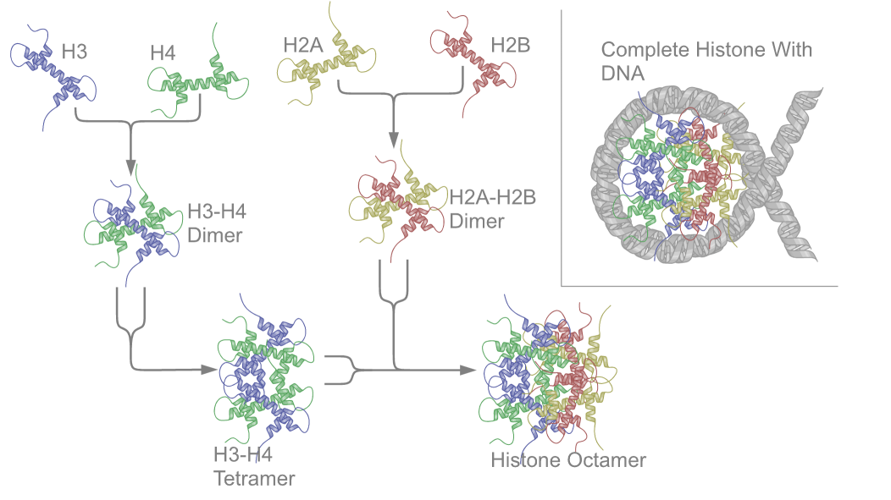
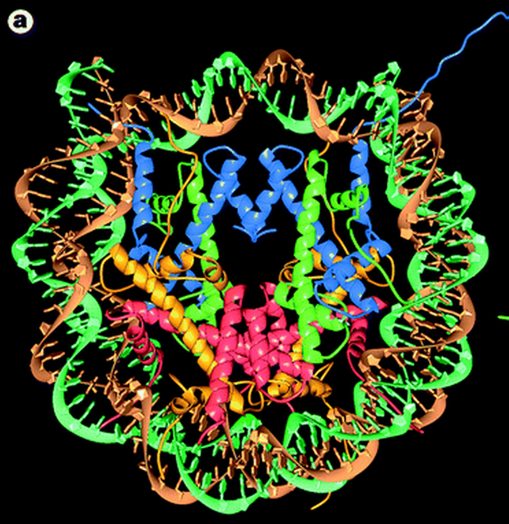

Nucleosome structure

Slide 9
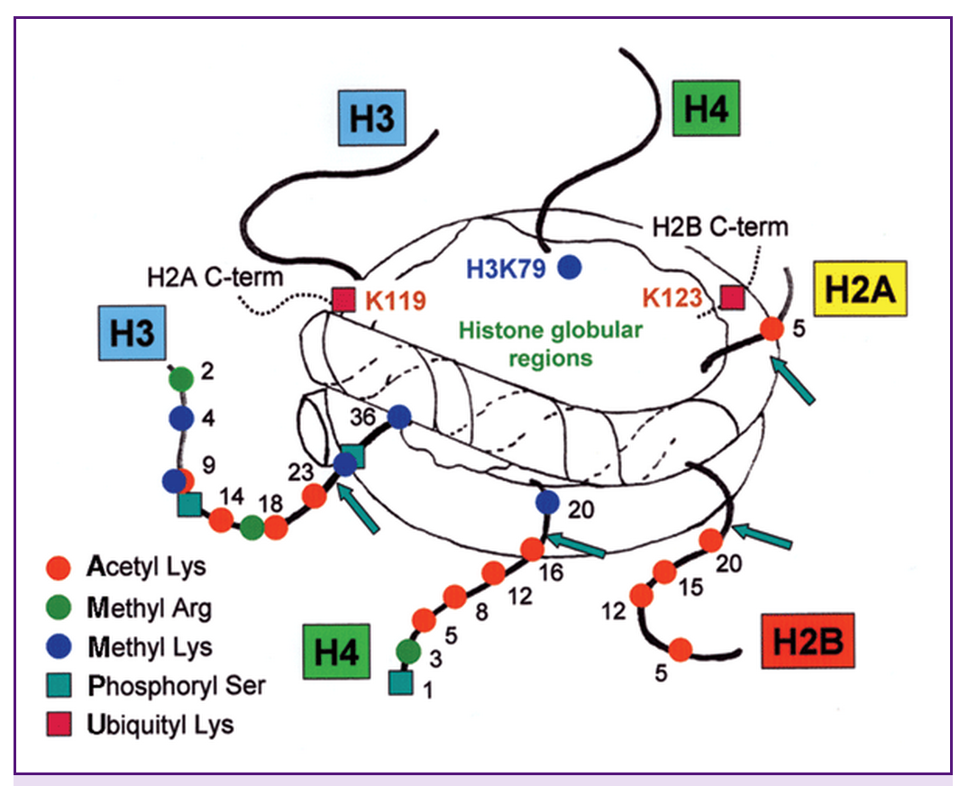
Histone post translational modification
Lysine acetylation
Lysine methylation
Arginine methylation
Serine phosphorylation
Threonine phosphorylation
ADP-ribosylation
Ubiquitylation
Sumoylation
...

Slide 10
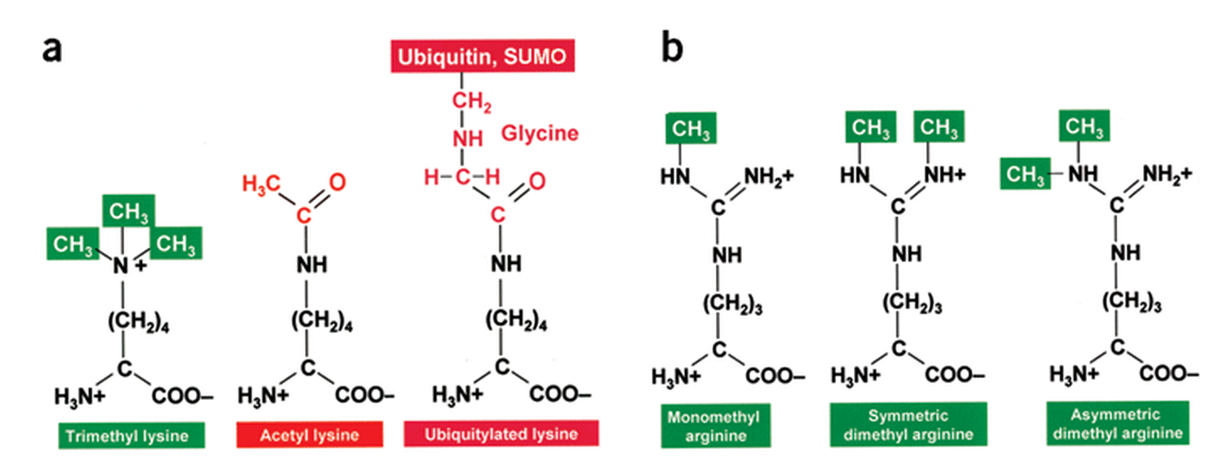
Some alternative modifications

Slide 11
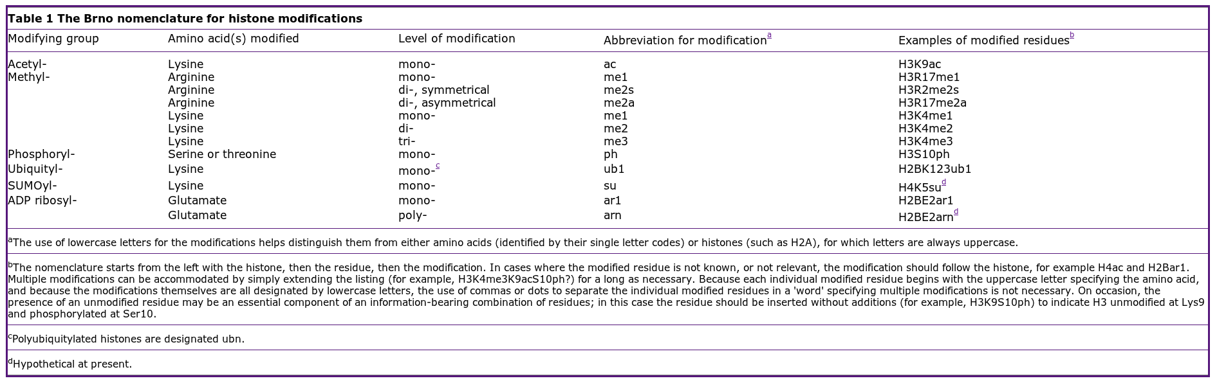
The Brno nomenclature
The nomenclature set out here was devised following the first meeting of the Epigenome Network of Excellence (NoE), at the Mendel Abbey in Brno, Czech Republic. For this reason, it can be referred to as the Brno nomenclature.

Slide 12
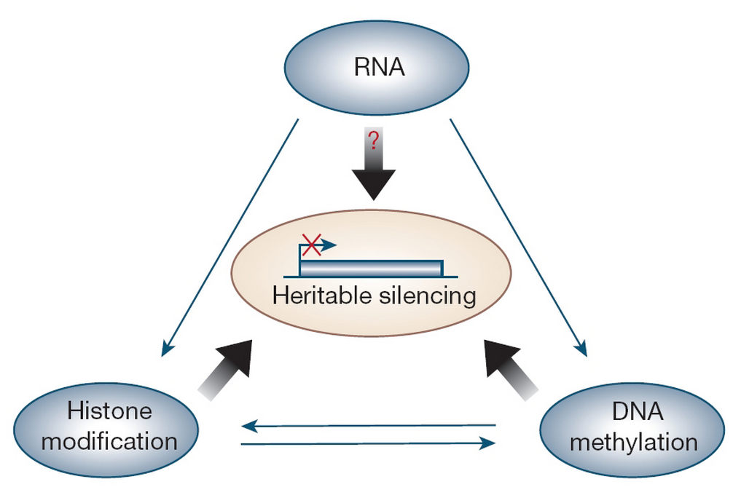

Epigenetic
Epigenetics involves genetic control by factors other than an individual's DNA sequence
  Histone modifications
  DNA methylation
Epigenetic modifications may be inherited mitotically or meiotically

Slide 13
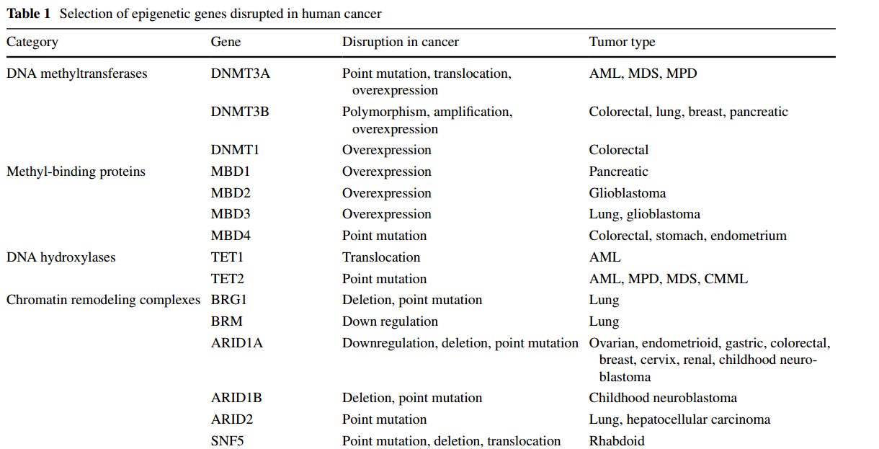
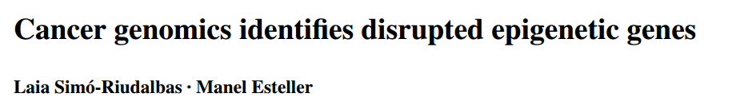
Epigenetic and cancer

Slide 14
Chromatine immuno-precipitation (ChIP)
Used for:
  TF localization
  Histone modifications

Slide 15
Data processing
& file formats

Slide 16
Fastq file format
Header
Sequence
+ (optional header)
Quality (default Sanger-style)
@QSEQ32.249996 HWUSI-EAS1691:3:1:17036:13000#0/1 PF=0 length=36
GGGGGTCATCATCATTTGATCTGGGAAAGGCTACTG
+
=.+5:<<<<>AA?0A>;A*A################
@QSEQ32.249997 HWUSI-EAS1691:3:1:17257:12994#0/1 PF=1 length=36
TGTACAACAACAACCTGAATGGCATACTGGTTGCTG
+
DDDD<BDBDB??BB*DD:D#################

Slide 17
Sanger quality score
Sanger quality score (Phred quality score): Measure the quality of each base call
  Based on p, the probality of error (the probability that the corresponding base call is incorrect)
  Qsanger= -10*log10(p)
  p = 0.01 <=> Qsanger 20
Quality score are in ASCII 33
Note that SRA has adopted Sanger quality score although original fastq files may use different quality score (see: http://en.wikipedia.org/wiki/FASTQ_format)

Slide 18
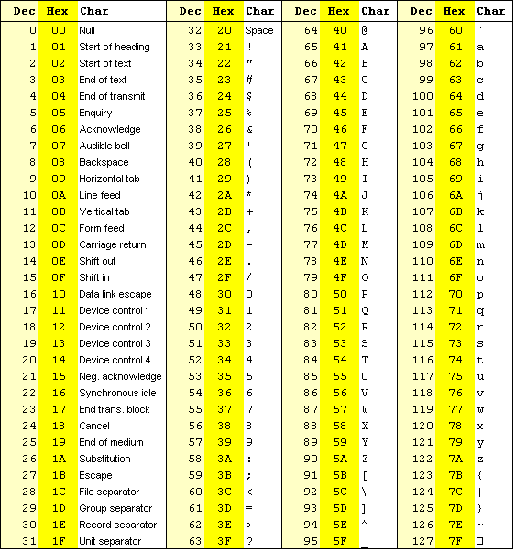
ASCII 33
Storing PHRED scores as single characters gave a simple and space efficient encoding:
Character ”!” means a quality of 0
Range 0-40

Slide 19
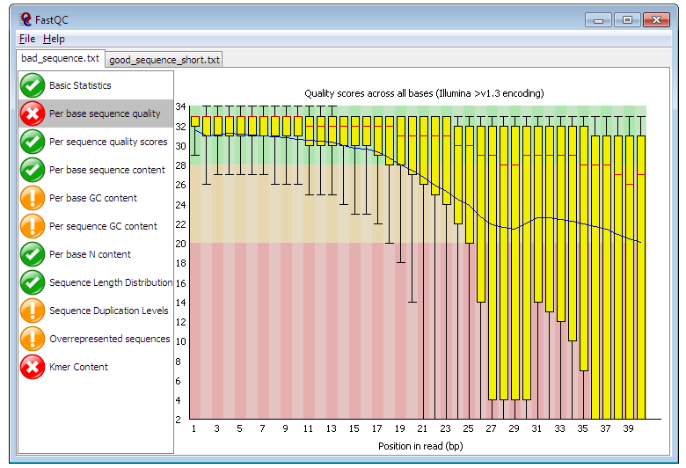
Quality control for high throughput sequence data
FastQC
  GUI / command line
  http://www.bioinformatics.bbsrc.ac.uk/projects/fastqc
  ShortRead
    Bioconductor package

Slide 20
Trimming
Depending on the aligner this step can be mandatory
Tools
  FASTX-Toolkit
  Sickle
    Window-based trimming (unpublished)
  ShortRead
    Bioconductor package
  ...

Slide 21
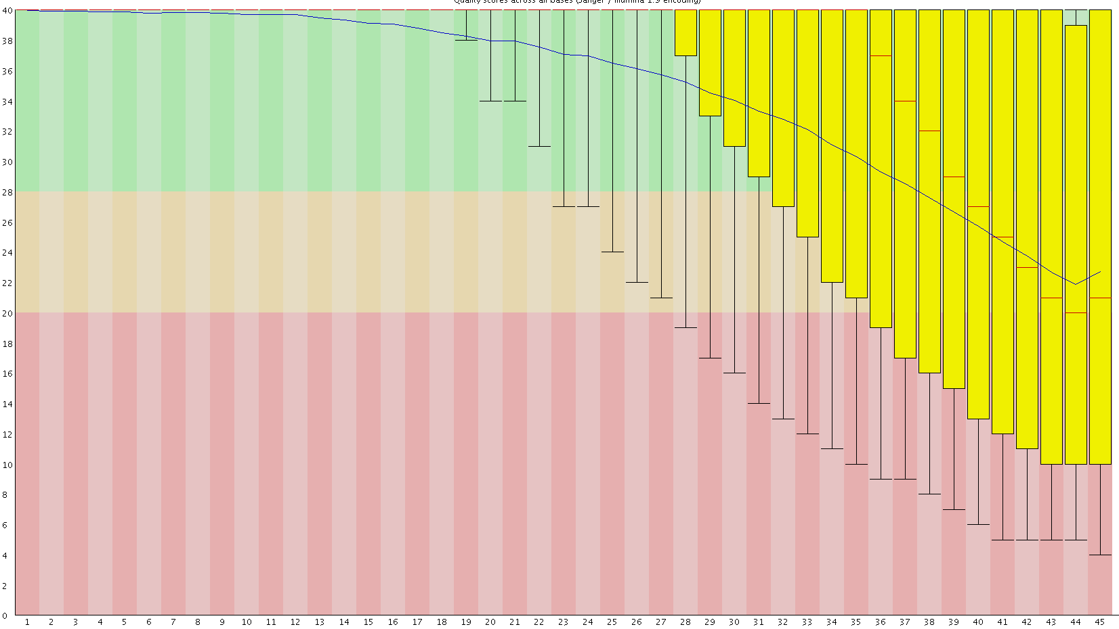
Quality control with FastQC
Quality
Position in read

Slide 22
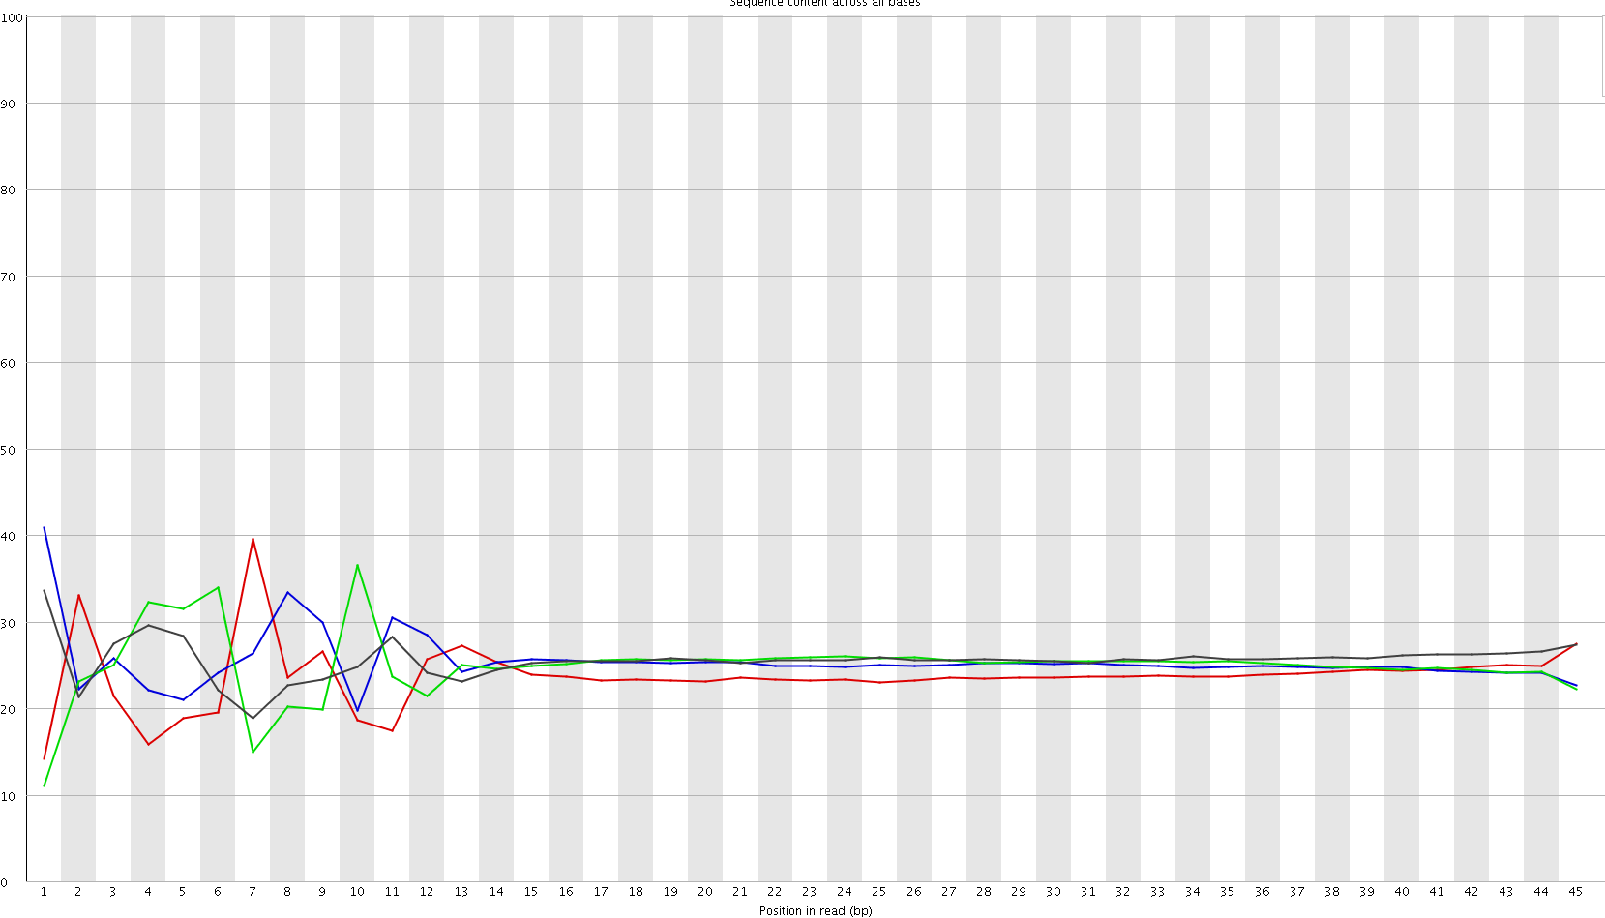

Quality control with FastQC
Position in read

Slide 23
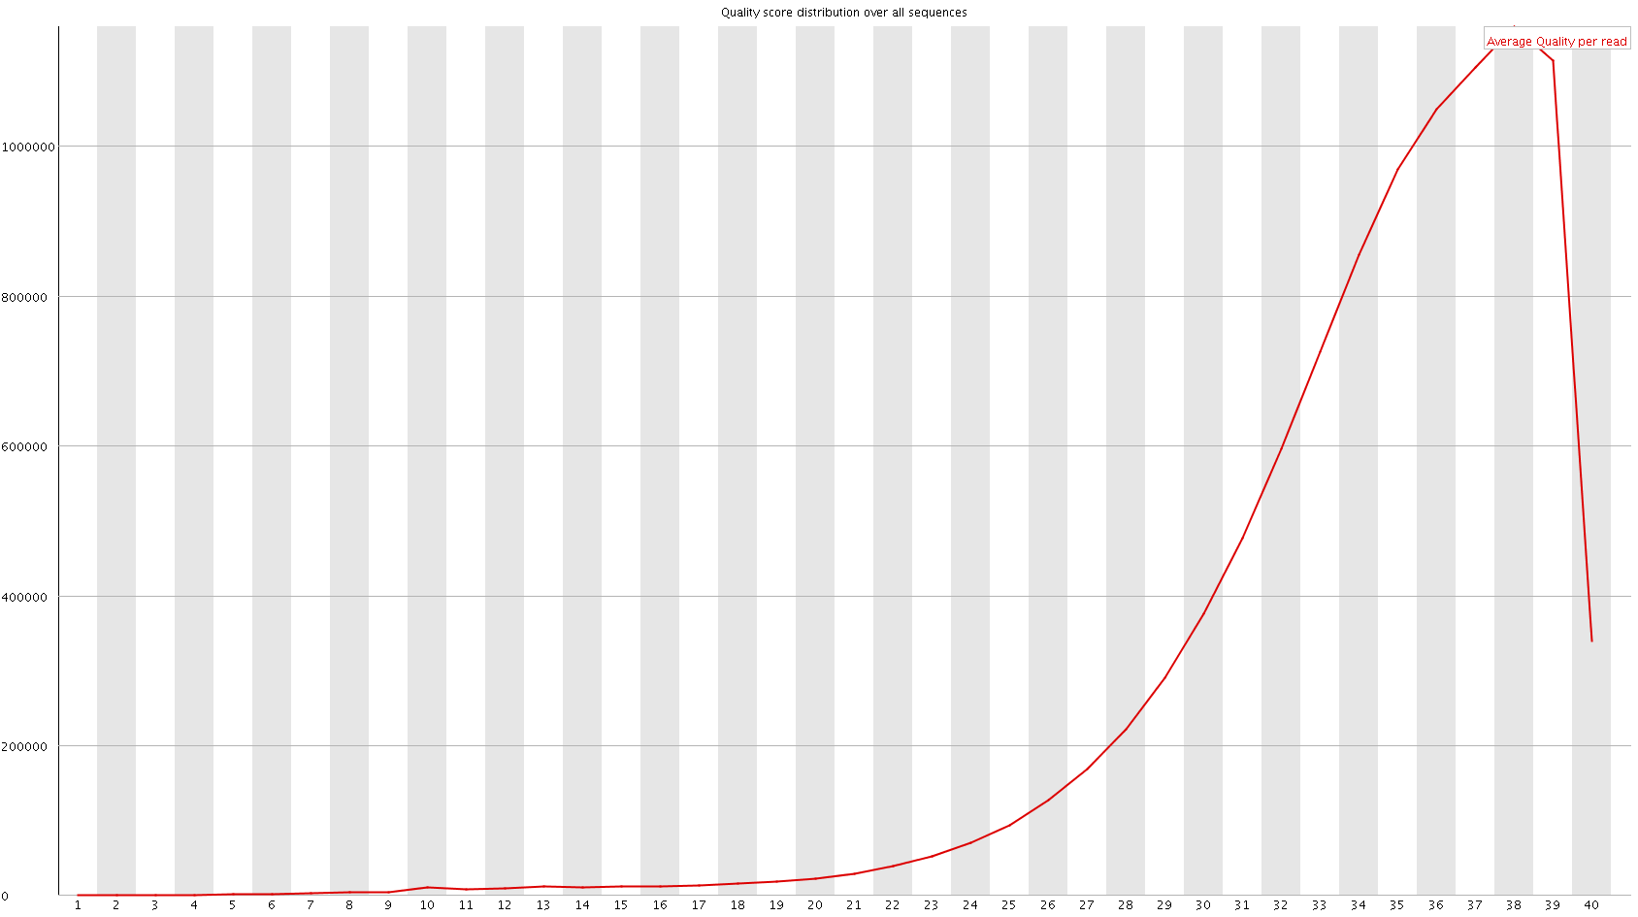
Quality control with FastQC
Nb Reads
Mean Phred Score

Slide 24
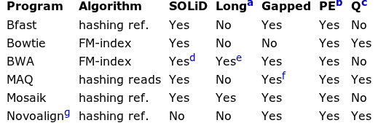
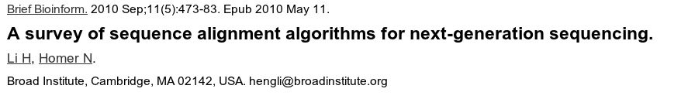
Mapping reads to genome: general softwares
ªWork well for Sanger and 454 reads, allowing gaps and clipping.
^{b}Paired end mapping.
^{c}Make use of base quality in alignment.dBWA trims the primer base and the first color for a color read.
^{e}Long-read alignment implemented in the BWA-SW module. fMAQ only does gapped alignment for Illumina paired-end reads.
^{g}Free executable for non-profit projects only.

Slide 25

Bowtie principle
Use highly efficient compressing and mapping algorithms based on Burrows Wheeler Transform (BWT)
The Burrows-Wheeler Transform of a text T, BWT(T), can be constructed as follows.
  The character $ is appended to T, where $ is a character not in T that is lexicographically less than all characters in T.
  The Burrows-Wheeler Matrix of T, BWM(T), is obtained by computing the matrix whose rows comprise all cyclic rotations of T sorted lexicographically.
acaacg$
caacg$a
aacg$ac
acg$aca
cg$acaa
g$acaac
$acaacg
$acaacg
aacg$ac
acaacg$
acg$aca
caacg$a
cg$acaa
g$acaac
1
2
3
4
5
6
7
7
3
1
4
2
5
6
T
BWT (T)
acaacg$
gc$aaac

Slide 26
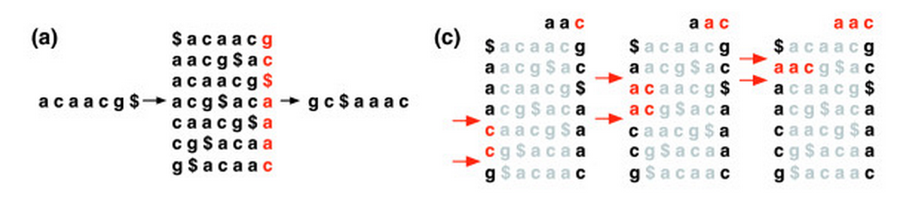
Bowtie principle
Burrows-Wheeler Matrices have a property called the Last First (LF) Mapping.
  The ith occurrence of character c in the last column corresponds to the same text character as the ith occurrence of c in the first column.
  Example: searching ”AAC” in ACAACG
7
3
1
4
2
5
6

Slide 27
Storing alignment: SAM Format
Store information related to alignement
  Read ID
  CIGAR String
  Bitwise FLAG
    read paired
    read mapped in proper pair
    read unmapped, ...
  Alignment position
  Mapping quality
  ...

Slide 28
Bitwise flag
read paired
read mapped in proper pair
read unmapped
mate unmapped
read reverse strand
mate reverse strand
first in pair
second in pair
not primary alignment
read fails platform/vendor quality checks
read is PCR or optical duplicate

Slide 29
Bitwise flag
00000000001 → 2^0 = 1 (read paired)
00000000010 → 2^1 = 2 (read mapped in proper pair)
00000000100 → 2^2 = 4 (read unmapped)
00000001000 → 2^3 = 8 (mate unmapped) …
00000010000 → 2^4 = 16 (read reverse strand)
00000001001 → 2^0+ 2^3 = 9 → (read paired, mate unmapped)
00000001101 → 2^0+2^2+2^3 =13 ...
...
http://picard.sourceforge.net/explain-flags.html

Slide 30
The extended CIGAR string
Exemple flags:
  M alignment match (can be a sequence match or mismatch)
  I insertion to the reference
  D deletion from the reference
  http://samtools.sourceforge.net/SAM1.pdf
ATTCAGATGCAGTA
ATTCA--TGCAGTA
ATTCAGATGCAGTA
ATTCA--TGCAGTA
5M2D7M

Slide 31
Mapping reads
Main Issues:
  Number of multi­hits
    Issue with short reads → mappability
  PCR duplicates
    Warning with ChIP-Seq (library complexity)
  Number of allowed mismatches
    Depend on sequence size (sometimes heterogeneous length)
    Depend of the aligner

Slide 32
ChIP-Seq technical considerations and expected results

Slide 33

ChIP-Seq: technical considerations
Quality of antibodies: one of the most important factors ('ChIP grade')
  High sensitivity
    Fivefold enrichment by ChIP-PCR at several positive-control regions
  High specificity
    The specificity of an antibody can be directly addressed by immunoblot analysis (knockdown by RNA-mediated interference or genetic knockout)
  Polyclonal antibodies may be prefered
    Offer the flexibility of the recognition of multiple epitopes
Cell Number
  Typically
    1 × 10⁶ (e.g, RNA polymerase II/histone modifications)
    10 × 10⁶ (less-abundant proteins)

Slide 34
ChIP-Seq: technical considerations
Open chromatin regions are easier to shear
    Higher background signals
  Two solutions
    Isotype control antibodies
      Immunoprecipitate much less DNA than specific antibodies
        Overamplification of particular genomic regions during the library construction step (PCR)
          Duplicate PCR
    Input
      Non-ChIP genomic DNA
      Better control

Slide 35
ChIP-seq signal for transcription factors
ChIP seq on DNA
binding TF
read densities
on +/- strand
We expect to see a typical strand asymmetry in read densities
→ ChIP peak recognition pattern

Slide 36
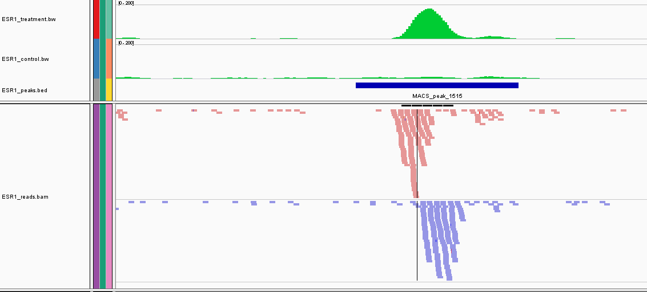
ChIP-seq signal for transcription factors
treatment read density (=WIG)
input read density (=WIG)
peak (=BED)
aligned reads + strand (=BAM)
aligned reads - strand (=BAM)
(this is the data you are going to manipulate ...)

Slide 37
ChIP-seq signal for transcription factors
ChIP seq on DNA
binding TF
read densities
on +/- strand
Binding of several TF as complexes tend to blur this asymmetry

Slide 38
ChIP-seq signal for histone marks
ChIP seq on histone
modifications
read densities
on +/- strand
The strand asymmetry is completely lost when considering
ChIP datasets for diffuse/broad histone modifications

Slide 39
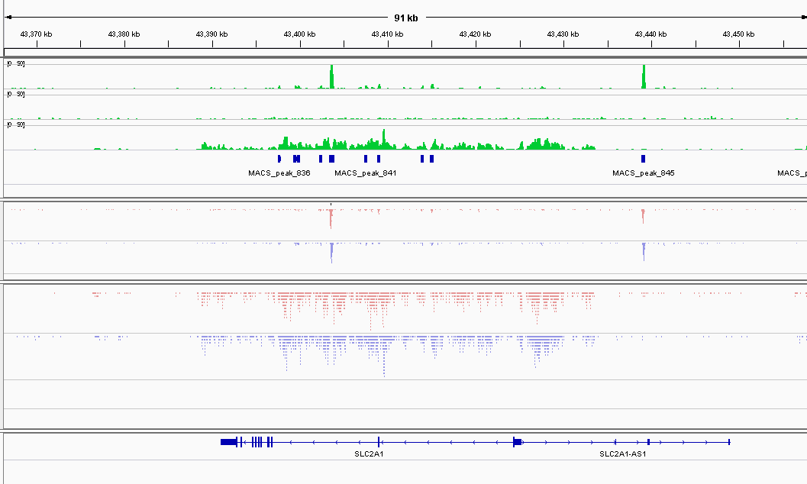
Real example of ChIP-seq signal
ESR1
input
H3K4me1
ESR1
reads
H3K4me1
reads

Slide 40
Keys aspects of “peak” finding
Treating the reads
Modelling noise levels
Scaling datasets
Detecting enriched/peak regions
Dealing with replicates

Slide 41
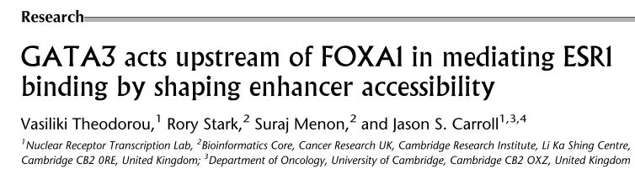
Datasets used
estrogen-receptor (ESR1) is a key factor in breast cancer developement
goal of the study: understand the dependency of ESR1 binding on presence of co-factors, in particular GATA3, which is mutated in breast cancers
approaches: GATA3 silencing (siRNA), ChIP-seq on ESR1 in wt vs. siGATA3 conditions, chromatin profiling

Slide 42
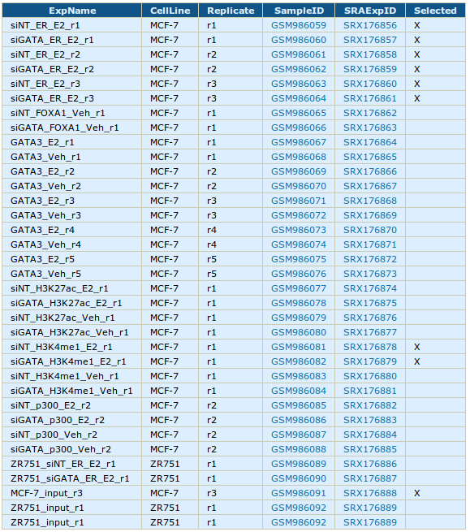
Datasets used
ESR1 ChIP-seq in WT & siGATA3 conditions
( 3 replicates = 6 datasets)
H3K4me1 in WT & siGATA3 conditions
(1 replicate = 2 datasets)
Input dataset in MCF-7
(1 replicate = 1 dataset)
p300 before estrogen stimulation
GATA3/FOXA1 ChIP-seq before/after estrogen stimulation
microarray expression data, etc ...

Slide 43
Hands on !!
Let's have a look at the data

Slide 44
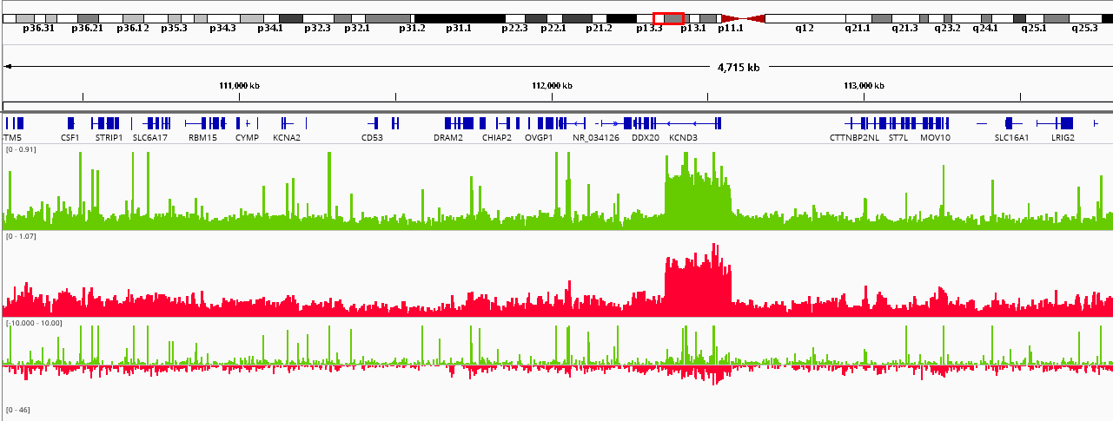
What we want to do
do we have
more signal here ...
… than here ?

Slide 45
Keys aspects of ChIP-seq analysis
Quality Control : do I have signal ?
Determine signal coverage
Modelling noise levels
Scaling/normalizing datasets
Detecting enriched peak regions
Performing differential analysis

Slide 46
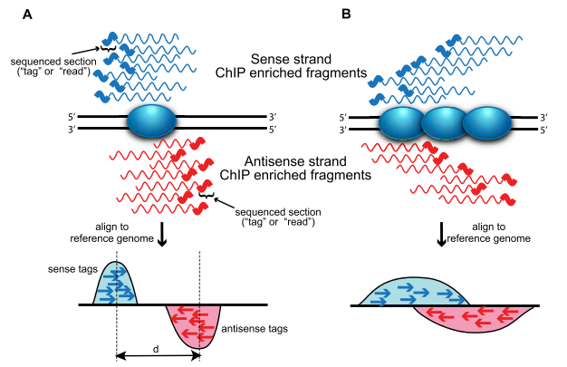
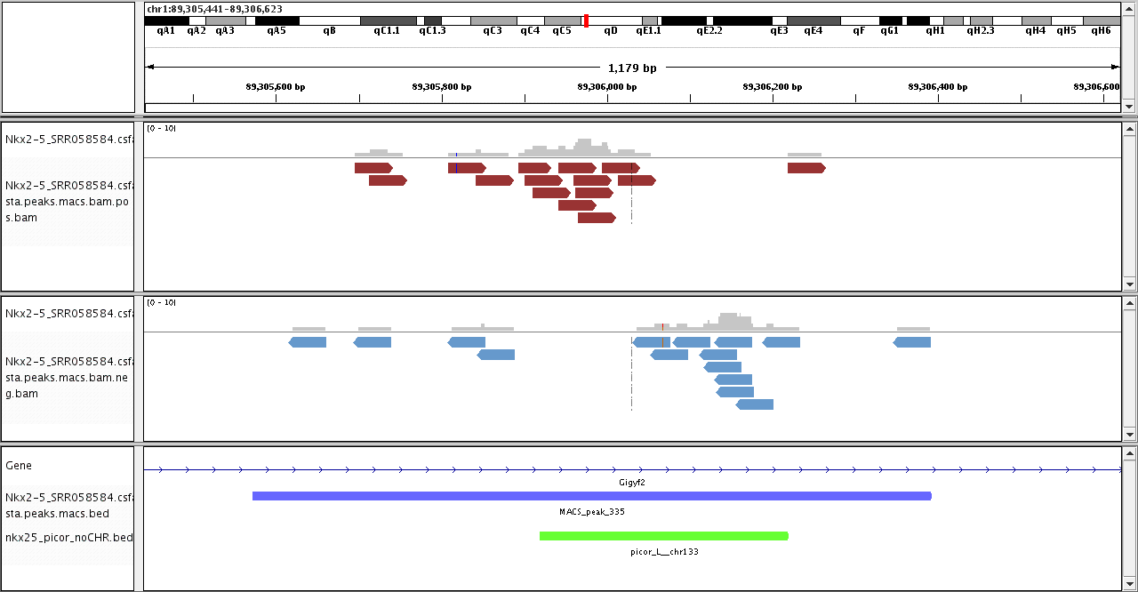
0. Principle of ChIP-seq
The binding site itself is
generally not sequenced !
We expect to see a typical strand asymetry in read densities
→ ChIP peak recognition pattern
[Wilbanks & Faccioti PLoS One (2010)]

Slide 47
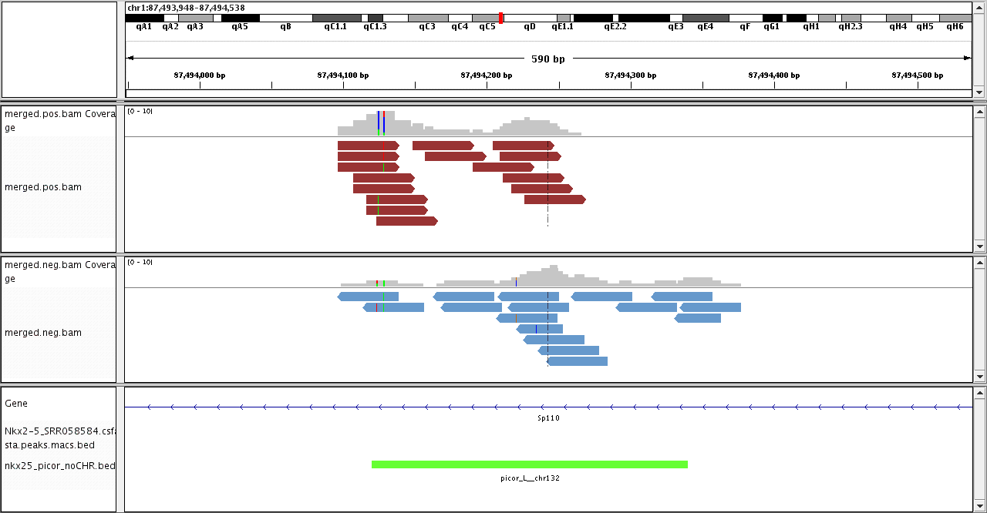
0. Principle of ChIP-seq
Strand asymetry is blurred when multiple proteins bind
or in case of histone modifications ChIP
[Wilbanks & Faccioti PLoS One (2010)]

Slide 48
Principle of ChIP-seq
treatment read density (=WIG/bigWig)
input read density (=WIG/bigWig)
peak (=BED)
aligned reads + strand (=BAM)
aligned reads - strand (=BAM)

Slide 49
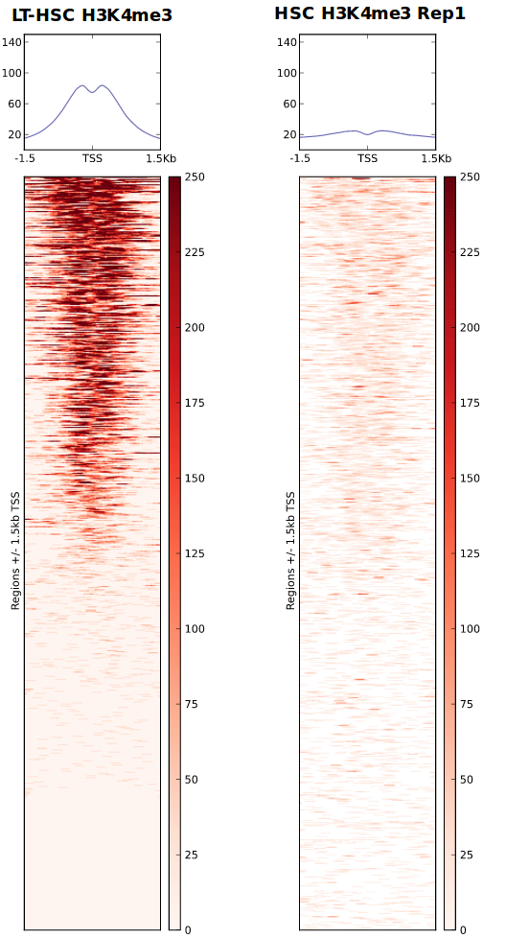
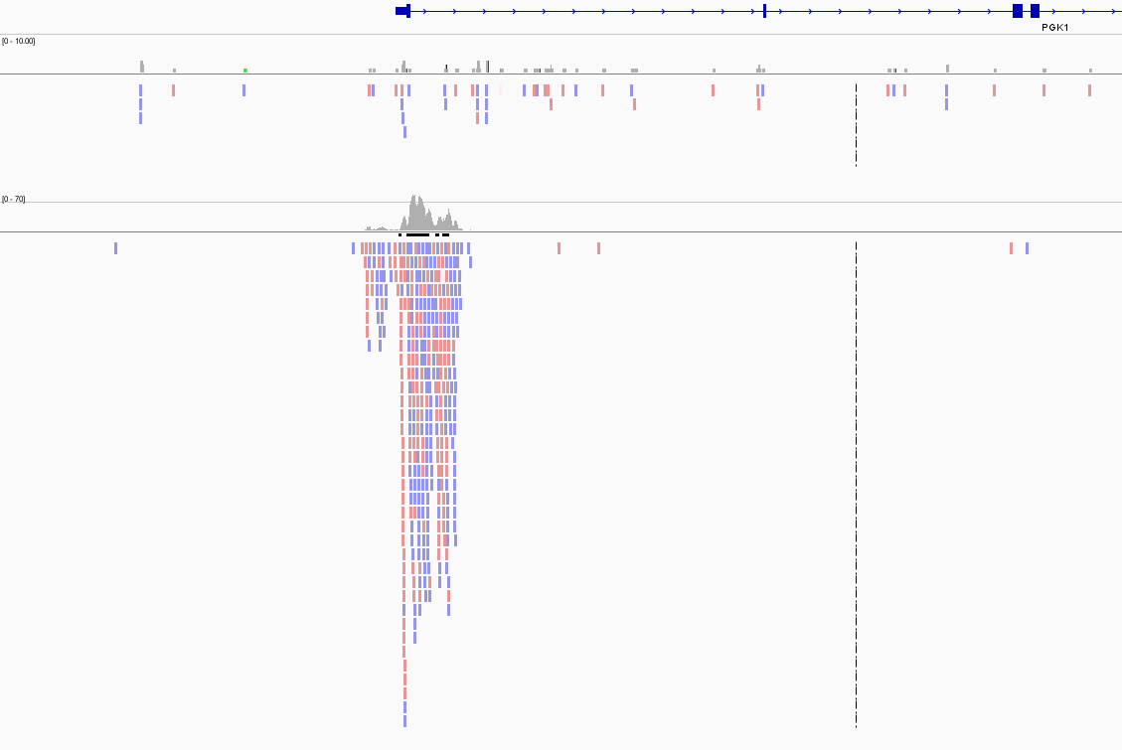
1. Quality control
Qualitative
  Look at your favorite gene/locus in IGV !
  Heatmap of signal
  → e.g. H3K4me3 at promoters

Slide 50
ChIP-Seq quality control

Slide 51
1. Quality control
Quantitative
  Fraction of reads in peaks (FRiP)
  → depends on type of ChIP (TF/histone)
  PCR Bottleneck coefficient (PBC) :
  measure of library complexity
Genomic positions
with 1 read aligned
Genomic positions
with ≥ 1 read aligned
PBC < 0.5
0.5 < PBC < 0.8
0.8 < PBC
https://www.encodeproject.org/data-standards/2012-quality-metrics/

Slide 52
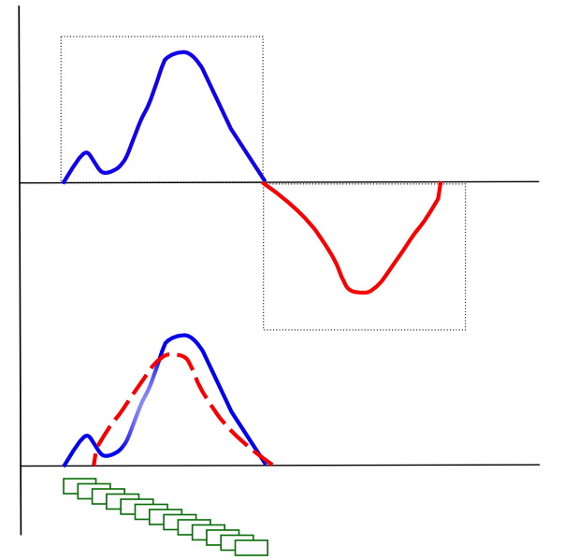
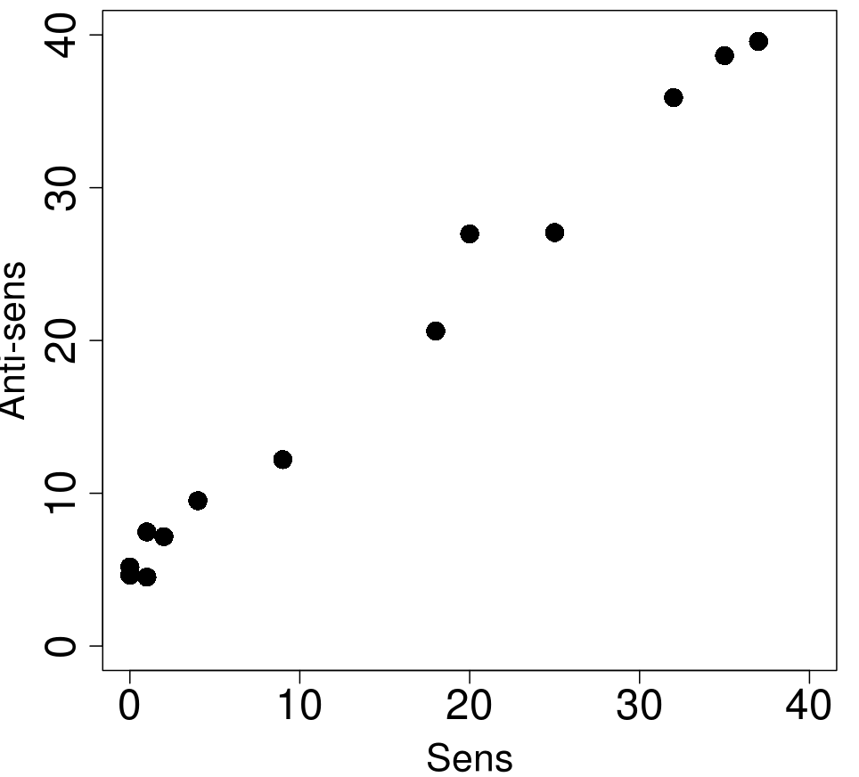
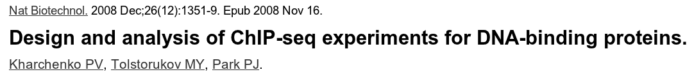
1. Quality control
Strand cross-correlation analysis

Slide 53
Determine signal coverage

Slide 54
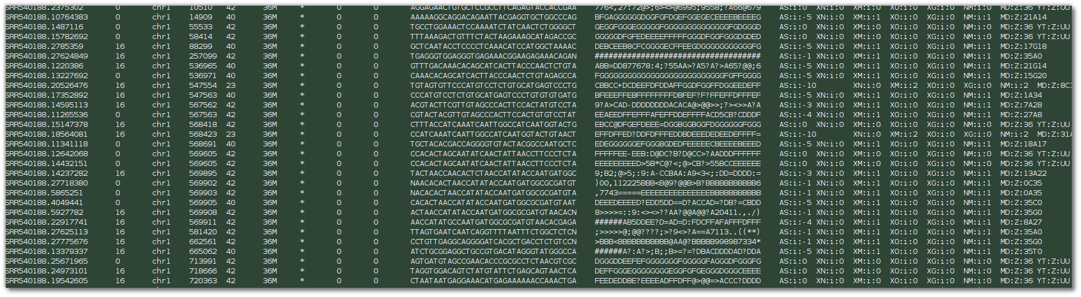
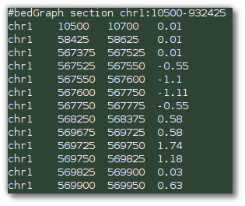
2. from reads to coverage
to visualize the data, we use coverage plots (=density of fragments per genomic region)
need to reduce BAM file to more compact format
→ bigWig/bedGraph

Slide 55
2. from reads to coverage
Reads are extended to 3' to fragment length
Read counts are computed for each bin
Counts are normalized
  reads per genomic content
  → normalize to 1 x coverage
  reads per kilobase per million reads per bin
→ deepTools : bamCoverage

Slide 56
2. from reads to coverage
ESR1
input
H3K4me1
ESR1
reads
H3K4me1
reads

Slide 57
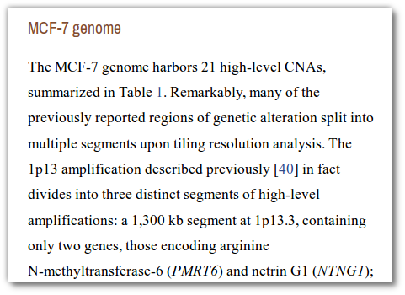
3. signal and noise
MCF7 genome
hg19 reference genome

Slide 58
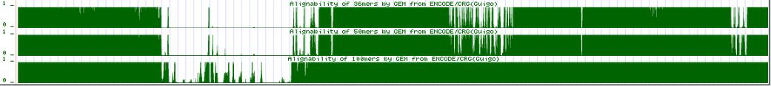
3. signal to noise
treatment
input
k=35
k=50
k=100
Mappability issue : alignability track shows, how many times a read from a given position of the genome would align
  a=1 → read from this position ONLY aligns to this position
  a=1/n → read from this position could align to n locations
→ we usually only keep uniquely aligned reads : positions with a < 1 have no reads left

Slide 59
3. signal to noise
The availability of a control sample in
mandatory !
→ mock IP with unspecific antibody
→ sequencing of input (=naked) DNA
→ Preferred

Slide 60
4. modelling background level
How to get a noise free track ?
naïve subtraction treatment – input is not possible, because both libraries have different sequencing depth !
Solution 1 : before subtraction, scale both libraries by total number of reads (library size)
  RPGC
  RPKM

Slide 61
4. modelling background level
scale smaler dataset
Treatment
N= 10 M reads
Input
N'= 12 M reads
Problem : signal influences scaling factor
More signal (but equal noise) → artificial noise over-estimation

Slide 62
4. modelling background level
input
1
area ~ number of reads = 10
10
5
treatment
1
area ~ number of reads = 10 + 4 + 4 = 18
10
Scaling by library size : upscale input by 18/10 = 1.8
5
treatment
estimated noise level
1
Noise level is over-estimated !
10

Slide 63
4. modelling background level
input
1
area ~ number of reads = 10
10
5
treatment
1
area ~ number of reads = 10 + 9 + 4 = 23
10
Scaling by library size : upscale input by 23/10 = 2.3
5
treatment
estimated noise level
1
10

Slide 64
4. modelling background level
input
1
area ~ number of reads = 10
10
5
treatment
1
area ~ number of reads = 10 + 9 + 4 = 23
10
Scaling by library size : upscale input by 23/10 = 2.3
5
treatment
estimated noise level
1
10

Slide 65
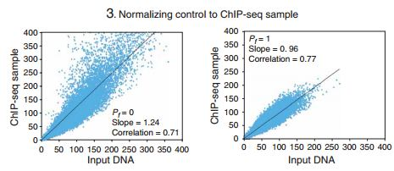
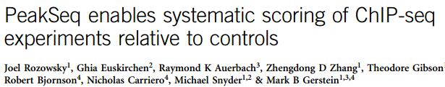
4. modelling background level
more advanced : linear regression by exclusing peak regions (PeakSeq)
read counts in 1Mb regions in input and treatment
all regions
excluding enriched (=signal) regions

Slide 66
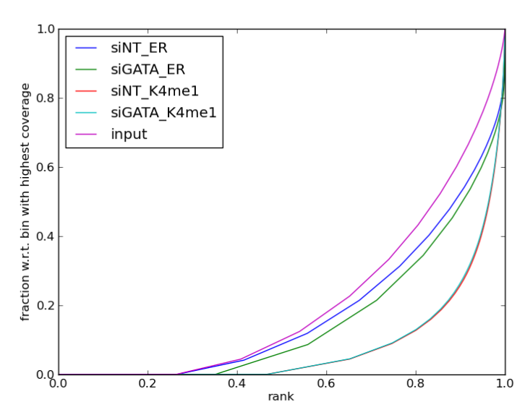
4. modelling background level
Alternative strategy
(deepTools → Diaz et al.)
  bin genome into n 10 kb windows
  count reads in each window for input (X_{i}) and treatment (Y_{i})
  total number of reads is N_{X} and N_{Y}
  order Y_{i} from less to most enriched → Y_{(i)}
  define and plot
  p_{j} = proportion of reads in the j less enriched windows
25% of the genome
contains no reads !
90% of the genome
contain ~ 25% of reads

Slide 67
4. modelling background level
this is were pj and qj
differ most
both datasets contain only noise in this range
treatment dataset
contains signal
→ scale according to number of reads in this range

Slide 68
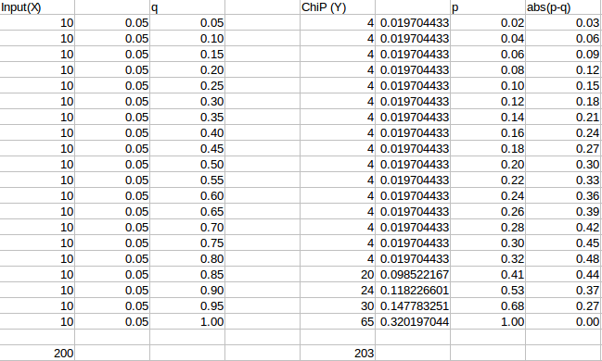
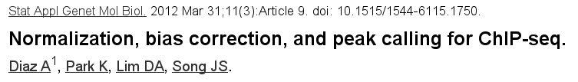
Scaling unequal datasets
Signal Extraction Scaling (SES)

Slide 69
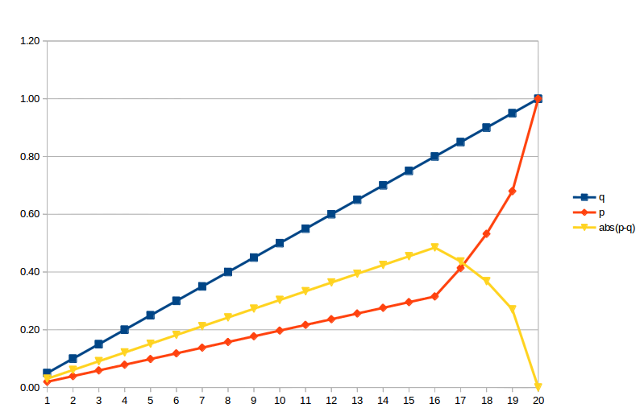
Scaling unequal datasets
Signal Extraction Scaling (SES)

Slide 70
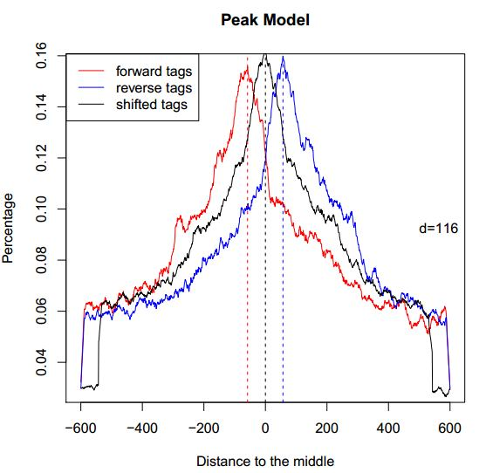
5. from reads to peaks
Tag shifting vs. extension
  positive/negative strand read peaks do not represent the true location of the binding site
  fragment length is d and can be estimated from strand asymmetry
  reads can be elongated to
  a size of d
  reads can be shifted by d/2
  → increased resolution
example of MACS model building
using top enriched regions

Slide 71
5. from reads to peaks
“Read shifting”
d

Slide 72
5. from reads to peaks
“Read extension”
d

Slide 73
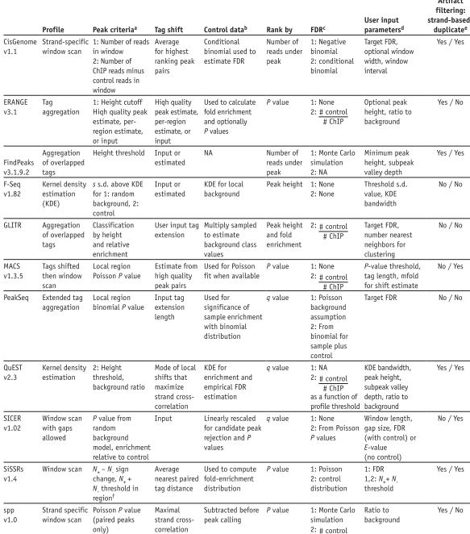


Slide 74
Some methods separate the tag densities
into different strands and take advantage
of tag asymmetry
Most consider merged densities and
look for enrichment

Slide 75
Tag shift
Tag extension
Tags unchanged

Slide 76
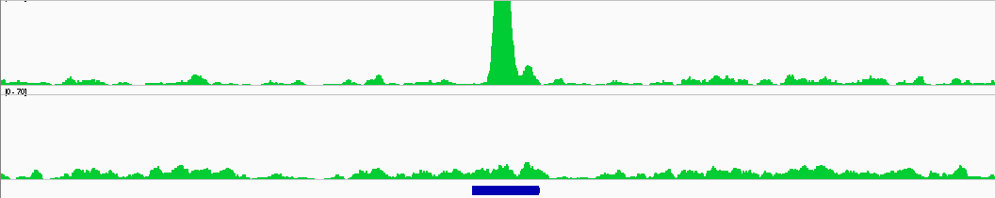
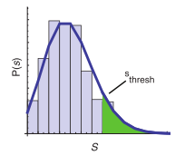
5. from reads to peaks
Determining “enriched” regions
  sliding window across the genome
  at each location, evaluate the enrichement of the signal wrt. expected background based on the distribution
  retain regions with P-values below threshold
  evaluate FDR
Pval < 1e-20
Pval ~ 0.6

Slide 77
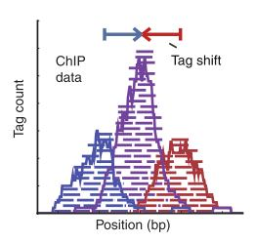
6. MACS [Zhang et al. Genome Biol. 2008]
Step 1 : estimating fragment length d
  slide a window of size BANDWIDTH
  retain top regions with MFOLD enrichment of treatment vs. input
  plot average +/- strand read densities → estimate d
enrichment
> MFOLD
treatment
control

Slide 78

5. MACS [Zhang et al. Genome Biol. 2008]
Step 2 : identification of local noise parameter
  slide a window of size 2*d across treatment and input
  estimate parameter λlocal of Poisson distribution
estimate λ over diff. ranges
→ take the max
1 kb
5 kb
10 kb
full genome

Slide 79
5. MACS [Zhang et al. Genome Biol. 2008]
Step 3 : identification of enriched/peak regions
  determine regions with P-values < PVALUE
  determine summit position inside enriched regions as max density
P-val = 1e-30

Slide 80
5. MACS [Zhang et al. Genome Biol. 2008]
Step 4 : estimating FDR
  positive peaks (P-values)
  swap treatment and input; call negative peaks (P-value)
increasing P-value
# negative peaks with Pval < p
FDR(p) =
# positive peaks with Pval < p
FDR = 2/25=0.08

Slide 81
6. differential analysis
given ChIP-set datasets in different conditions, we want to find differential binding events between 2 conditions
  binding vs. no binding → qualitative analysis
  weak binding vs. strong binding → quantitative analysis
Condition A
Condition B
stronger
binding
in A
stronger
binding
in B
binding in A
no binding in B
no difference
binding in B
no binding in A

Slide 82
6. differential analysis
simple approach → compute common and specific peaks
Condition A
Condition B
Drawback :
- common peaks can hide differences in binding intensities
- specific peaks can result from threshold issues

Slide 83
6. differential analysis
quantitative approach
  select regions which have signal (union of all peaks)
  in these regions, perform quantitative analysis of differential binding based on read counts
statistical model
  without replicates : assume simple Poisson model (→ SICER-df)
  with replicates : perform differential test using DE tools from RNA-seq (diffBind using EdgeR, DESeq,...) based on read counts

Slide 84
6. differential analysis
without replicates (sicer-df)
  consider one condition to be the reference (condition A)
  call peaks on each condition independently
  take union of peaks
  assume Poisson model based on
  expected number of reads in region
  compute P-value, log(fold-change)
λ₁
λ₂
λ₃
λ₄
λ₅
n₁
n₂
n₃
n₄
n₅

Slide 85
6. differential analysis
with replicates (diffBind)
  provide list of peaks for replicates A and replicates B
  determine consensus peakset based on presence in at least n datasets
  compute read counts in each consensus peak in each dataset
  run DESeq / EdgeR to determine differential peaks between condition A and B (negative binomial model, variance estimated on replicates)
peaks A
peaks B
consensus peaks (if n ≥2)

Slide 86
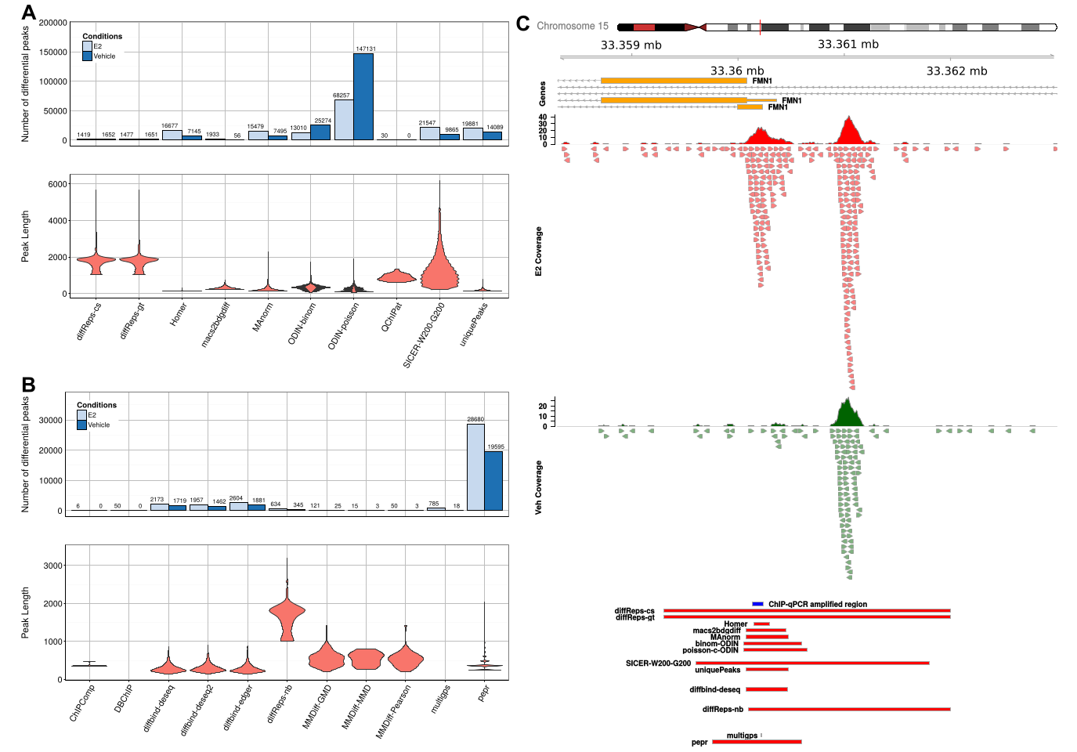
6. differential analysis
Considerable differences in peak numbers and sizes !

Slide 87
Annotating Peaks ?
Classical approach
  Associate Peaks to the nearest genes
  Check if the list of genes is enriched in gene related to :
      Pathways, GO terms, ...
 | Terme | !Terme
Liste | x | k-x | k
!Liste | m-x | n-(k-x) | N-k
 | m (white) | n (black) | N
N genes in the genome
m genes associated to a term (e.g. Cell cycle)
  marked genes
k genes (associated with peaks)
If no bias, we expect the same proportion or marked genes in k and in N.
Hypergeometric test: what is the probability to obtain by chance an intersection containing x or more genes ?
k
N
X
m

Slide 88
Nearest gene : problem
  Problem
    Associating peaks with gene located at n kb
      Discards lots of binding events (~ 50%)
    Associating peaks to the nearest gene
      Bias for genes within large intergenic regions
        These genes will tend to be associated frequently with peaks
        False positive enrichments ('multicellular organismal development')
  Solution
    GREAT: Annotate genomic regions

Slide 89
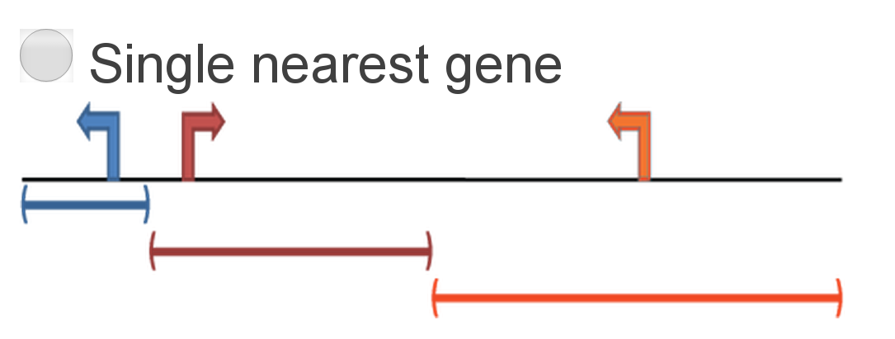
GREAT
GREAT (Genomic Regions Enrichment of Annotations Tool)
  Define gene regulatory domain around genes
    User may choose between several solutions
    E.g single nearest gene

Slide 90


GREAT
Use a binomial test to check for enrichment

Slide 91

DeepTools
DeepTools: user-friendly tools for the normalization and visualization of deep-sequencing data

Slide 92
Program of the Practical Session
Step 0 : Find datasets on Gene Expression Omnibus
Step 1 : Import datasets into your Galaxy history
Step 2 : data inspection : coverage plots, correlation,...
Step 3 : peak calling using MACS
Step 5 : differential analysis
Step 6 : visualizing results in IGV

