Slide 1
ChIP-seq analysis adapted from J. van Helden, M. Defrance, C. Herrmann, D. Puthier, N. Servant
D. Puthier TAGC – Inserm U1090
http://biow.sb-roscoff.fr/ecole_bioinfo/training_material/chip-seq/documents/presentation_chipseq.pdf

Slide 2
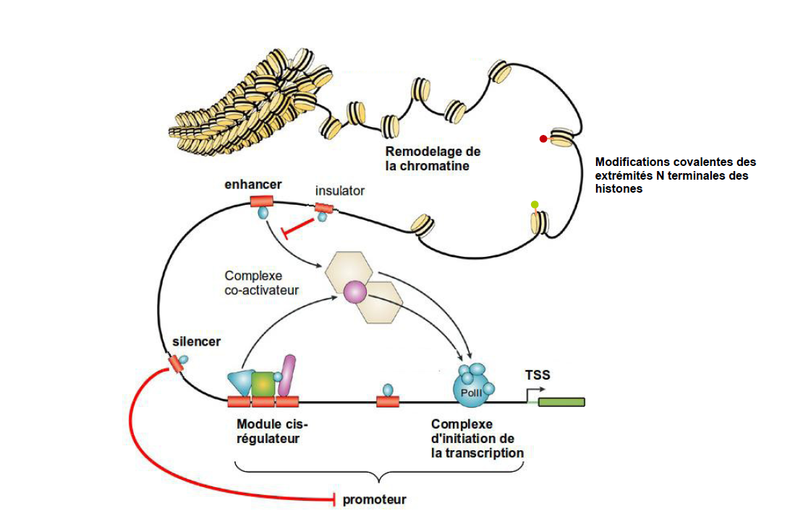
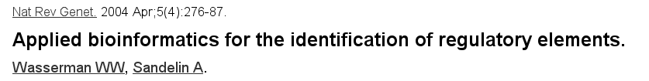
A model of transcriptional regulation

Slide 3
Chromatin constraints
Each diploid cell contains about 2 meters of DNA
  High level of compaction required
  Accessibility required
    Replication
    Transcription
    DNA repair
Specific machinery required

Slide 4
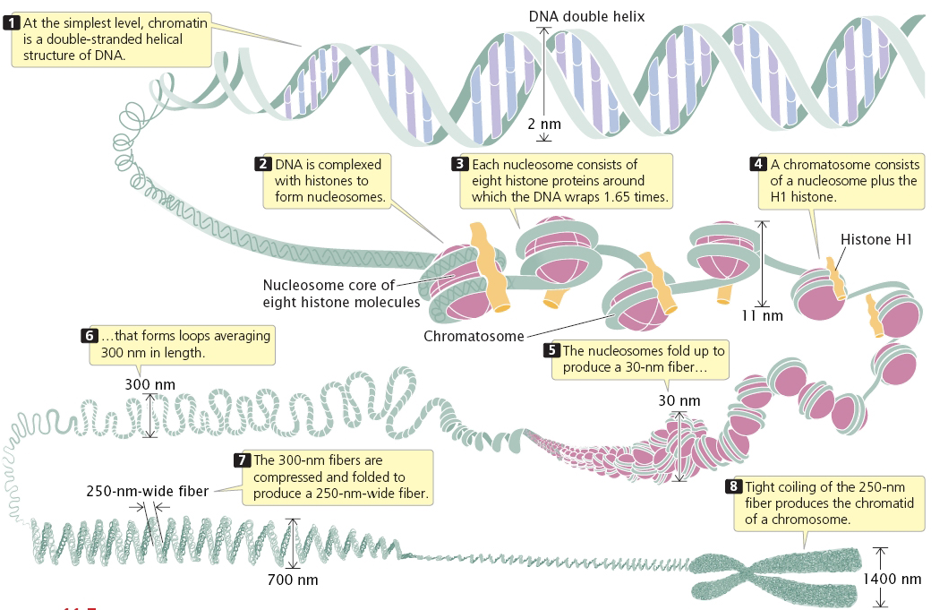
Chromatin has highly complex structure with several levels of organization
2005. Genetics: A Conceptual Approach, 2nd ed.
Notes:
H2A, H2B, H3,H4 x2

Slide 5
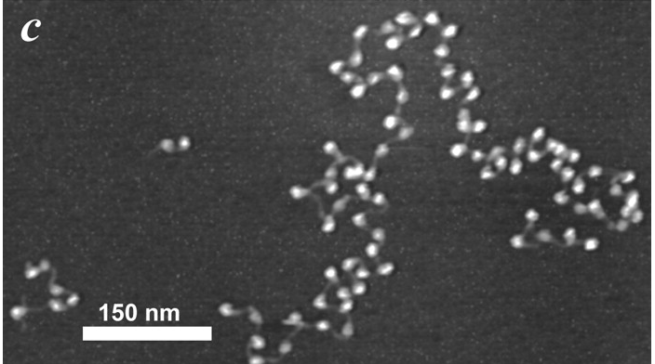

Beads on a string
Figure 4: Chromatin fibers purified from chicken erythrocytes. Each nucleosome (~12-15 nm) is well resolved, along with the linker DNA between the nucleosomes. Given the resolution, other components, if present, such as a transcribing RNA polymerase or transcription factor complexes, should be resolvable

Slide 6
Histones and nucleosomes
Histones
  Small proteins (11-22 kDa)
  Highly conserved
  Basic (Arginine et Lysine)
  N-terminal tails subject to post translational modification
Nucleosome
  Octamers of histone
    (H2A,H2B,H3,H4) x 2
  146bp DNA

Slide 7
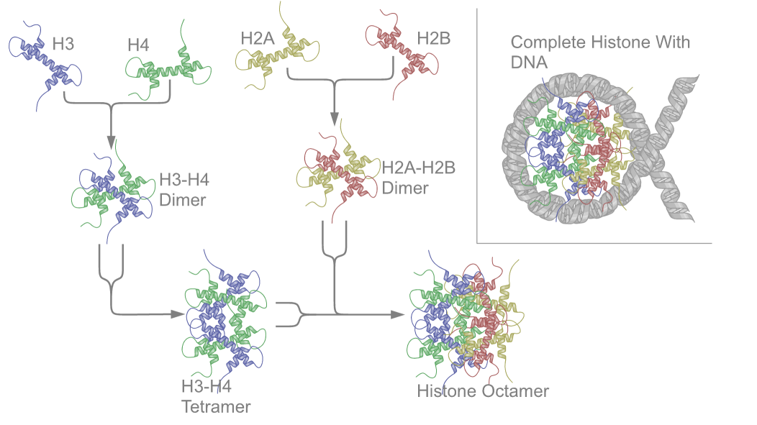
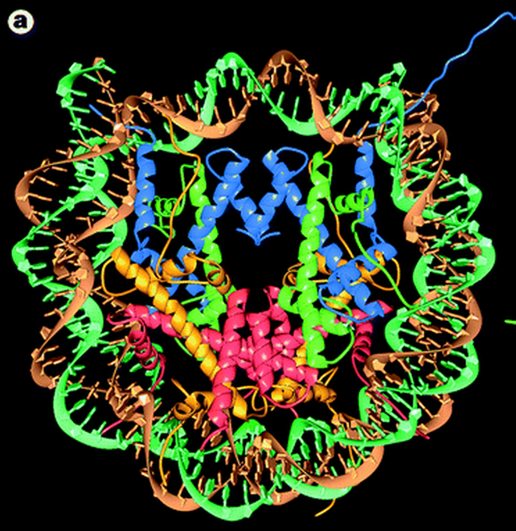

Nucleosome structure

Slide 8
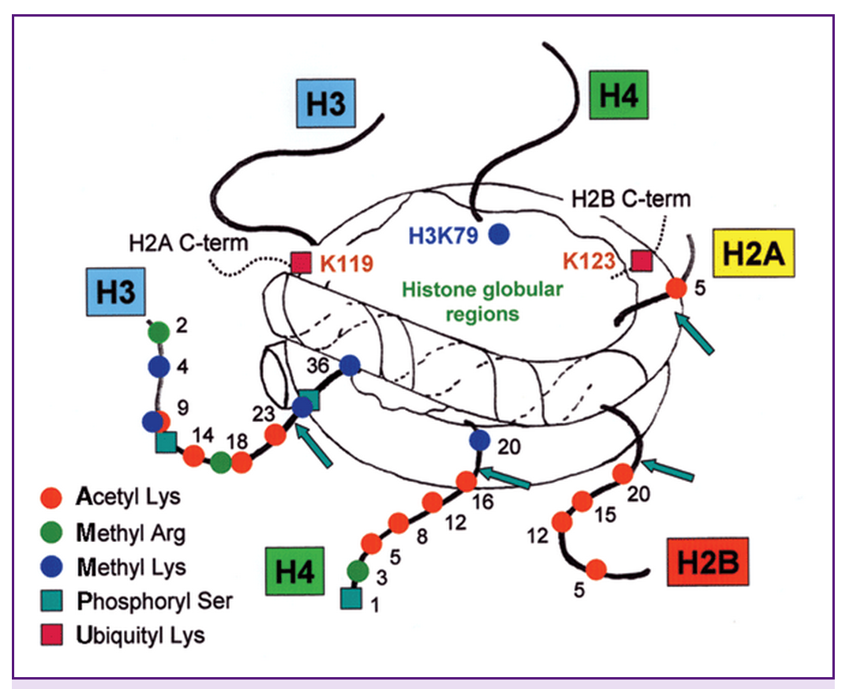
Histone post translational modification
Lysine acetylation
Lysine methylation
Arginine methylation
Serine phosphorylation
Threonine phosphorylation
ADP-ribosylation
Ubiquitylation
Sumoylation
...

Slide 9
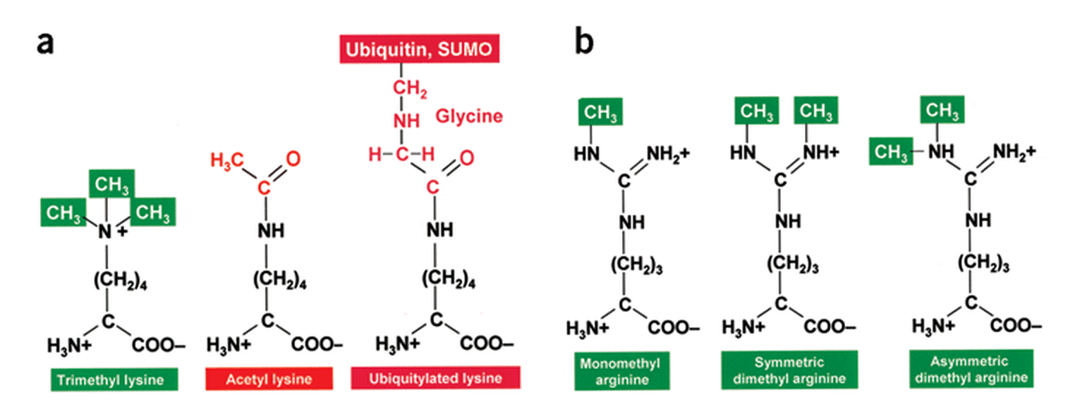
Some alternative modifications
+ - - + + +

Slide 10
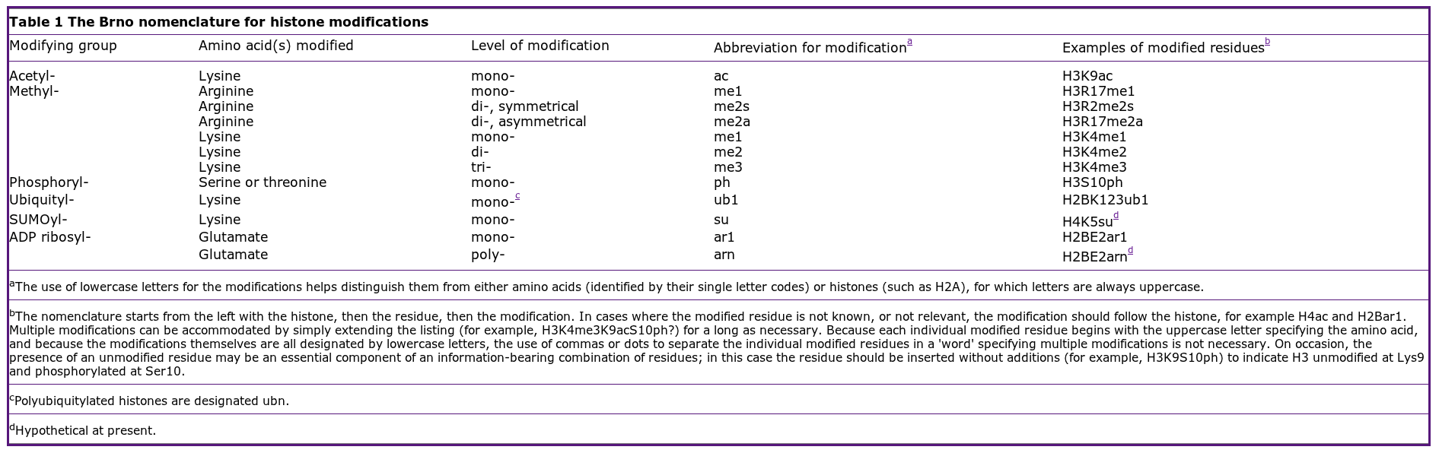
The Brno nomenclature
The nomenclature set out here was devised following the first meeting of the Epigenome Network of Excellence (NoE), at the Mendel Abbey in Brno, Czech Republic. For this reason, it can be referred to as the Brno nomenclature.

Slide 11
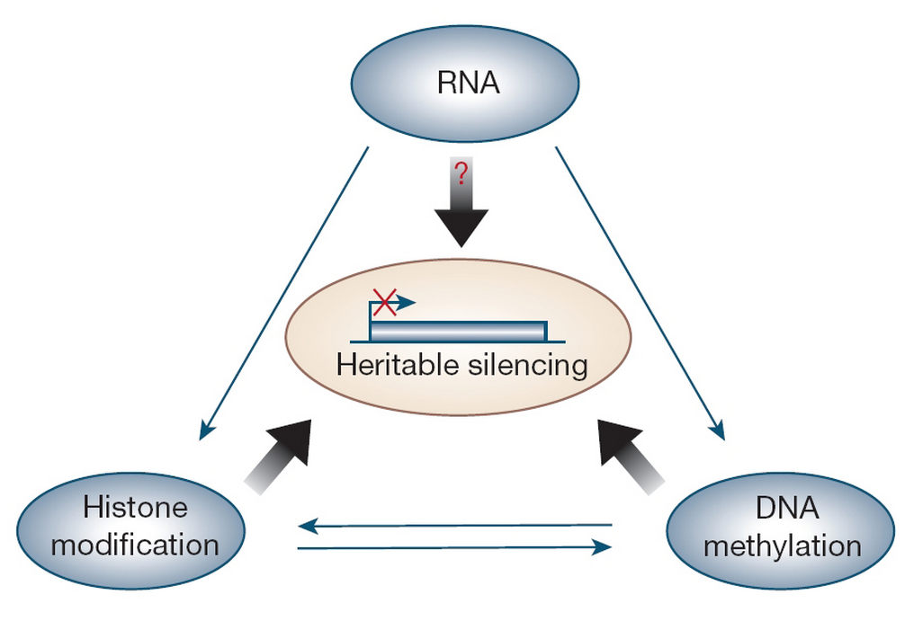

Epigenetic
Epigenetics involves genetic control by factors other than an individual's DNA sequence
  Histone modifications
  DNA methylation
Epigenetic modifications may be inherited mitotically or meiotically

Slide 12
Chromatine immuno-precipitation (ChIP)
Used for:
  TF localization
  Histone modifications

Slide 13

ChIP-Seq: technical considerations
Quality of antibodies: one of the most important factors ('ChIP grade')
  High sensitivity
    Fivefold enrichment by ChIP-PCR at several positive-control regions
  High specificity
    The specificity of an antibody can be directly addressed by immunoblot analysis (knockdown by RNA-mediated interference or genetic knockout)
  Polyclonal antibodies may be prefered
    Offer the flexibility of the recognition of multiple epitopes
Cell Number
  Typically
    1 × 10⁶ (e.g, RNA polymerase II/histone modifications)
    10 × 10⁶ (less-abundant proteins)

Slide 14
ChIP-Seq: technical considerations
Open chromatin regions are easier to shear
    Higher background signals
  Two solutions
    Isotype control antibodies
      Immunoprecipitate much less DNA than specific antibodies
        Overamplification of particular genomic regions during the library construction step (PCR)
    Input
      Non-ChIP genomic DNA
      Better control

Slide 15
ChIP-seq signal for transcription factors
ChIP seq on DNA
binding TF
read densities
on +/- strand
We expect to see a typical strand asymmetry in read densities
→ ChIP peak recognition pattern

Slide 16
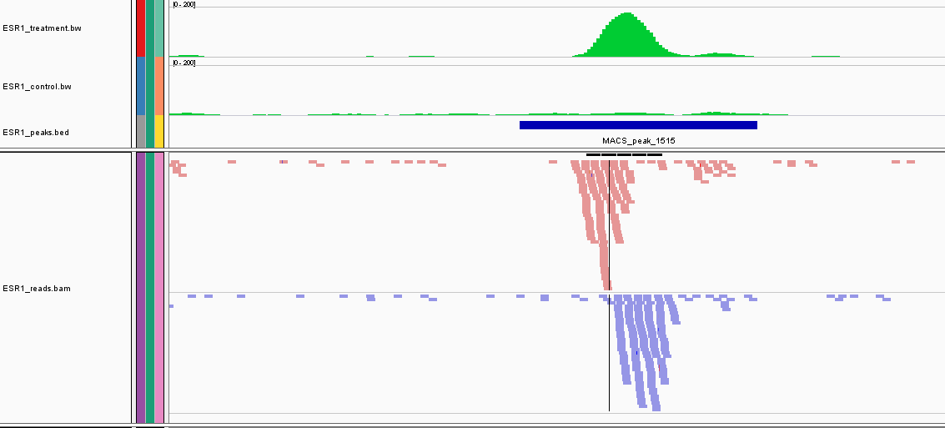
ChIP-seq signal for transcription factors
treatment read density (=WIG)
input read density (=WIG)
peak (=BED)
aligned reads + strand (=BAM)
aligned reads - strand (=BAM)
(this is the data you are going to manipulate ...)

Slide 17
ChIP-seq signal for transcription factors
ChIP seq on DNA
binding TF
read densities
on +/- strand
Binding of several TF as complexes tend to blur this asymmetry

Slide 18
ChIP-seq signal for histone marks
ChIP seq on histone
modifications
read densities
on +/- strand
The strand asymmetry is completely lost when considering
ChIP datasets for diffuse histone modifications

Slide 19
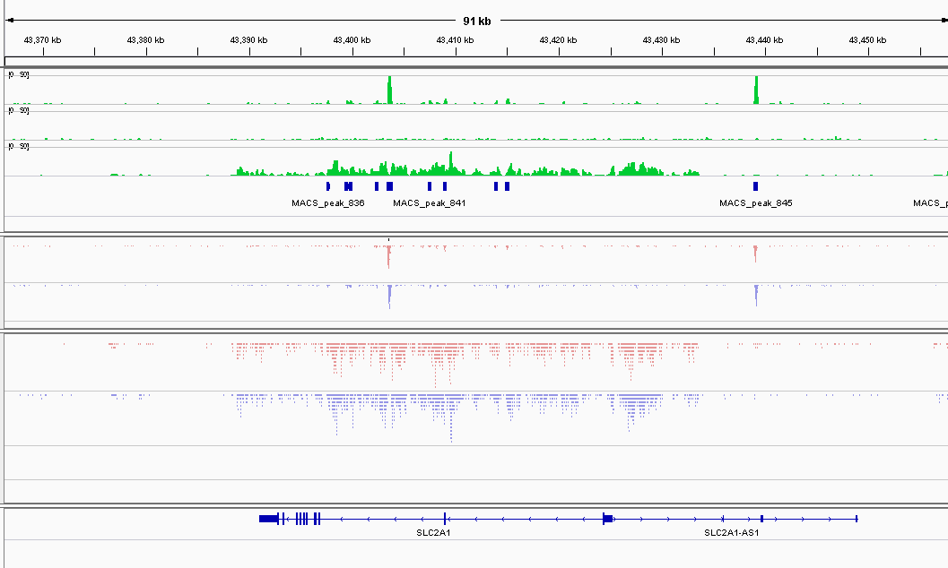
Real example of ChIP-seq signal
ESR1
input
H3K4me1
ESR1
reads
H3K4me1
reads

Slide 20
Keys aspects of “peak” finding
Treating the reads
Modelling noise levels
Scaling datasets
Detecting enriched/peak regions
Dealing with replicates

Slide 21
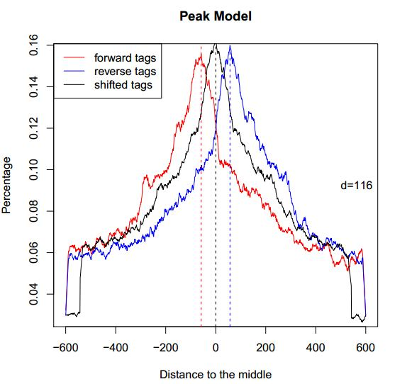
From aligned reads to binding sites
Tag shifting vs. extension
  positive/negative strand read peaks do not represent the true location of the binding site
  reads can be shifted by d/2 where d is the band size (MACS)
  → increased resolution
  reads can be elongated to
  a size of d (FindPeaks, PeakSeq,...)
  d can be estimate from the data
  (MACS) or given as input parameter
example of MACS model building
using top enriched regions

Slide 22
From aligned reads to binding sites
d/2
Tag shifting
shifted position
initial position
read densities
on +/- strand
Each tag is shifted by d/2 (i.e. towards the middle of the IP fragment)
where d represent the fragment length

Slide 23
From aligned reads to binding sites
Tag elongation
read densities
on +/- strand
Each tag is computationaly extended in 3' to a total length of d

Slide 24
Modelling noise levels
ChIP-seq dataset (=treatment)
=
signal
+
How do we estimate
the noise ?
background noise

Slide 25
Modelling noise levels
noise is not uniform (chromatin conformation, local biases, mappability)
input dataset is mandatory for reliable local estimation !
(although some algorithms do not require it … :-( )
chr1:114,720,153-114,746,839 → 26 kb
treatment
?
input

Slide 26
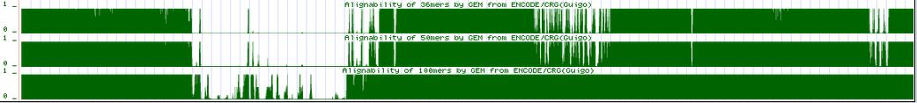
Modelling noise levels
the mappability is related to the uniqueness of the k-mers at a particular position of the genome
  repetitive regions → low uniqueness → low mappability
k=35
k=50
k=100
Longer reads → more uniquely mapped reads
  a=1 → read from this position ONLY aligns to this position
  a=1/n → read from this position could align to n locations

Slide 27
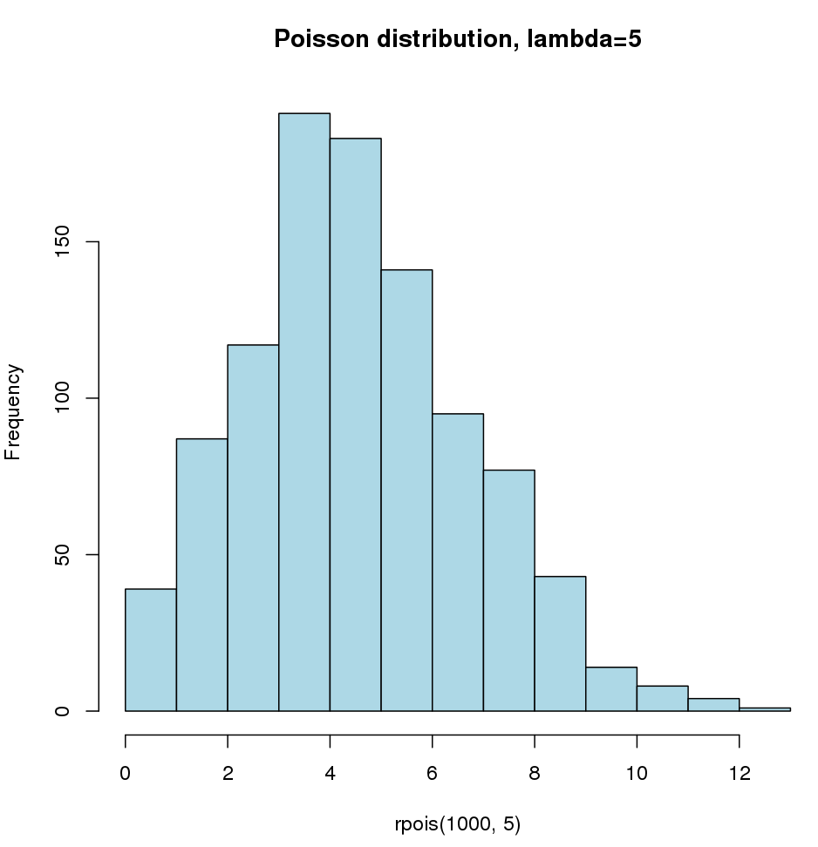
Modelling noise levels
random distribution of reads in a window of size w modelled using a theoretical distribution
  Poisson distribution
  1 parameter :
    λ = expected number of reads in window

Slide 28
Scaling unequal datasets
treatment (=signal + noise) and input (=noise) datasets generally do not have the same sequencing depth → need for normalization
input dataset should model the noise level in the treatment dataset
naïve approach : upscale/downscale the smaller/larger dataset
Input : N reads
ChIP-seq dataset → M > N reads
scale by library size : M → M' = N
Problem : signal influences scaling factor
More signal (but equal noise) → artificial noise over-estimation

Slide 29
Scaling unequal datasets by library size
input
1
area ~ number of reads = 10
10
5
treatment
1
area ~ number of reads = 10 + 4 + 4 = 18
10
Scaling by library size : upscale input by 18/10 = 1.8
5
treatment
estimated noise level
1
Noise level is over-estimated !
10

Slide 30
Scaling unequal datasets by library size
input
1
area ~ number of reads = 10
10
5
treatment
1
area ~ number of reads = 10 + 9 + 4 = 23
10
Scaling by library size : upscale input by 23/10 = 2.3
5
treatment
estimated noise level
1
10

Slide 31
Scaling unequal datasets by library size
input
1
area ~ number of reads = 10
10
5
treatment
1
area ~ number of reads = 10 + 9 + 4 = 23
10
Scaling by library size : upscale input by 23/10 = 2.3
5
treatment
estimated noise level
1
10

Slide 32
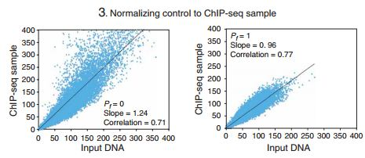
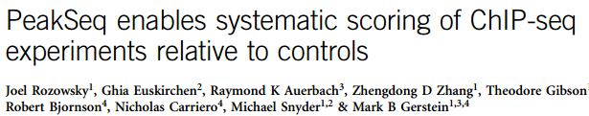
Scaling unequal datasets
more advanced : linear regression by exclusing peak regions (PeakSeq)
read counts in 1Mb regions in input and treatment
all regions
excluding enriched (=signal) regions

Slide 33
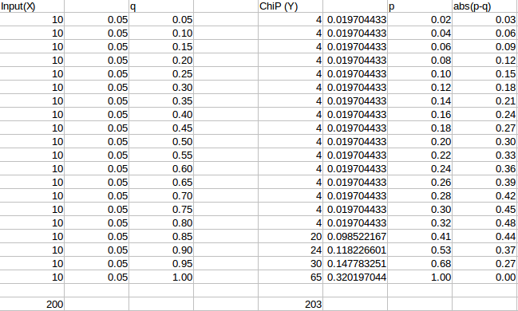
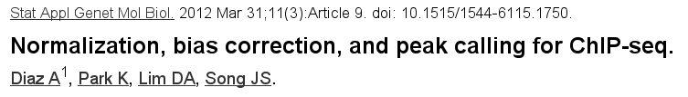
Scaling unequal datasets
Signal Extraction Scaling (SES)

Slide 34
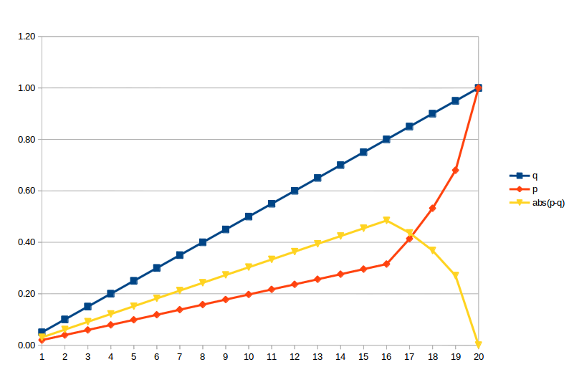
Scaling unequal datasets
Signal Extraction Scaling (SES)

Slide 35
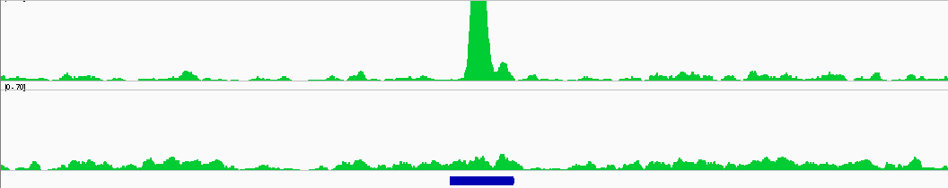
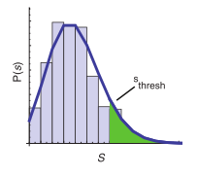
Defining “peaks”
Determining “enriched” regions
  sliding window across the genome
  At each location, evaluate the enrichment of the Signal vs background based on Poisson distribution
  retain regions with P-values below threshold
  evaluate FDR
Pval < 1e-20
Pval ~ 0.6

Slide 36
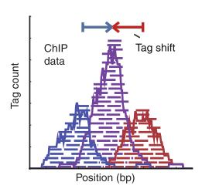
MACS
[Zhang et al. Genome Biol. 2008]
Step 1 : estimating fragment length d
  slide a window of size BANDWIDTH
  retain top regions with MFOLD enrichment of treatment vs. input
  plot average +/- strand read densities → estimate d
enrichment
> MFOLD
treatment
control

Slide 37

MACS
[Zhang et al. Genome Biol. 2008]
Step 2 : identification of local noise parameter
  slide a window of size 2*d across treatment and input
  estimate parameter λlocal of Poisson distribution
estimate λ over diff. ranges
→ take the max
1 kb
5 kb
10 kb
full genome

Slide 38
MACS
[Zhang et al. Genome Biol. 2008]
Step 3 : identification of enriched/peak regions
  determine regions with P-values < PVALUE
  determine summit position inside enriched regions as max density
P-val = 1e-30

Slide 39
MACS
[Zhang et al. Genome Biol. 2008]
Step 4 : estimating FDR
  positive peaks (P-values)
  swap treatment and input; call negative peaks (P-value)
# obsserved peaks with Pval < p
increasing P-value
FDR(p) =
# simulated peaks with Pval < p
+
# observed peaks with Pval < p
FDR = 2/(2+25)=0.074

Slide 40
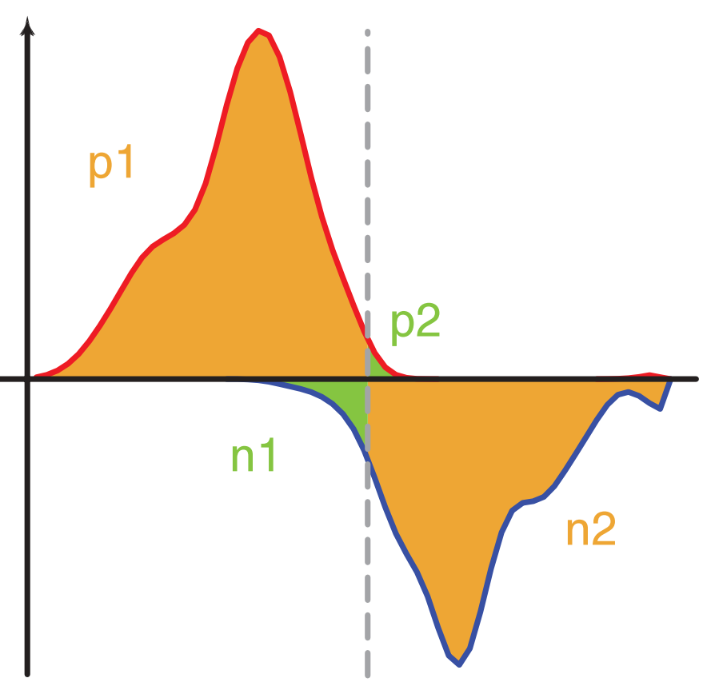

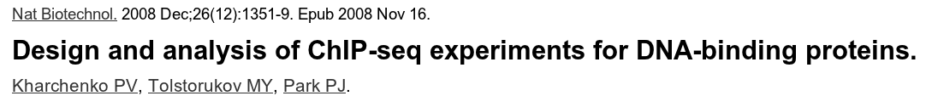
Peak-Calling: WTD
Window Tag Density (SPP package)
pd
pd= positive downstream
pu= positive upstream
pu
nd = negative downstream
nd
nu = negative upstream
nu

Slide 41
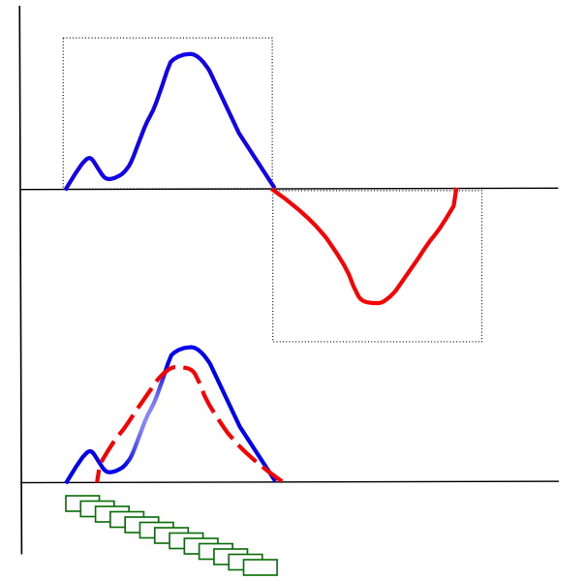
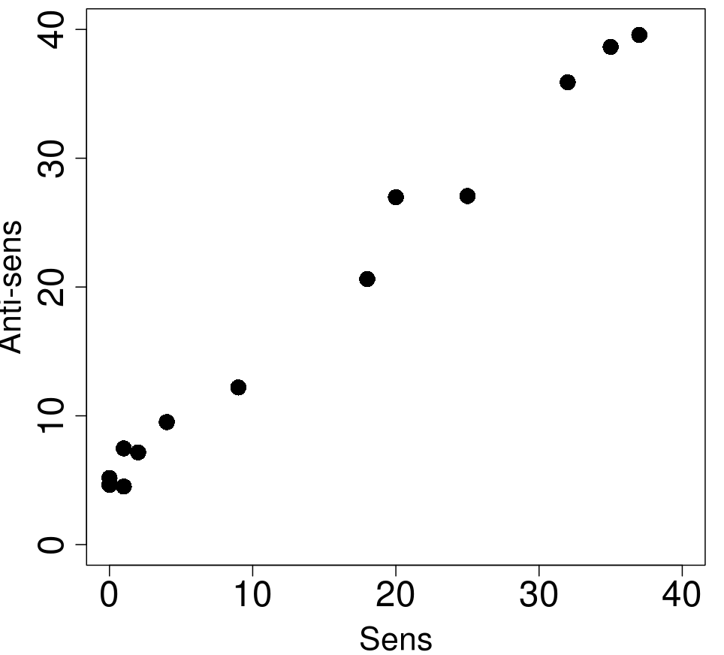
Peak-Calling: MTC
Mirror Tag Correlation (SPP package)
  Strand cross-correlation proﬁle

Slide 42
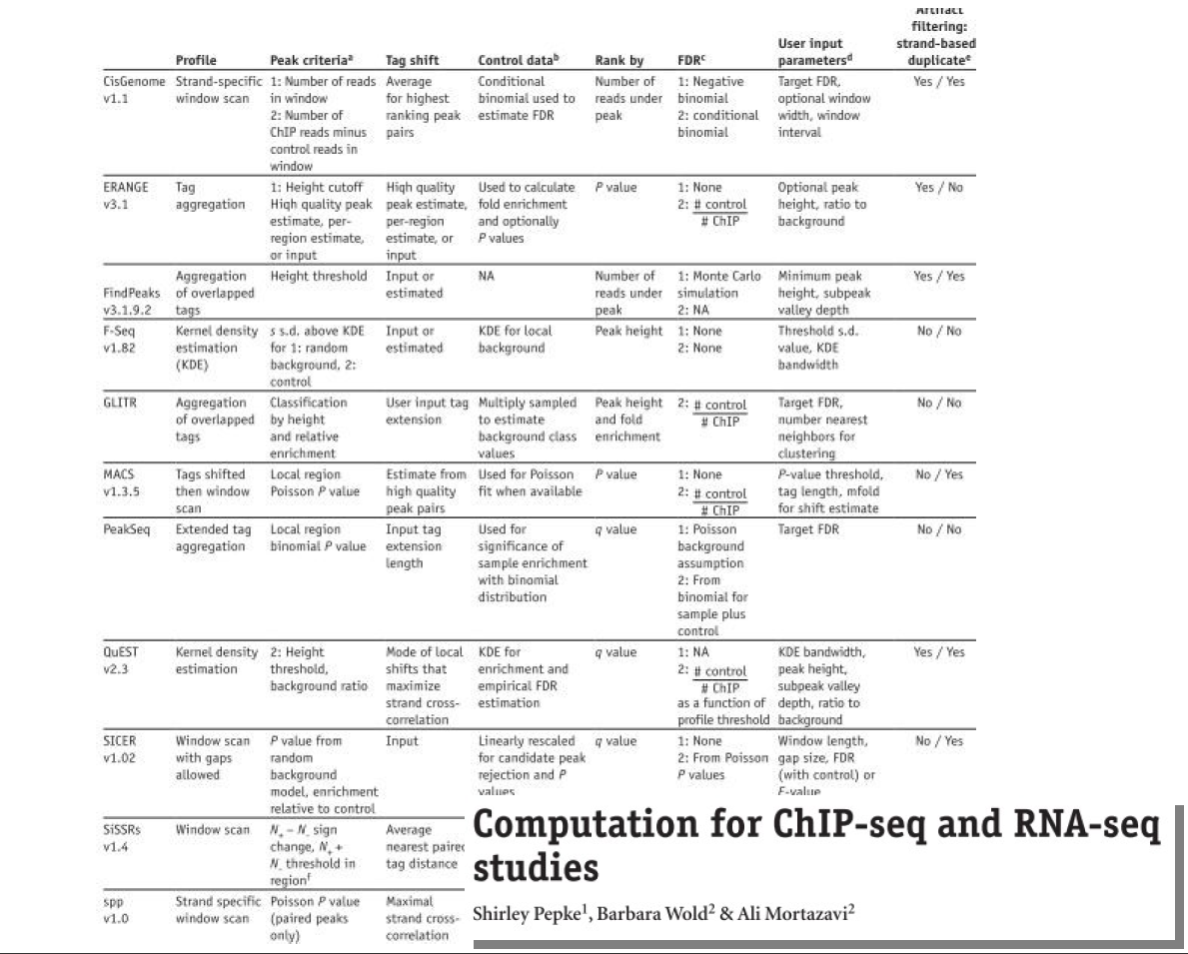

Slide 43
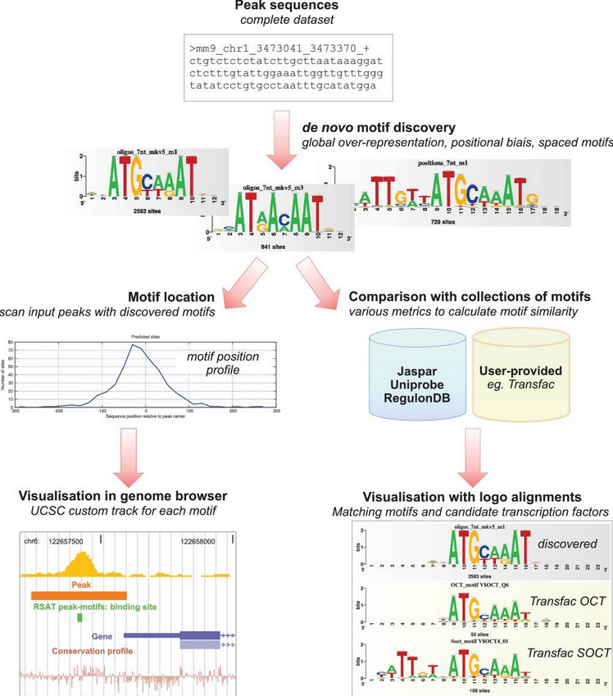
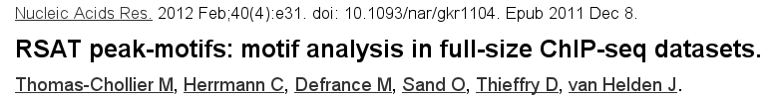
De novo motif discovery (Peak-motifs)

Slide 44
Annotating Peaks ?
Classical approach
  Associate Peaks to the nearest genes
  Check if the list of genes is enriched in gene related to :
      Pathways, GO terms, ...
 | Terme | !Terme
Liste | x | k-x | k
!Liste | m-x | n-(k-x) | N-k
 | m (white) | n (black) | N
N genes in the genome
m genes associated to a term (e.g. Cell cycle)
  marked genes
k genes (associated with peaks)
If no bias, we expect the same proportion or marked genes in k and in N.
Hypergeometric test: what is the probability to obtain by chance an intersection containing x or more genes ?
k
N
X
m

Slide 45
Nearest gene : problem
  Problem
    Associating peaks with gene located at n kb
      Discards lots of binding events (~ 50%)
    Associating peaks to the nearest gene
      Bias for genes within large intergenic regions
        These genes will tend to be associated frequently with peaks
        False positive enrichments ('multicellular organismal development')
  Solution
    GREAT: Annotate genomic regions

Slide 46
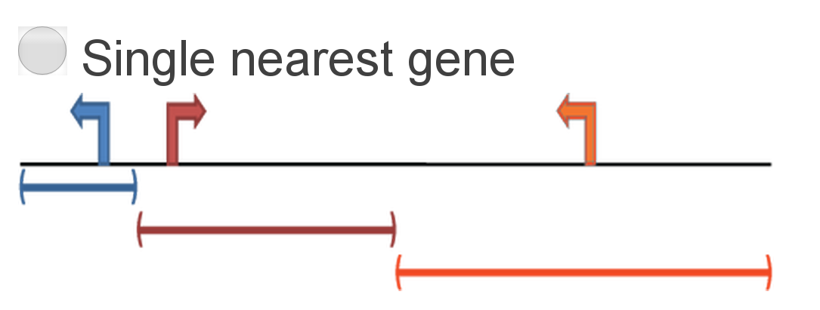
GREAT
GREAT (Genomic Regions Enrichment of Annotations Tool)
  Define gene regulatory domain around genes
    User may choose between several solutions
    E.g single nearest gene

Slide 47
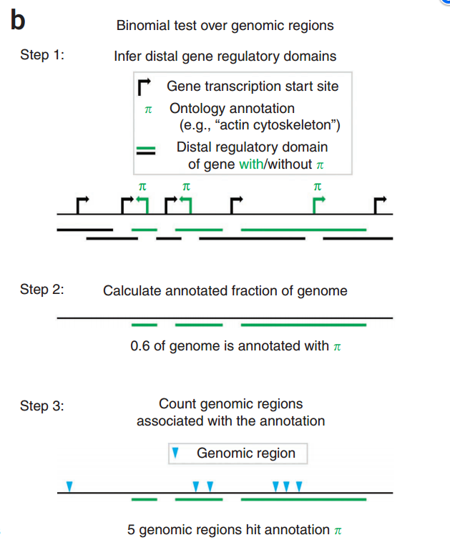
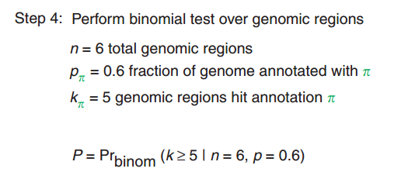
GREAT
Use a binomial test to check for enrichment

Slide 48
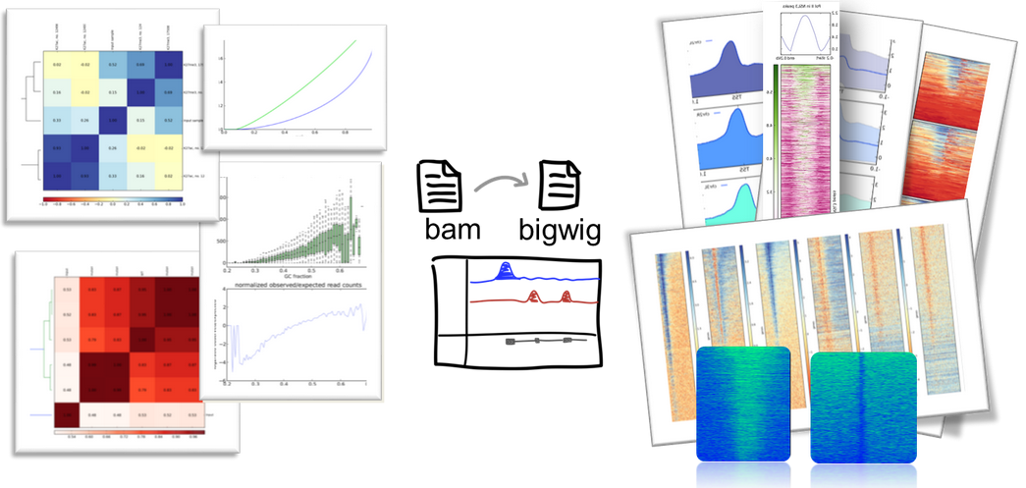
DeepTools
DeepTools: user-friendly tools for the normalization and visualization of deep-sequencing data

Slide 49
De novo motif discovery (Peak-motifs)

Slide 50
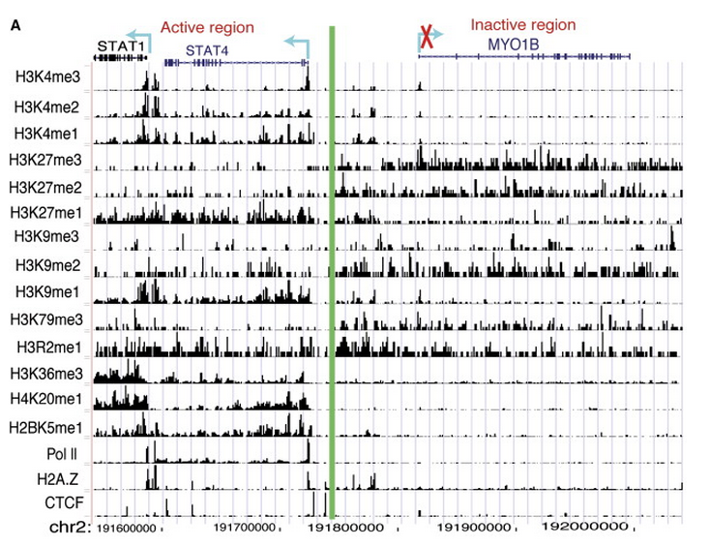
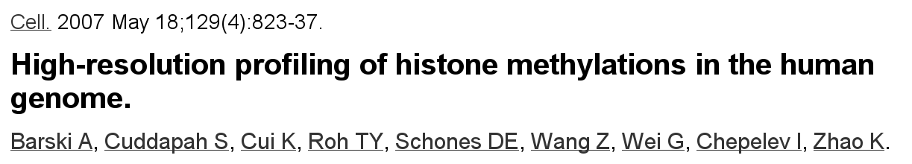
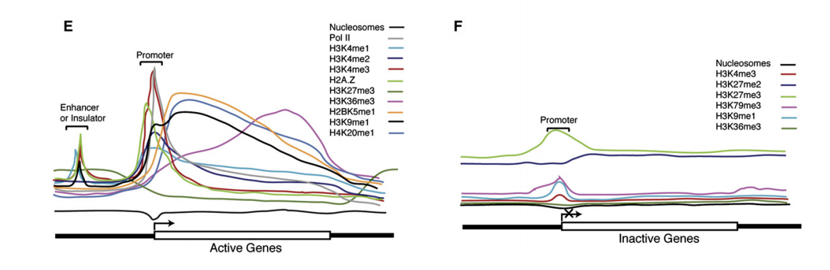
Histone modification profiles

Slide 51
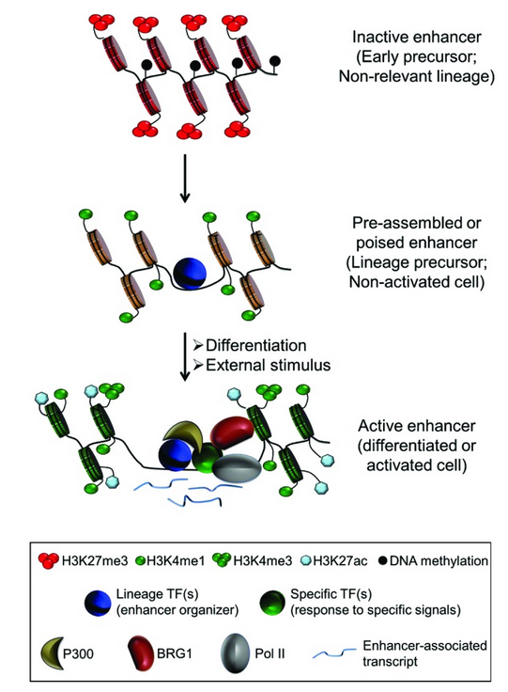

Epigenitic modifications at enhancer
Figure 2. Chromatin dynamics at tissue-specific enhancers during cell differentiation. In early precursors or non-relevant lineages, the enhancer region is cover by nucleosomes and often associated to repressive marks, such as H3K27me3 or DNA methylation. During differentiation, lineage-specific TFs (also called master regulators or enhancer organizers) bind to the majority of the tissue-specific enhancer repertoire. These enhancers are nucleosome free regions and enriched for H3K4me1, but are generally in a poised state. Subsequently, upon cell differentiation and/or external stimuli, induced or activated TFs binds to some of the accessible enhancers in order to fine-tune gene expression. Active enhancers are now associated with additional cofactors such as BRG1, p300 and Pol II and correlate with further nucleosome remodeling, acquisition of additional histone modifications, such as H3K27ac and H3K4me3, and local transcription.

Slide 52
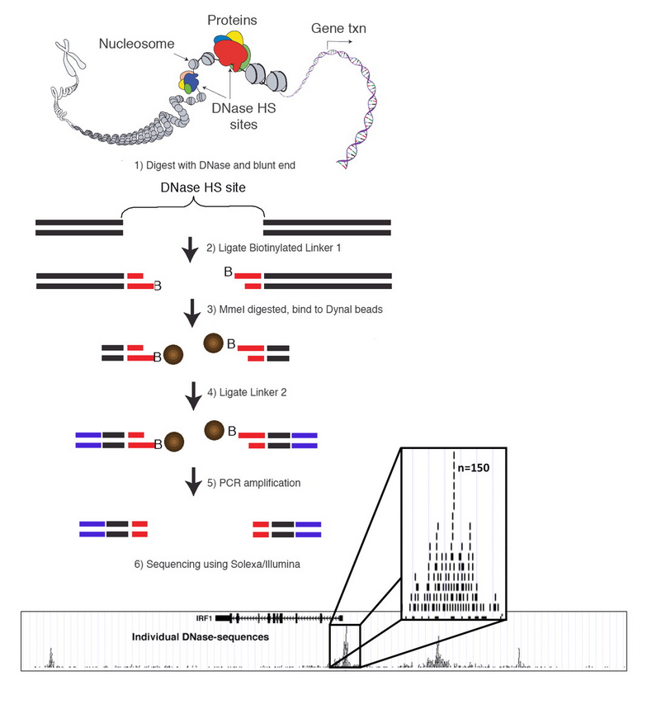
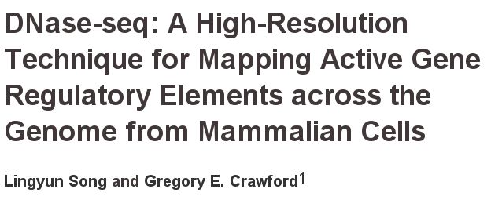
DNase-Seq

Slide 53
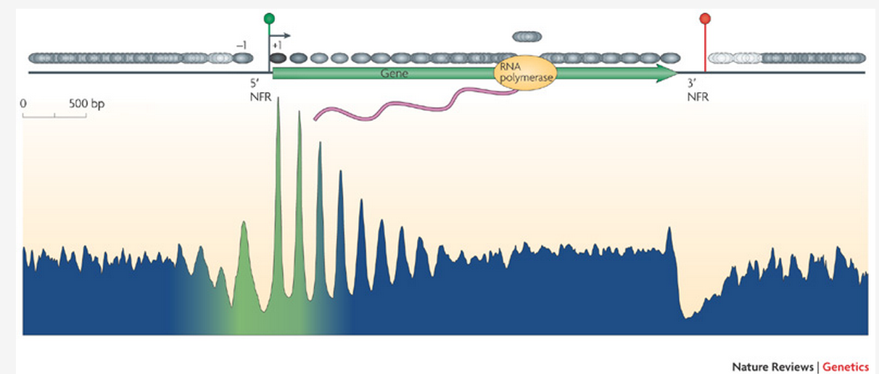
Nucleosome positioning
The consensus distribution of nucleosomes (grey ovals) around all yeast genes is shown, aligned by the beginning and end of every gene. The resulting two plots were fused in the genic region. The peaks and valleys represent similar positioning relative to the transcription start site (TSS). The arrow under the green circle near the 5' nucleosome-free region (NFR) represents the TSS. The green -blue shading in the plot represents the transitions observed in nucleosome composition and phasing (green represents high H2A.Z levels, acetylation, H3K4 methylation and phasing, whereas blue represents low levels of these modifications). The red circle indicates transcriptional termination within the 3' NFR. Figure is reproduced, with permission, from ref. 20 © (2008) Cold Spring Harbor Laboratory Press.

Slide 54
Data processing
& file formats

Slide 55
Fastq file format
Header
Sequence
+ (optional header)
Quality (default Sanger-style)
@QSEQ32.249996 HWUSI-EAS1691:3:1:17036:13000#0/1 PF=0 length=36
GGGGGTCATCATCATTTGATCTGGGAAAGGCTACTG
+
=.+5:<<<<>AA?0A>;A*A################
@QSEQ32.249997 HWUSI-EAS1691:3:1:17257:12994#0/1 PF=1 length=36
TGTACAACAACAACCTGAATGGCATACTGGTTGCTG
+
DDDD<BDBDB??BB*DD:D#################

Slide 56
Solid output
Read sequence in color (csfasta)
>1831_573_1004_F3
T00030133312212111300011021310132222
>1831_573_1567_F3
T03330322230322112131010221102122113
Quality scores (qual)
>1831_573_1004_F3
4 29 34 34 32 32 24 24 20 17 10 34 29 20 34 13 30 34 22 24 11 28 19 17 34 17 24 17 25 34 7 24 14 12 22
>1831_573_1567_F3
8 26 31 31 16 22 30 31 28 29 22 30 30 31 32 23 30 28 28 31 19 32 30 32 19 8 32 10 13 6 32 10 6 16 11

Slide 57
Solid output in fastq format
@1831_573_1004
T00030133312212111300011021310132222
+1831_573_1004
%>CCAA9952+C>5C.?C79,=42C292:C(9/-7
@1831_573_1004
T03330322230322112131010221102122113
+1831_573_1004
);@@17?@=>7??@A8?==@4A?A4)A+.'A+'1,

Slide 58
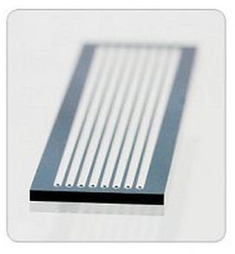
Illumina sequence identifiers
Sequences from the Illumina software use a systematic identifier:
@SRR038538.sra.2 HWI-EAS434:4:1:1:1701 length=36
NAATCGGAAATTTTATTTGTTCAGTACACCAAATAG
+SRR038538.sra.2 HWI-EAS434:4:1:1:1701 length=36
!0<<;:::<<<<<<<<<<<<<<;;;<<<<<<<<;76
HWI-EAS434 | Unique instrument name
4 | Flowcell lane
1 | Tile number within the flow cell
1 | 'x'-coordinate of the cluster within the tile
1701 | 'y'-coordinate
#0 | Index number for a multiplexed sample (opt.)
/1 | /1 or /2 for paired-end and maite-pair sequencing (opt.)

Slide 59
Sanger quality score
Sanger quality score (Phred quality score): Measure the quality of each base call
  Based on p, the probality of error (the probability that the corresponding base call is incorrect)
  Qsanger= -10*log10(p)
  p = 0.01 <=> Qsanger 20
Quality score are in ASCII 33
Note that SRA has adopted Sanger quality score although original fastq files may use different quality score (see: http://en.wikipedia.org/wiki/FASTQ_format)

Slide 60
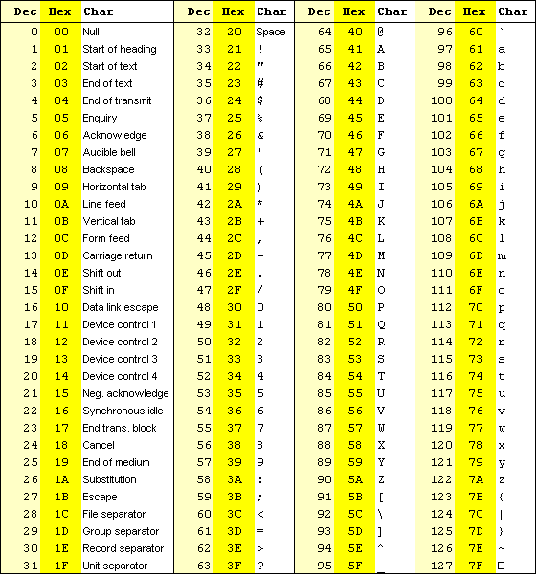
ASCII 33
Storing PHRED scores as single characters gave a simple and space efficient encoding:
Character ”!” means a quality of 0
Range 0-40

Slide 61
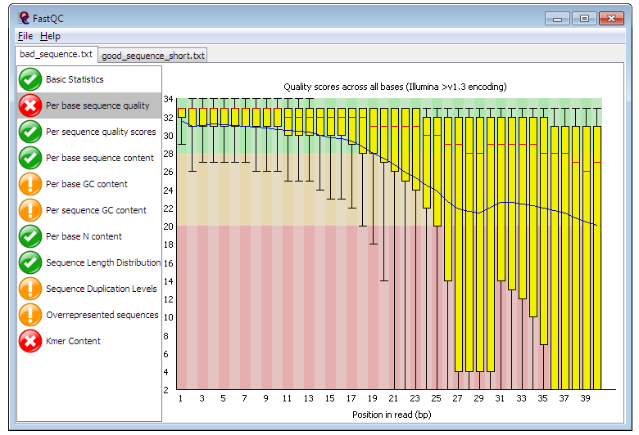
Quality control for high throughput sequence data
FastQC
  GUI / command line
  http://www.bioinformatics.bbsrc.ac.uk/projects/fastqc
  ShortRead
    Bioconductor package

Slide 62
Trimming
Essential step (at least when using bowtie)
  Almost mandatory when using tophat
FASTX-Toolkit
Sickle
  Window-based trimming (unpublished)
ShortRead
  Bioconductor package
csfasta_quality_filter.pl
  SOLiD
    Mean quality
    Continuous run of bad colors at the end of the read

Slide 63
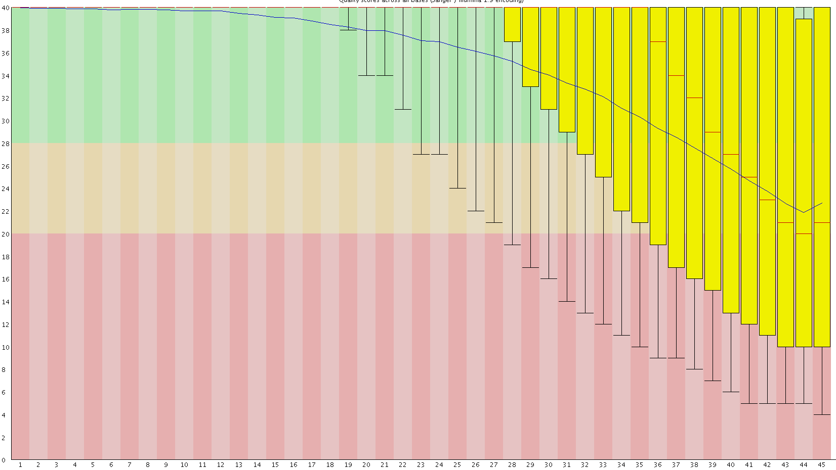
Quality control with FastQC
Quality
Position in read

Slide 64
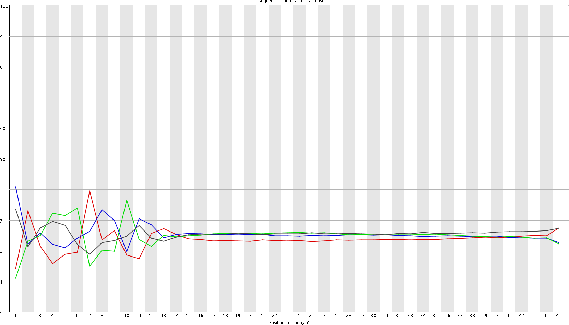

Quality control with FastQC
Position in read

Slide 65
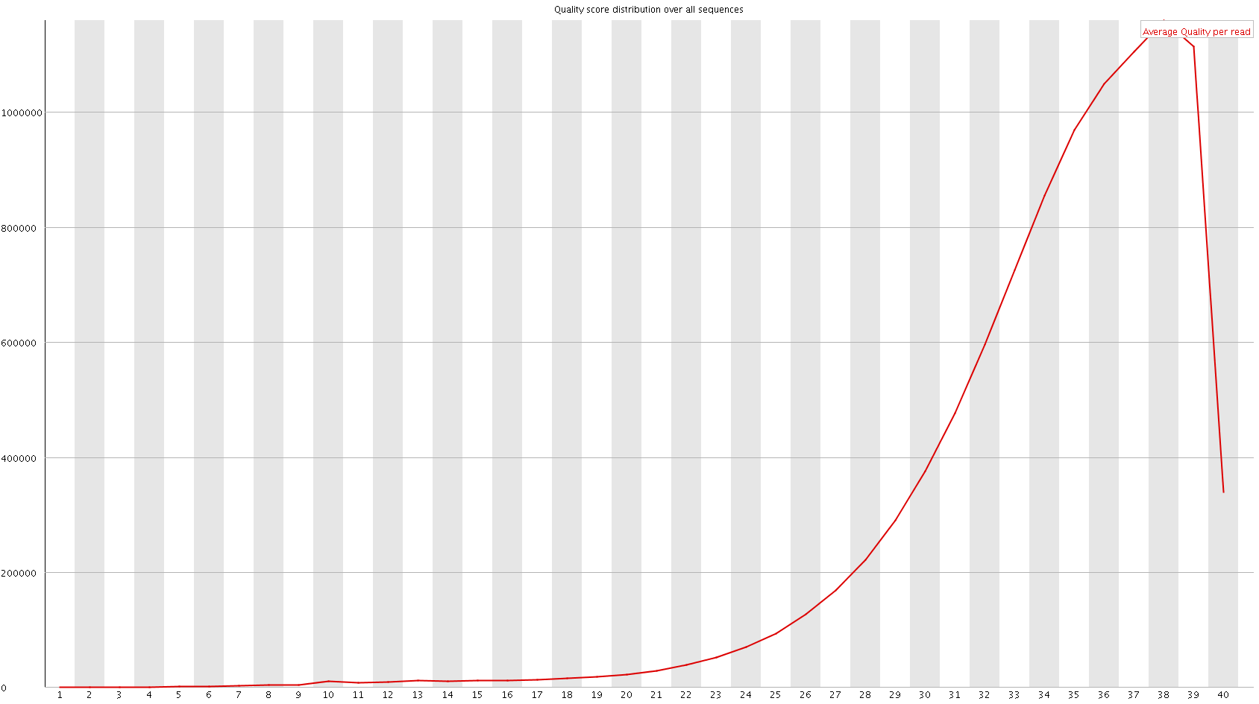
Quality control with FastQC
Nb Reads
Mean Phred Score

Slide 66
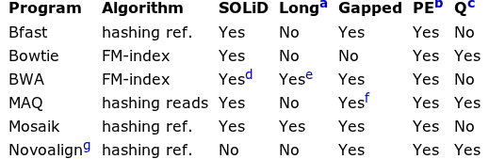
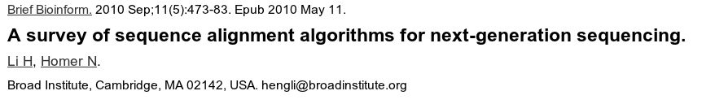
Mapping reads to genome: general softwares
ªWork well for Sanger and 454 reads, allowing gaps and clipping.
^{b}Paired end mapping.
^{c}Make use of base quality in alignment.dBWA trims the primer base and the first color for a color read.
^{e}Long-read alignment implemented in the BWA-SW module. fMAQ only does gapped alignment for Illumina paired-end reads.
^{g}Free executable for non-profit projects only.

Slide 67

Bowtie principle
Use highly efficient compressing and mapping algorithms based on Burrows Wheeler Transform (BWT)
The Burrows-Wheeler Transform of a text T, BWT(T), can be constructed as follows.
  The character $ is appended to T, where $ is a character not in T that is lexicographically less than all characters in T.
  The Burrows-Wheeler Matrix of T, BWM(T), is obtained by computing the matrix whose rows comprise all cyclic rotations of T sorted lexicographically.
acaacg$
caacg$a
aacg$ac
acg$aca
cg$acaa
g$acaac
$acaacg
$acaacg
aacg$ac
acaacg$
acg$aca
caacg$a
cg$acaa
g$acaac
1
2
3
4
5
6
7
7
3
1
4
2
5
6
T
BWT (T)
acaacg$
gc$aaac

Slide 68
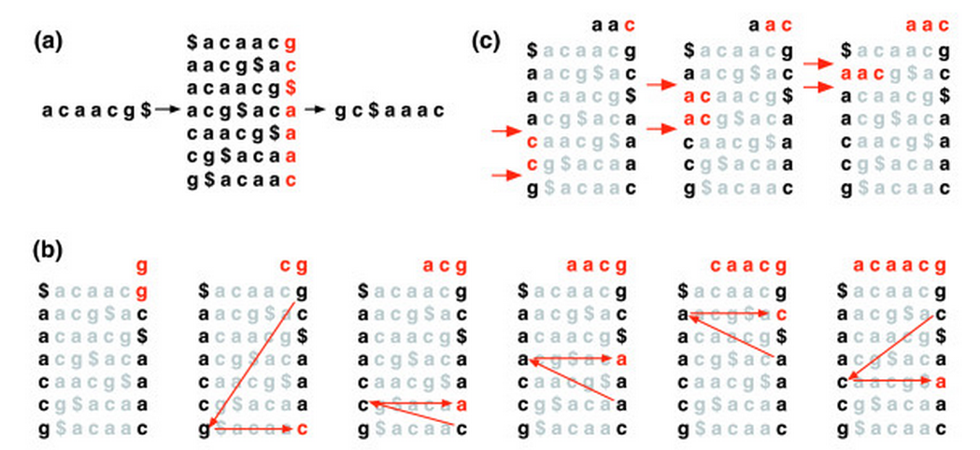
Bowtie principle
Burrows-Wheeler Matrices have a property called the Last First (LF) Mapping.
  The ith occurrence of character c in the last column corresponds to the same text character as the ith occurrence of c in the first column.
  Example: searching ”AAC” in ACAACG
7
3
1
4
2
5
6

Slide 69
Storing alignment: SAM Format
Store information related to alignement
  Read ID
  CIGAR String
  Bitwise FLAG
    read paired
    read mapped in proper pair
    read unmapped, ...
  Alignment position
  Mapping quality
  ...

Slide 70
Bitwise flag
read paired
read mapped in proper pair
read unmapped
mate unmapped
read reverse strand
mate reverse strand
first in pair
second in pair
not primary alignment
read fails platform/vendor quality checks
read is PCR or optical duplicate

Slide 71
Bitwise flag
00000000001 → 2^0 = 1 (read paired)
00000000010 → 2^1 = 2 (read mapped in proper pair)
00000000100 → 2^2 = 4 (read unmapped)
00000001000 → 2^3 = 8 (mate unmapped) …
00000010000 → 2^4 = 16 (read reverse strand)
00000001001 → 2^0+ 2^3 = 9 → (read paired, mate unmapped)
00000001101 → 2^0+2^2+2^3 =13 ...
...
http://picard.sourceforge.net/explain-flags.html

Slide 72
The extended CIGAR string
Exemple flags:
  M alignment match (can be a sequence match or mismatch)
  I insertion to the reference
  D deletion from the reference
  http://samtools.sourceforge.net/SAM1.pdf
ATTCAGATGCAGTA
ATTCA--TGCAGTA
ATTCAGATGCAGTA
ATTCA--TGCAGTA
5M2D7M

Slide 73
Mapping reads
Main Issues:
  Number of multi­hits
    Issue with short reads → mappability
  PCR duplicates
    Warning with ChIP-Seq (library complexity)
  Number of allowed mismatches
    Depend on sequence size (sometimes heterogeneous length)
    Depend of the aligner

Slide 74

Mappability
Sequence uniqueness of the reference
These tracks display the level of sequence uniqueness of the reference NCBI36/hg18 genome assembly. They were generated using different window sizes, and high signal will be found in areas where the sequence is unique.

Slide 75
Compressing and indexing files
Needed before visualization in Genome Browser
Or use Galaxy or IGVtools
[u@m] samtools view output.bam # output SAM format
[u@m] samtools sort output.bam output.sorted
[u@m] samtools index output.sorted.bam

Slide 76

Sequence read Archive (SRA)
The SRA archives high-throughput sequencing data that are associated with:
RNA-Seq, ChIP-Seq, and epigenomic data that are submitted to GEO

Slide 77


SRA growth

Slide 78
SRA Concepts
Data submitted to SRA is organized using a metadata model consisting of six objects:
Study – A set of experiments with an overall goal and literature references.
Experiment – An experiment is a consistent set of laboratory operations on input material with an expected result.
Sample – An experiment targets one or more samples. Results are expressed in terms of individual samples or bundles of samples as defined by the experiment.
Run – Results are called runs. Runs comprise the data gathered for a sample or sample bundle and refer to a defining experiment.

Slide 79
Getting fastq files using SRA toolkit
*.sra to fastq conversion
Fastq-dump
Note: use –split-files argument for paired-end library
fastq-dump -A SRRxxxx.sra

Slide 80
Merci

