Slide 1
Introduction to transcriptome analysis using High­Throughput Sequencing technologies
D. Puthier
2012

Slide 2
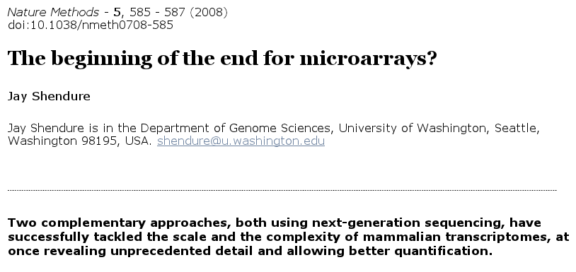
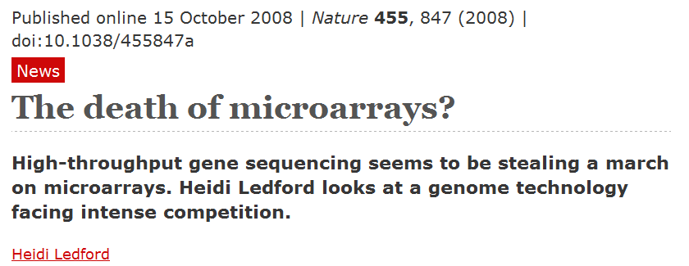
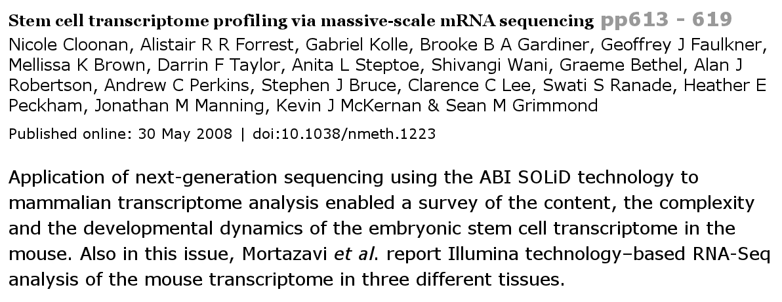
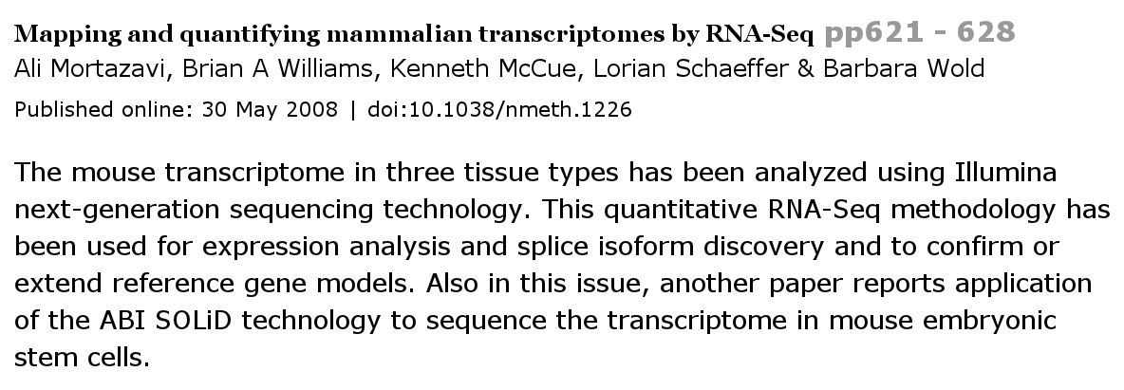

Slide 4
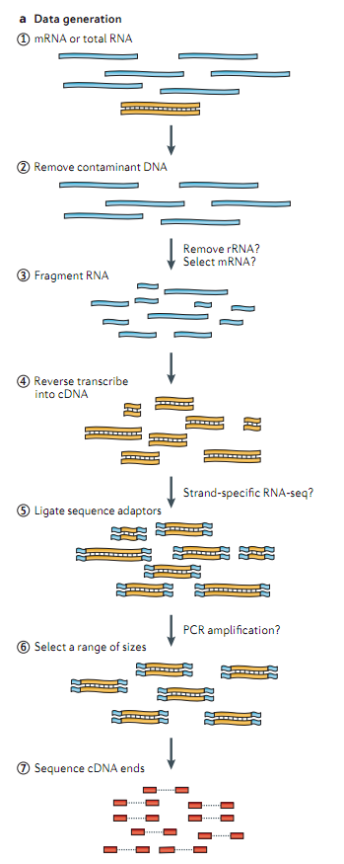

A typical RNA-Seq experiment
Library construction

Slide 5
Protocol variations
Fragmentation methods
  RNA: nebulization, magnesium-catalyzed hydrolysis, enzymatic clivage (RNAse III)
  cDNA: sonication, Dnase I treatment
Depletion of highly abundant transcripts
  Ribosomal RNA (rRNA)
    Positive selection of mRNA . Poly(A) selection.
    Negative selection. (RiboMinusTM)
      Select also pre-messenger
Strand speciﬁcity
  Most RNA sequencing is not strand-speciﬁc
Single-end or Paired-end sequencing
http://www.bioconductor.org/help/course-materials/2009/EMBLJune09/Talks/RNAseq-Paul.pdf
Notes:
The NEBNext RNase III RNA Fragmentation Module uses a riboendonuclease that cleaves long double stranded RNAs into RNA fragments with 5' phosphate and 3' hydroxyl termini. The NEBNext® Magnesium RNA Fragmentation module uses a divalent metal ion (Mg++) and heat to fragment RNA; creating RNA fragments with 5’ hydroxyl and 3’phosphate termini.

Slide 6
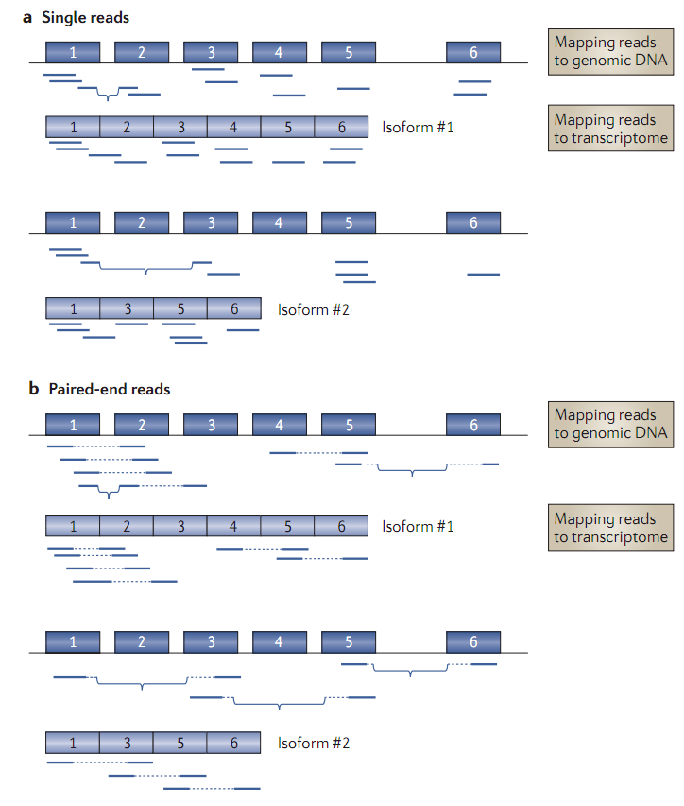
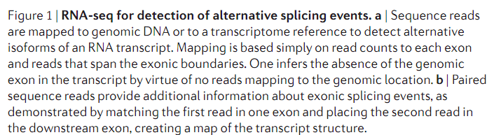
Single and paired-end sequencing

Slide 7
Microarrays versus RNA-seq
RNA-seq
  Counting
  Absolute abundance of transcripts
  All transcripts are present and can be analyzed
    mRNA / ncRNA (snoRNA, linc/lncRNA, eRNA,miRNA,...)
  Several types of analyses
    Gene discovery
    Gene structure (new transcript models)
    Differential expression
      Gene/isoforms
    Allele specific gene expression
    Detection of fusions and other structural variations
    ...

Slide 8
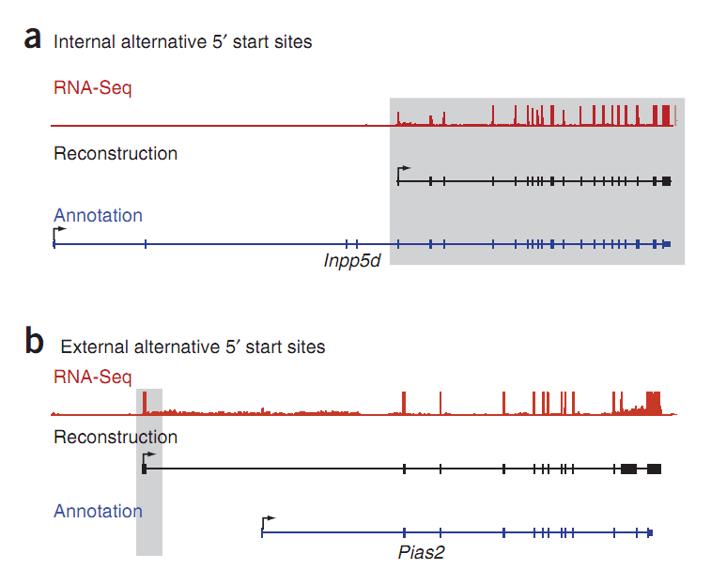
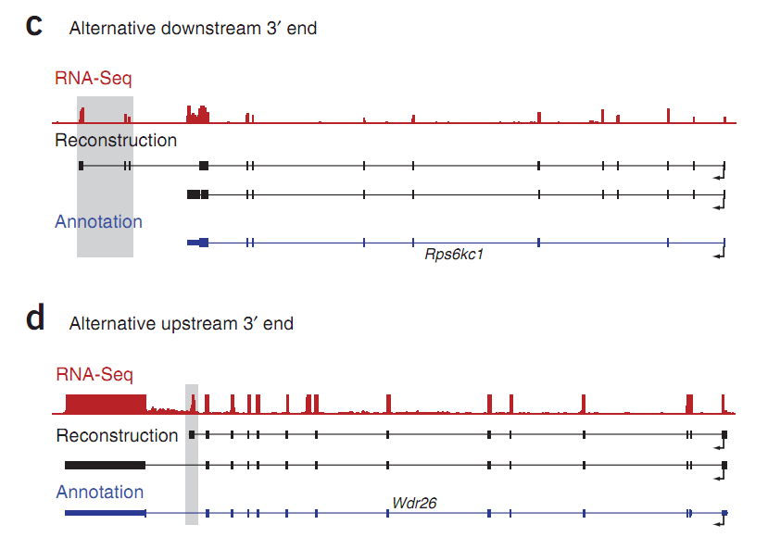
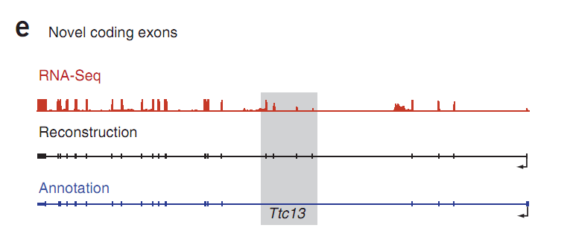
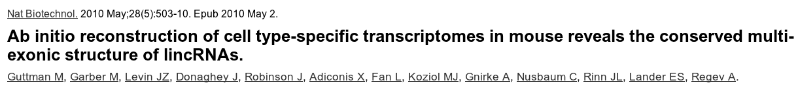
Microarrays versus RNA-seq

Slide 9
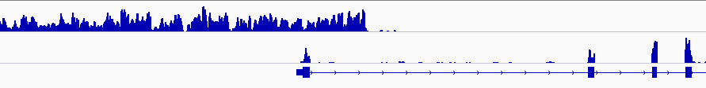
Microarrays versus RNA-seq
Strand-specific analysis

Slide 10
Microarrays versus RNA-seq
Microarrays
  Indirect record of expression level (complementary probes)
  Relative abundance
  Cross-hybridization
  Content limited (can only show you what you're already looking for)

Slide 11
Some RNA-Seq drawbacks
Current disadvantages
  More expensive than standard expression arrays
  More time consuming than any microarray technology
  Some (lots of) data analysis issues
    Mapping reads to splice junctions
    Computing accurate transcript models
    Contribution of high-abundance RNAs (eg ribosomal) could dilute the remaining transcript population; sequencing depth is important
http://www.bioconductor.org/help/course-materials/2009/EMBLJune09/Talks/RNAseq-Paul.pdf

Slide 12
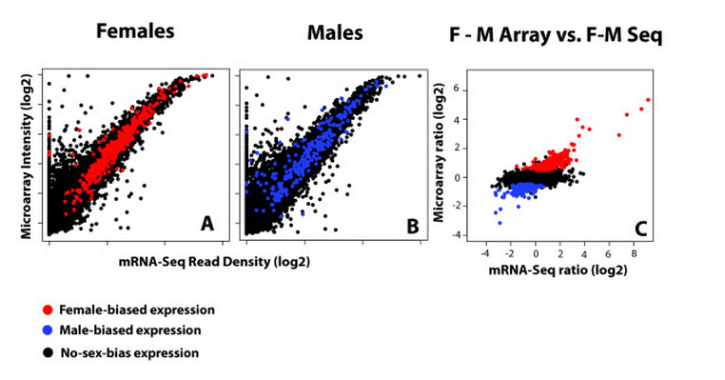

Do arrays and RNA-Seq tell a consistent story?
Do arrays and RNA-Seq tell a consistent story?
  ”The relationship is not quite linear … but the vast majority of the expression values are similar between the methods. Scatter increases at low expression … as background correction methods for arrays are complicated when signal levels approach noise levels. Similarly, RNA-Seq is a sampling method and stochastic events become a source of error in the quantification of rare transcripts ”
  ”Given the substantial agreement between the two methods, the array data in the literature should be durable”
Comparison of array and RNA-Seq data for measuring differential gene expression in the heads of male and female D. pseudoobscura

Slide 13
Sequencing technologies
RNA-Seq has been performed using SOLiD, Illumina and 454 platform
  However, RNA-Seq needs high dynamic range
    SOLiD and Illumina sequencers
    Need PCR amplification
      Low coverage of GC rich transcrits
  Future ?
    Helicos
      No PCR amplification
      Direct RNA sequencing seem possible
      High error rates
    Pacific Biosciences

Slide 14
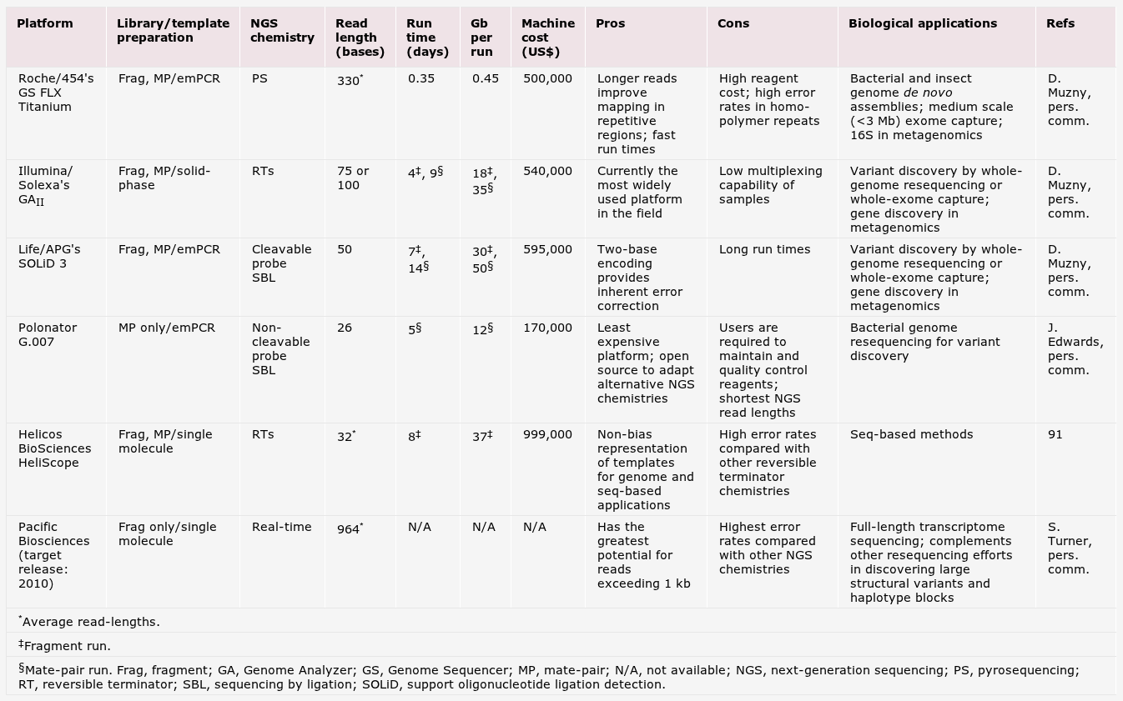
Sequencing technologies

Slide 15
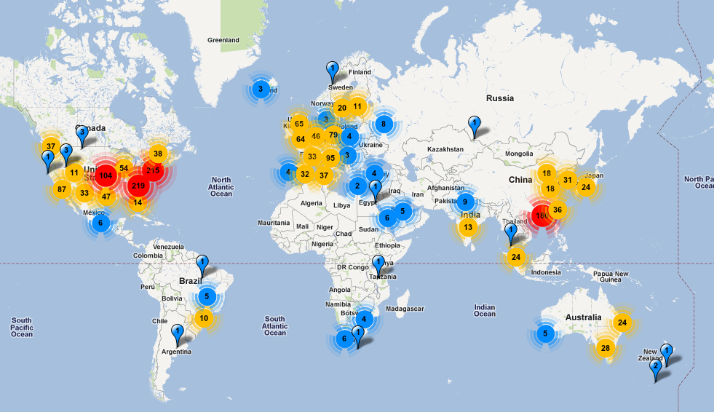
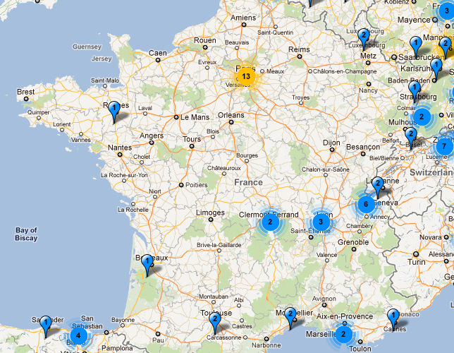
World Map of High-throughput Sequencers

Slide 16
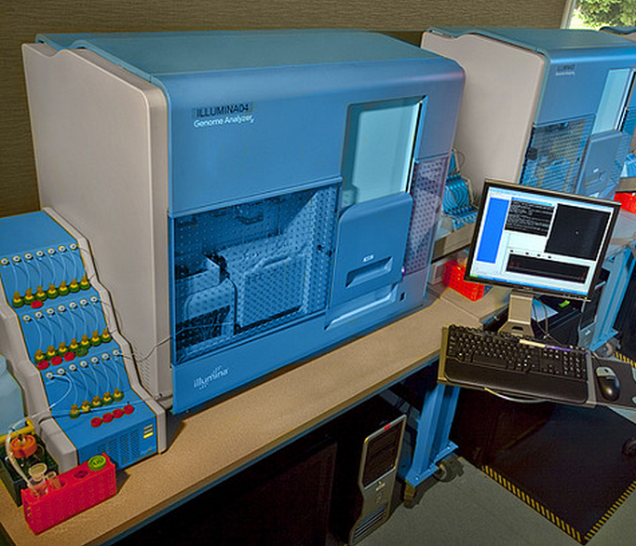
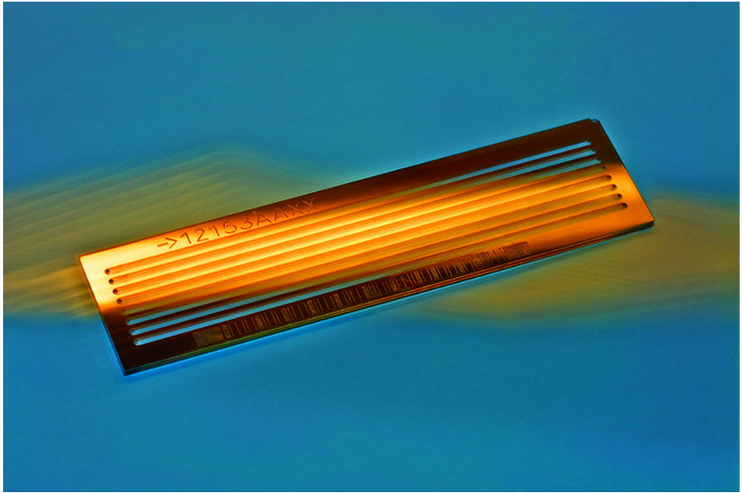
Illumina

Slide 17
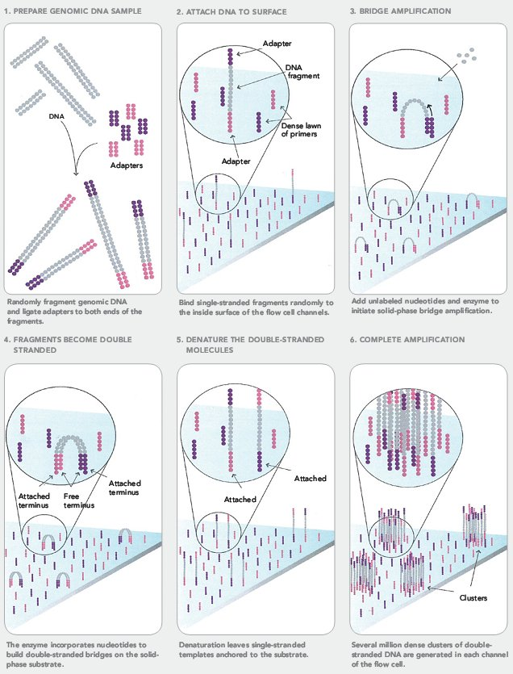
Illumina Genome Analyzer (I)

Slide 18
Illumina Genome Analyzer (II)

Slide 19
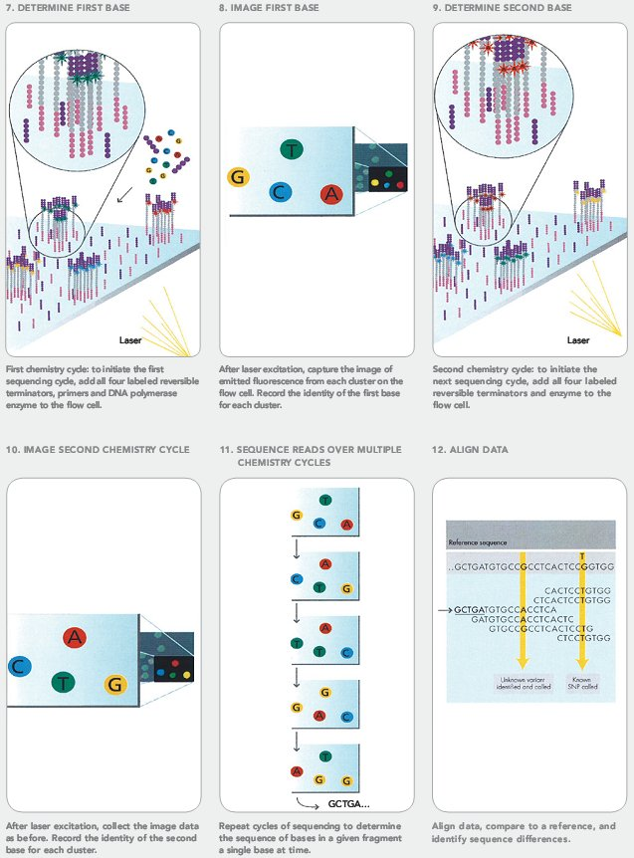
Illumina Genome Analyzer (III)

Slide 20
Illumina Genome Analyzer

Slide 21
Illumina Genome Analyzer

Slide 22
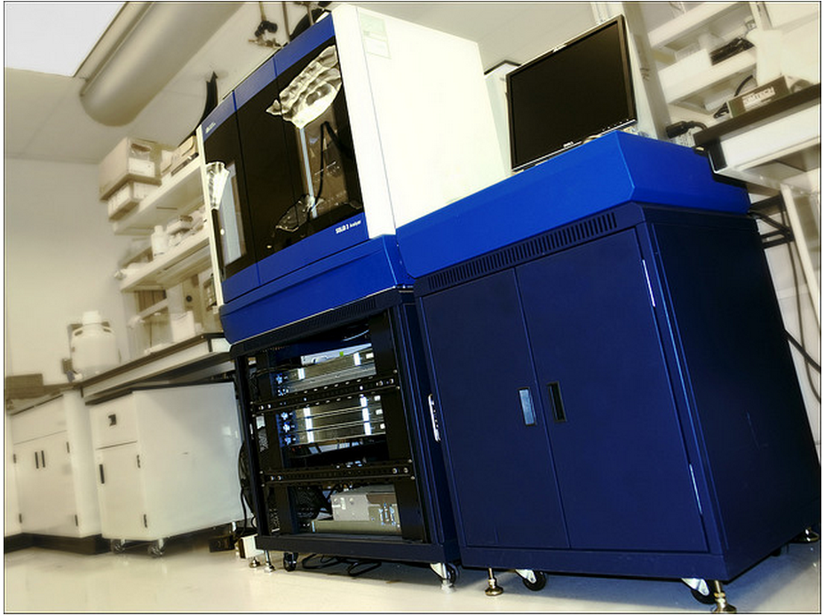
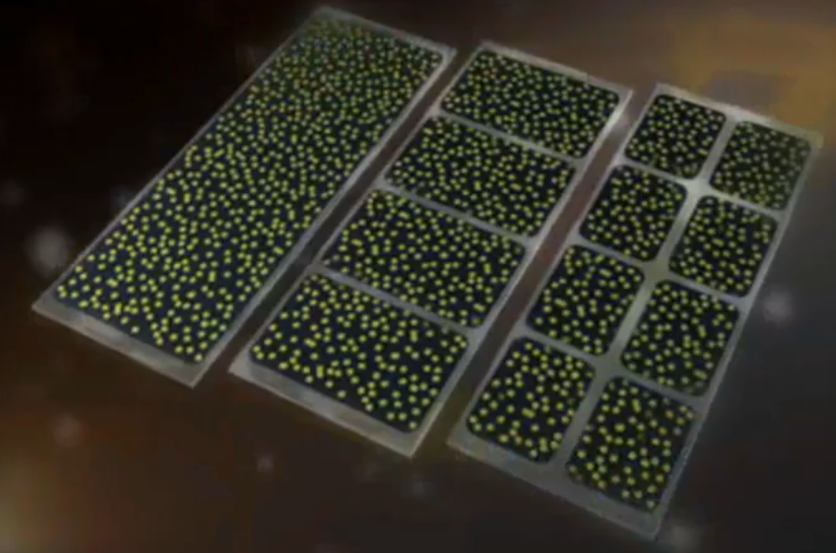
ABI Next Gen Sequencing: SOLiD
http://www.flickr.com/photos/ricardipus/4452215186/

Slide 23
ABI Next Gen Sequencing: SOLiD
Use emPCR on magnetic beads
Sequencing by ligation using fluorescent probes

Slide 24
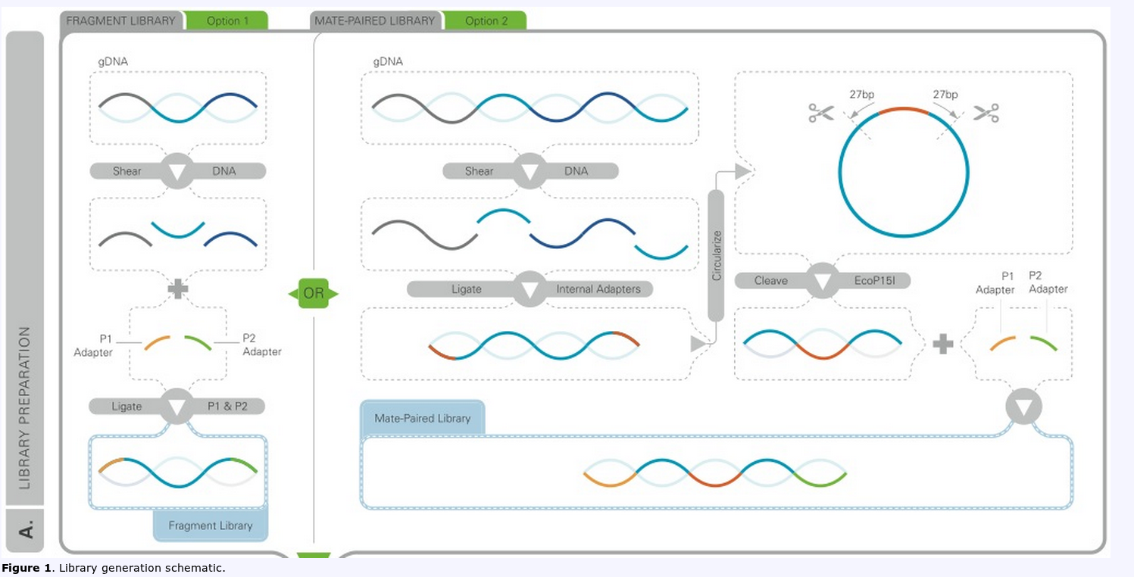
Sequencing by ligation (SOLiD)

Slide 25
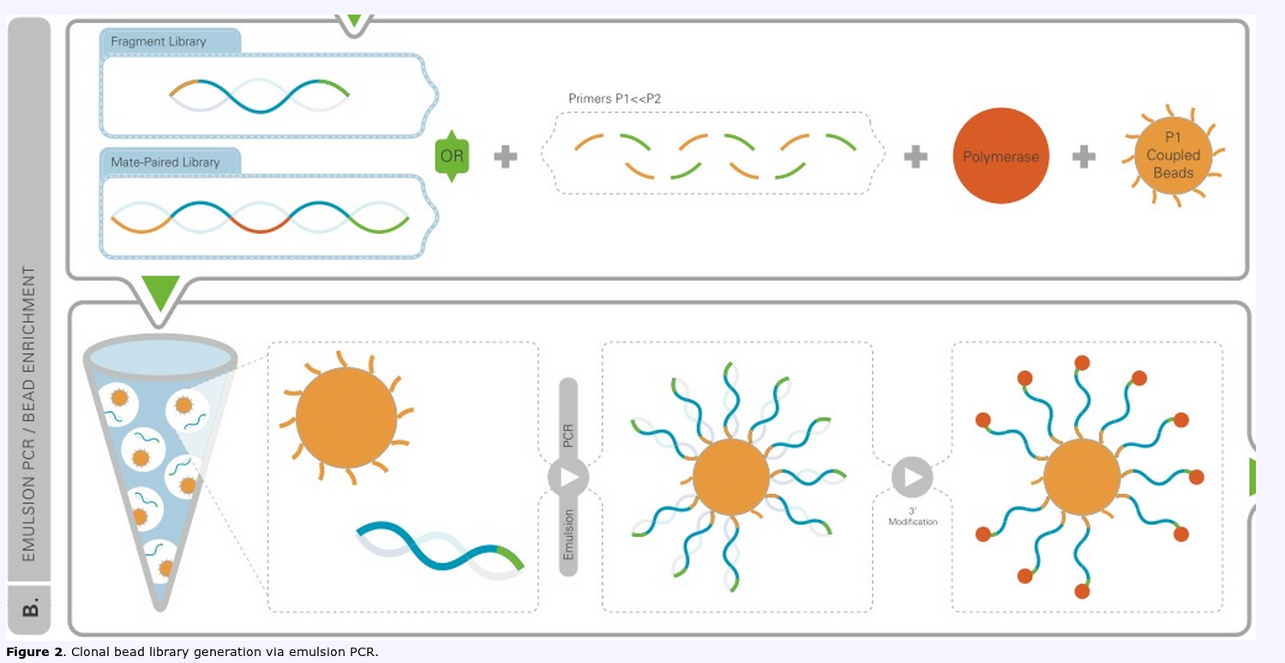
Sequencing by ligation (SOLiD)

Slide 26
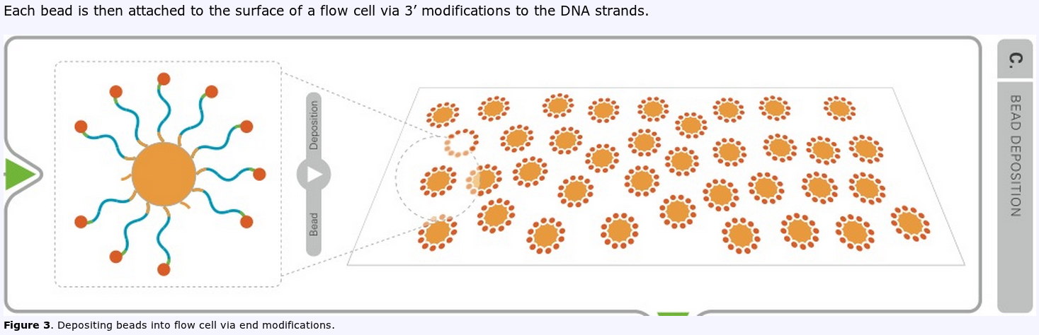
Sequencing by ligation (SOLiD)

Slide 27
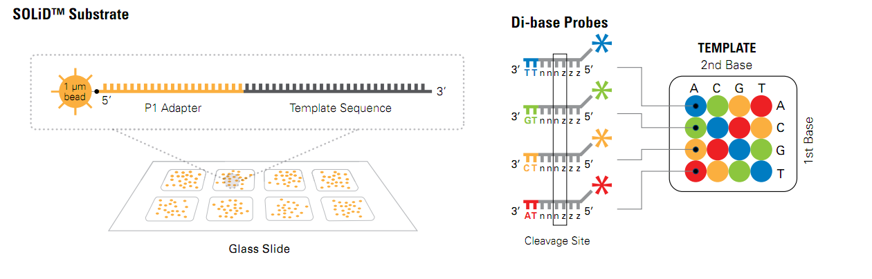
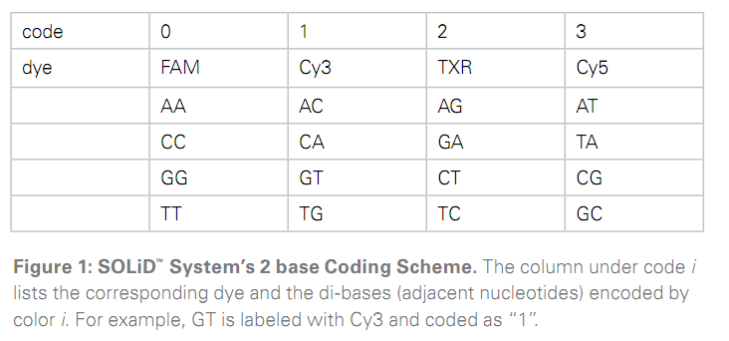
Sequencing by ligation (SOLiD)
We have a flow cell (basically a microscope slide that can be serially exposed to any liquids desired) whose surface is coated with thousands of beads each containing a single genomic DNA species, with unique adapters on either end. Each microbead can be considered a separate sequencing reaction which is monitored simultaneously via sequential digital imaging. Up to this point all next-gen sequencing technologies are very similar, this is where ABI/SOLiD diverges dramatically (see figure 4)

Slide 28
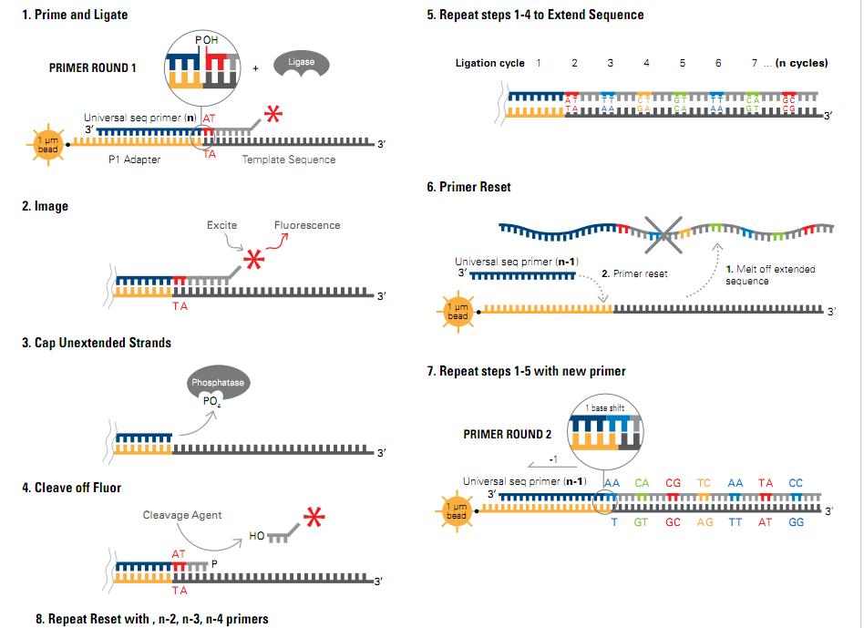
Sequencing by ligation (SOLiD)

Slide 29
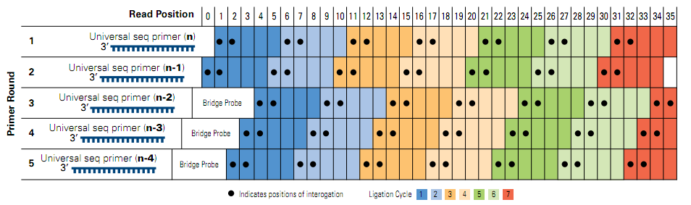
Sequencing by ligation (SOLiD)

Slide 30
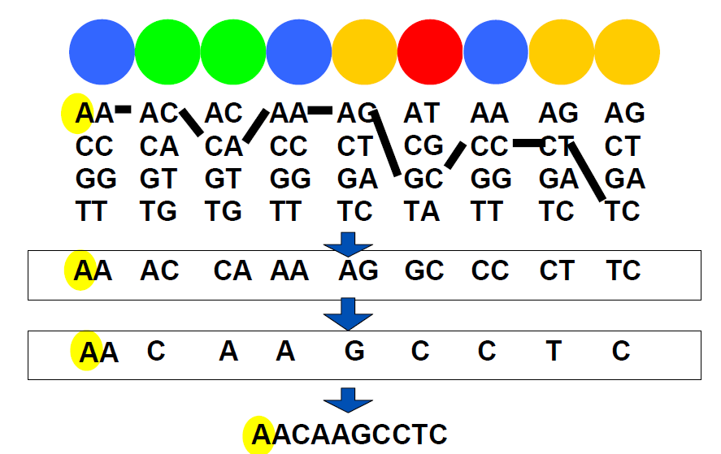
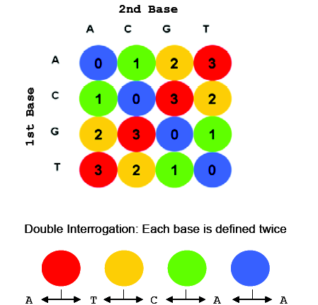
Sequencing by ligation (SOLiD)
According to colour code table four different dinucleotides may correspond to the same colour.
  This ambiguity is resolved using primer n-1 round
    The first ligation of this primer round analyses dinucleotide with one known nucleotide

Slide 31
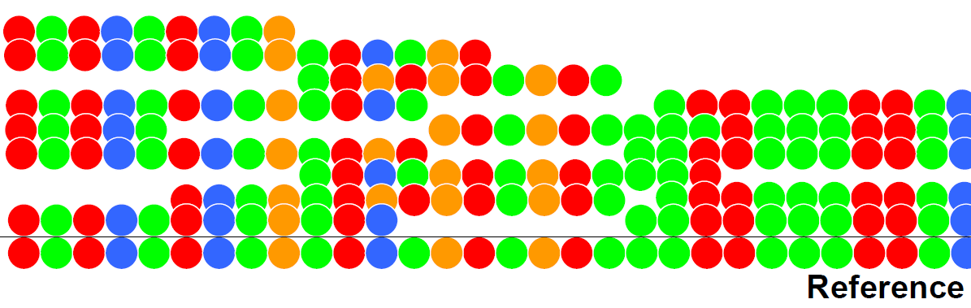
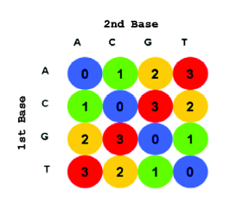
Sequencing by ligation (SOLiD)
Alignements are performed in color space
  Alignments of nucleotide transitions

Slide 32
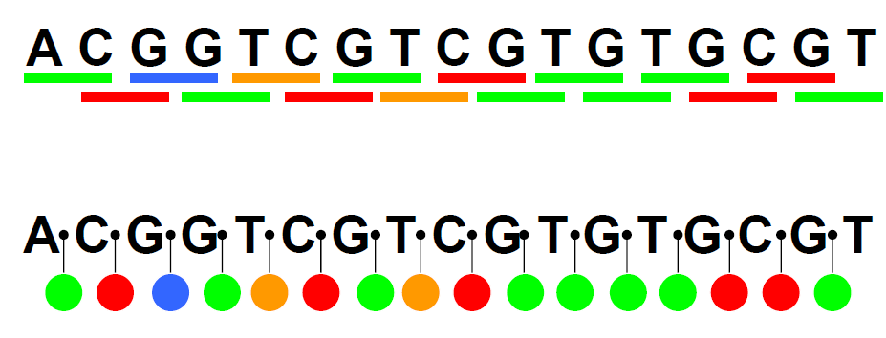
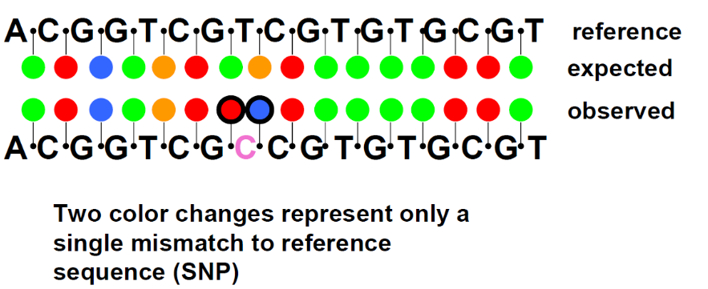
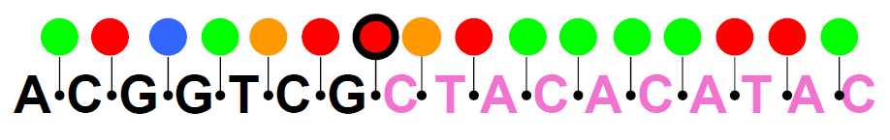
Advantages of 2 base pair encoding
Double base interrogation eases the discrimination between system errors and true polymorphisms
SNP
Error

Slide 33
Fastq file format
Header
Sequence
+ (optional header)
Quality (default Sanger-style)
@QSEQ32.249996 HWUSI-EAS1691:3:1:17036:13000#0/1 PF=0 length=36
GGGGGTCATCATCATTTGATCTGGGAAAGGCTACTG
+
=.+5:<<<<>AA?0A>;A*A################
@QSEQ32.249997 HWUSI-EAS1691:3:1:17257:12994#0/1 PF=1 length=36
TGTACAACAACAACCTGAATGGCATACTGGTTGCTG
+
DDDD<BDBDB??BB*DD:D#################

Slide 34
Solid output
Read sequence in color (csfasta)
>1831_573_1004_F3
T00030133312212111300011021310132222
>1831_573_1567_F3
T03330322230322112131010221102122113
Quality scores (qual)
>1831_573_1004_F3
4 29 34 34 32 32 24 24 20 17 10 34 29 20 34 13 30 34 22 24 11 28 19 17 34 17 24 17 25 34 7 24 14 12 22
>1831_573_1567_F3
8 26 31 31 16 22 30 31 28 29 22 30 30 31 32 23 30 28 28 31 19 32 30 32 19 8 32 10 13 6 32 10 6 16 11

Slide 35
Solid output in fastq format
@1831_573_1004
T00030133312212111300011021310132222
+1831_573_1004
%>CCAA9952+C>5C.?C79,=42C292:C(9/-7
@1831_573_1004
T03330322230322112131010221102122113
+1831_573_1004
);@@17?@=>7??@A8?==@4A?A4)A+.'A+'1,

Slide 36
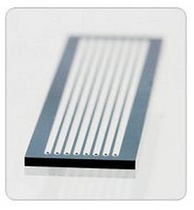
Illumina sequence identifiers
Sequences from the Illumina software use a systematic identifier:
@SRR038538.sra.2 HWI-EAS434:4:1:1:1701 length=36
NAATCGGAAATTTTATTTGTTCAGTACACCAAATAG
+SRR038538.sra.2 HWI-EAS434:4:1:1:1701 length=36
!0<<;:::<<<<<<<<<<<<<<;;;<<<<<<<<;76
HWI-EAS434 | Unique instrument name
4 | Flowcell lane
1 | Tile number within the flow cell
1 | 'x'-coordinate of the cluster within the tile
1701 | 'y'-coordinate
#0 | Index number for a multiplexed sample (opt.)
/1 | /1 or /2 for paired-end and maite-pair sequencing (opt.)

Slide 37
Sanger quality score
Sanger quality score (Phred quality score): Measure the quality of each base call
  Based on p, the probality of error (the probability that the corresponding base call is incorrect)
  Qsanger= -10*log10(p)
  p = 0.01 <=> Qsanger 20
Quality score are in ASCII 33
Note that SRA has adopted Sanger quality score although original fastq files may use different quality score (see: http://en.wikipedia.org/wiki/FASTQ_format)

Slide 38
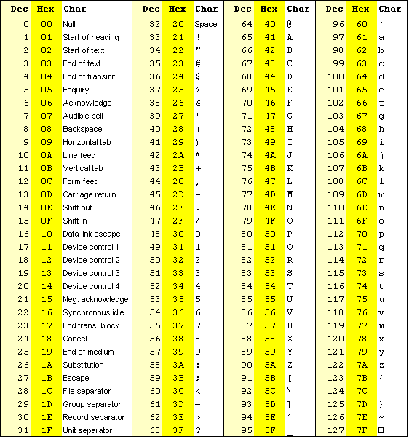
ASCII 33
Storing PHRED scores as single characters gave a simple and space efficient encoding:
Character ”!” means a quality of 0
Range 0-40

Slide 39
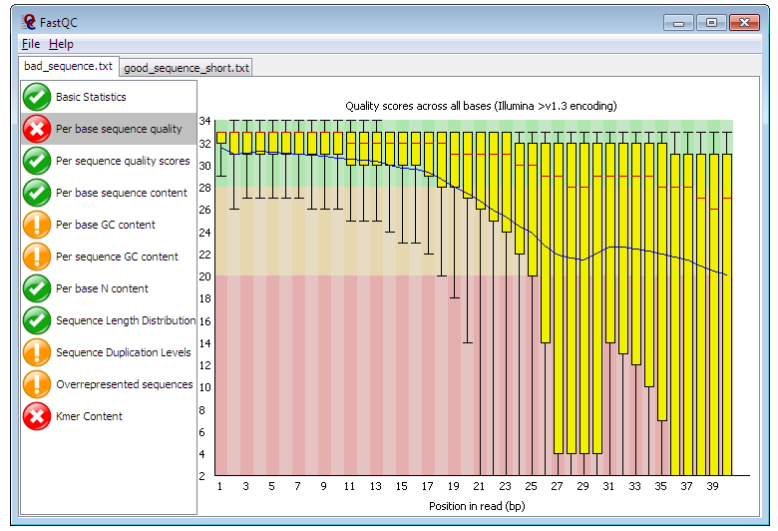
Quality control for high throughput sequence data
FastQC
  GUI / command line
  http://www.bioinformatics.bbsrc.ac.uk/projects/fastqc
  ShortRead
    Bioconductor package

Slide 40
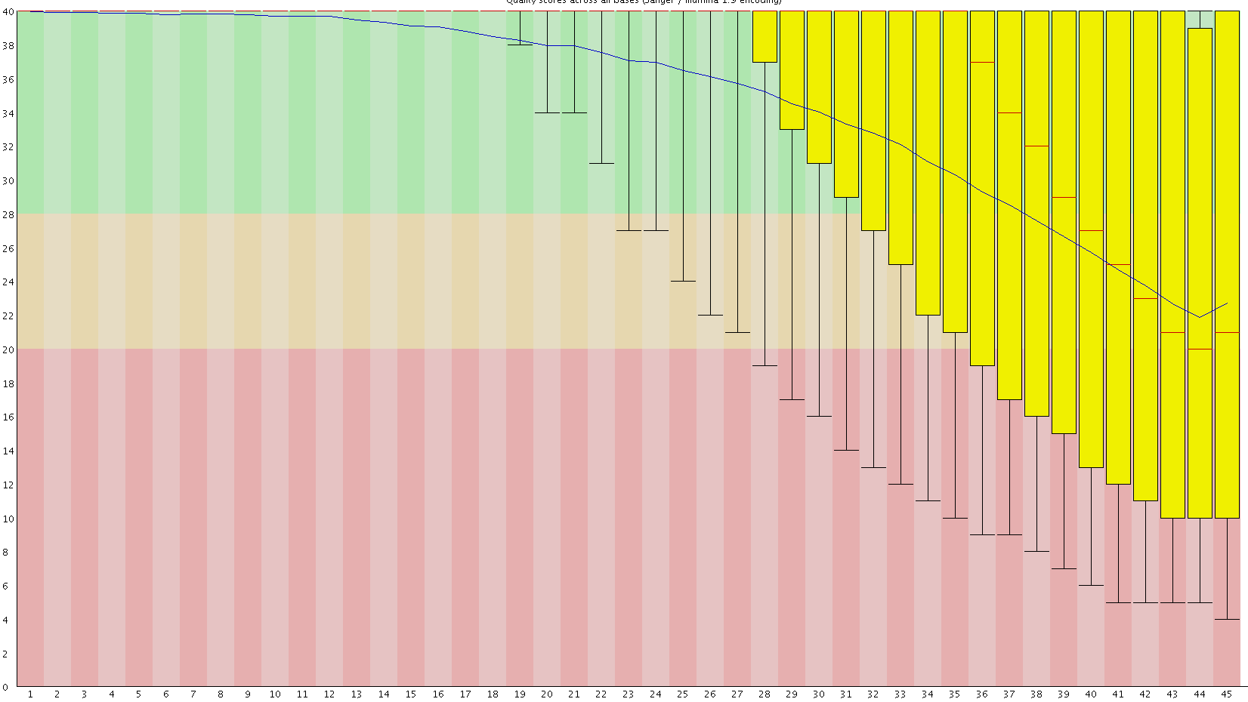
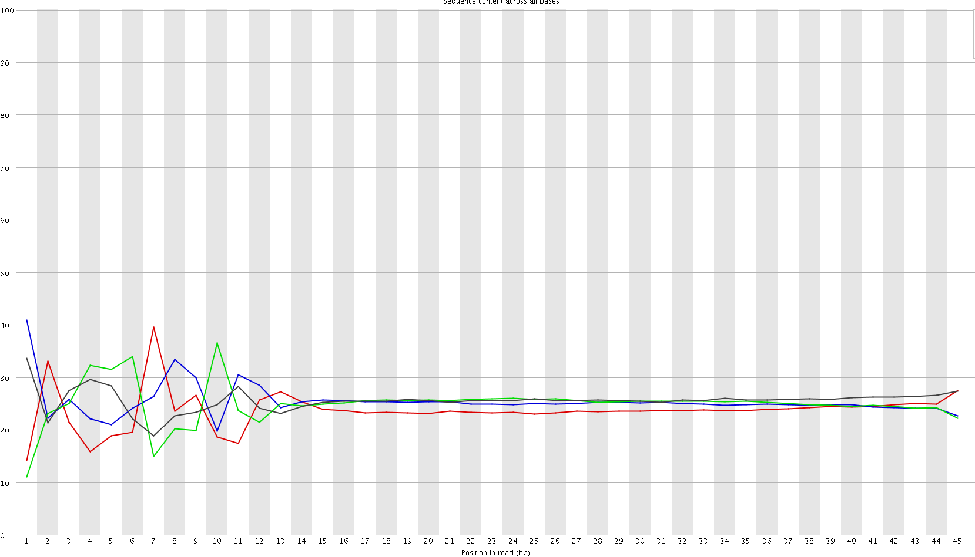

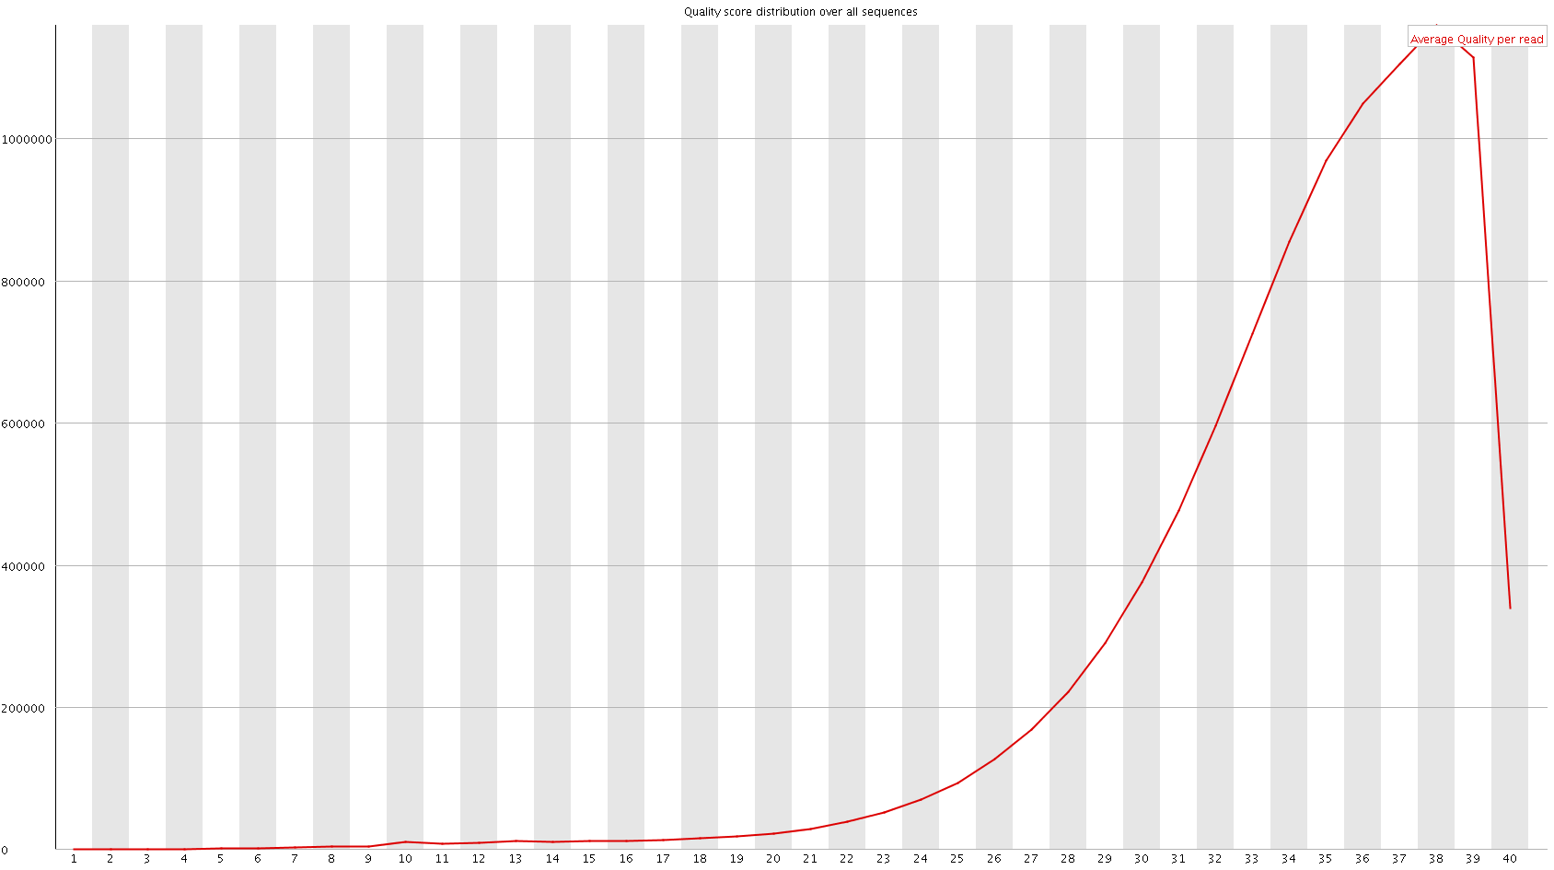
Quality control with FastQC
Quality
Position in read
Position in read
Look also at over-represented sequences
Nb Reads
Mean Phred Score

Slide 41
Trimming
Essential step (at least when using bowtie)
  Almost mandatory when using tophat
FASTX-Toolkit
Sickle
  Window-based trimming (unpublished)
ShortRead
  Bioconductor package
csfasta_quality_filter.pl
  SOLiD
    Mean quality
    Continuous run of bad colors at the end of the read

Slide 42
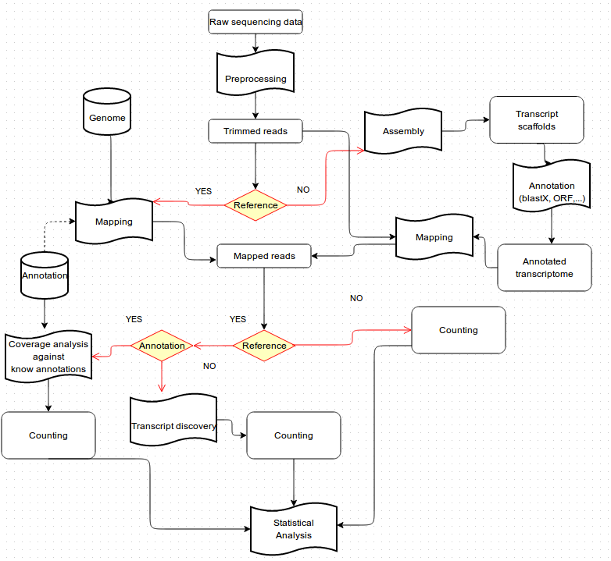
Reference mapping and de novo assembly

Slide 43
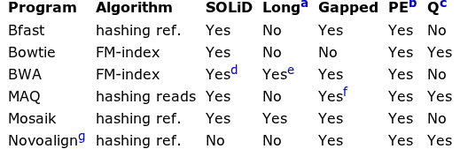
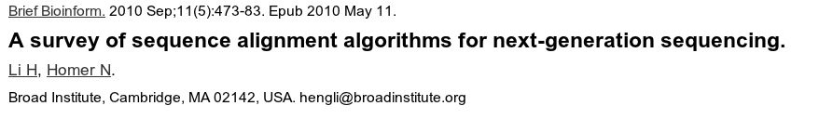
Mapping reads to genome: general softwares
ªWork well for Sanger and 454 reads, allowing gaps and clipping.
^{b}Paired end mapping.
^{c}Make use of base quality in alignment.dBWA trims the primer base and the first color for a color read.
^{e}Long-read alignment implemented in the BWA-SW module. fMAQ only does gapped alignment for Illumina paired-end reads.
^{g}Free executable for non-profit projects only.

Slide 44

Bowtie principle
Use highly efficient compressing and mapping algorithms based on Burrows Wheeler Transform (BWT)
The Burrows-Wheeler Transform of a text T, BWT(T), can be constructed as follows.
  The character $ is appended to T, where $ is a character not in T that is lexicographically less than all characters in T.
  The Burrows-Wheeler Matrix of T, BWM(T), is obtained by computing the matrix whose rows comprise all cyclic rotations of T sorted lexicographically.
acaacg$
caacg$a
aacg$ac
acg$aca
cg$acaa
g$acaac
$acaacg
$acaacg
aacg$ac
acaacg$
acg$aca
caacg$a
cg$acaa
g$acaac
1
2
3
4
5
6
7
7
3
1
4
2
5
6
T
BWT (T)
acaacg$
gc$aaac

Slide 45
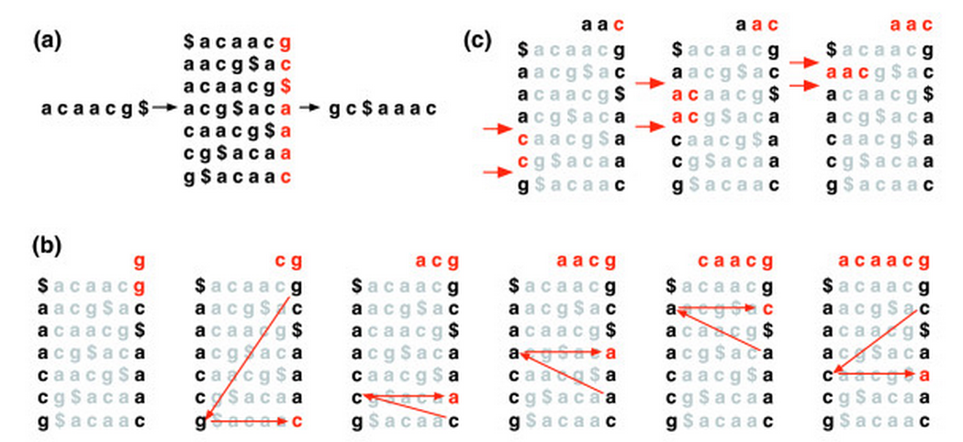
Bowtie principle
Burrows-Wheeler Matrices have a property called the Last First (LF) Mapping.
  The ith occurrence of character c in the last column corresponds to the same text character as the ith occurrence of c in the first column.
  Example: searching ”AAC” in ACAACG
7
3
1
4
2
5
6

Slide 46
Storing alignment: SAM Format
Store information related to alignement
  Read ID
  CIGAR String
  Bitwise FLAG
    read paired
    read mapped in proper pair
    read unmapped, ...
  Alignment position
  Mapping quality
  ...

Slide 47
The extended CIGAR string
Exemple flags:
  M alignment match (can be a sequence match or mismatch)
  I insertion to the reference
  D deletion from the reference
  http://samtools.sourceforge.net/SAM1.pdf
ATTCAGATGCAGTA
ATTCA--TGCAGTA
ATTCAGATGCAGTA
ATTCA--TGCAGTA
5M2D7M

Slide 48
Mapping reads
Main Issues:
  Number of allowed mismatches
    Depend on sequence size (sometimes heterogeneous length)
    Depend of the aligner
  Number of multi­hits
    Issue with short reads
  PCR duplicates
    Accepted with RNA-Seq
    Warning with ChIP-Seq (library complexity)
  Mates expected distance (mate/paired-sequencing)
RNA-Seq specific
  Considering exon junctions (RNA-Seq)

Slide 49
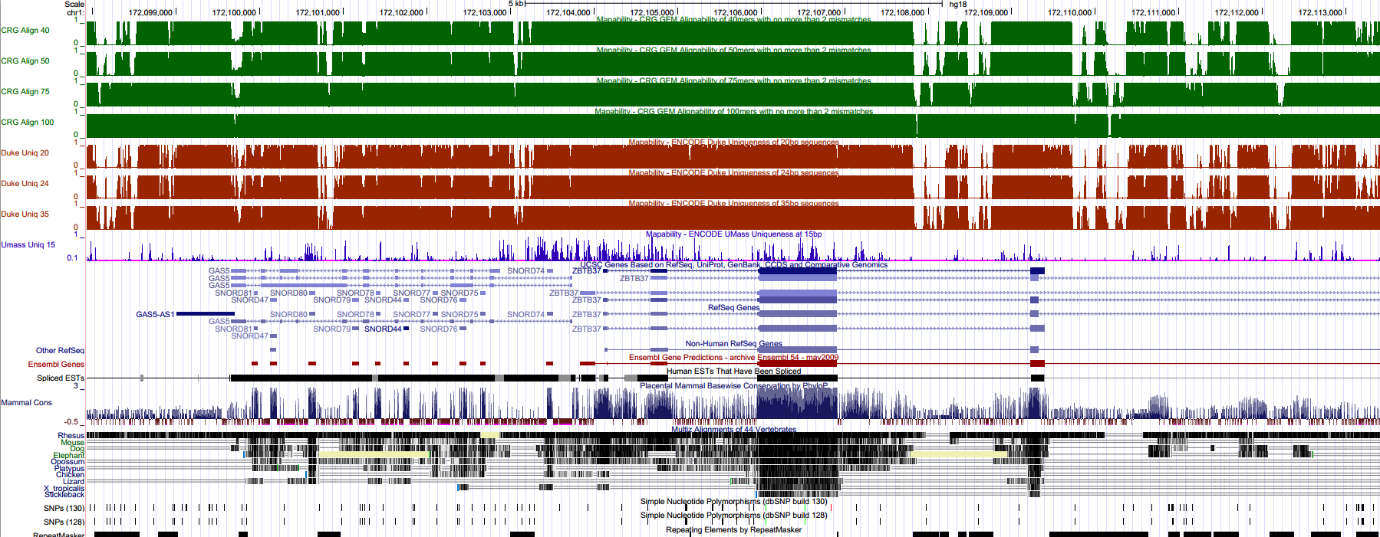
Mappability
Sequence uniqueness of the reference
These tracks display the level of sequence uniqueness of the reference NCBI36/hg18 genome assembly. They were generated using different window sizes, and high signal will be found in areas where the sequence is unique.

Slide 50
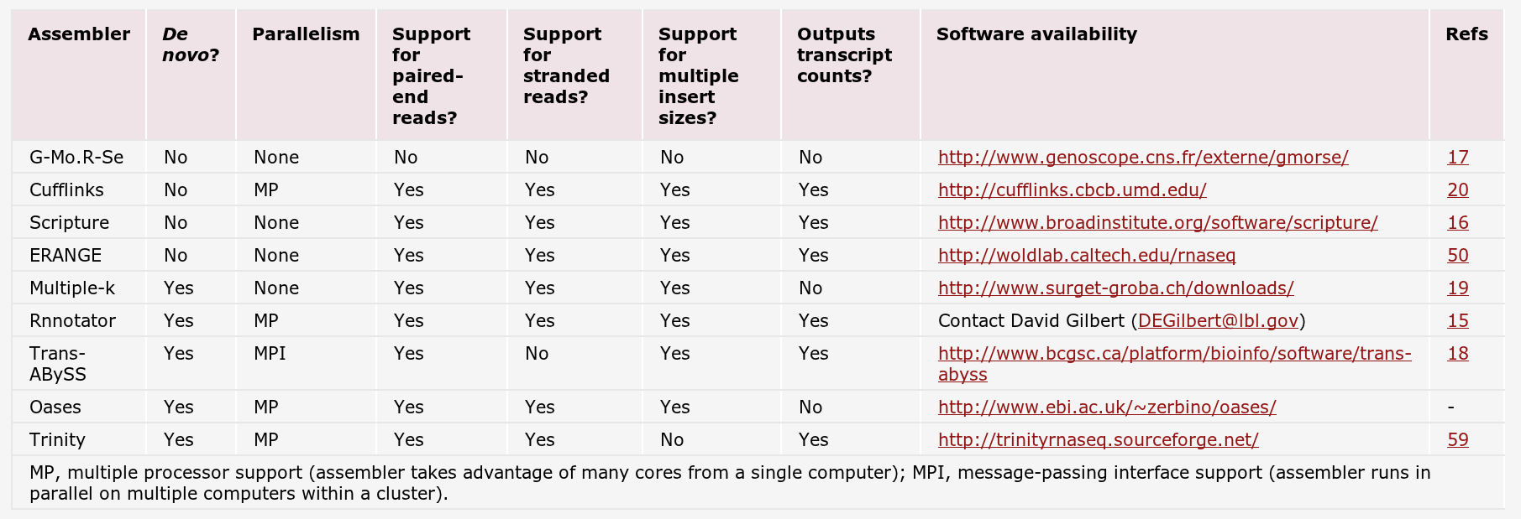
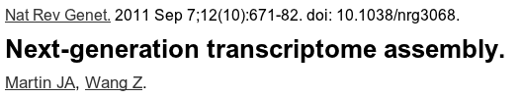
Mapping read spanning exons
One limit of bowtie
  mapping reads spanning exons
Solution: splice-aware short-read aligners

Slide 51
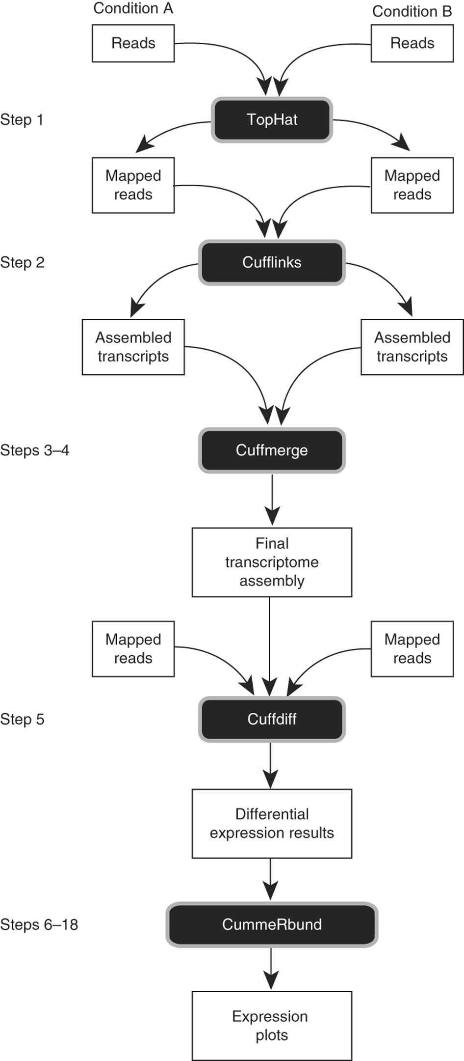

The Tuxedo pipeline

Slide 52

TopHat pipeline
RNA-Seq reads are mapped against the whole reference genome (bowtie).
TopHat allows Bowtie to report more than one alignment for a read (default=10), and suppresses all alignments for reads that have more than this number
Reads that do not map are set aside (initially unmapped reads, or IUM reads)
TopHat then assembles the mapped reads using the assembly module in Maq. An initial consensus of mapped regions is computed.
The ends of exons in the pseudoconsensus will initially be covered by few reads (most reads covering the ends of exons will also span splice junctions)
  Tophat a small amount of flanking sequence of each island (default=45 bp).

Slide 53

TopHat example results
Output : BAM file (compressed version of SAM)

Slide 54

TopHat pipeline
Weakly expressed genes should be poorly covered
  Exons may have gaps
To map reads to splice junctions, TopHat first enumerates all canonical donor and acceptor sites within the island sequences (as well as their reverse complements)
Next, tophat considers all pairings of these sites that could form canonical (GT–AG) introns between neighboring (but not necessarily adjacent) islands.
  By default, TopHat examines potential introns longer than 70 bp and shorter than 20 000 bp (more than 93% of mouse introns in the UCSC known gene set fall within this range)
Sequences flanking potential donor/acceptor splice sites within neighboring regions are joined to form potential splice junctions.
Read are mapped onto these junction library

Slide 55
Compressing and indexing files
Needed before visualization in Genome Browser
Or use Galaxy or IGVtools
[u@m] samtools view output.bam # output SAM format
[u@m] samtools sort output.bam output.sorted
[u@m] samtools index output.sorted.bam

Slide 56


Cufflinks: transcript assembly and quantification
Read pair
Gapped alignment

Slide 57
Running Cufflinks
Transcript assembly and FPKM (RPKM) estimates for RNA-Seq data.
  Should Cufflinks use a reference annotation ?
    No: No reference annotation used. Cufflinks will assemble transcript using TopHat results.
    Yes (-G): Cufflinks use the supplied reference annotation (GTF/GFF) to estimate isoform expression. Ignore alignments not structurally compatible with any reference transcript.
    Yes as a guide (-g): Cufflinks use the supplied reference annotation (GTF/GFF) to guide assembly of reference transcripts. Output will include all reference transcripts as well as any novel genes and isoforms that are assembled.

Slide 58


Summarization issues
Positive association between gene counts and length
  suggests higher expression among longer genes or non-linear dependence of gene counts on length
  Need to scale by gene length

Slide 59


RPKM/FPKM normalization
RPKM: Tag count is normalized for transcript length and total read number in the measurement (RPKM, Reads Per Kilobase of exon model per Million mapped reads)
  2kb transcript with 3000 alignments in a sample of 10 millions of mappable reads
  RPKM = 3000/(2 * 10) = 150
FPKM, Fragments Per Kilobase of exon model per Million mapped reads (paired-end sequencing)

Slide 60
Limits of RPKM/FPKM
If a large number of genes are highly expressed in, one experimental condition, the expression values of remaining genes will be decreased.
  Can force the differential expression analysis to be skewed towards one experimental condition.

Slide 61

Other normalization methods
Several methods proposed
Total count (TC): Gene counts are divided by the total number of mapped reads (or library size) associated with their lane and multiplied by the mean total count across all the samples of the dataset.
  First proposed
Median (Med): Also similar to TC, the total counts are replaced by the median counts different from 0 in the computation of the normalization factors.
  Warning : if lots of weakly expressed values
Upper Quartile (UQ): the total counts are replaced by the upper quartile of counts different from 0 in the computation of the normalization factors.
  Very similar in principle to TC (but really more powerful).
Trimmed Mean of M-values (TMM): This normalization method is implemented in the edgeR Bioconductor package (version 2.4.0). Scaling is based on a subset of M values.
  TMM seems to provide a robust scaling factor.
Quantiles (Q): First proposed in the context of microarray data, this normalization method consists in matching distributions of gene counts across lanes.
  Use with caution when comparing distantly related tissues.
Reads Per Kilobase per Million mapped reads (RPKM): This approach was initially introduced to facilitate comparisons between genes within a sample.
  Not sufficient (need to be combined with inter-sample normalization method)

Slide 62

Getting a GTF/GFF file
Ask UCSC

Slide 63
Differential expression analysis
Cufflinks includes a program, "Cuffdiff"
  Find significant changes in
    transcript expression
    Gene expression
  From the command line, run cuffdiff as follows:
[u@m] cuffdiff MyTranscrit.gtf tophat_result_1.bam tophat_result_2.bam
-o cuffdiff

Slide 64

Sequence read Archive (SRA)
The SRA archives high-throughput sequencing data that are associated with:
RNA-Seq, ChIP-Seq, and epigenomic data that are submitted to GEO

Slide 65


SRA growth

Slide 66

SRP000698 study

Slide 67
SRA Concepts
Data submitted to SRA is organized using a metadata model consisting of six objects:
Study – A set of experiments with an overall goal and literature references.
Experiment – An experiment is a consistent set of laboratory operations on input material with an expected result.
Sample – An experiment targets one or more samples. Results are expressed in terms of individual samples or bundles of samples as defined by the experiment.
Run – Results are called runs. Runs comprise the data gathered for a sample or sample bundle and refer to a defining experiment.

Slide 68
Getting fastq files using SRA toolkit
*.sra to fastq conversion
Fastq-dump
Note: use –split-files argument for paired-end library
fastq-dump -A SRRxxxx.sra

Slide 69

SRX011549 & SRX011550 experiments
SRX011550: human naïve T-cells
SRX011549: human activated CD4 T-Cells
Paired-end (2x45)
Runs

Slide 70
Getting fastq files using SRA toolkit
*.sra to fastq conversion
Fastq-dump
Note: use –split-files argument for paired-end library
fastq-dump -A SRRxxxx.sra

Slide 71
Merci

