Slide 1
Data Analytics: Netflix Movies and TV Show Catalog
Goal
Netflix is very selective about the ratings they release for their content. In this case study, I wanted to examine what patterns I could from a dataset containing their entire catalog in order to try and predict the content Netflix might produce or add to their catalog.
Method:
Netflix Movies and TV Show dataset from Kaggle of available content as of 2019.
Used Pandas and NumPy to analyze the data

Slide 2
Metric: Rate of content increase for global catalog
2015 – 2016: 406% increase
2016 – 2017: 185% increase
2017 – 2018: 37% increase
2018 – 2019: 32% increase

Slide 3
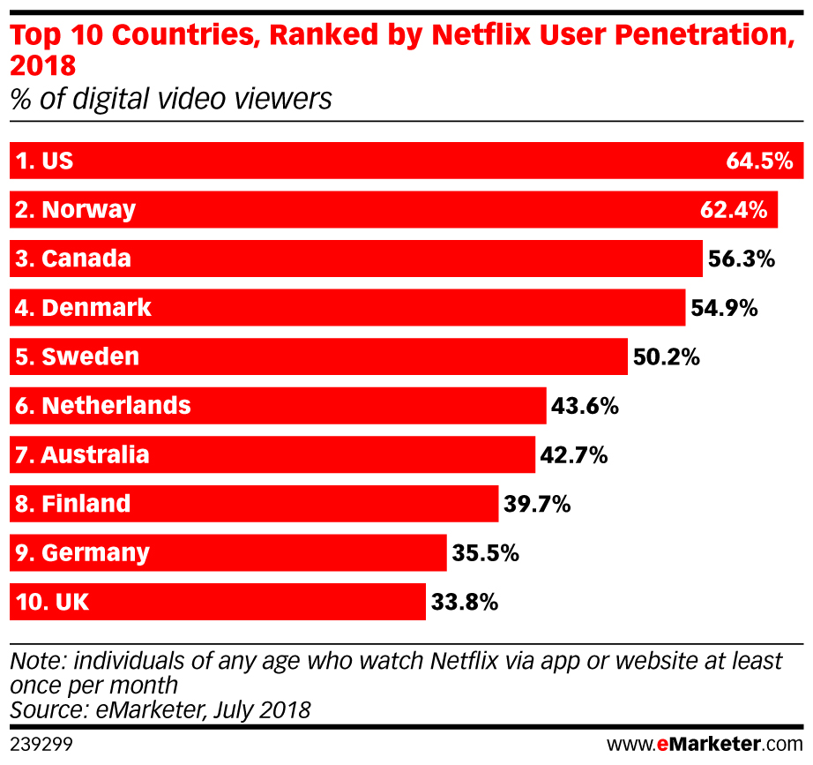
Content Breakdown by Country:
United States
India
UK
Canada
Japan
France
South Korea
Spain
Mexico
Australia

Slide 4
Content: Movies vs TV Shows
*Netflix say average users watches two hours per day
*In 2018, Netflix released a report showing that the number of TV shows has nearly tripled since 2010, while moves have decreased.

Slide 5
Content Availability for US Subscribers
Top 5 Movie Genres:
Documentaries
Dramas
Independent Movies
Comedies
Action & Adventure
Top 5 TV Show Genres:
Comedies
Dramas
Kids’ TV
Docuseries
Crime
*59% of US 16-34-year-olds say Netflix indispensable vs 35% of those aged 35+

