Slide 1
Singleton Pattern
Quick Presentation
By Dan Y.

Slide 2
Pattern Name and Category
“Singleton” pattern
(sometimes referred to as an “anti-pattern”)
A Creational Design pattern.
(deals with instantiation of objects)

Slide 3
Motivation
We may only want one object of a class at any point, to
provide a global access point to the object’s methods/attributes.
Singletons allow only one instance (object) of their class to be constructed and referenced globally (via a “getInstance()” method).
Very similar to simply being a “static” object.
Key benefits in “Lazy Construction” and keeping object out of Global Namespace

Slide 4
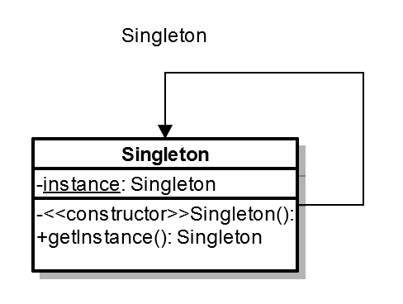
Definition
Wikipedia: “The singleton pattern is a design pattern that restricts the instantiation of a class to one object”

Slide 5
Example (‘Eager’ or ‘Early’ Instantiation)
class Singleton { private static Singleton instance = new Singleton(); private Singleton() { /*Private Constructor*/ } public static Singleton getInstance() { return instance; } public void doSomething() { /*Some Method*/ } }
The instance is generated immediately, appropriate if the object is always essential to program operation.

Slide 6
Example (“Lazy,” Instantiate When Needed)
class Singleton { private static Singleton instance; private Singleton() { /*Private Constructor*/ } public static synchronized Singleton getInstance() { if (instance == null)
{ instance = new Singleton(); } return instance; } public void doSomething() { /*Some Method*/ } }
The instance is generated when needed, appropriate if the cost of generating the object is high or not always necessary for program execution.

Slide 7
Usage Scenarios
Logging (one log file to access, not multiple)
State objects in a State pattern
Any I/O managing class (communication ports)
Handling concurrency issues
See Threaded Factory Instantiation
Also note special rules apply to Singleton itself
See Example for a Demonstration

Slide 8
Fin
Questions?

