Slide 1
Iterator Pattern
Quick Presentation
By Dan Y.

Slide 2
Pattern Name and Category
“Iterator” pattern
(adds functionality to collections of data structures)
A Behavioral Design pattern.
(deals with communication patterns between objects)

Slide 3
Motivation
We may want to traverse our own custom aggregate objects (aka “collections”).
Iterators allow containers of objects to be traversed. The iterator’s ability to traverse a collection should be independent of the collection’s implementation.
Very similar to simple “for” loop iteration.
Java implements Iterator/Collection classes to simplify this design pattern implementation.
Implementing the “Iterable” interface in Java allows one to use the enhanced for loop syntax < for (type item: iterableCollection) {…} >

Slide 4
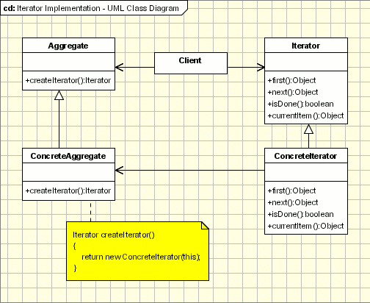
Definition
Wikipedia: “The iterator pattern is a design pattern in which an iterator is used to traverse a container and access the container's elements. The iterator pattern decouples algorithms from containers….”
Note: The algorithm for traversal of an aggregate object can be defined either in the iterator or the aggregate class itself.

Slide 5
Example
List<T> s;
Iterator<T> it = s.iterator();
…
while(it.hasNext())
{
T x =it.next();
…
}
List<T> s;
for(T x : s)
{
…
}
… is equivalent to…

Slide 6
Usage Scenarios
Typical “for” loops for specialized containers of objects.
See Example for a Demonstration

Slide 7
Fin
Questions?

