Slide 1




DQI Automation
Jan, 2020

Slide 2
Agenda
Problem Statement
Current Process
Proposed Solution
Technology Stack
Input Specifications
Output Specifications
Burn Down Chart

Slide 3
DQI Automation
Problem Statement:
Currently populating the DQI sheet is a time consuming, complicated process. Also it involves many manual mathematical calculations. Composition of data from various inputs.
No facility to generate Burn Down Chart.
Solution:
Tool is created to make the DQI population an automated process.
And for generation of Burn Down Chart.
3

Slide 4










Technology Stack
Spring Boot Framework is used to build
DQI-Automation project.
Apache POI is used to read and write excel sheets.
Git is used for source code repository.
Apache Log4j is used to generate logs.
JFreeChart is used to create Burn Down Chart.
JUnit is used for unit testing.
Java Swing used for UI.
For making exe with icon from executable jar.
Apache Maven is used for dependency management.
Swing
Sonarlint for static code analysis.

Slide 5

Demo
5

Slide 6


Current Process and Workflow:
Individual Team Members Data (Dev and QA Teams)
MTWB
DQI Sheet
6
6

Slide 7

Proposed Workflow (High Level Requirement):
MTWB
Input
Output
Data of team members in a defined format
System will aggregate data and populates MTWB and DQI sheet
DQI
7
7

Slide 8
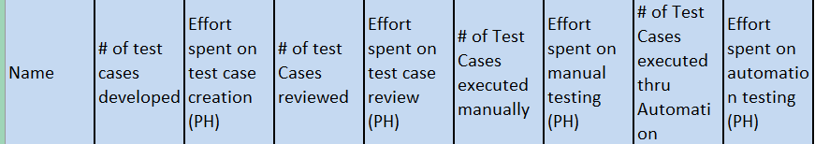
Input Specifications Parameters (To be given Sprint wise):
Dev Team (Sample Input data):
QA Team (Sample Input data):
8
8

Slide 9
Input Specifications Parameters (To be given Sprint wise):
Dev Team (Sample Input data for JIRA sheet):
9
9

Slide 10
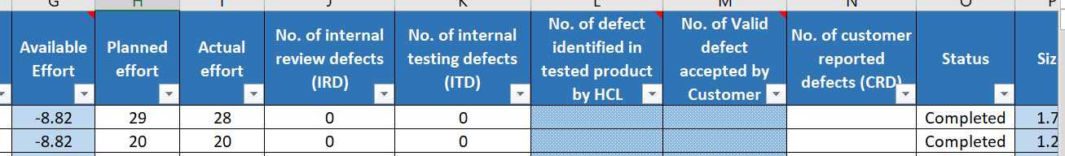
Output Specifications:
Sample MTWB snippet:
Sample DQI snippet
10
10

Slide 11
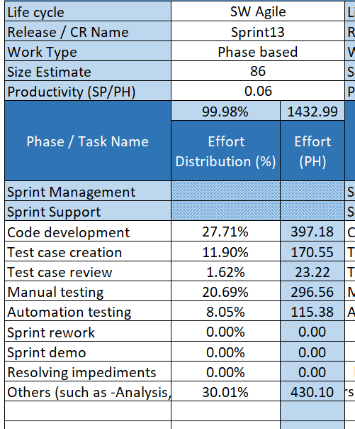
Setup Parameters Tab
11
11

Slide 12
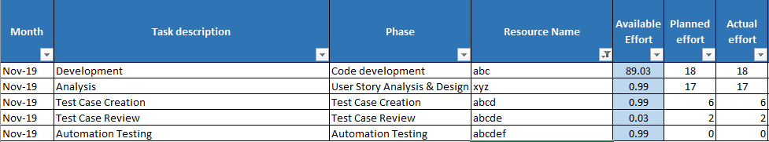
Data Collection tab

Slide 13
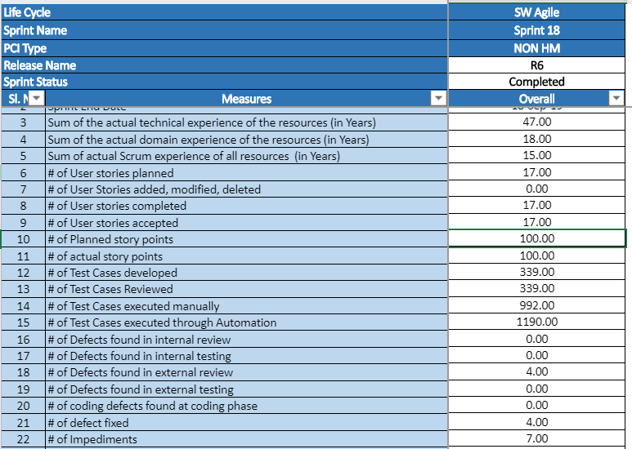
Base Measures Tab
13
13
13

Slide 14
Resultant Output:
Setup Parameters Tab
Base Measures Tab
Individual Efforts of QA Team and Dev Team Members
Productivity,TAE,StoryPoints
DataCollection
Note: The Output Sheet will comprise of the above tabs. Then the values from these may be copied and pasted into actual DQI Sheet.
14
14
14
14
14
14
14
14

Slide 15
Burn Down Chart
Input: Following are the inputs to be provided,
Sprint Number
Planned Efforts(in hours)
Day Wise Efforts Excel Sheet.
Output:
A jpeg image of Burn Down chart is created.
15
15
15

Slide 16
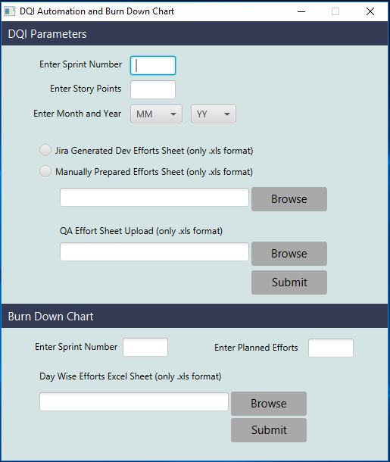
Snapshot
In DQI Parameters Section:
User has to provide following inputs,
Sprint Number
Story Points
Month and Year
Then upload either Jira Generated Efforts Sheet or Manually Prepared Efforts Sheet and also upload QA Effort Sheet.
In Burn Down Chart Section:
User has to provide following inputs,
Sprint Number
Planned Efforts(in hours)
Day Wise Efforts Excel Sheet.
16
16
16
16

Slide 17
Build & Execution
Developers can export the project as a Jar from their IDE.
Use Launch4j application to convert the Jar into .exe format
Add jar file into launch4j.
Download icon from deploy folder from git.
Add icon for the exe file.
Configure the java version as min 1.0.0 max - 1.10.0
Save the file with extension .exe.
Click on the settings tab to create final exe.
Export the exe file.
End user can directly download the exe file from
https://github.com/dqi-project/dqi-automation.git
A log file will be created in the same folder containing all the logs.
17
17
17

