Slide 1
2D LMS Algorithm
Devon Quaternik
Department of Electrical Engineering,
Santa Clara University, CA 95053, USA
Presentation
Date: Wed. Dec. 7, 2016

Slide 2
Outline
Introduction
Paper Details
Summary
Paper Results
Recreation Results
Conclusions

Slide 3
Introduction
Image enhancement can use adaptive weights to improve while running
Old methods would look in one dimension to update
2D LMS updates in both directions at once, giving better non-stationary performance

Slide 4
Paper Details
First describes a 2D Weiner Filter
Sets out to find 2D LMS gradient approximation of the 2D Weiner Filter
Implemented using a 2D Adaptive Line Enhancer

Slide 5
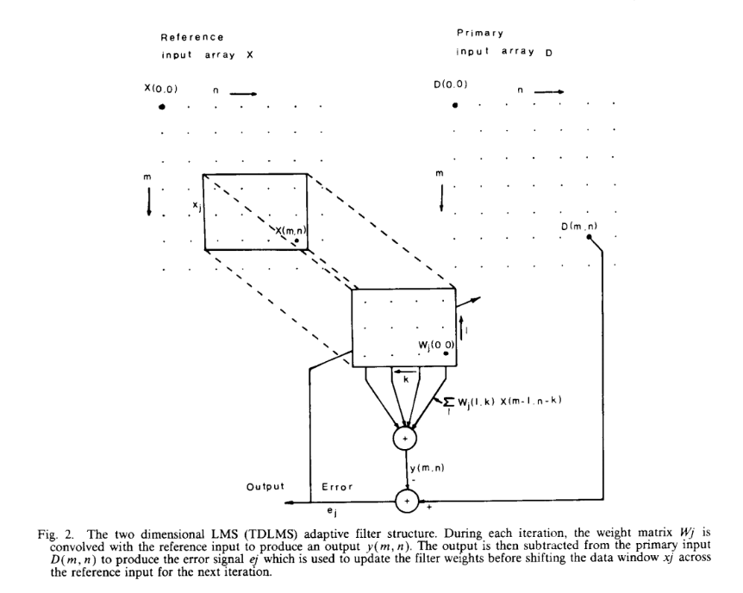




Paper Details
Structure for 2D LMS adapter and update equations

Slide 6
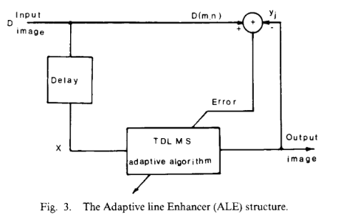
Summary
Recreated the TDLMS in MATLAB following the pattern of Diniz.
Created a TDALE that utilizes the TDLMS
Unable to force sum of weights to equal one, shows in results.

Slide 7
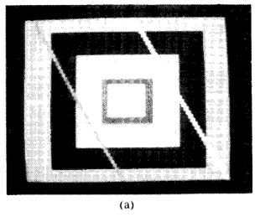
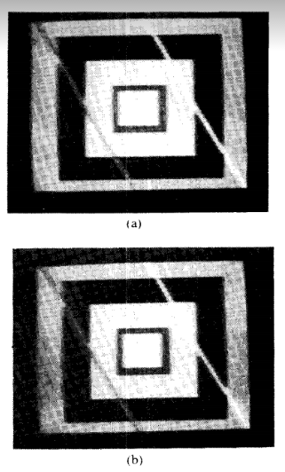
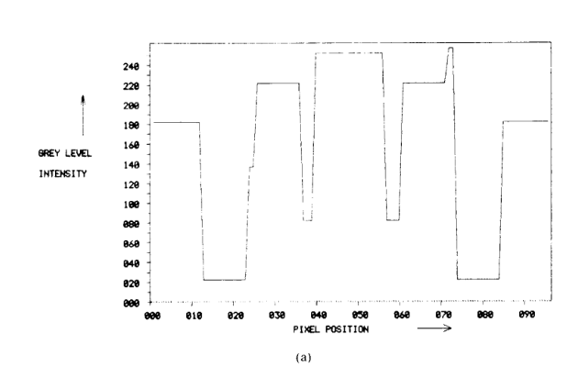
Paper Results

Slide 8
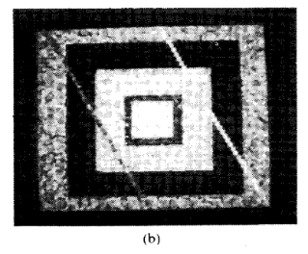
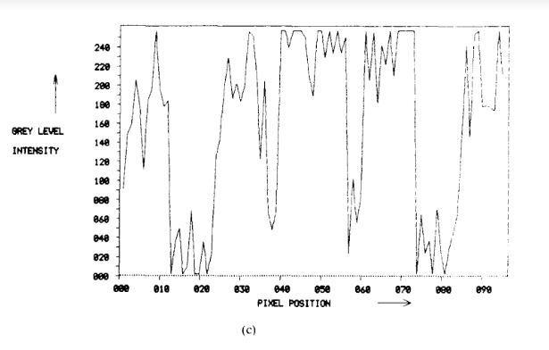
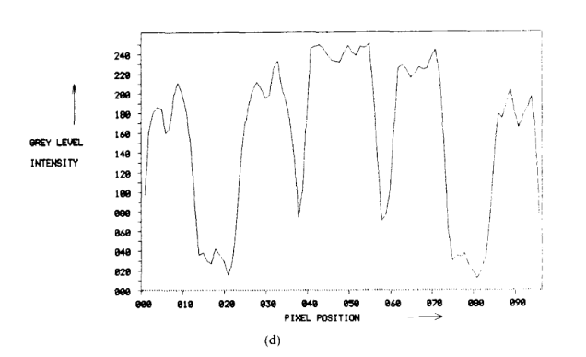
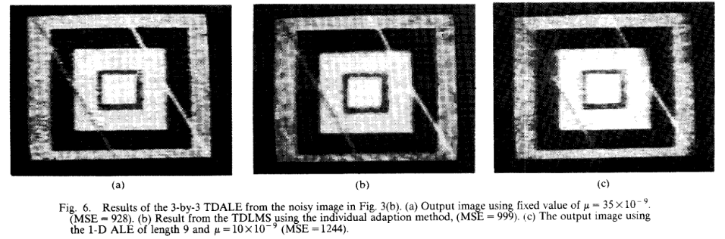
Paper Results

Slide 9


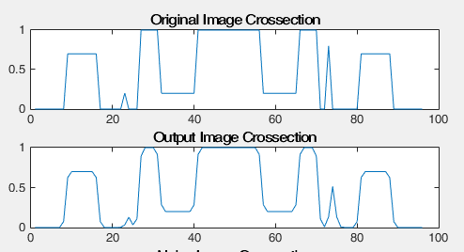

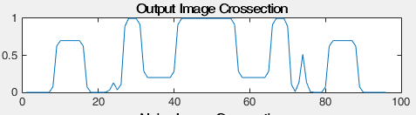

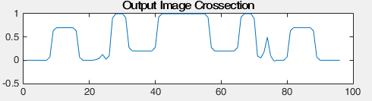

Recreated Results

Slide 10

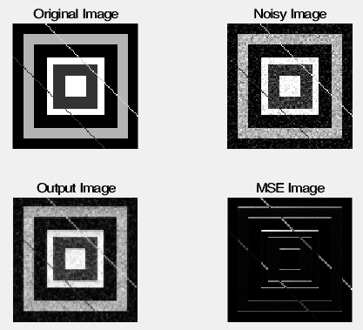
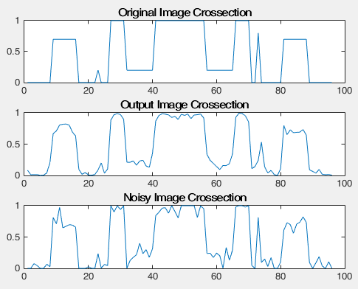
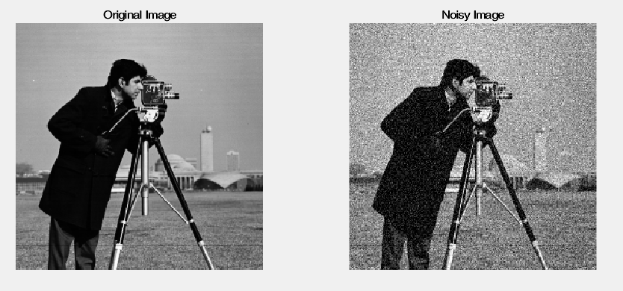
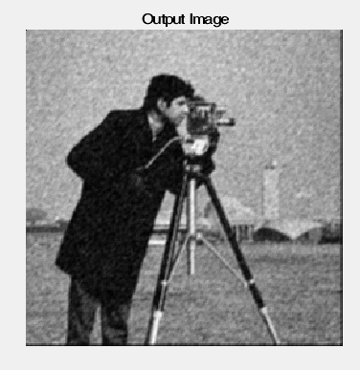
Recreated Results

Slide 11
Conclusions
2D LMS can be used to help restore images
Can see artifacts based on initial weights
Filter weights tend toward Weiner Solution

Slide 12
Acknowledgements
Diniz, Paulo Sergio Ramirez, Da Silva Eduardo A. B., and Sergio L. Netto. Digital Signal Processing: System Analysis and Design. Cambridge, U.K.: Cambridge UP, 2002. Print.
Hadhoud, M.m., and D.w. Thomas. "The Two-dimensional Adaptive LMS (TDLMS) Algorithm." IEEE Transactions on Circuits and Systems 35.5 (1988): 485-94. Web.
Professor Tokunbo Ogunfunmi

Slide 13
Questions?

