Slide 1
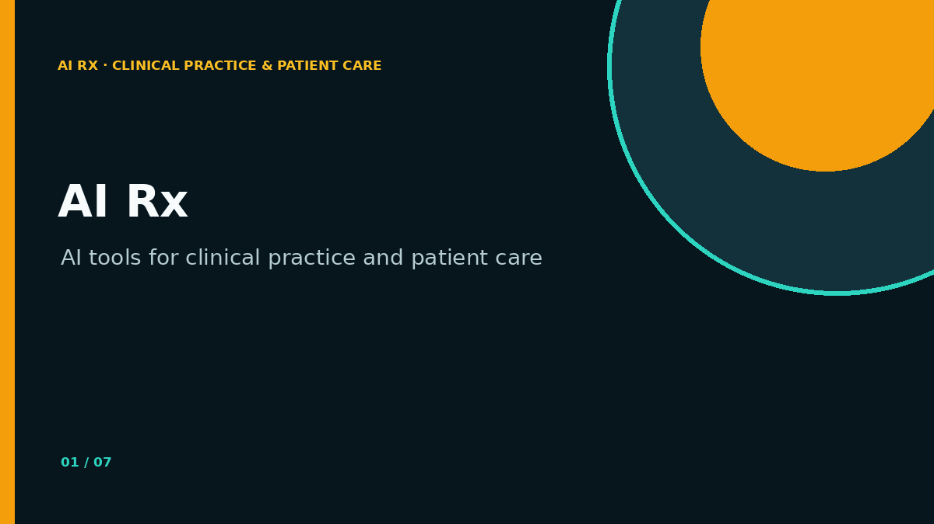
AI RX · CLINICAL PRACTICE & PATIENT CARE
AI Rx
AI tools for clinical practice and patient care
FACILITATOR DECK
Complete prompts, progressive clinical comparisons and patient-centred decision support
Notes:
Open by setting three expectations: participants will use complete prompts, compare model output with clinical judgement, and connect every activity to a patient-centred decision.
[Sources]
- AI Rx Live Demo Studio, project-authored workshop framework
[/Sources]

Slide 2
LEARNING ARCHITECTURE
02
How the workshop is designed
1
Copy-ready prompts
2
AI vs. Doctor
3
Cut the fog
323 specialty prompts are pre-loaded, complete and visible in one view.
Each specialty case exposes the AI impression and the clinician’s actual diagnosis.
Date, patient, series and procedure appear before any analysis.
4
Decision support
5
Audience fit
AI prepares options and uncertainties; the doctor owns interpretation and action.
Publicity and take-home language change for doctors, leaders, educators and researchers.
NORTH STAR · PATIENT CENTRICITY
AI Rx · Patient first · Doctor led · AI assisted
Workshop material · Not clinical advice
Notes:
Use this as the verbal contract for the session. The workshop is not a tour of AI tools. It is a structured comparison of what AI can prepare and what only a clinician can decide.
[Sources]
- AI Rx Live Demo Studio, project-authored workshop framework
[/Sources]

Slide 3
NORTH STAR
03
Patient centricity is the decision path
1
Patient need
2
Specialty context
3
Evidence
What matters now?
Which lens is required?
What data can be trusted?
4
AI support
5
Doctor judgment
6
Patient action
What options or gaps appear?
What fits this person?
What is safe and understandable?
AI Rx · Patient first · Doctor led · AI assisted
Workshop material · Not clinical advice
Notes:
Return to this sequence after every demonstration. Ask: did AI improve the decision path, or only produce more text? The last step must always translate into a safe, patient-understandable action.
[Sources]
- AI Rx Live Demo Studio, project-authored workshop framework
[/Sources]

Slide 4
PROMPT DELIVERY
04
A complete prompt protects the workflow
01
Role + boundary
FULL PROMPT · ONE VIEW
Copy. Paste. Replace only the patient fields.
02
Patient context
03
Decision question
No collapsed boxes
No prompt engineering
No hidden safety clauses
No zoom or drag
04
Non-negotiable rules
05
Six-step reasoning method
06
Required output
07
AI-versus-Doctor check
323 PROMPTS · 19 SPECIALTY LENSES
08
Safety + uncertainty block
AI Rx · Patient first · Doctor led · AI assisted
Workshop material · Not clinical advice
Notes:
Demonstrate the Prompt Library directly. The selected prompt must be fully expanded on the page. Participants should be able to scan the complete instruction, copy it, and print a booklet without editing the safety structure.
[Sources]
- AI Rx Live Demo Studio, project-authored workshop framework
[/Sources]

Slide 5
CORE DIFFERENTIATOR
05
AI-versus-Doctor makes tacit knowledge visible
SYNTHETIC TEACHING CASE · CHEST PAIN
AI perceived diagnosis
Doctor’s working diagnosis
Low-risk musculoskeletal pain based on a non-diagnostic first ECG and atypical symptom description.
Evolving acute coronary syndrome requiring serial ECG/troponin review and risk-context integration.
Blind spot
Tacit cue
Anchored on a single snapshot.
Trajectory + context changed the decision.
Value: compare reasoning, surface uncertainty, keep clinical ownership with the doctor.
AI Rx · Patient first · Doctor led · AI assisted
Workshop material · Not clinical advice
Notes:
State clearly that this is a synthetic teaching example, not a clinical recommendation. The comparison is the teaching engine: it reveals why sequence, context and tacit pattern recognition cannot be delegated.
[Sources]
- AI Rx Live Demo Studio, project-authored workshop framework
[/Sources]

Slide 6
CUT THE FOG
06
Every case begins with the source facts
01
Document date
When was the source created?
02
Patient information
Age band, context, red flags.
03
Procedure information
Test, intervention or encounter.
04
Series information
Sequence, comparison and trajectory.
05
Decision question
What must the clinician decide?
AI Rx · Patient first · Doctor led · AI assisted
Workshop material · Not clinical advice
Notes:
Model the discipline of reading the case header before the AI output. Date, series and procedure are not administrative details; they shape whether the AI’s interpretation can support the decision.
[Sources]
- AI Rx Live Demo Studio, project-authored workshop framework
[/Sources]

Slide 7
CLINICAL OWNERSHIP
07
Decision support requires six explicit checks
1
Need
2
Data
What decision is being supported?
What is present, missing or unreliable?
3
Options
4
Uncertainty
What plausible paths should be compared?
Where could the model be wrong?
5
Action
6
Ownership
What is safe, proportionate and reversible?
Who validates, communicates and follows up?
AI Rx · Patient first · Doctor led · AI assisted
Workshop material · Not clinical advice
Notes:
Use these checks before accepting any model output. The point is not to make AI sound cautious; it is to make uncertainty and ownership operational in the next clinical step.
[Sources]
- AI Rx Live Demo Studio, project-authored workshop framework
[/Sources]

Slide 8
FACILITATION PATTERN
08
Run each live demo as a three-act comparison
ACT 1
ACT 2
ACT 3
Before AI
With AI
After AI
State the patient need, specialty lens, evidence and decision question.
Paste the complete prompt. Inspect assumptions, omissions and uncertainty.
Compare with doctor judgment, decide the next action and explain it to the patient.
THE OUTPUT IS NOT THE ENDPOINT · THE DECISION IS
AI Rx · Patient first · Doctor led · AI assisted
Workshop material · Not clinical advice
Notes:
This repeatable pattern keeps demonstrations short and clinically grounded. Do not spend workshop time engineering prompts live. Spend it evaluating what changes in the decision.
[Sources]
- AI Rx Live Demo Studio, project-authored workshop framework
[/Sources]

Slide 9
PRIVACY AND RESPONSIBILITY
09
Consent stays literature-only
Include
Do not include
• Published guidance
• Institution-approved templates
• Plain-language teaching notes
• Clear limitations and review date
• Patient identifiers
• Real consent records
• Case-specific legal advice
• A substitute for local policy
Use synthetic cases for teaching. Validate all patient-facing content locally.
AI Rx · Patient first · Doctor led · AI assisted
Workshop material · Not clinical advice
Notes:
Keep this section deliberately light. The app contains literature-only consent guidance so the workshop does not become overloaded with legal material. Local policy and institutional review still govern actual use.
[Sources]
- AI Rx Live Demo Studio, project-authored workshop framework
[/Sources]

Slide 10
PUBLICITY AND MARKETING
10
Change the message for the audience
Doctors
Hospital leaders
Save time with complete prompts and compare AI reasoning with clinical judgment.
See where governed AI can support safer, more consistent decisions.
Educators
Researchers
Teach tacit knowledge through structured AI-versus-Doctor cases.
Turn questions into reproducible evidence workflows with explicit uncertainty.
ONE WORKSHOP · DIFFERENT REASONS TO CARE
AI Rx · Patient first · Doctor led · AI assisted
Workshop material · Not clinical advice
Notes:
Ask organisers to choose the audience before publishing the invitation. The app includes ready copy for multiple audiences and an animated publicity asset.
[Sources]
- AI Rx Live Demo Studio, project-authored workshop framework
[/Sources]

Slide 11
SOFT COPY + HARD COPY
11
Give people something they can use tomorrow
PROMPTS
HANDOUTS
MEDIA
323 complete prompts
Print-ready booklet
PPTs + promo GIF
Visible in one view, copy-ready and specialty filtered.
HTML and text formats for hard copy or offline use.
Editable teaching decks and animated workshop publicity.
DOWNLOAD EVERYTHING FROM PUBLICITY & PPTs
AI Rx · Patient first · Doctor led · AI assisted
Workshop material · Not clinical advice
Notes:
End the content section by showing the tangible takeaways: the complete prompt library, print-ready booklet, participant recap deck and animated publicity asset.
[Sources]
- AI Rx Live Demo Studio, project-authored workshop framework
[/Sources]

Slide 12
FACILITATOR TIMING
12
A 90-minute run of show
00–10
Frame
Patient need, boundaries, decision question
10–25
Prompt
Copy a complete specialty prompt
25–50
Case
AI output vs. doctor diagnosis
50–65
Decision
Apply the six checks
65–80
Practice
Small-group specialty transfer
80–90
Close
Patient-centred action + downloads
AI Rx · Patient first · Doctor led · AI assisted
Workshop material · Not clinical advice
Notes:
Keep the first ten minutes disciplined. The biggest block belongs to the AI-versus-Doctor case because that is where participants surface tacit clinical reasoning. Adjust examples by specialty, but retain the same structure.
[Sources]
- AI Rx Live Demo Studio, project-authored workshop framework
[/Sources]

Slide 13
AI RX · CLINICAL PRACTICE & PATIENT CARE
AI Rx
AI tools for clinical practice and patient care
CLOSE
One question: what patient-centred decision will you support better tomorrow?
Notes:
Invite one concrete commitment. Direct participants to the app’s Prompt Library, Synthetic Cases, Decision Support and Publicity & PPTs pages for the take-home materials.
[Sources]
- AI Rx Live Demo Studio, project-authored workshop framework
[/Sources]

