Slide 1
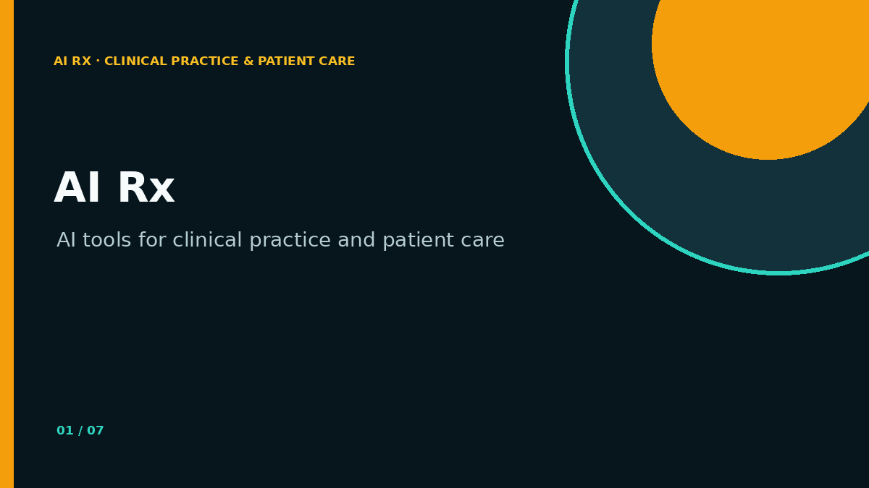
AI RX · CLINICAL PRACTICE & PATIENT CARE
AI Rx
AI tools for clinical practice and patient care
PARTICIPANT RECAP
Seven slides to take back to practice · Copy-ready prompts and patient-centred decision support
Notes:
Use this short deck as the participant take-home recap. It is intentionally concise and mirrors the app navigation.
[Sources]
- AI Rx Live Demo Studio, project-authored workshop framework
[/Sources]

Slide 2
RULE 1
02
Start with the patient—not the model
Patient need → Specialty context → Evidence → AI support → Doctor judgment → Patient action
AI IS A SUPPORTING STEP · NOT THE NORTH STAR
AI Rx · Participant recap
Workshop material · Not clinical advice
Notes:
Use this sequence to decide whether AI belongs in the workflow at all. If the patient need and decision question are unclear, do not begin with a model.
[Sources]
- AI Rx Live Demo Studio, project-authored workshop framework
[/Sources]

Slide 3
RULE 2
03
Use the full prompt exactly as supplied
COPY → PASTE → REPLACE FIELDS
Replace only
The visible prompt already contains role, context, uncertainty, output structure and safety boundaries.
• Patient details
• Source date + series
• Procedure information
• Decision question
• Material to analyse
AI Rx · Participant recap
Workshop material · Not clinical advice
Notes:
The library’s prompts are deliberately detailed. Read the full prompt in one view and keep its safeguards intact. Do not paste patient identifiers into unapproved systems.
[Sources]
- AI Rx Live Demo Studio, project-authored workshop framework
[/Sources]

Slide 4
RULE 3
04
Compare AI output with clinical judgment
AI perceived diagnosis
Doctor’s actual diagnosis
What pattern did the model recognise?
What did it omit?
How confident did it sound?
Which trajectory or tacit cue changed the interpretation?
What action follows?
THE DIFFERENCE IS THE LEARNING
AI Rx · Participant recap
Workshop material · Not clinical advice
Notes:
The purpose of comparison is not to score the doctor against the model. It is to expose hidden assumptions and make tacit clinical knowledge teachable.
[Sources]
- AI Rx Live Demo Studio, project-authored workshop framework
[/Sources]

Slide 5
RULE 4
05
Run six checks before acting
1
Decision need
2
Data quality
3
Plausible options
4
Uncertainty
5
Safe next action
6
Human ownership
IF OWNERSHIP IS UNCLEAR, DO NOT ACT
AI Rx · Participant recap
Workshop material · Not clinical advice
Notes:
Use these six checks for documentation, research, diagnosis support and patient communication. The clinician remains accountable for validation and follow-up.
[Sources]
- AI Rx Live Demo Studio, project-authored workshop framework
[/Sources]

Slide 6
RULE 5
06
Keep consent guidance light and safe
LITERATURE-ONLY
Use published guidance and institution-approved templates. Do not upload patient identifiers, real consent records or case-specific legal material.
SYNTHETIC CASES FOR TEACHING · LOCAL POLICY FOR PRACTICE
AI Rx · Participant recap
Workshop material · Not clinical advice
Notes:
This slide is not legal advice. It reinforces the boundary between educational material and real patient consent processes.
[Sources]
- AI Rx Live Demo Studio, project-authored workshop framework
[/Sources]

Slide 7
AI RX · CLINICAL PRACTICE & PATIENT CARE
AI Rx
AI tools for clinical practice and patient care
YOUR NEXT ACTION
Choose one specialty case. Copy one complete prompt. Compare one AI answer with a doctor’s judgment.
Notes:
Close with a small, testable action. Encourage participants to use synthetic data first and document what the model added, missed and left uncertain.
[Sources]
- AI Rx Live Demo Studio, project-authored workshop framework
[/Sources]

