Slide 1
ALKEM | AI MASTERCLASS
GenAI for
Patient-Centric
Healthcare
🤝
Patient engagement
🩺
Clinical workflow
🔬
Pharma & research
Practical, responsible workflows for doctors and pharma professionals
🛡️
Responsible AI
60 MIN THEORY
90 MIN HANDS-ON
SYNTHETIC DATA
Four pillars • medical-specific demos • qualified human decisions
Notes:
Open by asking participants to name one task they would improve—not one tool they want to use. Set the contract: synthetic data, bounded tasks, source checks, and qualified human authority.
Sources / verification links:

Slide 2
ALKEM | AI MASTERCLASS
OPENING
The learning contract
Useful output is not the goal. Verified, accountable workflow improvement is.
1
Use approved data
2
Bound the task
Synthetic, public, or institution-approved de-identified inputs only.
Draft, extract, structure, compare, or explain—never silently decide.
3
Verify the source
4
Keep human authority
Check every consequential fact, citation, ambiguity, and omission.
Record accept, edit, reject, or escalate—and who owns it.
GenAI for Patient-Centric Healthcare
02
Notes:
Use a prescription example: fluency cannot compensate for one wrong strength. Explain that approval, data handling, and review requirements come from the organisation and the intended use—not from the model's confidence.
Sources / verification links:
- https://www.who.int/publications/i/item/9789240029200
- https://www.nist.gov/itl/ai-risk-management-framework

Slide 3
ALKEM | AI MASTERCLASS
PROGRAMME MAP
Four pillars—from patient need to responsible implementation
01
02
03
04
Patient Understanding
and Engagement
Clinical Workflow
and Decision Support
Pharma, Research and
Professional Productivity
Responsible AI, Governance
and Implementation
Explain • translate • teach back
Structure • observe • escalate
Search • extract • document
Classify • control • monitor
Human decision
at the end
Human decision
at the end
Human decision
at the end
Human decision
at the end
GenAI for Patient-Centric Healthcare
03
Notes:
The four pillars are a programme structure, not a maturity score. A workflow may span pillars; the selection engine maps roles and tasks to complete supported workflows.
Sources / verification links:

Slide 4
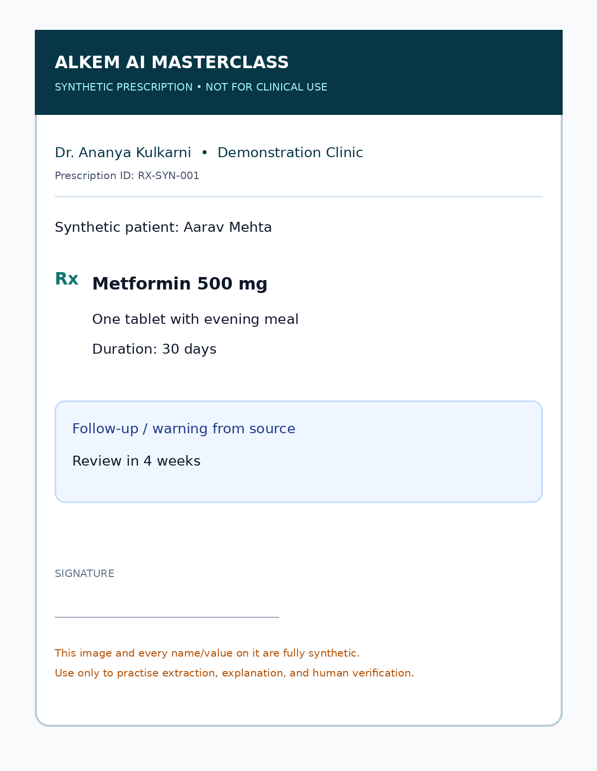
ALKEM | AI MASTERCLASS
PILLAR 1
Prescription extraction: separate reading from explaining
A synthetic image, an exact source table, and a clinician/pharmacist decision.
1
Extract
Transcribe legible fields exactly.
Never let the model
2
Flag
• reconstruct unclear text
• infer the indication
• prescribe or substitute
• assess interactions autonomously
• overrule the source prescription
Mark ambiguity [UNREADABLE]; never guess.
3
Explain
Use plain language without adding advice.
4
Verify
Compare field-by-field; record human decision.
Owner: clinician or pharmacist
GenAI for Patient-Centric Healthcare
04
Notes:
Run the synthetic prescription demo. Keep the facilitator reference hidden until participants have extracted the fields. Score exactness, ambiguity handling, and scope—not elegance.
Sources / verification links:

Slide 5
ALKEM | AI MASTERCLASS
PILLAR 1
From discharge summary to patient action plan
Preserve the medicine, date, warning, and follow-up—change only clarity.
CLINICIAN SOURCE
PATIENT ACTION PLAN
“Continue medication as listed. Review as advised. Return if symptoms worsen.”
1. What happened—in plain words
2. Exact medicine/action schedule
3. Warning signs and urgent route
4. Follow-up: who, when, where
5. Three teach-back questions
What is missing for a patient?
• exact action
• urgency threshold
• timing
• comprehension check
Bilingual drafts require fluent clinical review.
GenAI for Patient-Centric Healthcare
05
Notes:
Ask: what must never change when simplifying? Elicit medicine, dose, duration, dates, red flags, follow-up, and uncertainty. For translation, preserve medicine/test names and require a fluent clinical reviewer.
Sources / verification links:

Slide 6
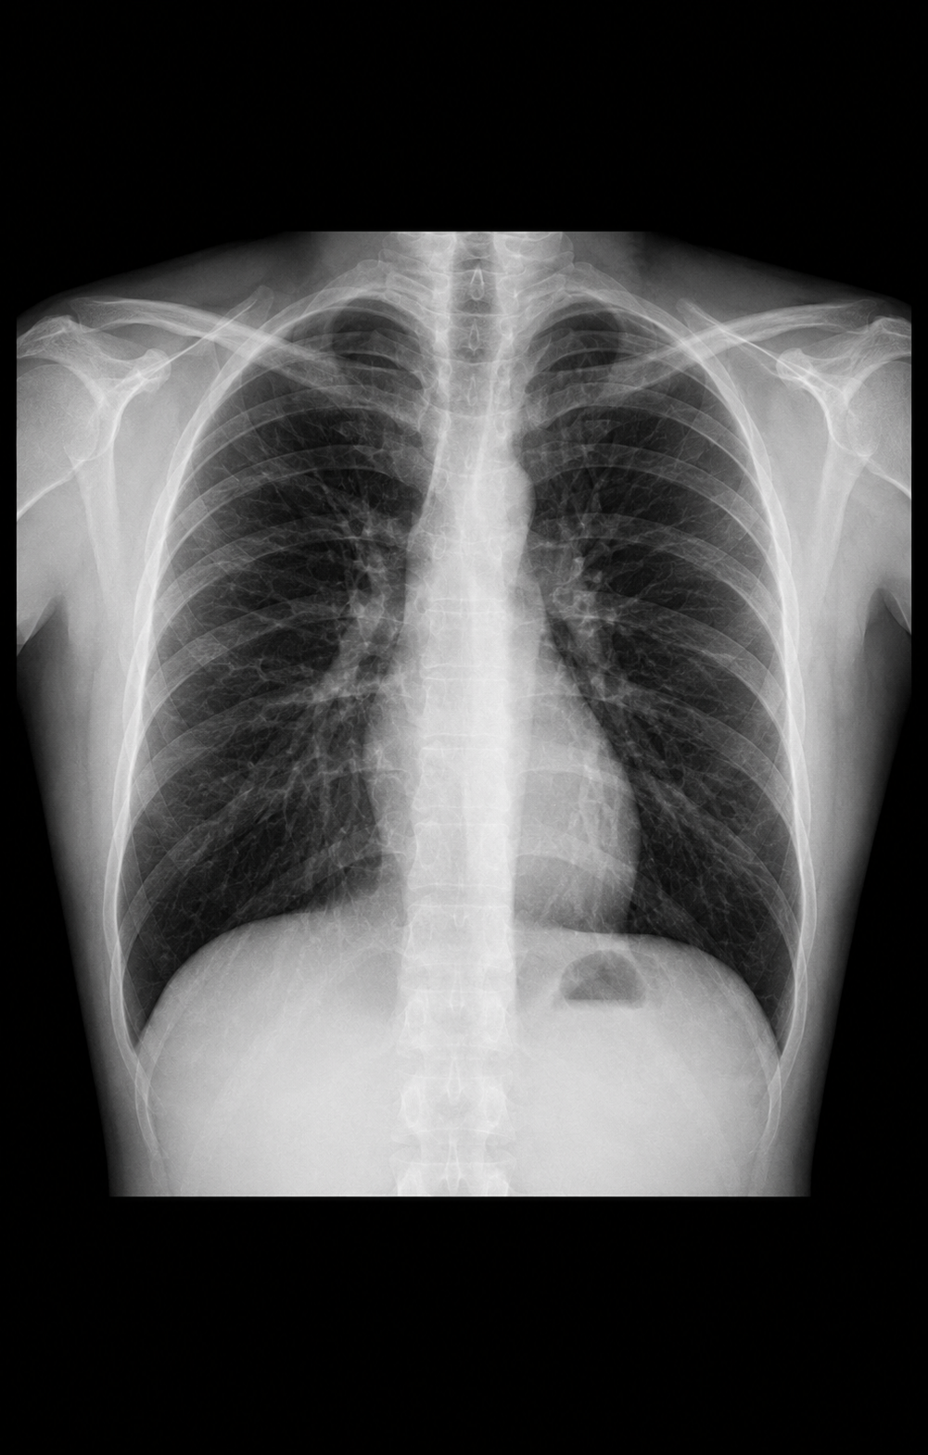
ALKEM | AI MASTERCLASS
PILLAR 2
Medical images: demonstrate the boundary, not a diagnosis
General-purpose image models are not a substitute for qualified interpretation or validated medical-device workflows.
FULLY SYNTHETIC • NO GROUND TRUTH
Practise
Do not claim
✓ image adequacy
✓ neutral visible observations
✓ cannot-assess items
✓ uncertainty
✓ human escalation
✕ diagnosis
✕ emergency clearance
✕ treatment advice
✕ “normal” or “safe” verdict
✕ validated performance
GenAI for Patient-Centric Healthcare
06
Notes:
Do not ask the model for a diagnosis. The demonstration is about image adequacy, descriptive observation, uncertainty, and escalation. Explicitly mention the product limitation on specialised medical images.
Sources / verification links:
- https://help.openai.com/articles/8400551-chatgpt-image-inputs-faq
- https://www.fda.gov/medical-devices/software-medical-device-samd/artificial-intelligence-enabled-medical-devices

Slide 7
ALKEM | AI MASTERCLASS
PILLAR 2
Clinical reasoning: use AI to reduce omission, not own the decision
COMMON
Common / likely
CAN'T MISS
Cannot-miss
Keep prevalence and presentation in view.
Separate severity from probability.
MISSING
History / exam gaps
ESCALATE
Urgency triggers
Make absent information visible.
Define when human action cannot wait.
Always ask: What evidence supports this? What opposes it? What would change urgency?
GenAI for Patient-Centric Healthcare
07
Notes:
Run a cognitive forcing pause after the model response: What did it omit? Where could anchoring or automation bias occur? What new data would change urgency? Diagnosis and treatment remain clinician-owned.
Sources / verification links:

Slide 8
ALKEM | AI MASTERCLASS
PILLAR 3
Two lanes: safety intake and evidence verification
Both gain speed from structure. Neither delegates qualified judgement.
PHARMACOVIGILANCE
EVIDENCE
AI may help
AI may help
• structure chronology
• screen seriousness fields
• identify missing data
• draft neutral follow-up
Never decide causality, expectedness,
coding, or reportability.
• form PICO/PECO
• expand search concepts
• extract supplied sources
• map evidence gaps
Never invent a citation.
Open and verify every source.
Human-owned: safety decisions • screening log • source checks • interpretation • disclosure
GenAI for Patient-Centric Healthcare
08
Notes:
Contrast the two lanes. In PV, qualified reviewers own causality, expectedness, coding, and reporting. In evidence work, the team owns the reproducible search, screening decisions, source opening, extraction checks, and interpretation.
Sources / verification links:

Slide 9
ALKEM | AI MASTERCLASS
PILLAR 4
Risk follows data × impact × autonomy × reach
Use the highest-risk dimension to set minimum controls and a stop condition.
DATA
Synthetic → identifiable / highly sensitive
LOWER
HIGHER
Minimum decision record
IMPACT
Communication → influences care
LOWER
HIGHER
• accountable owner
• allowed data
• human review
• monitoring metric
• incident route
• stop / rollback rule
AUTONOMY
Draft → default → autonomous action
LOWER
HIGHER
REACH
Sandbox → patient / population scale
LOWER
HIGHER
GenAI for Patient-Centric Healthcare
09
Notes:
Use the governance workbench in the app. The score is a discussion aid, not legal or regulatory advice. High or critical use cases need multidisciplinary review and may need validated or regulated pathways.
Sources / verification links:
- https://www.nist.gov/itl/ai-risk-management-framework
- https://www.who.int/publications/i/item/9789240029200
- https://www.meity.gov.in/documents/act-and-policies/digital-personal-data-protection-rules-2025-gDOxUjMtQWa

Slide 10
ALKEM | AI MASTERCLASS
TOOL SELECTION
Choose the workflow first; let supported options cascade
The app offers only intersections backed by a complete prompt, dataset, output, verification, and reviewer.
1
2
3
4
5
6
Pillar
Role
Task
Input
Language
Workflow
DATA FIT
Can this account and workflow process the intended data?
CAPABILITY
Does the tool support the input and output—and with what limitations?
EVIDENCE
Can claims and citations be opened, traced, and checked?
HUMAN FIT
Who reviews, what gets escalated, and what stops the workflow?
GenAI for Patient-Centric Healthcare
10
Notes:
Demonstrate the Prompt Studio. Every option is derived from workflows remaining after previous selections. An unmatched free-text search returns a labelled closest verified alternative; it never fabricates a new workflow.
Sources / verification links:

Slide 11
ALKEM | AI MASTERCLASS
HANDS-ON
90 minutes: six medical and pharma exercises
For every lab: 3 min orient • 6 min run • 4 min verify • 2 min decide.
01
Prescription extraction
02
Image observation
03
Discharge + language
Exactness • ambiguity • explain
Adequacy • boundary • escalate
Meaning • teach-back • review
04
Differential + red flags
05
PV intake
06
Evidence verification
Omission • bias • urgency
Neutrality • missingness • route
Search log • source checks
Decision record for every output: ACCEPT • EDIT • REJECT • ESCALATE
GenAI for Patient-Centric Healthcare
11
Notes:
Assign teams and tools before starting. Do not require any participant to upload real patient or company-confidential data. Have an offline fallback for every live tool demonstration.
Sources / verification links:

Slide 12
ALKEM | AI MASTERCLASS
CLOSE
Your 30-day responsible pilot
Start with a reversible workflow, a measurable outcome, and a stop rule.
PAIN POINT
OWNER
DATA
One bounded task worth improving
One accountable person or team
Allowed, prohibited, and minimum necessary
MEASURE
REVIEW
STOP
Baseline, target, and quality/safety metric
Human checks, escalation, and audit evidence
Threshold that pauses or rolls back the pilot
The model drafts. The source constrains. The qualified human decides.
TAKE THE WORKBOOK + APP + VERIFIED TOOL MATRIX
GenAI for Patient-Centric Healthcare
12
Notes:
Close with each team naming one pilot and one stop condition. Direct participants to the workbook, facilitator handbook, app, dataset kit, and verified tool matrix.
Sources / verification links:

