Slide 1

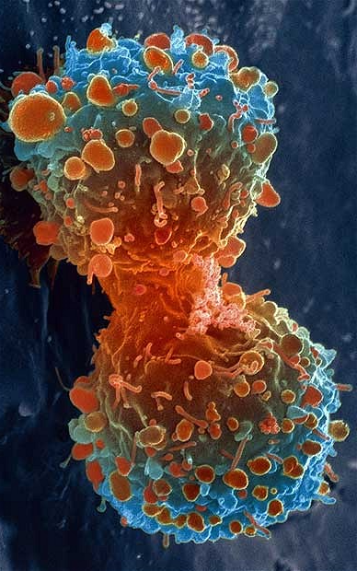
Classifying Cancer: A Machine Learning Based Approach
Alex Artsiomenka
Sergey Klimov
Igor Mandric
Danny Kneller
Doug Stone

Slide 2
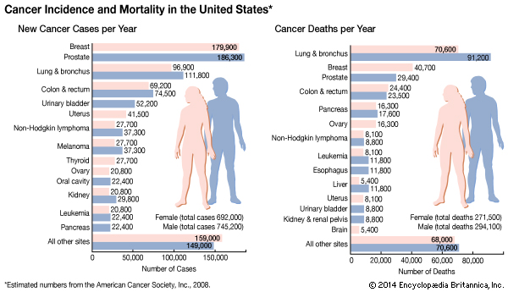
Why study Cancer?
Changes in gene expression are a hallmark of cancer cells
Notes:
Doug
Oncogenes and tumor suppression genes especially
<number>

Slide 3
Characterizing cancer using gene expression has precedence
Machine learning applications in cancer prognosis and prediction. (Kourou et al. 2014)
Using epigenomics data to predict gene expression in lung cancer. (Li et al. 2015)
Using high-throughput transcriptomic data for prognosis: a critical overview and perspectives. (Domany 2014)
Case-based retrieval framework for gene expression data. (Anaissi et al. 2015)
Validation and Reproducibility of a Microarray-Based Gene Expression Test for Tumor Identification in Formalin-Fixed, Paraffin-Embedded Specimens (Pillai et al. 2011)
MicroRNAs accurately identify cancer tissue origin. (Rosenfeld et al. 2008)
Notes:
sergey
<number>

Slide 4
Hypothesis and overview
Primary site cancer type can be determined from gene expression information taken from metastatic site biopsy tissue.
Web Server
Input data processing
Input: Gene expression data
Output: Cancer type
Expression Comparison
ICGC Database
Data Processing
Machine Learning
Notes:
danny
<number>

Slide 5

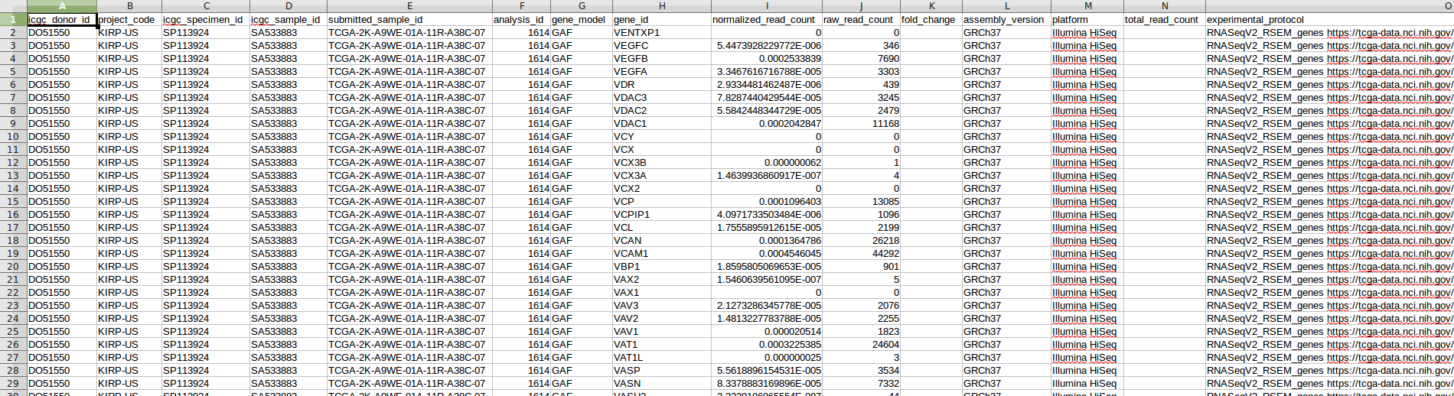
Data Mining
Downloaded RNAseq from ICGC
Tab separated value files
15 cancer types
8,093 donors
52.7 GB compressed
61.0 GB uncompressed
Notes:
Danny
<number>

Slide 6
Data Parser
#Opens, reads, then iterates through raw data
with open(‘Foo.tsv') as csvfile:
reader = csv.reader(csvfile, delimiter=' ')
reader.next()
#Generates a sorted array with only data of interest
#Sample ID, Gene and expression value
Specimen_Array = [[row[3], row[7], row[8]] for row in reader if 'GAF' in row[6]]
Specimen_Array.sort(key=lambda x: x[0])
#Creates objects as a dictionary in a dictionary
#{sample ID : {Gene ID : expression value}}
for item in Specimen_Array:
if item[0] == current:
genedict[item[1]] = float(item[2])
else:
TumorDict[current] = genedict
genedict = {}
current = item[0]
gene = []
TumorDict[current] = genedict
#Serializes to .JSON file
with open (‘bar.json', mode = 'w') as filename:
json.dump(TumorDict, filename)
#Total data from 61GB to 5GB
Notes:
sergey
<number>

Slide 7
Parser Troubleshooting
Problems Solutions
1. Microarray vs RNAseq
1. Gene model counter program
- RNAseq had samples for every type
2. Gene model/probe data
2. Gene model counter program
- GO Annotation File (GAF)
3. Large data sets/files
3. Cleared storage space and created test files
4. Duplicate data in some samples
4. Code to ignore duplicates
5. Specimen vs Donor vs Sample ID
5. ID counter program
- Specimen ID
Notes:
doug
Lesson learned: look at you data very carefully!
<number>

Slide 8
Gene model counter program
 | GAF | Ensembl
 | specimen_id | sample_id | submitted sample_id | analysis_id | specimen_id | sample_id | submitted sample_id | analysis_id
Bladder | 315 | 318 | 318 | 318 | 0 | 0 | 0 | 0
Blood | 173 | 173 | 173 | 173 | 161 | 161 | 161 | 58
Brain | 619 | 619 | 619 | 619 | 0 | 0 | 0 | 0
Breast | 1172 | 1172 | 1177 | 1177 | 0 | 0 | 0 | 0
Cervix | 264 | 264 | 264 | 264 | 0 | 0 | 0 | 0
Colorectal | 647 | 657 | 657 | 656 | 0 | 0 | 0 | 0
Head & Neck | 1090 | 1090 | 1090 | 855 | 0 | 0 | 0 | 0
Kidney | 848 | 852 | 852 | 852 | 136 | 136 | 136 | 136
Liver | 345 | 345 | 345 | 345 | 0 | 0 | 0 | 0
Lung | 1012 | 1016 | 1016 | 1012 | 0 | 0 | 0 | 0
Ovary | 265 | 265 | 265 | 265 | 111 | 111 | 111 | 111
Pancreas | 172 | 175 | 175 | 145 | 145 | 145 | 145 | 127
Prostate | 431 | 431 | 431 | 431 | 0 | 0 | 0 | 0
Skin | 434 | 434 | 434 | 434 | 0 | 0 | 0 | 0
Uterus | 536 | 540 | 540 | 540 | 0 | 0 | 0 | 0
Sample ID in the GAF model had most unique samples
Notes:
doug
<number>

Slide 9
Machine Learning Methods
Supervised Learning
Support vector Machine (SVM)
Random Forest Classifier
Notes:
alex
<number>

Slide 10
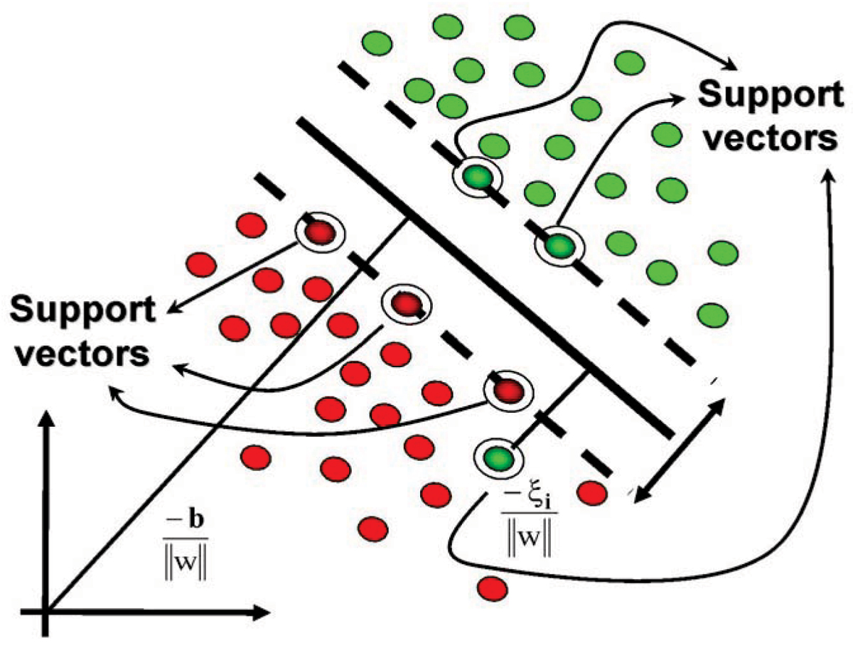
Support Vector Machine
http://galleryhip.com/support-vector-machine-hyperplane.html

Slide 11
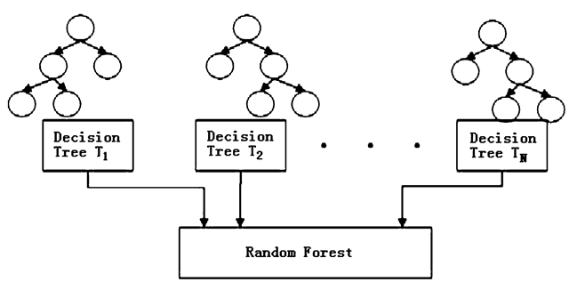
Random Forest Classifier
http://what-when-how.com/face-recognition/facial-landmark-localization-face-recognition-techniques-part-1/

Slide 12
Validation
5-fold cross validation
Accuracy
Model\Fold | 1 | 2 | 3 | 4 | 5 | Mean(+/- std)
SVM | 0.45 | 0.45 | 0.44 | 0.47 | 0.46 | 0.45 (+/- 0.01)
Linear SVM | 0.93 | 0.92 | 0. 90 | 0.91 | 0.89 | 0.91 (+/- 0.03)
Random Forest | 0.98 | 0.99 | 0.98 | 0.97 | 0.99 | 0.98 (+/- 0.01)

Slide 13
Identifying deviation in gene expression
#Finds average expression for all reference data per cancer type
for item in Specimen_Array: if item[1] in Count: Count[item[1]] += 1 Sum[item[1]] += float(item[2]) else: Count[item[1]] = 1 Sum[item[1]] = float(item[2]) for key in Count: Average[key] = Sum[key] / Count[key]
#Largest increase in expression = input change / average reference change
#Largest decrease in expression = largest expression of reference when input expression = 0
Notes:
Sergey
<number>

Slide 14



Web interface
Technologies used
Haskell Yesod web framework
Heroku Cloud application platform
Python socket web server
Notes:
igor
<number>

Slide 15

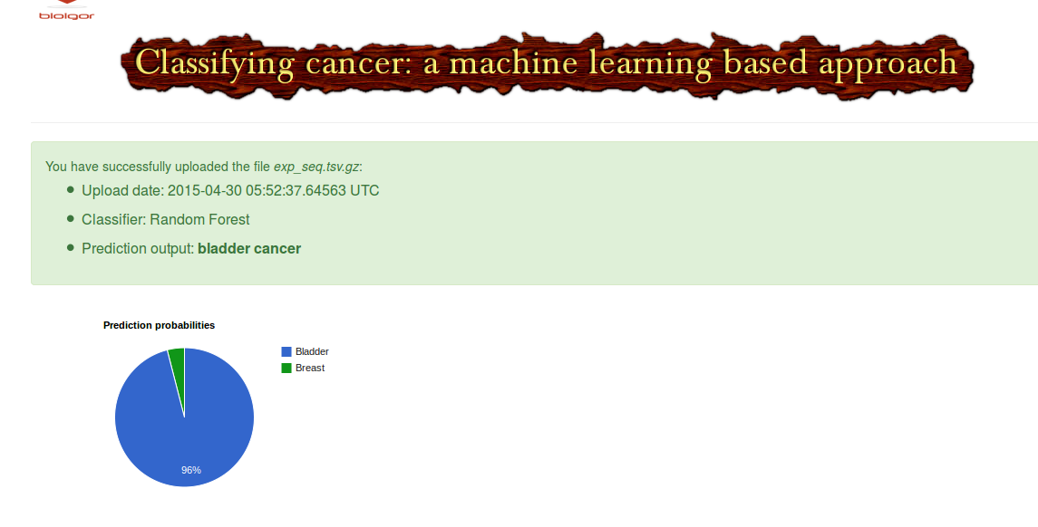



Architecture
Notes:
igor
<number>

Slide 16
Testing accuracy of each model
Cancer Type | Tested Samples | Tissue of origin
 |  | Bladder | Blood | Brain | Breast | Cervix
Bladder | 5 | 3 |  | 1 |  | 1
Blood | 5 |  |  | 5
Brain | 5 |  |  | 5
Breast | 6 |  |  |  | 5 | 1
Cervix | 10 | 2 |  |  |  | 8
Support Vector Machine Learning (SVM)
Cancer Type | Tested Samples | Tissue of origin
 |  | Bladder | Blood | Brain | Breast | Cervix
Bladder
Blood
Brain
Breast
Cervix
Random Forrest Machine Learning
Notes:
Danny
<number>

Slide 17
Summary
We created a server that uses machine learning on mined RNAseq data to predict cancer types from an entered gene expression
Significance:
This application can find primary cancer site from biopsy data from metastatic sites
Can identify rare cancer subtypes
Notes:
Danny
<number>

Slide 18
Future Directions
Information for oncogene and tumor suppression gene with largest changes in expression
Prediction of prognosis
Histological features
Clinical data
Treatment efforts
Prediction of treatment
Improved user interface
Bioinformatics statistics
Multiple input formats
Testing on all the cancer types
Notes:
Sergey
Clinical data like tumor stage and survival time (which are all on ICGC)
<number>

