Slide 1






STEPs4GROWTH [Successful Training and Effective Partnerships for Growing Regional Opportunities in the Workforce To Harness] the NC Clean Energy Alliance.
Dr. Balu Gokaraju, PI
Associate Prof. of Computational Data Science and Engineering
Associate Director of Visualization and Computation Advancing Research (ViCAR) Center
Dr. Gregory H. Monty, Co-PI
Director
Center for Energy Research and Technology, NC A&T State Univ.
Dr. Ray Tesiero
Asst. Prof. Civil Architectural and Env. Eng.
NC A&T State Univ.

Slide 2
NC Clean Energy ApprenticeshipNC with OJT
Dr. Balu Gokaraju, PI
Associate Prof. of Computational Data Science and Engineering
Associate Director of Visualization and Computation Advancing Research (ViCAR) Center
Dr. Gregory H. Monty, Co-PI
Director
Center for Energy Research and Technology, NC A&T State Univ.
Dr. Ray Tesiero
Asst. Prof. Civil Architectural and Env. Eng.
NC A&T State Univ.

Slide 3
STEPs4GROWTH—NC Clean Energy Alliance--Members
Technical Team
Balu Gokaraju, (NCAT & CERT))
Greg Monty (Director of CERT & NCAT)
Ray Tesiero (NCAT & CERT)
Steve Kalland— CTC, NCSU
Allison Carr– CTC, NCSU
Rhonda High—HCC
Advisory Members :
Star Hodge —NCDEQ
Caroline Sullivan– NCBCE
Wanda Ramos-McPherson (App.NC)
Andrea DeSantis– Policy Advisor, Office of Governor
Center for Energy and Research Technology (CERT)
NC Business Council for Education (NCBCE)
NC Department of Environmental Quality (NCDEQ)
Office of Governor
Halifax Community College (HCC)
ApprenticeshipNC (App.NC)
Clean Tech Center (CTC), NCSU
NC A&T State University (NCAT)

Slide 4
In Meeting today:
Central Piedmont CC
Kandi Deitemeyer
Heather Hill
Kristi Douglas
EDNC
Hunt Institute
NC A&T State Univ.
Balu, Greg and Ray
Halifax Community College
Ms. High,
Gaston CC:
Dr. Woodson, Lisa Albright-Jurs, Luke Upchurch.
Guilford Tech CC-
Kara Baldwin, Ms. Bargebuhr
Forsyth Tech:
Jacob Surat, Dr. Singleton, Dr. Dinkins, Dr. Burcham
Martin CC
Dr. Tabitha Miller.
Craven CC
Dr. Gery Boucher ; Robin Matthews
Pitt CC
Dr. Rouse, Dr. Tim Gould
Alamance CC
Dr. Algie Gatewood, Mr. Scot Doron, Mr. Louis Judge
Carteret Community College
Dr. Perry Harker, VP,
Notes:
Gaston :-- Dr. Woodson; Lisa Albright-Jurs; Luke Upchurch.
GTCC-Kara Baldwin: Ms. Bargebuhr
Forsyth :Jacob Surat; Dr. Singleton. Dr. Dinkins; Dr. Burcham
Martin :-- Dr. Miller.
Craven CC : Dr. Gery Boucher ; Robin Matthews
Pitt :Dr. Rouse :-- Dr. Tim Gould
Alamance :-- Algie Gatewood:

Slide 5
Present in this Meeting:
Brian Maragno, VP SIEMENS Energy Charlotte Hub.
Industry employer Partner
Balu, Greg and Ray from NC A&T State Univ.
Lead Institution as System Lead Entity
Rob Cox, Mike Mazzola from EPIC, UNCC
Serve as Backbone Organization in this Good Jobs Challenge Proposal.
$800K for 4 years.
NSF-ERC Proposal & Digital Twin for Nuclear Reactor in Collaboration.
Mike Realon from Olympic High School
20 students did apprenticeship/internship at SIEMENS
is a training partner institution in this Good Jobs Challenge Proposal.
$800K for equipment to Charlotte. +440K for operational Cost
John Morrison & Lukas Brun from e4Carolinas
Serve as Backbone Organization in this Good Jobs Challenge Proposal
$800K for 4 Years.

Slide 6

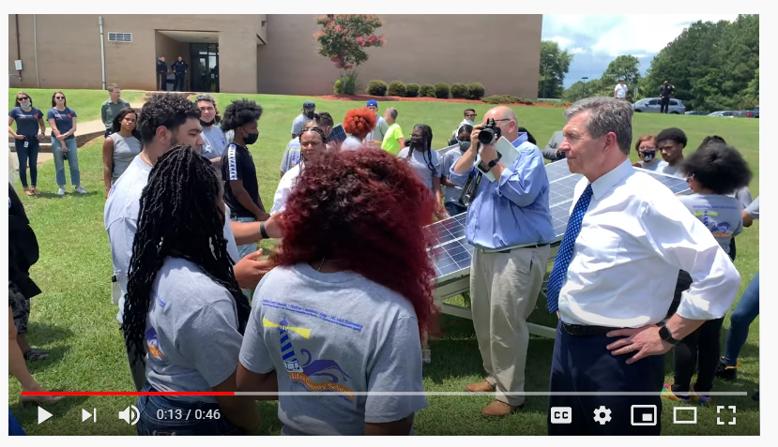
3. Apprenticeships &Workforce Development-NCDEQ
While we are planning forward to create new jobs by training the early-career workforce for this new CE technology– Apprenticeships are great models.
We also need to plan for the incumbent and displaced workers with wrap-around services.
These are hi-tech skills, hi-paying Good Jobs.
2021-NCDEQ sponsorship; OJT to 31 students, in 3 counties
93 % minority and 67% female in Solar and Energy Efficiency (EE).
2022-NCDEQ sponsorship; OJT to 60 students, in 7 counties
89% minority and 70% female in Solar, EE and Weatherization.
NC Clean Energy Apprenticeship—A&T Sponsor,2021
Energy Efficiency and
Solar Energy Registered Apprenticeships,
First in the Nation encouraged through NCDEQ Vision and Office of Governor.

Slide 7
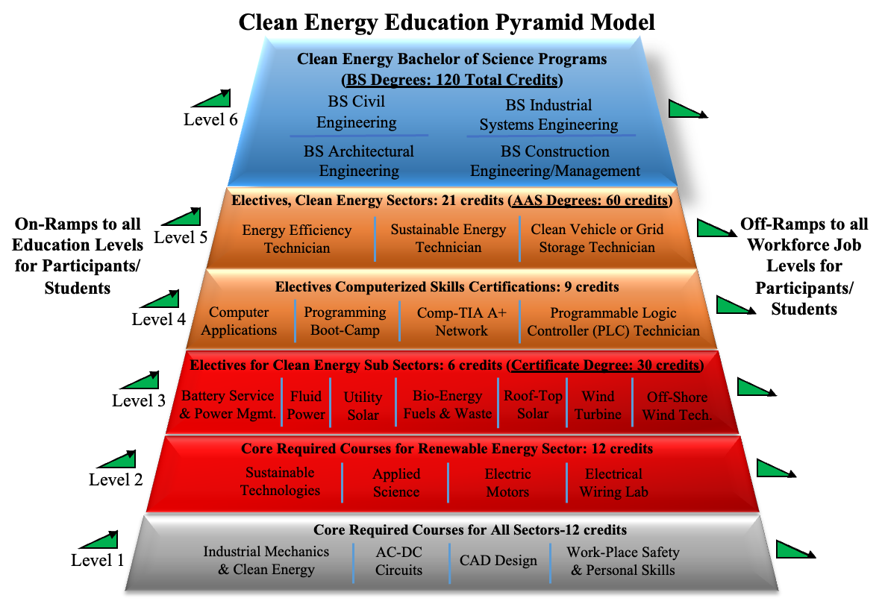
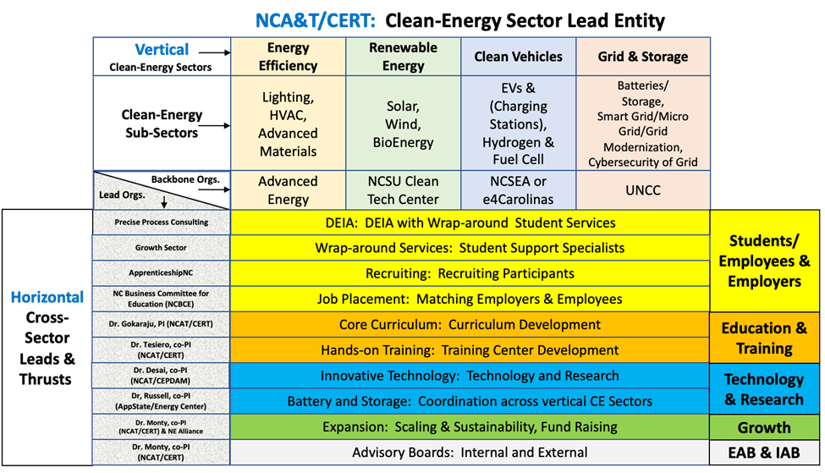
4. Sector-Strategy Partnerships and Education Pyramids. $ 25 Million Statewide Proposal-GJC, expanded to $16 Nation-wide Registered Apprenticeship (RAP)-HUB
Figure 4 : Education Pyramid Model for Renewable Energy
Figure 3. Sector-Strategy Framework for STEPs4GROWTH.
Notes:
Associates in Engineering. GTCC will follow Statics; applied engineering;

Slide 8
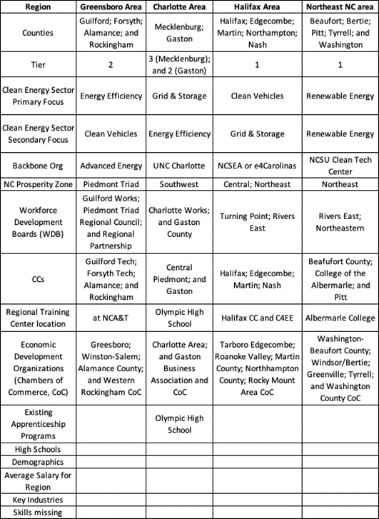
RiversEast Workforce Board :--
Counties : Add Randolph due to Toyota.
More solar companies Grid are coming between Charlotte and PTRC.
School Buses, City Buses, DC fast chargers would be from the VolksWagon Money, REI, Infrastructure bill.
NCA&T, Guilford
HaliFax CC
Martin CC
Notes:
Head of DWS (Workforce Solutions)→ DOC; 83 smaller NCWorks Centers→ WBD;

Slide 9
Budget Line items for Regional Tech. Comm. College
Set up 4 Regional Training Centers +2 mobile trailers in Community Colleges with equipment ( estimate of up to ($800K) *6) comprising of all the 9 subsectors listed in Figure 1 in the attached summary.
4 regional Tech. Centers (Halifax, Martin Community College, NC A&T & GTCC, and CPCC-Olympic High School, in Charlotte).
$50K for the college/High School per each year (in 4 years = $200K) in each region, for Administrative Cost and Curriculum Development.
$60K for the college/High School/Training Partner per each year (in 4 years= $240K) in each region, for Administrative Cost and Career Support Specialist.
Notes:
Wind Off-Shore --(GWO training)– hardware training needed-- high cost of equipment;
TurbineBlades Manufacturing ;
Boat Manufacturing Program.

Slide 10
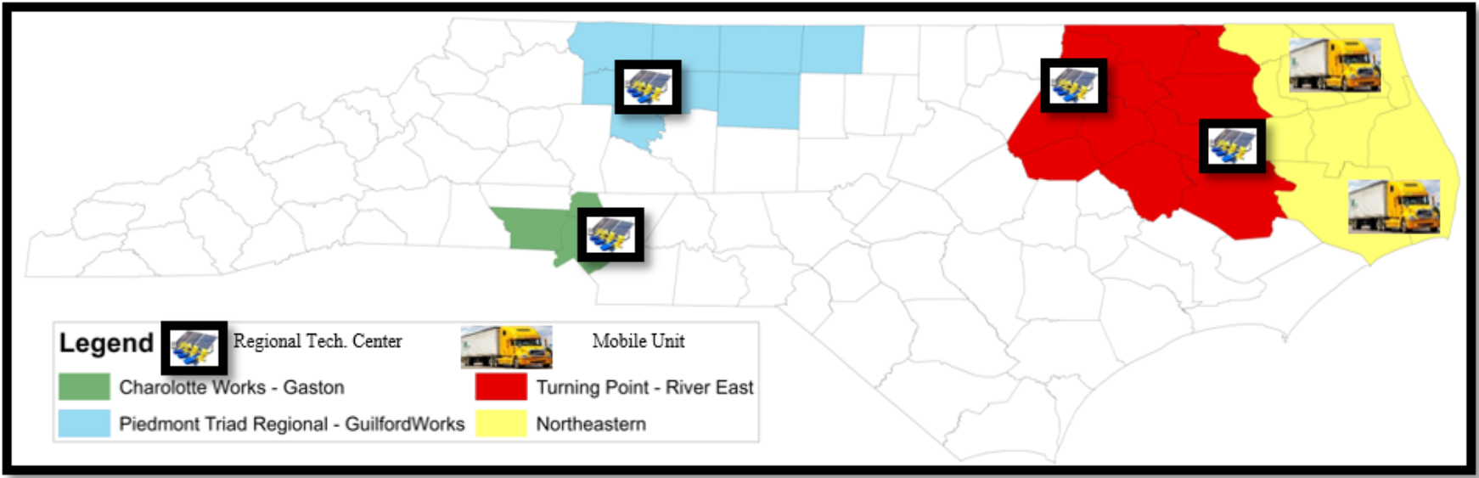
Notes:
Steve Kalland already have one mobile unit. Already using for 8 years ( 1 existing, 6 year older). Flat bed, small roof with arrays, roof is modular. Davidson comm. College has machining mobile unit. Opportunities to upgrade from our GJC grant.
PTRC also have a mobile trailer. Fees paid by Community college (training service agreement). Spring break training in CS. Custom training for industries.

Slide 11
Update from EDA Good Jobs Challenge : $25.2 Million
July 7: Asked for changes in SOW and also submit the SF424A.V1.0 PDF (budget standard form)
July 1: “Reduced Budget & allowed for change in scope: $23, 687, 365.00 (6% reduction)”
June 23 : “projected job placements by the end of the project term
June 17: “Facility Space Commitments & Safety Compliance from 6 RTCs”
June 16 : “Updated Bio sketches for all Sub Awardees”
June 14 : Submit a breakdown of funding by program component phase
Templates of Staffing and Budget Excel Formats (5)
Review attached Uniform Guidance on how to distinguish subawardees from contractors
Provide the Unique Entity ID for each SubAwardee
Provide organizational documentation : articles of incorporation and by-laws
Include a Travel budget line item for at least annual 2-3 convenings, but without increasing the overall federal request
Submit a 1-2 page scope of work (describing major objectives/milestones/outcomes of the program)
May 28: Called SIEMENS ENERGY; VP of Energy Production, Charlotte, Brian Maragno
May 30: Called SONDER ENERGY; Owner; Brian O’Hara. Chapel Hill.
May 16 : Clarify the specifics around the $900,000 in equipment purchases
Clarify the length (i.e., number of years) of your program and at what timeline the program will move into the Program Design and Program Implementation phases
Clarify the number and/or target of employer commitments

Slide 12
Positions to be hired
2 Post-Docs : 1- in electrical engineering and 1 in Advanced Manufacturing.
1 Grants Manager
1 Admin Assistant
2 Program Managers
1 Apprenticeship Consultant
1 Eng. Tech. Instructor for Mobile Unit : Consultant
5 Graduate & 4 UG Students :1 mobile Trailer Driver : Consultant
25 SubAwardees : includes 16 CCs
5 Contract Services.
Space Location :
IRC -110 (full-time) & IRC-11 (Grad students); (request to space committee) for 8 people.
2 Project Managers & 4 UG Students (space in COE)
Lab Facilities : 1200 Sq. Ft. (committed Provost Dr. Smith-Jackson)
Notes:
ADVANCE Grant:-- Request Calvin

Slide 13
Questions to Discuss :--
How to make the Standardized Curriculums in Solar Energy – Certifications or AAS deg. Courses.
How to Share Resources, Online Material, Distance Learning Instruction, Mobile Labs, Experienced Faculty.
How to Share the revenue in Distance Learning Instruction.
how to recruit more underserved populations in rural NE NC?
how to provide hands-on training to underserved rural populations in NC?
Any relocation Costs?. Do we need Funding for Wrap Around Services ?
how to attract underserved to apprenticeship opportunities in counties outside of where those people live?
how to attract underserved to full-time opportunities in counties outside of where those people live today?
Equipment of $800K per Regional Tech. Center is not enough for 4 CE sectors.
Notes:
RVLC :-- Catherine Davis; System Office. NC VLC url: https://vlc.nccommunitycolleges.edu/.
CPCC:-- EVs

Slide 14
Success Metrics for CE Workforce Development:--
STEPs4GROWTH and each grantee will together measure key metrics, including breakouts by demographics:
# of workers participating;
# workers completing education and work-based training;
# of workers placed in jobs);
# of certificates earned;
Average wages of job placements;
Average wage growth of job placements (longitudinal participant tracking);
Retention of workers placed (also included in longitudinal tracking);
Amount spent on wrap- around services; and
Total Average cost per worker in the program; and others.
STEPs4GROWTH will collect data on salaries paid for apprenticeships and full-time jobs directly from the industry partners.
Apprenticeship jobs will be posted in Navigator, and all salary information for jobs offered or filled will be gathered with the Navigator tool.
A yearly report will give a summary of the job positions offered and filled.
Additionally, the SSSs

Slide 15
Acceptable Terms with Employers :
NC A&T will Pay directly to student: $10/hour; 30hrs/week for 10 weeks. Total $3,000.
Students Started on May 23rd (Guilford)
Bi-weekly payments of $600 each . 5 Checks will be mailed to your home addressed given in the W9 form.
Students Started on June 13. (charlotte and Wake)
June 28th : first check of $1500 was ordered. But only got processed for 10 students.
July 20th : second check of $1500 will be mailed.
Potential industries: HVAC, building automation, building energy management, energy engineering/design, renewable energy, sustainability, architectural, and more.
We provide the liability insurance from our University side.
Internship Period: June 13 through Aug. 19th
Check-in with supervisors: Beginning of 3rd week, 6th week and 9th week.
Check-in with student : End of 1st week, 4th week and 7th week and 10th week about their experience.

Slide 16
Charlotte Students :-- Paid
Fowell - Paid 6/29 on Check #01012496 (received)
Fowler - Paid 6/29 on Check #'01012497
Mayberry - Paid 6/29 on Check #01012529
Shanti - Paid 6/29 on Check #01012554 (not received) --
Charlotte Students :-- In Process:
Chen - PO approved/invoiced 6/22 with requested payout on 6/28 but was not processed yet.
Guzman - PO still pending approval (late W9)
Hay - PO approved/invoiced 6/22 with requested payout on 6/28 but was not processed yet.
Schettini - PO approved/invoiced 7/1 (late W9) with requested payment 7/7
Zhang - PO approved/invoiced 6/27 (late W9) with requested payout on 6/30 but was not processed yet.
Wake County Students :-- Paid
1) Cahua - Paid 6/29 on Check #01012473
2) Hood - Paid 6/29 on Check #01012511. (received it).
Wake County Students :-- in Process
3) Coe - PO approved/invoiced 6/22 with requested payout on 6/28 but was not processed yet.
4) Vazquez-Mendoza - PO approved/Invoiced 6/22 with requested payout on 6/28 but was not processed yet.
5) Sydney Parker :-- incomplete Holds

Slide 17
Deliverables and Tracking
Additionally SSSs assigned to each of the 4 regions will have direct communication with the participants and will track their progress through STEPs4GROWTH.
This will include gathering data related to their education, OJT, and job placements.
The SSSs will additionally track the students after employment for a few years to understand student pathways using similar systems like Apprenticeship Registration and Tracking System (ARTS) adopted by the state of Washington.
Yearly surveys of jobs by industry partners will be used to estimate workforce (job) needs of the industry, and to plan for accommodating students in the training pipeline.
Collaboration between STEPs4GROWTH and National-CE-RAPs will be evaluated to ensure a strong working relationship.
Evaluation will include surveys given to the leaders from the teams, from backbone organizations, from Thrust leaders and key personnel, and from students/participants in the project.
A yearly report on the collaboration will be delivered in September each year.

Slide 18
Milestones from Good Jobs Challenge :--
STEPs4GROWTH believes the metrics for success are achievable in the time frame of the
EDA grant (4 years).
With very strong support and ability to coordinate a large team of stakeholders,
2000-4000 credentialed/certified or degreed skilled CE workers per year will be trained
(>$120M in new wages/yr).
Ten Tier 1 counties, with African American (AA) population ~3.4x the nations average, and all other Tier 2 and 3 counties, with AA population ~2 times the nations average.
Salaries across all 4 regions are underperforming, and due to new manufacturing factories like Toyota batteries in Greensboro, new jobs created will increase wages 30-50% over current average family incomes in the regions served.

Slide 19
Milestones Timeline
The requested 4-year budget for STEPs4GROWTH is $25,187,365. SysDev phase=$3,290,001 (over 7 months).
ProgDes phase=$7,446,281 (over 12 months). ProgImp phase=$14,451,483 (over 29 months).
A 7-month SysDev planning phase will establish the curriculum (leveraging online and self-paced education whenever possible), and training needed in four CE sectors and will install equipment to do hands-on training.
The 12-month ProgDes phase will run Alpha tests (summer 2023) in 4 CE sectors and 4 regions. At the end of the ProgDes phase, equipment will be in place to teach all 4 CE sector Pyramid Models in all 4 regions.
The last 29-month ProgImp phase is the ramp-up of all training to be able to serve 2000-4000 credential/certificate-earning participants per year, and to place them into the workforce.
A Beta test (summer 2024) of the training system begins at the beginning of ProgImp, and two additional Pilots (summers 2025, 2026) will optimize the training system for all 4 CE sectors.

Slide 20
Outcomes
STEPs4GROWTH will enhance National-CE RAP projects through its CoP around the Framework and Pyramid Models. Outputs will include incremental improvements in shared metrics compared to the original goals of the projects as defined by the National-CE-RAPs. The goals of these grantee projects are to bring new high-paying jobs to people in support of high-growth CE economic sectors. Metrics defined above will help measure the outputs of STEPs4GROWTH’s additive contribution to each project.
The CoP will deliver outcomes: proof that the Framework and Pyramid Model approach, when supported by constellations of stakeholders, strong project management, and collective impact methods, makes a strong National Model for economic development in multiple sectors.

Slide 21
Challenges
how to recruit more underserved populations in rural NE NC?
how to provide hands-on training to underserved rural populations in NC?
how to attract underserved to apprenticeship opportunities in counties outside of where those people live?
how to attract underserved to full-time opportunities in counties outside of where those people live today?
Equipment of $800K per Regional Tech. Center is not enough for 4 CE sectors.

