Slide 1
C++ Boot Camp
Session 1: Variables, Types and Functions

Slide 2
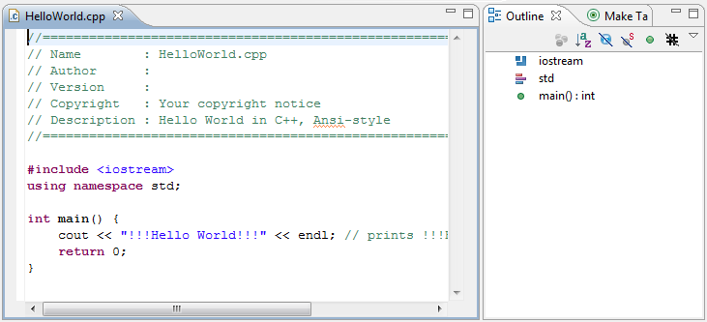
Basic Program Structure

Slide 3
Variables
Consist of characters, numbers and underscores
Must begin with a letter
Case Sensitive
Cannot be keywords
Examples: majorKey, we_the_best, Another1_

Slide 4
Types
Used to indicate how much storage a variable will use
Basic Types:
Char - one byte, holds a character value
Int - 16 bits, holds an integer value
Double - used to represent floating point numbers
Bool - true or false value

Slide 5
Functions
Basic function structure:
type name (parameters…) {statements}
Example:
int addition (int a, int b)
{
int r;
r=a+b;
return r;
}

Slide 6
Input/Output
Output: uses insertion operator <<
example: cout << “Sample output” << endl;
Input: uses extraction operator >>
example: int age;
cin >> age;

Slide 7
Input/Output Example
// i/o example
#include <iostream>
using namespace std;
int main ()
{
int i;
cout << "Please enter an integer value: ";
cin >> i;
cout << "The value you entered is " << i;
cout << " and its double is " << i*2 << ".\n";
return 0;
}

Slide 8
Examples
Write a program that asks a user for a base and exponent and then computes a power.
2. Write a program that takes a number and reverses it.
3. Create an array that can hold ten integers, and get input from user.
Display those values on the screen, and then prompt the user for an integer. Search through the array, and count the number of times the item is found.

