Slide 1
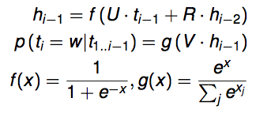
U
t(i-1)
V
t(i)
R
h(i-1)
h(i-2)

Slide 2
U
t(i-1)
W
f
HS decisions
R
h(i-1)
h(i-2)

Slide 3
sh(m)
tS
sU
s(i-1)
tW
tU
tf
HS
sW
t(i-1)
sf
tR
th(i-1)
sR
sh(i-1)
th(i-2)
sh(i-2)
French sentence (length m)
English sentence

Slide 4
dS
sh(m)
rS
sU
tS
s(i-1)
tW
tU
tf
HS
sW
t(i-1)
sf
tR
th(i-1)
sR
sh(i-1)
th(i-2)
sh(i-2)
French sentence (length m)
English sentence

