Slide 1

Adaptive Nearest Neighbor Density Peak
Clustering Based On Fuzzy Logic
Houshen Lin, Jian Hou and Huagiang Yuan.
¹ School of Computer Science and Technology, Dongguan University of Technology, Dongguan

Slide 2


CONTENTS
1
4
Introduction
Algorithm Framework
2
5
Problem Statement
Experiment
3
6
Preparatory Work
Conclusion

Slide 3
iko90
Introduction
Clustering is considered to be one of the key techniques of unsupervised learning, which requires dividing the samples of the dataset into different clusters.
The density peak clustering (DPC) algorithm is simple and practical, and can adapt to more complex cluster shapes. Since its inception, DPC has attracted attention in various fields.
Problem Statement
Preparatory Work
Algorithm Framework
Experiment
Conclusion
Notes:
difficulties: 1. Model generalization: the model needs strong generalization capabilities to adapt to various quantities of support positions for carrier-based aircraft. It must navigate complex constraints and prescribed task sequences during scheduling. 2. Action space: the more carrier-based aircraft there are, the more challenging the effectiveness of the algorithm there is. The total action space is equal to the number of carrier-based aircraft times tasks without considering resource constraints. 3. Cooperation form: the total completion time depends on the slowest task, so carrierbased aircraft must collaborate to minimize it during scheduling.
our works: 1. We model a decision scheduling of carrier-based aircraft support plan as a DecPOMDP problem, which can automatically learn solutions using a machine learningbased approach. 2. We propose the Multi-NPDQ method, particularly for the problem of the complex action space in single-agent reinforcement learning dynamic environments, which combines the MADRL basic QMIX algorithm and PER mechanism. 3. We use a heuristic strategy to block unavailable support positions regarding to resource-limited problems in the scheduling process. 4. We present a new strategy called Non-Stop, which together with the immediate reward strategy, thus makes it easier to obtain optimal solutions.

Slide 4
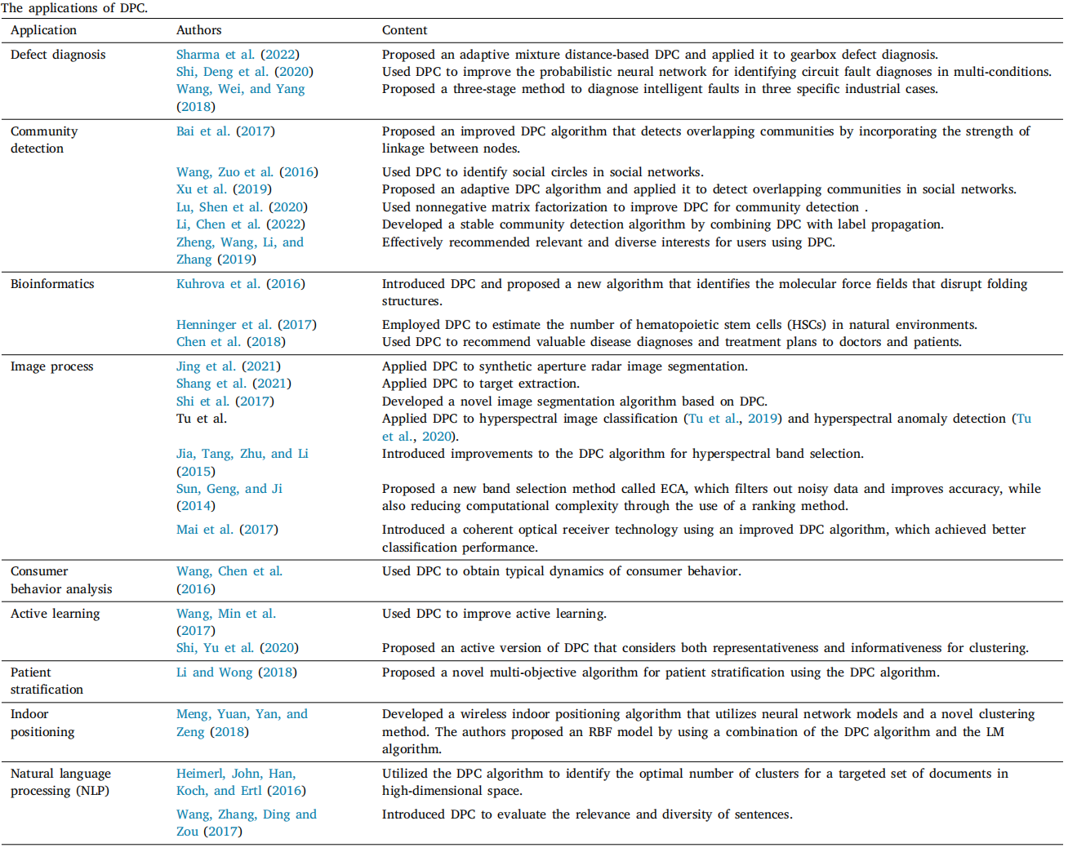
iko90
Introduction
Problem Statement
Preparatory Work
Algorithm Framework
Experiment
Conclusion
Notes:
difficulties: 1. Model generalization: the model needs strong generalization capabilities to adapt to various quantities of support positions for carrier-based aircraft. It must navigate complex constraints and prescribed task sequences during scheduling. 2. Action space: the more carrier-based aircraft there are, the more challenging the effectiveness of the algorithm there is. The total action space is equal to the number of carrier-based aircraft times tasks without considering resource constraints. 3. Cooperation form: the total completion time depends on the slowest task, so carrierbased aircraft must collaborate to minimize it during scheduling.
our works: 1. We model a decision scheduling of carrier-based aircraft support plan as a DecPOMDP problem, which can automatically learn solutions using a machine learningbased approach. 2. We propose the Multi-NPDQ method, particularly for the problem of the complex action space in single-agent reinforcement learning dynamic environments, which combines the MADRL basic QMIX algorithm and PER mechanism. 3. We use a heuristic strategy to block unavailable support positions regarding to resource-limited problems in the scheduling process. 4. We present a new strategy called Non-Stop, which together with the immediate reward strategy, thus makes it easier to obtain optimal solutions.

Slide 5
iko90
Introduction
The DPC algorithm has some problems that need to be improved.
The local density and the neighbor distance are easily contaminate by noise.
The algorithm is sensitive to the parameter and prior knowledge is required to determine the specific value.
The cluster center is affected by the local density ρ and the neighbor distance δ.
The allocation strategy may produce a "domino effect".
Problem Statement
Preparatory Work
Algorithm Framework
Experiment
Conclusion
Notes:
This paper mainly focuses on the third step. The specific scheduling process is shown in the next slide.

Slide 6
iko90
Introduction
By considering the distribution of shared neighbors among data points to measure their similarity, it can more accurately reflect the density distribution of data points in their local neighbors.
Regarding the value of the neighbor parameter k,the algorithm proposed in this paper combines the natural nearest neighbor and can dynamically and adaptively determine the optimal value of the neighbor parameter k according to the local characteristics of the data.
Problem Statement
Preparatory Work
Algorithm Framework
Experiment
Conclusion

Slide 7
iko90
Introduction
Besides, we no longer manually determine cluster centers through decision graphs, but instead achieve automatic identification of cluster centers in the dataset.
We divide the non-cluster center into three categories of density data points, and design a fuzzy logic-based allocation strategy for each category of density data points, which is more targeted.
Problem Statement
Preparatory Work
Algorithm Framework
Experiment
Conclusion

Slide 8
iko90
Introduction
The algorithm steps are as follows:
Initializes the dataset X and calculates the distance matrix of the dataset.
Implement the natural nearest neighbor algorithm to obtain the natural neighbor eigenvalue λ.
Calculate the local density and the neighbor distance.
Identify cluster centers and Initialize queue to store it.
Inspired by fuzzy logic, allocate data points based on their respective allocation strategies for different density types.
Problem Statement
Scheduling Model
Algorithm Framework
Experiment
Conclusion
Notes:
In this paper, we propose a MADRL algorithm called Multi-NPDQ, which combines the QMIX algorithm with the PER mechanism. The PER mechanism selects quality sample data for learning. We introduce a heuristic strategy to mask unsupported positions and propose a new strategy, Non-Stop, which enhances solution quality and stability in dynamic environments with immediate reward.

Slide 9
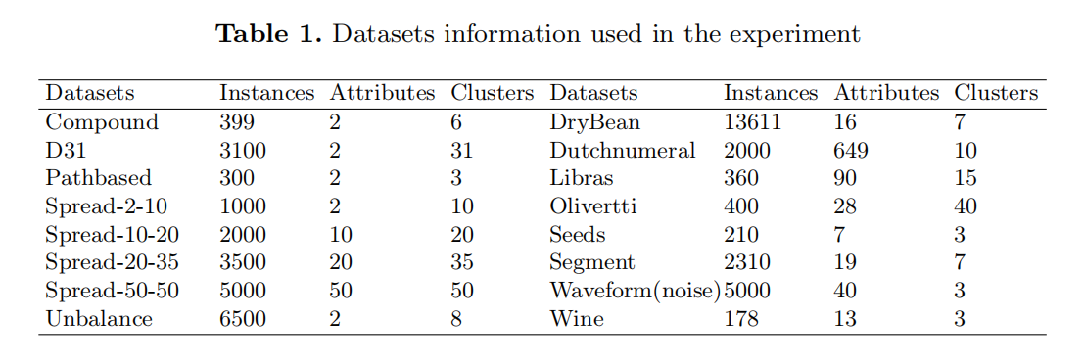
iko90
Introduction
Problem Statement
Scheduling Model
Algorithm Framework
Experiment
Conclusion

Slide 10
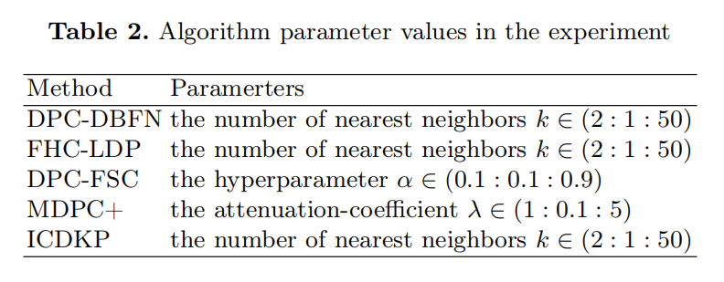
iko90
Introduction
Problem Statement
Scheduling Model
Algorithm Framework
Experiment
Conclusion

Slide 11
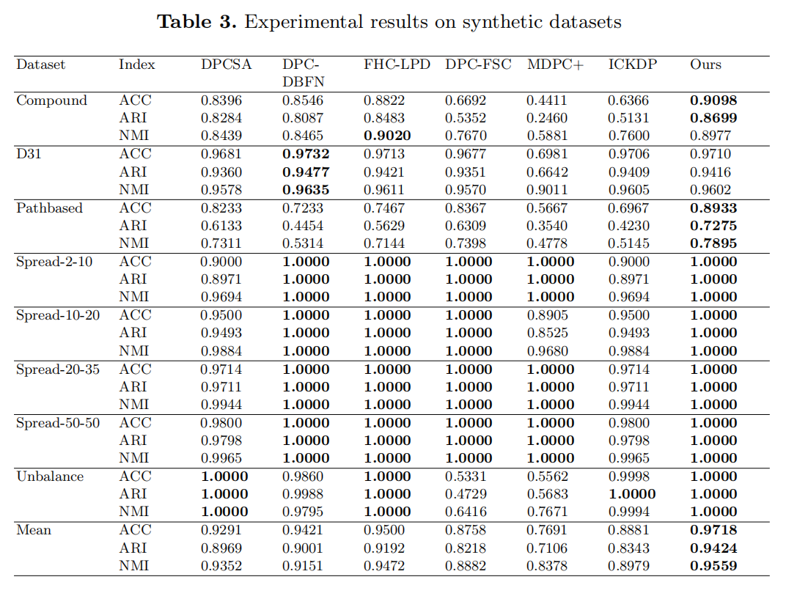
iko90
Introduction
Problem Statement
Scheduling Model
Algorithm Framework
Experiment
On the Spread series datasets, our algorithm can achieve a clustering accuracy of 1 under different indicators.
On the Compound and Unbalance datasets, the performance of the algorithms involved in the experiment varies greatly, while our algorithm performs robustly on these datasets and has higher clustering results.
The average clustering result of our proposed algorithm ranks first in all indicators. This also shows that our algorithm has excellent clustering ability, which is no less than the current excellent improved algorithm.
Conclusion

Slide 12
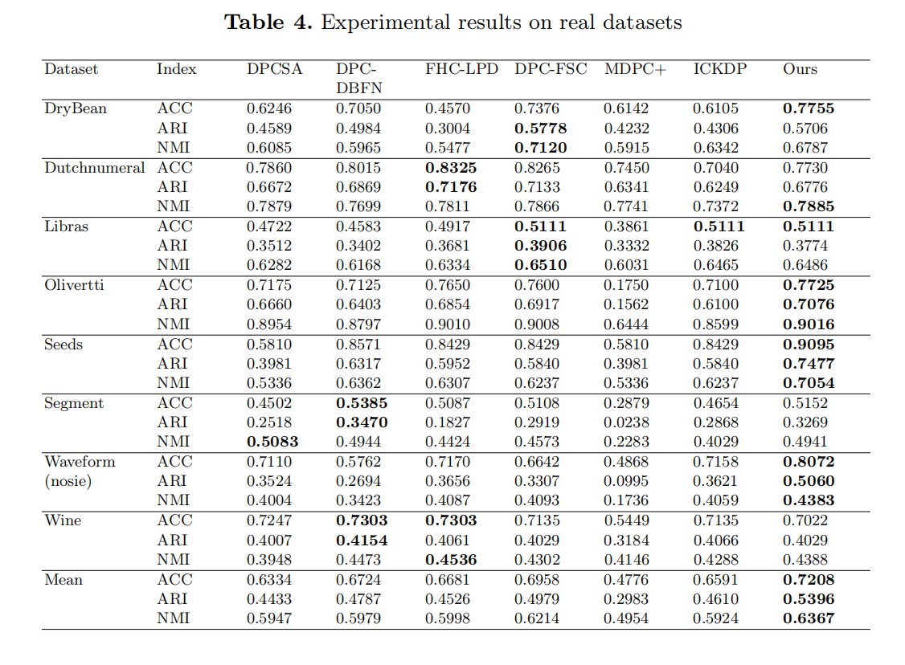
iko90
Introduction
Problem Statement
Scheduling Model
Algorithm Framework
Experiment
On the Dutchnumeral and Seeds datasets, tour algorithm and the comparative experimental algorithm can show a high clustering effect, especially the algorithm proposed in this paper is better than other algorithms.
On the DryBean and Olivertti datasets, the differences between the algorithms are large. Our algorithm performs robustly on these datasets and has a high clustering result.
In the real data set, the average clustering results of our algorithm under different indicators are 0.7208, 0.5396, and 0.6367, respectively, also ranking first.
Conclusion

Slide 13
iko90
The primary contributions of this study are as follows:
(1) We introduce the ideas of shared nearest neighbor algorithm and natural nearest neighbor into DPC algorithm and design a new method to calculate ρ and δ so as to more easily identify cluster centers. In addition, the parameters can be determined according to the situation of the dataset itself, thus avoiding the influence of human selection errors.
(2) Inspired by fuzzy logic, based on the original DPC algorithm allocation strategy, we design appropriate allocation strategies according to data points of different density types to ensure the robustness of the allocation process of data points of different density types.
Introduction
Problem Statement
Scheduling Model
Algorithm Framework
Experiment
Conclusion

Slide 14
THANK YOU

