Slide 1
HOSPITAL OPERATIONS / COURSERA
Hospital Operational Efficiency Improvement
20%
Executive recommendation
Conditional Option B integration pilot
less administrative processing time per admission
Illustrative target within six months
Hypothetical case study. Numerical inputs and targets are illustrative.
01
Notes:
Source: user Case Studies conversation and Coursera Project Worksheet. No interviews, measured baseline or pilot results are claimed. All added thresholds, priorities and timings are proposed for validation.

Slide 2
HOSPITAL OPERATIONS / COURSERA
Problem statement and scope
Case problem
Duplicate entry, delayed record access and manual handoffs may create avoidable administrative work.
Scope
Admissions, patient records and interdepartmental communication.
Boundary
Initial proposal excludes full EHR replacement, clinical decision systems, scheduling and billing redesign.
Hypothetical case study. Numerical inputs and targets are illustrative.
02
Notes:
Source: user Case Studies conversation and Coursera Project Worksheet. No interviews, measured baseline or pilot results are claimed. All added thresholds, priorities and timings are proposed for validation.

Slide 3
HOSPITAL OPERATIONS / COURSERA
Business requirements
ID | Functional requirement | Acceptance focus
FR01 | Reuse verified patient data | Confirmed identity, mapped fields and manual match resolution
FR02 | Timely access through existing interfaces | Usable admission data after successful submission
FR03 | Notify the receiving ward | Delivery, acknowledgement, retry and escalation
Release controls: RBAC, audit logs, availability and reliable integration.
Detailed requirements and test criteria appear in the accompanying BRD.
Hypothetical case study. Numerical inputs and targets are illustrative.
03
Notes:
Source: user Case Studies conversation and Coursera Project Worksheet. No interviews, measured baseline or pilot results are claimed. All added thresholds, priorities and timings are proposed for validation.

Slide 4
HOSPITAL OPERATIONS / COURSERA
Stakeholder analysis
Stakeholder | Interest / influence | Planned engagement
Hospital administration | High / High | Decision gates, benefits and cost review
Physicians | High / Medium | Workflow review and access testing
Nurses | High / Medium | Handoff design, pilot and training
IT department | Medium / High | Architecture, security, support and testing
Patients | Medium / Low | Accessible feedback and privacy expectations
Admissions staff | High / Medium | Data entry observation, design and UAT
Role ratings are case assumptions. Interviews and validation sessions remain planned.
Hypothetical case study. Numerical inputs and targets are illustrative.
04
Notes:
Source: user Case Studies conversation and Coursera Project Worksheet. No interviews, measured baseline or pilot results are claimed. All added thresholds, priorities and timings are proposed for validation.

Slide 5
HOSPITAL OPERATIONS / COURSERA
Gap analysis
Current state hypothesis | Desired state | Proposed response
Duplicate manual entry | Verified data reused across interfaces | FR01 plus NFR04
Delayed record access | Usable records after submission | FR02 plus NFR01–03
Manual handoff | Traceable ward notification | FR03 plus NFR02–04
Validate the gaps with staff observation, system inventory and timestamps.
No hospital baseline or verified root-cause study is available.
Hypothetical case study. Numerical inputs and targets are illustrative.
05
Notes:
Source: user Case Studies conversation and Coursera Project Worksheet. No interviews, measured baseline or pilot results are claimed. All added thresholds, priorities and timings are proposed for validation.

Slide 6
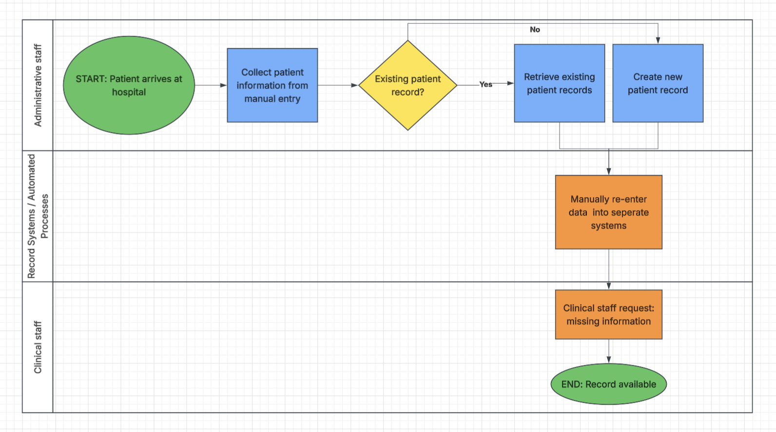
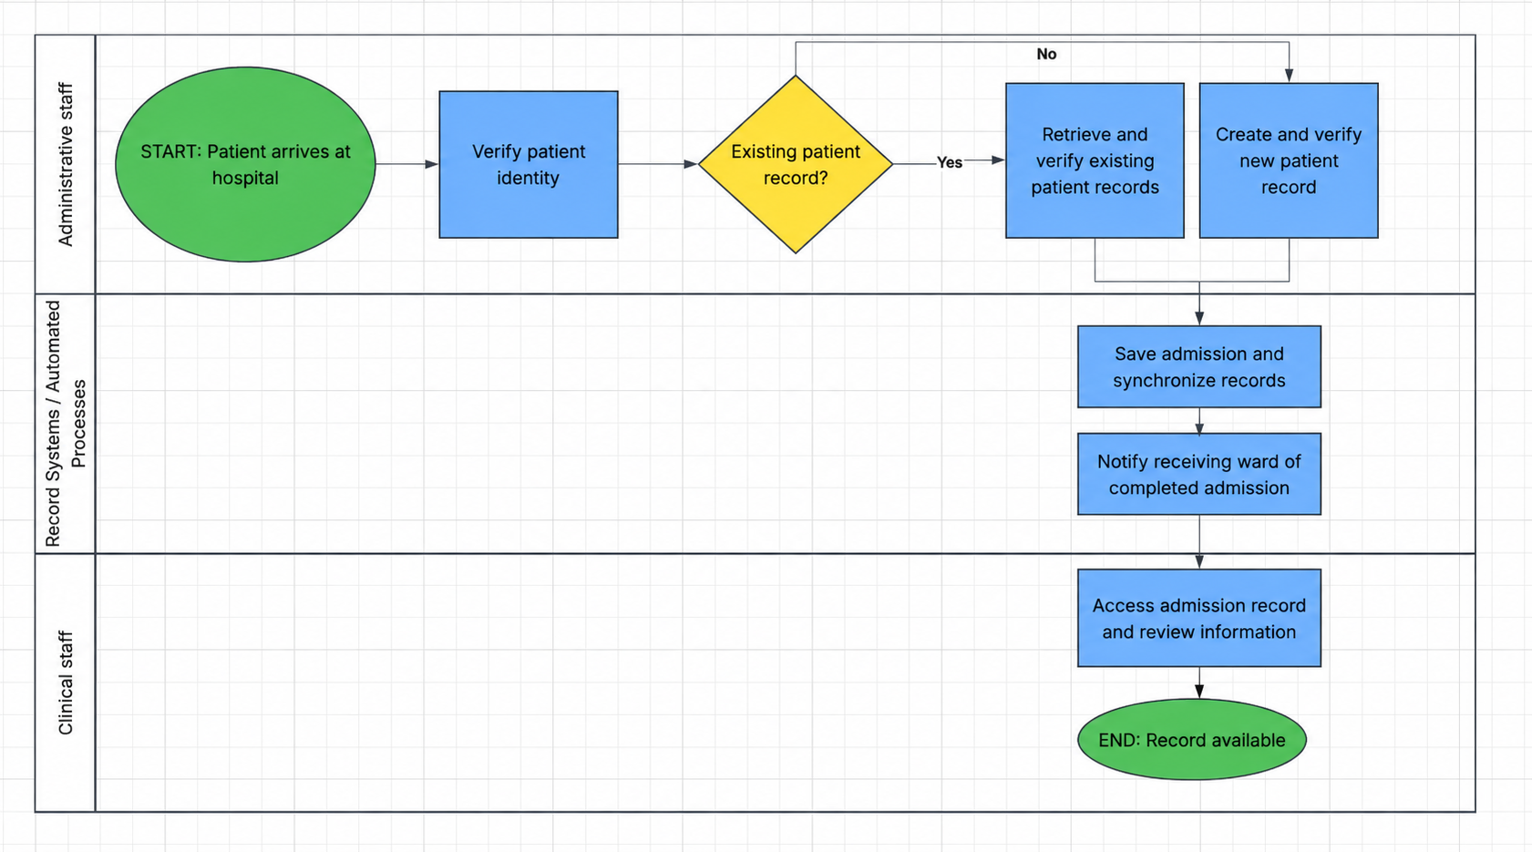
HOSPITAL OPERATIONS / COURSERA
Current and future process flows
AS-IS
TO-BE
Illustrative unvalidated workflows based on the supplied Lucidchart diagrams.
TO-BE placeholder connector removed. AS-IS retains “seperate” and a lane issue.
The BRD specifies failure handling, acknowledgement and transfer readiness.
Hypothetical case study. Numerical inputs and targets are illustrative.
06
Notes:
Source: user Case Studies conversation and Coursera Project Worksheet. No interviews, measured baseline or pilot results are claimed. All added thresholds, priorities and timings are proposed for validation. Images: user-supplied image(20261113-114743).png AS-IS and image(20261113-113834).png TO-BE. TO-BE reproduction cleaned with the built-in image editor to remove unused connector and stray line. See larger reproductions in BRD. Manual re-entry sits in the system lane. Text requirements govern exception handling.

Slide 7
HOSPITAL OPERATIONS / COURSERA
Requirements prioritization
Requirement | Impact | Feasibility / cost | Priority
NFR01–04 controls | High | Medium / high | Must, release gate
FR01 data reuse | High | Medium / medium | Must, pilot core
FR02 timely access | High | Medium / medium | Must, pilot core
FR03 notifications | High | Medium / medium | Must, pilot core
NFR05 usability | High | High / low–medium | Must, acceptance
Qualitative assumptions. Prove controls and integration first, then reuse and access.
Notifications depend on reliable availability. Advanced analytics remain outside scope.
Hypothetical case study. Numerical inputs and targets are illustrative.
07
Notes:
Source: user Case Studies conversation and Coursera Project Worksheet. No interviews, measured baseline or pilot results are claimed. All added thresholds, priorities and timings are proposed for validation.

Slide 8
HOSPITAL OPERATIONS / COURSERA
Technology assessment
Option | Assessment | Decision
A Full EHR replacement | Broader transformation, migration and disruption | Fallback for strategic review
B Targeted integration | Existing interfaces, vendor and mapping dependencies | Preferred conditionally
C Process changes only | Limited technology spend, gaps may persist | Interim fallback
Illustrative financial case
Illustrative case: EUR 45k initial cost, EUR 10k annual support. At 24k admissions, 2 minutes saved releases 800 hours. EUR 18k net capacity value supports 2.5-year payback.
Hypothetical case study. Numerical inputs and targets are illustrative.
08
Notes:
Source: user Case Studies conversation and Coursera Project Worksheet. No interviews, measured baseline or pilot results are claimed. All added thresholds, priorities and timings are proposed for validation. Financial assumptions: EUR 35 per staff hour, gross capacity value EUR 28,000, net EUR 18,000 after recurring cost. Capacity is not cash savings. Three full operating years yield EUR 9,000 before discounting/tax. 10% time reduction yields EUR 4,000 annually and 11.25-year payback. See complete sensitivity and assumptions in BRD. No vendor pricing or proven ROI exists. Evaluate licensing, build, testing, training, support and recurring costs. Retaining legacy interfaces may raise ongoing cost.

Slide 9
HOSPITAL OPERATIONS / COURSERA
Implementation and change management
Illustrative period | Delivery focus | Exit condition
Month 1 | Discovery and baseline | Agreed scope and measurements
Month 2 | Integration proof and cost case | Technical and financial approval
Months 3–4 | Build, UAT and staff preparation | Safe release readiness
Month 5 | Controlled ward pilot | Critical issues resolved
Month 6 | Evaluate and decide scale | Evidence-based sponsor review
Admissions and ward champions support scenario training and shift-based help.
Rebaseline the schedule if vendor access or testing needs more time.
Hypothetical case study. Numerical inputs and targets are illustrative.
09
Notes:
Source: user Case Studies conversation and Coursera Project Worksheet. No interviews, measured baseline or pilot results are claimed. All added thresholds, priorities and timings are proposed for validation.

Slide 10
HOSPITAL OPERATIONS / COURSERA
Risk mitigation
Risk | Mitigation | Accountable role
Integration incompatibility | Interface proof, vendor commitment and staged testing | IT lead
Wrong match or conflicting data | Identity verification, manual resolution and reconciliation | Admissions lead
Unauthorized access or data exposure | Access matrix, security tests and restricted logs | Security owner
Outage or lost notification | Monitoring, retries, escalation and rehearsed fallback | IT operations
Staff resistance or added effort | Co-design, training and pilot feedback | Change lead
Cost or timetable overrun | Lifecycle cost gate, contingency and scope control | Sponsor
Unresolved critical identity, access or synchronization failures block release.
Hypothetical case study. Numerical inputs and targets are illustrative.
10
Notes:
Source: user Case Studies conversation and Coursera Project Worksheet. No interviews, measured baseline or pilot results are claimed. All added thresholds, priorities and timings are proposed for validation.

Slide 11
HOSPITAL OPERATIONS / COURSERA
Solution evaluation metrics
KPI | Illustrative target | Measurement
Active administrative minutes / admission | 10 min to 8 min by month 6 | Comparable admission tasks
Record availability delay | 20 min to 10 min by month 6 | Submission to first authorized access
Admission completion to transfer | 30 min baseline, 24 min target | Secondary, affected by bed readiness
Notification reliability and safety | 95% within service intervals | Delivery, acknowledgement, errors
Baselines above are synthetic assumptions, not observed hospital data.
Improvement = (baseline mean − follow-up mean) ÷ baseline mean × 100.
Service levels: 95% delivered in 60 seconds, 95% acknowledged in five minutes.
Hypothetical case study. Numerical inputs and targets are illustrative.
11
Notes:
Source: user Case Studies conversation and Coursera Project Worksheet. No interviews, measured baseline or pilot results are claimed. All added thresholds, priorities and timings are proposed for validation. No numerical example represents measured hospital performance. Baseline across shifts and new/returning patients. Report cohort size, variation, downtime and exceptions. Availability design target 99.9% requires service-window agreement.

Slide 12
HOSPITAL OPERATIONS / COURSERA
Conclusion and executive decision
Preferred direction
Option B targets duplicate work and delayed information while retaining familiar interfaces.
Decision requested
Approve discovery and a gated pilot only after technical feasibility, security and lifecycle cost pass review.
Success to demonstrate
20% less administrative time and 50% less record availability delay by month 6 remain illustrative targets until measured.
Hypothetical case study. Numerical inputs and targets are illustrative.
12
Notes:
Source: user Case Studies conversation and Coursera Project Worksheet. No interviews, measured baseline or pilot results are claimed. All added thresholds, priorities and timings are proposed for validation.

