Slide 1
Direct manipulation and multimedia interfaces for learning
Matt Smith
Institute of Technology
Blanchardstown
A presentation at ED-TECH 2002
Institute of Technology, Carlow, Ireland, 16th-17th May 2002
http://staffweb.itsligo.ie/staff/bmulligan/EdTech2002/

Slide 2
The talk
preview …
Motivations for this research
Description of the music tool
  Pitch Circles
Description of the computer graphics tool
  LEG 01
Conclusions & further work

Slide 3
Pitch Circles (Smith 2002)
novel multimedia (computer) tool for
  exploring simple harmony
  intervals, chords, scales, chord/key progressions
Reification, concrete implementation of
  formal representation of harmony
  (Lerdahl 1994)

Slide 4
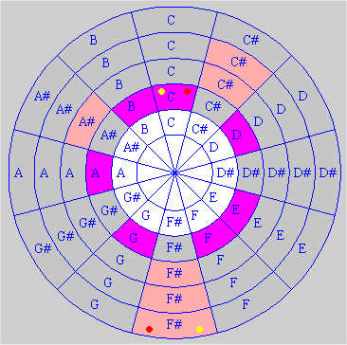
Pitch Circles

Slide 5
LEG 01
Learning Environment for Graphics
LEG – Learning Environment for Graphics
interactive tool for computer graphics students
Allows messages to be sent to transform a graphical object
  such as rotation, scaling, shearing etc.
GOAL
  Students learn the matrices and their correspondence to transformations

Slide 6
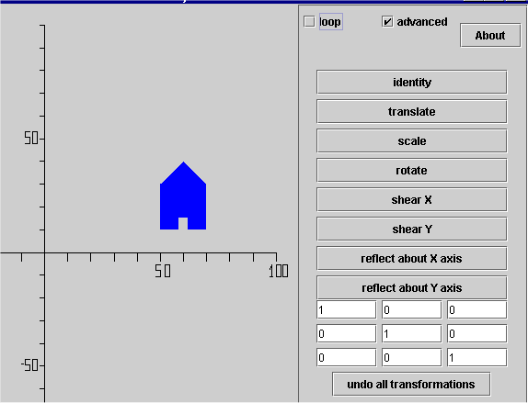
LEG01

Slide 7
Motivations for this research
Matt’s background
  AI
  Computer supported learning
    Adaptive user / student / learner models
  Computer music
  Teaching
    Computer graphics programming moving into Mmedia
  Learning objects (LOM, reusability, interoperability)
    Meta data, repositories of learning objects
long term goal
  Intelligent Computer Supported Learning

Slide 8
Multimedia
& Interactive Multimedia
Def. “multimedia” (p.51, Elsom-Cook 2001)
  The combination of a variety of communication channels into a coordinated communicative experience for which an integrated cross-channel language of interpretation does not exist
Def. “interactive multimedia” (p.51)
  Two (or more) agents engaging in
  communicative interaction utilising
  multimedia communications

Slide 9
Direct Manipulation
Direct Manipulation, approach to computer interface design
  users feel task is performed directly
  i.e. effectively do not notice computer
  have experience whereby the artefacts presented by the computer respond to controls as if real world objects
Important features include:
  continual visual/audio communication of system state
  Loss of distinction between Input/Output …

Slide 10
Direct Manipulation
(Shneiderman 1982)
Visibility of objects of interest
Incremental action at the interface
  rapid / real-time feedback on all actions
Reversibility of all actions
  Little/no penalty for user exploration
Syntactic correctness of all actions
  So all user actions are legal
Communication language of ACTIONS to manipulate objects DIRECTLY
  As opposed to command-based languages

Slide 11
Benefits of direct manipulation
Music & graphics
  The “chord circle rule”
    "move the pcs [pitch classes] at levels a-c four diatonic steps to the right or left (mod 12) on level d" (Lerdahl 1984, p322).
  Create a matrix to transform an object first by rotating by 20 degrees clockwise then by reflection about the X-axis
In DM interface
  Click the chord circle button and see the change
  Click the rotation / reflection button and see the change
    Currently parameterised, but could add DM control to set/show angle of rotation etc.

Slide 12
Limitations of DM
WYSIWYG
  What you see is what you get
WYSIAYG
  What you see is all you get
DM has limitations
  A simple action-based language
  Repetition of a set of actions may be laborious
BUT
  Good for novices
  Good when a strongly visual representation of a domain has been identified

Slide 13
Computer Supported Learning
(physical interaction)
Interactive
learning experience
Computer
learner
Mental state
Learning goals
Interactive computer learning system

Slide 14
INTELLIGENT
Computer Supported Learning
(communicative interaction)
Interactive
learning experience
Computer
learner
Mental state
Learning goals
Interactive computer learning AGENT
Mental state
Learning support goals
Learner model

Slide 15
Desription of the music tool
“Pitch Circles”
Lerdahl’s (1988) theory:
Modeling of WTM declarative knowledge
  key (harmonic region/set of pitches)
  chord (sub-space within/related to a region)
  region and chord sequences
  comparisons between chords and regions
non-symmetrical (if region is)
representation of multiple levels in single model

Slide 16
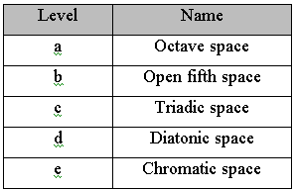
Lerdahl’s pitch space hierarchy

Slide 17
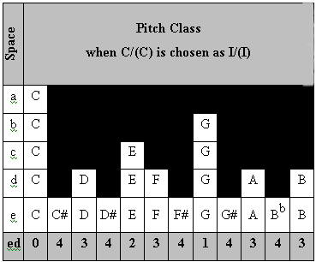
Pitch space for I/(I) in alphabetic formats

Slide 18
Pitch Circles

Slide 19
Arpeggio’s / steps
Traditional
  Step – adjacent chromatic/diatonic movement
  Arpeggiation – adjacent movement of triads
Pitch Spaces – ‘steps’ at different levels
  Everything ‘step’ or ‘skip’
  Arpeggiation is a ‘step’ in a higher level
    E.g. triadic level
  Circle of fifths ‘step’s
    Open fifth space

Slide 20
Dimensions of pitch spaces
Dimension 2:
pitch space level
Dimension 1: Pitch Class
(0..11, C, C#, D, D#, E etc.)

Slide 21
More dimensions of pitch spaces
Dimension 2 =
pitch space level
Dimension 3 =
octaves
Dimension 4 = time
(sequence of active pitch spaces)
Dimension 1 = Pitch Class

Slide 22
The tool (prototype)
only visualise 2D at present
supports dynamic manipulation of chord and region roots
soon
  support comparison of chords and regions

Slide 23
So why use a computer
To animate the theory
  declarative knowledge is static
  music is dynamic in time
To support dynamic exploration/construction
  of musical objects
  (so can relate to dynamic music)
  between multiple learners
  (and educational/domain experts)
To reify the ‘hidden dimensions’ of the theory
  octaves
  real, contiguous sequences of pitch spaces

Slide 24
The proposed computer tool(s)
Reify declarative musical knowledge
  so student can understand and apply such knowledge
  so an intelligent agent can use the knowledgebase in analysis and dialogue with student
  have explicit library of constraints,
  ready for application and negotiation
support (and record) dialogue between multiple agents
support analysis of existing artifacts
  MIDI >> PitchCircle artifact conversion
  stored MIDI files
  audio to MIDI software

Slide 25
Desription of the computer graphics tool “LEG01”
Tool to support students’
  understanding of graphical transformations
  Matrix representation of single and multiple transformations
  Ability to visualise and apply transformations to objects
  Experience of link between mathematical theory and practical application
Not fully DM, some parameter interaction at present

Slide 26
LEG01

Slide 27
“mapping” goal of LEG01
Aim of LEG01 is different to Pitch Circles
  Explicit aim to help students move AWAY from
  purely DM understanding of transformations
  Towards ABSTRACT, MATHEMATICAL understanding
Results
  Some success, acceptance by students
  Found additional materials needed about matrices
  Appears to require Intelligent Computer-Supported Learning system to reinforce the link between abstract and direct manipulation

Slide 28
Conclusions
Initial, informal experiments encouraging
The music tool preserves advantages of underlying theory
  Extensions as circular, interactive tool facilitate interactive learning
The graphics tool provides interactive experience to link abstract theory with practical skills and application
  A less rich theoretical grounding
  But clean match with underlying mathematics of computer graphics

Slide 29
Further work
Add more functionality to tools
Use iterative, prototype approach to improve user interface
  Comprehensive usability & educational evaluations
Begin work on generic AI educational agent for the communicate interaction elements
  Learner modelling
  Learning support goals
  Non-DM language of communication

Slide 30
References
Mark Elsom-Cook (2001)
  “Principles of Interactive Multimedia”
  McGraw-Hill, London UK
Fred Lerdahl (1988)
  Fred Lerdahl, Tonal Pitch Space, Music Perception, 5 (3):351-350.
Ben Shneiderman (1982)
  The future of interact systems and the emergence of direct manipulation, in Behaviour and Information Technology, 1:237-256.
Matt Smith (2002)
  “Pitch Circles – from music theory to computer-based learning tool”, in The ITB Journal (Spring 2002 issue), Published by the Institute of Technology Blanchardstown, Dublin, Ireland.

Slide 31
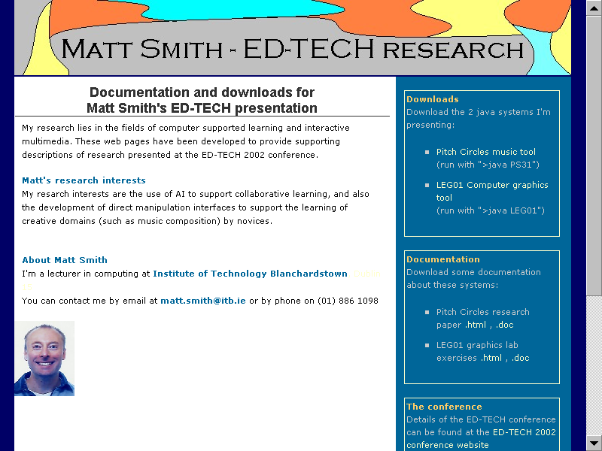
www.itb.ie/staff/mattsmith/

