Slide 1

Reinventing Capital Market Participation
Nate Bachmeier (AWS) | Salli (Octank) and Matt (Customer)
Notes:
Timebox: 1min
Purpose: Introduce
Say: Include the anecdote here

Slide 2
Recap…
Octank Financial is seeking to grow their customer’s market engagement
Make their customers more money with lower risk
Increase transaction volume and assets under management
Sell more profitable complex products
Progress so far
Business Development Mgrs interviewed customers
Data Science team has hackathon POC
Asking AWS how to actually build for 100k customers

Slide 3
Alexa, Why are we here?
4 in 5 adults do not understand capital markets
22 thousand median retirement account
351% missed opportunities since 2008
Notes:
Timebox: 30sec
3 in 5 adults do not understand their finances
A typical American retirement account has less than 22k
Meanwhile if those same accounts could engage in markets would equal nearly 78k

Slide 4
Alexa, demo <buy|selling> {name} shares…
D E M O
Notes:
Timebox: 10min

Slide 5
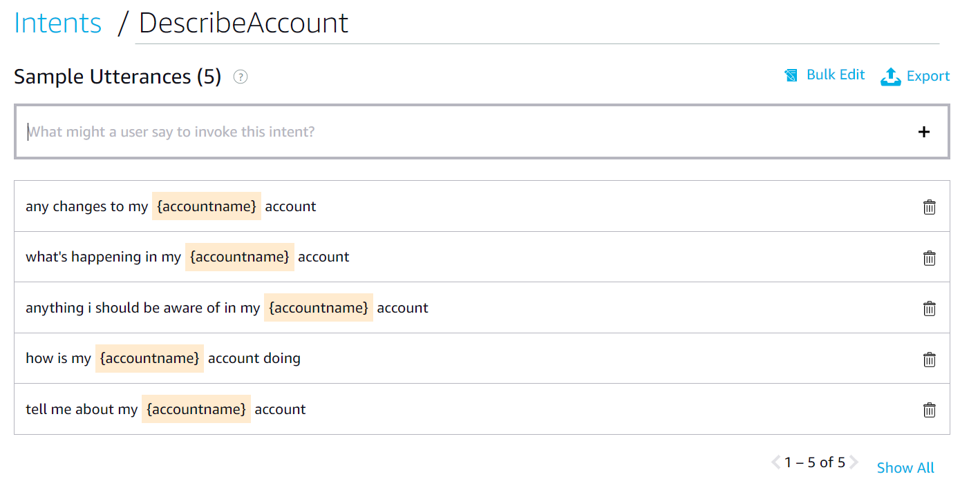
Binding voice to code…
Notes:
https://developer.amazon.com/alexa/console/ask/build/custom/amzn1.ask.skill.9f4cb90e-4c57-41c2-a942-c2e6685888ba/development/en_US/intents/DescribeAccount

Slide 6
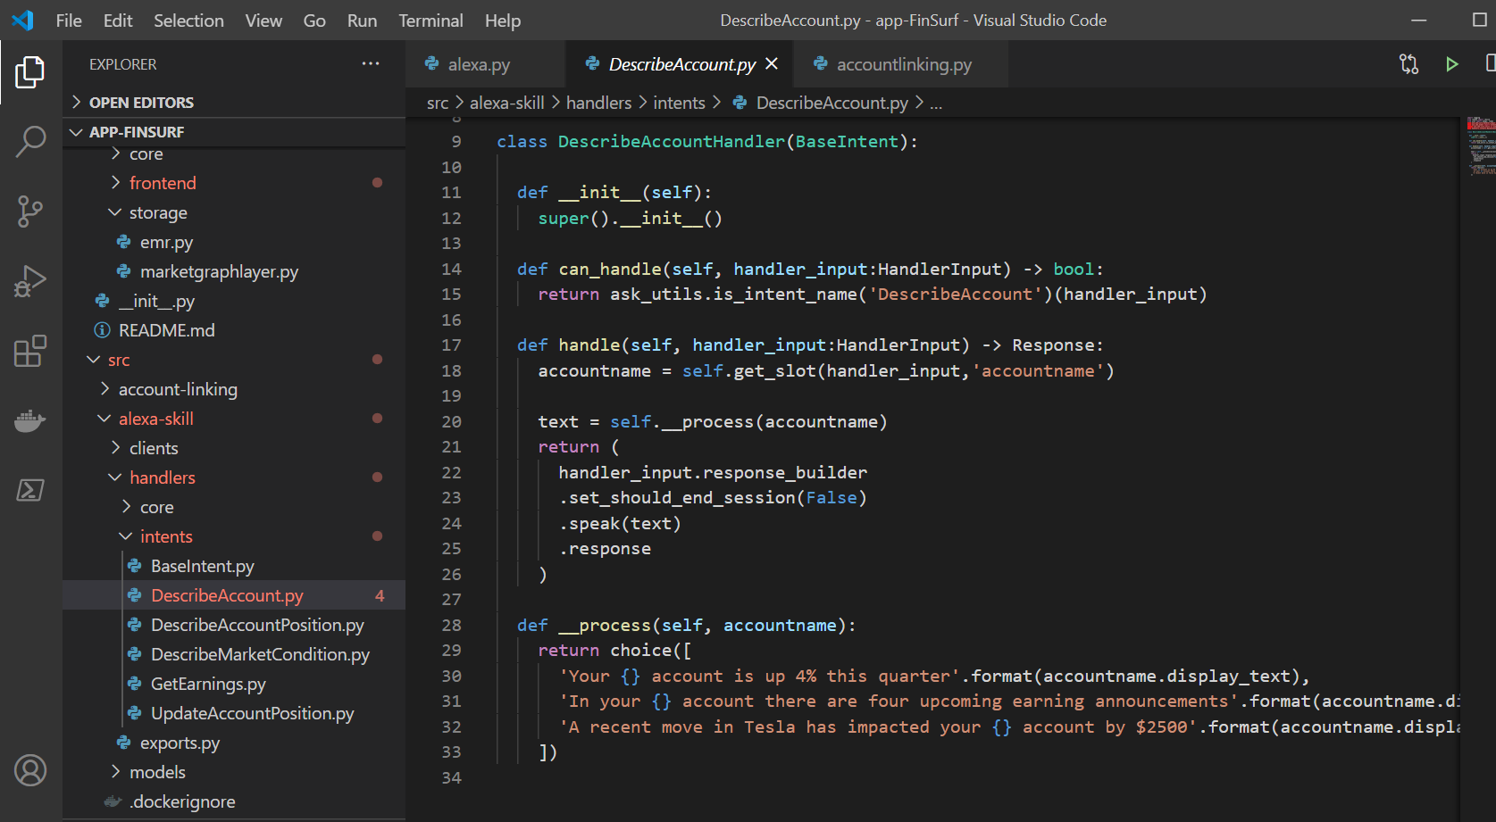
Alexa Intent Code Behind

Slide 7
Total Cost of Ownership: $15,700/mo.
Frontend
$500/mo
Amazon API Gateway
Compute
$3000/mo (- 30% with RI)
Amazon ECS – 3 instances - r5.xlarge
Storage
$18000/mo (– 30% with RI)
Amazon Neptune – 3 instances – r5.12xlarge
Amazon Kinesis -10 shares – 2day retention
$750/mo
Amazon Alexa
Connectivity
Amazon Lex
Amazon Dynamo DB
Outbound Networking
AWS Lambda – 15 million GiB-hours
Assumptions:
5-yr market data storage
100,000 active customers
15 monthly touch points
Using 3-year Reserve Instances
6,300/mo savings
Amortized cost
0.01 per touch point

Slide 8
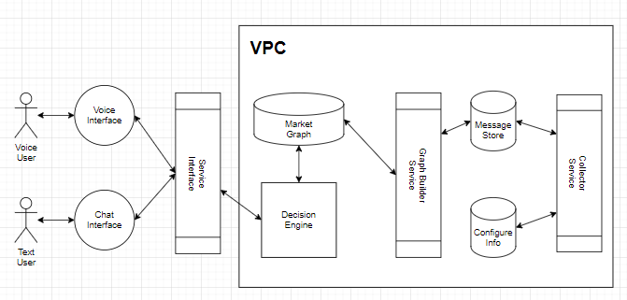








Systems Architecture
Notes:
Timebox: 5min

Slide 9
Deploying this starter pack
Python
CDK
Cloud Formation
Deployed
Notes:
Timebox: 3 min
- https://github.com/dr-natetorious/app-FinSurf

Slide 10
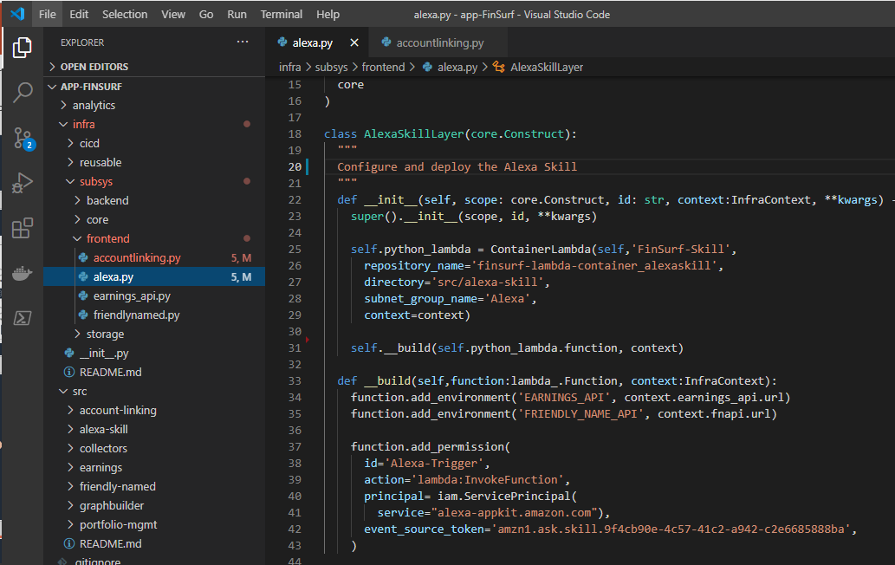
Cloud Development Kit
Concepts:
Application
Stacks
Constructs
Resources
Notes:
Timebox: 2min
https://github.com/dr-natetorious/app-FinSurf/blob/alexa/infra/subsys/frontend/alexa.py

Slide 11
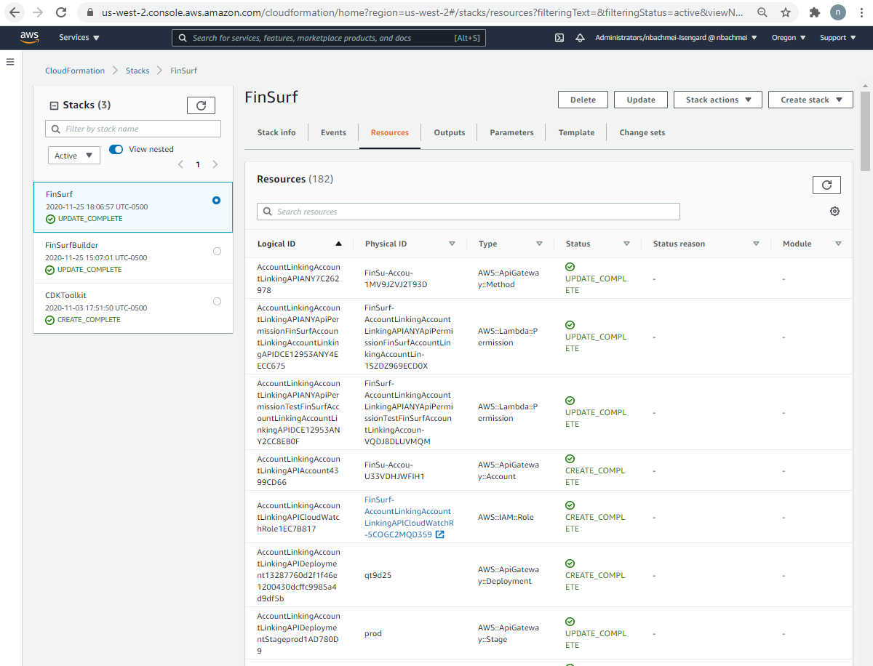
Cloud Formation
Iterate Faster
More Consistency
Reduced Overhead
Notes:
Timebox: 2min
https://us-west-2.console.aws.amazon.com/cloudformation/home?region=us-west-2#/stacks/resources?filteringText=&filteringStatus=active&viewNested=true&hideStacks=false&stackId=arn%3Aaws%3Acloudformation%3Aus-west-2%3A581361757134%3Astack%2FFinSurf%2Fea0140e0-2f72-11eb-a311-028ffeef84c1

Slide 12

Next steps
What problem can we help
solve?

Slide 15
Why are these opportunities missed
Fear
Barrier to Entry
Mathematical Mumbo Jumbo
Products are Complex
Avoidance and Safety
Notes:
Timebox: 60 second
Fear
Barrier to entry
Mathematical Mumbo Jumbo
Product Complexity

Slide 16
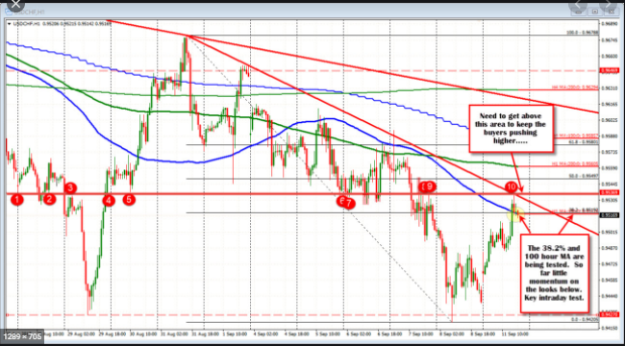
How are we solving the problem today
Notes:
Did you know the candle stick chart dates back to the 18th century for Japanese rice trading?
Yet despite nearly 120 years– this staple continues without reinvention
Behavior economist and usability experts would say
Its too dense with low signal to noise
Color scheme promotes selling low and buying high
Fails to engage most users
Instead our customers want
Solutions that personalize low volume / high quality information
More natural interface that closely mimics a trusted advisor
Access to yield boosting and risk transference strategies that are currently out of reach
Services that promote engagement on their schedule

Slide 17
What do customers want
Trusted Advisor
Personalizes Information
Promotes Engagement
Take Action
Reducing Risk
Notes:
Instead our customers want
Solutions that personalize low volume / high quality information
More natural interface that closely mimics a trusted advisor
Access to yield boosting and risk transference strategies that are currently out of reach
Services that promote engagement on their schedule

Slide 18
Considering the differences in customers
 | Alice | Bob
Age | 30 | 60
Portfolio | 25k | 250k
Strategy | Growth | Maintain
Liquidity | Years | Months
Core Position | Technology | Bonds

Slide 19
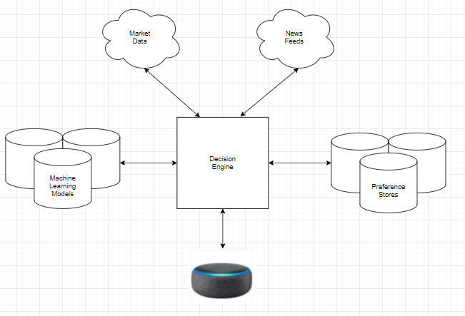
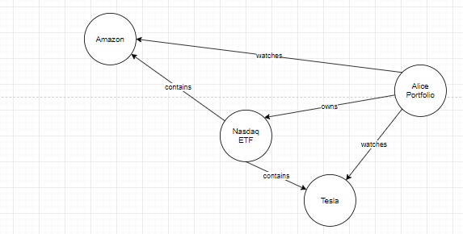
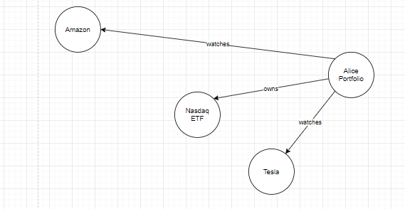
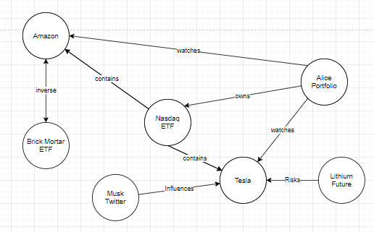
Simplification through conversation
Notes:
Would you recommend buying Tesla
Ok buy 100 shares of Apple this quarter
Now protect my Apple shares
Sell my Apple shares at a fair price
What is my Apple position

Slide 20
Total Cost of Ownership: $15,700/mo.
Frontend
$500/mo
Amazon API Gateway
Compute
$3000/mo (- 30% with RI)
Amazon ECS – 3 instances - r5.xlarge
Storage
$18000/mo (– 30% with RI)
Amazon Neptune – 3 instances – r5.12xlarge
Amazon Kinesis -10 shares – 2day retention
$750/mo
Amazon Alexa
Connectivity
Amazon Lex
Amazon Dynamo DB
Outbound Networking
AWS Lambda – 15 million GiB-hours
Assumptions:
5-yr market data storage
100,000 active customers
15 monthly touch points
Using 3-year Reserve Instances
6,300/mo savings
Amortized cost
0.01 per touch point

