Slide 1
Purpose of the AWSome Builder I Deck
For Internal Use Only
Provide SAs with a consistent mechanism to demonstrate how they conduct a meeting, interact with customers, and share internal and external products and services that solve customers needs.
Individual GEOs/Verticals may add content to suit the needs of their customers; however, use judgement and keep modifications minimal to allow the SA to complete the presentation on-time.
Notes:
AWSome Builder Deck:
The AWSome Builder I slide deck is not intended to be utilized as a marketing deck with external customers.
The deck provides a consistent experience and evaluation for all SAs to demonstrate in a safe environment their readiness to conduct a live customer meeting. An evaluation rubric is aligned to the deck to ensure specific outcomes are demonstrated during the first meeting. The deck can be modified slightly to meet specific SA business needs and geographical differences but must align to the evaluation rubric.
It is important that SAs review the deck for accuracy and make necessary changes to provide the correct information to the customer.
Recommended Resources:
Presentation Remote
Pen and notebook
Business cards
Cord adaptors
Whiteboard markers (AWSome Builder II and III)
Personal items (mints, hand sanitizer, etc.)
AWSome Builder I Scorecard:
The AWSome Builder I Scorecard is a guide to ensure SAs are prepared to interact with customers. There isn’t a specific score that must be achieved. SAs should become familiar with the Scorecard by conducting self-evaluations and practicing with peers/mentors.
The AWSome Builder I Scorecard the your Mentor and Participants will be using can be found here: http://awsomebuilder.corp.amazon.com/resources/AWSomeBuilderOneEvalFramework.docx
Comments
Please enter any details as they pertain to the questions specific to the scorecard and/or recommended follow-up actions for the candidate.
Questions?
If you have any questions or feedback about the Scorecard please submit a trouble ticket here: https://tiny.amazon.com/18cxmfo47
Other Tips:
SAs should work with their mentor and manager to determine key products and services you should be focusing on level 200, 300, 400 content depth on. A demo topic for AWSome Builder II and III doesn’t need to be determined until after AWSome Builder I meeting completion.
Keep your answers succinct. If you are unsure of the answer be honest with the participants.
This is a teaching exercise meant to familiarize yourself with the communication style and terms/definitions we use here at AWS. Do not be scared of feedback. It’s meant to help you grow and not as a way of saying who is right or wrong.
Use a spreadsheet with a row for each slide. For columns you could have message of the slide, possible case study, question to ask about customer, and finally any extra notes with topic that you have want to make sure you have the wording precise.
The animations in the deck are used to help with pacing. You click then talk about a point. Then you click and talk about the next and so forth. It’s a good way of drawing the focus to you as a presenter vs. the audience trying to read tons of text.

Slide 2
Cloud Computing with AWS for Octank Travel
Nate Bachmeier – Senior SA
September 2020
Notes:
1. State the name of meeting
2. Collect introductions
3. Record titles and roles

Slide 3
Agenda
What challenges and opportunities do you face today
How are you approaching those situations today
Where do you want to be tomorrow
Notes:
1. I would like to propose that we cover this agenda.
2. For each of these areas, lets drill into the challenges and opportunities that exist for making your business more efficient.
3. This works better as a dialog than monologue, so please feel empowered to ask questions and participate in the conversation.

Slide 4

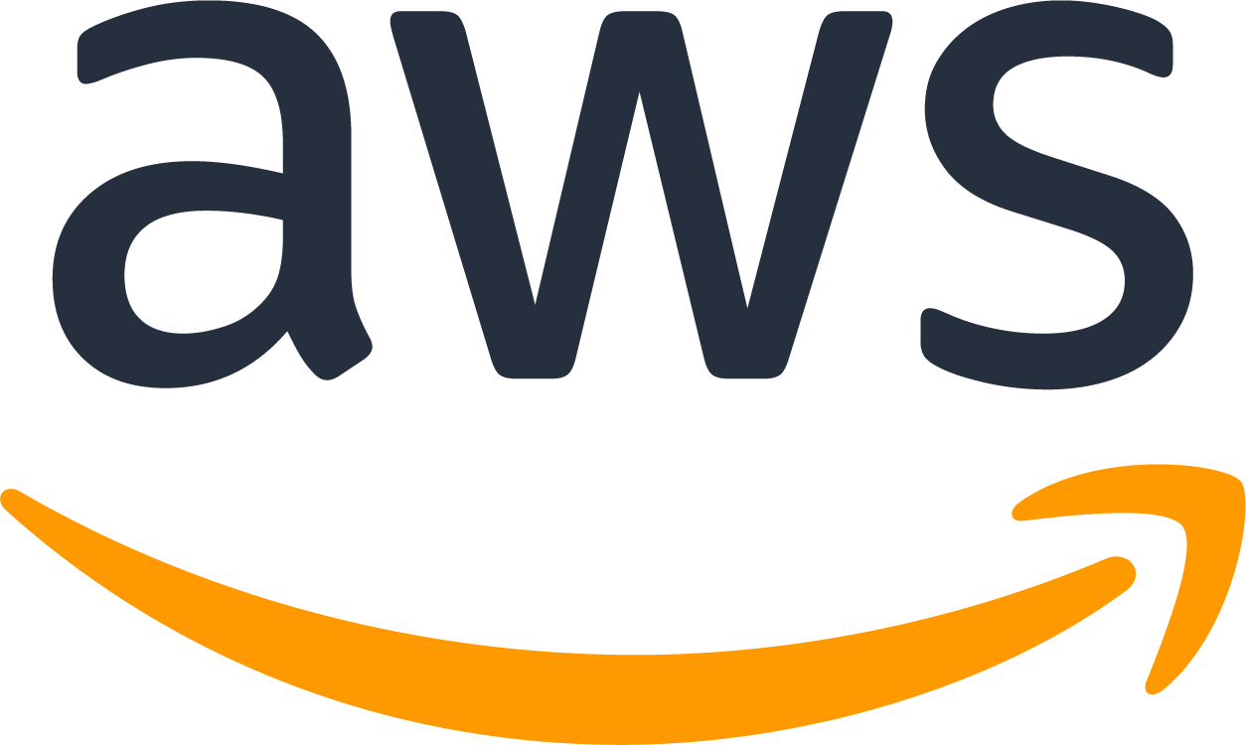

What is Cloud?
What is Amazon Web Services (AWS)?
A broad and deep platform that helps customers
build sophisticated, scalable, secure applications
Notes:
Discuss
Quick level set “its like electricity metaphor”
Why did amazon create AWS
Core competencies
Customer-obsessed
Remove non value differentiated heavy lifting
Do you have any workloads in the cloud today
What specifically interests you about the cloud
Capacity forecasting?
After over a decade of building and running the highly scalable web application, Amazon.com, the company realized that it had developed a core competency in operating massive scale technology infrastructure and data centers, and embarked on a much broader mission of serving a new customer segment—developers and businesses—with web services they can use to build sophisticated, scalable applications.

Slide 5
Getting started in your cloud journey
Continuous Reinvention
Value
Cloud native
Modernization
Project
Foundation
Legacy applications
and data
Migration
Time
Notes:
Getting into the cloud
We have worked with tens of thousands of customers migrating millions of workloads
What we consistently hear is that getting to the cloud is not a technical challenge
1. Senior leadership agreement
2. Aggressive top-down delivery
3. Training of staff
4. Avoid paralysis
- What question do you have up to here
- Finally, lets look at the progression to modernization
Now that you have more information what additional workloads come to mind
A lot of the biggest challenges for large organizations to move to the cloud aren't technical, they’re about people and culture. The biggest differences between organizations that talk about moving to the cloud, and those that actually do it and are having the most success often comes down to a few key things:
First, the senior leadership team needs to be aligned and truly committed that they want to move to the cloud. And they need to be setting clear direction and expectations with the rest of the organization to get everyone on the same page and working towards the same thing. It’s easy for others to do nothing or block things if the leadership team isn’t making the move a priority and building a culture for change.
Then, the most successful organizations moving to the cloud started with an aggressive top-down goal that forced the organization to move faster than it would have organically.
Third, it’s really important that organizations are trained on the cloud and comfortable with the concepts as part of the whole process. We train hundreds-of-thousands of people a year for that purpose.
And last, sometimes we find that organizations can get paralyzed if they can't figure out how to move every last workload. There is no need to boil the ocean. So we often work with organizations to do a portfolio analysis to assess each application and build a plan for what to move short term, medium term, and last. This helps organizations get the benefits of the cloud for many of their applications much more quickly, and it really helps inform how they move the rest.

Slide 6
What are the advantages of moving to the cloud?
Agility
Teams can experiment and innovate more quickly and frequently
Cost Savings
Only pay for what you use, lower upfront expenses
Elasticity
Easily Scale up or down with the needs of the business
Innovate Faster
Ability to focus on business differentiators, not infrastructure
Go Global in Minutes
Most extensive, reliable, and secure global cloud infrastructure
Notes:
There are five reasons companies are moving so quickly to the AWS cloud.
The first is agility. AWS lets customers quickly spin up resources as they need them, deploying hundreds or even thousands of servers in minutes. This means customers can very quickly develop and roll out new applications, and it means teams can experiment and innovate more quickly and frequently. If an experiment fails, you can always de-provision those resources without risk.
The second reason is cost savings. If you look at how people end up moving to the cloud, almost always the conversation starter ends up being cost. AWS allows customers to trade capital expense for variable expense, and only pay for IT as they consume it. And, the variable expense is much lower than what customers can do for themselves because of AWS’s economies of scale. For example, Dow Jones has estimated that migrating its data centers to AWS will contribute to a global savings of $100 million in infrastructure costs.
The third reason is elasticity. Customers used to over provision to ensure they had enough capacity to handle their business operations at the peak level of activity. Now, they can provision the amount of resources that they actually need, knowing they can instantly scale up or down along with the needs of their business, which also reduces cost and improves the customer’s ability to meet their user’s demands.
The fourth reason is that the cloud allows customers to innovate faster because they can focus their highly valuable IT resources on developing applications that differentiate their business and transform customer experiences instead of the undifferentiated heavy lifting of managing infrastructure and data centers.
The fifth reason is that AWS enables customers to deploy globally in minutes. AWS has the concept of a Region, which is a physical location around the world where we cluster data centers. We call each group of logical data centers an Availability Zone. Using AWS, customers can leverage 76 Availability Zones across 24 geographic regions worldwide. And, we don’t plan to stop there.

Slide 7
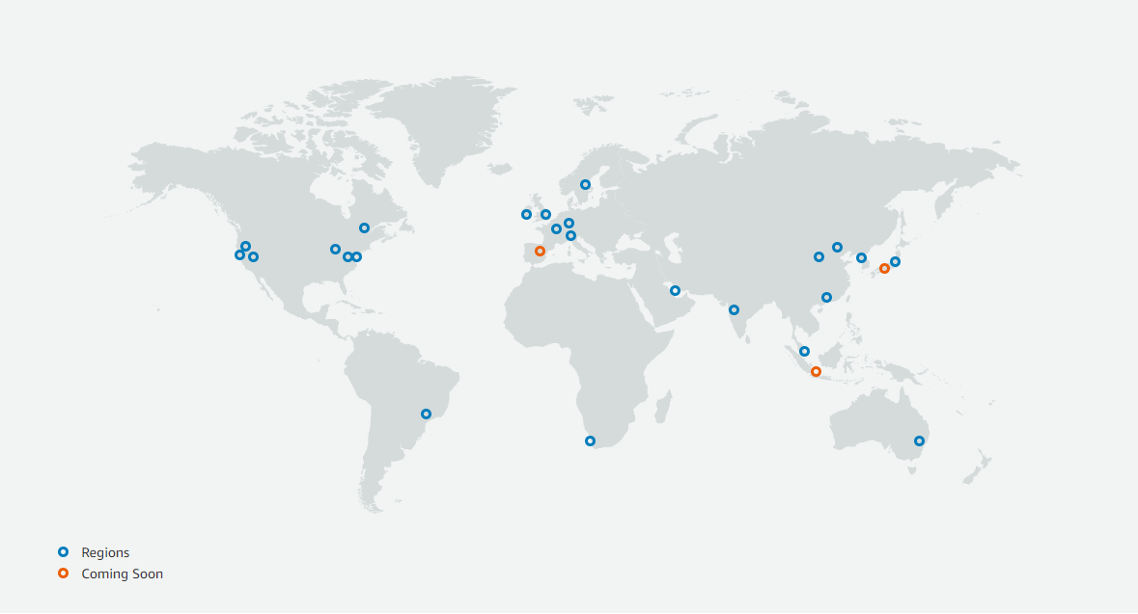
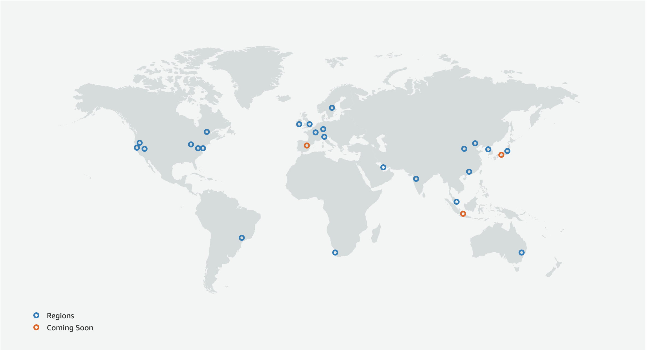
Scale globally with resilience in every region
The largest global foot print consistently built with a multi-AZ and multi-datacenter design
AWS Region
AWS Availability Zone (AZ)
Transit
AZ
Datacenter
Datacenter
AZ
AZ
AZ
Datacenter
Transit
#
Region & Number of Availability Zones
Announced Regions
A Region is a physical location in the world where we have multiple Availability Zones.
Availability Zones consist of one or more discrete data centers, each with redundant power, networking, and connectivity, housed in separate facilities.
Jakarta, Milan, Spain and Osaka
24 Regions
77 Availability Zones
220 Points of Presence
Notes:
Conversations topics:
Where are your customers located?
What is your current infrastructure footprint?
Let’s talk about the resource deployment model
Regions are….
Within each region are 2 or more AZ
An AZ is an isolated partition of the AWS infrastructure
We have the largest global community of customers and partners. We have millions of active users on our platform and tens of thousands of APN partners across the globe.
We have the most mature cloud platform. There’s no compression algorithm for experience, especially when it comes to scale, security, and performance.

Slide 8
Broad and Deep Functionality
Infrastructure
Compute
Storage
Intel/AMD ARM GPUs
Networking
SSD Disks Cold Storage
VPN CDN VPC
Containers K8s Serverless
Managed Services
Common Asks
Hadoop Redis Casandra
IoT Machine Leaning
DevOps Lifecycles
Specialized Needs
Big Data HPCS
Databases and Lakes
Virtual Tapes Storage Gateways
Notes:
We have the broadest range of services with the most depth of features.
This enables startup and fortune 500 companies to avoid boiler plate efforts and begin full speeds ahead
Conversations topics:
What kind of technologies and solutions are you leveraging today?
Where areas are working well for you, and which aren’t?
What functionality or capabilities are you interested in?
Do you have resources that spend time working on non-business related tasks (managing backups, storage admins, etc.)
We provide customers with the broadest and deepest cloud platform. AWS has more services and more capabilities within each service than any other cloud provider. With AWS, customers can get the right tools for the job they want to get done.
We deliver innovation to customers at the fastest pace. In 2011, we released over 80 new significant services and features, followed by nearly 160 in 2012; 280 in 2013; 516 in 2014; 722 in 2015; 1,017 in 2016; 1,430 in 2017; and 1,957 in 2018.

Slide 9


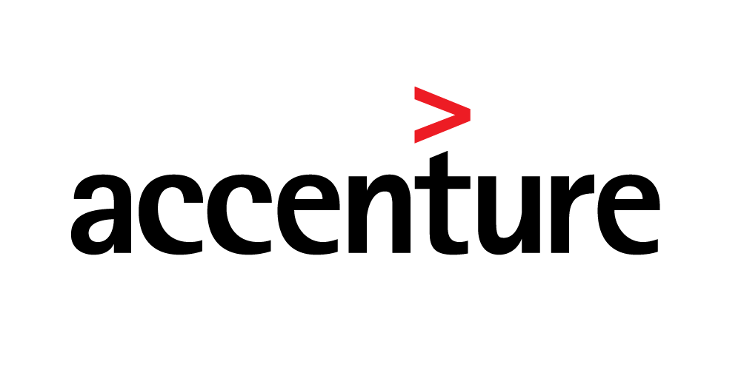
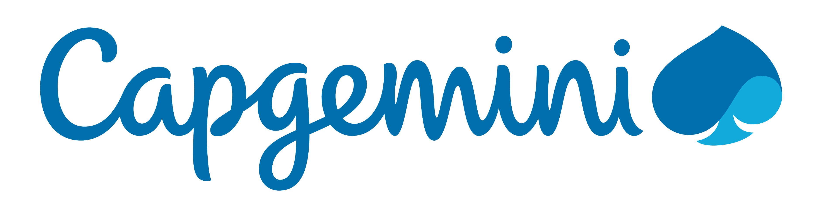


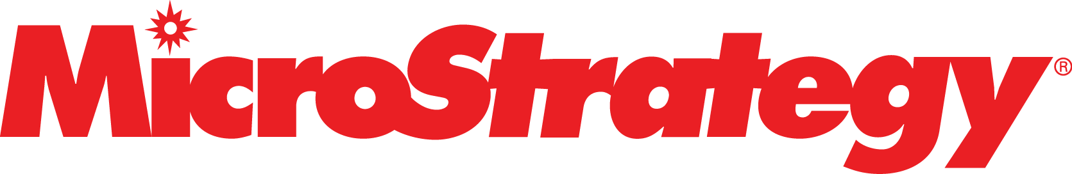
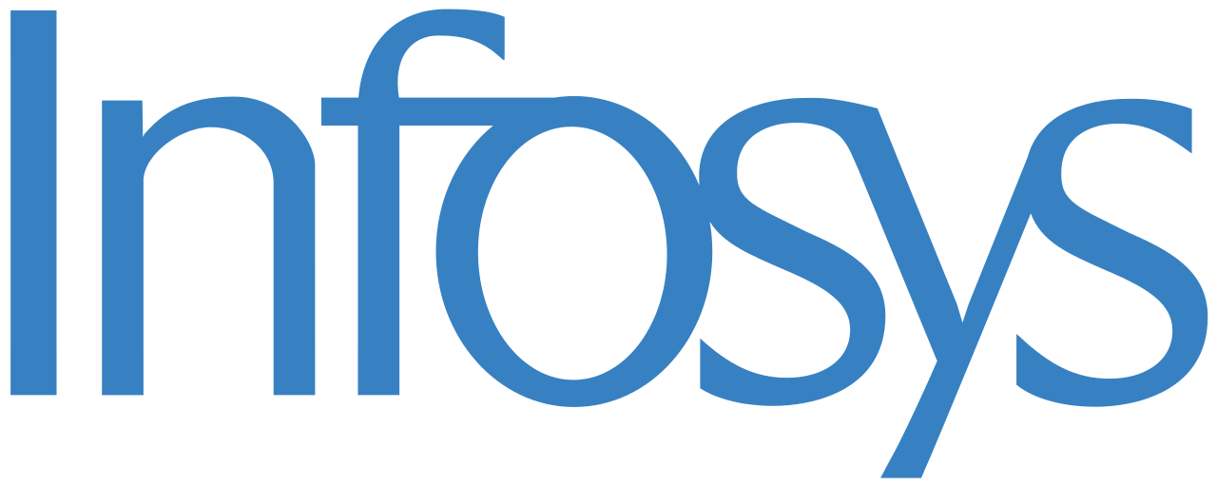
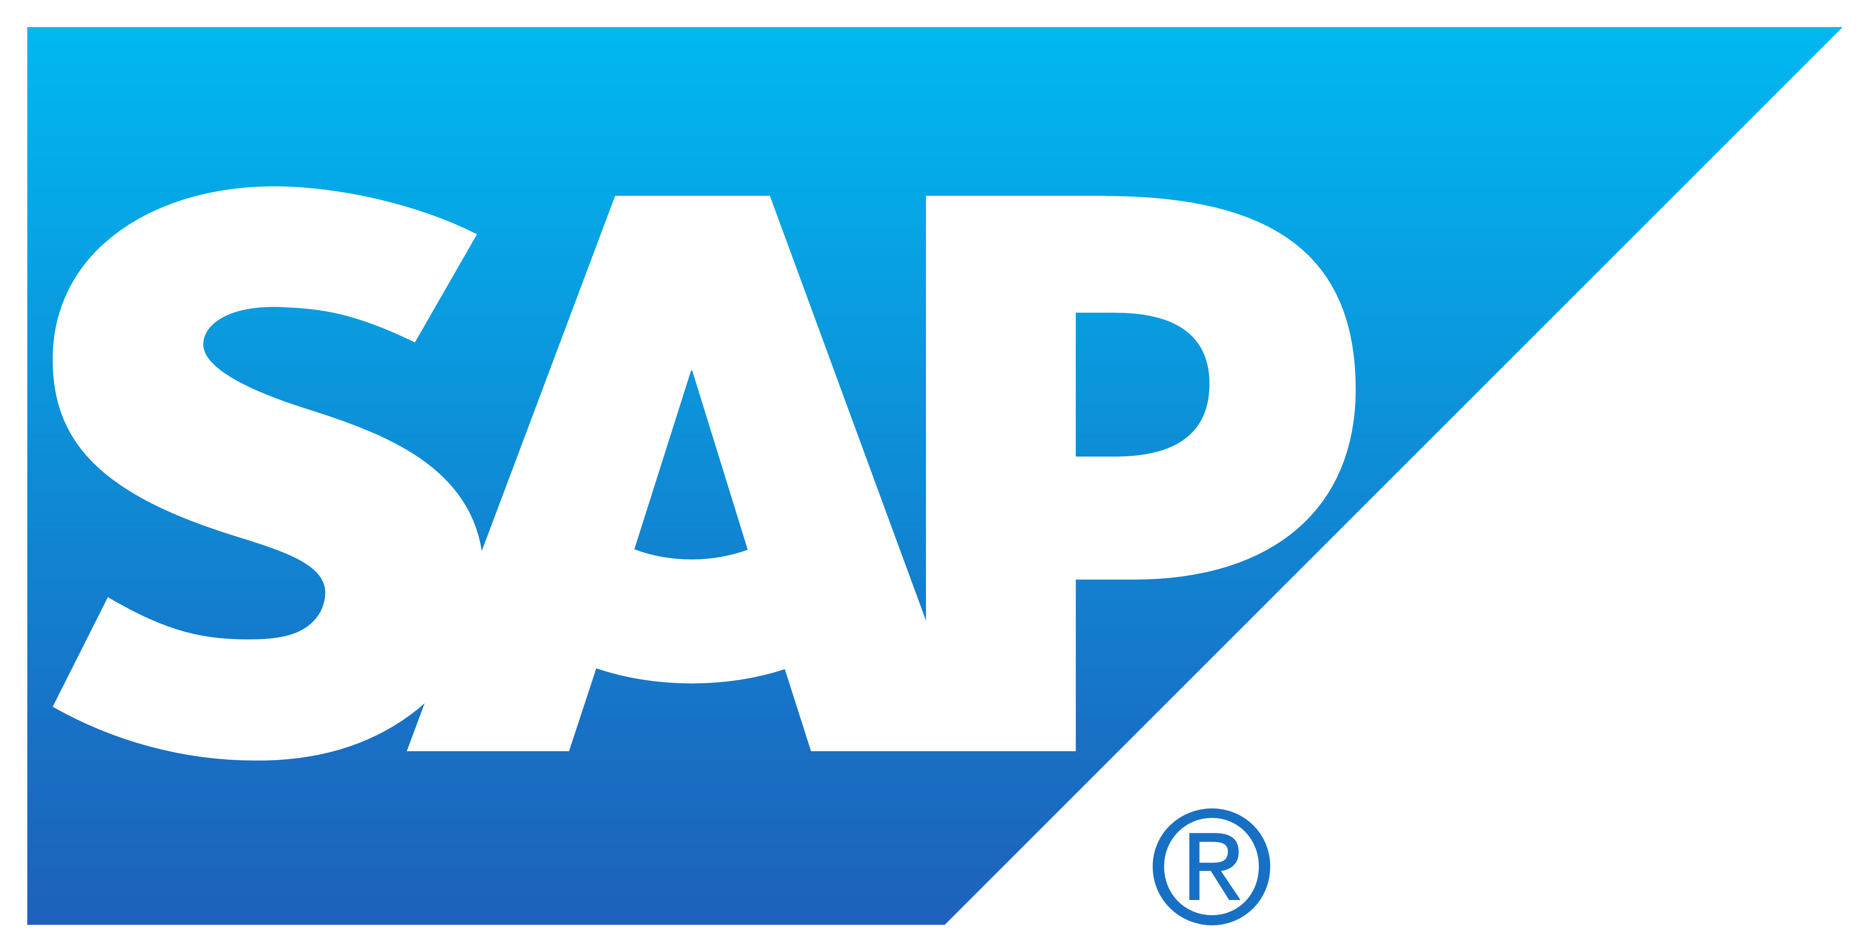

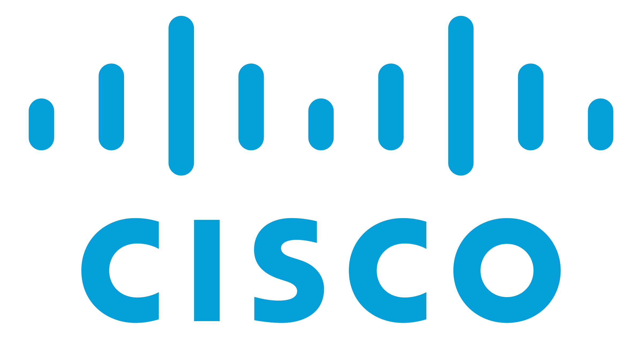
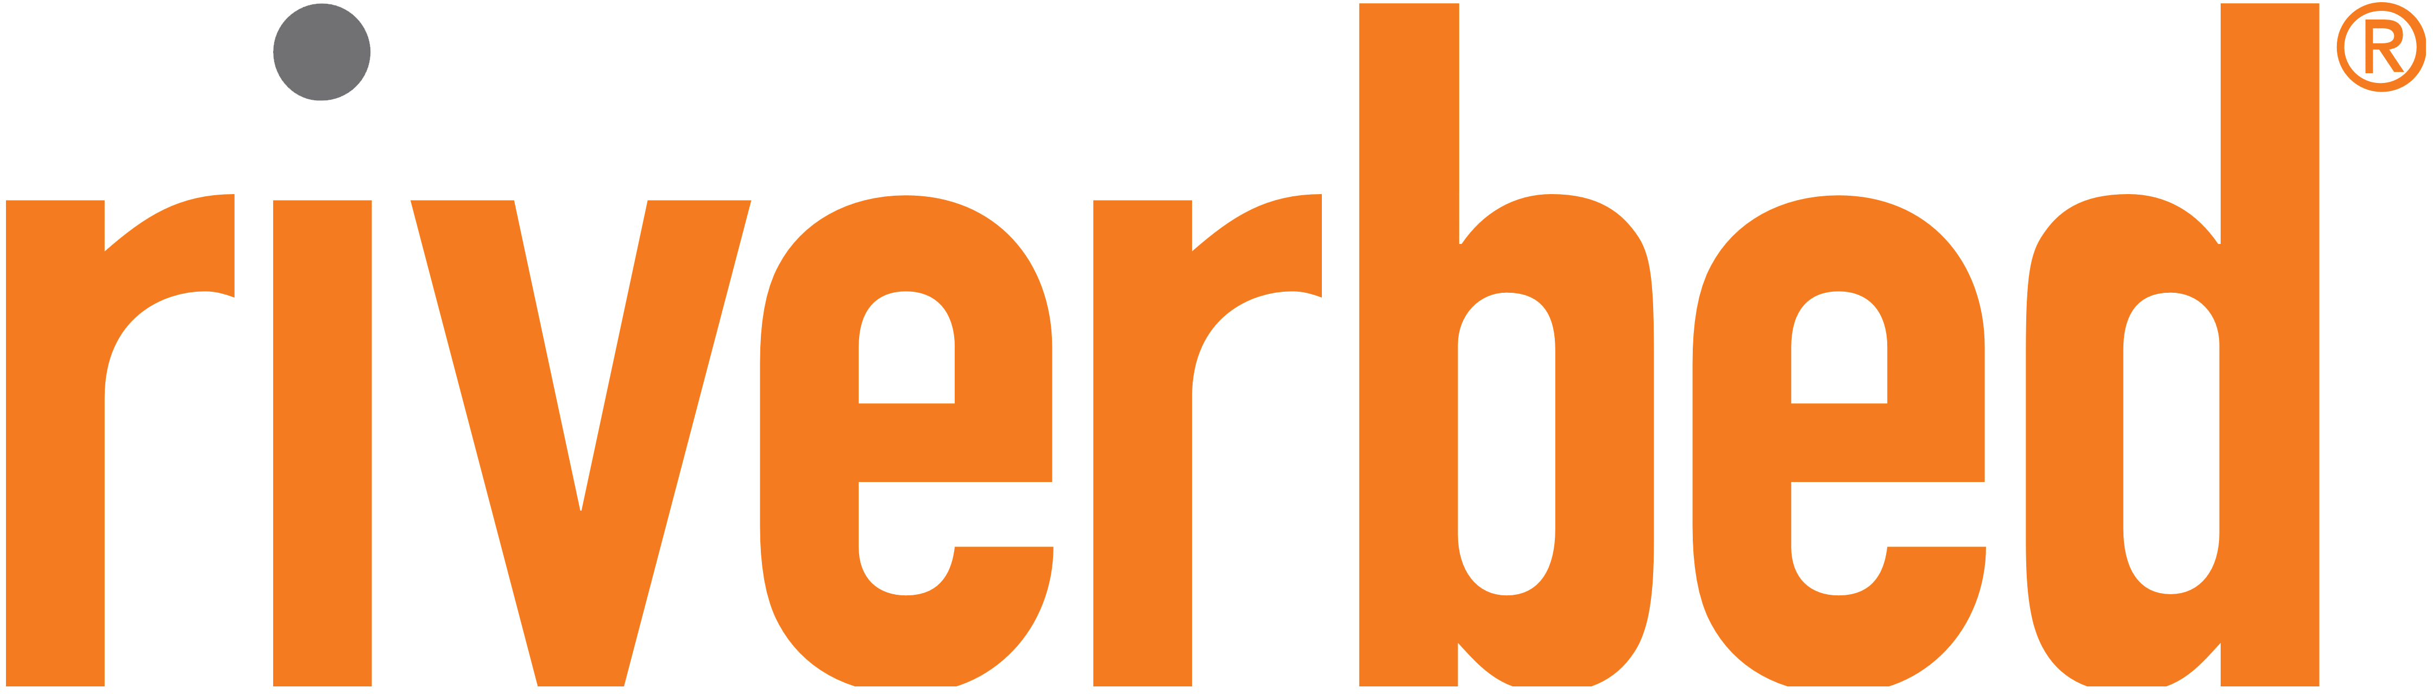

An Expansive Ecosystem
Thousands of the world’s largest technology and consulting companies
48+ Global Premier Consulting partners
12+ Enterprise-focused competencies
2,200+ products available for 1-click deployment across 35 distinct product categories
Customers run over 143M hours of software per month
Notes:
Conversations topics:
Do you currently have AWS or cloud expertise in house?
Do you work with any consulting partners today?
What type of commercial and open source software do you leverage today?
AWS has the largest and most dynamic community. There is a real network effect when you use AWS.
When you look at AWS’s partner network, it is not just the thousands of systems integrators who built practices around AWS, but most ISVs and SaaS providers will adapt their technology to work on one technology infrastructure platform. Some will do two, very few will have the time to do three. And they all start with AWS because of our significant leadership position. It's why you see a much more vibrant collection of ISVs and SaaS providers on AWS as you're moving to the cloud and want those capabilities.
You see it when Salesforce runs the vast majority of what they do on top of AWS, as does Workday and Splunk, Informatica and Infor and Acquia and Datadog and Databricks. Just a much broader collection of software that, when you're moving to the cloud, you can use really easily on top of our platform.

Slide 10
Share your security responsibility with AWS
Customer data
Platform, applications, identity, & access management
Operating system, network, & firewall configuration
Client-side data encryption & data integrity authentication
Server-side encryption (file system &/or data)
Network traffic protection (encryption/integrity/identity)
Customer is responsible for security in the cloud
Compute
Storage
Database
Networking
AWS Global Infrastructure
Regions
Edge locations
Customer
Availability Zones
AWS
AWS is responsible for security of the cloud
Notes:
We use a model called shared responsibility of the cloud
AWS owns security of the cloud
Customer owns security in the cloud
Conversations topics:
What kind of security controls/processes do you have at the moment?
AWS exposes over 200 security controls, governance, and policy capabilities
We have a shared responsibility model with the customer; AWS manages and controls the components from the host operating system and virtualization layer down to the physical security of the facilities in which the services operate, and AWS customers are responsible for building secure applications. We provide a wide variety of best practices documents, encryption tools, and other guidance our customers can leverage in delivering application-level security measures. In addition, AWS partners offer hundreds of tools and features to help customers meet their security objectives, ranging from network security, configuration management, access control, and data encryption.

Slide 11

Inherit global security and compliance controls
Certifications / Attestations |  |  | Laws / Regulations / Privacy |  |  | Alignments / Frameworks
C5 | 🇩🇪 | ✔ | Agentina Data Privacy |  | ✔ | CIS (Center for Internet Security) | 🌐 | ✔
Cyber Essentials Plus | 🇬🇧 | ✔ | CISPE | 🇪🇺 | ✔ | CJIS (US FBI) | 🇺🇸 | ✔
DoD SRG | 🇺🇸 | ✔ | EU Model Clauses | 🇪🇺 | ✔ | CSA (Cloud Security Alliance) | 🌐 | ✔
FedRAMP | 🇺🇸 | ✔ | FERPA | 🇺🇸 | ✔ | ENS High | 🇪🇸 | ✔
FIPS | 🇺🇸 | ✔ | GDPR | 🇪🇺 | ✔ | EU-US Privacy Shield | 🇪🇺 | ✔
FAA | 🇺🇸 | ✔ | GLBA | 🇺🇸 | ✔ | FFIEC | 🇺🇸 | ✔
IRAP | 🇦🇺 | ✔ | HIPAA | 🇺🇸 | ✔ | FISC | 🇯🇵 | ✔
ISO 9001 | 🌐 | ✔ | HITECH | 🌐 | ✔ | FISMA | 🇺🇸 | ✔
ISO 27001 | 🌐 | ✔ | IRS 1075 | 🇺🇸 | ✔ | G-Cloud | 🇬🇧 | ✔
ISO 27017 | 🌐 | ✔ | CCPA | 🇺🇸 | ✔ | GxP (US FDA CFR 21 Part 11) | 🇺🇸 | ✔
ISO 27018 | 🌐 | ✔ | My Number Act | 🇯🇵 | ✔ | ICREA | 🌐 | ✔
K-ISMS | 🇰🇷 | ✔ | UK DPA - 1988 | 🇬🇧 | ✔ | IT Grundschutz | 🇩🇪 | ✔
MTCS | 🇸🇬 | ✔ | VPAT/Section 508 | 🇺🇸 | ✔ | MITA 3.0 (US Medicaid) | 🇺🇸 | ✔
PCI DSS Level 1 | 🌐 | ✔ | Data Protection Directive | 🇪🇺 | ✔ | MPAA | 🇺🇸 | ✔
SEC Rule 17-a-4(f) | 🇺🇸 | ✔ | Privacy Act [Australia] | 🇦🇺 | ✔ | NIST | 🇺🇸 | ✔
SOC 1, SOC 2, SOC 3 | 🌐 | ✔ | Privacy Act [New Zealand] | 🇳🇿 | ✔ | PHR | 🇺🇸 | ✔
 |  |  | PDPA—2010 [Malaysia] | 🇲🇾 | ✔ | Uptime Institute Tiers | 🌐 | ✔
 |  |  | PDPA—2012 [Singapore] | 🇸🇬 | ✔ | Cloud Security Principles | 🇬🇧 | ✔
 |  |  | PIPEDA [Canada] | 🇨🇦 | ✔
🌐 = industry or global standard |  |  | Spanish DPA Authorization | 🇪🇸 | ✔
 |  |  | Spanish DPA Authorization | 🇪🇸 | ✔
Notes:
Conversations topics:
What kind of compliance requirements do you have?
Sorry for name dropping but when it comes to compliance
We have massive workload that are extremely sensitive today
Including 4000 government agencies, medical facilities, and financial firms like Inutuit makers of TurboTax
AWS has achieved a number of internationally recognized certifications and accreditations, demonstrating compliance with 3rd party assurance frameworks, such as ISO 27017 for cloud security, ISO 27018 for cloud privacy, and SOC 1, SOC 2 and SOC 3. Customers can be PCI and HIPAA compliant on AWS, and we have achieved important certifications like FedRAMP at the Moderate and High levels), as well as SRG Impact Levels 2, 4, 5 and 6 for DoD systems. These certifications help support customer compliance with requirements such as ITAR, FISMA, CJIS, and NIST 800-53 and 171. We also have ISO9001 which is primarily for healthcare, life sciences, medical devices, automotive and aerospace.

Slide 12





























































Industry leaders are building on AWS
Merck
Notes:
Talking points:
Share a few examples of how these businesses have become more agile and innovated to create new sources of revenue, drive deeper customer relationships, and operate more efficiently.
Talk about how the customer can leverage the expertise we bring from working with the customers listed here
Businesses of all sizes and industry – startup to fortune 500
Every use case and workload;
Dow Jones and Intuit the makers of TurboTax (Security and Compliance)
Netflix, Disney, and HBO streams billions of hours of content (Scale and Reliablility)
Over 4000 government agencies worldwide (security)
- Countless startups like Uber, AirBnB, and Pinterest are disrupting long standing business
This comes from more agility and innovation
To create new sources of revenue
Drive Deeper customer relationships and operate more efficiently

Slide 13

Next steps
What problem can we help
solve?
Notes:
Conversations topics:
What is a workload that the customer is willing to experiment with in AWS?
What are the customers keys to success?
Would you be available next week to deep dive on some of these areas?

Slide 16
Broad and Deep Functionality
Notes:
Sorry for the eye chart it’s a little overwhelming.
We have the broadest range of services with the most depth of features.
This enables startup and fortune 500 companies to avoid boiler plate efforts and begin full speeds ahead
Think of us as being Home Depot…were here to remodel the kitchen and when ready for the bathroom, we got that covered too.
Having these services available, ensures you don’t need to hunt down custom suppliers in the future.
Conversations topics:
What kind of technologies and solutions are you leveraging today?
Where areas are working well for you, and which aren’t?
What functionality or capabilities are you interested in?
Do you have resources that spend time working on non-business related tasks (managing backups, storage admins, etc.)

