Slide 1

Who are you? And Why are we here?
You are the C-Suite of Octank, a technology company specialized in AI-focused safety solutions
Octank has a a range of customers in a variety of industries concerned with on-site PPE compliance
Octank is developing a solution to do real-time compliance monitoring of workplace environments and is looking for the best set of tools and services to help their engineering teams.

Slide 2
Elastic Personal
Protection Monitoring
10-22 SA Launch Group 3
Notes:
Timebox: 1min
Purpose: Introduce
Say: Include the anecdote here

Slide 3
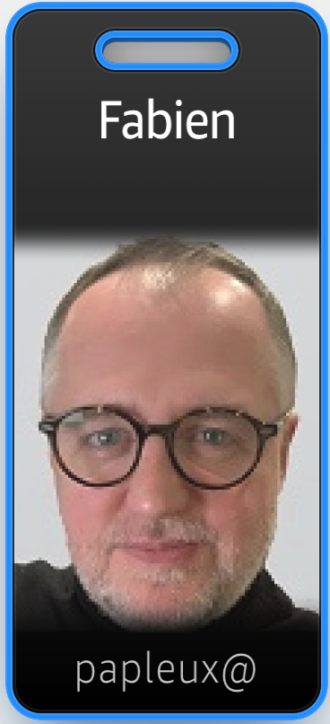
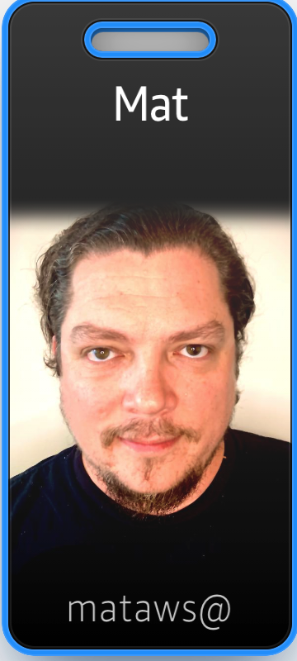
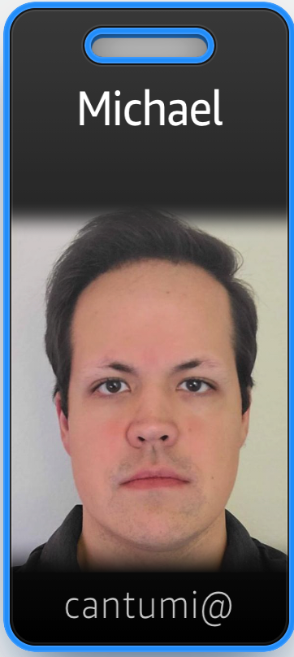
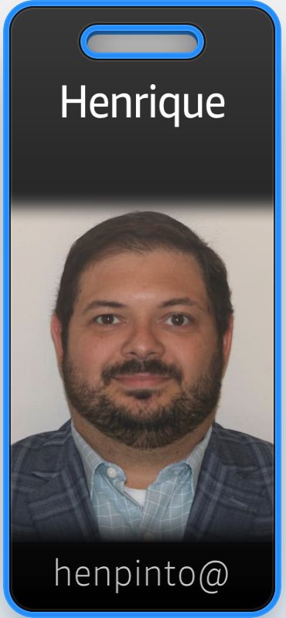
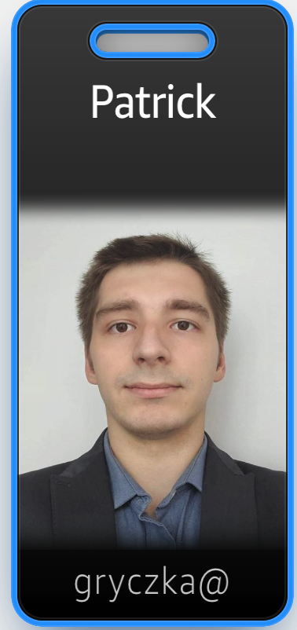
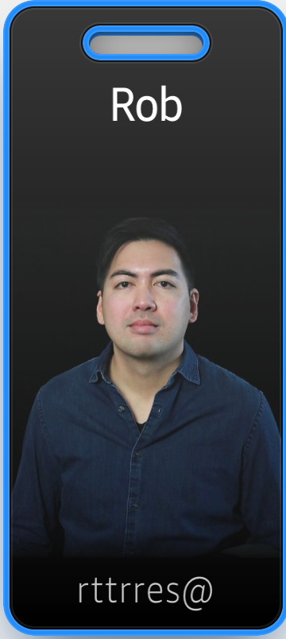
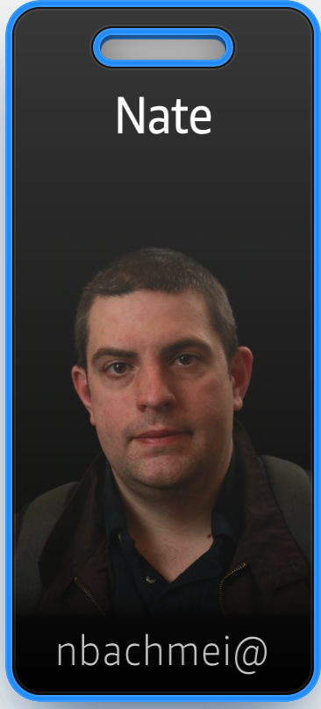
We are your account team – Group 3

Slide 4
Need for Workplace Safety Monitoring System
4,493 preventable injury related deaths in 2018
4.5 million medically consulted injuries per year
$170.8 billion work injury costs for companies per year
Notes:
Timebox: 30sec
Say: A lot of people are injured every year, that don’t need to be. Look at these rates, we can do better.
https://injuryfacts.nsc.org/work/work-overview/work-safety-introduction/

Slide 5
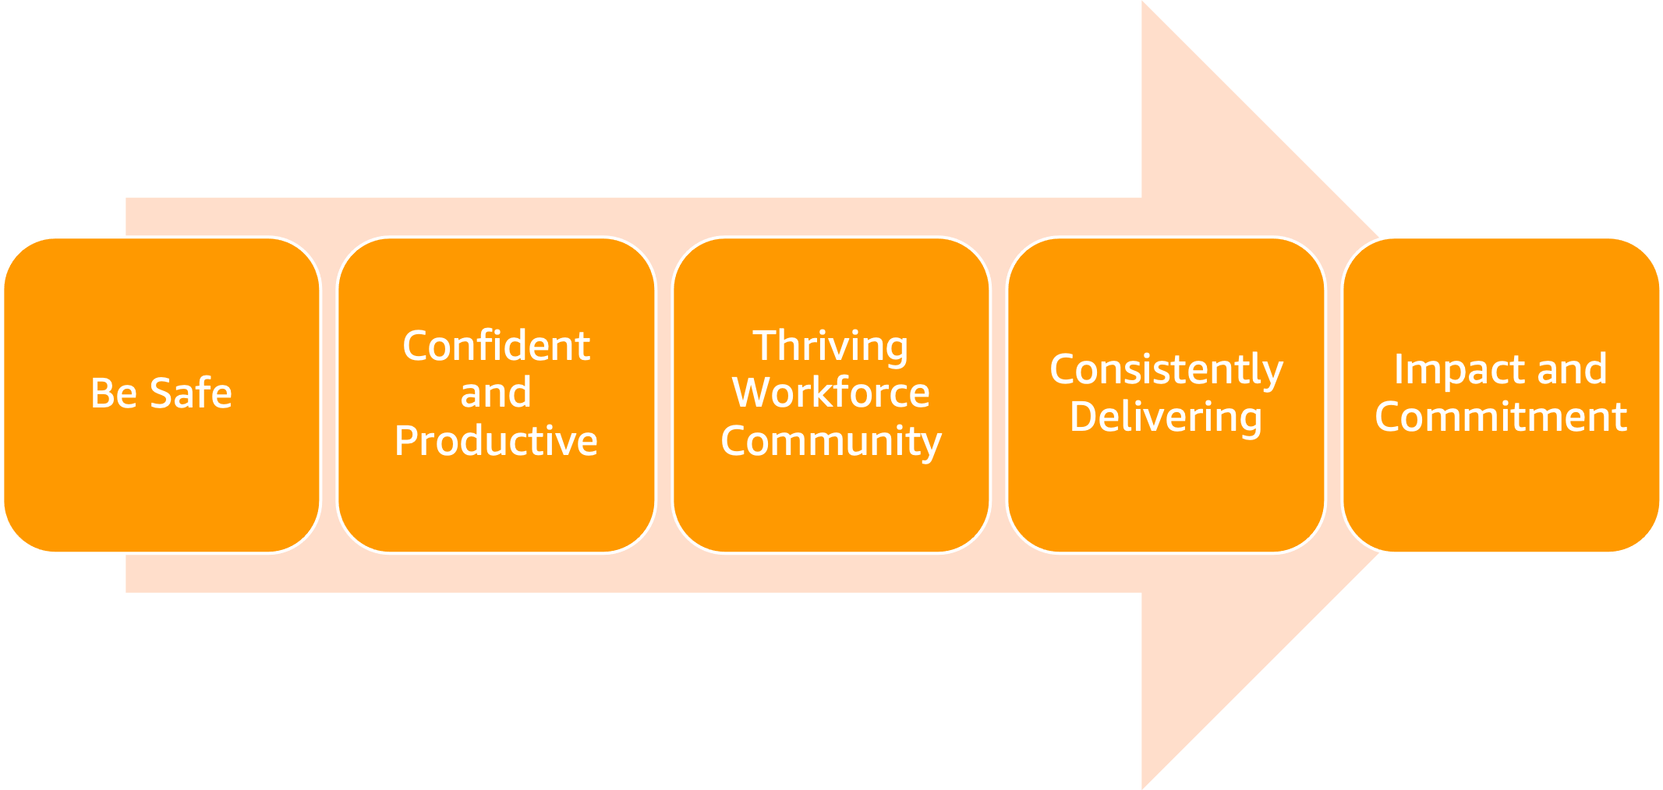
What are the key concerns?
Notes:
Timebox: 60 second
1. We need everyone to feel safe
2. So they are confident and productive at work
3. To enable a thriving workforce and community
4. to continue consistently delivering on our companies mission
5. impacts our commitment to the community

Slide 6

How do we address this?
Are employees or customers wearing their PPE?
Can we place policies around a workplace and have detection on compliance?
Can we do it at scale?
Notes:
Timebox: 60 second

Slide 7
Looking at the people involved…
Site Administrators
Define Safety policies
Site Managers
Monitor Worker safety compliance
Site Workers
Maintain compliance status
Notes:
Timebox: 2min here
Outline 3 user journeys
Concepts that connect them together
80% spend on problem statement
User journey
Admin: I want to define a collection of policies and then have automated monitoring of their being met
If an employee violates those policies, I want a record so they can receive additional training
Those policies should be configurable and take into account PPE, density, and similar scenarios
Manager: I want a report of employees that are in compliance or need additional training
Employee: I want to know my compliance status and what polices are important for a “job site”
Reseller: I want to sell this solution as a SaaS product in Amazon Marketplace

Slide 8
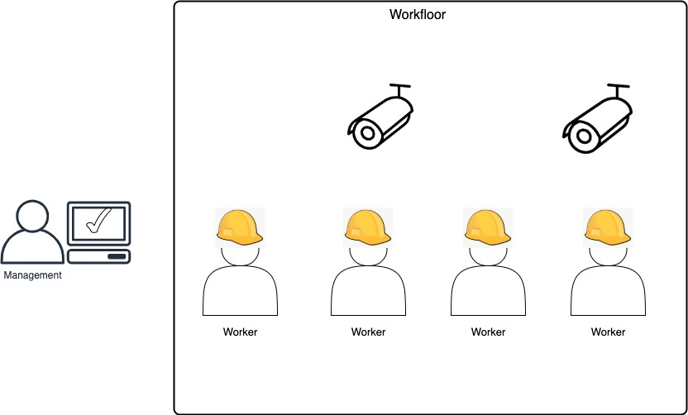
Envisioning a solution
Notes:
2020 bar napkin

Slide 9
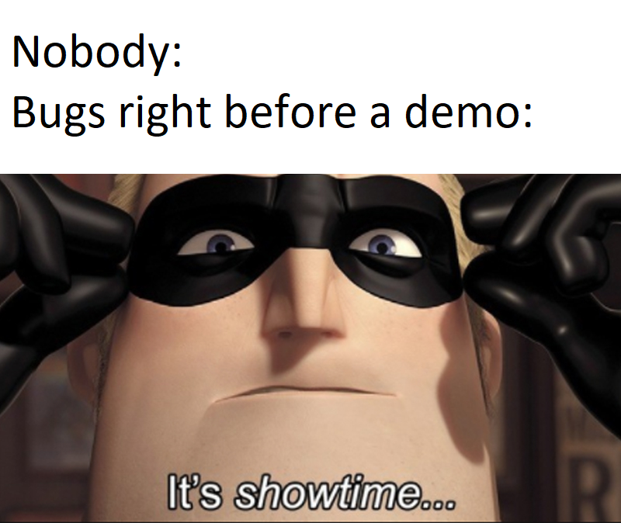
Proof of Concept Demo
Notes:
Demo: 2min
Have the preloaded
demo / D3m01234
Core use-case: detect members of your workforce with network connected cameras and determine if they are wearing PPE
In this case we’ve set the PPE requirement to facemasks
Configurable PPE detection (Facemask, Helmet, Safety Goggles, Gloves, etc)
Rekognition PPE
Customizable workplace setup (zones, cams, etc)
Real-time notifications
Management and reporting dashboard
Patrick to talk about the architecture

Slide 10
AWS Elastic Personal Protection Monitoring
What is it
What it does
How
AI-based Workplace Safety Solution
Automated Safety Checks for Compliance
PPE Detection, Monitoring and Data Analysis
Notes:
Timebox: 45 sec
Outline 3 user journeys
Concepts that connect them together
80% spend on problem statement

Slide 11
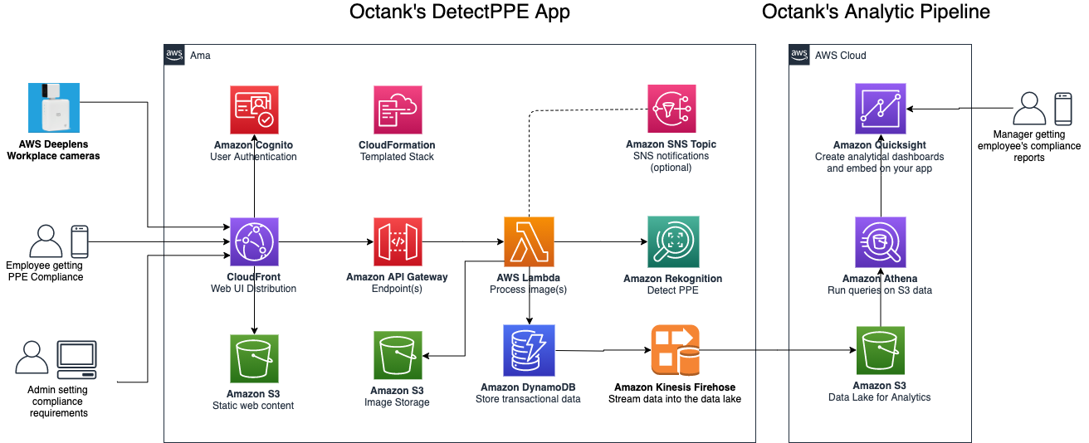
Architecture
Notes:
Timebox: 45 sec
Be mindful of the audience level. Use “friendly” terms not “tech speak”
Bring up the core tenants
Elasticity
Automated Compliance checks
Consumption priced components

Slide 12
Total Cost of Ownership
Item | Cost Per Unit
Deep Lens Cameras | $250
Encrypted Image Storage | 0.02 per GiB
Metadata Storage | 0.02 per GiB
Administrator Dashboard License | $5 per user/month
Amortized cost per camera | $12.50 per month
Amortized cost per administrator | $5 per user/month

Slide 13
In summary
Automation
Elasticity
Cost
Quick detection and augmentation of enforcement
Solution scales in/out based on requirement
  No upfront hardware investment
Notes:
This template was inserted from Power-user, the productivity add-in for PowerPoint, Excel and Word.
Get thousands of templates, icons, maps, diagrams and charts with Power-user. Visit https://www.powerusersoftwares.com/!

Slide 14

Next steps
What problem can we help
solve?

