Slide 1
Improving elderly and special needs care through human activity recognition
Nate Bachmeier
Northcentral University
My Peeps: <et al.> ☺
Notes:
START:
Come on everyone, get on camera and off mute my job is to talk with you not at you.
I want this to be a dialog with lots of question if you don’t get something your buddy doesn’t either. Ask!
The reason I invited everyone is explain a really cool problem.
SLIDE INSTRUCTIONS:
During this slide you should provide a brief introduction of yourself in the notes that you will share with the audience.
Your presentation should be between 30-40 minutes. Each slide will be around 1-2 minutes of discussion. A slide takes approximately 1-2 minutes to share depending on the content, so consider this length when planning the slides.
Depending on your study, you may need to add additional slides or remove slides. However, the basic setup should be the same and mirror the sections in the Dissertation Manuscript, so use your DM to complete the slides.
Your Chair needs to review your presentation draft and offer suggestions prior to your actual presentation.
You may keep your presentation simple or add graphics as appropriate. If you add graphics, you need to consider their purpose as your committee, or the audience may ask why they were used. In other words, do not use graphics simply for aesthetic purposes.
POWERPOINT PRESENTATION INSTRUCTIONS FOR ALL SLIDES:
Avoid smaller than 18-point font and larger than 40-point font on slides. Be consistent in font usage.
Be consistent in font color – black works best.
Short bulleted points on slide. 3-6 bullets per slide. 3-6 words per bullet point. NOTE: The bullets are your talking points.
Use the Notes section below the slide for further information addressing the bullet points on the slide. You can read these notes as no one will see you doing so since your camera will be off when you start presenting.

Slide 2
INTRODUCTION
People live longer, have fewer children, and medical costs are increasing
Nearly 80% of global elderly population will be low/middle income
Can we reduce need for long-term care facilities
How would we build those products
TITLE
YOUR NAME
Northcentral University
Dissertation Chair: Fill In
Subject Matter Expert: Fill In
Academic reader: Fill in
Notes:
SLIDE INSTRUCTIONS:
1. Brief introductory remarks from the Introduction of Chapter 1 should include:
A. You want to provide an overview of your topic.
B. Provide the larger context in which the problem exists, with citations.
C. Present an overview of why this research topic is relevant and warranted, with citations.
D. Briefly explain what research has been done on the topic, with citations.
Here’s the problem:
So, I bought these IPCameras and put them around my house and started writing OpenCV with them.
That sparked interest in the Rekognition Heroes program at AWS… so, I joined and:
Wrote the most impactful guide Identity Verification on AWS
Wrote the tech track for Content moderation on AWS
Write the book Computer Vision on AWS
In parallel, I needed a doctoral thesis and said “what’s a business challenge” this solves? Old people!?! pause.
We all get old and when I’m old, I’d like it to be looked after in my home not an assisted living center.
The problem is how can I defer this time? For instance, 80% of people retire with minimal savings and assisted living centers are expense.
Living centers are expensive because nurses are $75K pre pandemic and declining workforce. So, we need automation and IoT systems that monitors and serves people.
Well, that sounds super creepy. No one wants to be recorded in their bathroom. We need security and privacy controls that protect user data without transmitting over the internet.

Slide 3
PROBLEM & PURPOSE STATEMENTS
The problem to be addressed in this study is the inability of elderly and special needs care organizations to capitalize on the effectiveness and efficiency of autonomous assistants (Blackhurn, 2021; Kim & Kim, 2021).
The purpose of this constructive research design is to study the effectiveness and efficiency of autonomous assistants detecting and responding to patient behaviors to reduce cost while improving consistency and quality for elderly and special needs care organizations. These organizations need human activity recognition models for numerous scenarios, such as handling patient falls (Shirai et al., 2021).
Notes:
SLIDE INSTRUCTIONS:
You will copy/paste your sentence that states, “The problem is…” and the purpose sentence that states, “The purpose of this…”
While you are presenting your problem and purpose statement on the slide exactly as it appears in your manuscript, you will want to paraphrase , rather than read it word for word in your actual Defense.
You should have notes to further elaborate on the problem.
So how do we build these autonomous agents when we can’t get the data? It’s too expensive to collect from a global population.
In this project, I built an analytics pipeline that does human activity recognition.
My goal was to build

Slide 4
RESEARCH QUESTIONS
What is the effectiveness of autonomous assistance for classifying behaviors of elderly and special needs patients for care organizations?
What is the efficiency of autonomous assistance for classifying behaviors of elderly and special needs patients for care organizations?
Notes:
SLIDE INSTRUCTIONS:
Research questions and hypotheses must be verbatim from manuscript.
2. Use multiple slides as needed to ensure visibility of information to audience.

Slide 5
THEORETICAL FRAMEWORK
Guideline | Description
Design as an Artifact | Design-science research must produce a viable artifact as a construct, a model, a method, or an instantiation.
Problem Relevance | Design-science research aims to develop technology-based solutions to important and relevant business problems.
Design Evaluation | A design artifact’s utility, quality, and efficacy must rigorously demonstrate well-executed evaluation methods.
Research Contributions | Effective design-science research must provide transparent and verifiable contributions to design artifacts, foundations, and/or design methodologies.
Research Rigor | Design-science research relies on rigorous methods to construct and evaluate the design artifact.
Design as a Search Process | The search for a compelling artifact requires utilizing available means to reach desired ends while satisfying laws in the problem environment.
Communication of Research | Design-science research must be presented effectively both to technology-oriented and management-oriented audiences.
Notes:
SLIDE INSTRUCTIONS:
Identify guiding framework(s) for your study.
2. If you have multiple concepts or theories, explain how they connect.
3. Explain how the framework frames the problem, purpose, and research questions.
NOTE 1: If you used a Conceptual Framework, then remove the word Theoretical from the slide’s title. If you used a Theoretical Framework, then remove the word Conceptual from the slide’s title.
NOTE 2: Keep this slide brief, only touch on the most important or relevant aspects of the framework.

Slide 6
REVIEW OF THE LITERATURE
Evolution of Computer vision
Evolution of Neural Networks
Human activity recognition challenges & opportunities
Hyperscale models and their training
Challenges from the reproducibility crisis
Notes:
SLIDE INSTRUCTIONS:
Briefly discuss 4-5 major studies/ideas
NOTE: Look at the sections of your Literature Review to determine the most important info to convey. TIP: The start of your Literature Review will be the broader info, so when determining what to use, consider looking at later sections in the Literature Review, which are more specific.
How does Computer vision work
Neural dynamics – Level 1: Retina to neurons (1982)
Embodiment – Level 2: Hierarchical object classification (1988)
Awareness – Level 3: Awareness (mid 90s) emerges with ”notion of gaze control”
Evolution of NN
Perceptron / Markov Chains
Graphs have lots of cool math properties.
Like Markov chains <X>
ANN era
Who remembers sci-kit learn? These systems are still useful today.
DNN era
Around 2012 the ubiquitous access to cloud and GPU era kicked off
Transformer era
Then you have today… ChatGPT? Get over yourselve am I right?
HAR challenges/opportunities
CNN
RNN
Transformers
GNN
Hyperscale models
Scaling to billions of parameters
Fault tolerant design challenges
Continuous learning vs Scheduled
Reproducability crisis
Non determinism introducing factors – incorrect assumptions and unknown unknowns
Influences of societal norms and ethical design – you can’t assume “people are people”
Most research isn’t reproducable

Slide 7
RESEARCH METHODOLOGY & DESIGN
Design science is a research methodology that creates and uses purposeful artifacts to study a phenomenon.
Identify Challenge
Create Artifacts
Use Artifacts
Answer Questions
Notes:
SLIDE INSTRUCTIONS:
Describe and justify the choice of research methodology and specific design.
2. Elaborate upon the appropriateness of the choices for educational research and in relation to the study problem, purpose, and research questions.
Describe the specific data analysis used.
Design science is a research methodology that creates and uses purposeful artifacts to study a phenomenon (Hevner et al., 2004). Academic and business communities employ this method as a standard approach to information technology and communication (IT&C) problems (Bryar & Carr, 2021; Peffers et al., 2007). The methodology comes with well-defined guidelines to implement a three-phased procedure. First, the researcher(s) must identify a domain-specific challenge. Next, that researcher creates artifacts that study this phenomenon. Third, those artifacts assess the topic and communicate answers to the research questions.

Slide 8
POPULATION & SAMPLE
Statistic | Value
Total Categories | 700
Minimum Videos Per Category | 250
Maximum Videos Per Category | 881
Standard Deviation Videos Per Category | 128
Median Videos Per Category | 611
95th Percentile Videos Per Category | 838
99th Percentile Videos Per Category | 860
Notes:
SLIDE INSTRUCTIONS:
Describe the population, including the estimated size and relevant characteristics.
A. Explain appropriateness of the population for your research.
2. Describe the sample that was obtained.
A. Note the inclusion criteria (they should align with the population).
B. Explain how the sampling procedures aligned with the chosen design and method.
- For quantitative studies, a power analysis must be reported to include the parameters (e.g., effect size, alpha, beta, number of groups) included and evidence of the minimum sample size expected for rigorous analysis.
C. Note recruitment efforts.
Describe the population, including the estimated size and relevant characteristics.
Explain appropriateness of the population for your research.
Describe the sample that was obtained
Note the inclusion criteria (they should align with the population).
Explain how the sampling guidelines that are associated with the chosen methodology and design were followed.
For quantitative studies, a power analysis must be reported to include the parameters (e.g., effect size, alpha, beta, number of groups) included and evidence of the minimum sample size expected for rigorous analysis.
Note recruitment efforts.

Slide 9

INSTRUMENTATION
Amazon CloudWatch
AWS X-Ray
TensorBoard
Notes:
SLIDE INSTRUCTIONS:
Describe any materials that were used such as documents, reports, etc. (If no materials were used then delete the word “Materials” from the slide’s heading.)
Describe the instruments (e.g., tests, questionnaires, observation protocols) that were used. For qualitative studies, discuss who created the instruments and if they were field tested (expert reviewed) or piloted (small-scale preliminary test). For quantitative studies, note the reliability and validity of each instrument used.
NOTE: If no materials were used then delete the word “Materials” from the slide’s heading.
Describe any materials that were used such as documents, reports, etc. (If no materials were used then delete the word “Materials” from the slide’s heading.)
Describe the instruments (e.g., tests, questionnaires, observation protocols) that were used.
For quantitative studies, note the reliability and validity of each instrument used.
The study has three aspects that require data collection: ML training performance, model accuracy, and inference performance. This information originates from the Amazon SageMaker services (AWS, 2021), which offer capabilities to build custom ML algorithms. Researchers essentially bundle custom automation and open-source tooling into a virtualized process. SageMaker uses public cloud resources like computing and storage to execute the experiment hundreds or thousands of times. It also integrates into TensorFlow 2 for collecting accuracy and performance metrics. These features reduce the complexity of building boilerplate instruments for many standard requirements.

Slide 10
https://youtu.be/6DwglelS4H0
Notes:
Talk about the OpenPose library and how it helps with HAR
This wasn’t sufficient for creating an extensible movement taxonomy
Drinking milk and beer are similar motions but different behaviors.
It wasn’t implemented but thermal cameras as another source was considered

Slide 11
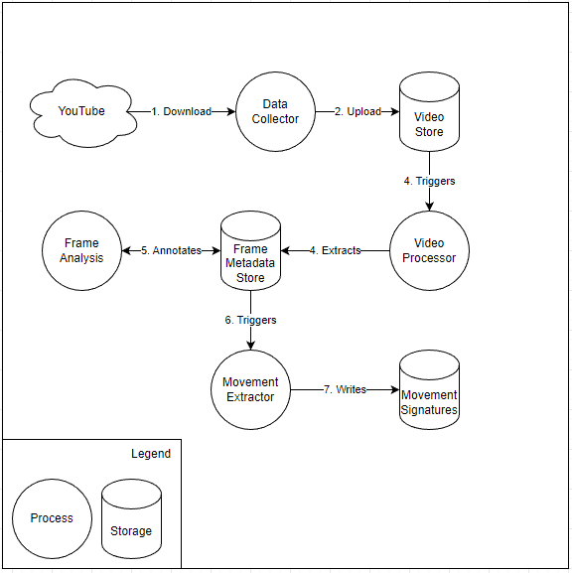
STUDY PROCEDURES
Notes:
SLIDE INSTRUCTIONS:
1. Recap for your committee the exact steps you followed to collect the data.
NOTE: You want to provide enough detail that you can show others how the study can be replicated.

Slide 12
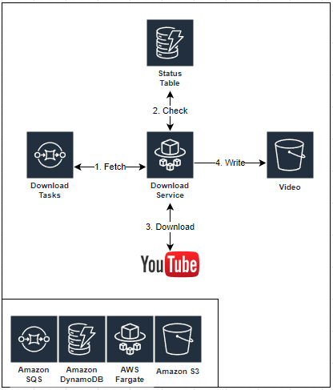
Data Collector
Notes:
SLIDE INSTRUCTIONS:
1. Recap for your committee the exact steps you followed to collect the data.
NOTE: You want to provide enough detail that you can show others how the study can be replicated.

Slide 13
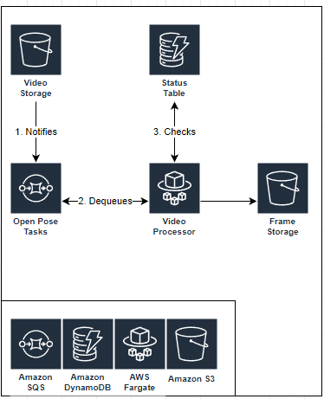
Video Processor
Notes:
SLIDE INSTRUCTIONS:
1. Recap for your committee the exact steps you followed to collect the data.
NOTE: You want to provide enough detail that you can show others how the study can be replicated.

Slide 14
DATA ANALYSIS
Download Video
Sample Frames
Detect Skeletons
Process Motion
Annotate
Aggregate
Notes:
SLIDE INSTRUCTIONS:
Describe the analysis used to test each hypothesis. Provide evidence that the statistical test that was chosen is appropriate to test the hypotheses and that the data meet the assumptions of the statistical tests.
NOTE 1: Discuss any software used.
NOTE 2: Use proper terminology in association with each design/analysis.
Describe the analysis used to test each hypothesis.
Provide evidence that the statistical test that was chosen is appropriate to test the hypotheses and that the data meet the assumptions of the statistical tests.
Note any software used.
Use proper terminology in association with each design/analysis (e.g., independent variable and dependent variable for an experimental design, predictor and criterion variables for regression).

Slide 15
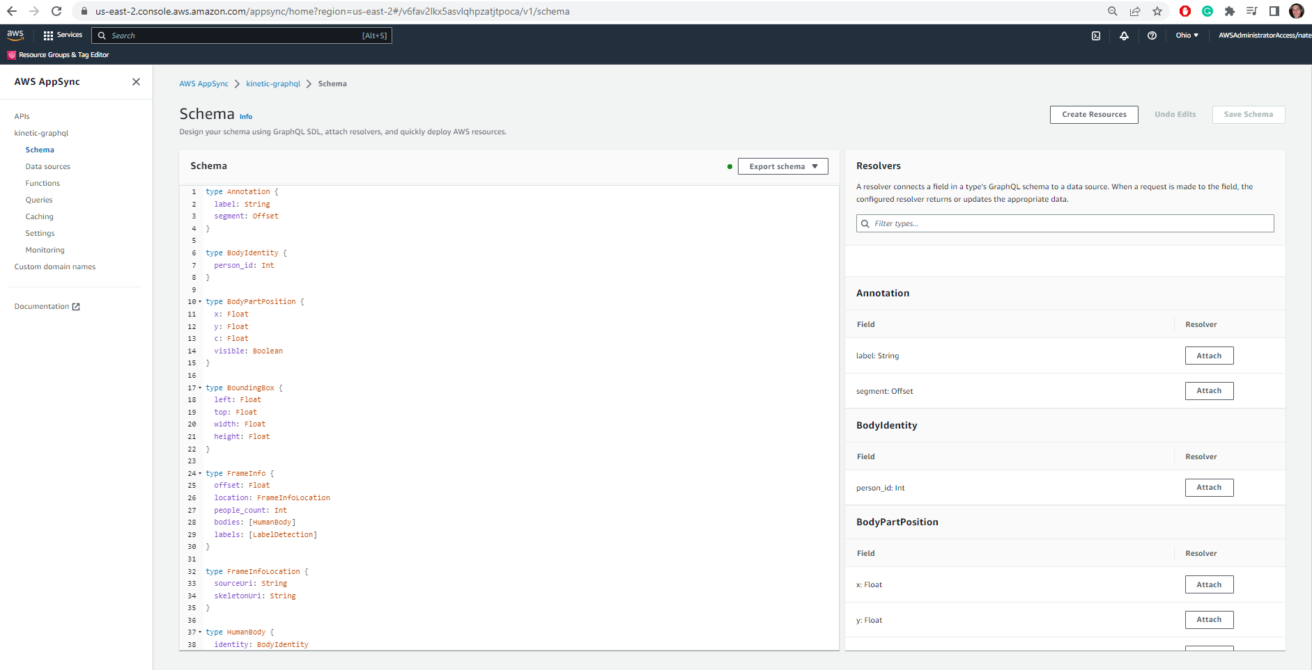
GraphQL
Notes:
I hadn’t anticipated that 650K videos would expand into 21.7M documents that span multiple databases and technologies.
GraphQL was the answer… here’s why
https://github.com/dr-natetorious/Dissertation/blob/master/cdk/src/data/schema.graphql

Slide 16
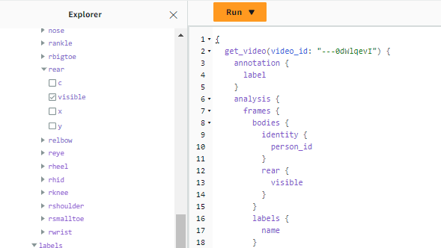

Slide 17
LIMITATIONS
All results based on the kinetic-700 data set
Human Activity Recognition is vast with unlimited permutations
Notes:
SLIDE INSTRUCTIONS:
1. Describe the study limitations.
NOTE : Remember to indicate what you did to mitigate these limitations, if possible.

Slide 18
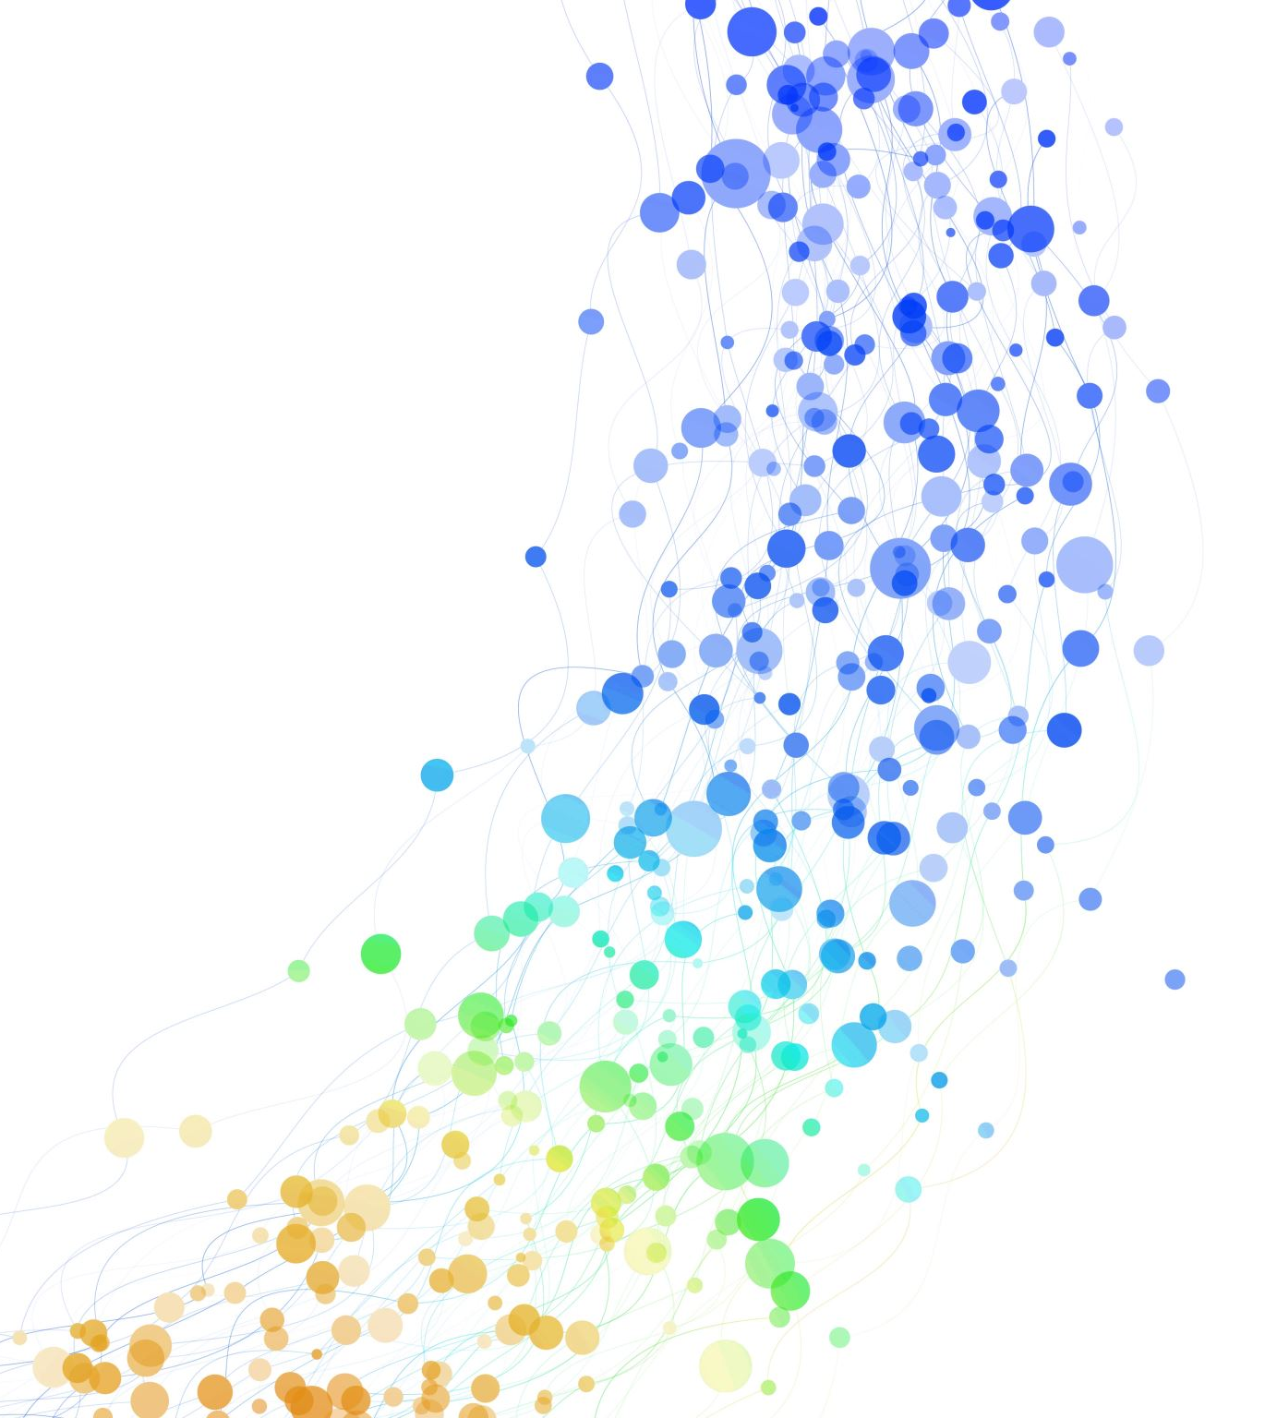
ETHICAL ASSURARANCES
Confirm your study received IRB approval
Data source is public YouTube videos
Notes:
SLIDE INSTRUCTIONS:
1. Confirm your study received IRB approval. You might want to just indicate the date you received approval on this bullet point.
2. If your study had more than minimal risk to participants, discuss the relevant ethical issues and how they were addressed.
3. Explain how you kept participants anonymous (if you did) and information confidential.
4. Note how you have securely stored your data.
5. Discuss relevant issues you faced as a researcher, including biases as well as personal and professional experiences with the topic, problem, or context. Present any strategies you used to prevent these biases and experiences from influencing the analysis or results.

Slide 19
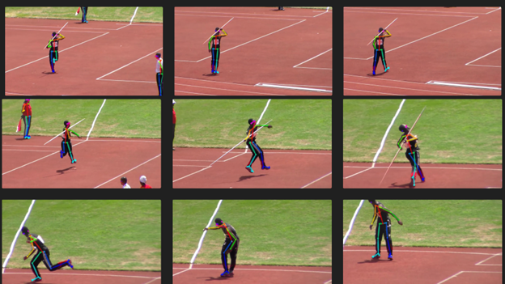
RESULTS
Notes:
SLIDE INSTRUCTIONS:
1. Address each research question. It is recommended you only address one research question per slide.
2. For each quantitative research question:
A. Note the formula(s) used and the results
B. Note whether the results supported the null or alternative hypothesis

Slide 20
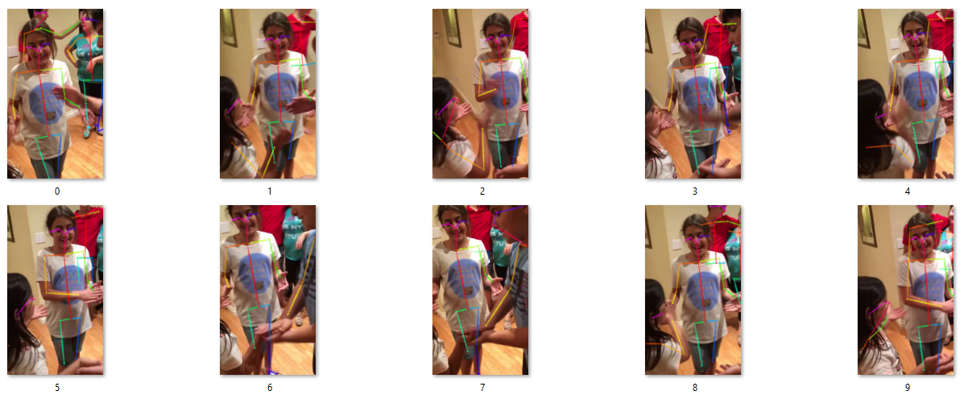
IMPLICATIONS
Research Question #1
Ensemble solution of dumb signals was very effective
GraphQL for the win
Research Question #2
Not every video worked
Sampling rate is important
Notes:
SLIDE INSTRUCTIONS:
Address each research question. It is recommended you address one research question per slide.
A. Present the implications/conclusions per research question. For a quantitative study, connect to the hypotheses.
B. Discuss any factors that might have influenced the interpretation of the results.
C. Describe the extent to which the results are consistent with existing literature and your conceptual or theoretical framework and provide potential explanations for unexpected or divergent results.
What is the effectiveness of autonomous assistants for classifying behaviors of elderly and special needs patients for care organizations?
Effectiveness is the degree to which something successfully produces a desired. Within this research context, that means that the analytics pipeline can reliably download, extract, and index kinetic-700 videos (see Chapter 4: Findings, RQ1). The pipeline invoked the loosely coupled components resulting in 21.7M prediction documents describing the state within sampled frames (2 fps).
What is the efficiency of autonomous assistants for classifying behaviors of elderly and special needs patients for care organizations?
Efficiency is the quality of doing something well without wasting time or resources. Within this research context, it means processing frames quickly and supporting an economically elastic computation scale-out model. The analytics pipeline can download, extract, and index metadata in near real-time utilizing a GPU farm.

Slide 21
Childcare
Sports
Prisons
Public/worker safety
Manufacturing
PRACTICAL APPLICATION
Notes:
SLIDE INSTRUCTIONS:
Discuss recommendations for how the findings of the study can be applied to educational practice and/or theory.
Support all the recommendations with at least one finding from the study and the literature from Chapter 2.
NOTE: Be careful to avoid overstating the applicability of the findings.
This dissertation examines human activity recognition using Deep Mind’s kinetic-700 dataset as a proxy for elderly and special needs behaviors. However, the capability broadly applies to markets that demand quality control and oversight. For instance, parents would likely pay a premium to daycares and school systems that can summarize their child’s positive and negative interactions. The court systems use naïve ankle monitoring because continuous video monitoring would violate personal privacy. However, under the proposed implementation, tracking the defendant's actions and producing a secure log of behaviors is possible (Mickens, 2018). Also, numerous situations exist where public safety has priority over personal privacy, such as sporting events, public events, transportation, and prisons. There are commercial applications outside of continuous personal monitoring scenarios. For instance, manufacturing and assembly lines can monitor for health and safety risks.

Slide 22
RECOMMENDATIONS (FUTURE RESEARCH)
Start with this project’s deployment code
Multi-camera configurations
Decouple the AI/ML subsystems into multi-model
Decouple the schema with GraphQL
Thermal cameras, etc.
Notes:
SLIDE INSTRUCTIONS:
1. Based on the framework, results, and implications, explain what future researchers might do to learn from and build upon this study. Justify these explanations.
2. Discuss how future researchers can improve upon this study, given its limitations as discussed in Chapter 3.
3. Explain what the next logical step is in this line of research.
Future researchers can verify the results of this dissertation and quickly extend them within their private AWS accounts. The solution is fully automated using the AWS Cloud Development Kit (AWS CDK v2), which provisions an identical environment with minimal effort. The source code is available at https://github.com/dr-natetorious/Dissertation. Follow the README.md documentation for deployment instructions and troubleshooting guidance
This constructive research project examined a broad set of videos and extracted details about a diverse population. However, there is significant potential for improvements across the value chain. For example, the video analysis uses a fixed frame rate (2 fps) for all clips. No attempt to quantify a reasonable frame rate occurred during this project. Future research should determine the appropriate sampling necessary to make informed decisions.
The OpenPose framework also returns low-quality predictions when overlapping people exist in a small shot (see Figure 43). In these sequences like this clip, the camera pans and rotates as the children dance in a circle. Commercial libraries exist for path tracking within the video and could provide better support than the default OpenPose constructs. A cursory exploration shows these features support limited movements and are an open research topic. One potential solution is to leverage multiple cameras and calculate the 3-D space. That approach would allow depth-specific bounding boxes and improve collision detection with the scene’s objects.
This wasn’t sufficient for creating an extensible movement taxonomy
Drinking milk and beer are similar motions but different behaviors.
It wasn’t implemented but thermal cameras as another source was considered

Slide 23
CONCLUSIONS
Macroeconomic trends necessitate transitioning skilled human tasks to autonomous agents.
Computer vision-based models are broadly universal
Building and training models is challenging due to patient privacy concerns
Analytical pipeline with YouTube content mitigates these challenges
Results are effective/efficient and broadly applicable
Loosely-coupled AI/ML models was the effective/scalable
Notes:
SLIDE INSTRUCTIONS:
Provide strong, concise overarching conclusions as a summary focusing on the problem, purpose, and research questions.
From the evaluation and implications of the study results, emphasize specifically how the results of the study connect to your framework, practice, and to the literature; considering specifically the gap in the literature.
Present the main message of the entire study and concisely summarize the recommendations for future research.
Growing macroeconomic trends necessitate transitioning skilled human tasks to autonomous agents. These trends are evident in medical care facilities where the costs are increasing while the availability of trained professionals is decreasing. Meanwhile, automation and computer-aided capabilities are becoming ubiquitous. This situation requires research into autonomous agents that can facilitate tasks traditionally reserved for humans, like nursing. One of the most natural agent interaction models is through computer vision because body language is broadly universal. For example, when a person has a fall, their movement follows a similar signature regardless of nationality. The same statement is true regarding other actions like seating, running, jumping, and standing. However, building and training these computer vision-based agents has a litany of technical and practical challenges. First, researchers must provision enough cameras to collect the required training data, introducing scalability and economic constraints. Next, the patients are unlikely to permit researchers to record them 24/7. Third, other researchers still have issues reproducing snowflake data sets, assuming sufficient patients grant permission and forgo personal privacy. These limitations establish the need for training computer vision models with open-source video repositories.
This constructive research project built an AWS cloud analytics pipeline to process the kinetic-700 dataset. It reliably extracts foundational insights per frame and enables querying them through an industry standard GraphQL interface. These artifacts allow researchers to build sophisticated products for improving elderly and special needs care. It permits data scientists to extend the analytics pipeline with additional CV models. Similarly, developers can extend the GraphQL schema by defining domain-specific aggregate and composite states. This approach aligns with the literature review and goes beyond existing strategies. For instance, most practitioners create purpose-built models constrained to a finite action space. Instead, this research supports arbitrary extensions into the retrieval schema.
This study defined success criteria regarding the effectiveness (R1) and efficiency (R2) of identifying human behaviors within open-source videos. These two related questions aim to measure the accuracy and scalability of the proposed solution. Extracting skeletal movements from video demonstrated an ability to identify several foundational action sequences correctly. After enriching those frames with object detection metadata, the predictive system could handle an arbitrary depth of derived actions, each layer describing greater specificity. This metadata ensembling results in a highly efficient scalable design that future investments could mature to support the general corpus of human behavior. Furthermore, this research project demonstrated that these predictive capabilities could run on commoditized local hardware. That flexibility reduces personal privacy concerns since video recordings never leave the patient’s control.
The literature review paints a picture of researchers progressing into highly sophisticated deep-learning models. These technologies are compelling and will shape the future of AI, especially for generative content scenarios. However, this research demonstrates that simple designs with several dumb signals can still produce high-quality results. Each of these signals can use artificial intelligence. However, it’s critical not to forget that the system must solve a business problem. Within a business problem context, known rules can be codified directly in traditional programming languages. System designers must be mindful in choosing the right tool for the job, whether simple-branch or ANN/DNN constructs.

Slide 24

THANK YOU
Notes:
SLIDE INSTRUCTIONS:
You will copy/paste your sentence that states, “The problem is…” and the purpose sentence that states, “The purpose of this…”
While you are presenting your problem and purpose statement on the slide exactly as it appears in your manuscript, you will want to paraphrase , rather than read it word for word in your actual Defense.
You should have notes to further elaborate on the problem.

Slide 25

REFERENCES
Notes:
SLIDE INSTRUCTIONS:
Put your references in alphabetical order on the slides. Will require more than one slide.
NOTE: You can choose to put the references that only apply to your slides, or you can put all the references from your dissertation on these slides.
References
Aguida, M., Ouchani, S., & Benmalek, M. (2020). A review on cyber-physical systems. International Conference on Enabling Technologies (pp. 275-278). Basque Coast, Bayonne; France: IEEE. doi:https://doi.org/10.1109/WETICE49692.2020.00060
Aihara, S., Kitamura, S., Dogan, M., Sakata, S., Kondo, K., & Otaka, Y. (2021). Patients’ thoughts on their falls in a rehabilitation hospital: a qualitative study of patients with stroke. BMC Geriatrics, 21(1), 1-14. Retrieved from https://search.ebscohost.com/login.aspx?direct=true&AuthType=sso&db=edssjs&AN=edssjs.7A908AA7&site=eds-live&scope=site
Amerineni, R., Gupta, L., Steadman, N., Annauth, K., Burr, C., Wilson, S., . . . Vaidyanathan, R. (2021). Fusion models for generalized classification of multi-axial human movement: Validation in sport performance. Sensors, 24, 1-10. doi:10.3390/s21248409
Anderson, W., Choffin, Z., Jeong, N., Callibhan, M., Joeng, S., & Sazonav, E. (2022). Empirical study on human movement classification using insole footwear sensor system and machine learning. Sensors, 22(7), 2743-2763. doi:10.3390/s22072743
Ariely, D. (2009). Predictably irrational: the hidden forces that shape our decisions. HarperCollins Publishers.
Asimov, I. (1942). Runaround.
Atienza, R. (2018). Advanced deep learning with Tensorflow 2 and Keras. Birminghan, UK: Packt Publishing.
AWS. (2021). AWS RoboMaker. Retrieved from Amazon Web Services: https://aws.amazon.com/robomaker/
AWS. (2023). What is Amazon Simple Queue Service. Retrieved from AWS Developer Guide: https://docs.aws.amazon.com/AWSSimpleQueueService/latest/SQSDeveloperGuide/welcome.html
AWS. (n.d.). What is AWS Fargate. Retrieved from AWS Developer Documentation: https://docs.aws.amazon.com/AmazonECS/latest/userguide/what-is-fargate.html
Ballard, D., & Zhang, R. (2021). The hierarchial evolution in human vision modeling. Topics in Cognitive Science, 13(2), 309-328. doi:https://doi.org/10.1111/tops.12527
Barua, H., & Mondal, K. (2019). A comprehensive survey on cloud data mining (CDM) frameworks and algorithms. CM Computing Surveys. Sep2019, Vol. 52 Issue 5, p1-62. 62p, 1-62.
Bell, Koren, & Volinsky. (2009). The BellKor solution to the Netflix Prize. Retrieved from Netflix Prize: https://netflixprize.com/assets/GrandPrize2009_BPC_BellKor.pdf
Besada, D. E. (2020). Resource requirements for community-based care in rural, deep-rural and peri-urban communities in South Africa. PLoS ONE, 15(1), 1-19. doi:https://doi.org/10.1371/journal.pone.0218682
Bipin, K. (2018). Robot Operating System Cookbook. Packet Publishing.
Blackhurn, B. (2021). Sensitive situations in a nurse residency program: balancing confidentiality with meaningful solutions. Journal for Nurses in Professional Development, 37(3), 185-187. doi:10.1097/NND.0000000000000694
Boorugu, R., & Ramesh, G. (2020). A survey on NLP based text summarization for summarizing product reviews. International Conference on Inventive Research in Computing Applications (pp. 352-356). Coimbatore, India: IEEE. doi:https://doi-org.proxy1.ncu.edu/10.1109/ICIRCA48905.2020.9183355
Brown, T. (2015). A Primer on data security. CPA Journal May Volume 85, Issue 5, 58-62.
Bryar, C., & Carr, B. (2021). Working backwards: insights, stories, and secrets from inside Amazon.
Buchanan, B. (2005). A very brief history of artifical intelligence. AI Magazine, 26(4), 53-60. Retrieved from ttps://search-ebscohost-com.proxy1.ncu.edu/login.aspx?direct=true&db=ofs&AN=501189619&site=eds-live
Burr, V. (2015). Social constructionism. Routledge.
Cao, Z., Hidalgo, G., Simon, T., S, W., & Sheikh, Y. (2021). OpenPose: realtime multi-person 2D pose estimation using part affinity fields. IEEE Transactions on Pattern Analysis and Machine Intelligence, 43(1), 172-186. doi:10.1109/TPAMI.2019.2929257
CDC. (2016, July 6). Motor vehicle crash deaths. Retrieved from Centers for Disease Control and Prevention: https://www.cdc.gov/vitalsigns/motor-vehicle-safety/index.html
Centers for Disease Control and Prevention. (2020). Centers for disease control and prevention, National Center for Injury Prevention and Control. Web-Based Injury Statistics Query and. Retrieved from Centers for Disease Control and Prevention: http://www.cdc.gov/injury/wisqars
Chen, B., & Curtmola, R. (2017). Remote data integrity checking with server-side repair. Journal of Computer Security 25, 537-584.
Cheng, Y., Wang, D., Zhou, P., & Zhang, T. (2018, January). Model compression and acceleration for deep neural networks. IEEE Signal Processing Magazine, 35(1), 126-136. doi:https://doi-org.proxy1.ncu.edu/10.1109/MSP.2017.2765695
CMU. (2021). CMU graphics lab motion capture database. Retrieved from Carnegie Mellon University: http://mocap.cs.cmu.edu/
Cohen, B. (2013, November 14). The 10 smartest cities In North America. Retrieved from Fast Company: https://www.fastcompany.com/3021592/the-10-smartest-cities-in-north-america
Commission of the European Communities. (2009). Internet of Things — an action plan for Europe. Retrieved from http://eurlex.europa.eu/LexUriServ/site/en/com/2009/com2009_0278en01.pdf
Darwin, C. (1859). On the origin of species.
de Waal, D., & du Toit, J. (2011). Automation of generalized additive neural networks for predictive data mining. Applied Artificial Intelligence, 25(5), 380-425. doi:10.1080/08839514.2011.570156
DeepMind. (2020). Kinetics. Retrieved February 11, 2023, from DeepMind: https://www.deepmind.com/open-source/kinetics
Denis, D. (2015). Applied univariate, bivariate, and multivariate Statistics (1st ed.). John Wiley & Sons, Incorporated.
Dickson, A., Emad, H., & Adu-Agyum, J. (2018). Theoetical and conceptual framework: mandatory ingredients of quality research. International Journal of Scientific Research, 7, 438-441. Retrieved from https://www.researchgate.net/publication/322204158_THEORETICAL_AND_CONCEPTUAL_FRAMEWORK_MANDATORY_INGREDIENTS_OF_A_QUALITY_RESEARCH
Donovan, C. (2016, August 30). Power and effect size. Retrieved from YouTube: https://www.youtube.com/watch?v=9LVD9oLg1A0
Edureka. (2018, October 16). Natural language processing in 10 minutes. Retrieved from YouTube: https://www.youtube.com/watch?v=5ctbvkAMQO4
Fedus, W., Zoph, B., & Shazeer, N. (2022). Switch transformers: scaling to trillion parameter models. (A. Clark, Ed.) Journal of Machine Learning, 23, 1-40. doi:https://jmlr.org/papers/v23/21-0998.html
Ford, D. (2012, March 18). As cars are kept longer, 200,000 Is the new 100,000. Retrieved from The New York Times: https://www.nytimes.com/2012/03/18/automobiles/as-cars-are-kept-longer-200000-is-new-100000.html
Fridman, L. (2017, January 16). MIT 6.S094: Introduction to deep learning and self-driving cars. Retrieved from YouTube: https://www.youtube.com/watch?v=1L0TKZQcUtA&feature=youtu.be
Fridman, L. (2020, January). Deep Learning state of the art. (Massachusetts Institute of Technology (MIT)) Retrieved from YouTube: https://youtu.be/0VH1Lim8gL8
Friedman, L., Prokopenko, V., Katrychuk, D., & Komogortsev, O. (2023). Factors affecting inter-rater agreement in human classification of eye movements: a comparison of three datasets. Behavior Research Methods, 55(1), 417-427. doi:https://doi.org/10.3758/s13428-021-01782-4
Frolov, S. (2021). Quantum computing’s reproducibility crisis: Majorana fermions. Nature: International Weekly Journal of Science, 592(7854), 350-352. doi:https://doi.org/10.1038/d41586-021-00954-8
Fu, Z. (2019). An introduction of deep learning based word representation applied to natural language processing. International Conference on Machine Learning, Big Data and Business Intelligence, (pp. 92-104). doi:https://doi-org.proxy1.ncu.edu/10.1109/MLBDBI48998.2019.00025
Gan, Q., Li, Y., Wang, G., & Zhang, Y. (2020). Application research of optical tracking point layout in computer motion capture technology. International Conference on Innovation Design and Digital Technology (pp. 548-552). Zhenjing, China: IEEE. doi:10.1109/ICIDDT52279.2020.00109
García-Pérez, M. A. (2012). Statistical conclusion validity. Frontiers in Psychology, 3. doi:https://doi.org/10.3389/fpsyg.2012.00325
Gergen, K. (2010). Social constructionist ideas: theory and practice. (The Taos Institute) Retrieved from Vimeo: https://vimeo.com/15676699
Gorgulu, Y., & Tasdelen, K. (2020). Huamn activity recongition and temporal action localization based on depth sensor skeletal data. Innovations in Intelligent Systems and Applications Conference (pp. 1-5). Istanbul, Turkey: IEEE. doi:https://doi-org.proxy1.ncu.edu/10.1109/ASYU50717.2020.9259886
GraphQL. (2021, October). GraphQL specification. Retrieved from GraphQL: https://spec.graphql.org/October2021/
Guinness World Records. (2022). Heaviest man ever. Retrieved from https://www.guinnessworldrecords.com/world-records/heaviest-man
Hole, H., & Ahmad, S. (2019). Biologically driven artificial intelligence. Computer, 52(8), 72-75. doi:10.1109/MC.2019.2917455
Hornberg, A. (2017). Handbook of machine and computer vision. John Wiley & Sons, Incorporated.
Huang, M., Rust, R., & Maksimovic, V. (2019). The feeling economy: managing in the next generation of artificial intelligence. California Management Review, 61(4), 43-65. doi:https://doi-org.proxy1.ncu.edu/10.1177/0008125619863436
Jackson, B., & Rege, M. (2019). Machine learning for classification of economic recessions. IEEE 20th International Conference on Information Reuse and Integration for Data Science (pp. 31-38). Los Angeles, CA, USA: Institute of Electrical and Electronics Engineers. doi:10.1109/IRI.2019.00019
Jaisswal, A., & Naik, A. (2021). Effect of Hyperparameters on Backpropagation. Pune Section International Conference (pp. 1-5). IEEE. doi:10.1109/PuneCon52575.2021.9686489
Jason, L., & Glenwick, D. (2016). Handbook of methodological approaches to community-based research : qualitative, quantitative, and mixed methods . Oxford University Press.
Kahn Academy. (2014). Origin of Markov Chain. Retrieved from Kahn Academy: https://www.khanacademy.org/computing/computer-science/informationtheory/moderninfotheory/v/markov_chains
Kane, T. (2019, March). Artificial intelligence in politics: establishing ethics. Technology and Society Magazine, 38(1), 72-80. doi:10.1109/MTS.2019.2894474
Keller, J., Liu, D., & Fogel, D. (2016). Fundamentals of computational intelligence. John Wiley & Sons.
Kilgallon, S., De la Rosa, L., & Cavazos, J. (2017). Improving the effectiveness and efficiency of dynamic malware analysis with machine learning. Resilience Week (pp. 30-36). Wilmington, Delaware: IEEE. doi:10.1109/RWEEK.2017.8088644
Kim, J., & Kim, S. (2021). The determinants of caregiver use and its costs for elderly inpatients in Korea. BMC Health Services Research, 21(631), 1-10. doi:https://doi.org/10.1186/s12913-021-06677-w
Kim, K., & Cho, S. (2008). Evolutionary ensemble of diverse artificial neural networks using speciation. Neurocomputing, 71(7-9), 1604-1618. doi:https://doi.org/10.1016/j.neucom.2007.04.008
Klem, N., Bunzli, S., Smith, A., & Shields, N. (2022). Demystifying qualitative research for musculoskeletal practitioners Part 5: rigor in qualitative research. Journal of Orthopaedic & Sports Physical Therapy, 52(2), 60-62.
Krizhevshy, A., Sutskever, I., & Hinton, G. (2012). ImageNet classification with deep convolutional neural networks. 25th International Conference on Neural Information Processing Systems (pp. 1097-1105). Red Hook, NY: ACM. doi:https://dl.acm.org/doi/10.5555/2999134.2999257
Langer, M., He, H. Z., Rahayu, W., & Xue, Y. (2020). Distributed training of deep learning models: a taxonomic perspective. Transactions on Parallel and Distributed Systems, 31(12), 2802-2818. doi:https://doi.org/10.1109/TPDS.2020.3003307
Langston, A. (2022, March 14). In a historic milestone, Azure Quantum demonstrates formerly elusive physics needed to build scalable topological qubits. Retrieved from Microsoft Innovation Stories: https://news.microsoft.com/innovation-stories/azure-quantum-majorana-topological-qubit/
Lee, J., & Yoo, H. (2021). An overview of energy-efficient hardware accelerators for on-device deep-neural-network training. Open Journal of the Solid-State Circuits Society, 1, 115-128. doi:https://doi.org/10.1109/OJSSCS.2021.3119554
Lui, H., K, S., Fernando, C., & Kavukcuoglu, K. (2018). Hierarchical representations for efficient architecture search. International Conference on Learning Representations (pp. 1-13). Vancouver, WA: Carnegie Mellon University. doi:https://doi.org/10.48550/arXiv.1711.00436
Lukac, D., Milic, M., & Nikolic, J. (2018). From artificial intelligence to augmented age an overview. Zooming Innovation in Consumer Technologies Conference, (pp. 100-103). doi:https://doi-org.proxy1.ncu.edu/10.1109/ZINC.2018.8448793
Lytras, D., Evaggelos, S., Paris, I., Konstantinos, K., Ioannis, M., & Anastasios, K. (2022). Recording of falls in elderly fallers in Northern Greece and evaluation of aging health-related factors and environmental safety associated with falls: a cross-sectional study. Occupational Therapy International, 1-11. doi:10.1155/2022/9292673
Makarenko, O., & Osaulenko, V. (2018). Application of cellular automates in some models of artificial intelligence. IEEE First International Conference on System Analysis & Intelligent Computing (pp. 1-4). Kyiv, Kyiv City, Ukraine: Institute of Electrical and Electronics Engineers. doi:10.1109/SAIC.2018.8516837
Mejia, J., Quintero, D., & Builes, J. (2017). Knowledge-based model to support decision-making when choosing between two association data mining techniques. Revista Lasallista de Investigación, 14(2), 41-50. doi:https://doi.org/10.22507/rli.v14n2a4
Meta AI. (n.a.). Tanh Activation. Retrieved from Papers with Code: https://paperswithcode.com/method/tanh-activation
Miyakawa, T. (2020). No raw data, no science: another possible source of the reproducibility crisis. Molecular Brain, 13(1). doi:https://doi.org/10.1186/s13041-020-0552-2
Morris, J. (2008). Disability research and policy: current perspectives. Lawrence Erlbaum Associates.
Mullennex, L., & Bachmeier, N. (2023). Computer Vision on AWS. Packt Publishing.
Ng, A. (2016). Machine Learning. Retrieved from Coursera: https://www.coursera.org/learn/machine-learning
Nguyen, M., Huynh, N., Tran, D., & Ngo, H. (2019). Face recognition applied for smarthome using SoC. Advanced Computing and Applications (pp. 165-170). Nha Trang, Vietnam: IEEE. doi:https://doi-org.proxy1.ncu.edu/10.1109/ACOMP.2019.00033
Orhan, A. (2021). How much human-like visual experience do current self-supervised learning algorithms need in order to achieve human-level object recognition? Neural and Evolutionary Computing. doi:https://doi.org/10.48550/arXiv.2109.11523
Owen, C. (2017, November 8). A theorical hands-on introduction to fouculdian discourse analysis. Retrieved from YouTube: https://www.youtube.com/watch?v=6I6b3ePAZ5M
Oxford. (2022). Occam's razor. Retrieved from Lexico: https://www.lexico.com/en/definition/occam's_razor
Oxford. (2023). Effectiveness. Retrieved from Oxford Dictionary: oxfordlearnersdictionaries.com
Ozier, O. (2021). Replication redux: the reproducibility crisis and the case of deworming. World Bank Research Observer, 36(1), 101-130. doi:https://doi.org/10.1093/wbro/lkaa005
Parker, R. (1993). Threats to the validity of research. Rehabilitation Counseling Bulletin, 36(3), 130-138. Retrieved from https://search-ebscohost-com.proxy1.ncu.edu/login.aspx?direct=true&db=eric&AN=EJ458938&site=eds-live
Phua, K. H. (2021). Ageing in Asia: beyond the Astana declaration towards financing long-term care for all. International Journal of Health Policy and Management, 10(1), 32-36. doi:https://doi.org/10.34172/ijhpm.2020.15
Piirainen, K., & Gonzalez, R. (2013). Constructive synergy in design science research: a comparative analysis of design science research and the constructive research approach. Liiketaloudellinen Aikakauskirja, 3(4), 206-234. Retrieved from https://search.ebscohost.com/login.aspx?direct=true&AuthType=ip,shib&db=bth&AN=95116694&site=eds-live
Qiu, L., Wang, Y., & Rubin, J. (2018). Analyzing the analyzers: FlowDroid/IccTA and AmanDroid,. ISSTA’18, July 16–21, 2018, Amsterdam, Netherlands.
Rivera-Landos, E., Khomh, F., & Nikanjam, A. (2021). The challenge of reproducible ML. International Conference on Software Quality, Reliability and Security (QRS). 21, pp. 1079-1088. Hainan Island, China: IEEE. doi:10.1109/QRS54544.2021.00116
Sethi, T., & Kantardzic, M. (2018). Data driven exploratory attacks on black box classifiers in adversarial. Neurocomputing, 289, 129-143. doi:10.1016/j.neucom.2018.02.007
Shirazi, B., & Shekhani, S. (2021). Patient’s expectations of privacy and confidentiality in Pakistan. The Journal of the Pakistan Medical Association, 71(2A), 537-539. doi:https://doi.org/10.47391/JPMA.888
Silvestrini, R. P., & Sammito, G. (2012). Design of experiments for information technology systems. Defense AT&L, 41(5), 30-35. Retrieved from https://search-ebscohost-com.proxy1.ncu.edu/login.aspx?direct=true&db=bth&AN=80409129&site=eds-live
Smaira, L., Carreira, J., Noland, E., Clancy, E., Wu, A., & Zisserman, A. (2020, October 21). A short note on the Kinetics-700-2020 human action dataset. Computer Vision and Pattern Recognition. doi:https://doi.org/10.48550/arXiv.2010.10864
Smedley, R. (2019, December 4). Rob Smedley from Formula 1 talks about using AWS to improve the fan experience. Retrieved from YouTube: https://youtu.be/eBX7lPk5qmA
Snee, R. (2015). Practical approach to data mining. Quality Engineering, 27, 477-487. doi:10.1080/08982112.2015.1065322
Sonmez et al. (2018). Anomaly detection using data mining methods in IT systems: a decision support application. Sakarya University Journal of Science, 22(4), 1109-1123.
Starmer, J. (2017). What is principal component analysis. Retrieved from YouTube: https://www.youtube.com/watch?v=HMOI_lkzW08
Tan, Z. (2021). Ethics events and conditions of possibility. Business Ethics Quarterly, 31(1), 106-137. Retrieved from https://search-ebscohost-com.proxy1.ncu.edu/login.aspx?direct=true&db=edb&AN=147839336&site=eds-live
Thomas, R. (2019). The new era of NLP. Scientific Computing with Python. Austin, Texas: SciPy. Retrieved from https://youtu.be/KChtdexd5Jo
Tian, Y., Schuemie, M., & Suchard, M. (2018). Evaluating large-scale propensity score performance through real-world and synthetic data experiments. International Journal of Epidemiology, 47(6), 2005-2014. doi:https://doi.org/10.1093/ije/dyy120
Ting, W., Chun-Yang, C., Di, G., Xiao-ming, T., & Heng, W. (2014). Clock synchronization in wireless sensor networks: A new model and analysis approach based on networked control perspective. Mathematical Problems in Engineering Volume 2014, Article ID 731980, 1-19.
Tun, S., Madanian, S., & Mirza, F. (2021). Internet of things (IoT) applications for elderly care: a reflective review. Aging Clinical & Experimental Research, 33(4), 855-867. doi:10.1007/s40520-020-01545-9
Ünal, H., & Başçiftçi, F. (2021). Evolutionary design of neural network architectures: a review of three decades of research. Artif Intell Rev, 55, 1723-1802. doi:https://doi.org/10.1007/s10462-021-10049-5
Upchurch, M. (2018). Robots and AI at work: the propects for singularity. New Technology, 33(3), 205-218. doi:10.1111/ntwe.12124
US Bureau of Labor Statistics. (2020, May). Registered nurses. Retrieved from US Bureau of Labor Statistics: https://www.bls.gov/ooh/healthcare/registered-nurses.htm
Vosshall, P. (2018, November 27). How AWS minimizes the blast radius of failures. Retrieved from YouTube: https://youtu.be/swQbA4zub20
Waal, d., & Toit, d. (2011, May/June). Automation of generalized additive neural networks for predictive data mining. Applied Artificial Intelligence, 25(5), 380-425. doi:10.1080/08839514.2011.570156
Whitson, G. (2020). Artificial Intelligence. Retrieved from Salem Press Encyclopedia of Science: https://search.ebscohost.com/login.aspx?direct=true&AuthType=ip,sso&db=ers&AN=89250362&authtype=sso&custid=s1229530&site=eds-live&scope=site
Wilensky, U. (2014). BeeSmart hive finding. Retrieved from Netlogo: https://ccl.northwestern.edu/netlogo/models/BeeSmartHiveFinding
Zhang, J., Johnstone, M., Le, V., Khan, B., Anwar Hosen, M., Creighton, D., . . . Lynch, M. (2021). Dynamic time warp-based clustering: Application of machine learning algorithms to simulation input modelling. Expert Systems with Applications, 186. doi:https://doi.org/10.1016/j.eswa.2021.115684
Zhao, W. (2014). Building dependable distributed systems. John Wiley & Sons, Incorporated.
Zhu, X., Zhu, J., Li, H., Wang, X., Li, H., Wang, X., & Dai, J. (2021). Uni-perceiver: pre-training unified architecture for generic perception for zero-shot and few-shot tasks. Computer Vision and Pattern Recognition. doi:https://doi.org/10.48550/arXiv.2112.01522

