Slide 1
Discrimination Issues
Angelica Perry, Douglas Etchison, Elma Horsely, Nathan Bachmeier
Law 531
November 2, 2015
Maria Wood

Slide 2
Types of discrimination in a work environment
Sexual Harrassment
Age
Equal Pay/Compensation
Race or Nationality
Physical Characteristics
Notes:
Harassment can include “sexual harassment” or unwelcome sexual advances, requests for sexual favors, and other verbal or physical harassment of a sexual nature.
Age-The Age Discrimination in Employment Act (ADEA) only forbids age discrimination against people who are age 40 or older. It does not protect workers under the age of 40. The Equal Pay Act requires that men and women in the same workplace be given equal pay for equal work. ("EEOC Home Page," n.d.pg 1)
Title VII of the Civil Rights Act also prevent discrimination based on race or nationality.
The American Disabilities Act also requires that people not be discriminated against for any physical limitation

Slide 3
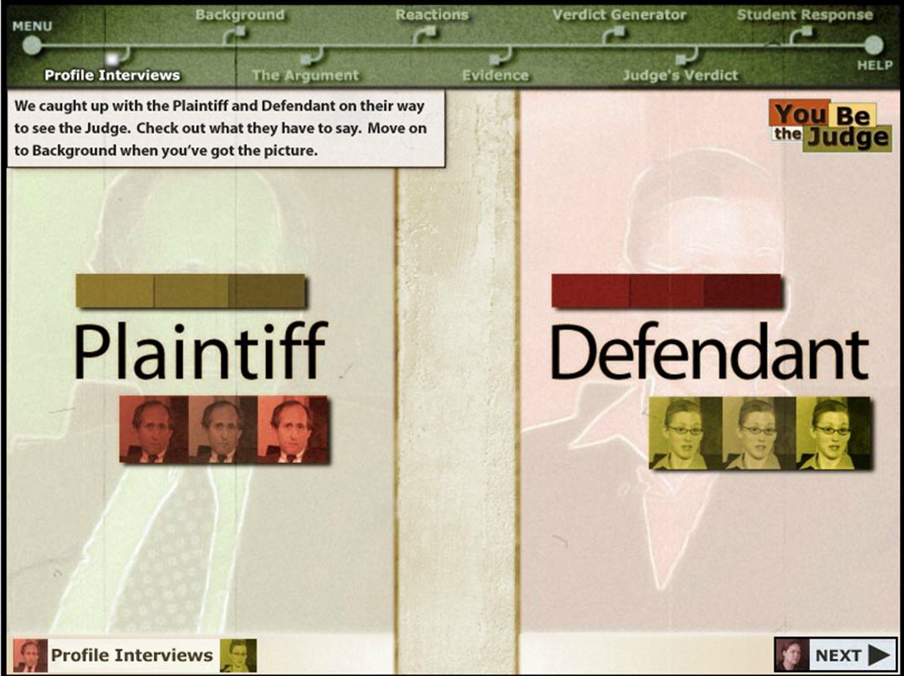
You be the Judge: Sexual Harassment
Notes:
The plaintiff alleged that the defendant has created a hostile work environment by using sexually explicit language.
He claims that this has been going on for some time, and has finally gone too far. She put a screensaver on his computer which depicted an animated stripper.
After his supervisor saw the screensaver, the plaintiff became ineligible for a promotion. This has damaged his career and needs to be compensated for the financial loss.

Slide 4
Sexual Harassment in the workplace
Inappropriate Behaviour
Explicit Screen savers
Quid pro quo
Hostile work environment
Misappropriate use of company Equipment
Types of Discrimination in the work place
Notes:
Quid pro quo harassment occurs in the workplace. Employees seeking justice for a quid pro quo harassment claim typically must file a complaint with a state and/or federal labor protection agency first. ("What is Quid Pro Quo Harassment? - FindLaw," n.d. pg 1). The work environment that would be intimidating, hostile, or offensive to reasonable people. Any employee who is found to have neglected or misused Company property will be subject to disciplinary action. the basis for the judge’s ruling was that, John only sought to sue Meredith once he thought he had lost the chance for promotion because of the screensaver.
Harassment can include “sexual harassment” or unwelcome sexual advances, requests for sexual favors, and other verbal or physical harassment of a sexual nature. Age-The Age Discrimination in Employment Act (ADEA) only forbids age discrimination against people who are age 40 or older. It does not protect workers under the age of 40. The Equal Pay Act requires that men and women in the same workplace be given equal pay for equal work. ("EEOC Home Page," n.d.pg 1)

Slide 5
Determining Sexual Harassment
Sexual Harassment in the workplace
Was the act unusual to the normal environment?
Did the plaintiff prove the act was detrimental to the promotion?
What was the relationship between the two co-workers before this event?
Notes:
In determining if the event was an act of sexual harassment there are many that must be taken into account. The two co-workers had been friends in the past. The two had maintained a friendship that often involved sharing events from outside the workplace. The two would often stories of their dating lives, and share sexual jokes.
The events of the past had never been mentioned by either party as being uncomfortable to either one. The environment in the team of the four employees allowed the freedom to talk about many different things both sexual and non-sexual without feeling as if there were any issues or anyone was uncomfortable.
The hiring manager never mentioned the reason for the plaintiff not getting the promotion. There was no proof of the manager even seeing the screen saver. The joking environment and the pranking that had happened in the past among the group was a welcoming environment for the prank. If the plaintiff was not wanting others to see the screensaver he should have replaced the screensaver with another that was more appropriate.

Slide 6
Sexual Harassment: Case Elements
Exceptions to the Law: Equal Opportunity Act
Examine the potential civil responsibility of both the employee and the employer.
Notes:
Examine the potential civil responsibility of both the employee and the employer.
The potential civil liability of the employee is to follow the company's handbook regarding to report it immediately to the department of human resources or to any other member in the company's management. The potential civil liability of the GHI-SOFT is to provide a work environment where employees are free of sexual harassment by a manager or colleagues with who the employee interacts in the course of them performing their duties. AT GHI-SOFT sexual harassment was specifically prohibited in the workplace, as GHI-SOFT states that they will be responsible for preventing sexual harassment in the workplace and taking immediate correcting action to make sure that the harassment is stopped and fully investigated. GHI-SOFT is ultimately liable due to the plaintiffs established with the company that the defendant had created a hostile environment and that “management neglected the obvious disruption to the plaintiffs work” (University of Phoenix, 2015).
Exceptions to the Law: Equal opportunity Act
The equal opportunity act of 2010 has some general exceptions to the law against discrimination. These exceptions pertain to particular circumstances where discrimination may not be against the law. For example, “a religious body may discriminate on the basis of religious belief or activity or to avoid upsetting the religious sensitives of its members. Discrimination may be permitted in circumstances that involve” ("Religious Belief Or Activity - Workplace", n.d.). Discrimination in some cases is acceptable when ordaining priests to a religious group, training people who wish to be priests., in addition to these circumstances, a business may discriminate if the discriminatory action is a necessity in order for them to comply to the orders believe system.

Slide 7
Court Decision
The victim of sexual harassment must prove the behavior was: “unwelcome […], severe or pervasive, and create[d] an environment that a reasonable victim would find hostile or abusive
Assuming this is true, the plaintiff also needs to prove that financial losses had occur.
The defendant won the case due to:
The behavior was welcomed
The business has clear stated policies for reporting sexual harassment
There was no way to prove the promotion was lost due to the prank
Notes:
The victim of sexual harassment must prove the behavior was: “unwelcome […], severe or pervasive, and create[d] an environment that a reasonable victim would find hostile or abusive (Mallor, Barnes, Langvardt, & Prenkert, 2014).” Assuming this is true, the plaintiff also needs to prove that financial losses had occur.
In this case the plaintiff cannot claim that it was unwelcome, as he willfully participates in the explicit conversations. He testified that these conversations frequently occurred during lunch. There was no reason why he had to continue having lunch with her if her behavior offended him. The screen saver that was placed on his computer was unprofessional, but it was animated and not overly offensive. Lastly the company has a zero tolerance policy for sexual harassment. If he felt the environment was hostile or abusive, then he had needed to report the problem to the human resources department.
In regards to the financial loss, he is speculating that the promotion would have been given to him. He is also speculating that her prank is what prevented him from getting the promotion. There are any number of other reasons why things he did not receive the promotion. Aside from the hiring manager testifying the reason he was passed over, it is not possible to establish that her actions resulted in the loss.

Slide 8
References
EEOC Home Page. (n.d.). Retrieved from http://www.eeoc.gov/
What is Quid Pro Quo Harassment? - FindLaw. (n.d.). Retrieved from http://employment.findlaw.com/employment-discrimination/what-is-quid-pro-quo-harassment.html
Chelliah, J. (2015). Sexual harassment: A costly affair for employers. Human Resource Management International Digest, Vol. 23 Iss: 3, 37 - 38.
Mallor, J., Barnes, A., Langvardt, A., & Prenkert, J. (2014). Business Law: The Ethical, Global, and E-Commerce Environment 16th Edition. McGraw-Hill Education.
University of Phoenix. (2015, November 2). You be the Judge! Sexual Harassment [multimedia]. Retrieved from University of Phoenix: University of Phoenix, LAW 531 website

