Slide 1
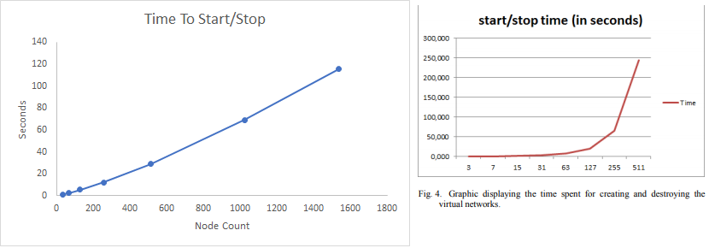
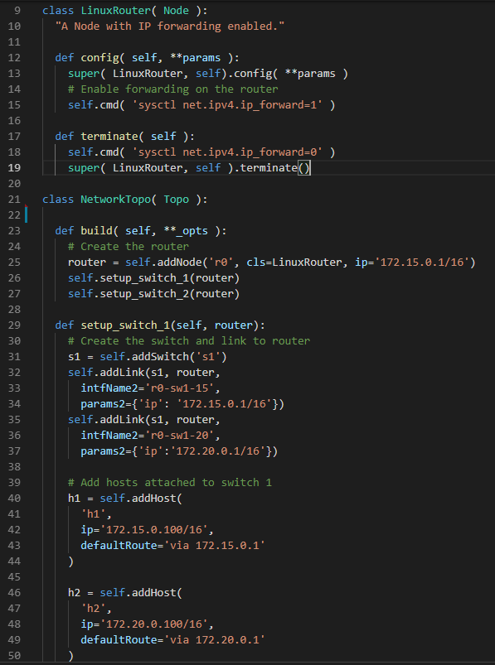
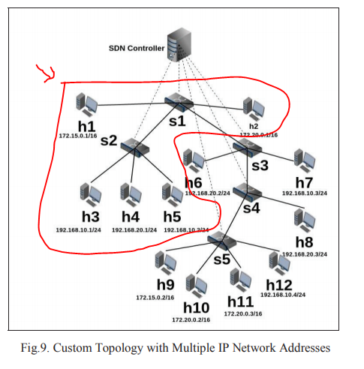
Mininet
What is Mininet?
Define custom network graphs
Each node is a virtual server
Each edge is routing policy
Run everything from single laptop
Time to create topologies
Fully Scriptable from Python
Previous research suggested that start times are exponential (red). Updated test results (blue) show environments scale linearly
Nate Bachmeier
TIM-7010 Computer Networking
August 18th, 2019 - NCU

