Slide 1
Database Quantum Supremacy
Nate Bachmeier
TIM-7020: Database and Business Intelligence
Section 2: Week 6: Cutting Edge Technology (2020.01.12)

Slide 2
Agenda
What is a quantum database?
… their strengths and disadvantages
… their evolution from NoSQL stores
… where they fit in the business environment (eventually)

Slide 3
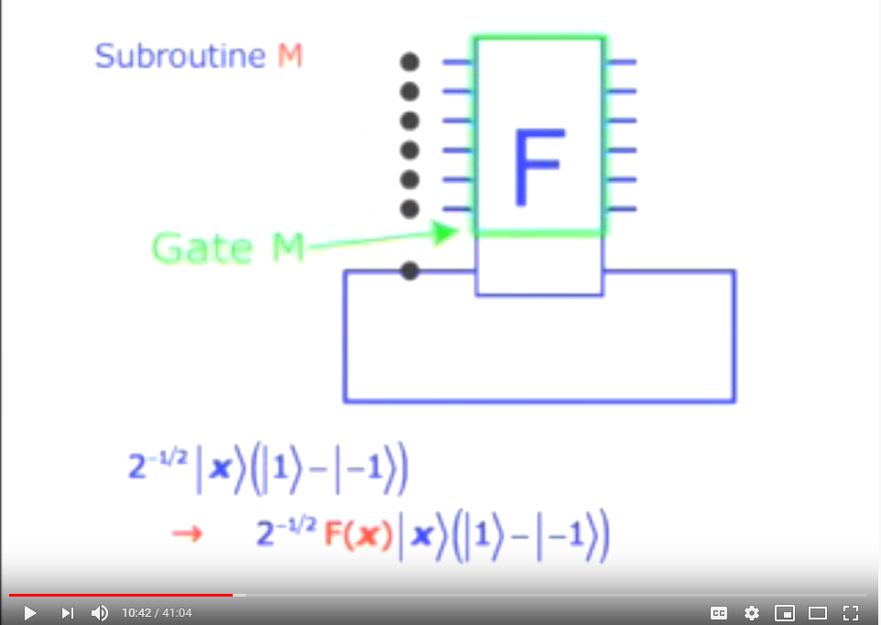
Section 1 Identify and Discuss

Slide 4
How did we get here?
If we asked the experts to describe the future
Era | Decade | Perspective
Vertical Scaled | 2000 | Relational stores all the way
 | 2010 | Mostly Relational / Little NoSQL
Horizontal Scaled | 2020 | Some Relational / Mostly NoSQL
 | 2030 | Mostly SQL+NoSQL / Little Quantum
Exponentially Scaled | 2040 | Mostly Quantum enabled SQL+NoSQL
Notes:
2000s…
If we had asked database administrators twenty years ago to predict the landscape of data management today, they would have likely pictured faster vertically scaled relational stores that enforce strong consistency and ACID compliance.
2010s…
When we asked the question a decade later, their answer would have changed include NoSQL technologies, like Mongo, as the emergence of ICBM (IoT, Cloud, Big Data, and Mobile) introduced specific challenges.
However, for many practitioners in 2010, these issues occurred in specific scenarios and were impractical to consider for daily workloads.
2020s…
Today, those same experts would agree that modern data architectures require combinations of technology that rely on various design trade-offs. For instance, in-memory NoSQL stores, such as ElasticSearch, allow for real-time data exploration versus Big Data platforms, such as Apache Hive, focus on longitudinal reporting through batch processing. A critical advantage of these NoSQL stores comes with their ability to horizontally scale-out capacity.
2030s…
However, several studies show that the volume of ICBM data is doubling every year (Mansouri, Nadjaran, & Buyya, 2017), which means that a linear solution is attempting to solve an exponential problem. Instead, a “fundamental paradigm shift ‘from 10x to 10^{x}’ needs to happen (Brandao & Kessler, 2019), like the one expected from quantum computing.”
Note: The qualitative measurements are for illustrative purposes of the evolution and not intended represent literal values.

Slide 5
What is database quantum supremacy
Quantum supremacy is “the point that a quantum processing unit (QPU) can perform a task better than a central processing unit (CPU)”
Similarly, Database Quantum Supremacy is a QDB exceeds the capabilities of mainstream databases
Build on the advancements of cloud native NoSQL solutions
Likely to be achieved within the next decade or so
Notes:
What is Supremacy
Quantum Supremacy occurs when a quantum processing unit (QPU) can perform a task more efficiently than a central processing unit (CPU). According to Brandao and Kessler (2019), the task does not need to be interesting or useful, and any proof of concept is enough. An extension of this idea resides in quantum database supremacy, which occurs when a quantum database can exceed the capabilities of classical databases.
Where is this likely to happen first
There are specific aspects of data management that are more likely to demonstrate this trait than others. These aspects tend to exist within matrix transformations (Brandao & Kessler, 2019), optimization problems (Harrison, 2020), and unsorted datasets (Grover, 1996). There are other areas, such as fetching an indexed row, that will be difficult to exceed classically designed systems because the algorithms are already extremely efficient and can rely on known insights into the data structure.
How could a hybrid strategy upfold
It would, therefore, stand to reason that hybrid CPU/QPU databases exist before native QPU technologies, as this improves economics for businesses that purchase these systems. Such a hybrid model would need to build on the advancements of cloud-native NoSQL solutions, and rely on the QPU for specific query acceleration scenarios.
What about GPU
Some scientific enterprises are already adopting Graph Processing Units (GPU) to accelerate their databases (Roozmeh, Torino, & Lavagno, 2017) (Marcin & Csillaghy, 2017), which introduces another dimension to the complexity of the procurement process. Both QPU and GPU technologies specialize in transforming matrices though they will have different performance and cost characteristics.

Slide 6
An (extremely) brief introduction to Quantum Computing
Qubit holds a Boolean that can be in a super position (both true and false)
Entanglement occurs when the value of a Qubit depends on the value of another Qubit
Hadamard Gates form circuits for the Qubit processing, like traditional logic gates
Amplitude as the entanglement is collapsed through the gates, probability distributions form allowing for fuzzy logic to predict the correct location
Notes:
What is a Qubit
A traditional computer operates on bits, which can hold a discrete value of either on or off. In contrast, a quantum bit or Qubit can hold a superposition that expresses two distinct probabilities of being on and off simultaneously. These probabilities can become entangled with other qubits where the resolved state of (A) cascades into (B) and (C).
How does entanglement work
Until that resolution occurs, these entangled values can act as wildcards that connect many potential futures. Consider the analogy that Alice has a 90% chance (amplitude) of paying Bill, and Bill might go to a movie will Charlie if Alice pays him—thus whether Charlie sees the movie with Bill is dependent (entangled) with Alice. This quantum circuit can be modeled with Hadamard Gates, which are analogous to logic gates on traditional hardware (Gueddana, Chatta, & Boudriga, 2010).
Bringing it back to data management
Similar problems occur in various data management scenarios, such as transactions, where the committed result becomes entangled with processing results. That is fundamentally different than traditional systems that rely on more acts such as locking and stacked storage constructs (Mansouri, Nadjaran, & Buyya, 2017). Through the elimination of blocking and I/O intensive actions, the database could potentially scale to higher numbers of transactions. Mansouri et al. highlight that a key driver of workloads into eventual consistency solutions is to lessen the influence of transaction locking. However, fundamentally reducing this characteristic could push adoption back into strongly consistent technologies.

Slide 7
Grover’s algorithm
Grover’s fast quantum mechanical algorithm for database search
Find a value from an unordered set in exactly sqrt(N) steps
Classical solutions have average time of N/2
Process
Initialize the probability evenly across all indexes
Iterative enumerate for sqrt(N) times
Use an oracle to provide hint
Boost the amplitude based on hints (entanglement)
Apply the hints through a Hadamard gate
Collapse the function and the resulting value is the index of record
Notes:
What is Grover’s Algorithm
Quantum database theory often builds on Grover’s fast quantum mechanical algorithm for database search (1996). His algorithm can find a specific value from an unordered set in exactly sqrt(N) steps. Consider the scenario where a million IoT sensors emit thousands of data points every few seconds continuously, resulting in 100 trillion records in the data lake. If the analysis needs to filter on an unindexed attribute, then the query could take a very long time to complete. However, the application of a Grover search would reduce the search space to only ten million steps, a large but manageable feat.
What is an analogy for Grover
To understand Grover’s search, imagine trying to find a ball contained within one of ten identical boxes. Initially, there’s a ten percent chance of randomly selecting the correct choice. Then each box is shaken horizontally, causing boxes 3, 6, and 9 to rattle, so the amplitude (probability) increases for these boxes. Next, the boxes are shaken vertically and at various angles. As each iteration completes, more evidence accumulates that the probability that, e.g., box 7, is the correct instance.
How does this apply to data management
Similar problems exist in distributed storage scenarios, where user records reside on arbitrary nodes. Today, retrieving those values requires a distributed hash algorithm or a secondary index (Mansouri, Nadjaran, & Buyya, 2017). However, it can be economically prohibitive to index every value, which further leads to the need for discovery after creation. Specific technologies, like Apache Lucene, expose term indexing to improve the costs and performance of these scenarios today, though the deployment relies on an entirely separate second data store. In a quantum-accelerated system, a redundant copy and the synchronization overhead does not need to exist.

Slide 8
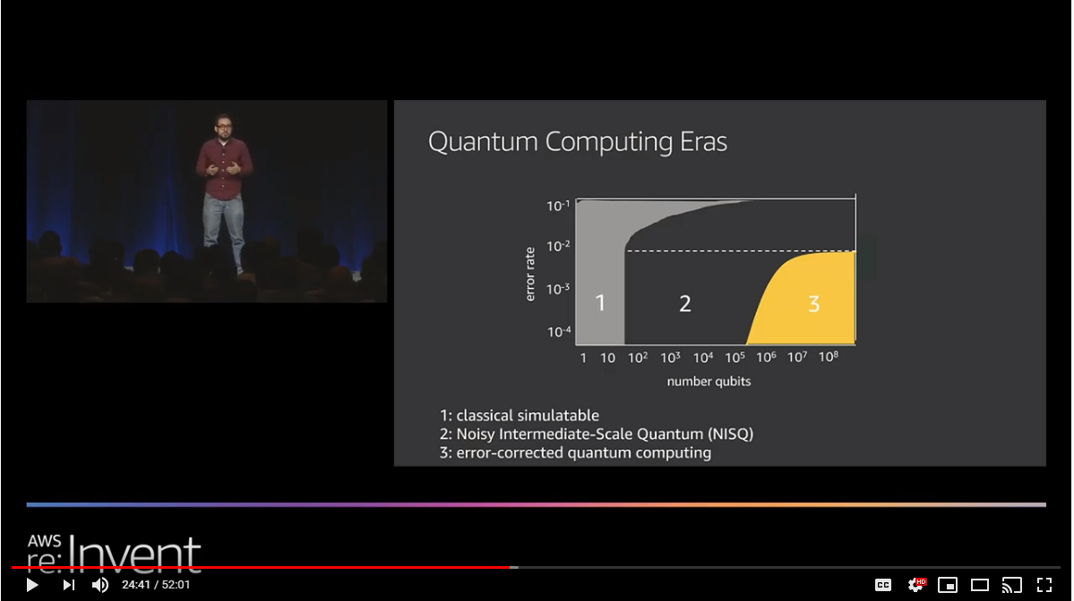
Section 2 Strengths and Weakness

Slide 9
Advantages of Quantum Datastores
The primary strength of quantum comes with its ability to solve linear algebra and similar matrix multiplication problems
These efficient solutions can restore natural joins, a missing aspect of many NoSQL systems
Entanglement evolves the design of transactions reducing the gap between ACID and BASE technologies
Notes:
What do we really gain from quantum
The primary strength of quantum databases comes in their ability to encode sequences of potential future values. Consider an aggregation pipeline that sequences a series of qubits such that various permutations are solvable in parallel. This optimization reduces the I/O requirements on the query engine and provides a richer experience for the customer. Another scenario might involve fuzzy matching and approximation, like neural networks today, to make recommendations or propose classifications. In contrast, typical data machine learning workflows are complex due to the decoupling of storage and machine learning platform. This separation creates the need for extract-transform-load systems that can become unwieldy (Harrison, 2020). Another benefit comes from the performance improvements through Grover searches, which could allow natural joins could become part of the NoSQL toolset, further reducing the learning curve for traditional SQL users.

Slide 10
Disadvantages of Quantum
Presently only available in mathematical proofs
Qubit noise and error rates limit practical use cases
A full implementation is unlikely to happen for several years
Hybrid systems will come first
Amazon Bracket (QaaS)
Azure Quantum
Mainstream NoSQL systems are cheaper
Cloud Resources are pennies per hour
Reaching supremacy means it has become better
Notes:
Limitation: It’s mostly theoretical
A critical hindrance to quantum databases is they only exist in mathematical proofs, and it will be several years before these concepts become mainstream, despite Quantum as a Service (QaaS) solutions like Azure Quantum and Amazon Bracket. According to Brandao (2019), many non-trivial algorithms need between 100 to 500 qubits, assuming error-free storage and mitigate random bit flipping similar to traditional random-access memory (RAM). Redundant encoding schemes, such as using three bits and a majority-wins voting protocol, cause the algorithms to need 0.5 to 1.0 million qubits. There are also limitations in simulation, as the entanglement of long qubit strings requires enormous amounts of storage, e.g., 50 qubits equals 16 petabytes.
Limitation: Existing technologies are better understood
Aside from the technical challenges of building a reliable QPU, there is also the need for this technology to reach supremacy. Data scientists can perform approximations and machine learning offline at relatively low costs, and GPU acceleration cards are readily available today. Public cloud providers, such as Amazon Web Services (AWS), support a notion of Elastic Interference Interfaces (EII) that can dynamically add and remove GPUs to hosted databases to meet demand fluctuations. Engineering teams also lack the training to take advantage of complex physics algorithms and providing that education would remove focus from the organization’s core competencies. Database administrators are also squeezing comparable performance from their system by optimizing indexes and data partitions around business questions. For instance, analyzing a trillion sensor data points is less of an issue if the storage grouped those values into time-ordered blocks—allowing for exclusion of entire ranges during the pre-query phase.

Slide 11
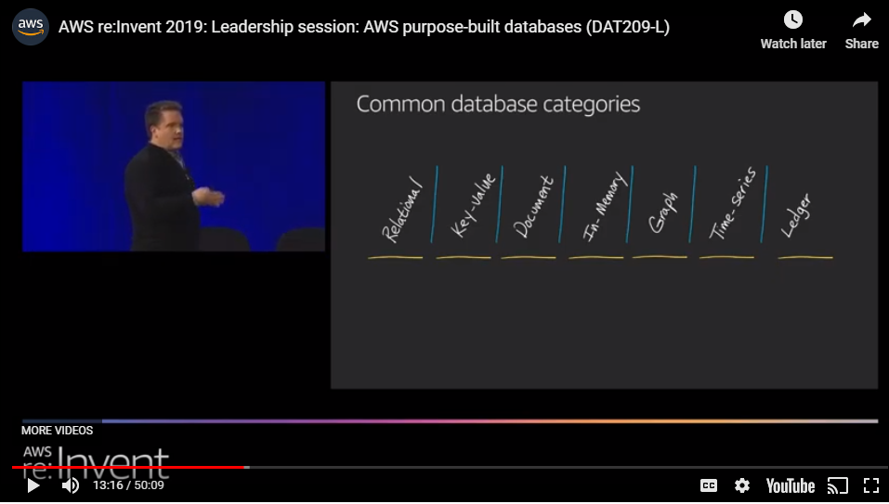
Section 3 Evolution the technology

Slide 12
Evolution from Relational to Quantum
Evolving into the cloud
Reducing operational overhead
Improving agility
Evolving from SQL to NoSQL
Reaching “Internet Scale” and increased availability
Reducing failure time
Evolving from Generic NoSQL to Purpose Built Systems
Control over optimization point (e.g., latency over costs)
Heterogeneous technologies with complex replication
Evolving to Quantum
Removing the multi-store strategies, focus on single store supporting multiple use-cases
Notes:
Evolving into the cloud
Before many organizations can consider their quantum-accelerated implementation, they first need to migrate from traditional relational stores, such as SQL Server and Postgres, toward more cloud-native solutions. Network administrators have some freedom to the degree of their cloud adoption investment size. For instance, SQL Azure and Amazon Aurora present a NewSql interface that is familiar to engineering teams and offers capabilities such as automated fail-over and increased availability. Other organizations might choose to make a larger investment and select a NoSQL technology, such as Apache Casandra, Azure CosmosDb, or Amazon DynamoDB. These technologies make specific trade-offs in terms of throughput over functionality, like natural joins and built-in aggregations.
Evolving into Purpose Built NoSql
As the organization’s data management strategy matures, it will discover that different workloads require different technologies to gain specific optimizations. For example, the business uses a graph database, like Apache Tinkerpop, to store and query relationship information from a known point. However, the data structures would not be efficient for holding time-series information about those entities and would need a separate time-series store like Influx or OpenTSDB. Since the graph queries start from a known vertice, a term store like Apache Solr or Elastic Search can hold metadata about the graph entities. Answer extraction to common business questions into OLAP stores provides a consistent interface for visualization tooling. Though many OLAP technologies, such as Amazon Redshift, batch retrieval, so the Redis cache clusters need to hold temporal data, such as results for the website’s homepage for additional performance.
Finally throwing most of it away with Quantum
At this point, the organization takes a step back at the vast collection of built-for-purpose tooling they need to support and asks, what’s one more? Now they are ready for quantum. Joking aside-- the vision of quantum is that it reduces the need for these decoupled tooling. For instance, Grover searches remove the need to maintain separate term stores. The benefits of segmenting ACID-compliant NewSql from BASE-optimized NoSql are limited to ‘schema-on-read’ versus ‘schema-on-write.’ As the number of distinct technologies decreases, the operational and capital costs (OPX/CAPX) improve, allowing the organization to become more agile.

Slide 13
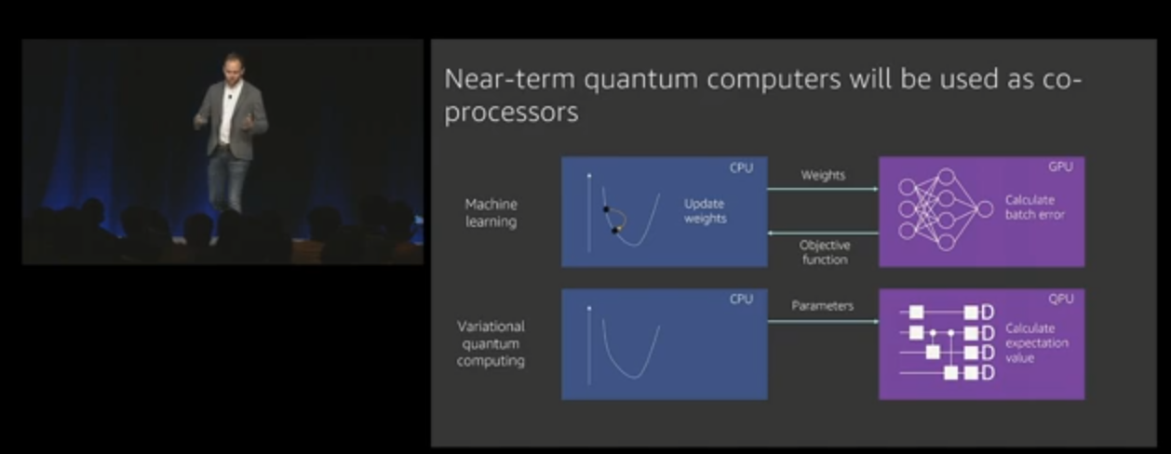
Section 4 Evaluate for Business Adoption

Slide 14
What business challenges does this (eventually) address
Optimization Problems
Machine Learning
Fuzzy Logic
Acceleration of matrix computation
Notes:
What does Quantum Databases Solve for Business
When academia first proposed neural networks, the business community did not understand the practical application of these systems. Since then, neural networks have touched every aspect of our online lives. Quantum databases will have a similar impact on society as they address optimization problems, machine learning, fuzzy logic, and become a standard server acceleration card. As quantum technologies mature, they will grow as cloud-native extensions of the enterprise environment and unlock new insights through massively parallel processing that powers rich business intelligence platforms. For instance, Brandano (2019) describes the challenges with modeling nitrogen processes as they contain over seventy states that High-Performance Computing (HPC) clusters can only approximate. As that estimations improve those manufacturing processes, gain huge efficiencies reducing global energy waste. Other success stories are waiting to be discovered across all industries and workloads.

