Slide 1
Threat Prevention and Response Solutions
Nate Bachmeier TIM-7030: Managing Risks, Privacy, and Security
July 5th, 2020

Slide 2
Industry Tools to Prevent Intrusion and Malware
Vendor | Strengths | Weaknesses
Cisco | Market leader in network technologies | Expensive Requires multiple consoles
Intel Security (McAfee) | Easy to configure Extensive signature collection Low false positive rates | Requires multiple management platforms Not strong enterprise presence Rebranding risk as business priorities shift
IBM | Very low false positives Included in many IBM server purchases Quality reporting | Not a strategic supplier The incomplete solution requires third-party extensions
Gartner Magic Quadrant states these are the market leaders
Cisco
McAfee
IBM

Slide 3
Access-Control Matrix
A matrix of subjects (rows) and objects (columns) that describes their rights
Defines explicit transition states that are hard to verify holistically
Only primitive permissions available
Use cases
Simple finite systems
Server Management Software
Notes:
An access control matrix encodes the system in terms of the subjects (users, nodes, …) with their explicit access to various system objects. One of the challenges with this model is that the matrix can grow exponentially large, making it challenging to scale across enterprise environments. Instead it might exist for more simple scenarios like partitioning resources and then allowing a singleton executive control over that chunk.

Slide 4
MACL vs DACL vs RBAC
Control | Description | Use Case
Mandatory Access Control | Security labels and policy | Broad administrative policy (e.g., tags)
Discretionary Access Control | Rights controlled by the object owner | User permission on personal files
Role-Based Access Control | Permission align with the person’s job | Standardizing access to distinct job requirement instead of N-groups
Notes:
MACL
Administrators often want the simplicity of placing labels on subjects within the system, then stating anything with the label will must meet a constraint. For example, a database might be labeled as ‘secure-system’ and only other network components with the same property can connect. This results in a rigorous collection of rules that can transcend technology stacks.
DACL
If the administrator must control every policy decision down to the individual object, that would be tedious and often its acceptable to offload that responsibility to the object owner. For example, a user created text file might be sensitive or benign – only that person would have the appropriate insights. So, for these situations allowing the user to make these sharing decisions is often the right choice at the leaf levels.
RBAC
The DACL model can become overly complex when considering how files should be shared across multiple groups. For instance, the finance team can edit the report versus the support team can read it. Modeling these organizational distinctions is further complicated by political shifts. Instead, the control can be scoped more broadly to the different roles – developer, support staff, etc.

Slide 5
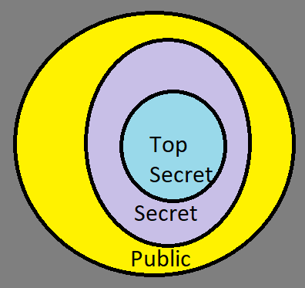
Bell-La Padula vs Biba Integrity Model
Model | Focus | Approach | Use case
BLP | Confidentiality | Read Down/Trust Up | Audit logs
Biba | Integrity | Trust Down/Read Up | ClocksGPS
Notes:
BLP
BLP introduce the notion of security isolation with rings (e.g., public -> secure -> top secret), as a mechanism for mainframe terminal isolation. The basic idea is that anyone can write anywhere, but no one can a more classified document, but anyone could write a secure document. This model is referred to read/down trust/up because the process can read anything lower and must trust the things above it.
This can be useful for scenario like audit log collection or voting systems, where the individual data should not be accessible. However those systems that are “in the know” can push down aggregate statistics or anonymized data sets for less trusted environments to process.
BIBA
Has the exact opposite requirement where the system wants to have a trusted base system that anyone can read. These scenarios appear frequently with sensors where no risk exists for reading the clock, but manipulating the shared resource would be disastrous.

Slide 6
Lipner Model
Adapted BLP and Biba for commercial use
Includes ideas that
Not all users are programmers
Programs will have errors
Managers and auditors need access to system state
Use cases
UNIX-like permission systems
User / Kernel separation
Notes:
BLP and Biba show the duality of integrity and confidentiality in system controls. However, many applications need both characteristics and at variable levels of enforcement.
For instance, modern operating systems have different rings of trust for user and kernel mode applications. Some kernel structures are highly sensitive and must be hidden, while others are more like the clock.
Lipner understood that commercial applications would need both, so he formalized a model that works in multi-tenant environments. Another advantage of this system is that it can hand application faults because it has mitigations against programming faults and other negligence scenarios.

Slide 7
Clark-Wilson Model
Formalizes notion of information integrity
Delineates certification and enforcement rules
Prevents against corruption from fault or maliciousness
Use cases
Data management systems
Notes:
For decades prior, data management systems could prevent corruption scenarios by parity bits and similar strategies. However, there was weak controls against ensuring that the user can update a specific row in the table. Clark-Wilson formalized these concepts to protect against both erroneous behavior and malicious intent.
Another contribution comes from separating certification from enforcement – as this allows separation of duties between subsystems, resulting in more extensible and scalable systems.

Slide 8
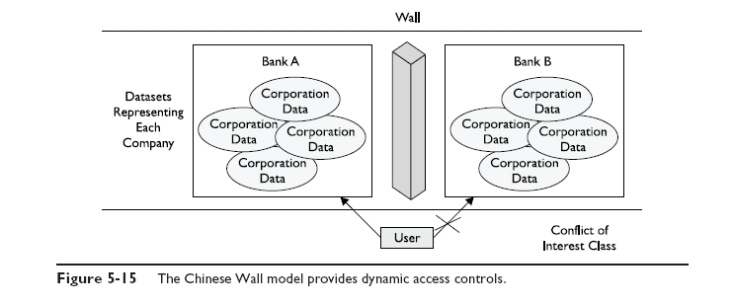
Brewer-Nash (Chinese Firewall)
Protects against conflicts of interest
Subject can access at-most-one from a given set
Use cases
Quota systems (check-out any single machine)
Notes:
In many situations there’s a need for limiting conflicts of interest, such as a lawyer cannot represent both parties in the same lawsuit. Another scenario might involve quota systems, which allow e.g., the user to access any single virtual machine but not a specific instance. These setups allow the flexibility of the subject to make the best personal choice without impacting others within the ecosystem.
Image from: http://www.personal.psu.edu/staff/g/m/gms/sp09/456/chinese-wall.jpg

Slide 9
Graham-Denning Model
Builds on previous ACL models
Uses the tuple { subject, domain }
Use cases
Web browser and process isolation
Notes:
There are scenarios where two or more processes execute under the identity of a given user, but still need isolation from each other. For example, web browsers need to allow the user to look at various website without malicious content corrupting the user state.
Other domains can exist such as master/slave process relationships as a mechanism of preventing erroneous application faults.

Slide 10
References
See speaker note section.
Notes:
Bellovin, S. (2005, September 12). Access Control Matrix. Retrieved from Columbia University: https://www.cs.columbia.edu/~smb/classes/f05/l03.pdf
Brame, D. (2019, December 27). The best-hosted endpoint protection and security software for 2020. Retrieved from PC Mag: https://www.pcmag.com/picks/the-best-hosted-endpoint-protection-and-security-software
Brewer, D., & Nash, M. (1989). The Chinese Wall Security Policy. IEEE Symposium on Security and Privacy, 206-214. doi:https://doi.org/10.1109/SECPRI.1989.36295
Conrad, E. (2017). Eleventh Hour CISSP. Retrieved from https://www.sciencedirect.com/book/9780128112489/eleventh-hour-cissp
Gartner. (2015, November 16). Magic Quadrant for Intrusion Prevention. Retrieved from Cisco: https://www.cisco.com/c/dam/assets/global/CN/partners/pdfs/Gartner2015_Magic_Quadrant.pdf
Jeannot, F. (2019, February 2). Brewer and Nash security model. Retrieved from Fanck Jeannot: https://www.franckjeannot.com/brewer-and-nash-security-model/
Kennedys, S. (2016). Lipners Model. Retrieved from Catholic University: https://www.coursehero.com/file/39442960/Lipners-Modelpdf/
Massachi, S. (u.d.). Bell-LaPadula. Retrieved from Computer security - a brief look: https://sites.google.com/site/cacsolin/bell-lapadula
Techotopia. (2016, October 27). The mandatory, discretionary, role, and role-based access controls. Retrieved from Techotopia: https://www.techotopia.com/index.php/Mandatory,_Discretionary,_Role_and_Rule_Based_Access_Control
tehjk723. (2016, May 2). Week 7 Graham-Denning access control model. Retrieved from WordPress: https://tehjk723.wordpress.com/2016/05/02/week-7-graham-denning-access-control-model/
Wright, C. (2008). The IT regulatory and standards compliance handbook. How to Survive Information Systems Audit and Assessments, 73-114. doi:https://doi.org/10.1016/B978-1-59749-266-9.00005-9
Young, B. (u.d.). Foundations of computer security. Retrieved from University of Texas: https://www.cs.utexas.edu/~byoung/cs361/lecture24-4up.pdf

