Slide 1
Mobile Device Management
Nate Bachmeier
TIM-7030: Managing Risks, Privacy and Security
July 19th, 2020

Slide 2
Agenda
Introduction
Risks Associated with Mobility
Frameworks and Tooling
Conclusion
Legal Frameworks

Slide 3
How Did We Get Here?
Master Data Management
Sharing business entities to enable business workflows
Traditional environments are highly controlled
Client Management Tooling (CMT)
Administrators have full control
Modern environments include BYOD
System and Data owner are different people
Ecosystem becomes highly diverse
Partially trusted clients becomes the norm
Information becomes portable and decentralized
Mainframes and Data warehouses
Centralize single sourced
Easy to manage through boarder security

Slide 4
General Data Protection Regulations
European law that gives users control over their information
Establishes mandatory fines for negligently handling information
Users own the data
Right to be Forgotten
Right for digital copy

Slide 5
Financial and Internal Process Controls
Sarbanes Oxley (SOX) created in 2002
Response to several high-profile scandals
WorldCom
Enron
Creates a strong emphasis on
Process Auditing
Internal Controls
Enforceable through
Holding executives personally accountable
Monetary fines for non-compliance
Shareholders discard investments

Slide 6
Health Care Privacy Reform
1996
Health Insurance Portability and Accountability Act (HIPAA)
Protects patient confidentiality
Modernizes Health Care Information Flow
2009
Health Information Technology for Economic and Clinical Health Care (HITECH)
Removes several loop-holes in HIPAA
Highly incentives adoption of Electronic Medial Records (EMR)
2014
Omnibus Rule
PHI is confidential for 50years after death
Exceptions center around billing scenarios

Slide 7
Educational Privacy
Family Education Rights and Privacy Act enables parents/guardians
Access to child assessment records
Ability to amend files
Control over disclosure
Establishes the minimum bar for student data
Individual states can increase requirements
Penalties can include
Loss of federal funding
Civil suits on behalf of the student

Slide 8

Legal Mandates Themes
User privacy is critical design aspect
User privacy is very broad
This creates a challenges between
Personalization
Functionality
User Privacy

Slide 9
Common Risks with Mobile Devices
Maliciousness
Stolen Device
Mobile Malware and Vulnerabilities
Advanced Threats
Negligence
Lost Device
Multiple Usage Context
User Behavior and Monitoring

Slide 10
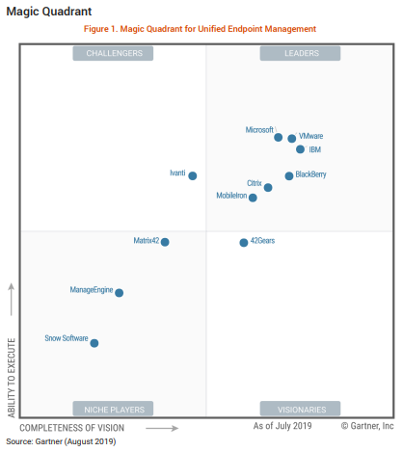
Addressing these issues
Unified Endpoint Management
Data Context Isolation
Remote Locking/Wiping
Patch Management
Asset Inventory Reporting
Desired Configuration Management

Slide 11
Mobile Device Management Solutions
Manufacturer | Product | Description | Strengths | Weaknesses
Microsoft | Azure Intune | Azure Based solution that manages 100M+ devices of all shapes and sizes | Tight integration into Microsoft ecosystem (e.g., ConfigMgr) | No ChromeOs or 3rd party identity support
MobileIron | Unified Endpoint Management | Cloud solution for segmenting and protecting corp data on personal devices | High quality support | Inconsistent release schedules and slowing vendor support
IBM | Enterprise Mobility Management | Integration for MaaS360 with Watson | Lots of templates and SaaS make easy to get started | MaaS360 has limited international availability
VMWare | Workspace ONE | AirLift platform has strong focus on migrating from legacy client management to UEM | Partnership with Microsoft. Device Compliance focus | Requires purchasing virtualization and UEM licenses

Slide 12
Building a Privacy First Framework
Organizational Commitment
Policy Enforcement
Systems of Oversight
Executive sponsorship and accountability
People, Processes, and Products
Internal stakeholders and external auditors can inspect the process
Service Transparency
Individuals can assess the data collection details and intent
Remediation Strategies
Policy violations can be corrected through repeatable processes

Slide 13
Integrating Existing Risk Management Frameworks
Identity
Plan
Act
Check
What is the threat or issue
Determine appropriate responses
Implement the plan
Confirm the response is sufficient

Slide 14
Key Take-aways and conclusions

Slide 15
References…
See speaker notes.

