Slide 1
Importance of Risk Mitigation Strategies
Nate Bachmeier TIM-7030 Managing Risks, Security and Privacy
June 14th, 2020

Slide 2
Agenda
Identification
Risks for Privacy and Security
Value of Data
Mitigation
Assessment Processes
Security Roles
Relationship between Roles
Roles
Strategies to Manage those Risks

Slide 3
Process for categorizing risks for privacy and security
Risks come from negligent and malicious sources
These sources can be further subdivided into people, processes, and products
Cyber crime has similar categories of Advanced Persistent Threats (APT), scammers, and malware
Strategies need to exist for each bucket that feeds into a coherent corporate strategy
Risks
Cyber Risk
Cyber Crime
APT
People
Processes
Products
Scammers
Malware

Slide 4
Value of Corporate Data and Cost of Ownership
Data
Risk
Confidentiality
Value
Availability
Business Intelligence
Platform Differentiation
Protections
Authentication
Authorization
Auditing
Integrity
Encryption
Malicious Theft
Tampering
Hardware Failures (DR)
Marketing
Empowering Users
Negligent Permissions
Service Failures (DOS)
Erroneous Deletion
Regulatory Risks
Corruption
Privacy Challenges

Slide 5
Process of Risk Assessment or Analysis
Numerous Risk Assessment Frameworks exist
NIST Cybersecurity Framework
ISO 27000
Risk Management Framework
COBIT v5
Each follows a feedback loop that
Identifies assets and attack vectors
Prioritizes addition of controls
Evaluates mitigation effectiveness
Determine if appropriate reduction occurred
Plan
Do
Check
Act

Slide 6
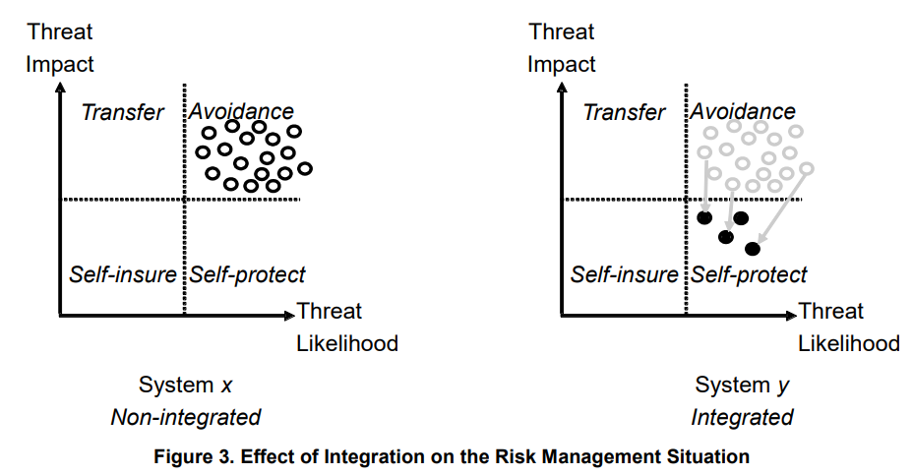
Risk Management Strategies and Countermeasures
Transfer
Purchase Insurance
Avoidance
Reduce feature set
Disallow market access
Self-Insure
Cash reserves
Options contracts
Self-Protect
Internal systems and processes
Notes:
Graph from:
Richard Baskerville, Frantz Rowe, and François-Charles Wolff. 2018. Integration of Information Systems and Cybersecurity Countermeasures: An Exposure to Risk Perspective. SIGMIS Database 49(1), 33–52. https://doi.org/10.1145/3184444.3184448.

Slide 7
Information Security Roles
Role | Description
Chief Risk Management Officer | Reduces the blast radius of process failures across the corporate strategy
Chief Information Security Officer | Accountable for the corporate strategy protecting business assets
Director of Information Security | Defines the policies that enact the corporate security strategy
Director of Privacy and Compliance | Ensures following of regulatory requirements around the handling of data
Security Engineer | Validates the implementation details of the security policy decisions
Everyone Else | Interacts with those policies and is critical for their successful execution

Slide 8
Relationship between these
C-Level
Set the vision and broad strategy
Determine acceptable cultural norms
DIS and Security Engineers
Deliver incremental aspects of the vision
Minimize Risks
Users
Maximize Convenience
Do what they understand, not what you expect
C-Level
User
Implementor
Notes:
Busby JS, Green B, Hutchison D. Analysis of Affordance, Time, and Adaptation in the Assessment of Industrial Control System Cybersecurity Risk. Risk Analysis: An International Journal. 2017;37(7):1298-1314. [https://doi-org.proxy1.ncu.edu/10.1111/risa.12681](https://doi-org.proxy1.ncu.edu/10.1111/risa.12681). [AnalysisAffordanceControlSystem.pdf](AnalysisAffordanceControlSystem.pdf).

Slide 9
Conclusion and References

