Slide 1
NCU-Cares Project Proposal: Reducing Police Violence
Nate Bachmeier TIM-7101: Statistics for Technology Leaders September 20th, 2020
Notes:
Good afternoon, I am Nate Bachmeier. Today I will be reviewing the project proposal for NCU-Cares (NCU-C) next initiative, reducing police violence in America. This presentation embodies eight long weekends of looking at this problem from a unique perspective.

Slide 2
Agenda
Plan
Evaluate
Data Analysis
Deliver
Implementation
Methodology
Problem Statement
Hypothesis
Data Requirements
Output Inference
Research Limitations
Monitoring Progress
Reflect
Learnings
Conclusions
Notes:
The agenda for this discussion will cover the planning, evaluation, and delivery of an effective strategy to address this issue. Then we will conclude with reflections into learnings, future topics, and conclusions. Each of these sections will further drill into a collection of relevant subtopics.

Slide 3

Planning
Problem Statement
Hypothesis
Data Requirements
Methodology

Slide 4
Problem Statement
Death of George Floyd raises several questions about police violence
Are minorities disproportionally victims
Does mental health play a role in the killings
These issues are not race issues, but human issues
Should we defund police and invest into civil services
Should we consider alternative responses

Slide 5
Research Questions and Hypothesis
R1: Does race or sanity explain the data set
R2: Are these even-handed or racially profiled
R3: Does another variable better explain the data set

Slide 6
Data Collection and Requirements
Washington Post Data Set
Demographics (age, race)
Context (armed, sanity)
Location (city, state, date)
Statistical Effect and Power
Effect measures the magnitude of a phenomenon
Power is the ability to distinguish an actual effect versus chance
There needs to be sufficient samples for cross-comparisons

Slide 7
Methodology
Descriptive statistics…
Produce a contextually sensitive summary
Highly dependent on inputs and curation
Quasi-experimentation is…
Standard process for social welfare policy research
Compares two populations to measure effect of a variable
Considering variables…
Race: Black, Hispanic, White
Sanity: Acting normal (TRUE), Encountering health crisis (FALSE)
Provocation: Unarmed, Armed, Has Gun/Knife (subset of armed)

Slide 8

Evaluating
Data Analysis
Outcome Inference
Research Limitations

Slide 9
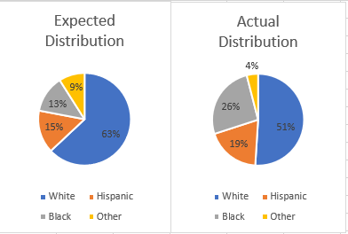
Data Analysis
Data Analysis
Race
Weapon
Location
Unarmed
Gun/Knife
Raw Counts
Demographics
Pop. Adjusted
Sanity
Age
Armed

Slide 10
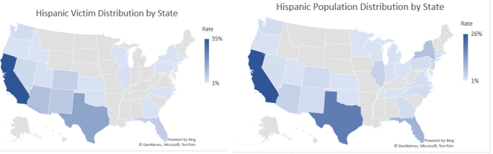
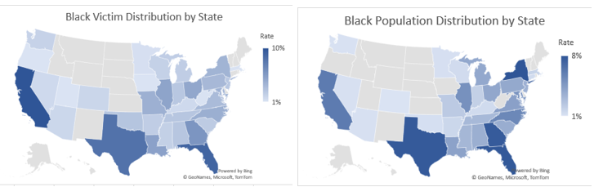
Outcome Inference
R1 does race or sanity explain data?
No, the effect size is too small
R2 are these even-handed or racially profiled deaths?
No, after demo. adj. populations are consistent
R3 should we evaluate a different aspect? Yes!

Slide 11
Limitation Identification
Source | Description
Internal Threat | Contamination by the research team
External Threat | Contamination outside of the study’s controls
Statistical Conclusion Validity | Results are arbitrary or non-reproducible
Construct Validity | Controls are not enforceable or consistent

Slide 12

Strategy Delivery
Strategy Implementation
Monitor Progress

Slide 13
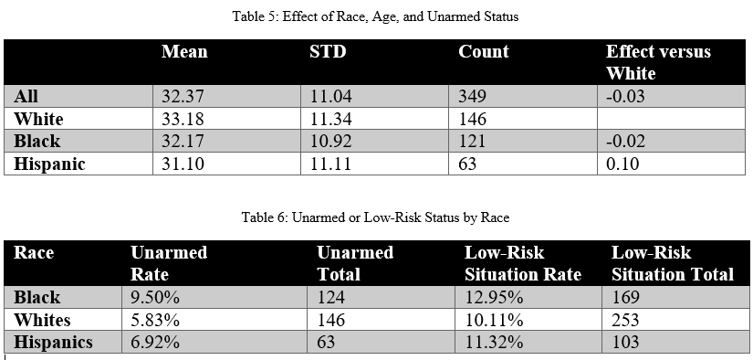
Implementing Plan
120
1000
53 Million
Unarmed Victims
Civilian Fatalities
Police Interactions

Slide 14
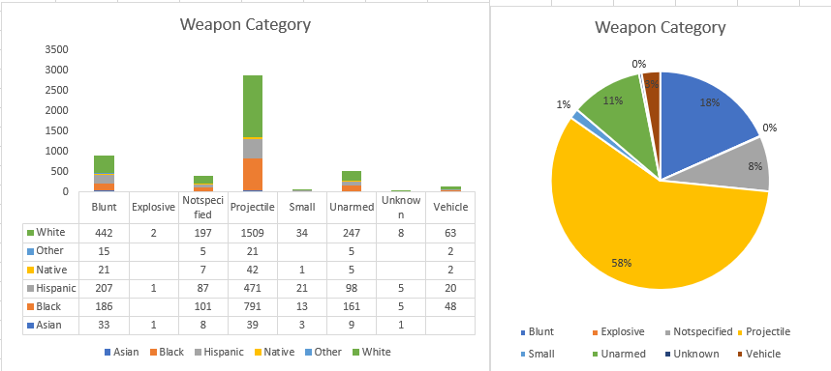
Monitoring Progress
Police Safety
Fewer Killings
Civilian Safety
Fewer Killings

Slide 15

Reflecting
Learnings
Conclusions
References

Slide 16
Learnings and Future Considerations

Slide 17
Conclusion

Slide 18
References
See speaker notes.
Notes:
References
BJS. (2015, October). Contacts between police and the public. Retrieved from Bureau of Justice Statistics: https://www.bjs.gov/content/pub/pdf/cpp15_sum.pdf
BLM. (2020, May 30). #DefundThePolice. Retrieved from Blac Lives Matter: https://blacklivesmatter.com/defundthepolice/
Census Bureau. (2019). Quick facts. Retrieved from United States Census Bureau: https://www.census.gov/quickfacts/fact/table/US/PST045219
Crary, D., & Morrison, A. (2020, June 11). Black Lives Matter goes mainstream after Floyd's death. Retrieved from AP News: https://apnews.com/347ceac3ea08978358c8c05a0d9ec37c
DeCarlo, M. (2018). Principles of Sociological Inquiry: Qualitative and Quantitative Methods. Blackstone Textbooks. Retrieved from https://scientificinquiryinsocialwork.pressbooks.com/chapter/12-1-experimental-design-what-is-it-and-when-should-it-be-used/
Donovan, C. (2016, August 30). Power and effect size. Retrieved from YouTube: https://www.youtube.com/watch?v=9LVD9oLg1A0
KBP. (2020, August 11). Police shootings database. Retrieved from Killed By Police: https://killedbypolice.net/
KilledByPolice. (2020, August 2). Police Shootings Database. Retrieved from Killed By Police: https://killedbypolice.net/
Lamb, H., Weinberger, L., & DeCuir, W. (2014). The police and mental health. Psychiatric Services, 53(10), 1266-1271. doi:https://doi.org/10.1176/appi.ps.53.10.1266
Lyons, R. (1984, October 30). How the release of mental-patients began. Retrieved from The New York Times: https://www.nytimes.com/1984/10/30/science/how-release-of-mental-patients-began.html
McCaskill, N. (2020, July 16). Trump has tried to make 'Black Lives Matter' a partisan issue. A federal agency says it is not. Retrieved from Politico: https://www.politico.com/news/2020/07/16/trump-special-counsel-black-lives-matter-366177
Nix, J., Campbell, B., Byers, E., & Alpert, G. (2017, February 8). A bird's eye view of civilians killed by police in 2015. Criminology and public policy, 16(1), 309-340. doi:https://doi-org.proxy1.ncu.edu/10.1111/1745-9133.12269
NLEOMF. (2019, April 10). A year-by-Year breakdown of law enforcement deaths throughout U.S. history. Retrieved from National Law Enforcement Officers Memorial Fund: https://nleomf.org/facts-figures/officer-deaths-by-year
Parker, R. (1993). Threats to the validity of the research. Rehabilitation Counseling Bulletin, 36(3), 130-138. Retrieved from https://search-ebscohost-com.proxy1.ncu.edu/login.aspx?direct=true&db=eric&AN=EJ458938&site=eds-live
Pierce, A. (2019, October 25). Whose lives matter? The black lives matter movement and the contested legacy of philosophical humanism. Journal of Social Philosophy, 51(2), 261-282. doi:https://doi-org.proxy1.ncu.edu/10.1111/josp.12305
Smith, C. (2020, Spring). Blue lives matter versus black lives matter: beneficial social policies as the path away from punitive rhetoric and harm. Vermont Law Review, 44(3), 463-291. Retrieved from https://search-ebscohost-com.proxy1.ncu.edu/login.aspx?direct=true&db=ofs&AN=143809860&site=eds-liv
Trump, D. (2020, July 1). @realDonalTrump. Retrieved from Twitter: https://twitter.com/realDonaldTrump/status/1278324681477689349
United Health Foundation. (2017). Public health funding. Retrieved August 16, 2020, from America's health rankings: https://www.americashealthrankings.org/explore/annual/measure/PH_funding/state/ALL
Washington Post. (2020, August 1). Data police shootings. Retrieved from GitHub: https://github.com/washingtonpost/data-police-shootings/commit/2ea87a4ed725b164be1489878e20827fb5944d1b

