Slide 1
NCU-Cares Project Proposal: Reducing Police Violence
Nate Bachmeier TIM-7101: Statistics for Technology Leaders September 20th, 2020
Notes:
Good afternoon, I am Nate Bachmeier. Today I will be reviewing the project proposal for NCU-Cares (NCU-C) next initiative, reducing police violence in America. This presentation embodies eight long weekends of looking at this problem from a unique perspective.

Slide 2
Agenda
Plan
Evaluate
Data Analysis
Deliver
Implementation
Methodology
Problem Statement
Hypothesis
Data Requirements
Output Inference
Research Limitations
Monitoring Progress
Reflect
Learnings
Conclusions
Notes:
The agenda for this discussion will cover the planning, evaluating, and delivery of an effective strategy to address this issue. Then we will conclude with reflections into learnings, future topics, and conclusions. Each of these sections will further drill into a collection of relevant subtopics. Without further ado, let us jump into the details.

Slide 3

Planning
Problem Statement
Hypothesis
Data Requirements
Methodology

Slide 4
Problem Statement
Death of George Floyd raises several questions about police violence
Are minorities disproportionally victims
Does mental health play a role in the killings
These issues are not race issues, but human issues
Should we defund police and invest into civil services
Should we consider alternative responses
Notes:
In May, the death of George Floyd is rising to the national debate stage questions around civil rights and police violence. This event triggered a series of global protests that are pointedly asking why a disproportionate people of color are falling victim. These discussions propose various solutions, such as defunding the police to increase investments into mental health and civil services. Meanwhile, others argue that these actions are the result of a few bad apples and not evidence of systematic bias.
It is challenging to understand these perspectives because the problem has become highly partisan, and neither side willing to objectively look at the data. Anytime that preventable death occurs, emotions run high, and both parties approach the issue with skepticism, pain, and frustration.
NCU-C, our politically neutral non-profit foundation, believes that the truth rarely lives at the extreme and generally lies in the middle. If we remove the politics and assess the situation, only then can an efficient strategy be formed, striking at the heart of the problem.

Slide 5
Research Questions and Hypothesis
R1: Does race or sanity explain the data set
R2: Are these even-handed or racially profiled
R3: Does another variable better explain the data set
Notes:
The central idea of the Black Lives Matter (BLM) movement is that police violence disproportionally victimizes people of color (Pierce, 2019). Assuming this statement is true, to what extent is this true? Data collectors are quick to cite that “black people represent 24% of all police killings, despite being only 13% of the population (KilledByPolice, 2020).” However, can these two data points be uniformly compared? Alternatively, does a demographically adjusted accounting provide greater insight into racial injustice hotspots? Processes that can uncover such disparity could lead to laser-focused policies versus broad debate on the national stage. These actions would not represent the final stage but do offer a path for measurable short term improvements.
Another central theme is that shifting funding from police departments to civil services will change the risk calculus. Assuming this statement is true, to what extent? What portion of the population is going through a medical crisis during their time of demise? Until examining the data, it can be challenging to separate the norm from media machines selling advertising. Perhaps a more accurate perspective is that scenario-specific categories exist, and additional training programs can target those situations, reducing the mortality rates.

Slide 6
Data Collection and Requirements
Washington Post Data Set
Demographics (age, race)
Context (armed, sanity)
Location (city, state, date)
Statistical Effect and Power
Effect measures the magnitude of a phenomenon
Power is the ability to distinguish an actual effect versus chance
There needs to be sufficient samples for cross-comparisons
Notes:
There are numerous strategies for approaching this problem with varying levels of sophistication and planning. One standard solution is to perform statistical application analysis on the Washington Post’s police shootings data set (Nix, Campbell, Byers, & Alpert, 2017). This data source contains demographic, location, and contextual information on all publicly known fatalities of police violence between 2015 to the present (Washington Post, 2020). While there are several limitations to this aggregate feed, it provides a best-intentioned sampling of the broader population.
For an experiment to be successful, it needs to have sufficient power to measure the effect in question. Several knobs feed into the power of an investigation, such relaxing the confidence interval, using parametric statistics, converting to a one-tail model, increasing the samples, or adjusting the sensitivity (Donovan, 2016). Choosing an appropriate value is scenario-specific and can be somewhat of an art form.

Slide 7
Methodology
Descriptive statistics…
Produce a contextually sensitive summary
Highly dependent on inputs and curation
Quasi-experimentation is…
Standard process for social welfare policy research
Compares two populations to measure effect of a variable
Considering variables…
Race: Black, Hispanic, White
Sanity: Acting normal (TRUE), Encountering health crisis (FALSE)
Provocation: Unarmed, Armed, Has Gun/Knife (subset of armed)
Notes:
There are multiple strategies for determining which variable has more effect on a situational outcome. News articles typically approach the problem by looking at the raw descriptive statistics, such as the ratio of victims experiencing a mental crisis. A challenge with this solution is that the telemetry only communicates what happened, not why. Consider the extreme example that one hundred percent of all police violence within a given community is against a specific race. While this scenario immediately raises questions around racial profiling, it should also invite a discussion around the diversity of the inflicted population.
DeCarlo (2018) states that quasi-experiments are particularly useful in social welfare policy research (see chapter 12.2). Under a quasi-experiment, the researcher team does not use random assignment and instead looks at different populations. This method could be highly effective for examining the impact of both race and sanity variables. For example, how does race impact police violence when comparing diverse metropolitan areas (e.g., Chicago and Detroit) to homogenous cities (e.g., Brandsen or Sioux Falls)? Likewise, for every dollar that Nevada spends on public health, Alaska invests six (United Health Foundation, 2017). From examining these groups that are both similar and complete opposites, it should lead to a quantitative sense of the underlying effect of these variables.

Slide 8

Evaluating
Data Analysis
Outcome Inference
Research Limitations

Slide 9
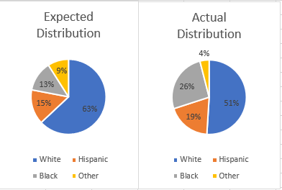
Data Analysis
Data Analysis
Race
Weapon
Location
Unarmed
Gun/Knife
Raw Counts
Demographics
Pop. Adjusted
Sanity
Age
Armed
Notes:
The research team began with a collection of descriptive statistics, comparing various pivots to ensure sufficient coverage exists for the chosen tests. During this step, it became necessary to reduce the exploration to only focus on Black, Hispanic, and White people because other groups lacked the required representation.
Our first test plots the distribution by race for all victims between 2015 to 2019. These results are compared with diversity statistics according to the U.S. Census over that same period. From this view, a skew becomes evident, which aligns with the position of many peaceful protesters. Next, the data set partitioning along various lines, such as demographics, location, and weapon status, allows for comparisons between populations. Nix et al. use a similar approach in their article for Nature, cited over 200 times. The contexts of their analysis were reproducible, and our team confirmed their insights, such as Black-people are twice as likely as White-people to die unarmed (5 vs. 10%).

Slide 10
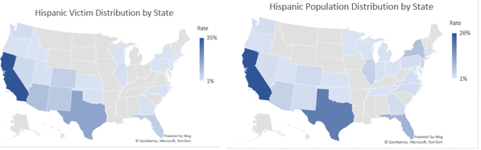
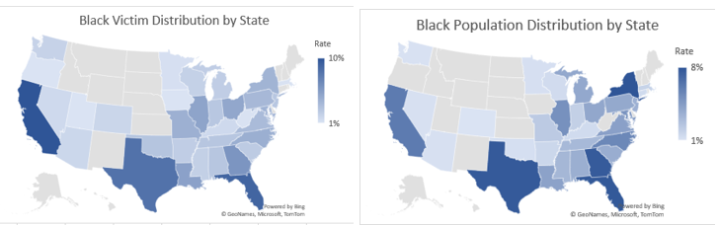
Outcome Inference
R1 does race or sanity explain data?
No, the effect size is too small
R2 are these even-handed or racially profiled deaths?
No, after demo. adj. populations are consistent
R3 should we evaluate a different aspect? Yes!
Notes:
According to the data analysis results, a skew exists, disproportionately impacting Black people more than White people. However, the research team asks if this is the entire story? Instead of treating America as a single homogeneous group, an experiment maps the victim into their states. One observation from this perspective is that death rates for people of color generally aligns with the diversity ratios of that state. For example, in Texas, 39% of fatalities are Hispanic compared to representing 34% of the residents. The ratios are maintained across all states, suggesting that these are even-handed, not racial profiling. The distinction comes from national statistics, including areas that lack minorities among the residents, such as Montana and Utah.
Going back to the research questions, R1 does race or sanity explain the data set? No, using DeCarlo’s proposal, the statistical effect of these feature values is relatively small across the population assessments. Within the full paper are details on these groupings by age, race, sanity, weapon type, and location. R2 are these even-handed or racially profiled? Once the results are demographically adjusting to the population of an individual state, then the rates are consistent. The national skew originates from the inclusion of rural areas that are void of either victims or minorities. R3 should a practical strategy focus on a different aspect of the problem? Absolutely; there is another piece to this puzzle that needs to be front-and-center.

Slide 11
Limitation Identification
Source | Description
Internal Threat | Contamination by the research team
External Threat | Contamination outside of the study’s controls
Statistical Conclusion Validity | Results are arbitrary or non-reproducible
Construct Validity | Controls are not enforceable or consistent
Notes:
There are several challenges and limitations to studying police brutality. First, national officials do not require official reporting of statistics. Without a federally managed database, researchers must rely on open-source datasets. Information for this study comes from the Washington Post, and they rely on third-party media coverage. This game of telephone could be missing data points or erroneously reporting features. Since data is relatively sparse, some pivots and comparisons lack large sample sizes. Further, given the small statistical effect between different partitions of that grouping, underlying trends may be missing from the analysis.
Other potential issues could have arisen from incorrectly chosen statistical tests or inconsistent control processes during the exploration phase. While the researchers follow due diligence and best effort, this study has finite time and resources.

Slide 12

Strategy Delivery
Strategy Implementation
Monitor Progress

Slide 13
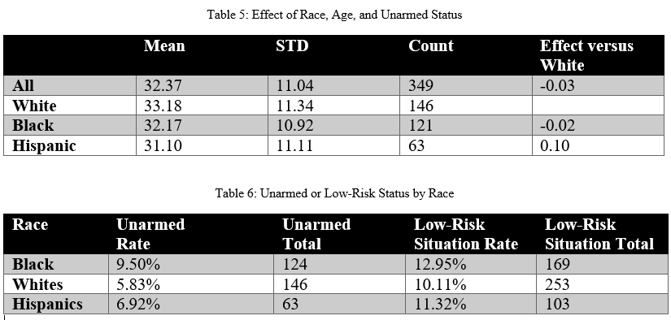
Implementing Plan
120
1000
53 Million
Unarmed Victims
Civilian Fatalities
Police Interactions
Notes:
NCU-C predicts that improvements to police safety will translate into a reduction of civilian fatalities. This strategic position differs from other mainstream views around police funding, mental health facilities, and racial inequality.
There are fifty-three million people who interact with the police each year (BJS, 2015). Annually, 167 (+/- 6) officers and 66 (+/- 16) unarmed civilians die during these altercations (NLEOMF, 2019). These situations must introduce a wide range of emotions and hostility, which creates challenges while balancing the safety of officers and civilians. NCU-C should invest additional resources into exploring solutions to reduce this friction. For instance, of the incidents that result in death, 76% (3853 of 4937) involve the suspect having a weapon (see Figure 6).
Training and procedures could exist to address these scenarios in a manner that improves the probability of a peaceful resolution. While it does not address all the concerns, this is a significant source of police brutality. Specifically, the unarmed and unspecified groups need further consideration to reduce the loss of life for these subgroups. However, it might be impossible to eliminate due to this group representing 0.00002% (119 of 53 million) interactions per year.

Slide 14
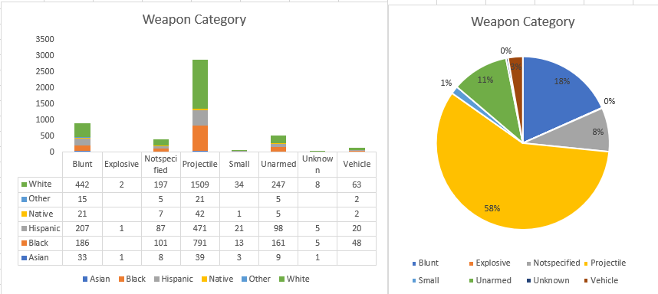
Monitoring Progress
Police Safety
Fewer Killings
Civilian Safety
Fewer Killings
Notes:
The conversation of police brutality needs to consider the safety of all participants, including both law enforcement and civilians. Progression into that journey is monitorable through descriptive statistics of injury and death on either side. These metrics should feed into one another, acting as a catalyst to reciprocally accelerate the other. For instance, a police officer that is confident of returning home should be less dispositioned to draw a weapon. With fewer fatal alternations, incentives exist for suspects to surrender versus resisting arrest. As these challenges de-escalate, the number of unarmed civilian deaths should naturally diminish into the smaller population.

Slide 15

Reflecting
Learnings
Conclusions
References

Slide 16
Learnings and Future Considerations
Example Quotes
Black people were 24% of those killed despite being only 13% of the population
Unarmed Blacks are twice as likely as Whites to be the victim
Challenges and clarifications
What population and context is chosen
Those that context address the underlying questions
Notes:
Researchers and media sources use the Washington Post’s data to quantify the racial basis of law enforcement. Their observations become statistical statements such as “unarmed Blacks are twice as likely as Whites to be the victim (Nix, Campbell, Byers, & Alpert, 2017).” Another frequently cited metric that “Black people were 24% of those killed despite being only 13% of the population (KBP, 2020).” Over 200 publications that reference Nix et al.’s paper in Nature magazine and Google returns 7.7 million results for the second quote. When NCU-C set out to assess the problem, the initial expectation was to find racial inequality and bias decisions against people of color. While both conclusions are true, that does not appear to be the entire story about police brutality in America.
Fundamentally these differences are a matter of contextualizing what filtration and inclusion encroach into the calculus. For example, a previous statement claims, “13% of the population,” referring to the national total. While this summation is perfectly valid, it will come to a different outcome than a demographically adjusted formula. Similarly, subtle changes to other data partitioning schemes can vastly influence conclusions. These distinctions make it critical that researchers clarify the methodology and strategy to their approach. Without that information, the results can arbitrarily confirm any outcome and prevent the formation of strategic decision making.

Slide 17
Conclusion
Police brutality is a partisan issue
Is it racist or bad apples
Should we defund the law enforcement
How do we fix the system
The issues are even-handed and consistent
Address the safety of law and citizens
Reduce the armed stand-offs
Work collaboratively on both sides to end this war
Notes:
NCU-C set out to understand police brutality and ways to reduce the frequency. This issue is highly partisan with questions surrounding all aspects of the problem. The distortion between these perspectives asks if the victimization is racially motivated or a few bad apples. Either way, a solution needs to exist for eliminating these scenarios, such as defunding the police and investing in mental health and civil service programs. After analyzing the data from the Washington Post, the organization suggests that investment into law and civilian safety is the best path forward. As the armed stand-offs decrease, so would this relatively small population of people die during police altercations. This approach does not discredit alternative solutions; however, according to this data set, those efforts do not address underlying challenges.

Slide 18
References
See speaker notes.
Notes:
References
BJS. (2015, October). Contacts between police and the public. Retrieved from Bureau of Justice Statistics: https://www.bjs.gov/content/pub/pdf/cpp15_sum.pdf
BLM. (2020, May 30). #DefundThePolice. Retrieved from Blac Lives Matter: https://blacklivesmatter.com/defundthepolice/
Census Bureau. (2019). Quick facts. Retrieved from United States Census Bureau: https://www.census.gov/quickfacts/fact/table/US/PST045219
Crary, D., & Morrison, A. (2020, June 11). Black Lives Matter goes mainstream after Floyd's death. Retrieved from AP News: https://apnews.com/347ceac3ea08978358c8c05a0d9ec37c
DeCarlo, M. (2018). Principles of Sociological Inquiry: Qualitative and Quantitative Methods. Blackstone Textbooks. Retrieved from https://scientificinquiryinsocialwork.pressbooks.com/chapter/12-1-experimental-design-what-is-it-and-when-should-it-be-used/
Donovan, C. (2016, August 30). Power and effect size. Retrieved from YouTube: https://www.youtube.com/watch?v=9LVD9oLg1A0
KBP. (2020, August 11). Police shootings database. Retrieved from Killed By Police: https://killedbypolice.net/
KilledByPolice. (2020, August 2). Police Shootings Database. Retrieved from Killed By Police: https://killedbypolice.net/
Lamb, H., Weinberger, L., & DeCuir, W. (2014). The police and mental health. Psychiatric Services, 53(10), 1266-1271. doi:https://doi.org/10.1176/appi.ps.53.10.1266
Lyons, R. (1984, October 30). How the release of mental-patients began. Retrieved from The New York Times: https://www.nytimes.com/1984/10/30/science/how-release-of-mental-patients-began.html
McCaskill, N. (2020, July 16). Trump has tried to make 'Black Lives Matter' a partisan issue. A federal agency says it is not. Retrieved from Politico: https://www.politico.com/news/2020/07/16/trump-special-counsel-black-lives-matter-366177
Nix, J., Campbell, B., Byers, E., & Alpert, G. (2017, February 8). A bird's eye view of civilians killed by police in 2015. Criminology and public policy, 16(1), 309-340. doi:https://doi-org.proxy1.ncu.edu/10.1111/1745-9133.12269
NLEOMF. (2019, April 10). A year-by-Year breakdown of law enforcement deaths throughout U.S. history. Retrieved from National Law Enforcement Officers Memorial Fund: https://nleomf.org/facts-figures/officer-deaths-by-year
Parker, R. (1993). Threats to the validity of the research. Rehabilitation Counseling Bulletin, 36(3), 130-138. Retrieved from https://search-ebscohost-com.proxy1.ncu.edu/login.aspx?direct=true&db=eric&AN=EJ458938&site=eds-live
Pierce, A. (2019, October 25). Whose lives matter? The black lives matter movement and the contested legacy of philosophical humanism. Journal of Social Philosophy, 51(2), 261-282. doi:https://doi-org.proxy1.ncu.edu/10.1111/josp.12305
Smith, C. (2020, Spring). Blue lives matter versus black lives matter: beneficial social policies as the path away from punitive rhetoric and harm. Vermont Law Review, 44(3), 463-291. Retrieved from https://search-ebscohost-com.proxy1.ncu.edu/login.aspx?direct=true&db=ofs&AN=143809860&site=eds-liv
Trump, D. (2020, July 1). @realDonalTrump. Retrieved from Twitter: https://twitter.com/realDonaldTrump/status/1278324681477689349
United Health Foundation. (2017). Public health funding. Retrieved August 16, 2020, from America's health rankings: https://www.americashealthrankings.org/explore/annual/measure/PH_funding/state/ALL
Washington Post. (2020, August 1). Data police shootings. Retrieved from GitHub: https://github.com/washingtonpost/data-police-shootings/commit/2ea87a4ed725b164be1489878e20827fb5944d1b

