Slide 1
SonarQube vs. CodeGuru
Nate Bachmeier
TIM-7140: Software Engineering
March 14, 2021

Slide 2

What is the problem
Developers require static analysis tooling
Its challenging to support multiple toolsets
Need a mechanism to choose the best option

Slide 3
How would you execute the study
Build
Build baseline from the F-Droid projects
Transform
Convert the unstructured recommendations into signatures
Analyze
Compare the tool sets signature trees
Produce
Generate recommendations from tools across the project corpus

Slide 4
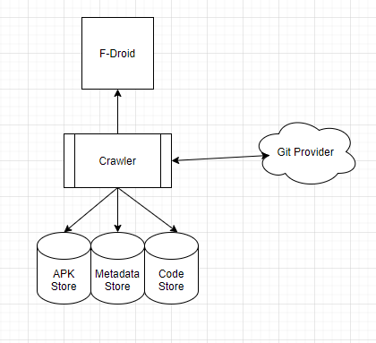
Creating the baseline

Slide 5
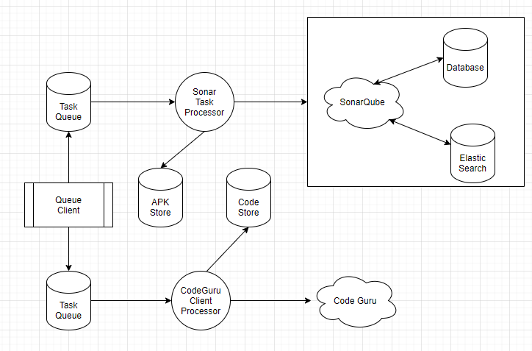
Generate Recommendations

Slide 6
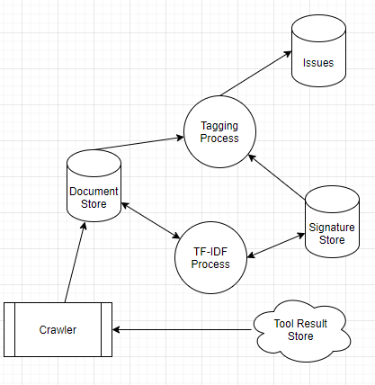
Generating the Signatures

Slide 7
Assessing the signature trees
Issues
Security
Performance
Reliability
Resource Leak
Missing Permission
Unused Variable
Duplicate Operation
Unsafe Action
Bad Catch

