Slide 1
Constructive Research Problems
Nate Bachmeier TIM-7241: Constructive Research Design May 9th, 2021 Northcentral University

Slide 2
Agenda
Examine Constructive Research Studies
Analyzing E-Cigarette Conversations (2021)
Intelligent Dispatch of Photovoltaic Systems (2021)
Power to the People (2018)
Conclusion
References

Slide 3
Analyzing E-Cig Conversations (2021)
Problem
28.9% of Indonesians are smokers
Smoking burdens its public health care
Require mechanisms for monitoring e-cig sentiment
Research Questions
Can we perform real-time analysis via Twitter
Can we determine why someone is in Favor/Against e-cigs
Notes:
Analyzing E-Cigarette Conversations on Twitter (2021)
Problem
Indonesia has one of the highest smoking populations (28.9%). Regulators and lobbyists are concerned that e-cigarettes (e-cigs) will increase this value and create burdens on its public health care system. They need to understand the population’s perspective on the safety, taxation, and regulation of e-cigs.
Approach
Kaunag et al. (2021) approach this problem by training classification models with 8079 tweets discussing vaping (e.g., Favor or Against smoking). Each tweet goes through a pre-processing pipeline to remove punctuation, duplicate words, and common keywords (e.g., lol). After cleaning, the messages are tagged and clustered. Finally, they tease out the user’s decision rationale using topic modeling (e.g., NMF and LDA).
Conclusion
The authors deliver a process for analyzing e-cig sentiment and rationale from a corpus of tweets. These insights enable regulators to track changes in public opinion and design more effective marketing campaigns. For instance, when Muhammadiyah fatwa approved e-cigs usage, an enormous influx of support occurred. Future efforts could also consider demographic information or consider additional social media sources.

Slide 4
Intelligent Dispatch of Photovoltaic (2021)
Problem
Distributed energy producers periodically fail
Smart grids mitigate these with batteries
Power companies pre-emptively charge before an outage
Data necessary to predict an outage is non-standard
Research Questions
Can we centralize the sensor data
Can we make accurate predictions with it
Notes:
CPS Applications with Case Study of Intelligent Dispatch of PV (2021)
Problem
Distributed energy grids encounter intermittent failures, causing service disruptions in the availability of electricity for customers. Smart grids mitigate these issues with battery backup systems that collect and discharge energy as necessary. Like other commodities, electricity has a variable spot price that reacts to supply and demand changes. Power companies need to forecast these disruptions and charge their batteries before the prices jump. It is challenging to build these predictive capabilities due to the limited standardization of sensor data.
Approach
Riggs et al. (2021) construct an ingestion pipeline that pushes sensor data into a NoSQL database. This approach simplifies data centralization by relaxing schema at write requirements. Next, an Extract-Transform-Load (ETL) process normalizes the instrument readings for multiple machine learning algorithms. The authors compare the performance and accuracy of Markov models, Genetic algorithms, and Support Vector Machines (SVM). This step requires simulating traffic and replaying historical data.
Conclusion
The author’s system can more gracefully handle disruptions and more accurately decide when to charge the batteries. Administrators that deploy this solution would save 2.7% ($10k daily savings assuming $370k expenses). Deploying the system more broadly would further reduce costs and volatility for all participants within the swarm.

Slide 5
Power to the People
Problem Statement
Villages in India can purchase prepaid solar energy
These services are typically cheaper than gas
However, customers are not onboarding into the program
Research Questions
Why are customers using the cheaper renewable energy
Can we modify the service or component to increase access
Notes:
Power to The People (2018)
Problem
Villages in rural India can use prepaid electricity services to power their home. These businesses typically use solar energy to deliver a more economical solution than natural gas and kerosene. Solar farms have a high initial cost and require sufficient customer adoption to justify the investment. However, customers are not onboarding into the program at a fast enough pace. These challenges risk the sustainability of local providers. Simmonds (2021) wonders what prevents people from using cheaper and renewable electricity? Are these defects in the service offering or superficial usability issues?
Approach
Simmonds (2021) traveled from Finland to rural India. After arriving, she interviewed several villagers and observed their service interactions. She noticed that most neighborhoods would recruit a child to update the system. This decision stems from the control panel using English, a foreign language to many. The panel also contains too many irrelevant technical details. Meanwhile, the most common action, checking the remaining balance, was hidden.
The author built a prototype replacement using a mobile phone and a discarded cereal box. She revised the display to show the remaining balance by default and moved the technical details into an advanced menu. Next, she translated all instructions into Hindi.
Conclusion
Simmonds re-assessed the usability of her control panel. The villagers welcomed the design changes and found onboarding into the prepaid electric services easier. She states that these updates were discoverable only after monitoring the customers. This strategy represents a stark difference from previous designers, who built for their local norms.

Slide 6

Alignment Evaluation
 | E-Cig (2021) | Electric Distr. (2021) | Power People (2018)
Problem | Regulating electronic cigarettes – 29% of Indonesia smokes | Forecasting failures in electric power grids | Indian Villagers have low adoption rates of Prepaid electric
Questions | Are people for/against regulation? What drives those positions? | How can we centralize data from heterogeneous sensors Can we build a forecasting model to predict reliability issues | Why aren’t they using the service Are there design changes to promote engagement
Study Purpose | Understand the impact of increased taxes and marketing | Improve efficiencies in the spot market and reduce customer costs | Prepaid electric business models require “enough” customers to be sustainable. Can we make service more popular
Notes:
All three articles begin with a clear problem statement and then explain the impact of not solving the issue.
For example, in “Power to the People,” the solar farms need to increase adoption rates or risk going out of business. Simmonds approaches the problem by meeting with customers and examining how they use the service today. Those interactions drive conversations around product requirements that ultimately promote engagement.
Similarly, regulating e-cigarettes among a heavy smoking population is challenging. Kaunang et al. (2021) devise an effective mechanism for monitoring real-time sentiment. This capability enables the regulators to be agile and target their advertising campaigns.
Finally, forecasting electricity service disruptions reduces price shocks, making the spot market more efficient.
These stories draw a straight line between the business challenges, questions, and the purpose of their study.

Slide 7
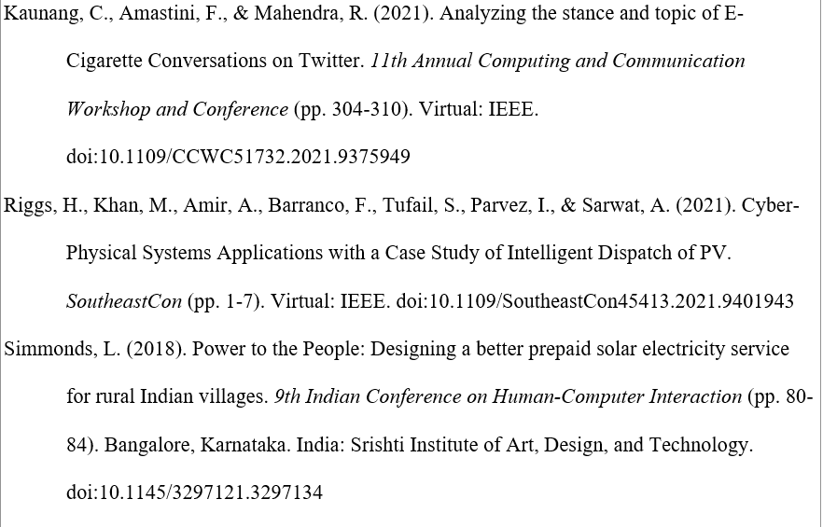
Conclusions and References

