Slide 1
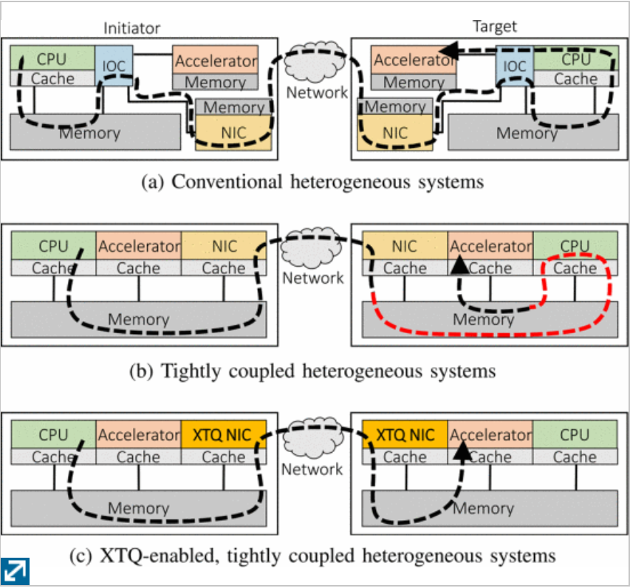
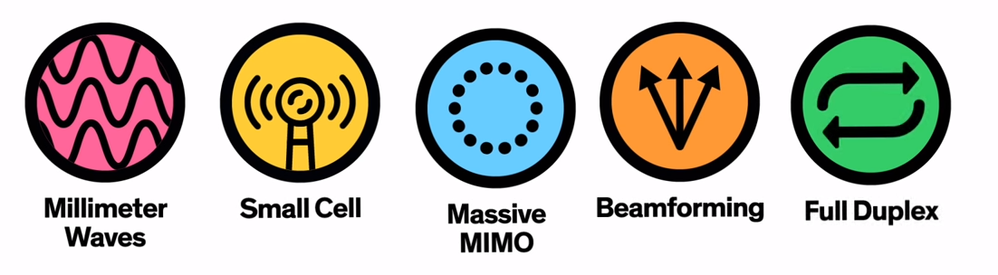
5G: Emerging Technology
What would you do with 1 TiB/s connectivity?
What is 5G?
The fifth generation of wireless technology brings the capabilities for billions of devices to access network speeds of 1TiB/s.
It will enable smart ubiquitous connectivity and networking.
Autonomous Vehicles
Broadcast safety information to other vehicles’ AI
Enrich local sensor information with rich web services
Enhance supply chain efficiency with troves of metrics
How Does 5G Work?
1. The frequency range is increased to support billions of simultaneous devices
2. MM waves are fragile over long distances, lots of small repeating stations are deployed
3. Base stations increase from 12 to 100 antennas
4. With so many antennas broadcasting in all directions leads to interference – thus beam directly at the device
5. Communication channels are full duplex for improved efficiency
Share device resources
Tap into remote memory and accelerator cards– at comparable speeds to local resources.
Expanding device capabilities to virtually unlimited in size.
Consume dozens of GPUs to generate photorealistic real time graphics for gaming

