Slide 1



Are Code Examples on an Online Q&A Forum Reliable?
A Study of API Misuse on Stack Overflow
Tianyi Zhang¹, Ganesha Upadhyaya², Anastasia Reinhart³, Hridesh Rajan², Miryung Kim¹
¹University of California, Los Angeles
²Iowa State University
³George Fox University

Slide 2
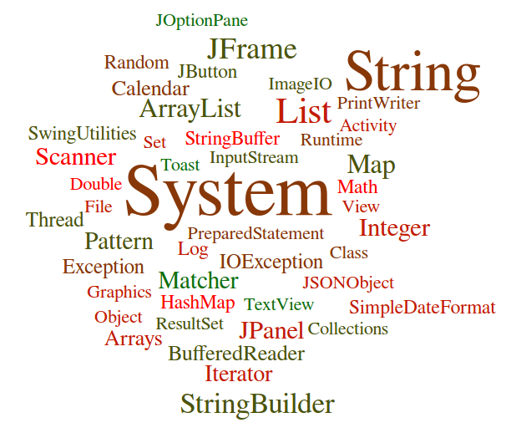

Using APIs properly is a key challenge in Programming
e.g., Java APIs

Slide 3



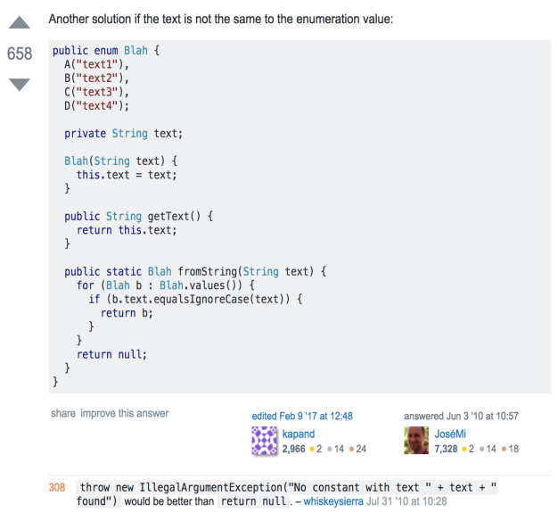


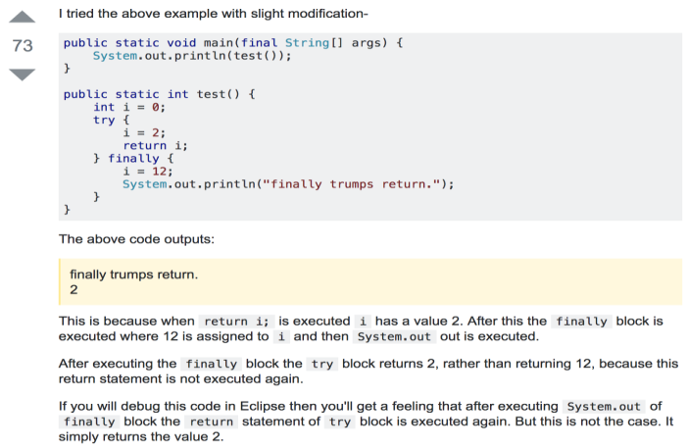
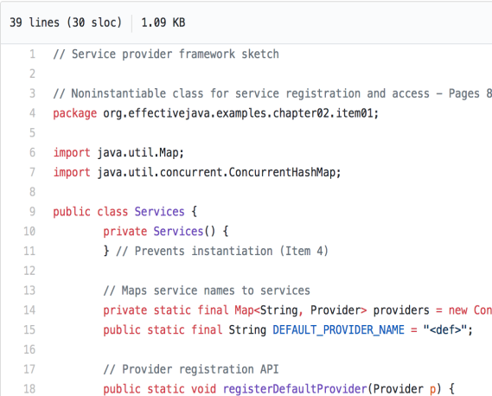
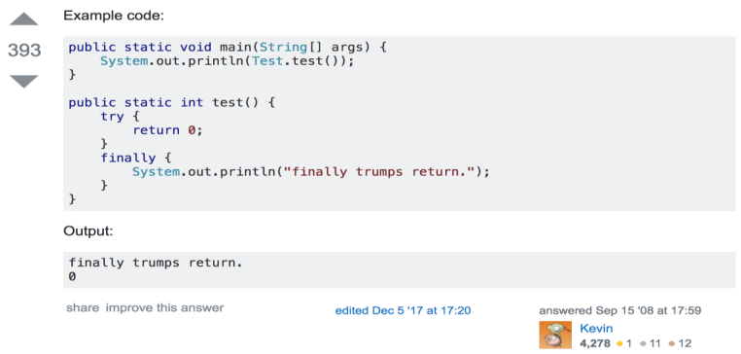
The Status Quo of Learning APIs
Developers often search online for code examples to learn APIs [Sadowski et al. 2016]

Slide 4
The Limitation of Online Code Examples
Programmers can only inspect a handful of search results. [Brandt et al., 2009, Starke et al., 2009, Duala-Ekoko and Robillard, 2012]
Individual code examples may suffer from
insecure coding practices [Fischer et al., 2017]
unchecked obsolete usage [Zhou and Walker, 2016]
low readability [Treude and Robillard, 2017]

Slide 5
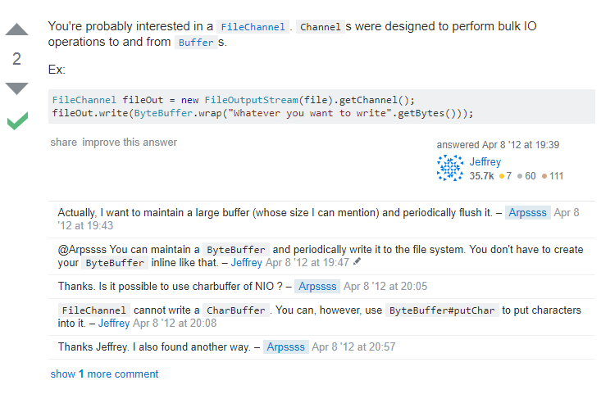
“How do I write data to a file using FileChannel?”

Slide 6
“How do I write data to a file using FileChannel?”

Slide 7
“How do I write data to a file using FileChannel?”
This example forgets to close the FileChannel object properly.

Slide 8
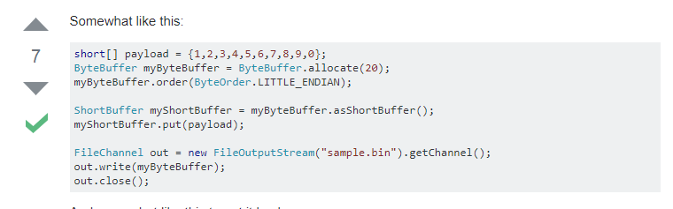
“How do I write data to a file using FileChannel?”

Slide 9
“How do I write data to a file using FileChannel?”
This example forgets to handle potential exceptions such as IOException and FileNotFoundException.

Slide 10
Research Questions
RQ1. Is API misuse prevalent on Stack Overflow?
RQ2. Are highly voted posts more reliable?
RQ3. What are the characteristics of API misuse?

Slide 11
Outline
Problem Statement
API usage mining from 380K Java Projects on GitHub
An Empirical Study of API Misuse on Stack Overflow

Slide 12
API Usage Mining from GitHub
We contrast SO snippets with API usage patterns mined from 380K GitHub projects.
1
2
Frequent Sequence Mining
Code Search
Program Slicing
Call Sequence Extraction
380K Java Repositories on GitHub
API usage patterns
Structured API call sequences
3
SMT-based Guard Condition Mining

Slide 13
Insight 1: Mining a Large Code Corpus
Our code corpus includes 380K GitHub projects with at least 100 revisions and 2 contributors.
1
2
Frequent Sequence Mining
Code Search
Program Slicing
Call Sequence Extraction
380K Java Repositories on GitHub
API usage patterns
Structured API call sequences
3
SMT-based Guard Condition Mining
Dyer et al. Boa: A language and infrastructure for analyzing ultra-large-scale software repositories. ICSE 2013.

Slide 14
Insight 2: Removing Irrelevant Statements via Program Slicing
We perform backward and forward slicing to identify data- and control-dependent statements to an API method of interest.
1
2
Frequent Sequence Mining
Code Search
Program Slicing
Call Sequence Extraction
380K Java Repositories on GitHub
API usage patterns
Structured API call sequences
3
SMT-based Guard Condition Mining

Slide 15
void initInterfaceProperties(String temp, File dDir) {
if(!temp.equals("props.txt")) {
log.error("Wrong Template.");
return;
}
// load default properties
FileInputStream in = new FileInputStream(temp);
Properties prop = new Properties();
prop.load(in);
... init properties ...
// write to the property file
String fPath=dDir.getAbsolutePath()+"/interface.prop";
File file = new File(fPath);
if(!file.exists()) {
file.createNewFile();
}
FileOutputStream out = new FileOutputStream(file);
prop.store(out, null);
in.close();
}
GitHub example of File.createNewFile
The focal API method

Slide 16
void initInterfaceProperties(String temp, File dDir) {
if(!temp.equals("props.txt")) {
log.error("Wrong Template.");
return;
}
// load default properties
FileInputStream in = new FileInputStream(temp);
Properties prop = new Properties();
prop.load(in);
... init properties ...
// write to the property file
String fPath=dDir.getAbsolutePath()+"/interface.prop";
File file = new File(fPath);
if(!file.exists()) {
file.createNewFile();
}
FileOutputStream out = new FileOutputStream(file);
prop.store(out, null);
in.close();
}
Data dependency up to one hop, i.e., direct dependency
control
The focal API method
data

Slide 17
void initInterfaceProperties(String temp, File dDir) {
if(!temp.equals("props.txt")) {
log.error("Wrong Template.");
return;
}
// load default properties
FileInputStream in = new FileInputStream(temp);
Properties prop = new Properties();
prop.load(in);
... init properties ...
// write to the property file
String fPath=dDir.getAbsolutePath()+"/interface.prop";
File file = new File(fPath);
if(!file.exists()) {
file.createNewFile();
}
FileOutputStream out = new FileOutputStream(file);
prop.store(out, null);
in.close();
}
Data dependency up to two hops
control
The focal API method
data

Slide 18
Insight 3: Capture the Semantics of API Usage
It is important to capture the temporal ordering, enclosing control structures, and appropriate guard conditions of API calls.
1
2
Frequent Sequence Mining
Code Search
Program Slicing
Call Sequence Extraction
380K Java Repositories on GitHub
3
API usage patterns
Structured API call sequences
SMT-based Guard Condition Mining

Slide 19
Insight 3: Capture the Semantics of API Usage
It is important to capture the temporal ordering, enclosing control structures, and appropriate guard conditions of API calls.
1
2
Frequent Sequence Mining
Code Search
Program Slicing
Call Sequence Extraction
380K Java Repositories on GitHub
3
API usage patterns
Structured API call sequences
SMT-based Guard Condition Mining
new File (String); try {; new FileInputStream(File)@arg0.exists(); } catch (IOException) {; }

Slide 20
Insight 3: Capture the Semantics of API Usage
It is important to capture the temporal ordering, enclosing control structures, and appropriate guard conditions of API calls.
1
2
Frequent Sequence Mining
Code Search
Program Slicing
Call Sequence Extraction
380K Java Repositories on GitHub
3
API usage patterns
Structured API call sequences
SMT-based Guard Condition Mining
new File (String); try {; new FileInputStream(File)@arg0.exists(); } catch (IOException) {; }

Slide 21
Insight 3: Capture the Semantics of API Usage
It is important to capture the temporal ordering, enclosing control structures, and appropriate guard conditions of API calls.
1
2
Frequent Sequence Mining
Code Search
Program Slicing
Call Sequence Extraction
380K Java Repositories on GitHub
3
API usage patterns
Structured API call sequences
SMT-based Guard Condition Mining
new File (String); try {; new FileInputStream(File)@arg0.exists(); } catch (IOException) {; }

Slide 22
Insight 3: Capture the Semantics of API Usage
It is important to capture the temporal ordering, enclosing control structures, and appropriate guard conditions of API calls.
1
2
Frequent Sequence Mining
Code Search
Program Slicing
Call Sequence Extraction
380K Java Repositories on GitHub
3
API usage patterns
Structured API call sequences
SMT-based Guard Condition Mining
new File (String); try {; new FileInputStream(File)@arg0.exists(); } catch (IOException) {; }

Slide 23
Insight 4: Variations in Guard Conditions
GitHub developers may write the same predicate in different ways.
1
2
Frequent Sequence Mining
Code Search
Program Slicing
Call Sequence Extraction
380K Java Repositories on GitHub
Structured API call sequences
3
SMT-based Guard Condition Mining

Slide 24
Insight 4: Variations in Guard Conditions
GitHub developers may write the same predicate in different ways.
if (start>=0 && start<=s.length()) {
s.substring(start);
}
p : arg0>=0 && arg0<=rcv.length()
if (i>-1 && i<log.length()+1) {
log.substring(i);
}
q : arg0>-1 && arg0<rcv.length()+1

Slide 25
Insight 4: Variations in Guard Conditions
GitHub developers may write the same predicate in different ways.
if (start>=0 && start<=s.length()) {
s.substring(start);
}
p : arg0>=0 && arg0<=rcv.length()
if (i>-1 && i<log.length()+1) {
log.substring(i);
}
q : arg0>-1 && arg0<rcv.length()+1

Slide 26
Insight 4: Variations in Guard Conditions
GitHub developers may write the same predicate in different ways.
if (start>=0 && start<=s.length()) {
s.substring(start);
}
p : arg0>=0 && arg0<=rcv.length()
if (i>-1 && i<log.length()+1) {
log.substring(i);
}
q : arg0>-1 && arg0<rcv.length()+1

Slide 27
Insight 4: Variations in Guard Conditions
We group guard conditions based on their logic equivalence.
We use Z3 to prove the logic equivalence of guard conditions.
p ⇔ q is valid iff. ¬((¬p ∨ q) ∧ (p ∨ ¬q)) is UNSAT.
Two equivalent guard conditions for substring(int):
arg0>=0 && arg0<=rcv.length() ⇔ arg0>-1 && arg0<rcv.length()+1

Slide 28
Outline
Problem Statement
API usage mining from 380K Java Projects on GitHub
An Empirical Study of API Misuse on Stack Overflow

Slide 29
Data Set: API Usage Patterns
We learn 245 API usage patterns of 100 Java API methods.
We manually inspect these patterns.
180 patterns can be confirmed by online documentation.
API method | Pattern
ArrayList.list | loop {; get(int)@arg0<rcv.size(); }
Scanner.nextLine | loop {; nextLine()@rcv.hasNextLine(); }
SQLiteDatabase.query | query(…)@true; close()@true
TypedArray.getString | getString(int)@true; recycle()@true
FileChannel.write | try {; write(ByteBuffer)@true; }; catch(IOException) {; }

Slide 30
Data Set: SO Posts
We extract code snippets in the markdown <code> from the SO posts with the Java tag.
We parse and analyze these snippets using JavaBaker. [Subramanin et al., ICSE 2014]
We find 217,818 SO posts with code snippets that use the 100 Java API methods in our study scope.
Dataset: http://web.cs.ucla.edu/~tianyi.zhang/examplecheck.html

Slide 31
Method of API Misuse Detection
We develop an automated API misuse detection technique and examine 220K SO posts with 180 confirmed patterns.
Subsequence Check
query
180 Valid Patterns
java
Call Sequence Extraction
Guard Condition Check
pattern(s)
Stack Overflow snippets
Structured API call sequences
API usage violations

Slide 32
Method of API Misuse Detection
We develop an automated API misuse detection technique and examine 220K SO posts with 180 confirmed patterns.
Subsequence Check
query
180 Valid Patterns
java
Call Sequence Extraction
Guard Condition Check
pattern(s)
Stack Overflow snippets
Structured API call sequences
API usage violations

Slide 33
Method of API Misuse Detection
We develop an automated API misuse detection technique and examine 220K SO posts with 180 confirmed patterns.
Subsequence Check
query
180 Valid Patterns
java
Call Sequence Extraction
Guard Condition Check
pattern(s)
Stack Overflow snippets
Structured API call sequences
API usage violations

Slide 34
Method of API Misuse Detection
We develop an automated API misuse detection technique and examine 220K SO posts with 180 confirmed patterns.
Subsequence Check
query
180 Valid Patterns
java
Call Sequence Extraction
Guard Condition Check
pattern(s)
Stack Overflow snippets
Structured API call sequences
API usage violations

Slide 35
Method of API Misuse Detection
We develop an automated API misuse detection technique and examine 220K SO posts with 180 confirmed patterns.
Subsequence Check
query
180 Valid Patterns
java
Call Sequence Extraction
Guard Condition Check
pattern(s)
Stack Overflow snippets
Structured API call sequences
API usage violations

Slide 36
RQ1. Is API Misuse Prevalent on Stack Overflow?
31% of SO posts contain API usage violations.
Two authors independently inspected 400 SO posts with reported API usage violations.
289 posts can negatively impact a target program if reused as-is.

Slide 37
public ArrayList get_user_by_id(String id) {
ArrayList listUserInfo = new ArrayList();
SQLiteDatabase db = this.getReadableDatabase();
Cursor cursor = db.query(...);
if (cursor != null) {
while (cursor.moveToNext()) {
UserInfo userInfo = new UserInfo();
userInfo.setAppId(cursor.getString(cursor.getColumnIndex( COLUMN_APP_ID)));
// HERE YOU CAN MULTIPLE RECORD AND ADD TO LIST 11
listUserInfo.add(userInfo);
}
}
return listUserInfo;
}
A code example of getting data from SQLite database in Android [Post ID 31531250]

Slide 38
public ArrayList get_user_by_id(String id) {
ArrayList listUserInfo = new ArrayList();
SQLiteDatabase db = this.getReadableDatabase();
Cursor cursor = db.query(...);
if (cursor != null) {
while (cursor.moveToNext()) {
UserInfo userInfo = new UserInfo();
userInfo.setAppId(cursor.getString(cursor.getColumnIndex( COLUMN_APP_ID)));
// HERE YOU CAN MULTIPLE RECORD AND ADD TO LIST 11
listUserInfo.add(userInfo);
}
}
return listUserInfo;
}
A code example of getting data from SQLite database in Android [Post ID 31531250]

Slide 39
public ArrayList get_user_by_id(String id) {
ArrayList listUserInfo = new ArrayList();
SQLiteDatabase db = this.getReadableDatabase();
Cursor cursor = db.query(...);
if (cursor != null) {
while (cursor.moveToNext()) {
UserInfo userInfo = new UserInfo();
userInfo.setAppId(cursor.getString(cursor.getColumnIndex( COLUMN_APP_ID)));
// HERE YOU CAN MULTIPLE RECORD AND ADD TO LIST 11
listUserInfo.add(userInfo);
}
}
return listUserInfo;
}
A code example of getting data from SQLite database in Android [Post ID 31531250]

Slide 40
public ArrayList get_user_by_id(String id) {
ArrayList listUserInfo = new ArrayList();
SQLiteDatabase db = this.getReadableDatabase();
Cursor cursor = db.query(...);
if (cursor != null) {
while (cursor.moveToNext()) {
UserInfo userInfo = new UserInfo();
userInfo.setAppId(cursor.getString(cursor.getColumnIndex( COLUMN_APP_ID)));
// HERE YOU CAN MULTIPLE RECORD AND ADD TO LIST 11
listUserInfo.add(userInfo);
}
}
return listUserInfo;
}
A code example of getting data from SQLite database in Android [Post ID 31531250]

Slide 41
public ArrayList get_user_by_id(String id) {
ArrayList listUserInfo = new ArrayList();
SQLiteDatabase db = this.getReadableDatabase();
Cursor cursor = db.query(...);
if (cursor != null) {
while (cursor.moveToNext()) {
UserInfo userInfo = new UserInfo();
userInfo.setAppId(cursor.getString(cursor.getColumnIndex( COLUMN_APP_ID)));
// HERE YOU CAN MULTIPLE RECORD AND ADD TO LIST 11
listUserInfo.add(userInfo);
}
}
return listUserInfo;
}
A Cursor object is created but never released.
A code example of getting data from SQLite database in Android [Post ID 31531250]

Slide 42
RQ1. Is API Misuse Prevalent on Stack Overflow?
Many SO snippets use hardcoded input for illustration.
They may crash with real-world input data.
String text = "<img src=\"mysrc\" width=\"128\" height=\"92\" border=\"0\" alt=\"alt\" /><p><strong>";
text = text.substring(text.indexOf("src=\""));
text = text.substring("src=\"".length());
text = text.substring(0, text.indexOf("\""));
System.out.println(text);
A code example of extracting the src field from a html string [Post ID 12742734]

Slide 43
RQ1. Is API Misuse Prevalent on Stack Overflow?
Many SO snippets use hardcoded input for illustration.
They may crash with real-world input data.
String text = "<img src=\"mysrc\" width=\"128\" height=\"92\" border=\"0\" alt=\"alt\" /><p><strong>";
text = text.substring(text.indexOf("src=\""));
text = text.substring("src=\"".length());
text = text.substring(0, text.indexOf("\""));
System.out.println(text);
A code example of extracting the src field from a html string [Post ID 12742734]

Slide 44
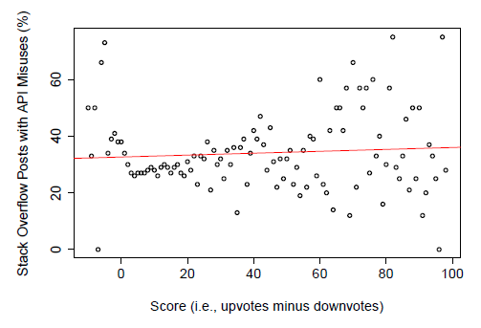
RQ2. Are highly voted posts more reliable?
Highly-voted posts are not necessarily more reliable in terms of correct API usage.

Slide 45
RQ3. What are characteristics of API misuse?
There are three types of API misuse--missing control structures, missing or incorrect order of API calls, and incorrect guard conditions.
Cursor emails = db.query(Email.CONTENT_URI,...);
while (emails.moveToNext()) {
String email = emails.getString(..);
}
emails.close();
Missing finally block [Post ID 31427468]

Slide 46
RQ3. What are characteristics of API misuse?
API misuse is caused by three main reasons---missing control structures, missing or incorrect order of API calls, and incorrect guard conditions.
Cursor emails = db.query(Email.CONTENT_URI,...);
while (emails.moveToNext()) {
String email = emails.getString(..);
}
emails.close();
Missing finally block [Post ID 31427468]

Slide 47
RQ3. What are characteristics of API misuse?
API misuse is caused by three main reasons---missing control structures, missing or incorrect order of API calls, and incorrect guard conditions.
ByteBuffer bb = ByteBuffer.allocate(4);
bb.put(newArgb);
int i = bb.getInt();
Missing an API call, bb.flip() [Post ID 12100651]

Slide 48
RQ3. What are characteristics of API misuse?
API misuse is caused by three main reasons---missing control structures, missing or incorrect order of API calls, and incorrect guard conditions.
TreeMap map = new TreeMap();
//OR SortedMap map = new TreeMap();
map.firstKey();
Incorrect guard condition, !map.isEmpty() [Post ID 21983867]

Slide 49
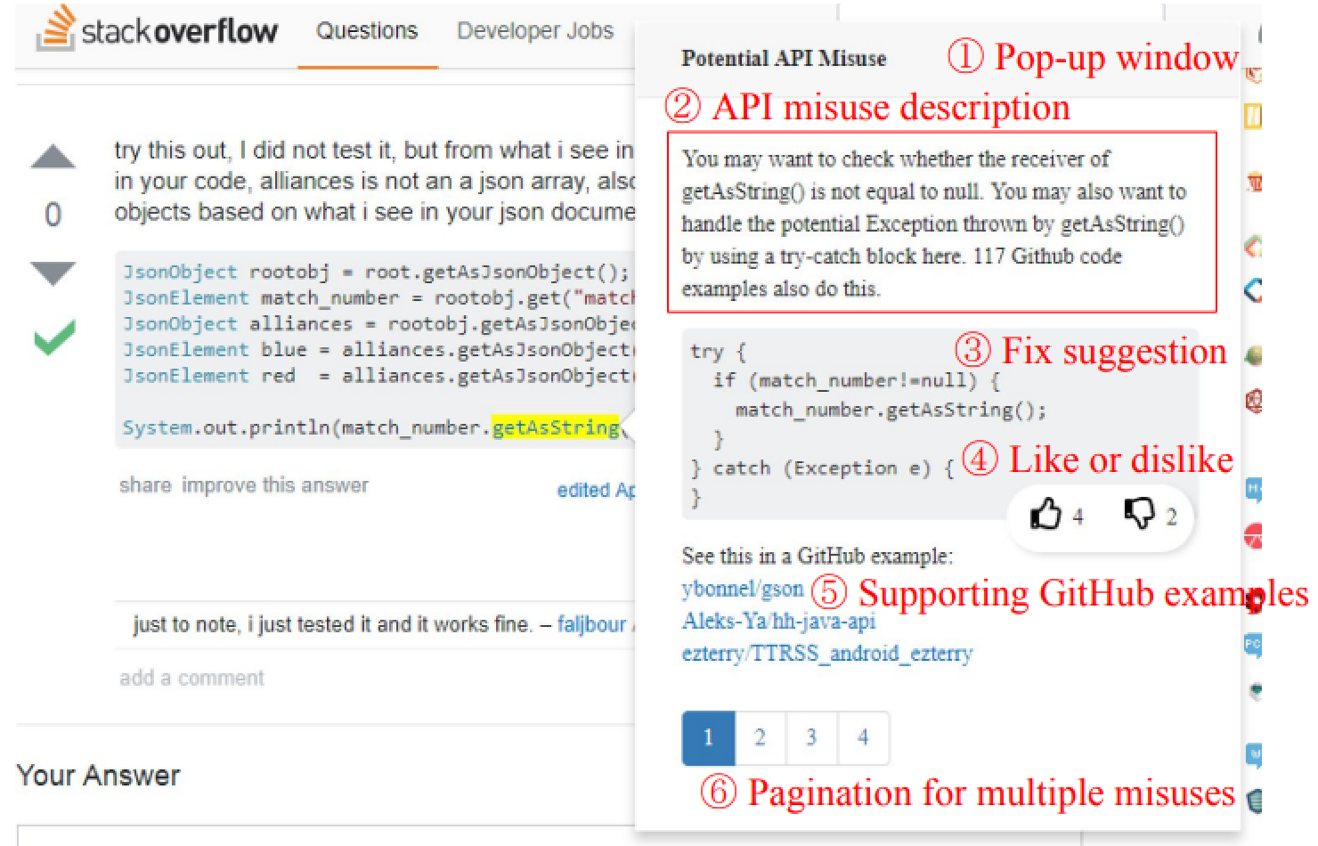

ExampleCheck: Checking API Misuse in Stack Overflow using Patterns Mined from GitHub

Slide 50
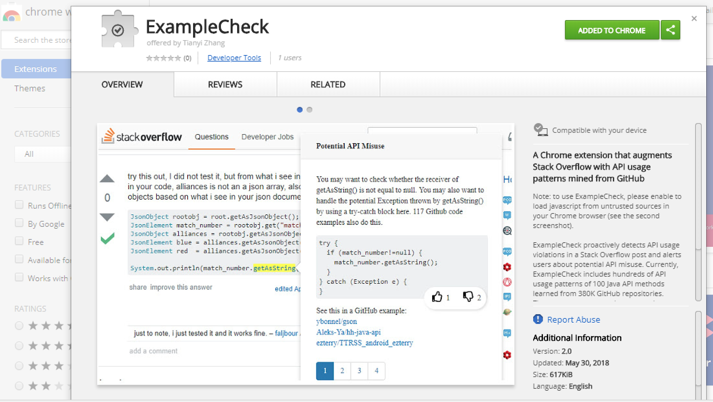
ExampleCheck: Checking API Misuse in Stack Overflow using Patterns Mined from GitHub
https://chrome.google.com/webstore/detail/examplecheck/amliempebckaiaklimcpopomlnklkioe

Slide 51
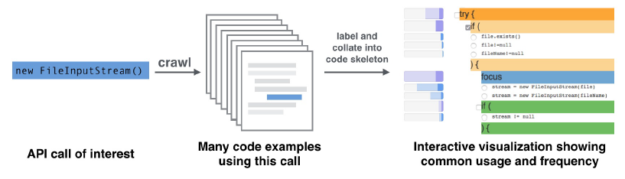
Examplore: Visualizing API Usage Examples at Scale [CHI 2018]
Examplore visualizes API usage features in hundreds of code examples along with their statistical distribution in histograms.
Tool: http://examplore.cs.ucla.edu:3000/

Slide 52
Our Contributions
An API usage mining technique that extracts patterns from over 380K GitHub projects
A large-scale empirical study of API misuse in 220K SO posts
A Chrome extension that augments Stack Overflow with API usage patterns mined from GitHub

Slide 53
Q&A

