Slide 1
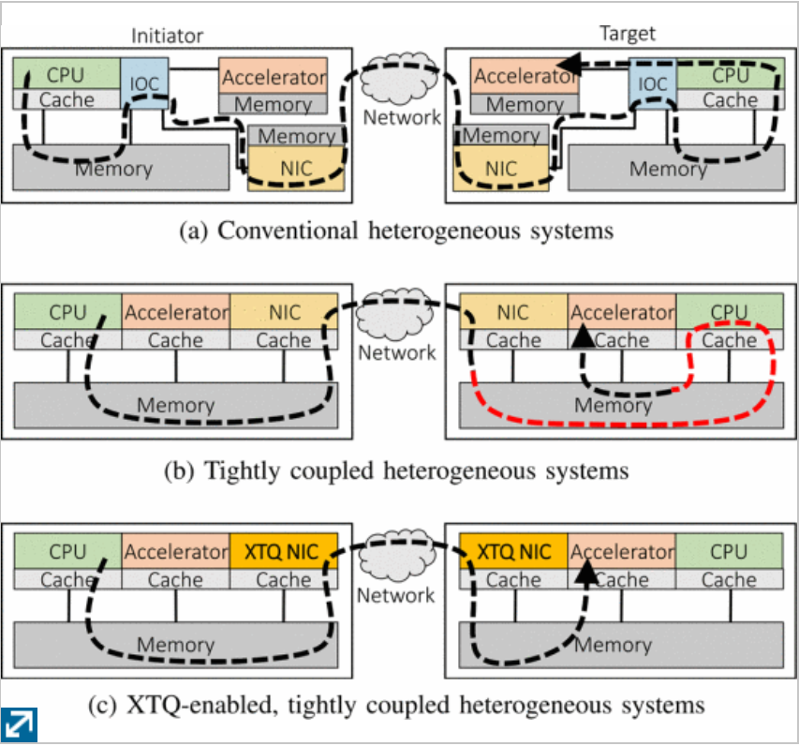
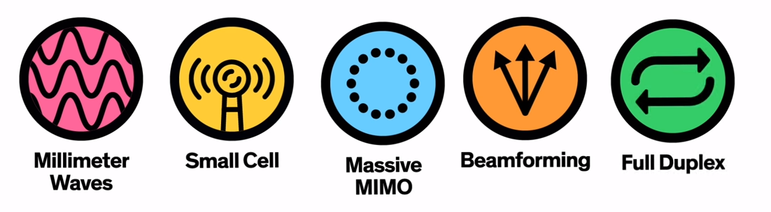
5G: Emerging Technology
What is 5G?
What would you do with 1 TiB/s connectivity?
The fifth generation of wireless technology brings the capabilities for billions of devices to access network speeds of 1TiB/s.
It will enable smart ubiquitous connectivity and networking.
IoT and Autonomous Vehicles
- Broadcast safety information to other meshed peers
- Enrich local sensor information with rich web services
- Enhance supply chain efficiency with troves of metrics
How Does 5G Work?
1. The frequency range is increased to support billions of simultaneous devices
2. MM waves are fragile over long distances, lots of small repeating stations are deployed
3. Base stations use MIMO to increase from 12 to 100 antennas
4. Many antennas broadcasting in all directions leads to interference – thus beam directly at the device
5. Communication channels are full duplex for improved efficiency
Share device resources
Tap into remote memory and accelerator cards– at comparable speeds to local resources.
Expanding device capabilities to virtually unlimited in size.
Consume dozens of GPUs to generate photorealistic real time graphics for gaming

