Slide 1
Coronavirus
Nate Bachmeier TIM-8130: Data Mining
Section 3: Week 6: March 15th, 2020

Slide 2
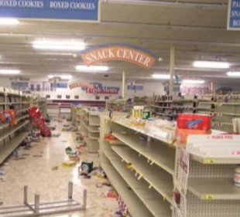
Why is everyone talking about Coronavirus
Corona Virus Disease 2019
Uncertainty drives panic
City-Wide Curfews
Grocery Stores Emptied
Global Recession
Mortality Rates lack context
Incorrect use of average
Rates lack context
Notes:
The world has become fixated on the Corona Virus Disease 2019 (COVID-19), as it continues to spread in a global pandemic. There is much uncertainty about how the disease will impact the general public leading to city-wide curfews, grocery stores emptied, and the end of the bull market. One of the drivers of the mass panic comes from the media’s reporting of the mortality rates without enough context. For instance, original estimates put the likelihood of death at roughly 1% and have since risen as high as 7%. However, these figures treat all entities as homogeneous, despite critical physical distinctions. Consider the differences between the immune systems of teenagers versus senior citizens, and how that changes their level from illness. Other features, such as pre-existing medical conditions and organ deterioration from cigarette smoking, influence the mortality calculus.

Slide 3
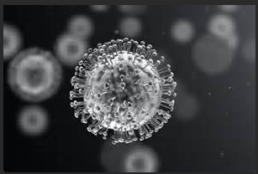
What is COVID-19
New Respiratory Infection
Some experience a cold
Others experience pneumonia
Previous Outbreaks include
SARS of 2003
MERS of 2012
Medication exists for the symptoms
Research won’t have near term solution
FDA approval further delays
Notes:
The name novel coronavirus disease 2019 incorporates several artifacts, starting with ‘novel’ meaning new. Corona, meaning crown, refers to the spikes that protrude out of the protein envelope. What makes this instance unique is its ability to infect humans, versus most coronavirus, are lethal to birds and mammals, particularly across the farming industries (Schoeman & Fielding, 2016). Both Severe Respiratory Syndrom (SARs) of 2003 and Middle Eastern Respiratory Syndrom (MERS) of 2012, are recent COVID outbreaks. These diseases target the respiratory system and create symptoms ranging from a cold to pneumonia. Doctors can prescribe medication for these symptoms, but not for the underlying condition. A COVID protein exists as a single-stranded RNA genome that requires host cells to assist with its replication. Some medical professionals believe stopping that process, similar Remdesivir for Human Immunodeficiency Virus (HIV) patients, holds the solution (Cara, 2020). However, even if these existing drugs are successful, it can take years to gain approval from the Food and Drug Administration (FDA). Without the availability of medical science to timely produce a cure, the world needs to rely on ‘toughening it out.’ That does not install confidence across the broad audience as it leads to more questions than answers.

Slide 4
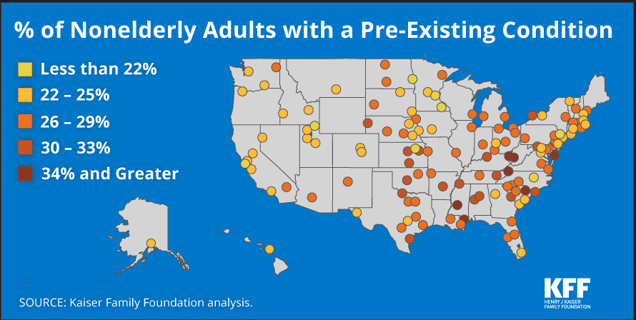
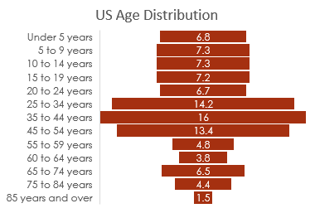
Hypothesis: A model can more accurately predict mortality rates
Current Mortally Reporting uses Population Deaths ------------------ Population Cases
However, the population is not uniform
Age Distributions
Demographic Shapes
Existing Condition Rates
Notes:
A heightened sense of fear exists as people do not understand their real risk of mortality. These challenges stem from media outlets taking a raw average of deaths divided by reported cases. Instead, the communities need preprocessing to cluster and classify members based on physical and demographic features. Kaiser Family Foundation (2016) states that West Virginia (36%), Mississippi (34%), and Kentucky (33%) have the highest rates of pre-existing conditions for nonelderly adults in the country. The number of deaths per thousand should naturally be higher in these states due to the impaired state. Another critical factor is the age of the population, with senior citizens having the highest risk. Perhaps the diversity of the community influences infection rates, such as homogeneous areas in Wyoming, that are unlikely to encounter international tourism. The population density of a city changes how people commute and the volume of interactions that transact every day. Each of these dimensions changes the probabilities of dying, along with the criticality of healthy individuals remaining so. Understanding these risks can increase targeted awareness and, in turn, save lives.

Slide 5
Features and Characteristics of the model

Slide 6
Data Sources for building the model

Slide 7
Usefulness of Statistical Based Mining

Slide 8
Statistical Functions and Evaluation Strategies

Slide 9
Analysis and Results

Slide 10
Challenges and limitations

Slide 11
Overcoming those issues…

