Slide 1
Business Needs Assessment
Nate Bachmeier TIM 8190: Comp. Sci Policy & Strategy

Slide 2
Agenda
Mission Statement
Description and purpose of assessment
Critical process controls, parameters, configuration
Importance of the current platform
Challenges introducing new policies
Critical processing controls
Network control policies

Slide 3
Mission statement
Leverage technology to democratize financial serves to customers across the most comprehensive portfolio of capabilities. We value long-term sustainable solutions that delight our customers over making a quick buck.
Notes:
NCU-F wants to democratize financial serves through a comprehensive portfolio of capabilities. The company’s founders found that existing banking services were not inclusive, often penalizing small account holders with arbitrary fees. While this approach is profitable, it does not create a positive customer experience or lead to a sustainable business model. This long-term focus earned the organization a broad customer base, which fuels its ability to acquire innovative competitors. Today, the business has numerous financial products that exist as application silos without a consistent interface. Instead, NCU-F envisions modernizing these systems to improve cross-selling, reduce operational overhead, and standardize the experience. These capabilities would benefit the organization and its customers.

Slide 4
Needs Assessment Results
Factor | Mobile App | Trading Platform
Political | High. The payment processing team is a cash cow | High. The application is a rising star
Economic | Low. Most customers use the service for free | High. Each customer spends thousands of dollars annually
Social | Medium. Customers view it as a free service | High. The release’s marketing campaign is colliding with negative reviews
Technology | Medium. Requires upgrading hardware and software systems | High. Requires upgrading hardware and software systems
Notes:
Organizations use needs assessments to uncover gaps between a feature or capabilities’ current and desired performance levels (US OPM, 2021). For instance, customers can transfer money to friends and family through the NCU-F mobile app. Today, completing that process takes nearly three minutes on average, significantly longer than competing products. Business Development Managers (BDM) demand a more responsive customer experience that requires no more than fifteen seconds. However, closing the distance between these durations necessitates both time and capital investments.
Meanwhile, the Investment Accounts division is requesting those same resources to support their newly acquired trading platform. Their leadership has concerns that product stability is creating negative press through social media channels. Recently, customers could not access the web application for over sixteen hours last month. Specific leaders might view this request as the IT department wanting to work on IT projects. Nevertheless, a challenging premier release might irrevocably damage the trading platform’s credibility and potentially limit future returns (Kang, 2016). The organization must balance these decisions within a broader context.
NCU-F only has time to complete one project and needs to examine the Political, Economic, Social, and Technology (PEST) factors (Langer & Yorks, 2013). This strategy seeks to rationalize the risks and rewards derived from various external forces (see Table 1). According to that analysis, the trading platform must be the business priority because of the substantial economic and brand risks. Meanwhile, the mobile app’s performance is not a regression. Customers that accept the current latencies today are unlikely to expect sudden improvements.

Slide 5
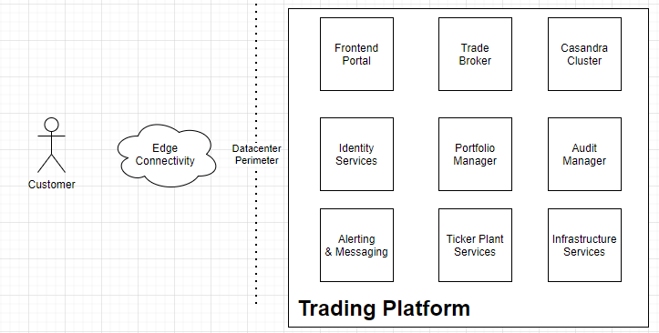
Critical Process Controls
Notes:
Several subsystems exist within the trading platform composed of various micro-services and vendor products (see Figure 1). Those services discover each other through Domain Name Service (DNS) queries to an internal zone. This approach decouples the network topology from the component implementations. After locating a dependent service, the caller sends the request and client certificate to the endpoint. NCU-F verifies those certificates with their Microsoft Public Key Infrastructure (PKI) services. If these core infrastructure services are unavailable, any dependent services will also miss its Service Level Agreements (SLA).
Specific critical parameters are outside of NCU-F’s control, such as regulatory and compliance requirements. For instance, the application must maintain an audit trail of every transaction for at least seven years. Other requirements state that the system must enforce customer privacy and the right to be forgotten (e.g., GDPR). When administrators fail to deliver those artifacts, it invites ethical and legal challenges.

Slide 6
Current Platform
Component | Scale | Primary Vendor | Bounding Resource
Edge Connectivity | 4 x circuits | Akamai | Networking
Container Services | 32 x servers | Open-Source | CPU and Disk
Frontend Portal | 8 x servers | Consultants | Networking
Identity Services | 4 x replicas | Microsoft | Active Directory
Alerting & Messaging | 8 x servers | COTS / PostgreSQL | Database Queries
Trade Broker | 16 x servers | COTS | CPU
Portfolio Manager | 4 x replicas | In-house | Memory
Ticker Plant Services | 32 x servers | In-house | Networking
Casandra Cluster | 8 x nodes | Open-Source | CPU and Disk
Audit Manager | 4 x replicas | Consultant Firm | Disk
Notes:
Hundreds of platforms enable customers to trade financial instruments through mobile, web, and desktop applications. However, those solutions focus on streamlining order entry, not providing customers with the best long-term focused experience. For instance, when the market dips, most brokers flood the screen with flashing red text and induce unnecessary stress. Instead, NCU-F’s solution uses a color gradient based on the long-term trend. This subtle behavioral economic “trick” discourages our customers from buying high and selling low. Across the platform, there are numerous additional mechanisms like intelligent search result sorting to prevent purchasing the wrong instruments.
NCU-F set an aggressive timeline for delivering the trading platform to customers. It met this expectation through numerous outsourcing engagements and licensing existing technologies (see Table 2). While this approach decreased time-to-market, it left them with a heterogeneous platform that spans several vendors. For example, the Identity Services is a service façade to Microsoft Active Directory. This design simplifies specific integrations in exchange for higher licensing costs and fewer concurrent transactions.

Slide 7




Challenges updating Policies
Costs teams time and resources
Increase consistency and collaboration
Budget Tech Debt versus Features
Formalize organizational procedures
Notes:
The business must strategically decide which governance policies to enforce versus recommend. When the organization mandates a shift in direction, it creates additional work and deprioritizes competing efforts. One approach is defining maturity levels and target groups, then slowly raising expectations on specific critical resources first. For instance, Identity Services’ recent outage makes it a candidate for targeted investments, such as reducing Domain controller requirements through data caching policies.
NCU-F must also devise plans for removing technical debt and implementing standards across the platform. That standardization enables the company to move faster with greater consistency. However, the business must be cognizant of the current business cycle since paying down debt also implies fewer new features. Without an adequate volume of improvements, the customer’s experience becomes stale and fails to meet expectations.
Lastly, formalizing organizational procedures such as disaster recovery and incident management will pay dividends later. For instance, the initial release of the trading platform stores customer data across eight different storage technologies. This approach decouples the implementation between microsystems and promotes engineering efficiency. However, end-users do not care. Instead, they want a consistent system state that withstands an individual server or partition failure.

Slide 8
Networking Policies
Enforce Compliance Requirements
Protect Customer Data
Restrict Physical Access
Audit Process Exceptions
Notes:
The trading application maintains a treasure trove of financial information that hackers want to steal. NCU-F must prevent this scenario with policies that limit how trusted users can access the production environment. For example, only the operations team should connect to the production environment using Multi-Factor Authentication and Virtual Private Networking (VPN) software. Next, controls must exist for auditing data access and limiting data exfiltration. Finally, mechanisms and processes must review those business justifications that require the ops team near sensitive information. Over time those policies need to mature and remove manual interactions, further avoiding negligence and unauthorized state changes.

Slide 9
Thank you

