Slide 1

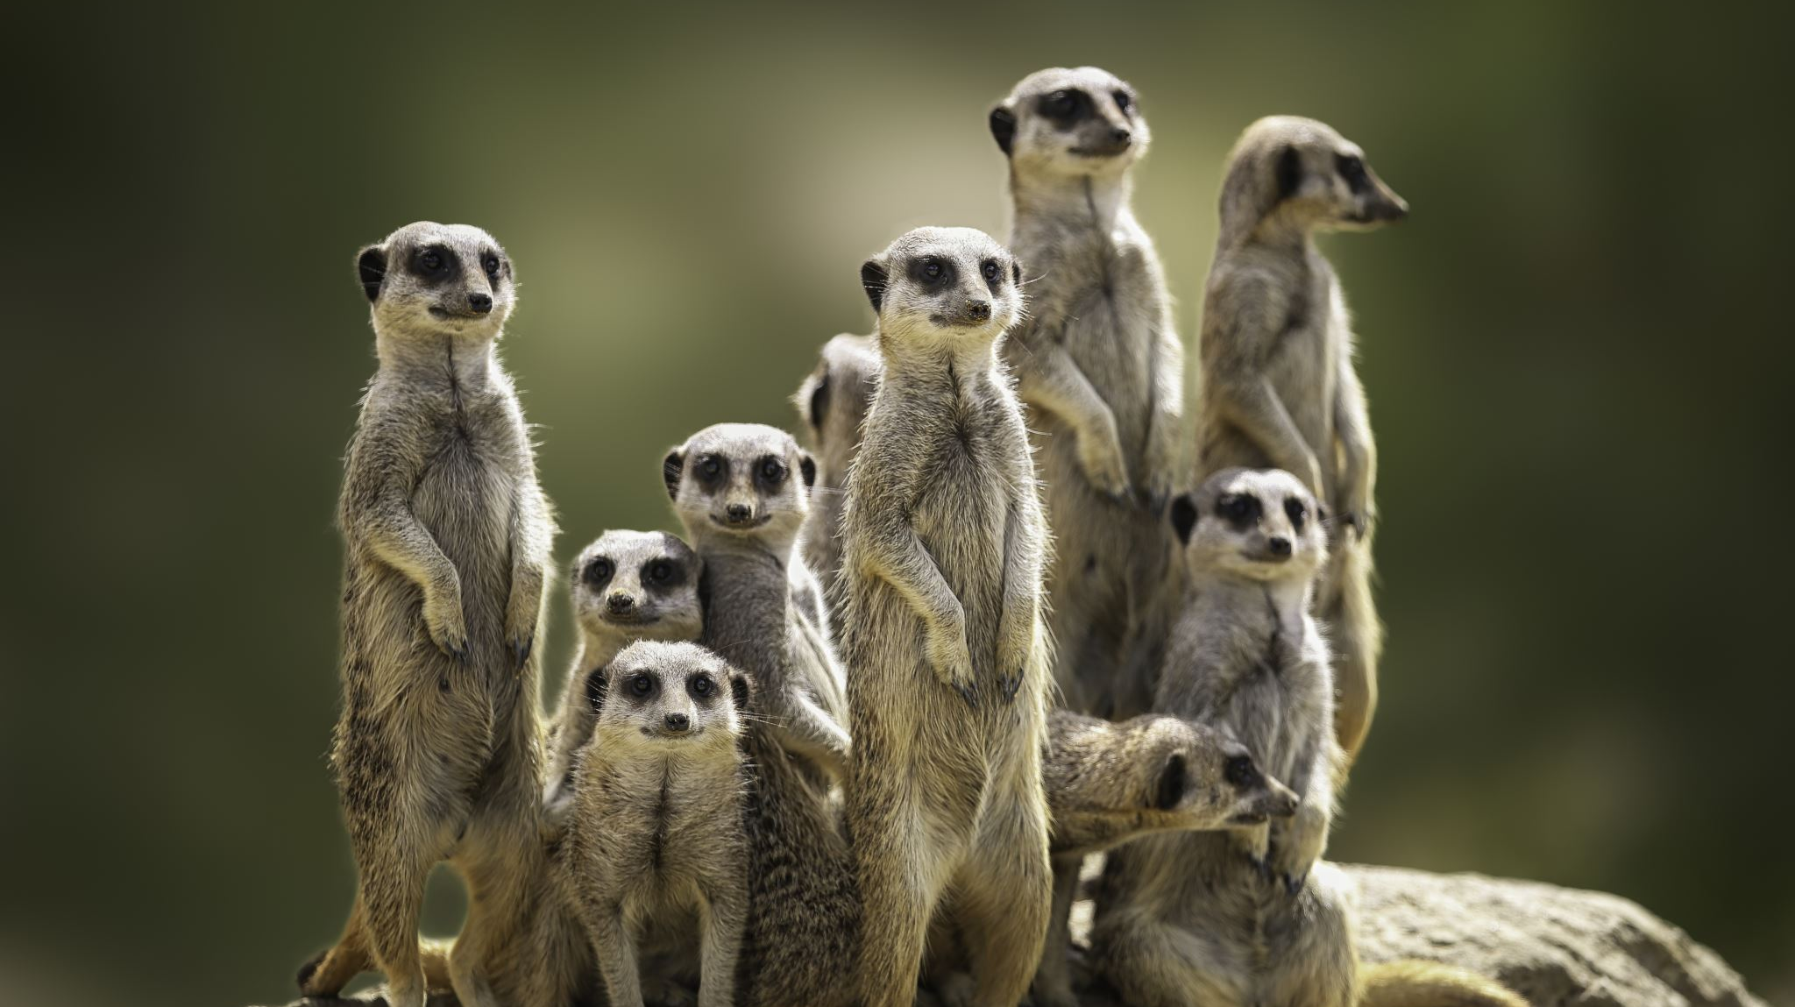
People and Security
TIM-8301: Principals of Security Nate Bachmeier

Slide 2

Framing a Security Message
How should we approach security?
It’s not the an afterthought
It’s not because “they” are specifically targeting “us”
It’s not because crypto APIs and firewalls are fantastic
Then what is it about? Why do I care?
It’s not about “stopping hackers” … its about stopping Fat Finger Bob!
It’s ensuring the reliability of our services

Slide 3

What is the goal of Security
A collection of processes that ensure availability, reliability, performance characteristics, and business continuity – even in the presence of erroneous behaviors.
It’s about preventing both negligence and maliciousness

Slide 4
How has the perception evolved
Focus on
Focus on individual attackers
Focus on
Focus on technology
Focus on
Focus on national states
Focus on
Focus on assume breach
Focus on
Focus on people

Slide 5
Why are people now the focal point
50% attacks are technology malicious
25% attacks are malicious against humans
25% attacks are human errors

Slide 6
Where do we need to protect humans
Network borders are abstract
Connections come across heterogeneous devices
Any communication/interaction could result in undesirable behavior

Slide 7
Understanding STRIDE categorizations
Spoofing
Tampering
Repudiation
Information Disclosure
Denial of Service
Elevation of Privileges

Slide 8
How do these apply to humans
Getting a free cup of coffee
Enumerate examples here

Slide 9
Using Threat Modeling
Assets, endpoints, trust boundaries, protocols, and threats

Slide 10
Creating a security aware culture
Security is about risk management protections
Be skeptical
Authenticate, authorize, and audit actions
Preventing negligence, how will this fail?
Think about quotas, fail-over, backup/recovery
Preventing maliciousness
Think about where data and commands become collide

Slide 11
Credential and Identity management
Influence of password policies
Influence of SSO/OAuth
Influence of MFA
Something you know
Something you have
Something you are
Somewhere you are
Something you do (gestures)

Slide 12
Device Management
Software patches
Desired Configuration Policies
Malware

Slide 13
Phishing sites
Why do they work
Why do these protections fail?

Slide 14
Doxing
Social networks
Publications
Public information
… resulting in advanced spear phishing

Slide 15
Untrusted networking
The Starbucks attack
DNS attacks
Discussing work issues outside of work
Unencrypted devices

Slide 16
Challenges with internationalization
GDRP
Chinese Cybersecurity Law
Notions of sovereignty

Slide 17
Conclusion

Slide 18
References

