Slide 1
Capabilities of Face Recognition
MTH/221
Date: 12/16/2013
Instructor: Serhat Altunc
Learning team A
Asrat Bedada
Cody Bailey
Avinash Shankar
Christie Calapan
Curtis Goldman

Slide 2
Introduction and agenda
Our Learning Team project will be on face recognition in the realm of computer vision.
We will apply the fundamentals of Discrete Mathematics in our project and go into the specifics of face recognition in the existing technologies and research efforts.

Slide 3
Logic and set theory
The logic which is the study of principles of valid reasoning and with facial recognition the logic behind it comes in many forms from security purposes to smart screen and or video on smart phones.
Set theory is to studies sets which are a collection of objects and for face recognition where the biometric software that contains the numeric codes and nodal points to recognize the face would be the objects that are studied.
Notes:
Facial recognition systems utilize numeric codes then these systems take and recognize the 80 nodal points of the human face (this would be the objects for the set theory)

Slide 4
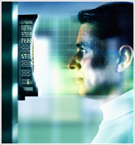
Logic and set theory cont.
Image retrieved from: http://www.nec.com/en/global/solutions/security/technologies/face_recognition.html
The logic behind face recognition includes:
Fast and accurate
Reliable matching
Diverse applications
Notes:
The basic reasoning behind face recognition is the accuracy, reliability and diversity of its uses to include law enforcement agencies.

Slide 5
Algorithmic Concepts
Four face recognition algorithms have been developed.
Standard PCA, or Eigenfaces, algorithm.
Combination PCA and LDA algorithm.
Bayesian Interpersonnel/Extrapersonal Image Difference Classifier.
Elastic Bunch Graph Matching Algorithm that uses localized landmark features.
Notes:
Standard PCA, or Eigenfaces, algorithm.
Eigenfaces can be created by performing a process called principal component analysis on a large set of images depicting different human faces. Basically a set individualistic aspects of the human face are recognized.
Combination PCA and LDA algorithm.
LDA is a method that uses statistics, pattern recognition and machine learning to find linear combinations of features and then characterizes them or separates two classes of objects or events.
Bayesian Interpersonnel/Extrapersonal Image Difference Classifier.
The Bayesian age difference classifier was built on eigenspaces framework and has the ability to verify the identity of individuals from pairs of separated face images
Elastic Bunch Graph Matching Algorithm that uses localized landmark features.
Elastic graph matching is a biologically inspired algorithm for object recognition and draws it’s biological inspiration from the visual features used in Gabor Wavelets and the matching algorithm and it’s dynamic linnk matching which is a model of invariant object recognition in the brain.

Slide 6
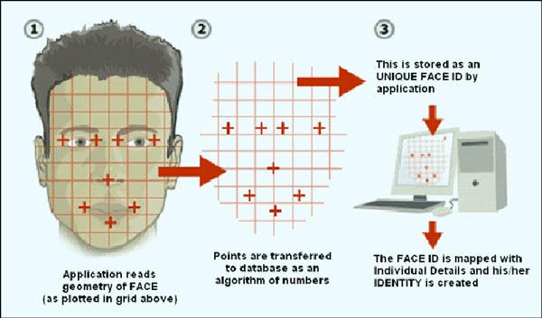
Algorithmic Concepts
Image retrieved from http://creativentechno.wordpress.com/2012/02/18/face-recognition/
Notes:
As we can see with this picture the use of algorithms of numbers are applied to the geometry of the face.
The basic predominant algorithms are based on two approaches:
Geometric which is feature based that are the nose, mouth, eyes and distances/angles etc
and photometric which is view based that is composed of major facial features to perform recognition of frontal views of faces.

Slide 7
Edge Detection
Edges are high value information in an image
Edges generally mark high intensity gradient changes
Noise is a serious factor
“Optimal” edge detection has three requirements

Slide 8
Relations and functions
Identify distinguishing marks
Distance between features
Face print
Notes:
Facial recognition works by identifying distinguished features and measurements of a human face in an image and comparing them to images stored in another database such as driver’s license or social networks (Waxman, 2013).
Software judges the overall facial structure and determine the distance between the eyes, nose, mouth, and jaw. It also measures distances between the eyes, width of the nose, depth of the eye socket, shape and height of the cheek bones, and length of the jaw line (Ex-sight, 2009). These are called nodal points. There are as many as 80 nodal points of reference in a human face.
The computer takes these features and creates a numerical code called a face print which the computer uses to represent the face in a database (Ex-sight, 2009).
The face print is as unique as a finger print and no two individuals will have the exact same numerical code within the database.

Slide 9
Relations and functions
Lighting
Pose
Expression
Notes:
Matching an image of a face to another image in the database is dependent on several factors. Differences in lighting, angle, expression, and pose can significantly impact the ability for a computer to get a successful match (De Chant, 2013) .
Lighting
Differences in lighting conditions between photos when compared to the photo on file such as a driver’s license photo can make it difficult for the software to accurately identify a subject. Photos that are partially darkened and obscure facial features reduce the accuracy of facial recognition software.
Pose
The pose or angle that a subject is facing relative to the camera that has taken the photo can also cause issues. Eyes are one of the biggest reference points for facial recognition using software (De Chant, 2013). Partial faces such as pictures with only one eye shown in the picture can cause huge issues during facial recognition. The computer relies on the other half of the face to compare distances between features and uses the eyes as a reference point.
Expression
Unless there are multiple photos on file for a particular subject expressions can create significant problems in facial recognition. Something as simple as a smile can change the distance between facial features such as the mouth edges and height of the cheeks. This causes issues because the computer is relying on predetermined data sets for those features and will not be able to match those features resulting in a lower probability of a match.

Slide 10
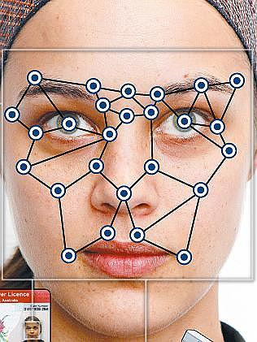
Graph Theory
Biometrics Theory
Elastic Bunch Graph Matching
Notes:
Biometrics theory uses the physiological shapes of the body. In the case of cellular phones it uses either fingerprints or eyes. For gaming systems it can use your face, hands, feet, and body. For facial recognition it is used by capturing an image of a person’s face and using the elastic matching. The elastic bunch graph matching uses a face recognition algorithm by locating landmarks features and then measures the similarity between the features. The graph has one node for each of the landmarks in the image. The landmarks on the face would be centered around the eyes, nose, and lips.

Slide 11





Trees
Face
Left Eye
Right Eye
Nose
Lips
a1
a2
a3
a6
a7
a8
a11
a12
a13
a16
a17
a18
a4
a5
a9
a10
a14
a15
a19
a20
Notes:
The tree is derived by the graph theory and landmarks. The landmarks would be left eye, right eye, nose, and lips. The main graph which is the face is broken out into the landmarks. The landmarks are then broken out into characteristics of each landmark. Some examples would be left corner of nose, bottom right corner of left eye, center of lips, and entire nose. The following picture shows a mock up for a facial tree structure. It’s important to note that a tree is a directed graph which has a special vertex R called the root of the tree (face). And it has one or may successors: left eye, right eye, nose, and lips.

Slide 12
Edge Detections
Edges generally mark high intensity gradient changes
“Optimal” edge detection has three requirements
Edges are high value information in an image
Noise is a serious factor
Notes:
Edges are where a large portion of the data that determines what someone or something is viewing actually is. Edges show shape, form, and in the right situations even the size of an object. Knowing just this is often enough to identify something. Think of all the simple line drawings you’ve seen. They are very easy to identify in most cases.
Computers can use edges to get more meaning out of an image as well, but how does a computer find these edges? Edges are usually areas in the image that mark a high intensity gradient. A gradient is simply a fade from one value to another. The good thing about gradients is there is math to work with them. This means a computer can use them easily.

Slide 13
Disadvantages
Face recognition can only be used when conditions are favorable
Problem Areas
Perspective
Light, Angles
Focus
Speed
Notes:
Biometric software will be unreliable in low light and other obstructions making it unfavorable . Computer vision can not comprehension the difference between a real object and it’s reflection. It would come off as having two images instead of an actual object and its shadow. We as humans know that when an shadow is presented we can tell the difference between the two. We understand that we can touch the actual image and the reflection is just a mirror image. Computer vision is not as evolved and would have a harder time separating the two. Each of the mention condition can effect what the computer see.

Slide 14
Conclusion
Advance Technology
Risk Reduction
Quality Control
Algorithmic Improvements
Notes:
Computer vision has its advantages and disadvantages. With the use of new detection devices and advance technology computer vision can compete with its human counterparts. Using the latest risk detection technique computer vision can reduce common errors in security awareness. Good quality control consist of ensuring a problem is detected before it has the chance to cause damage. The solution is algorithmic improvements and detail analysis.

Slide 15
References
De Chant, T. (2013). The limits of facial recognition. Retrieved from http://www.pbs.org/wgbh/nova/next/tech/the-limits-of-facial-recognition/
Discrete mathematics. (2013). Retrieved from http://en.wikipedia.org/wiki/Discrete_mathematics#Logic
Ex-sight. (2009). Face recognition - technology overview. Retrieved from http://www.ex-sight.com/technology.htm
Facial recognition. (2013). Retrieved from http://whatis.techtarget.com/definition/facial-recognition
Inside Samsung Galaxy S4's face and eye-tracking technology. (2013). Retrieved from http://www.computerworld.com/s/article/9237622/Inside_Samsung_Galaxy_S4_s_face_and_eye_tracking_technology
Face recognition. (2013). Retrieved from http://www.nec.com/en/global/solutions/security/technologies/face_recognition.html
Graph Theory. (2013) Retrieved fromhttp://www.engineersonline.nl/wosimages/nieuws_22452_26574_item_original.jpg

Slide 16
References
http://www.inf.u-szeged.hu/~ssip/2001/handouts/chetverikov/chetverikov1.pdf
http://www.cs.umd.edu/~djacobs/CMSC426/Blob.pdf
http://www.v3ga.net/processing/BlobDetection/
http://www.societyofrobots.com/programming_computer_vision_tutorial_pt3.shtml
http://en.wikipedia.org/wiki/Difference_of_Gaussians
http://www.cs.colostate.edu/evalfacerec/index10.php
http://en.wikipedia.org/wiki/Eigenface
Face Biometrics for Personal Identification: Multi-Sensory Multi-Modal Systems edited by Riad I. Hammoud, Besma R. Abidi, Mongi A. Abidi
http://www.scholarpedia.org/article/Elastic_Bunch_Graph_Matching

