Slide 1
Mathematics of Shipping Packages
Team C December 16th, 2013

Slide 2
Agenda
Apply Discrete Mathematics to Solving Problems with Shipping Packages
Determining Cost (Enumeration)
Representing the System in Relational Database (Relations and Functions)
Methods for Grouping Similar Packages (Logic and Set Theory)
Determining the Shortest Path (Graph Theory)
Determining Postage Options (Decision Trees)
Putting it together the Pieces (Boolean Algebra)

Slide 3
Determining Cost
Top 5 Expenses (Greatest to Least)
Salaries and Benefits
Purchased Transportation
Fuel
Depreciation and Amortization
Maintenance and Repairs
Notes:
Salaries and Benefits – This, being the largest expense of most companies today, holds true for carrier companies as well. Big name companies like UPS, FEDEX, and USPS all have to pay their employees as well as insurance and benefits for those employees.
Purchased Transportation – It may come as a shock to most but the second largest expense of the 3 major package carriers in the US is paying other people to transport their packages for them. To understand this relate it to your cell phone. You might make a call to a friend. That friend might be a long way away. In order for your call to go through it has to travel a long distance over and through many towers. All of those towers might not be owned by your cell phone provider so they must pay whoever owns that tower to use it for your call. This expense is often times negated to some degree by the 3 major carriers because they all use each other (and many smaller carriers) and they trade money back and forth so to speak.
Fuel – Falling in at number 3 is the thing most people would think of as number one or two, fuel. It cost a lot of money to fuel up a fleet of planes and delivery trucks across a nation and the carriers know it all too well.
Depreciation and Amortization – Debt! Even large companies owe the bank money. Bank payments rank number 4 in the expense list.
Maintenance and Repairs - Things wear out and they need fixing. Tools become outdated and need upgrading. It’s not cheap to keep a truck or plane up to code let alone a whole fleet of them. This along with software, scanners, uniforms, etc. cost enough money to bring it in as the 5th largest expense.

Slide 4
Addressing Cost With Automated Routing
Same top 5 expenses
Same workload, less workers
Grow to decrease spending
Even workloads means less trucks
Maintenance and Repairs
Notes:
All 3 of the major package carriers in the US have the same top 5 expenses. This means these expenses should be reviewed and reduced to increase revenue.
Same workload, less workers – This can be done without cutting salaries and/or benefits. Automated routing can capture information on inbound shipments ahead of time allowing delivery planners to adjust the loads and routes of drivers, optimizing deliveries. In other words, splitting the workload evenly will allow for less drivers needed for the same amount of work. Lowering this cost would allow for the growth needed to decrease spending on purchased transportation.
Grow to decrease spending – In the area’s a company is not (has no coverage) they have to pay for someone to pick up or drop off a package. With increased company growth this expense will shrink since the company will be doing it themselves.
Even workloads means less trucks – With an automated routing system evening out the workloads and optimizing the delivery routes drivers will increase the amount of stops they are able to make in a day and reduce mileage, ultimately reducing fuel costs. With thousands of trucks on the road daily this adds up to millions of dollars saved.
Less miles means less wear and tare – An easy point to understand. With optimized routes each truck is traveling less “out of its way” distances. This means more miles that produce money or as I like to call them, “Money Miles.”

Slide 5
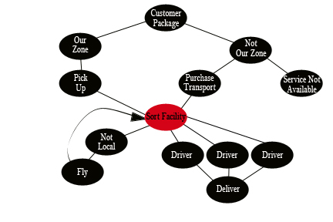
Cost Relations Chart
Notes:
Customer Package – A Christmas present from mom.
Our Zone – This means the package is in the normal zone of coverage and the company goes and gets it or it’s brought to the sort facility.
Not Our Zone – This is a zone that we don’t have a sort facility close to and is out of range for a driver to get to effectively for the cost.
Pick Up – The package is picked up during a drivers route.
Purchase Transportation – The company pays for the package to be delivered to them through another carrier.
Service Not Available – The package is denied because there is no cost efficient way to deliver it by the company.
Sort Facility – Where the packages go to be sorted.
Not Local – If a package is out of driving range then it is put in the not local truck to be taken to the airport.
Fly – The not local packages are sorted at the airport sort facility and flown to the appropriate sort facility.
Drivers – The delivery men and woman who drive the routes.
Delivery – Merry Christmas from mom’s house to yours.

Slide 6
Cost Relations
Focus on Sort Facilities
Increase efficiency saves money
Effects all other parts of the chart
Notes:
Focus on Sort Facilities – This is the bottle neck on the chart. This means this has to have peek efficiency or everything else slows down.
Increase efficiency – As aforementioned creating a more efficient sort facility will save the company millions of dollars by giving the right packages to the right drivers. These drivers will then have efficient routes to accomplish more deliveries in a day to maximize deliveries.
Effects all other parts of the chart – Creating efficient routes and giving the right package to the right driver saves money on fuel, maintenance and repairs, and labor costs. This is not the only thing it will effect though. Not only will the right package be given to the right driver but the right driver will have the correct pick-up stops on his/her route as well. Cutting these costs also opens up the company to new expansion opportunities allowing more sort facilities to be opened and less zones out of our area overall. Ultimately global coverage is the goal with maximized efficiency creating maximized profits.

Slide 7


Methods for Grouping Similar Packages
Group – is a structured collection of alike objects
Set - well-defined collection of objects.
Infinite sets
Finite sets
Null/Empty set
Notes:
When looking at grouping similar packages through an automated process we need to understand what these groups are. First off there is a difference between a group and a set. A set is a well-defined collection of objects while a group is a structured collection of alike objects. A group can be considered part of a set.
When grouping similar packages it is important to use the set theory to organize them. From here things can be placed into three type of sets. Infinite, finite, or null/empty.
The infinite set has no ending to its collection whereas the finite set is usually defined by a number of elements that will make up that set. The null/empty set is what one would think empty.
For grouping similar packages a company is going to focus on finite sets.

Slide 8
Methods for Grouping Similar Packages
Combination of sets
Union of sets
Intersection of sets
Difference of sets
Notes:
Now for any company that is going to do any type of automated processing needs to have a method of keeping stock of what they have. This can be broken down into the set theories combination of sets.
Sets can be combined in three different manners that can help a business through this automated process. The first method is the union of sets.
The union of two or more sets is a union that contains elements belonging to any of the combined sets. This can be useful if there are two or more sets of products that have could be classified under the same category such as clothing. The category of clothing could contain multiple sets that can be broken down into more detail later.
Intersection of sets is defined as a common occurrence of items from all of the sets in question. So how does this help with an automated process one may ask. If the company uses a web site to do its business and they allow items to be purchased from the company it will help out. Take for example when items are entered into a database they are usually entered by multiple people who may classify it as something different than someone else. Take a long sleeve shirt it can be classified as a T-shirt so it is placed in that set, but it could be placed in the Dress shirt set as well. By looking through the sets for common items a company can limit how many times the shirt is listed and save time and effort.
Difference of sets is the difference of elements from one set from another. The difference of sets can be used through a search feature. Search features provide the option to filter information and thus the results come back with only the items one wants. This feature does the same thing by eliminating the common items from each set.

Slide 9
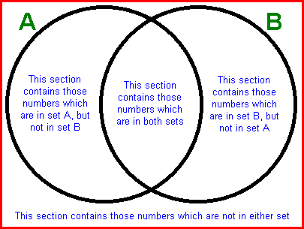
Methods for Grouping Similar Packages
Methods to sorting out pieces of a set
Cartesian product
Cross
Venn diagram
Randomness
Notes:
When it comes to looking through the sets of products a company may own it can become very tiresome. There are some methods that make things easier.
The Cartesian product is a method of taking one element from one set and one element from another set to come up with a specific set. This uses intersection of sets to get its information.
Another way to look at the Cartesian product is to think of it as placing one set of elements on a row and another set of elements on a column and then follow each until the location of where they cross matches the designated criteria.
Another method to sorting the sets into similar set could be by using a Venn diagram. This method will most likely not be used by a large company but a small one can still use it. The way a Venn diagram works is larger topic is the outlining subject or universe. This is placed on the outside of a box to remind what the elements pertain to. Next two circles will be placed in the box and these circles represent the classification of the subject matter. From here each classification is populated with elements from the sets that meet these classifications. In the middle there will be a section where both circles cross each other, here is where elements that meet both classification will go. These elements will be the elements from the sets that represent the subject matter with the desired classifications.
Lastly the one thing any company needs to take into account when grouping similar sets is the randomness of everything involved. First off many of the preceding techniques will help the company be better stocked and prepared for their customers. Randomness fits into the category of chance or supply and demand. Take Florida for example, companies such as Lowes and Home Depot will gather a larger than normal stock of generators during the months preceding Hurricane season. They are taking a chance that the weather will produce a demand for these items and they want to be prepared if the need arises. If there is no need though they then have to find a way to get rid of the excess items and thus consumers get their sales.
Grouping items from multiple sets can be difficult and time consuming but when done correctly any company will be able to provide the best results to their customers.

Slide 10
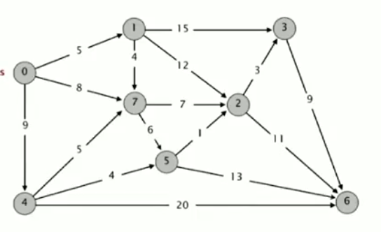
Determining the Shipping Path
Notes:
Scenario
Image that a package needs to be sent from Seattle to Miami. To get there it might go through San Diego, then directly there, or perhaps it is better from a time or distance perspective to send it through Denver, Cincinnati, to New York, then finally to Miami.
Build The Model
The problem can be modeled as a directed graph, where every city becomes a vertex and every edge becomes a route between these two cities. For every edge in the graph a weight can be computed where the weight might represent the time required to take the route. An example might be point 7 (Denver) to 2 (Cincinnati) would take 7 hours to travel. This needs to be computed for all edges of the graph.
Assumptions of the Model
While the weight function can present any arbitrary unit it is important that it returns a positive number (R+ or Z+).
It is also assumed that there is a path from the start to the finish.
There are no negative cycles
Graphic Copyright: Kevin Wayne and Robert Sedgewick

Slide 11
Shortest Path Algorithms
Greedy Algorithm
Dijkstra’s Algorithm (Binary Heap)
Acyclic Shortest Path
Bellman-Ford Algorithm
Notes:
Greedy Algorithm
The first solution to this problem would be to take an arbitrary path from the start to the finish and sum the weights of all edges along the way.
Next take a different arbitrary path and calculate its path, if it is less then the shortest path is “relaxed” or updated to the new smaller value.
Continue until all paths are iterated
This is slow but guaranteed to work. On large graphs it will likely take more time than anyone cares to wait.
Dijkstra’s Algorithm
Edsger W. Dijkstra created a very simple algorithm during the 70s which is still used to this day. His solution starts by creating a table of (Vertex #, Weight, and Best Edge To get there).
The initial weight of all vertex is initialized to positive infinity, this ensures everything can be properly relaxed later.
Vertex Total Distance Best Edge
1 infinity
2 infinity
3 infinity
Infinity
infinity
infinity
Infinity
Next we find all edges of the start and relax the weights where possible. Say for instance the start has edges to 1, 7, and 4 with respective weights of 5, 8, and 9
Vertex Total Distance Best Edge
1 5 0->1
2 infinity
3 infinity
9 0->4
infinity
infinity
8 0->8
Then we take the shortest distant vertex which would be Vertex #1, enumerate its edges 7, 2, 3 weights 4, 12, and 15 respectfully.
The value to get to that point also needs to be accounted for, such that route 0->1->3 costs weight( 0->1 ) + weight ( 1-> 3 ).
Vertex Total Distance Best Edge
1 5 0->1
2 5 + 12 = 17 1->2
3 5 + 15 = 20 1->3
9 0->4
infinity
infinity
8 0->8
This continues until all vertices have been enumerated or there are no more updates possible.
Acyclic Shortest Path
One optimization to Dijkstra’s algorithm is to topologically sort the graph first. By doing this it reduces the number of iterations required before shortest path is determined.
Bellman-Ford
Another variant of the Dijkstra’s algorithm is Bellman-Ford, which has support for detecting negative cycles.

Slide 12
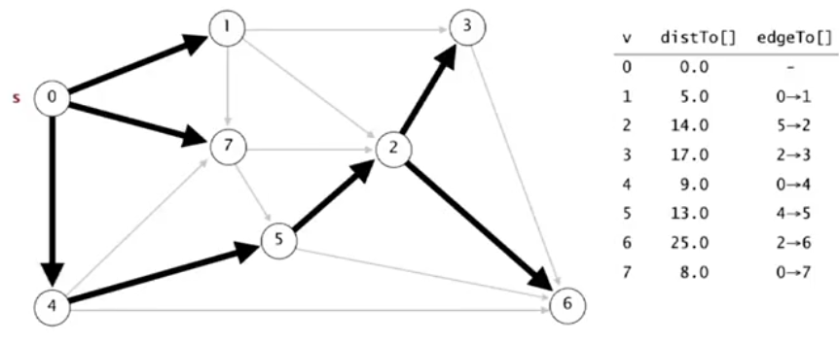
Solving the Shipping Path
Notes:
Here is the map with the shortest path highlighted. Going from 0->4->5->2->6 was the most efficient route.
References:
All material for the Shortest Path section was from Week 2 of the video lecture series “Algorithms Part 2” presented by Robert Sedgewick.
Wayne, K; Sedgewick, R (2013). Algorithms Part II. Retrieved from:
https://class.coursera.org/algs4partII-002/class/index
Graphic Copyright: Kevin Wayne and Robert Sedgewick

Slide 13
Determining Postage Options
USPS:
Current US price on postal stamps is $.46
Flat rate on 8 x 11.5 in envelope starts at $.92
Flat rate priority envelope is $5.05
Envelope package (priority) starts are $6.02
International starts at $1.10
Notes:
All pricing given is for USPS ground
Postal stamps for a regular envelope is $.46.
Flat rate on 8 x 11.5 envelopes (size of notebook paper) begins at the rate of $.92 but is based off weight. The more the envelope weighs the higher the price.
Flat rate priority envelopes are $5.05 no matter the weight.
Envelope package (when item does not fit in Flat Rate Priority envelope) will start postage at $6.02 but is dependent on the shipping zip code (the further the zip code the higher the postage).
International can be placed in any envelope and postage price is dependent upon the shipping destination and the weight of the envelope.

Slide 14
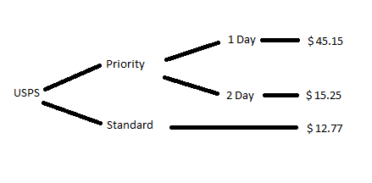
Determining Postage Options
Notes:
The Tree graph will be based off the previous example given for a 3 pound package to be delivered from Seattle (zip code 98101) to Miami (zip code 33133) using USPS system priority vs regular shipping.
For the 3 pound package to ship Priority Express-1 Day will be $45.15
For the 3 pound package to ship Priority Express-2 Day will be $15.25
For the 3 pound package to ship Standard will be $12.77
http://postcalc.usps.com/MailServices.aspx?m=6&p=3&o=0&dz=33133&oz=98101&pob=0&MailingDate=12/17/2013&MailingTime=8:00%20AM#

Slide 15
Putting it together the Pieces
This slide is owned by Momodu

Slide 16
Putting it together the Pieces
This slide is owned by Momodu

Slide 17
References
Grimaldi, R (2004). Discrete and Combinatorial Mathematics.
http://www.princeton.edu/~achaney/tmve/wiki100k/docs/Finite_set.html
http://whatis.techtarget.com/definition/null-set
Wayne, K; Sedgewick, R (2013). Algorithms Part II. Retrieved from:
https://class.coursera.org/algs4partII-002/class/index
http://postcalc.usps.com/

