Slide 1
OSD-38
GC-Col-0, FLT-Col-0, RNAlat-Col-0, and LN2-Col-0

Slide 2
Bacteria
a)
b)
c)
d)
https://www.nature.com/articles/nmeth.2066

Slide 3
e)
f)
The composition of the endophytic bacterial communities
We performed relative abundance analysis to elucidate the unique microbial communities associated with Arabidopsis thaliana. This approach allows us to delineate the distinct microbial signatures that differentiate Arabidopsis thaliana, emphasizing the comparisons for understanding microbial diversity. Our findings reveal that RNAlat-Col-0 is characterized by a pronounced dominance of Bacillus (abundance ratios of 84.7%), LN2-Col-0 dominance of Weizmannia (abundance ratios of 79.8%), GC-Col-0 and FLT-Col-0 are the dominance of Synechococcus (abundance ratios of 75% and 71.7%, respectively), marking a distinct microbial profile.
https://www.nature.com/articles/nmeth.2066

Slide 4
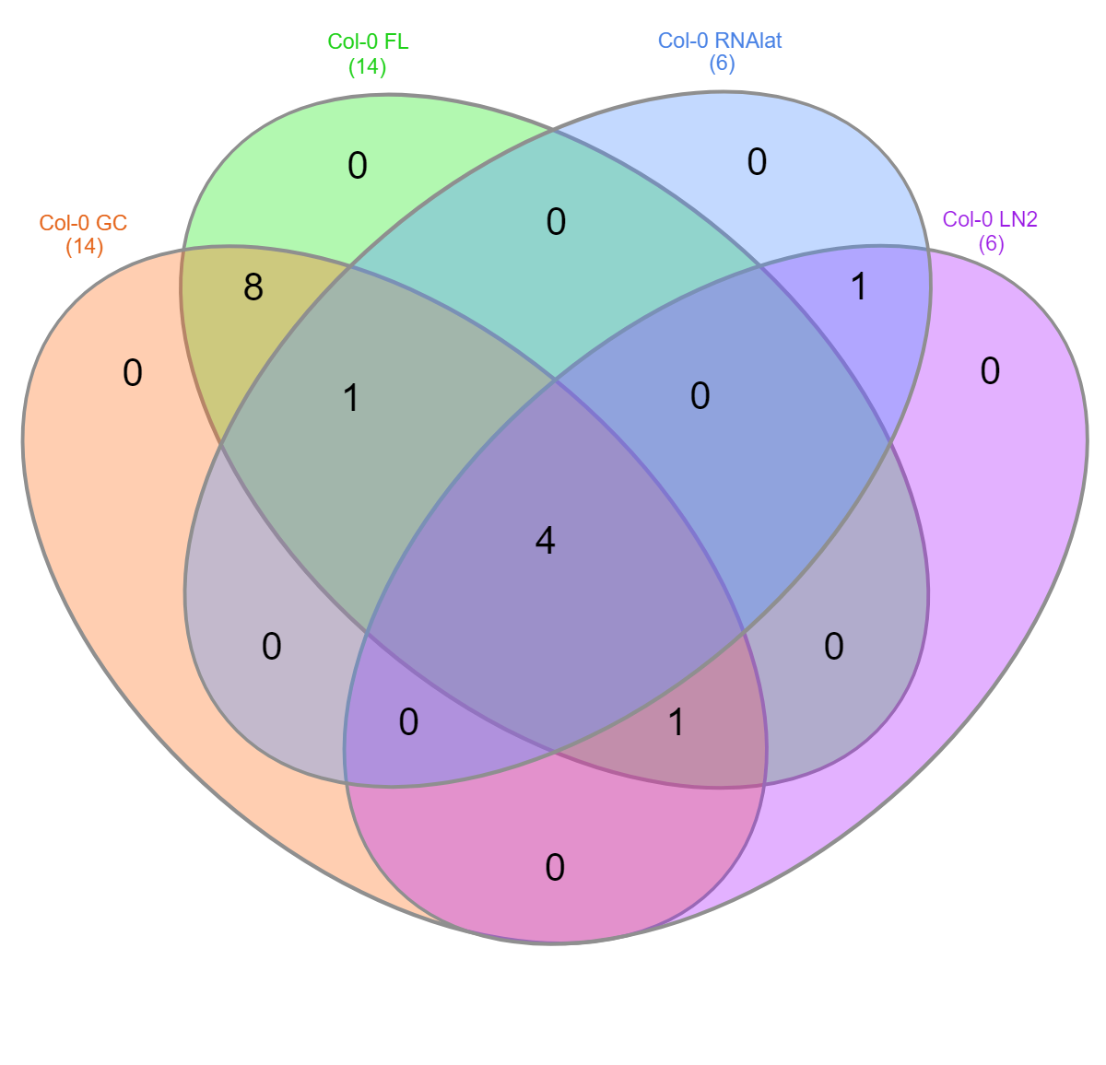

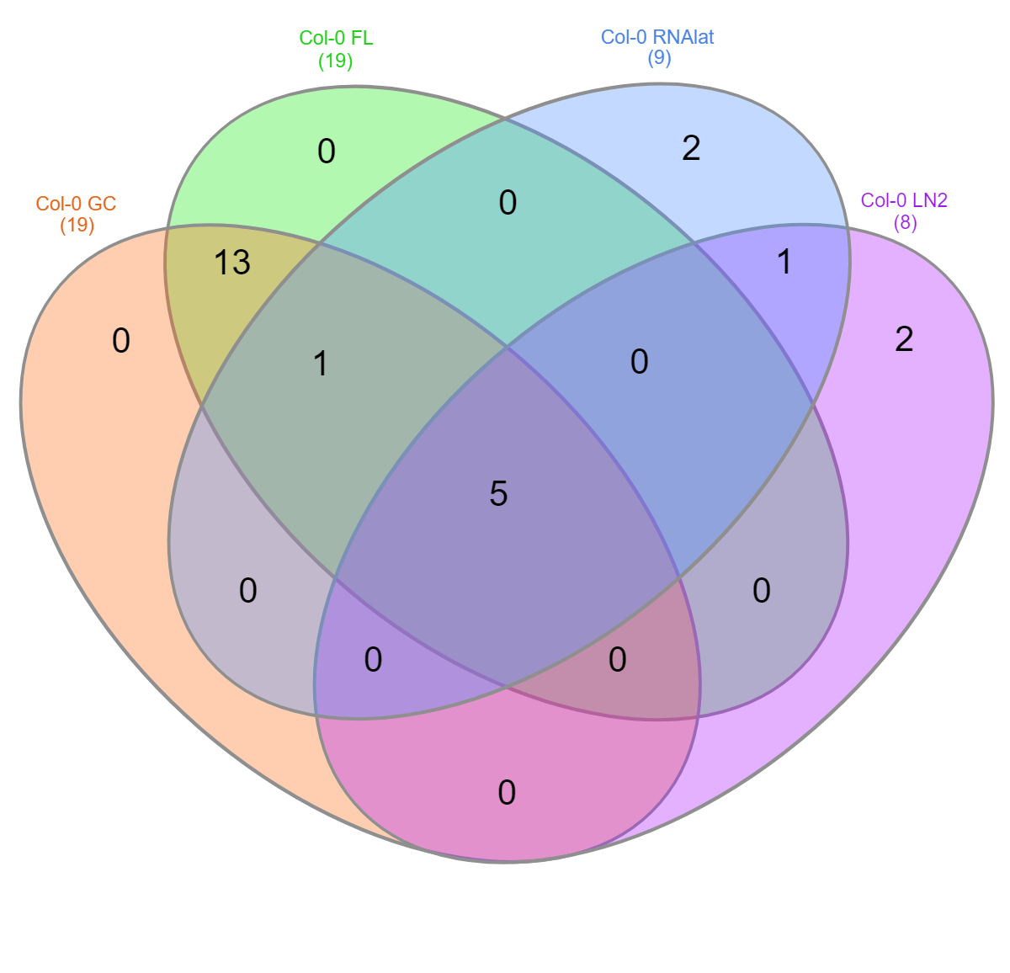
Bacteria
Family
Genus
Species
26.7%
26.3%
20.8%
Synechococcaceae
Comamonadaceae
Moraxellaceae
Propionibacteriaceae
Synechococcus
Comamonas
Acidovorax
Acinetobacter
Cutibacterium
Synechococcus elongatus
Comamonas denitrificans
Acidovorax ebreus
Acinetobacter junii
Cutibacterium acnes
Venn diagram for GC-Col-0, FLT-Col-0, RNAlat-Col-0, and LN2-Col-0
A Venn diagram represents the percentage and number of shared and unique microbiomes in the bacterial communities of the GC-Col-0, FLT-Col-0, RNAlat-Col-0, and LN2-Col-0 in the family, genus, and species level.
https://bmcbioinformatics.biomedcentral.com/articles/10.1186/s12859-015-0611-3

Slide 5
Bacteria
Alpha diversity comparisons of the Arabidopsis thaliana
The p-values for alpha diversity were calculated using the Kruskal-Wallis test. Alpha diversity for bacterial communities in different accessions of GC-Col-0, FLT-Col-0, RNAlat-Col-0, and LN2-Col-0 at the species level. There is no statistically significant difference between the groups in terms of alpha diversity. The groups have similar alpha diversity levels.
H.J. Motulsky, Analyzing Data with GraphPad Prism, 1999,. GraphPad Software Inc.

Slide 6
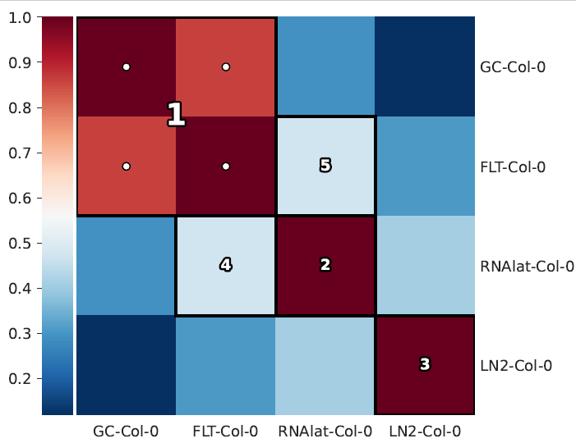
Bacteria
HAIIA (Hierarchical All-Against-All Association) analysis.
This study evaluated the relationships between GC-Col-0, FLT-Col-0, RNAlat-Col-0, and LN2-Col-0 using Spearman correlation. A very strong positive correlation was determined between GC-Col-0 and FLT-Col-0, and these two GC-Col-0 and FLT-Col-0 tended to increase or decrease together. Furthermore, RNAlat-Col-0 was moderately positively correlated with FLT-Col-0 and GC-Col-0. LN2-Col-0 had weaker but significant positive correlations with RNAlat-Col-0 and GC-Col-0.
https://pubmed.ncbi.nlm.nih.gov/35758795/

Slide 7
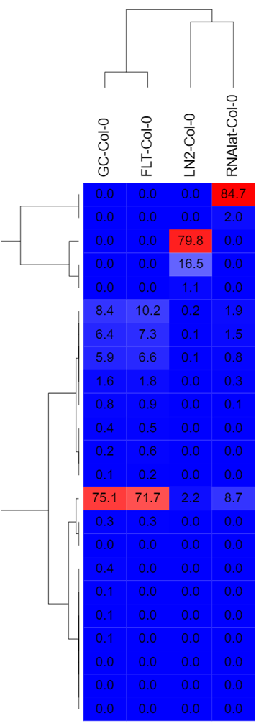
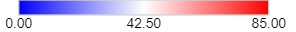
Bacteria
Bacillus subtilis
Weizmannia ginsengihumi
A heatmap was performed using Spearman correlation analysis to assess the relationships between specific variables.
RNAlat-Col-0 with Bacillus subtilis, LN2-Col-0 with Weizmannia ginsengihumi, GC-Col-0, and FLT-Col-0 with Synechococcus elongatus show a strong link between the variables.
Synechococcus elongatus
https://software.broadinstitute.org/GENE-E/

Slide 8
Fungi
a)
The composition of the endophytic fungal communities
Only GC-Col-0 and FLT-Col-0 were found to have a fungal community of Malassesiza restirica belonging to the genus Malassezia.
https://www.nature.com/articles/nmeth.2066

