Slide 1
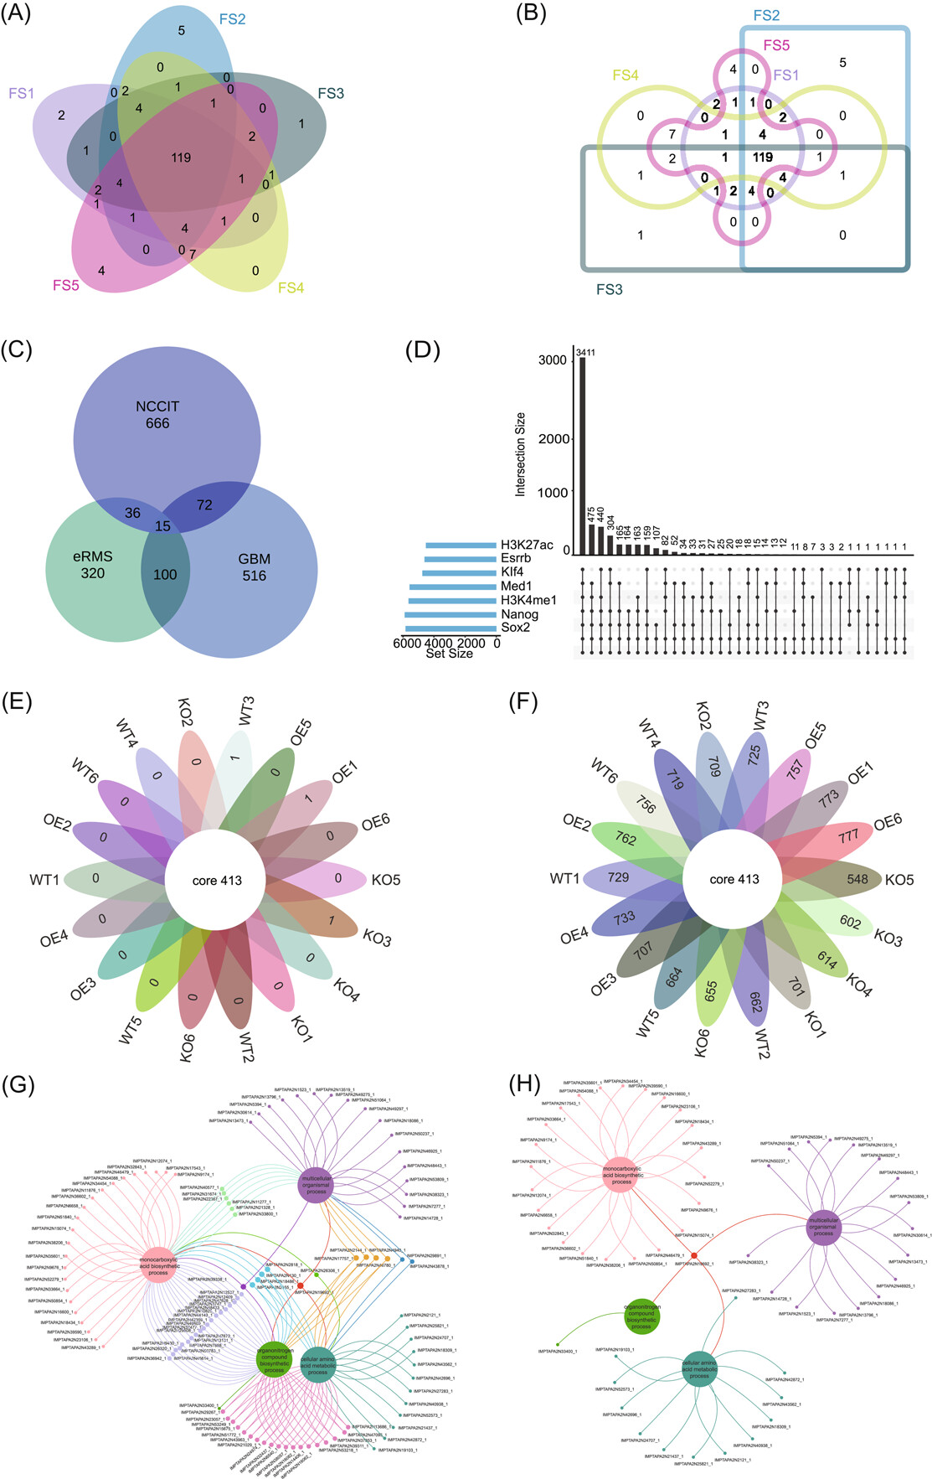
Visualizing set relationships: EVenn's comprehensive approach to Venn diagrams
iMeta, Volume: 3, Issue: 3, First published: 11 April 2024, DOI: (10.1002/imt2.184)
Notes:
Case demonstrations in EVenn. (A) Interactive Venn diagrams for differential metabolites of five parts of Poria cocos. (B) Interactive Edwards diagrams for differential metabolites of five parts of Poria cocos. (C) Euler diagrams for differentially expressed genes in three cell types following anticancer drug treatment. (D) UpSet plot for seven transcription regulators and their targeting genes in ChIP‐seq. (E) Interactive flower plot displaying 18 groups of common and unique elements of OTUs. (F) Interactive flower plot showcasing OTUs of common and after subtracting common elements in 18 groups. (G) Venn network diagrams for visualizing gene ontology enrichment analysis results for Andrographis paniculata. (H) Venn network diagram exclusively showcasing common and unique genes of four biological processes of Andrographis paniculata.
IF THIS IMAGE HAS BEEN PROVIDED BY OR IS OWNED BY A THIRD PARTY, AS INDICATED IN THE CAPTION LINE, THEN FURTHER PERMISSION MAY BE NEEDED BEFORE ANY FURTHER USE. PLEASE CONTACT WILEY'S PERMISSIONS DEPARTMENT ON PERMISSIONS@WILEY.COM OR USE THE RIGHTSLINK SERVICE BY CLICKING ON THE 'REQUEST PERMISSIONS' LINK ACCOMPANYING THIS ARTICLE. WILEY OR AUTHOR OWNED IMAGES MAY BE USED FOR NON-COMMERCIAL PURPOSES, SUBJECT TO PROPER CITATION OF THE ARTICLE, AUTHOR, AND PUBLISHER.

