Slide 1
OSD-37
Col-0 (GC-FLT), Cvi-0 (GC-FLT), Ler-0 (GC-FLT),and Ws-2 (GC-FLT)

Slide 2
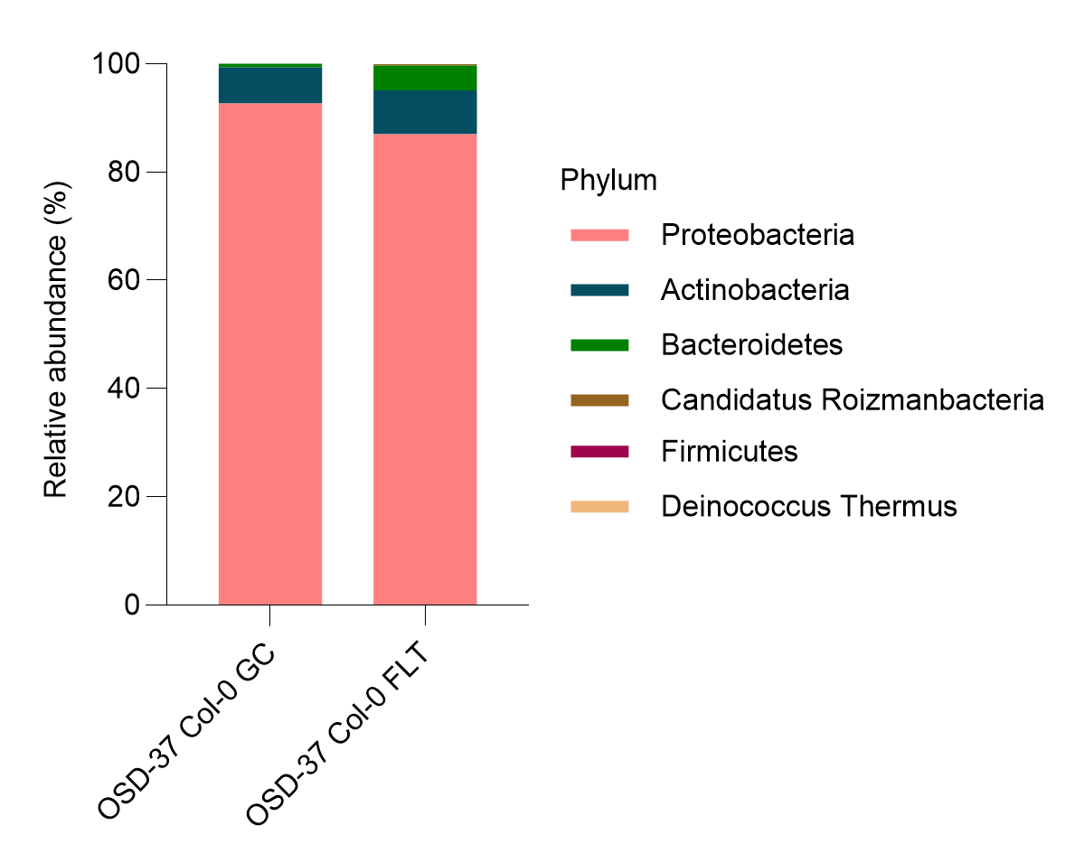
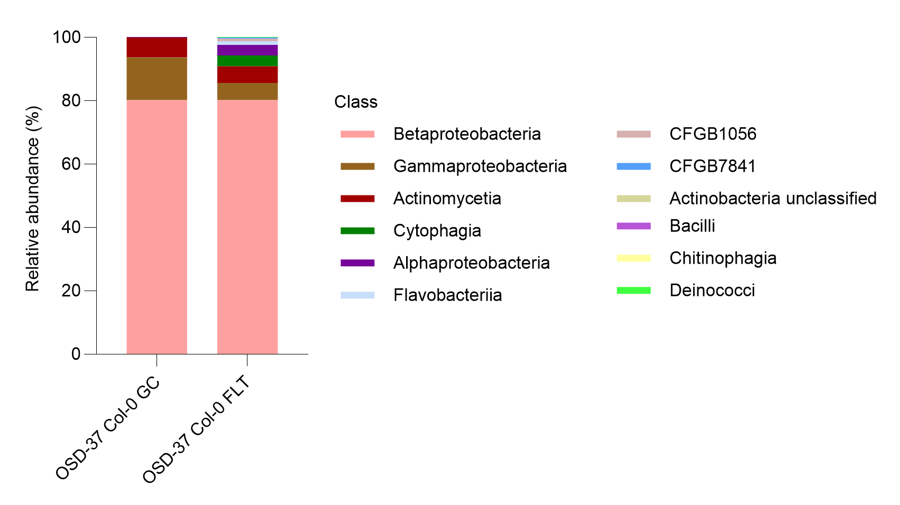
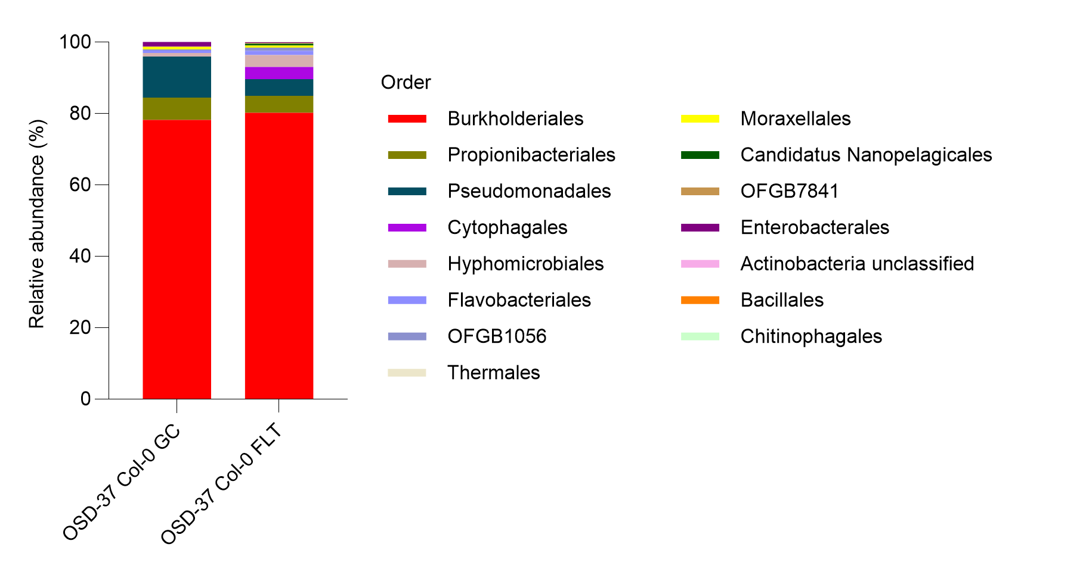
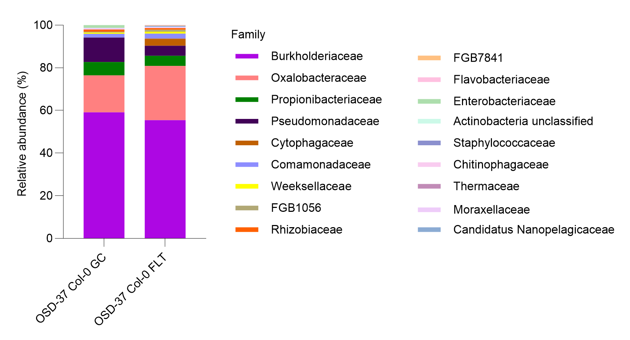
Bacteria - Col-0 (GC-FLT)
a)
b)
c)
d)
https://www.nature.com/articles/nmeth.2066

Slide 3
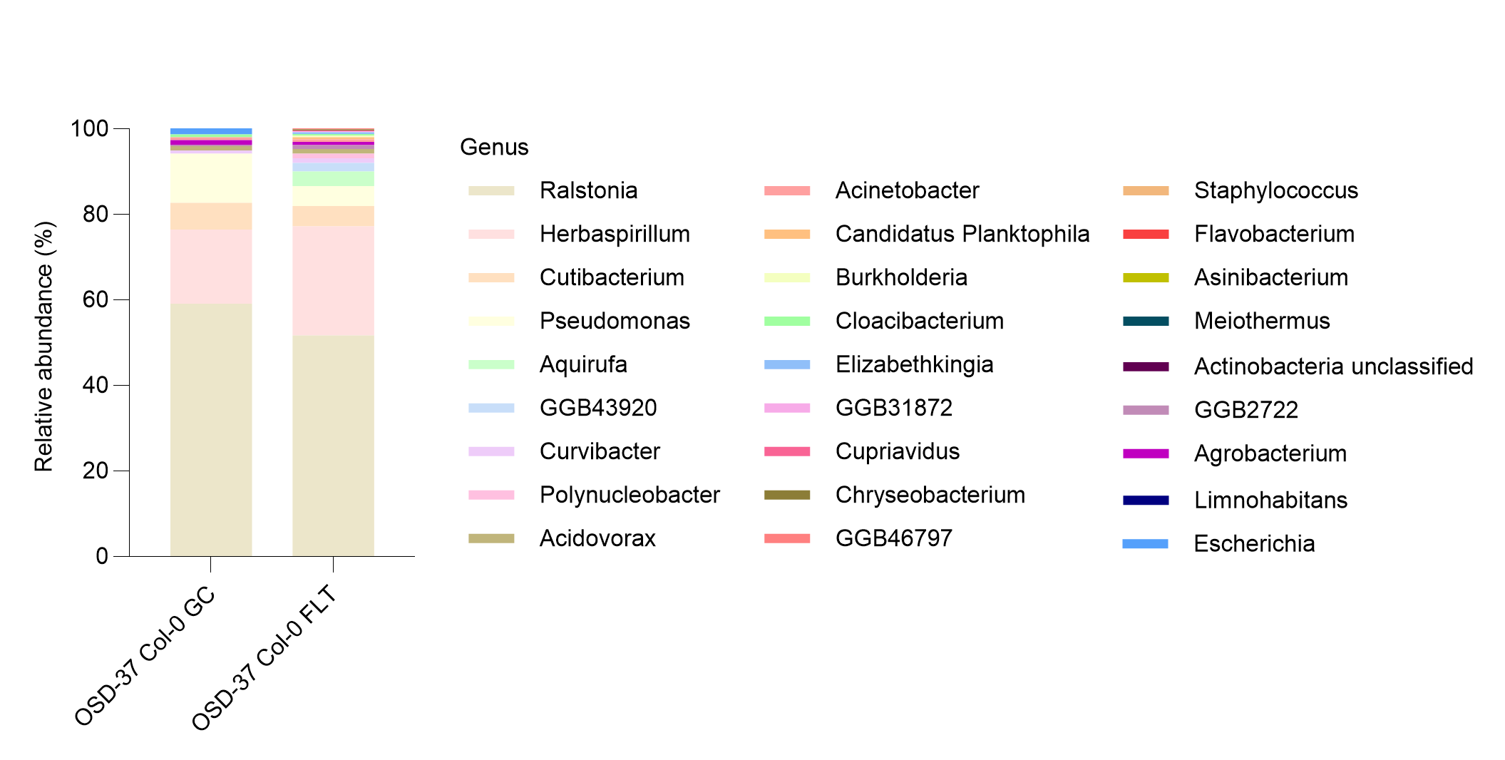
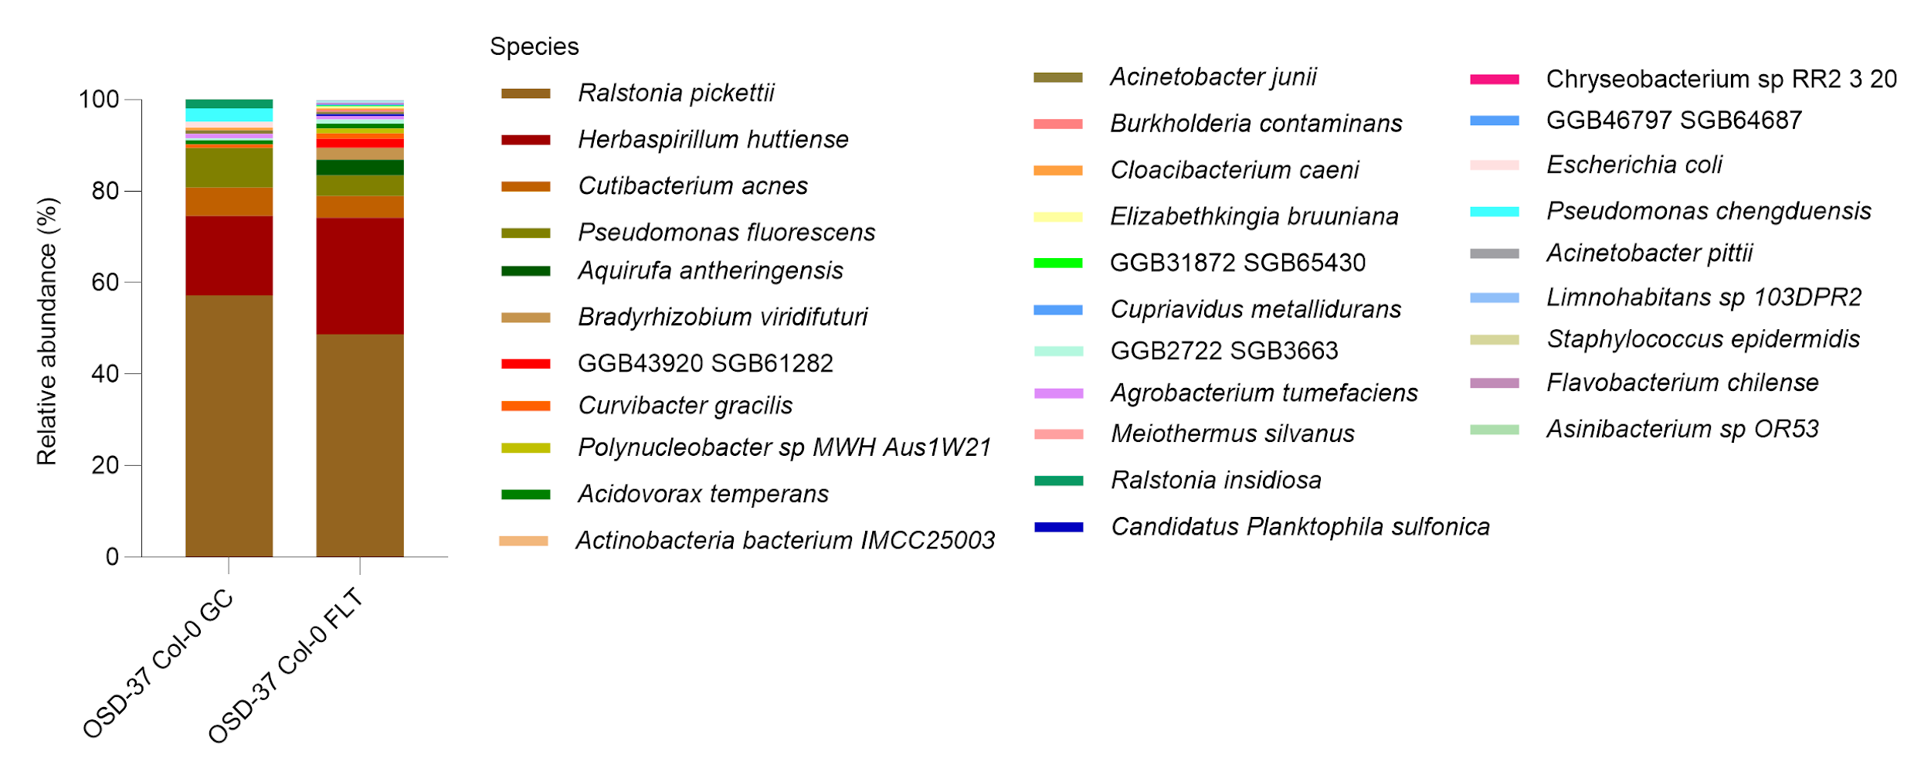
Bacteria - Col-0 (GC-FLT)
e)
f)
https://www.nature.com/articles/nmeth.2066

Slide 4
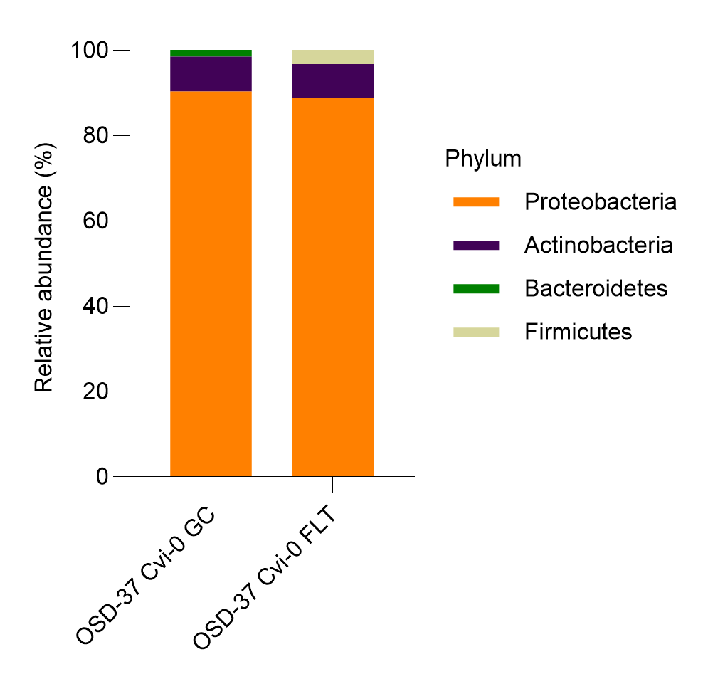
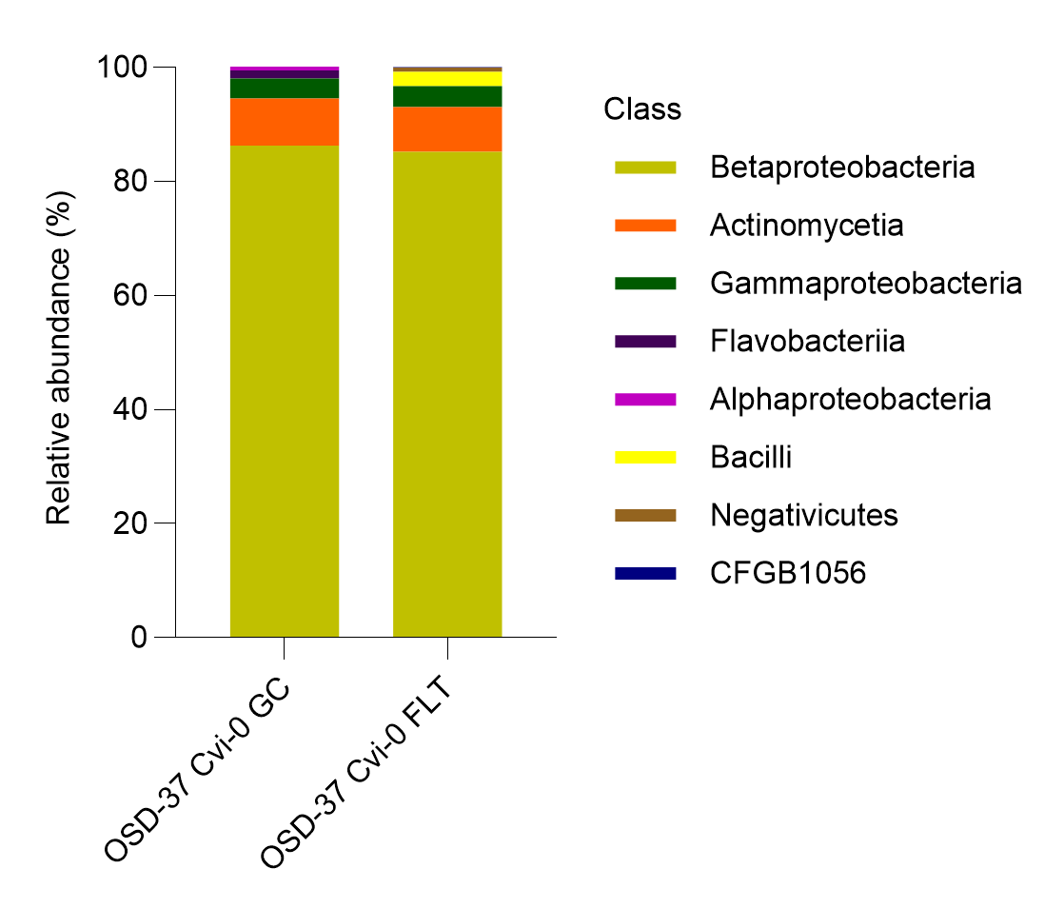
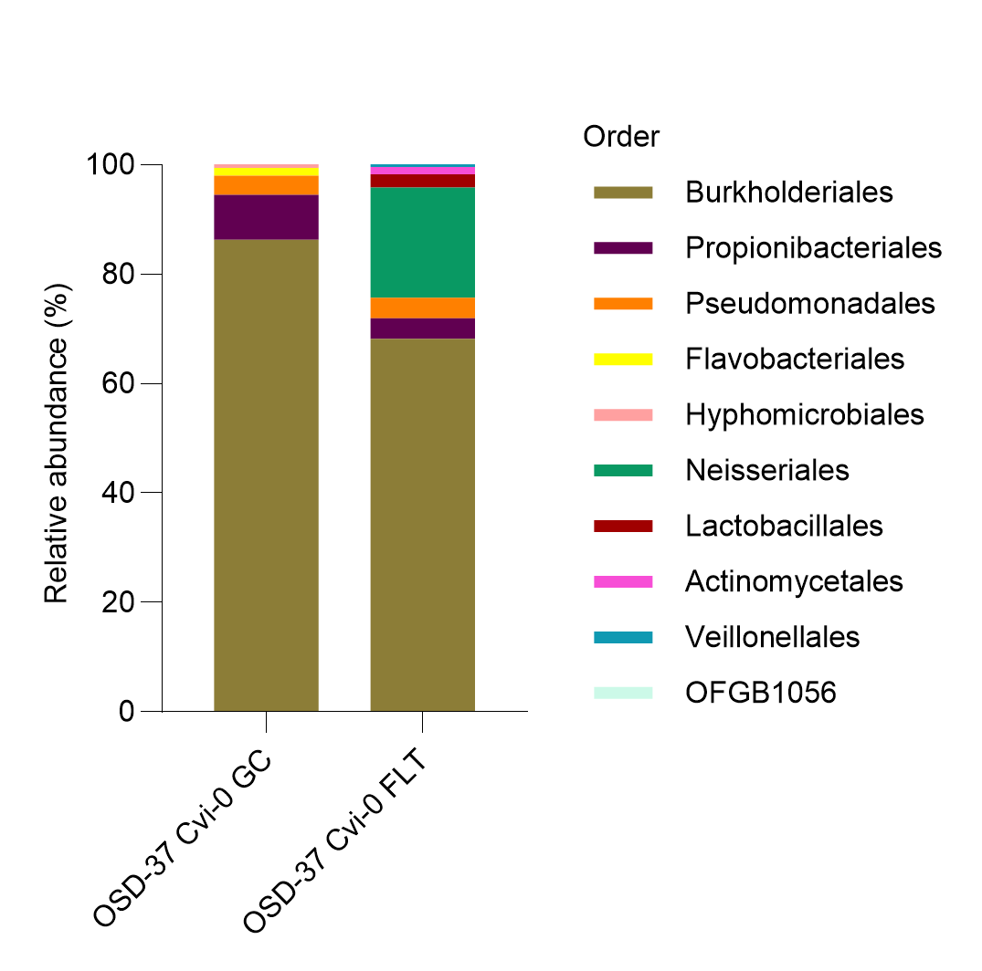
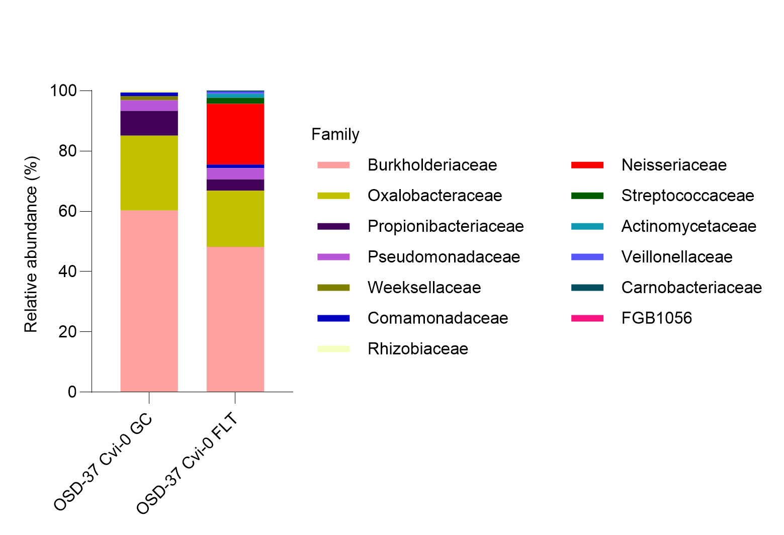
Bacteria - Cvi-0 (GC-FLT)
a)
b)
c)
d)
https://www.nature.com/articles/nmeth.2066

Slide 5
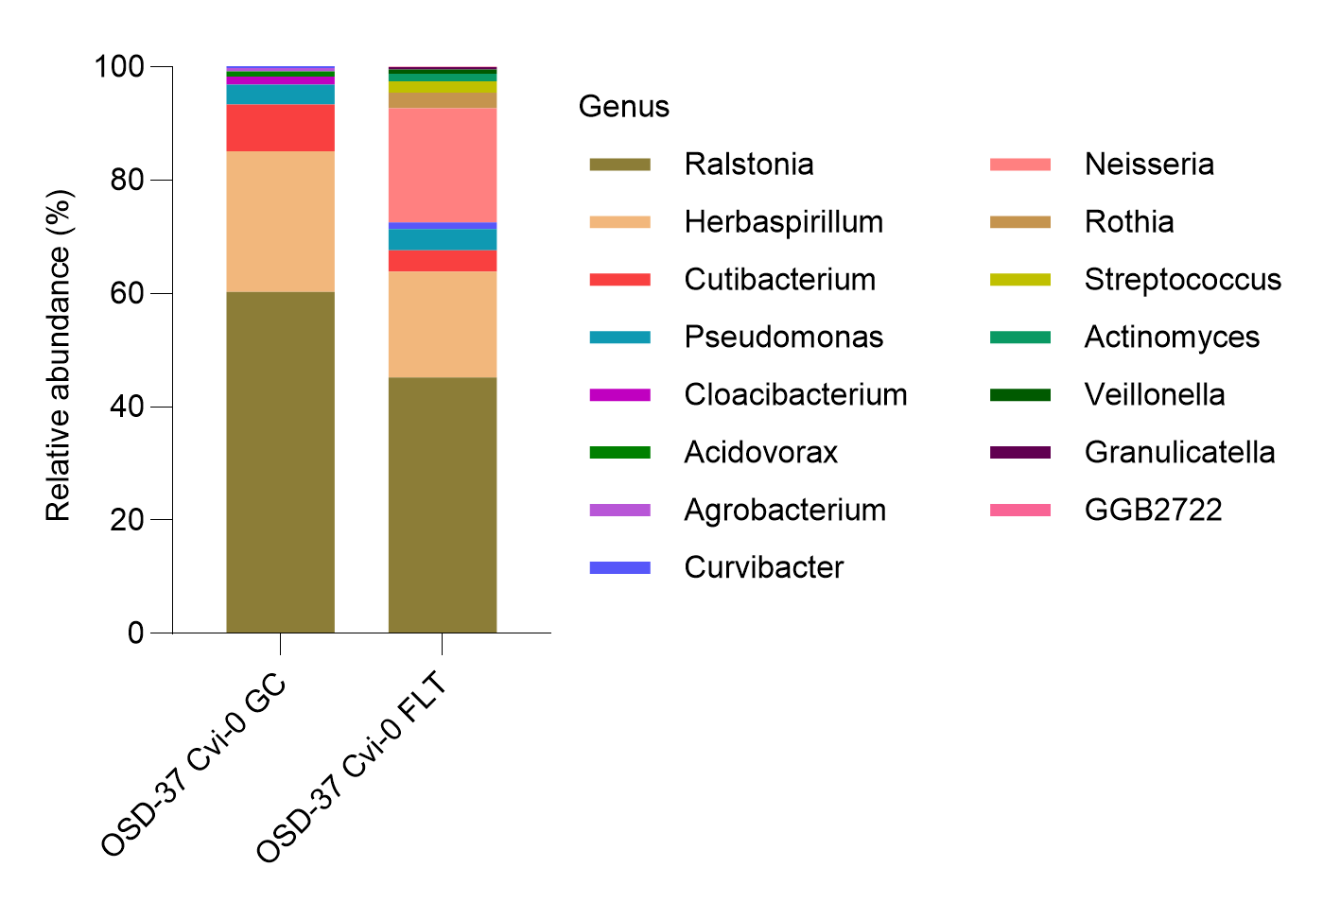
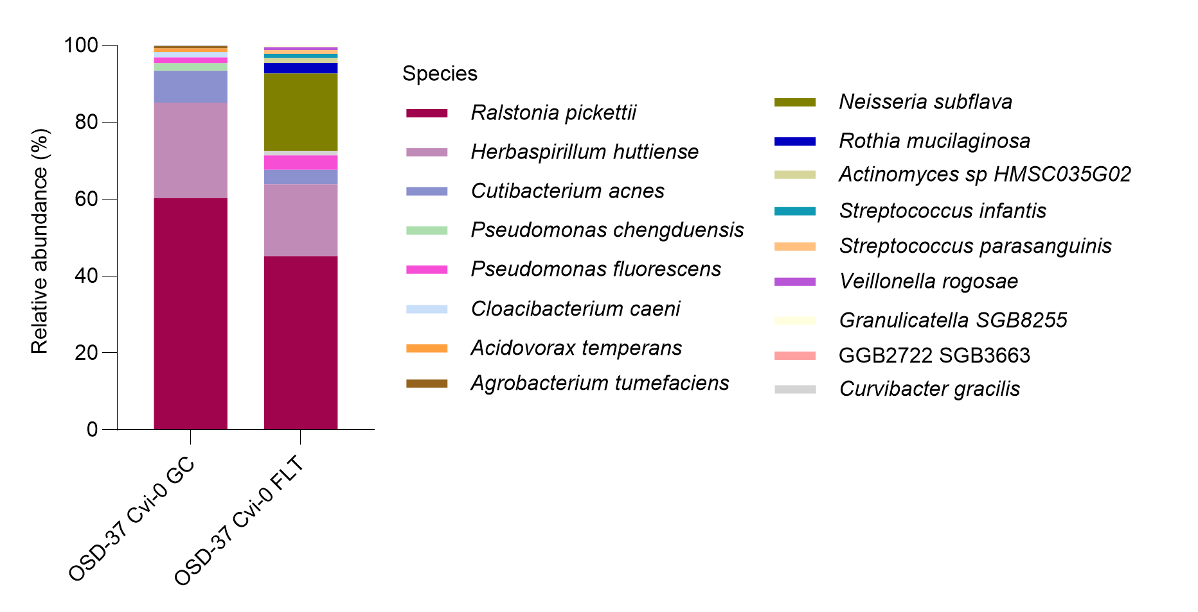
Bacteria - Cvi-0 (GC-FLT)
e)
f)
https://www.nature.com/articles/nmeth.2066

Slide 6
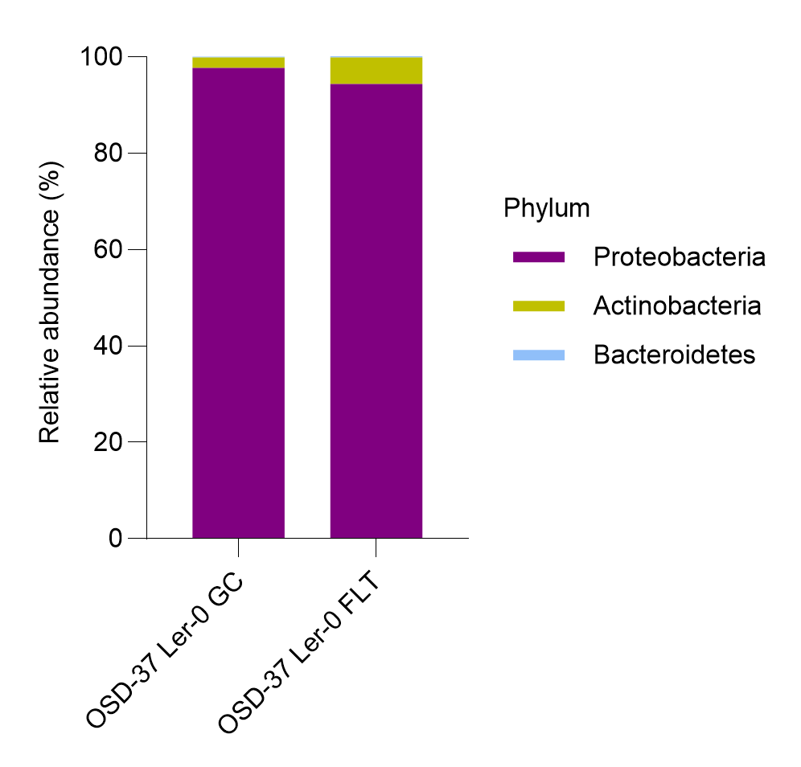
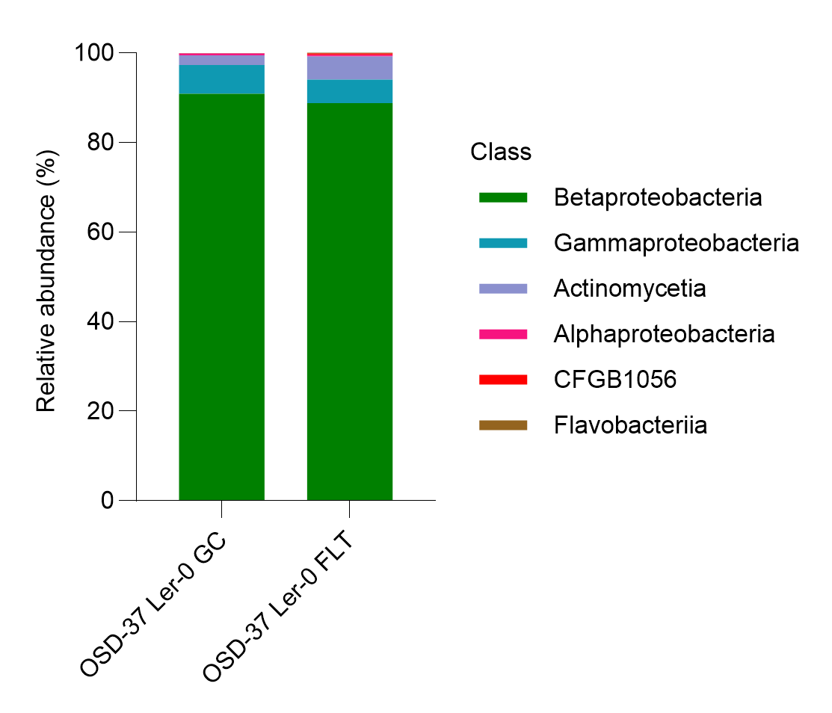
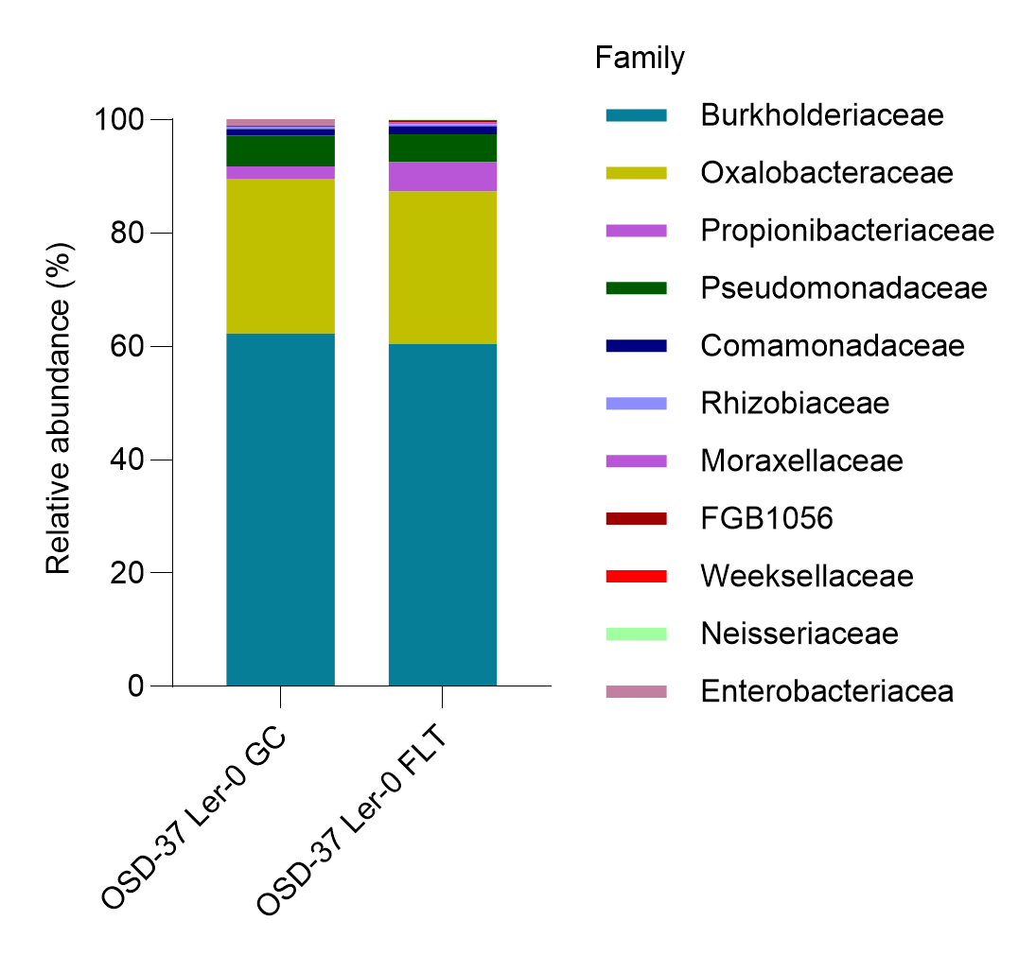
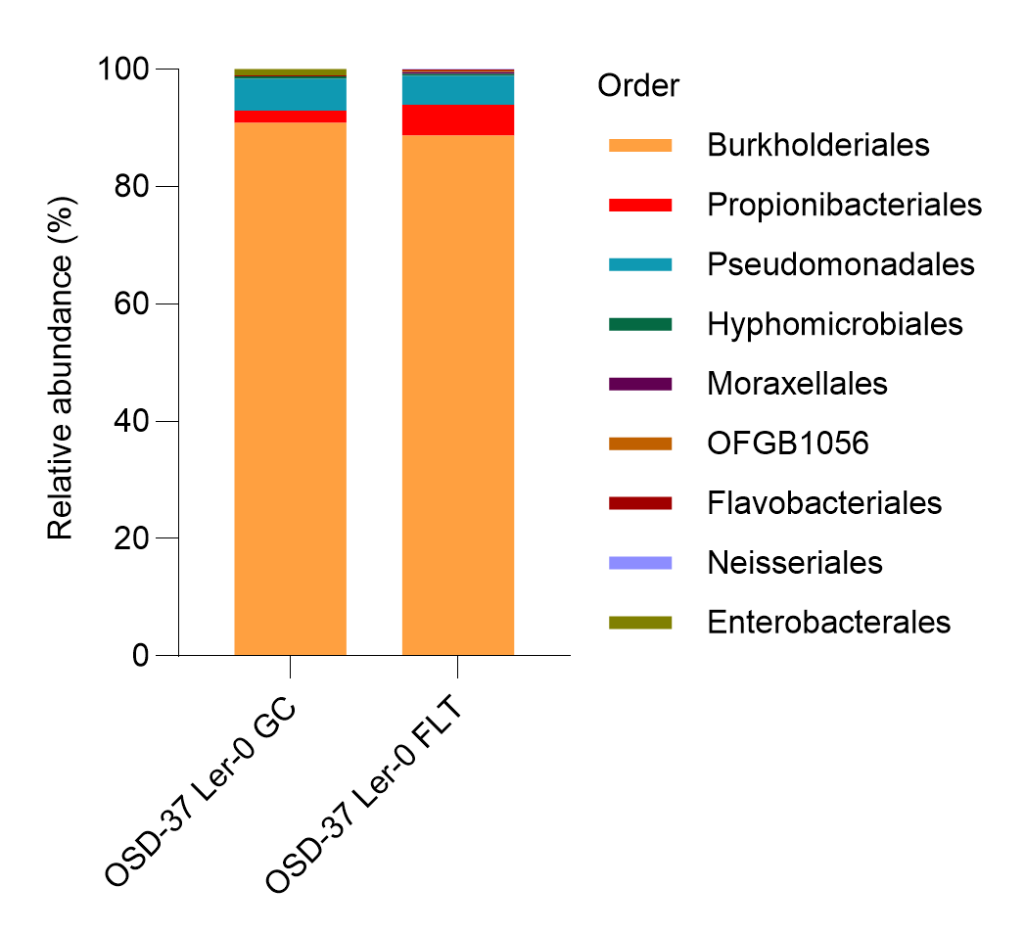
Bacteria - Ler-0 (GC-FLT)
a)
b)
c)
d)
https://www.nature.com/articles/nmeth.2066

Slide 7
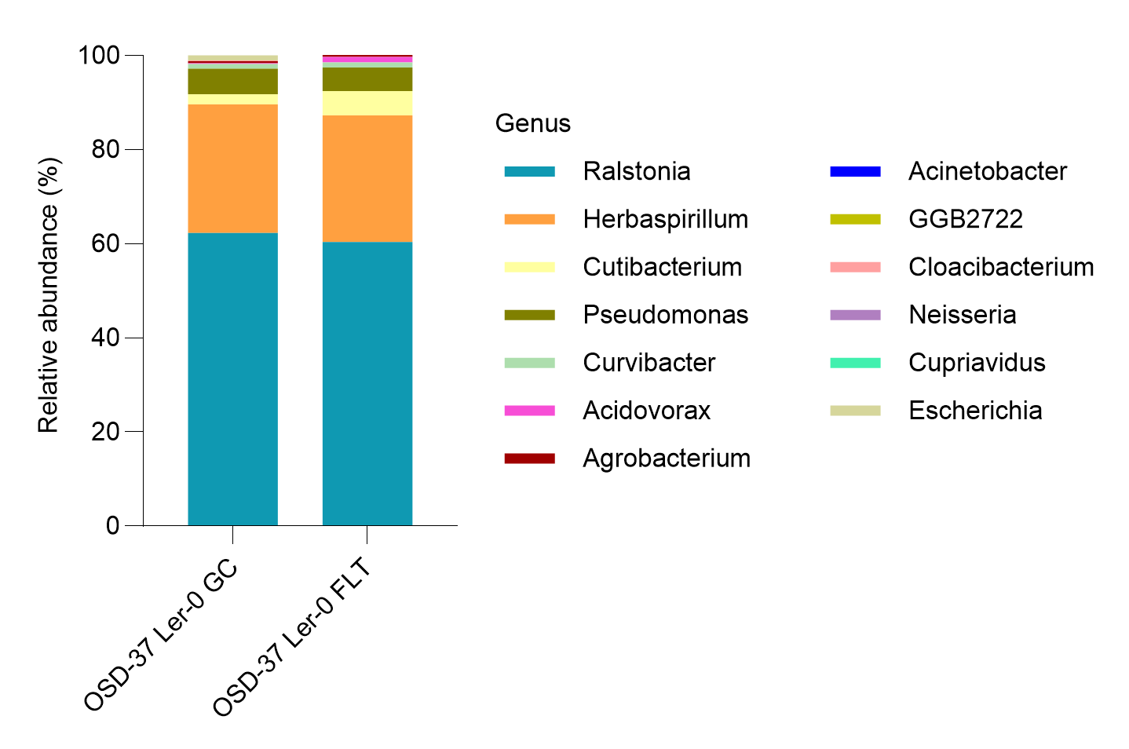
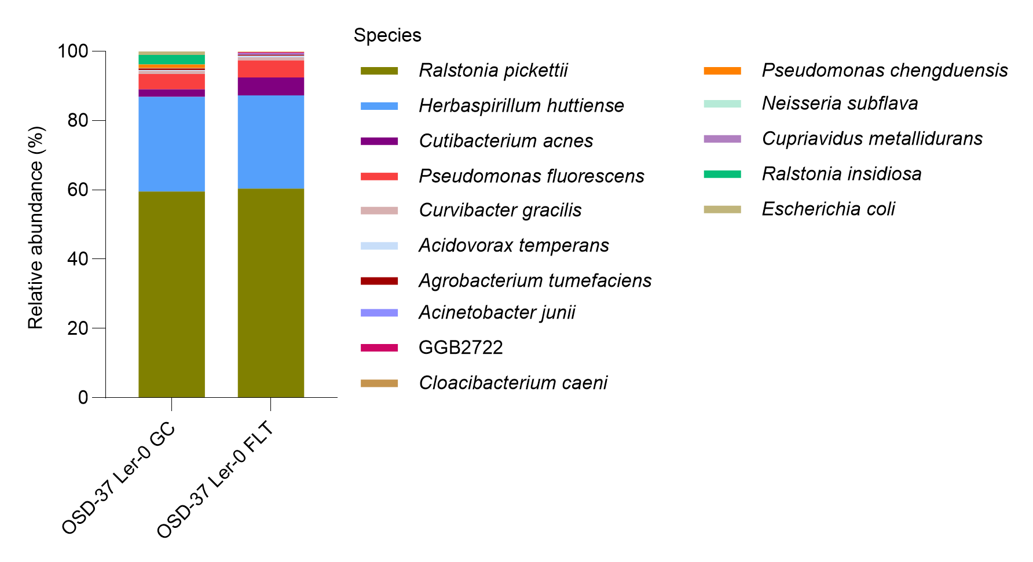
Bacteria - Ler-0 (GC-FLT)
e)
f)
https://www.nature.com/articles/nmeth.2066

Slide 8
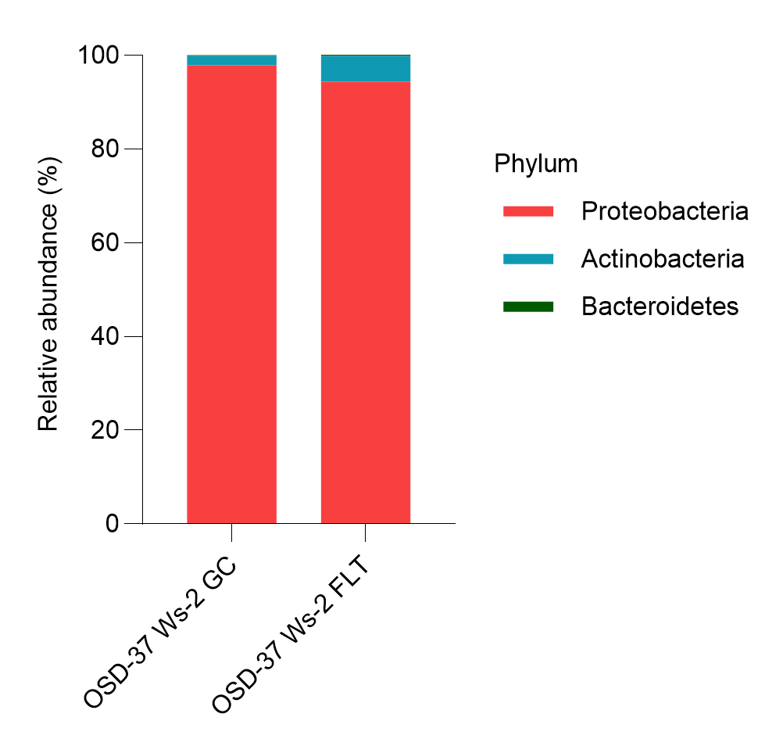
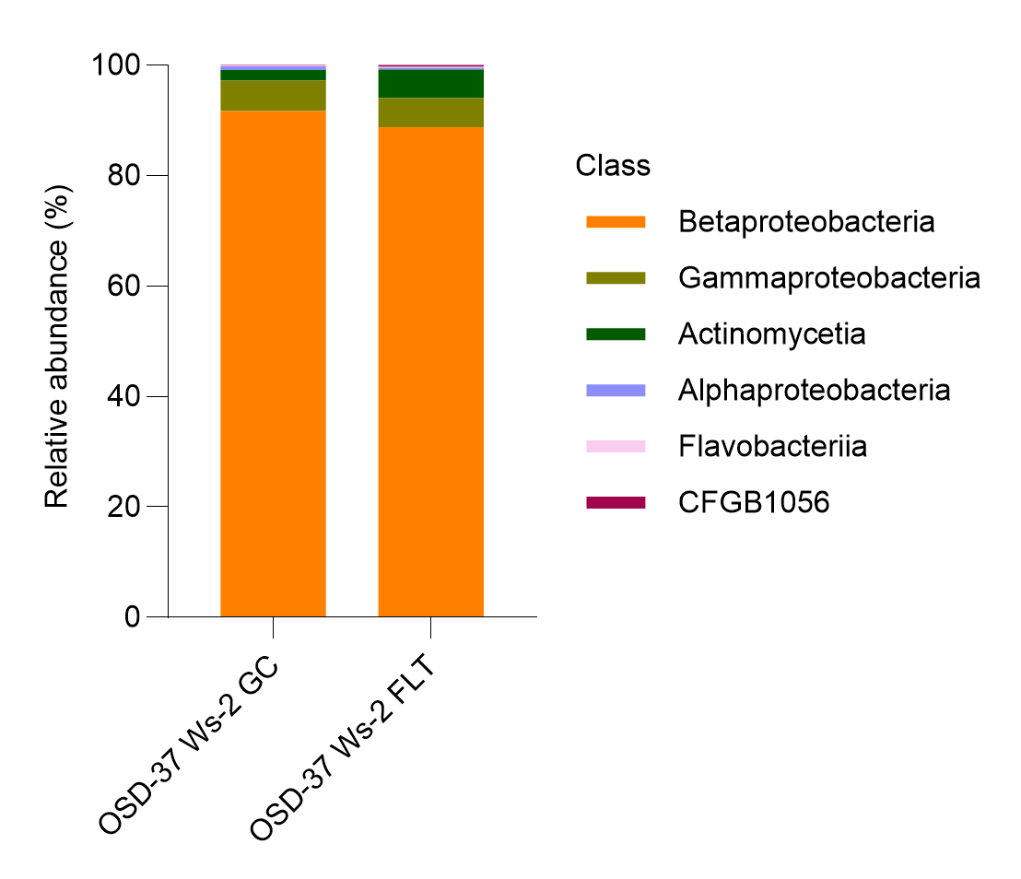
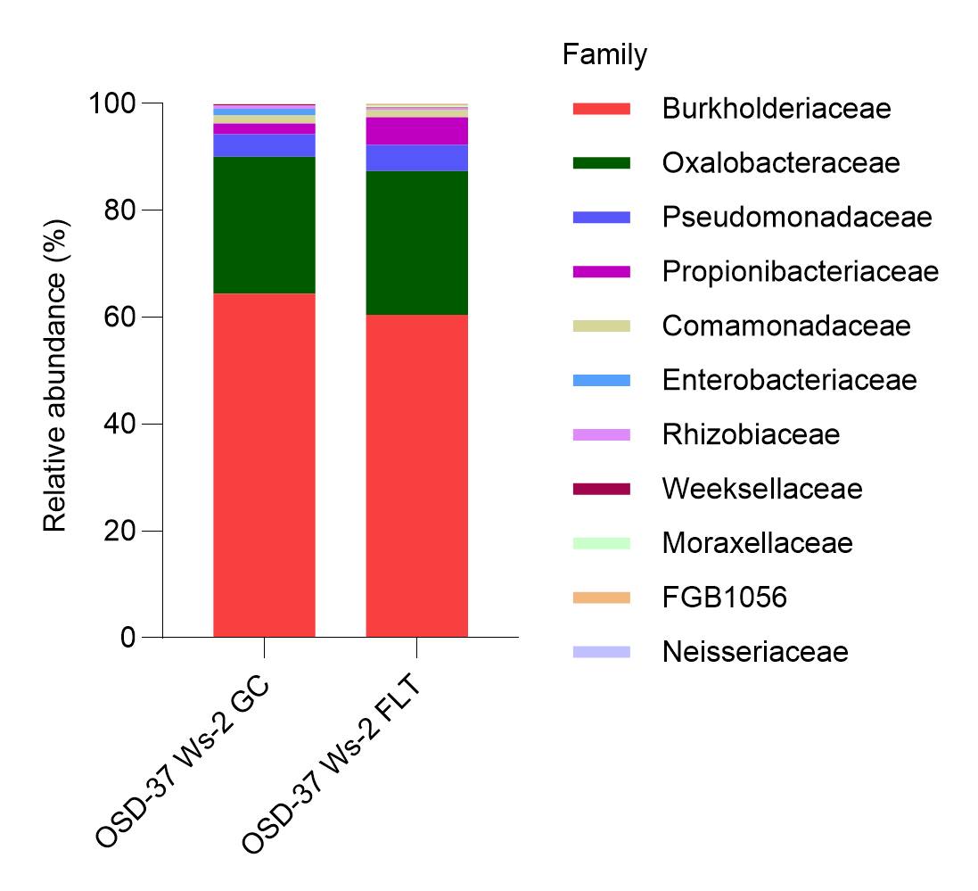
Bacteria - Ws-2 (GC-FLT)
a)
b)
c)
d)
https://www.nature.com/articles/nmeth.2066

Slide 9
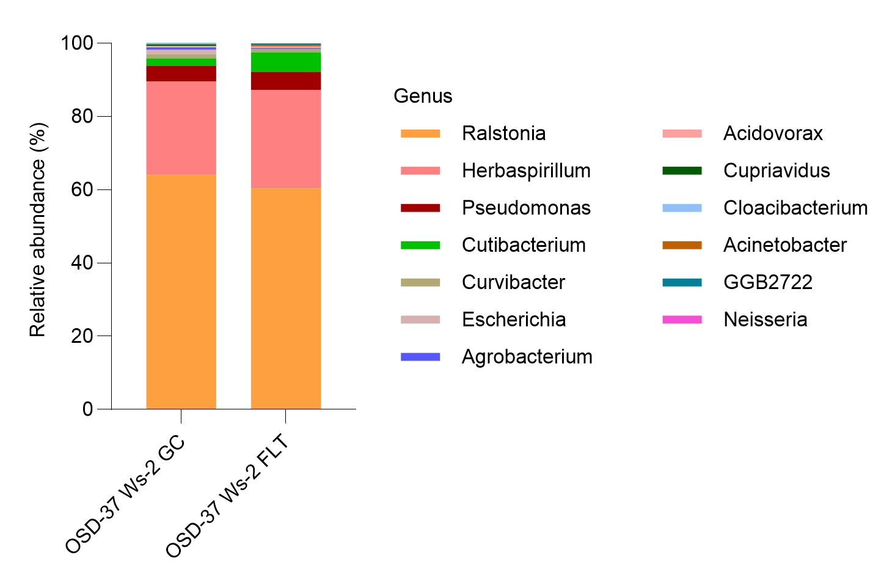
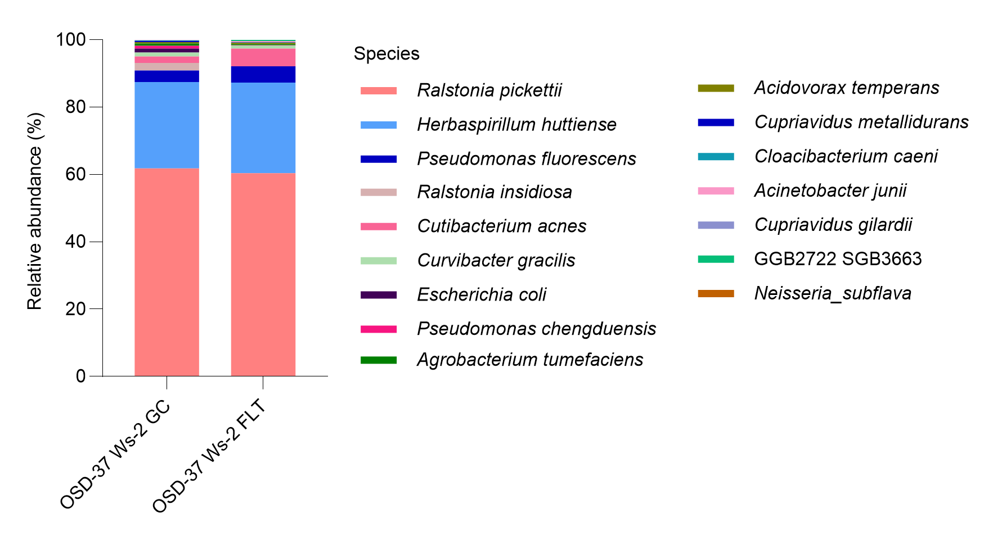
Bacteria - Ws-2 (GC-FLT)
e)
f)
https://www.nature.com/articles/nmeth.2066

Slide 10
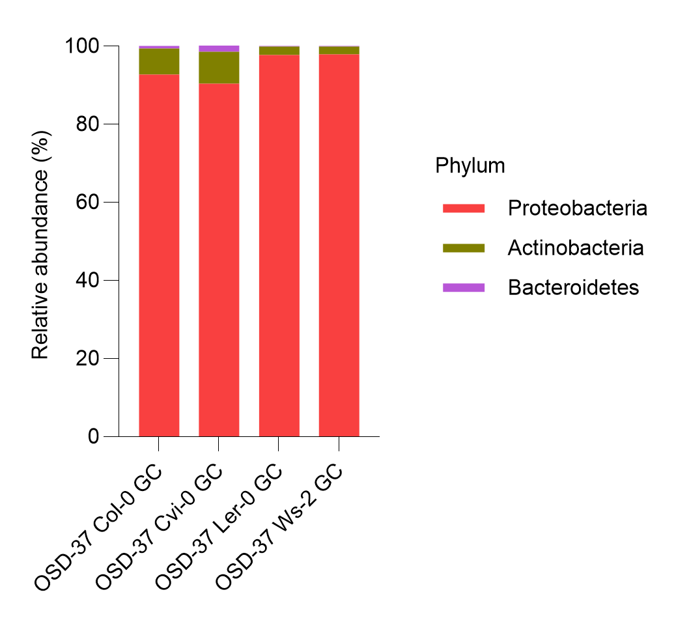
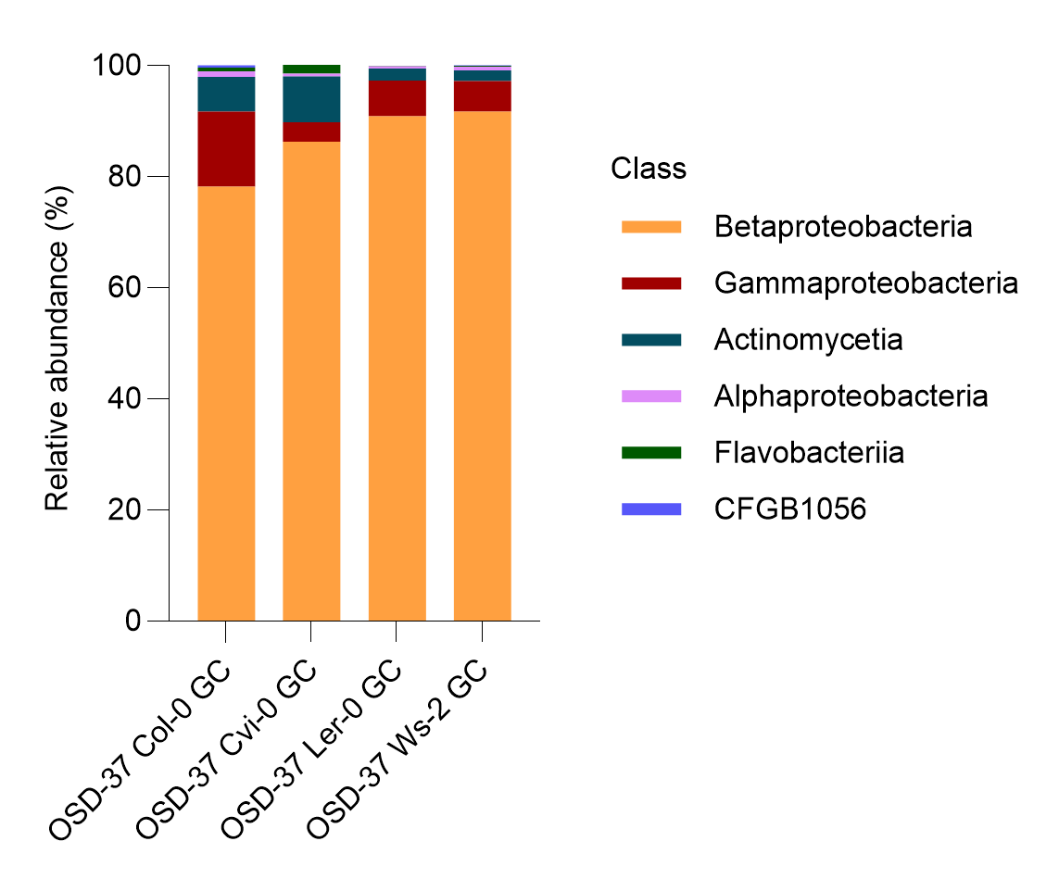
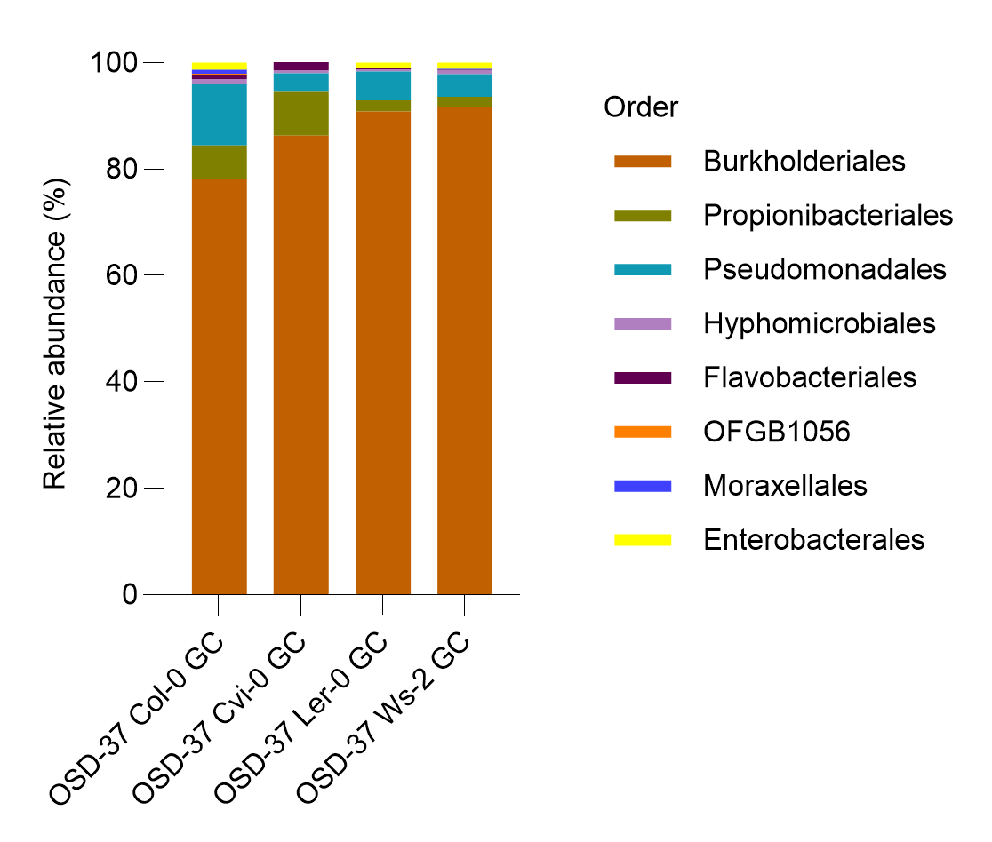
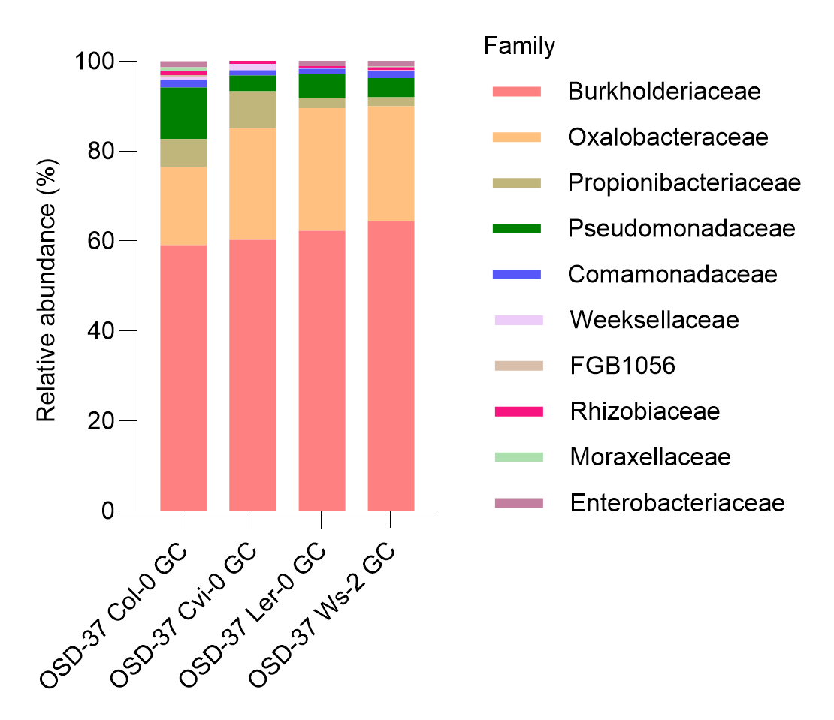
Bacteria – OSD-37 GC
a)
b)
c)
d)
https://www.nature.com/articles/nmeth.2066

Slide 11
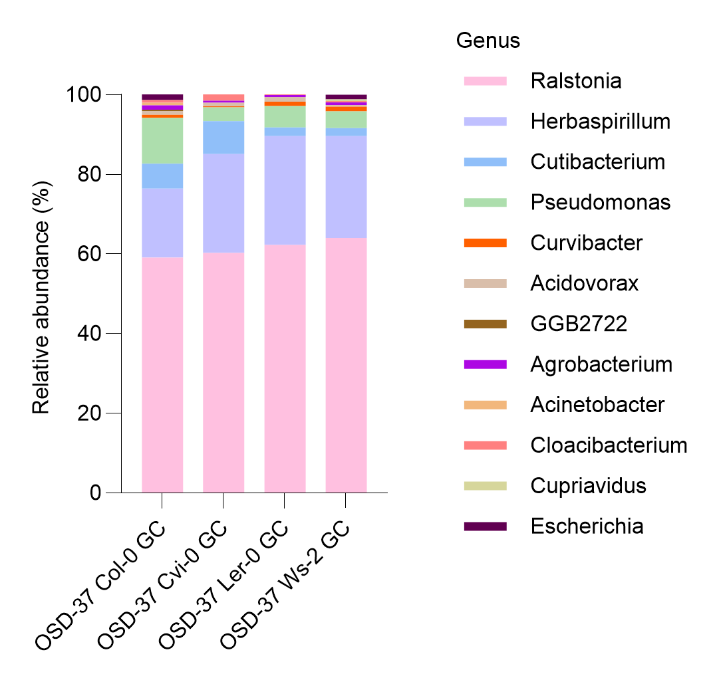
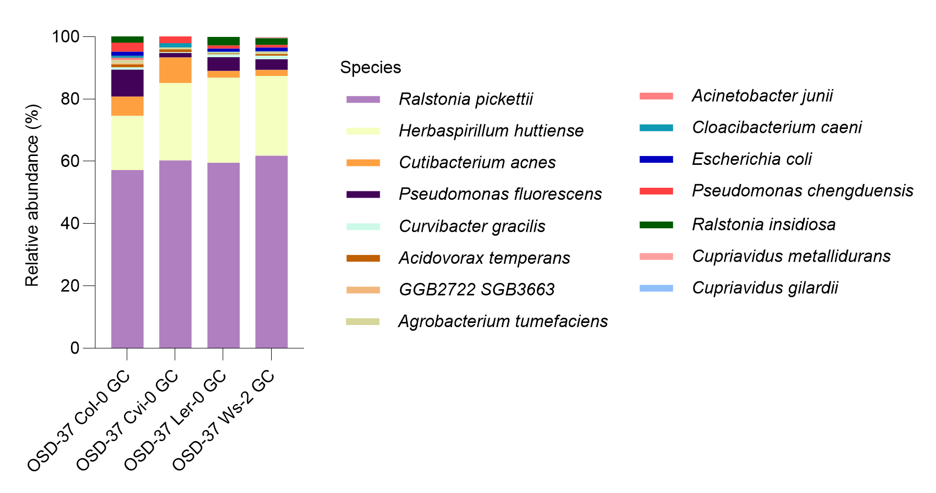
Bacteria – OSD-37 GC
e)
f)
https://www.nature.com/articles/nmeth.2066

Slide 12
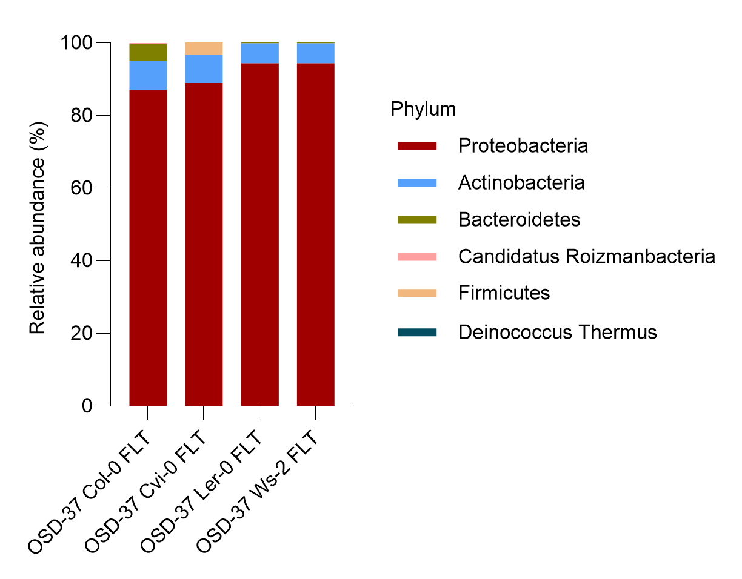
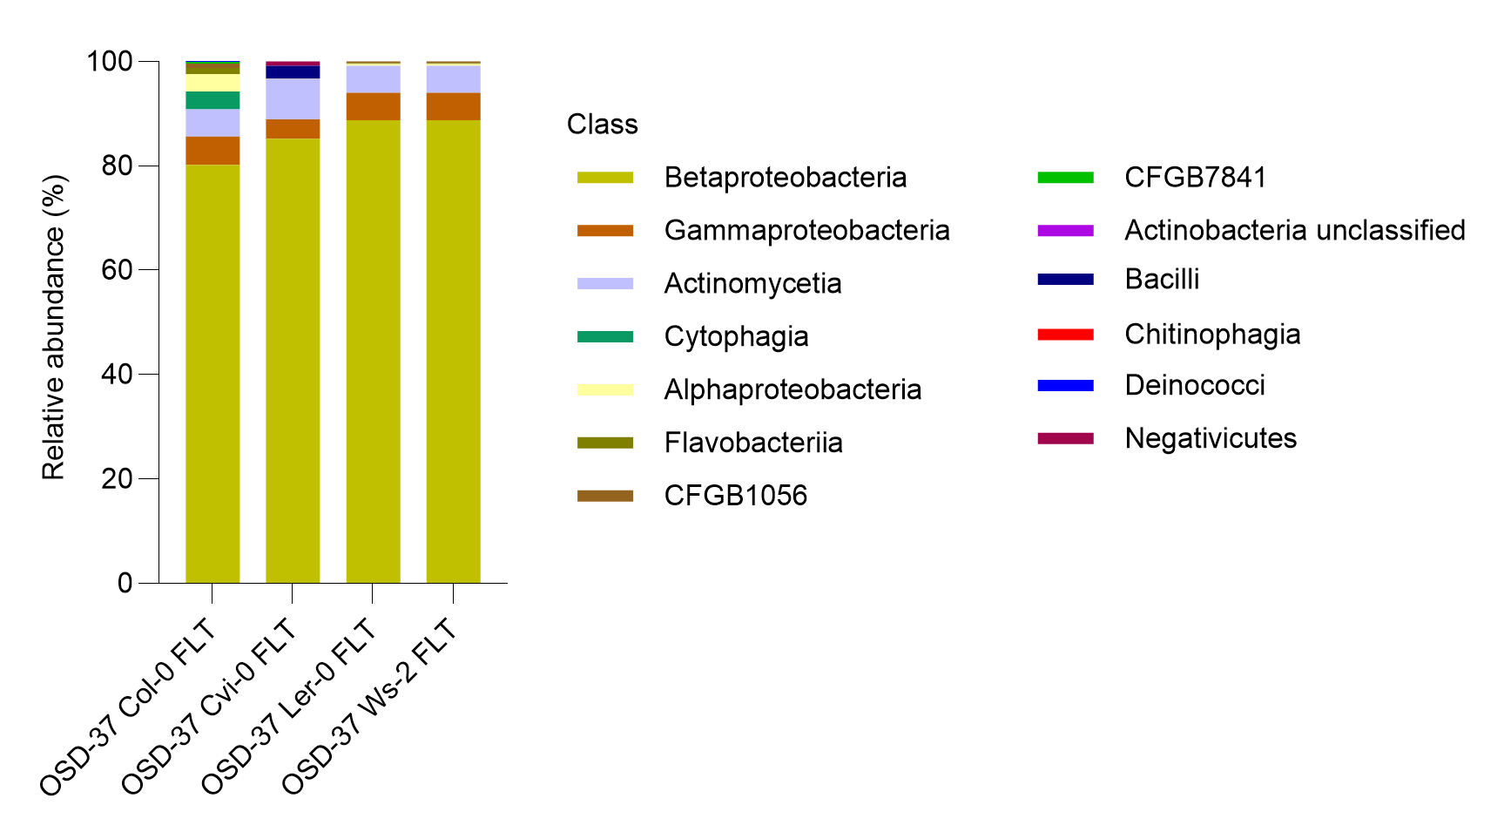
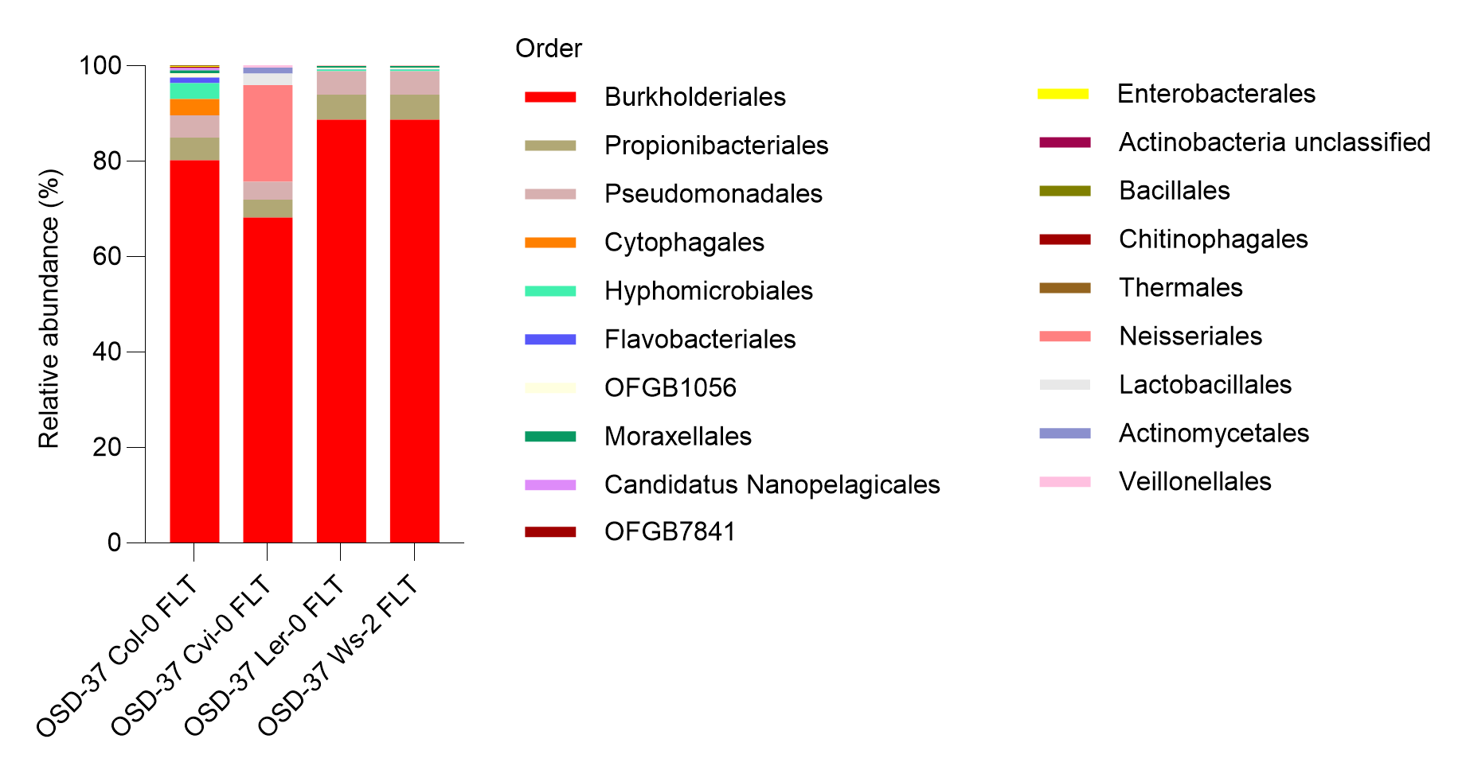
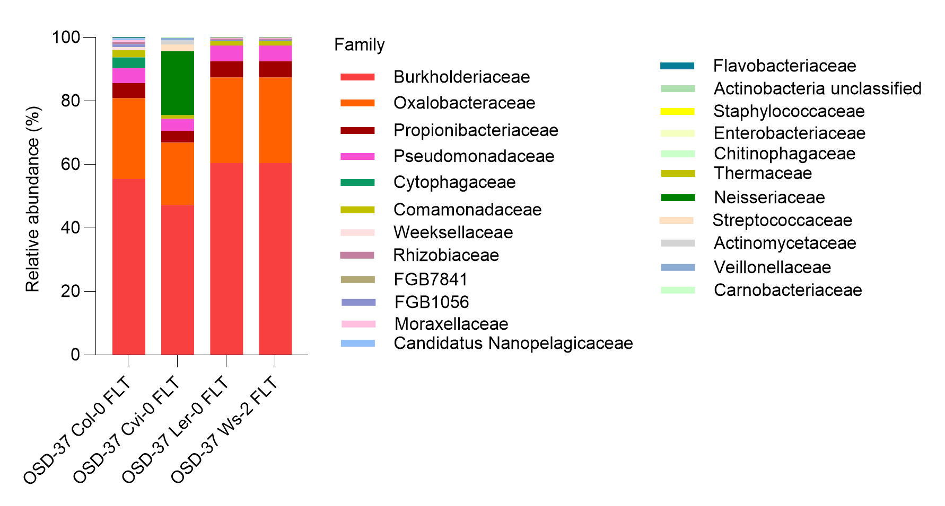
Bacteria – OSD-37 FLT
a)
b)
c)
d)
https://www.nature.com/articles/nmeth.2066

Slide 13
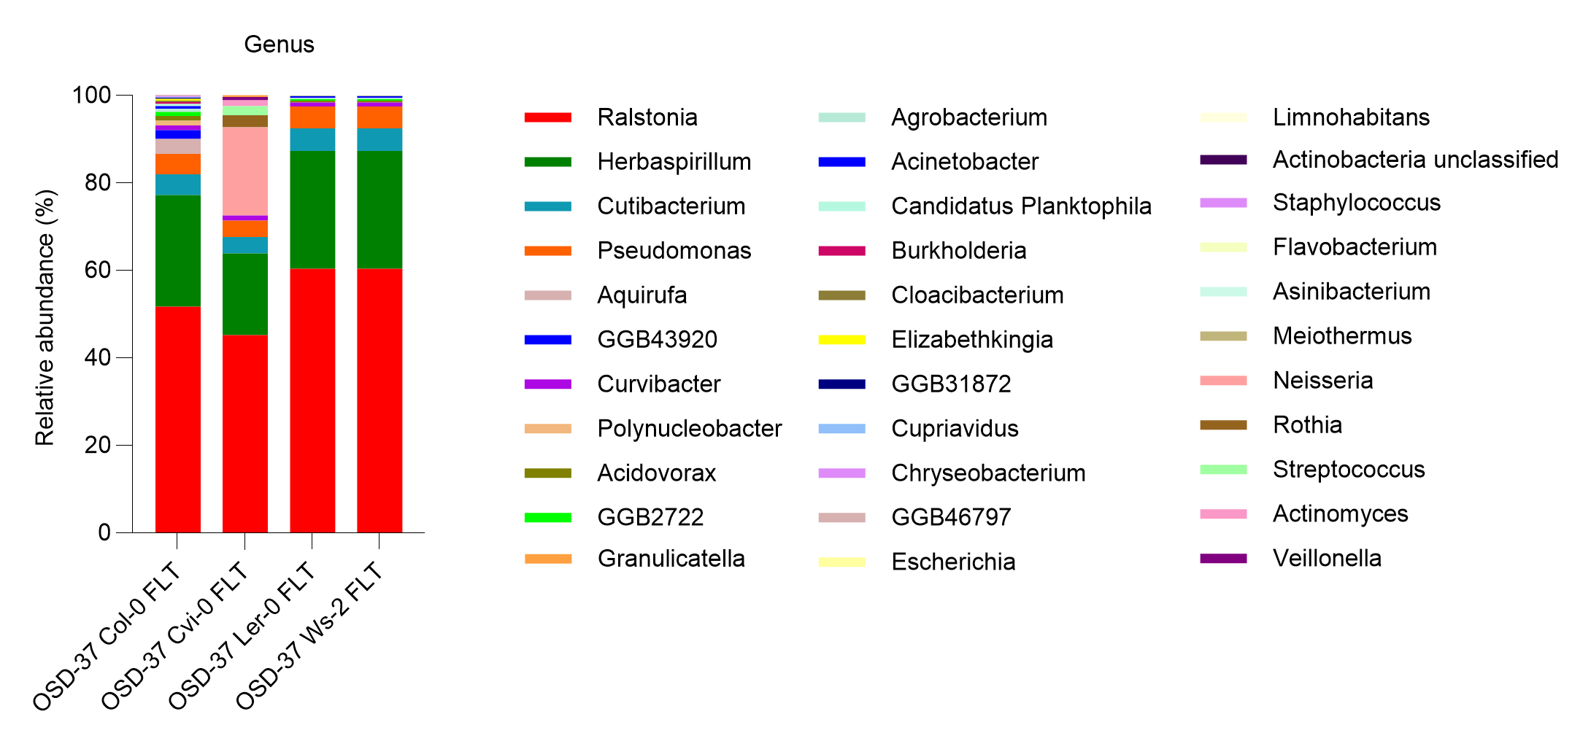
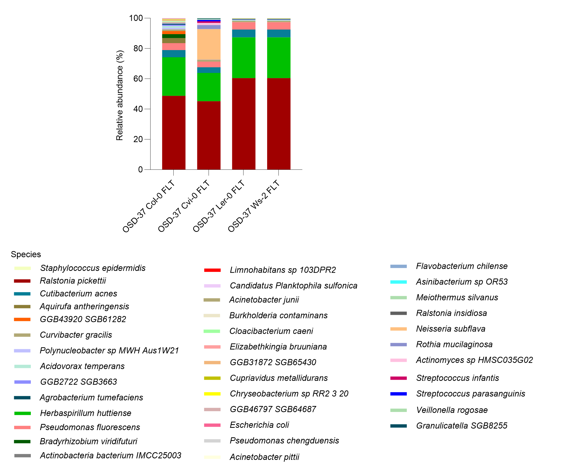
Bacteria – OSD-37 FLT
e)
f)
https://www.nature.com/articles/nmeth.2066

Slide 14
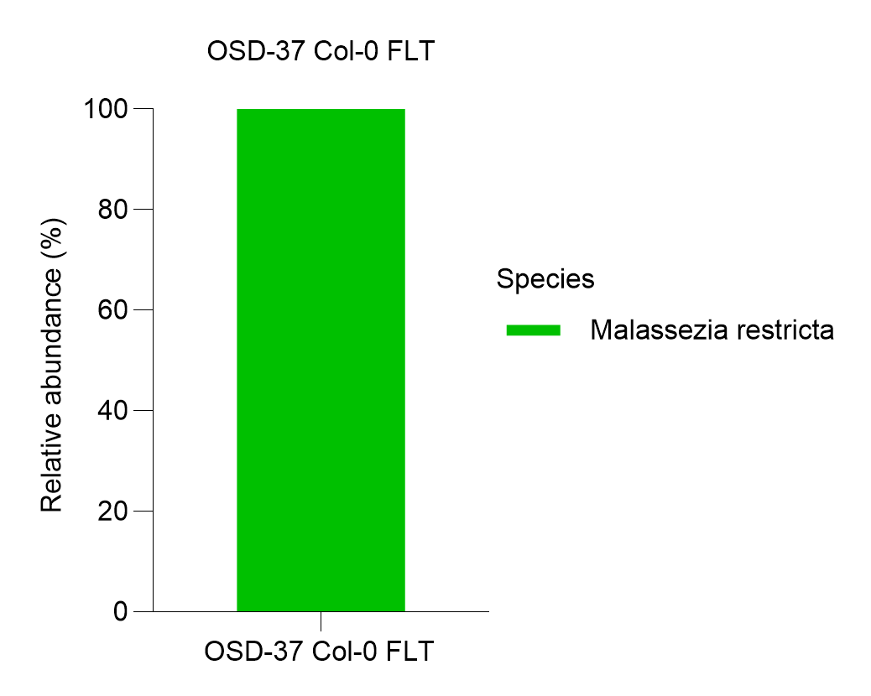
Result
The composition of the endophytic bacterial and fungal communities
We performed relative abundance analysis to elucidate the unique microbial communities associated with Arabidopsis thaliana. This approach allows us to delineate the distinct microbial signatures that differentiate Arabidopsis thaliana, emphasizing the comparisons for understanding microbial diversity. Our findings reveal that bacterial communities belonging to the Genus level Ralstonia and Herbaspirillium were abundant in OSD-37 Col-0 (GC (59.1%)-FLT (51.7%)), Cvi-0 (GC (60.2%)-FLT (45.1%)), Ler-0 (GC (62.2%)-FLT (60.3%)), and Ws-2 (GC (64%)-FLT (60.3%)). Furthermore, only the fungal community Malassezia restricta belonging to the genus Malassezia (abundance ratios of 0.01%) showed abundance in OSD-37 Col- FLT.
Fungi
Malassezia restricta is commonly found on skin.

Slide 15
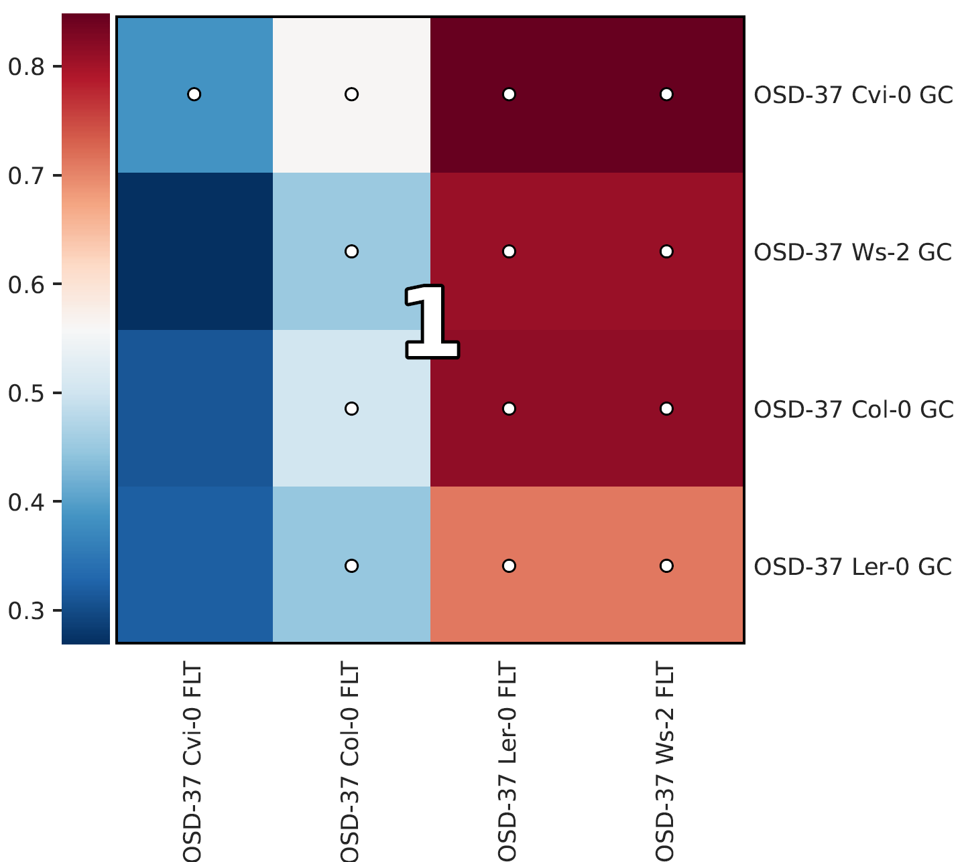
HAIIA (Hierarchical All-Against-All Association) analysis.
This study evaluated the relationships between Col-0 (GC-FLT), Cvi-0 (GC-FLT), Ler-0 (GC-FLT),and Ws-2 (GC-FLT) using Spearman correlation. A very strong positive correlation was determined between Col-0 GC, Cvi-0 GC, Ler-0 GC-,Ws-2 GC and Col-0 FLT, Cvi-0 FLT, Ler-0 FLT-,Ws-2 FLT (The false negative rate threshold was set at 20% and the false discovery rate threshold is set at 5%.).
https://pubmed.ncbi.nlm.nih.gov/35758795/

