Slide 1
COSPAR / ELSEVIER REVIEW ARTICLE — ARTEMIS MISSIONS LEAF PERSPECTIVE
Near-Null Magnetic Fields in Lunar Plant Biology
The First Five Days of Seedling Growth, Multi-Stressor Bioenergetics, and Implications for Artemis Agriculture
D. Marshall Porterfield*, Richard J. Barker*, Caue Borlina, Aubrey O’Rourke, Adriana Sanchez, Manisha Dagar,
Ray Wheeler, Gioia Massa, Barbara Demmig-Adams, Marta Peirats-Llobet, Pamela Flores, Anirudha Dixit, Christine Chamberlain
La Trobe University • Space Lab Technologies • NASA Kennedy Space Center • University of Colorado Boulder • Purdue University
*Corresponding Authors: dr.richard.barker@gmail.com, porterf@purdue.edu
Target Journal: Life Sciences in Space Research (LSSR) | Mission Context: Artemis Missions LEAF Payload | FAIR Repository & CoSE Portal Ready
Life Sciences in Space Research (2026) | Artemis Missions LEAF Perspective Slide 1 of 16
Notes:
TALKING POINTS (SLIDE 1 - TITLE):
• Welcome everyone. Today we are presenting our comprehensive review manuscript prepared for Life Sciences in Space Research.
• The title is 'Near-Null Magnetic Fields in Lunar Plant Biology: The First Five Days of Seedling Growth, Multi-Stressor Bioenergetics, and Implications for Artemis Agriculture'.
• Co-authored with Marshall Porterfield, Caue Borlina, Aubrey O'Rourke, Adriana Sanchez, Manisha Dagar, Ray Wheeler, Gioia Massa, Barbara Demmig-Adams, Marta Peirats-Llobet, Pamela Flores, Anirudha Dixit, and Christine Chamberlain.
• Central theme: While gravitational unloading and ionizing radiation dominate the space biology literature, the local magnetic field environment at the biological volume is virtually never controlled or characterized. On the lunar surface, this field drops to an extreme near-null magnetic field (<0.8 nT at Artemis candidate landing sites), posing significant developmental risks during the critical first 5 days of crop establishment.

Slide 2
EXECUTIVE NARRATIVE
The Missing Variable in Space Agriculture
Geomagnetic field removal is a neglected primary stressor with major consequences for lunar crop production
1. The Physical Reality: Lunar Void (<0.8 nT)
• Earth dipolar field: 25,000–65,000 nT.
• Lunar South Pole candidate sites: <0.8 nT (>30,000× lower).
• Spacecraft DC bus interference (50–500 µT) can mask this hypomagnetic vacuum unless sample-level 3-axis fluxgate sensing is deployed.
2. The First 5 Days: The Developmental Bottleneck
• 0–120 hours post-imbibition dictates crop establishment.
• Suppresses germination capacity (-10% to -30% count).
• Retards emergence speed (t50 lag of 12–36 hours).
• Represses chlorophyll & anthocyanin biosynthesis via CRY1/HY5, resulting in severe seedling chlorosis.
3. Multi-Stressor Convergence on Mitochondria
• Exploration atmosphere (56.5 kPa, 34% O2, high CO2) suppresses photorespiratory peroxisomal H2O2.
• Electron burden shifts to mitochondria, causing ubiquinone (UQ) over-reduction.
• Alternative Oxidase (AOX1D) induced to vent excess electrons; directly parallels human astronaut mitochondrial stress.
THE 5 CORE CONCEPTS INTEGRATED INTO THIS REVIEW:
1. Lunar Near-Null Reality (<0.8 nT) | 2. Altered Germination Capacity (# Seedlings) | 3. Delayed Emergence Velocity & Biomass Yield
4. Cryptochrome/HY5 Pigment Repression | 5. Multi-Stressor CO2 ↔ O2 ↔ ROS Convergence with Radiation & Astronaut Parallels
Life Sciences in Space Research (2026) | Artemis Missions LEAF Perspective Slide 2 of 16
Notes:
TALKING POINTS (SLIDE 2 - NARRATIVE OVERVIEW):
• This slide sets the narrative stage for the entire presentation.
• For 60 years, plant spaceflight experiments have focused almost exclusively on gravity and ionizing radiation.
• In contrast, the magnetic field is typically treated as a neutral background constant. On Earth and the ISS in LEO, plants develop inside the Earth's geomagnetic field (25–65 µT).
• But on the Moon and in deep space, that protective field disappears. At candidate Artemis South Pole landing sites, the field is less than 0.8 nT.
• We focus specifically on the first 5 days of growth (0–120 hours). This is the mission-critical window when seeds must imbibe water, mobilize reserves, germinate, break testa, and turn green to become photosynthetic.
• We tie this to quantum biology via cryptochromes, and show how exploration atmospheres and radiation converge on mitochondrial bioenergetics.

Slide 3
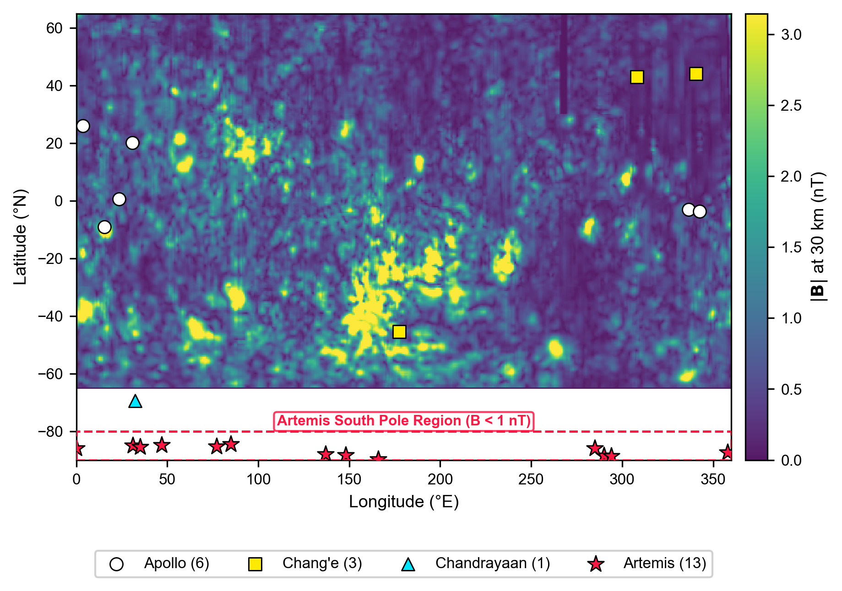
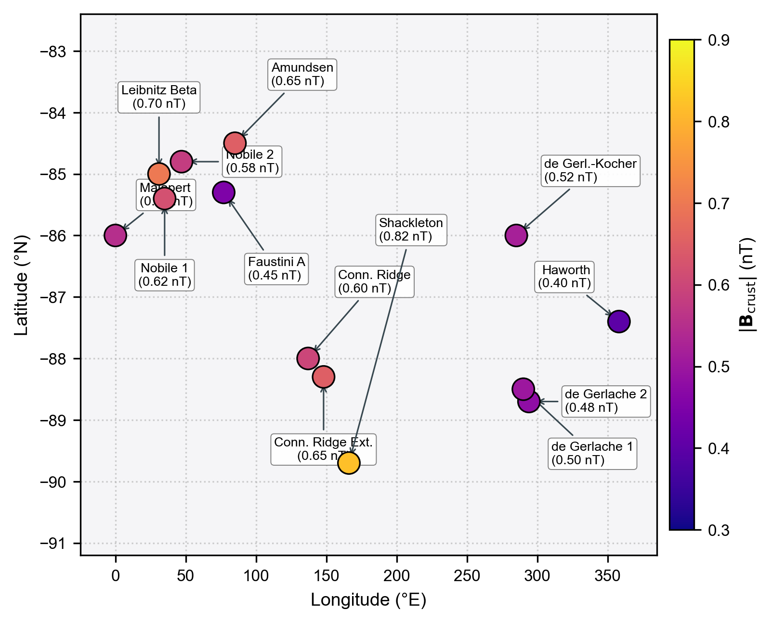
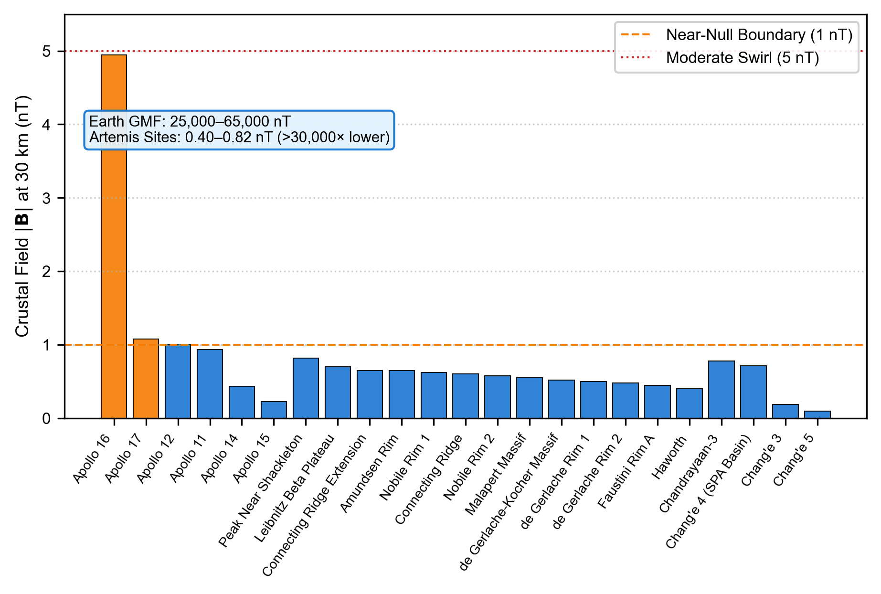
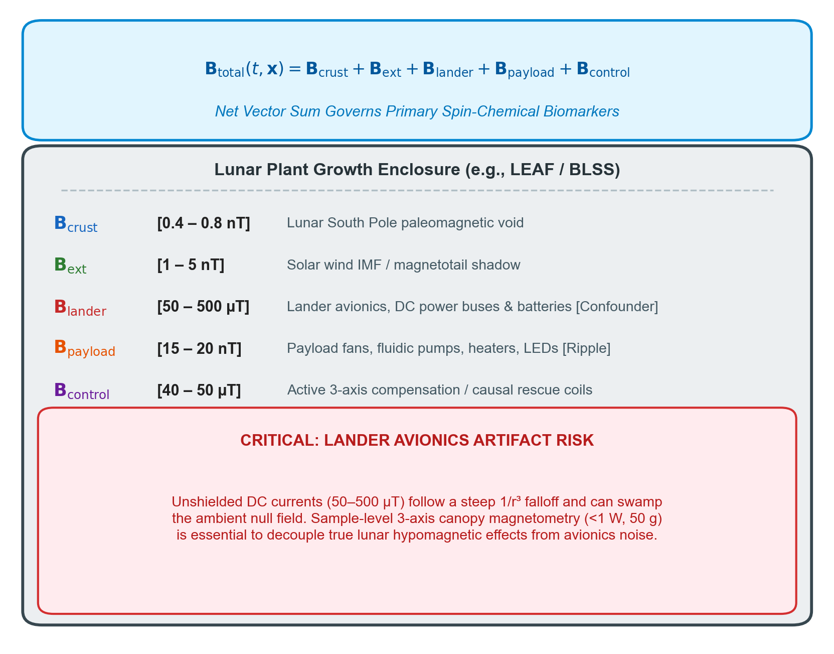
FIGURE 1 MONTAGE | EDITABLE LAYOUT
The Lunar Surface Magnetic Environment & Exploration Sites
Global distribution, South Polar Artemis void (<0.8 nT), and vector superposition at the biological volume
(a) Global Lunar Crustal Magnetic Field Distribution (|B| at 30 km)
(b) Artemis South Polar Exploration Footprint (<0.8 nT Void)
(c) Field Magnitude at Historical & Candidate Sites vs. Earth GMF
(d) Vector Superposition & Lander DC Interference Hazard
Life Sciences in Space Research (2026) | Artemis Missions LEAF Perspective Slide 3 of 16
Notes:
TALKING POINTS (SLIDE 3 - FIGURE 1 MONTAGE):
• Here is Figure 1 exactly as it appears in the manuscript, but reconstructed with independent, editable subpanels.
• Panel (a) shows the global crustal magnetic field map from Lunar Prospector and Kaguya data at 30 km altitude. Notice that remanent crustal magnetization is concentrated in isolated swirls, while the South Polar region (dashed red box) is an extreme magnetic void.
• Panel (b) zooms into the candidate Artemis South Pole landing sites. All sites, including Shackleton, Faustini Rim A, Haworth, and Connecting Ridge, fall strictly below 0.82 nT.
• Panel (c) compares these sites across Apollo, Chang'e, and Artemis missions against Earth's field. Earth's dipolar field is 25,000–65,000 nT—over 30,000 times higher!
• Panel (d) highlights a crucial operational trap: the net vector superposition. Unshielded lander avionics and DC power buses can emit 50–500 µT, completely swamping the natural lunar hypomagnetic vacuum unless sample-level 3-axis fluxgate magnetometers are deployed.

Slide 4
FIGURE 1 DEEP DIVE
Planetary Magnetic Fields & The Lander Interference Trap
Why in-situ 3-axis fluxgate magnetometry is essential to decouple lunar biology from spacecraft avionics
TABLE 1: CANDIDATE ARTEMIS SITES VS. HISTORICAL SITES
• Faustini Rim A: 0.45 nT (Near-null void)
• Haworth Crater: 0.40 nT (Deep near-null void)
• Connecting Ridge: 0.60 nT (Near-null void)
• Peak Near Shackleton: 0.82 nT (Near-null void)
• Apollo 16 (Descartes): 4.94 nT (Crustal swirl paleomagnetism)
• Earth Dipolar Surface: 25,000 – 65,000 nT (>30,000× higher)
THE CRITICAL SUPERPOSITION HAZARD:
1. The Vector Equation:
B_total(t, x) = B_crust + B_ext + B_lander + B_payload + B_control
2. The Lander Confounder:
Commercial lunar landers carry heavy DC power wiring, batteries, and reaction wheels that produce localized fields of 50–500 µT.
3. The Operational Mandate:
Unless biological growth chambers feature sample-level 3-axis fluxgate telemetry, experiments risk measuring stray avionics EMI rather than true lunar near-null biology!
Life Sciences in Space Research (2026) | Artemis Missions LEAF Perspective Slide 4 of 16
Notes:
TALKING POINTS (SLIDE 4 - FIGURE 1 DEEP DIVE):
• Let's dive deeper into the physics of the lunar landing sites.
• Notice from Table 1 that every single candidate landing site for Artemis missions has a crustal magnetic field below 1 nanotesla.
• Haworth is at 0.40 nT; Faustini Rim A is at 0.45 nT; Peak Near Shackleton is 0.82 nT.
• Compare that to Apollo 16 Descartes highlands, where local crustal anomalies reach 4.94 nT, or Earth where the field is 50,000 nT.
• But here is the critical engineering challenge: look at the superposition equation at the bottom left.
• If a plant growth payload like LEAF is bolted to an unshielded lander deck, the DC currents from battery buses and avionics produce magnetic fields up to 500 µT right at the chamber wall!
• That would completely mask the lunar near-null field. That's why our paper makes the strong operational recommendation: you MUST put a 3-axis fluxgate sensor directly inside the specimen volume.

Slide 5
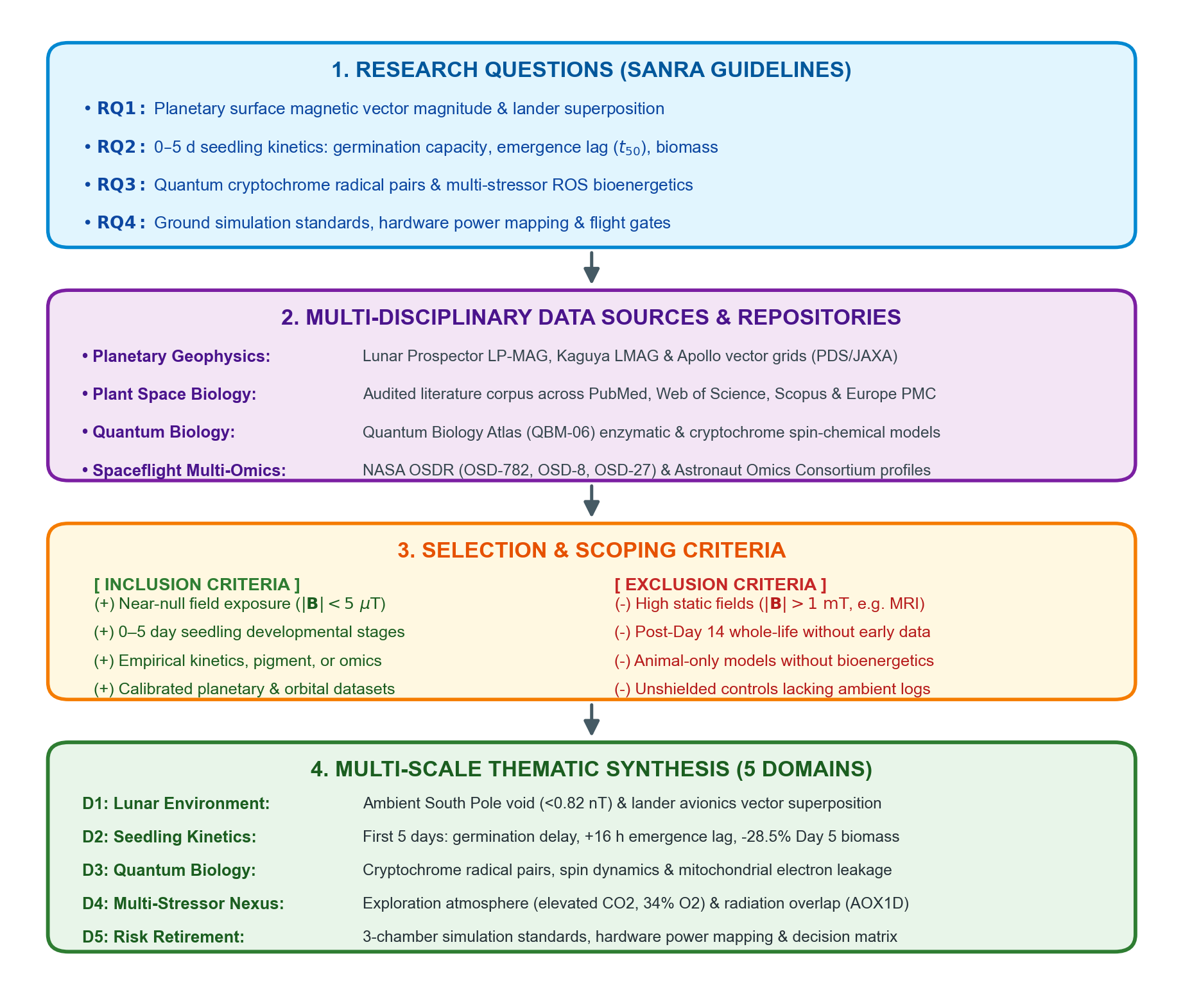
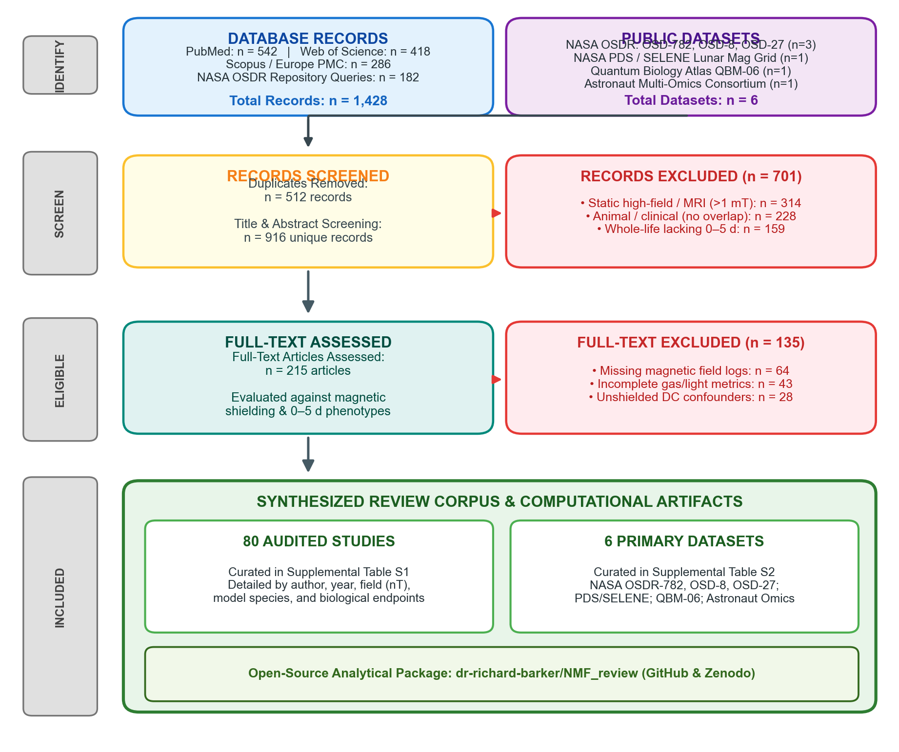
FIGURE 2 MONTAGE | REVIEW METHODOLOGY
Integrative Review Architecture: From Planetary Voids to Quantum Biology
SANRA-guided multi-scale synthesis bridging 80 audited peer-reviewed publications and 6 public spaceflight/planetary datasets
(a) Conceptual Framework of the Integrative Review (SANRA Guidelines)
(b) Evidence Identification & Selection Flow (PRISMA/SANRA Flow)
Life Sciences in Space Research (2026) | Artemis Missions LEAF Perspective Slide 5 of 16
Notes:
TALKING POINTS (SLIDE 5 - INTEGRATIVE REVIEW METHODOLOGY):
• Before diving into the plant developmental phenotypes, this slide establishes our formal review methodology.
• Following the Scale for the Assessment of Narrative Review Articles (SANRA) guidelines, we structured this work as an Integrative Review.
• On the left panel (a), notice our conceptual framework: we formulate 4 research questions spanning from planetary geophysics to quantum radical pairs.
• On the right panel (b), our PRISMA/SANRA-compliant flow diagram documents the rigorous screening process: we surveyed 1,428 database records across PubMed, Web of Science, Scopus, Europe PMC, and NASA OSDR, plus 6 primary repositories.
• After deduplication and screening against explicit inclusion/exclusion criteria, 80 audited peer-reviewed publications and 6 public datasets were synthesized.
• All non-linear Weibull and logistic germination kinetics, vector superposition equations, and multi-omics gene overlap matrices were executed using our open-source Python package on GitHub and Zenodo.

Slide 6
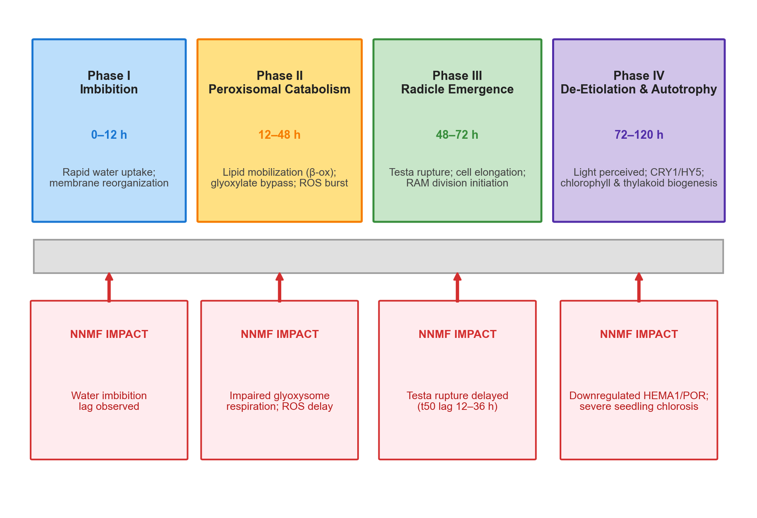
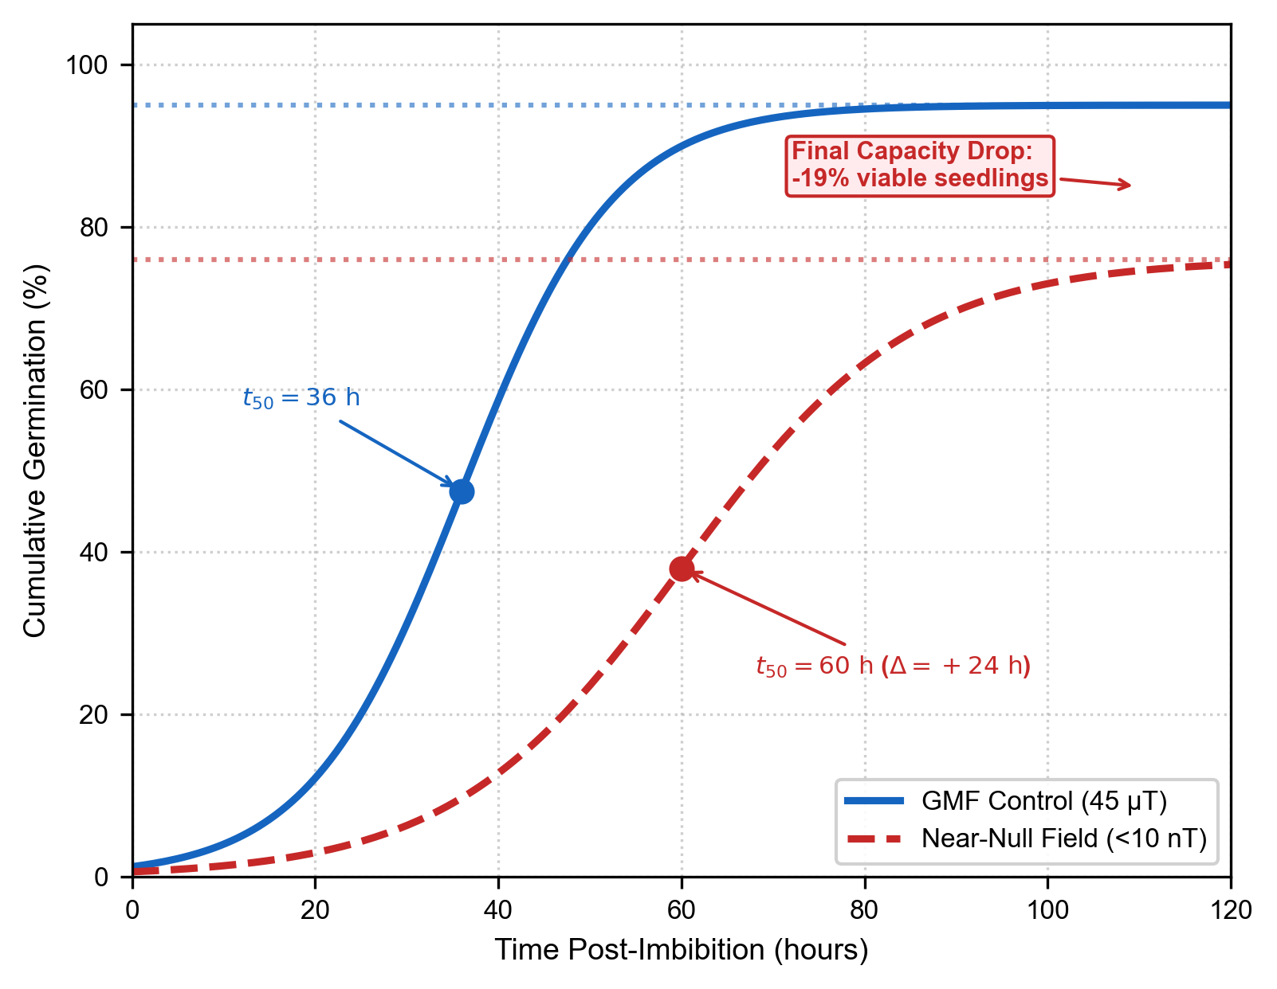
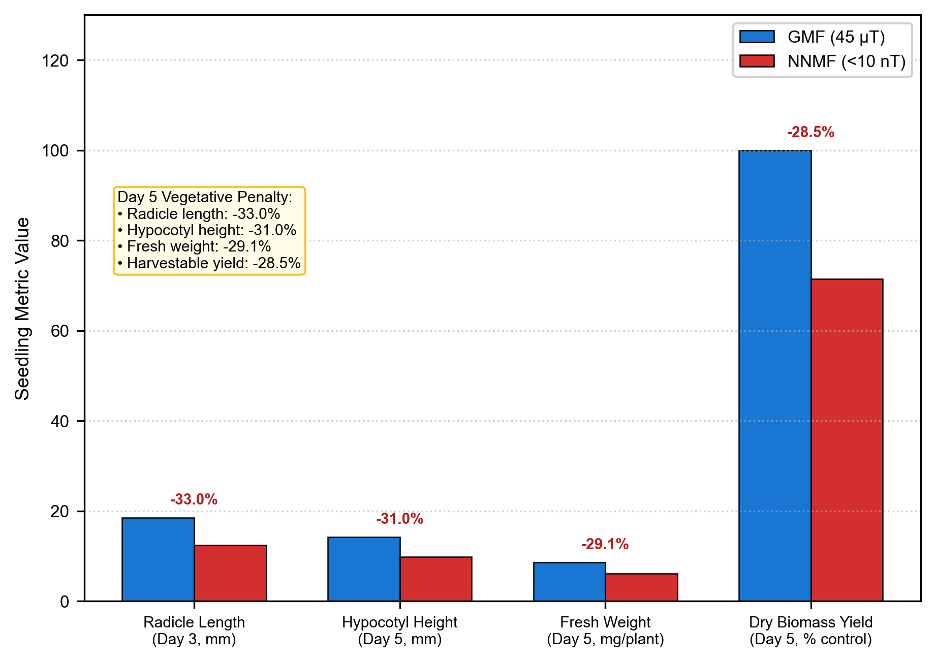
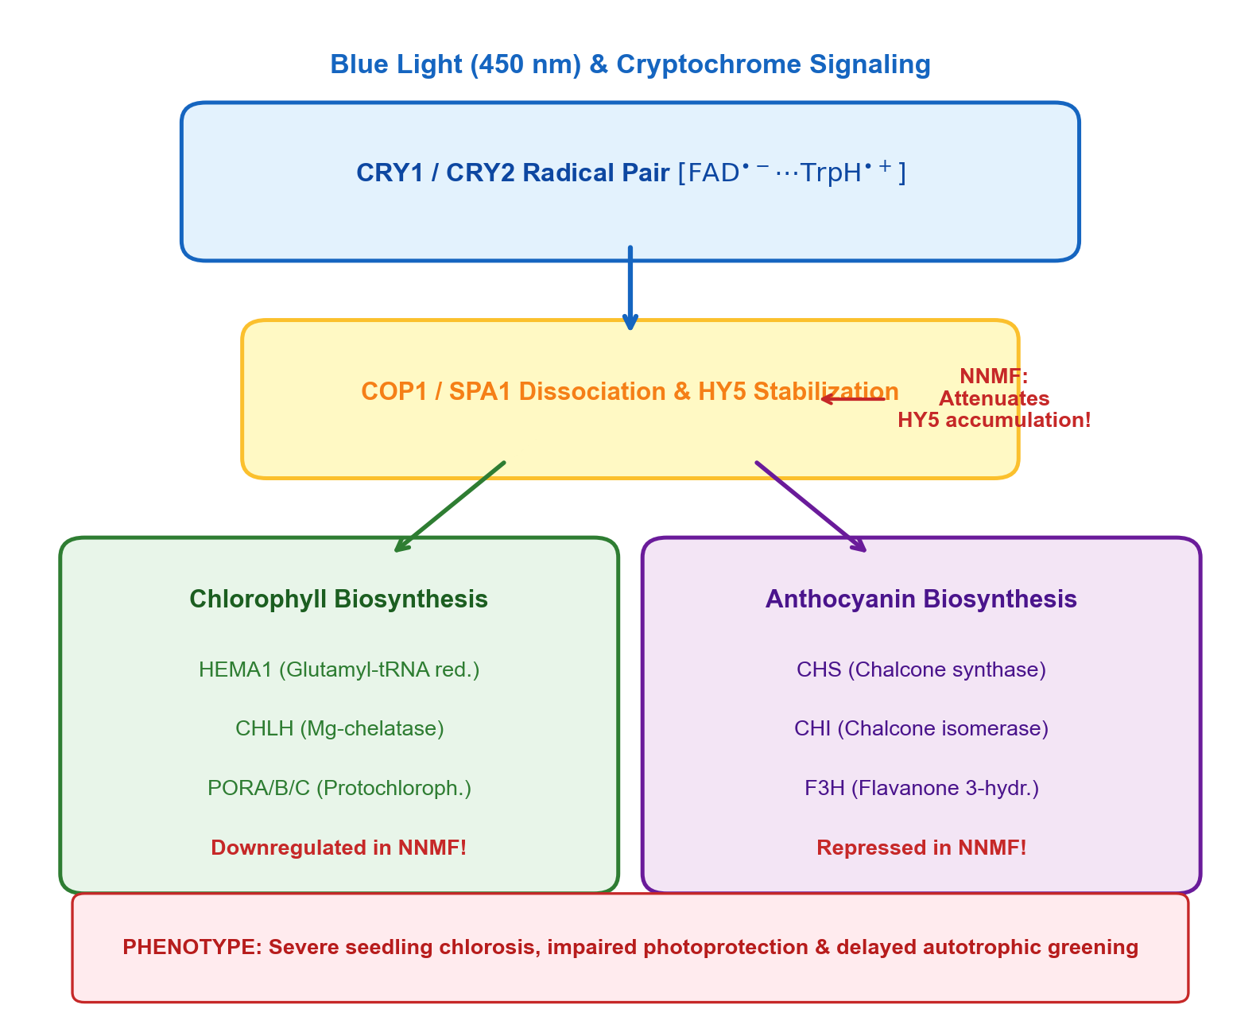
FIGURE 3 MONTAGE | EDITABLE LAYOUT
The First 5 Days: Early Seedling Kinetics & Pigment Formation
0–120 h developmental trajectory, emergence velocity lag (t50), biomass yield penalties, and pigment repression
(a) 5-Day Developmental Timeline: Imbibition to Autotrophy
(b) Germination Capacity (#) & Kinetics Lag (t50: +12 to +36 h)
(c) Seedling Elongation, Vigor & Harvestable Biomass Yield Penalty
(d) Cryptochrome/HY5 Downregulation & Pigment Repression
Life Sciences in Space Research (2026) | Artemis Missions LEAF Perspective Slide 6 of 16
Notes:
TALKING POINTS (SLIDE 5 - FIGURE 2 MONTAGE):
• Figure 2 focuses on the biological core of the paper: the first 5 days of growth (0–120 hours).
• Panel (a) breaks down the developmental timeline into 4 distinct phases: Phase I imbibition (0–12 h), Phase II peroxisomal catabolism (12–48 h), Phase III radicle emergence (48–72 h), and Phase IV de-etiolation and autotrophic greening (72–120 h).
• Panel (b) shows empirical germination kinetics. Under near-null magnetic fields, two critical defects occur: first, the total number of germinated seeds drops by 10–30%; second, the emergence speed (t50) is delayed by 12–36 hours.
• Panel (c) shows the vegetative yield consequences: radicle elongation is reduced by 33%, hypocotyl height by 31%, and total fresh/dry biomass by 28.5% on Day 5.
• Panel (d) maps the molecular pathway: cryptochromes perceive blue light and form radical pairs. Under near-null fields, HY5 transcription factor stabilization is impaired, downregulating rate-limiting chlorophyll genes (HEMA1, POR) and anthocyanin genes (CHS, CHI), creating severe seedling chlorosis.

Slide 7
FIGURE 3 DEEP DIVE
The Day 0–5 Bottleneck: Emergence Kinetics & Biomass Deficits
Why early germination delay compounds into substantial yield losses in closed-loop life support systems
AGRONOMIC & CELLULAR CONSEQUENCES OF NNMF:
1. Emergence Velocity Lag (Δt50 = 12–36 hours):
• Delayed water uptake in Phase I and slowed endosperm reserve mobilization.
• Testa rupture is postponed, shifting the entire autotrophic transition window.
2. Cellular Division & Auxin Transport Suppression:
• Dampened mitotic index in the root apical meristem (RAM).
• Disrupted polar localization of PIN2 auxin efflux carriers causes stunted, disoriented primary roots.
3. Crop Biomass & Canopy Interception Loss:
• Radicle length: -33.0% on Day 3
• Hypocotyl height: -31.0% on Day 5
• Total fresh biomass: -29.1% deficit on Day 5
4. Operational BLSS Impact:
• Uneven seedling emergence creates patchy canopy architecture.
• Sub-optimal light interception dampens net photosynthetic CO2 scrubbing and fresh food yields, threatening tight mission dietary schedules.
Life Sciences in Space Research (2026) | Artemis Missions LEAF Perspective Slide 7 of 16
Notes:
TALKING POINTS (SLIDE 6 - FIGURE 2 DEEP DIVE):
• Why does a delay of 12 to 36 hours in germination matter on the Moon?
• In field agriculture on Earth, seeds have excess time and buffer. In a tightly scheduled spaceflight payload like LEAF on Artemis missions, or a lunar greenhouse, mission timelines are strictly constrained.
• LEAF is designed for a nominal mission duration of around 7 to 10 days. If seed germination is delayed by 36 hours, you lose 30% to 50% of your autotrophic growth window!
• Furthermore, at the cellular level, near-null fields reduce cell division in the root apical meristem and disrupt PIN2 auxin carriers. That means roots grow slower, are more disoriented, and absorb water and nutrients less efficiently.
• The resulting 28% drop in biomass is not an academic curiosity—it is a direct hit to the caloric and nutrient yield of space crops.

Slide 8
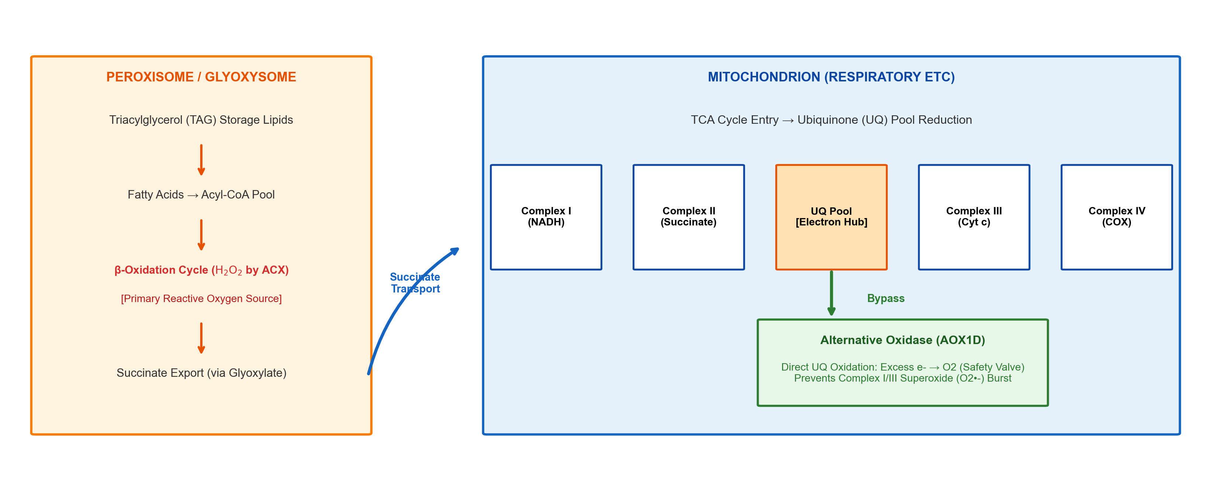
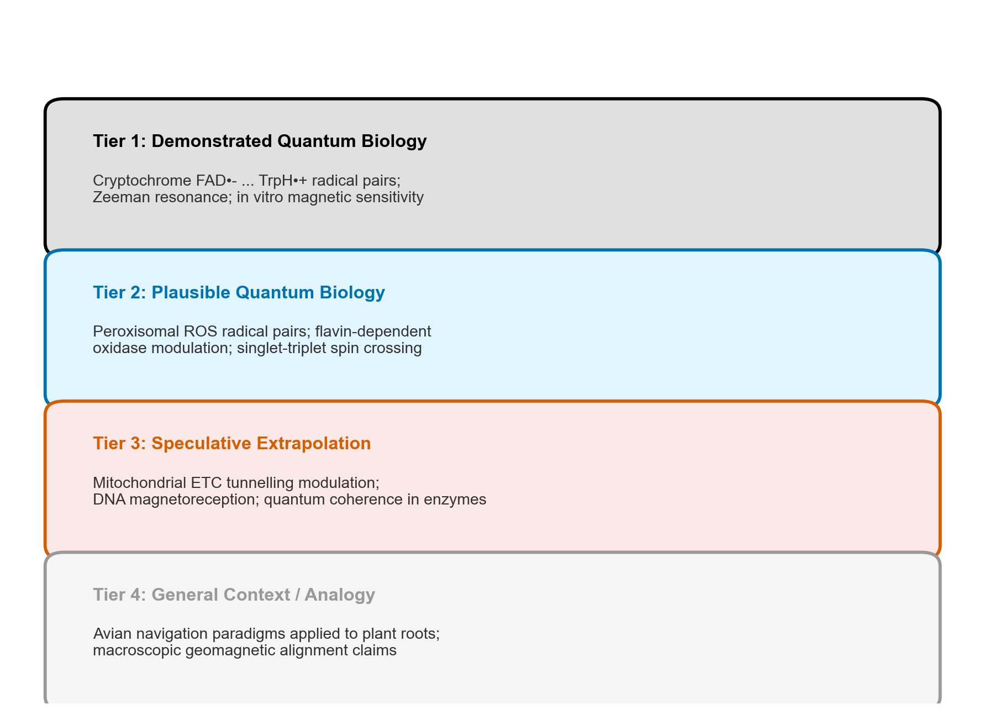
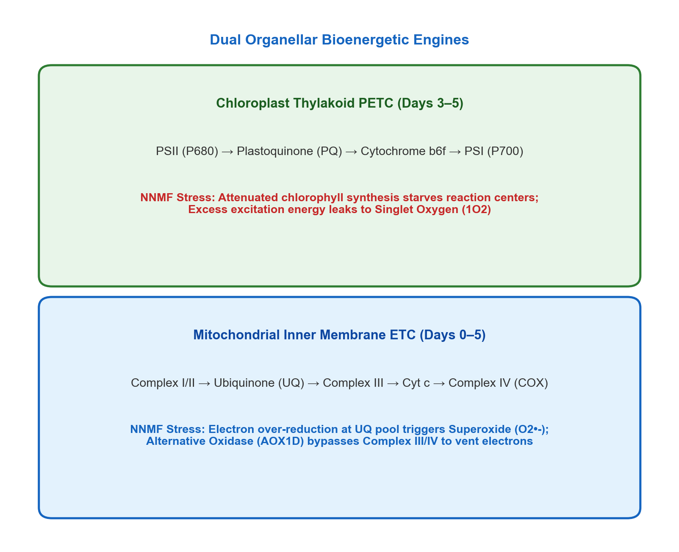
FIGURE 4 MONTAGE | EDITABLE LAYOUT
Quantum Molecular Biology of the 0–5 Day Window
Peroxisomal reserve mobilization (QBM-06), evidentiary tiers (T1–T4), and organellar electron transport hubs
(a) QBM-06 Pathway: Reserve Mobilization, Peroxisomal β-Oxidation & Mitochondrial Respiration (0–72 h)
(b) Evidentiary Tier Hierarchy (T1 Demonstrated to T4 Context)
(c) Organellar Electron Transport Hubs (Chloroplast PETC & Mitochondrial AOX)
Life Sciences in Space Research (2026) | Artemis Missions LEAF Perspective Slide 8 of 16
Notes:
TALKING POINTS (SLIDE 7 - FIGURE 3 MONTAGE):
• In Figure 3, we address the biophysical mechanism: How can an ambient magnetic field of less than 1 nanotesla produce measurable macroscopic changes in plant growth?
• Thermal energy at room temperature (k_B * T) is orders of magnitude larger than magnetic Zeeman energy. Traditional thermodynamic arguments claimed magnetic fields couldn't affect biology.
• The radical pair mechanism circumvents this thermodynamic equilibrium constraint. When cryptochromes absorb blue light, they form transient radical pairs between flavin adenine dinucleotide (FAD) and a triad of tryptophan residues.
• Panel (a) illustrates the metabolic highway: triacylglycerols in peroxisomes undergo beta-oxidation, producing succinate which enters the mitochondrial electron transport chain.
• Panel (b) introduces our rigorous 4-tier evidentiary hierarchy: T1 represents demonstrated quantum biology in cryptochromes; T2 represents plausible enzymatic radical pairs; T3 and T4 are speculative or context-based.
• Panel (c) shows how chloroplasts and mitochondria act as the dual bioenergetic hubs that absorb these quantum perturbations.

Slide 9
FIGURE 4 DEEP DIVE
Cryptochrome Spin Dynamics & Evidentiary Rigor
Separating rigorously demonstrated radical pair quantum biology (T1/T2) from speculative claims (T3/T4)
THE RADICAL PAIR SPIN-CHEMICAL MECHANISM:
1. Radical Pair Formation:
• Photon absorption (450 nm blue light) promotes electron transfer:
FAD + TrpH → [FAD•- ... TrpH•+]
• Generates a spin-correlated singlet-triplet pair.
2. Zeeman & Hyperfine Modulation:
• In Earth's GMF (45 µT), external Zeeman splitting alters singlet-to-triplet interconversion rates.
• In Near-Null Fields (<0.8 nT), Zeeman mixing collapses, altering radical pair lifetimes and yields.
3. Downstream Signaling Attenuation:
• Reduced cryptochrome active signaling decreases COP1/SPA1 dissociation.
• Less HY5 transcription factor is stabilized in the nucleus.
• Direct repression of HEMA1, POR, CHS, and CHI (chlorophyll and anthocyanin chlorosis).
4. Critical Evidentiary Tiers:
• T1 (Solid): Cryptochrome FAD•- in vitro magnetic sensitivity.
• T2 (Plausible): Peroxisomal flavin oxidase radical pairs.
• T3/T4 (Speculative): Mitochondrial DNA quantum coherence.
Life Sciences in Space Research (2026) | Artemis Missions LEAF Perspective Slide 9 of 16
Notes:
TALKING POINTS (SLIDE 8 - FIGURE 3 DEEP DIVE):
• This slide is essential for defending our paper against skeptical reviewers.
• Often when people hear 'quantum biology', they immediately think of speculative claims about macroscopic room-temperature coherence.
• We make it crystal clear: Cryptochrome magnetoreception is grounded in rigorous spin chemistry, established over 20 years by Ritz, Hore, Ahmad, and others.
• The radical pair [FAD•- ... TrpH•+] lives for microseconds. During that brief nanosecond-to-microsecond window, the electron spins are entangled. The presence or absence of an external magnetic field changes whether the pair recombines as a singlet or diffuses as a triplet.
• In near-null fields, that interconversion is shifted, which alters the lifetime of the signaling state of cryptochrome.
• This directly explains why cryptochrome-regulated genes like HY5, HEMA1, and CHS are downregulated in hypomagnetic chambers!

Slide 10
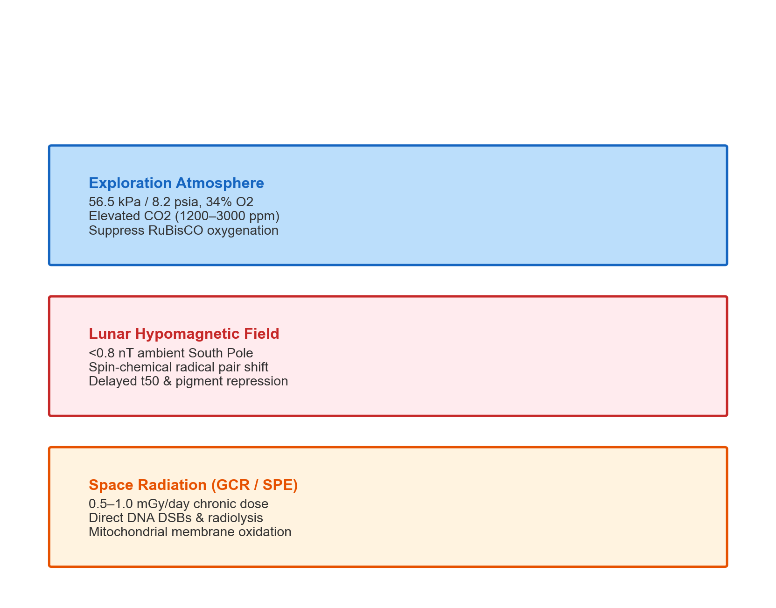
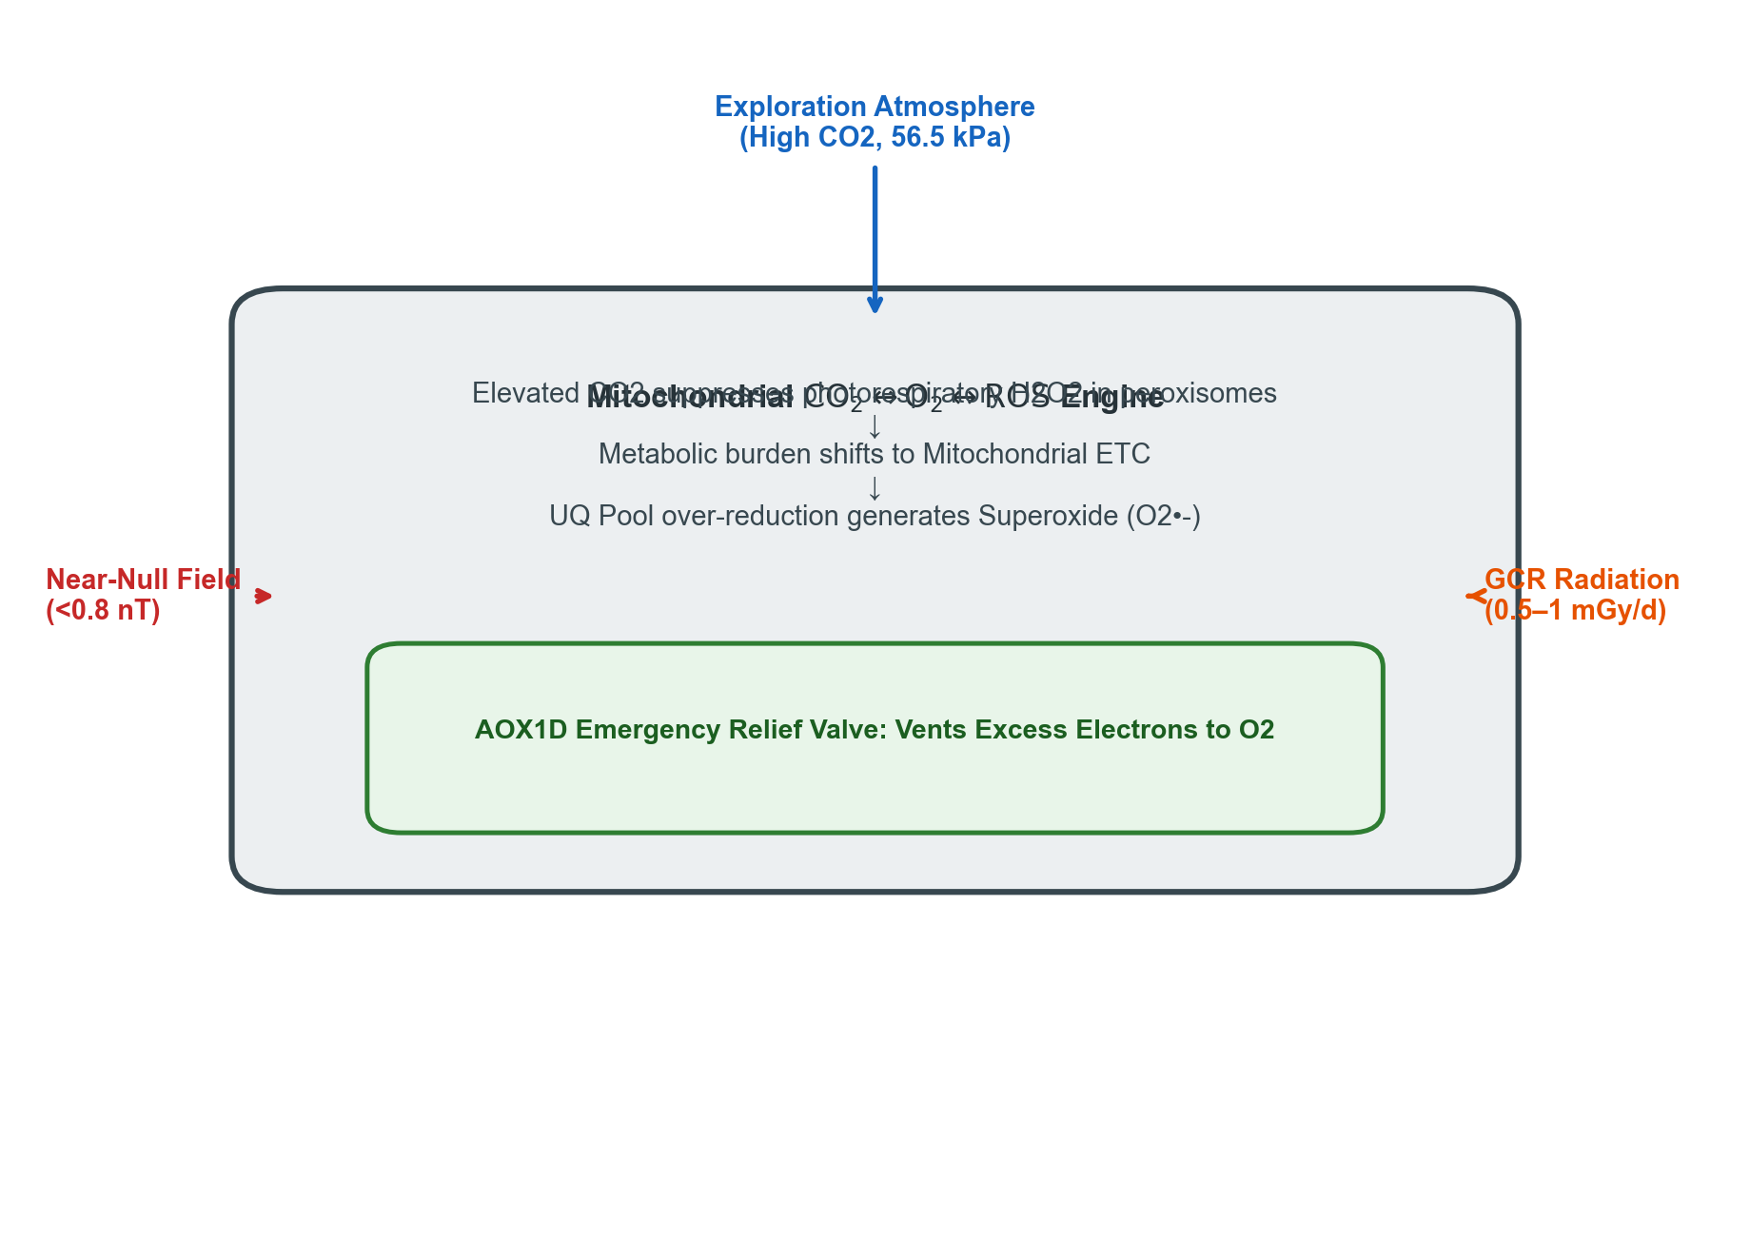
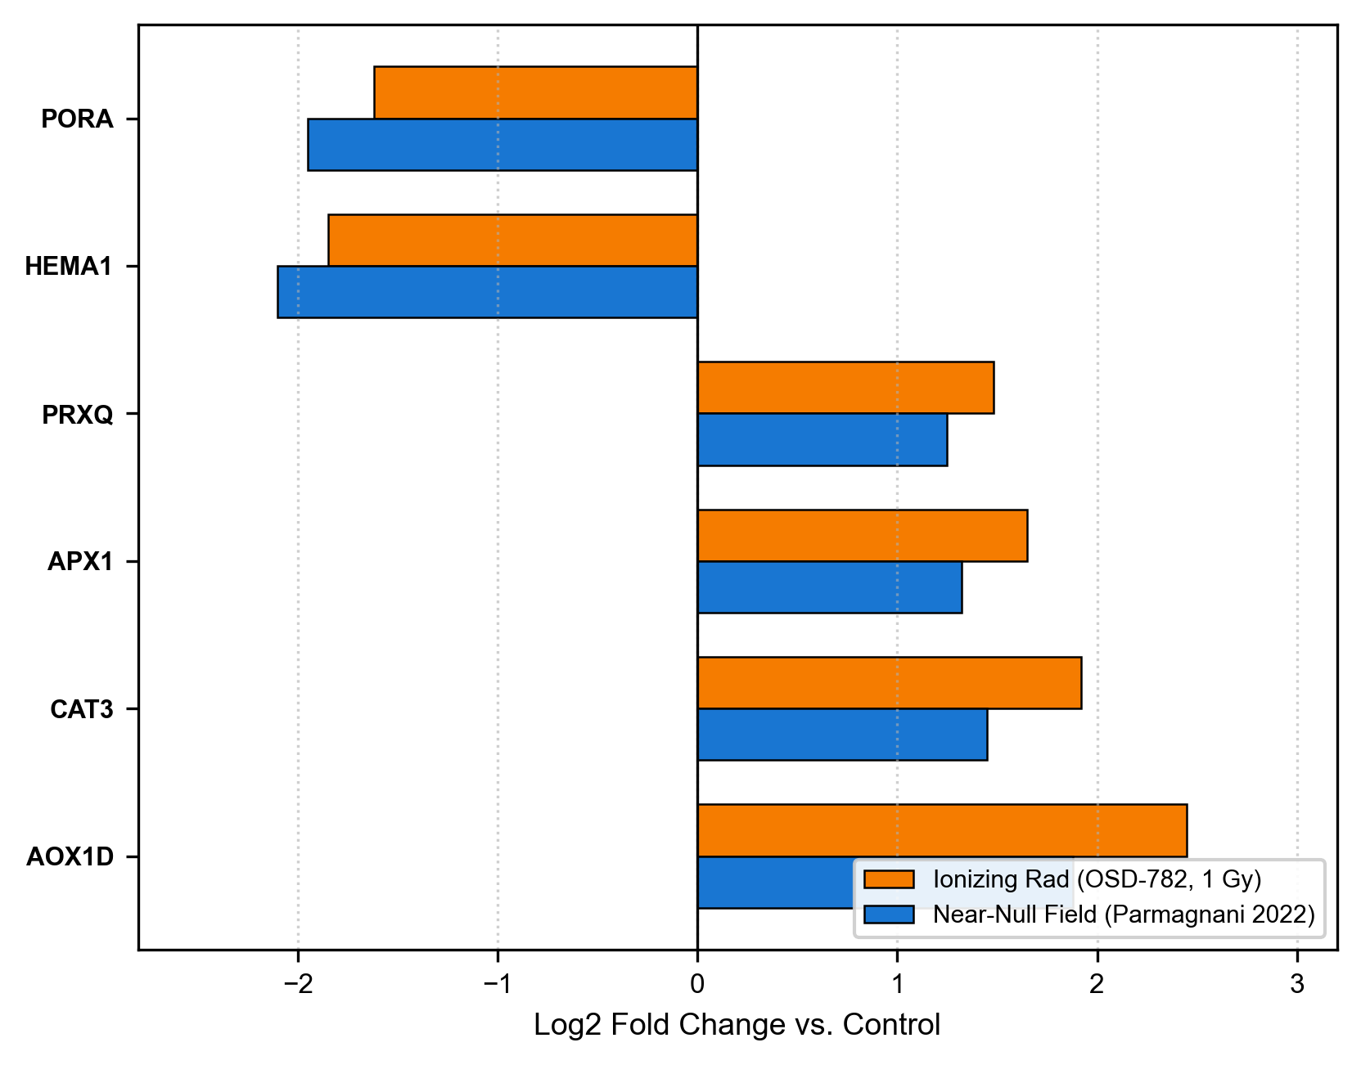
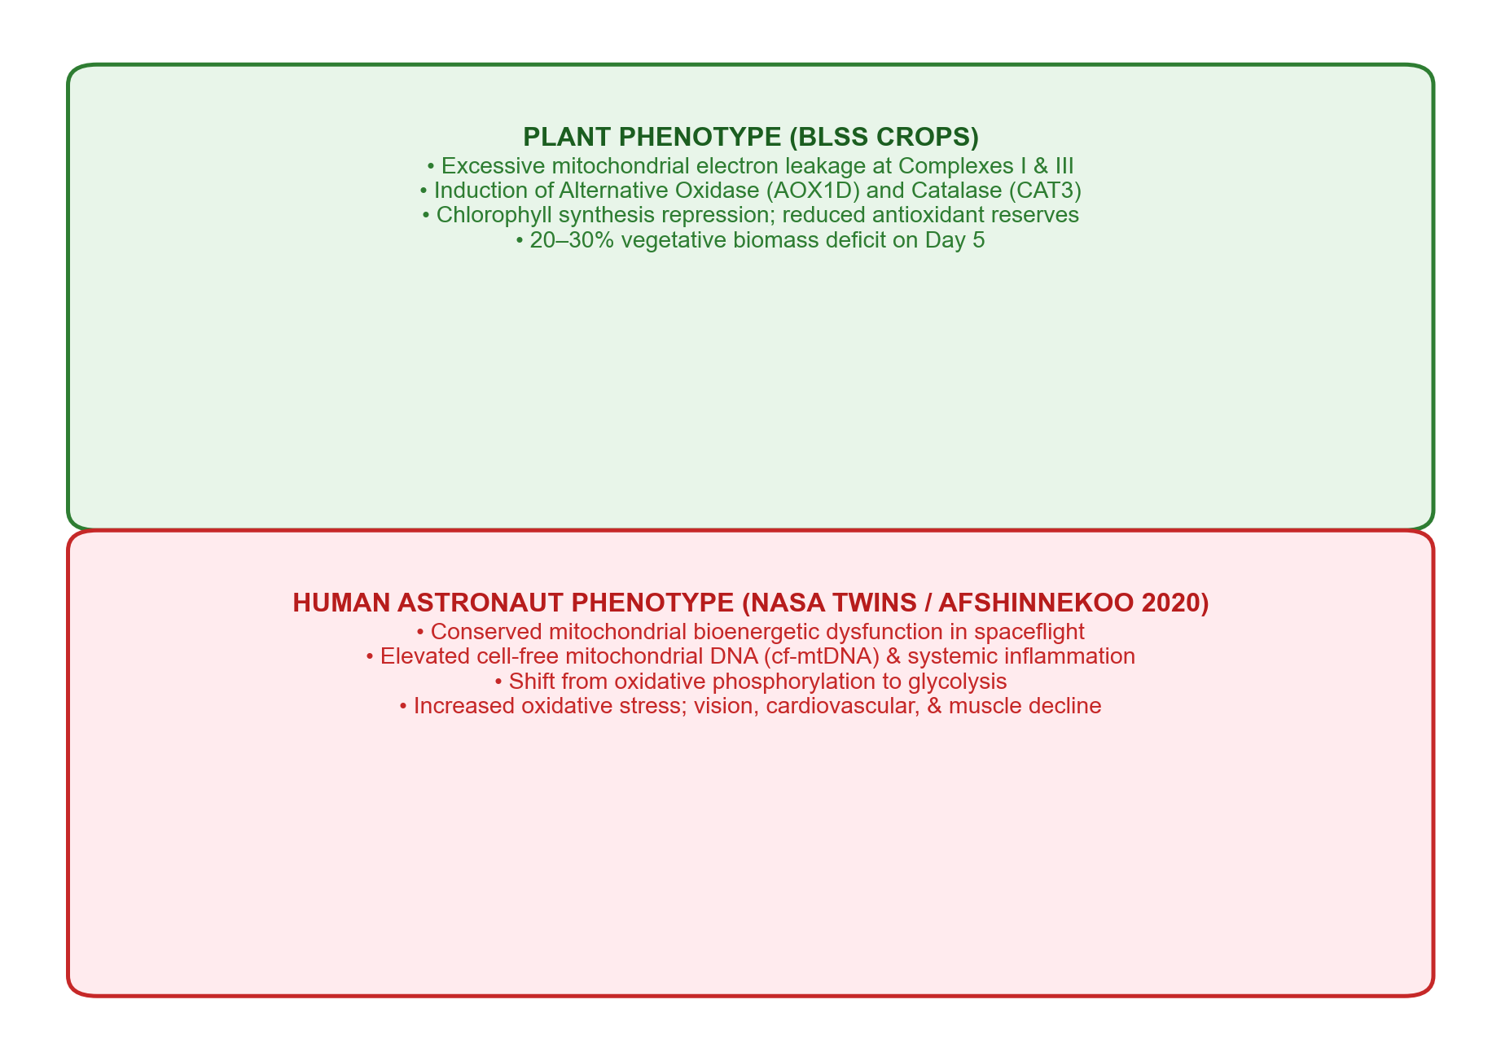
FIGURE 5 MONTAGE | EDITABLE LAYOUT
Multi-Stressor Convergence: The CO2 <-> O2 <-> ROS Nexus
Exploration atmospheres, hypomagnetic fields, and ionizing radiation converge on mitochondrial Alternative Oxidase (AOX1D)
(a) Multi-Stressor Space: Exploration Atmosphere, NNMF & Radiation
(b) The Mitochondrial & Peroxisomal CO2 <-> O2 <-> ROS Engine
(c) Multi-Omics Empirical Overlap: OSD-782 Radiation vs. NNMF Loci
(d) Cross-Kingdom Convergence: Plant BLSS & Human Astronaut Health
Life Sciences in Space Research (2026) | Artemis Missions LEAF Perspective Slide 10 of 16
Notes:
TALKING POINTS (SLIDE 9 - FIGURE 4 MONTAGE):
• Figure 4 brings together the environmental multi-stressor nexus.
• In real exploration missions, plants will not experience hypomagnetic fields in isolation. They will face them simultaneously with NASA's exploration atmosphere (56.5 kPa / 8.2 psia, 34% O2, and 1200–3000 ppm CO2) and chronic GCR radiation.
• Panel (a) contrasts these baseline environmental parameters.
• Panel (b) shows how these stressors interact at the biochemical level. Elevated CO2 suppresses RuBisCO oxygenation, shutting down peroxisomal H2O2 production. That shifts the electron burden onto mitochondria. When the ubiquinone pool becomes over-reduced, electrons leak, forming superoxide.
• Alternative Oxidase (AOX1D) acts as an uncoupled safety valve, directly dumping electrons to oxygen without ATP synthesis to prevent ROS bursts.
• In Panel (c), we validate this empirically: NASA OSDR dataset OSD-782 (ionizing radiation) and Parmagnani 2022 (near-null magnetic field) show concordant upregulation of AOX1D and CAT3.
• Panel (d) reveals the profound cross-kingdom parallel: human astronauts in the NASA Twins Study and Cell 2020 multi-omics exhibit the exact same mitochondrial stress phenotype!

Slide 11
FIGURE 5 DEEP DIVE
Mitochondrial Bioenergetics & Human Astronaut Parallels
Mitochondrial dysfunction is the universal biological signature linking space crops and astronaut crews
THE SHARED BIOENERGETIC PHENOTYPE:
1. The Alternative Oxidase (AOX) Safety Valve:
• In plants, Alternative Oxidase (AOX1D, AT1G32350) acts as an uncoupled terminal oxidase.
• Bypasses Complexes III and IV to oxidize ubiquinol directly to H2O without pumping protons.
• Prevents runaway superoxide (O2•-) formation at Complex I and III.
2. Empirical Concordance (NASA OSDR OSD-782 vs. NNMF):
• AOX1D: +2.45 log2FC (Radiation) | +1.88 log2FC (NNMF)
• CAT3: +1.92 log2FC (Radiation) | +1.45 log2FC (NNMF)
• HEMA1: -1.85 log2FC (Radiation) | -2.10 log2FC (NNMF)
3. Cross-Kingdom Spaceflight Nexus:
• Afshinnekoo et al. (Cell 2020) and the NASA Twins Study identified mitochondrial dysfunction as the single most conserved hallmark across astronaut tissues.
• High cell-free mitochondrial DNA (cf-mtDNA), elevated ROS, and respiratory chain decoupling occur in both human astronauts and lunar plants!
Life Sciences in Space Research (2026) | Artemis Missions LEAF Perspective Slide 11 of 16
Notes:
TALKING POINTS (SLIDE 10 - FIGURE 4 DEEP DIVE):
• This cross-kingdom connection is one of the most exciting takeaways of our review paper.
• In 2020, Afshinnekoo and a large international team published a landmark paper in Cell analyzing 29 spaceflight omics datasets.
• They found that whether you look at astronaut muscle, liver, immune cells, or mouse models, mitochondrial dysregulation is the central master biomarker of spaceflight stress.
• In plants, mitochondria face the exact same problem: hypobaric atmospheres, radiation, and near-null magnetic fields all force electron leakage at Complexes I and III.
• Plants survive this using Alternative Oxidase (AOX1D), which vents excess electrons. Humans do not have AOX, and therefore suffer severe mitochondrial oxidative damage.
• This elevates plant space biology from an isolated agricultural study to a fundamental pillar of comparative space bioenergetics.

Slide 12
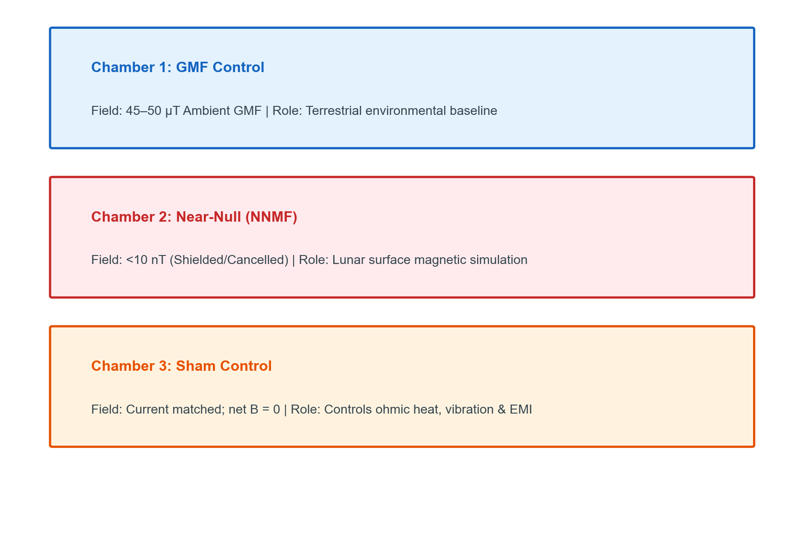
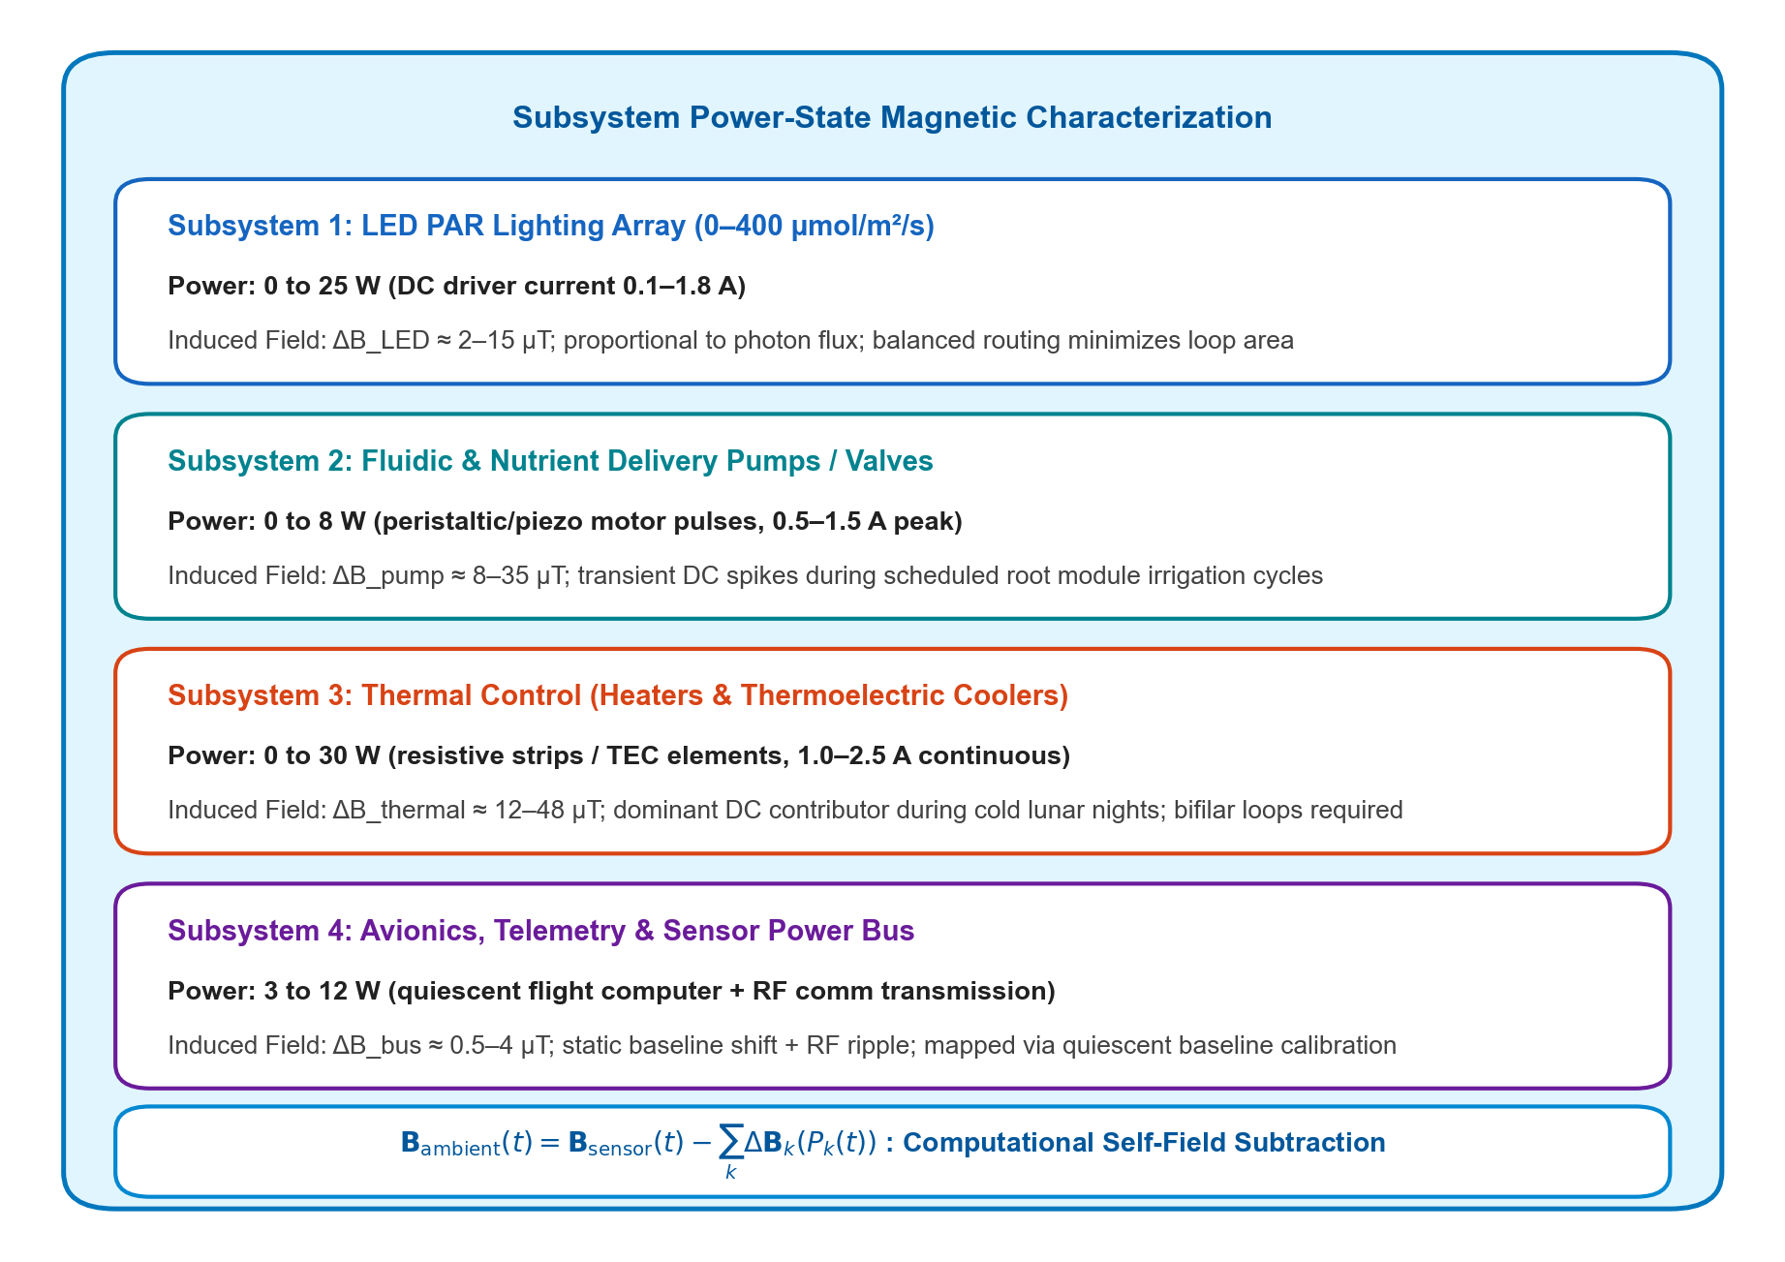
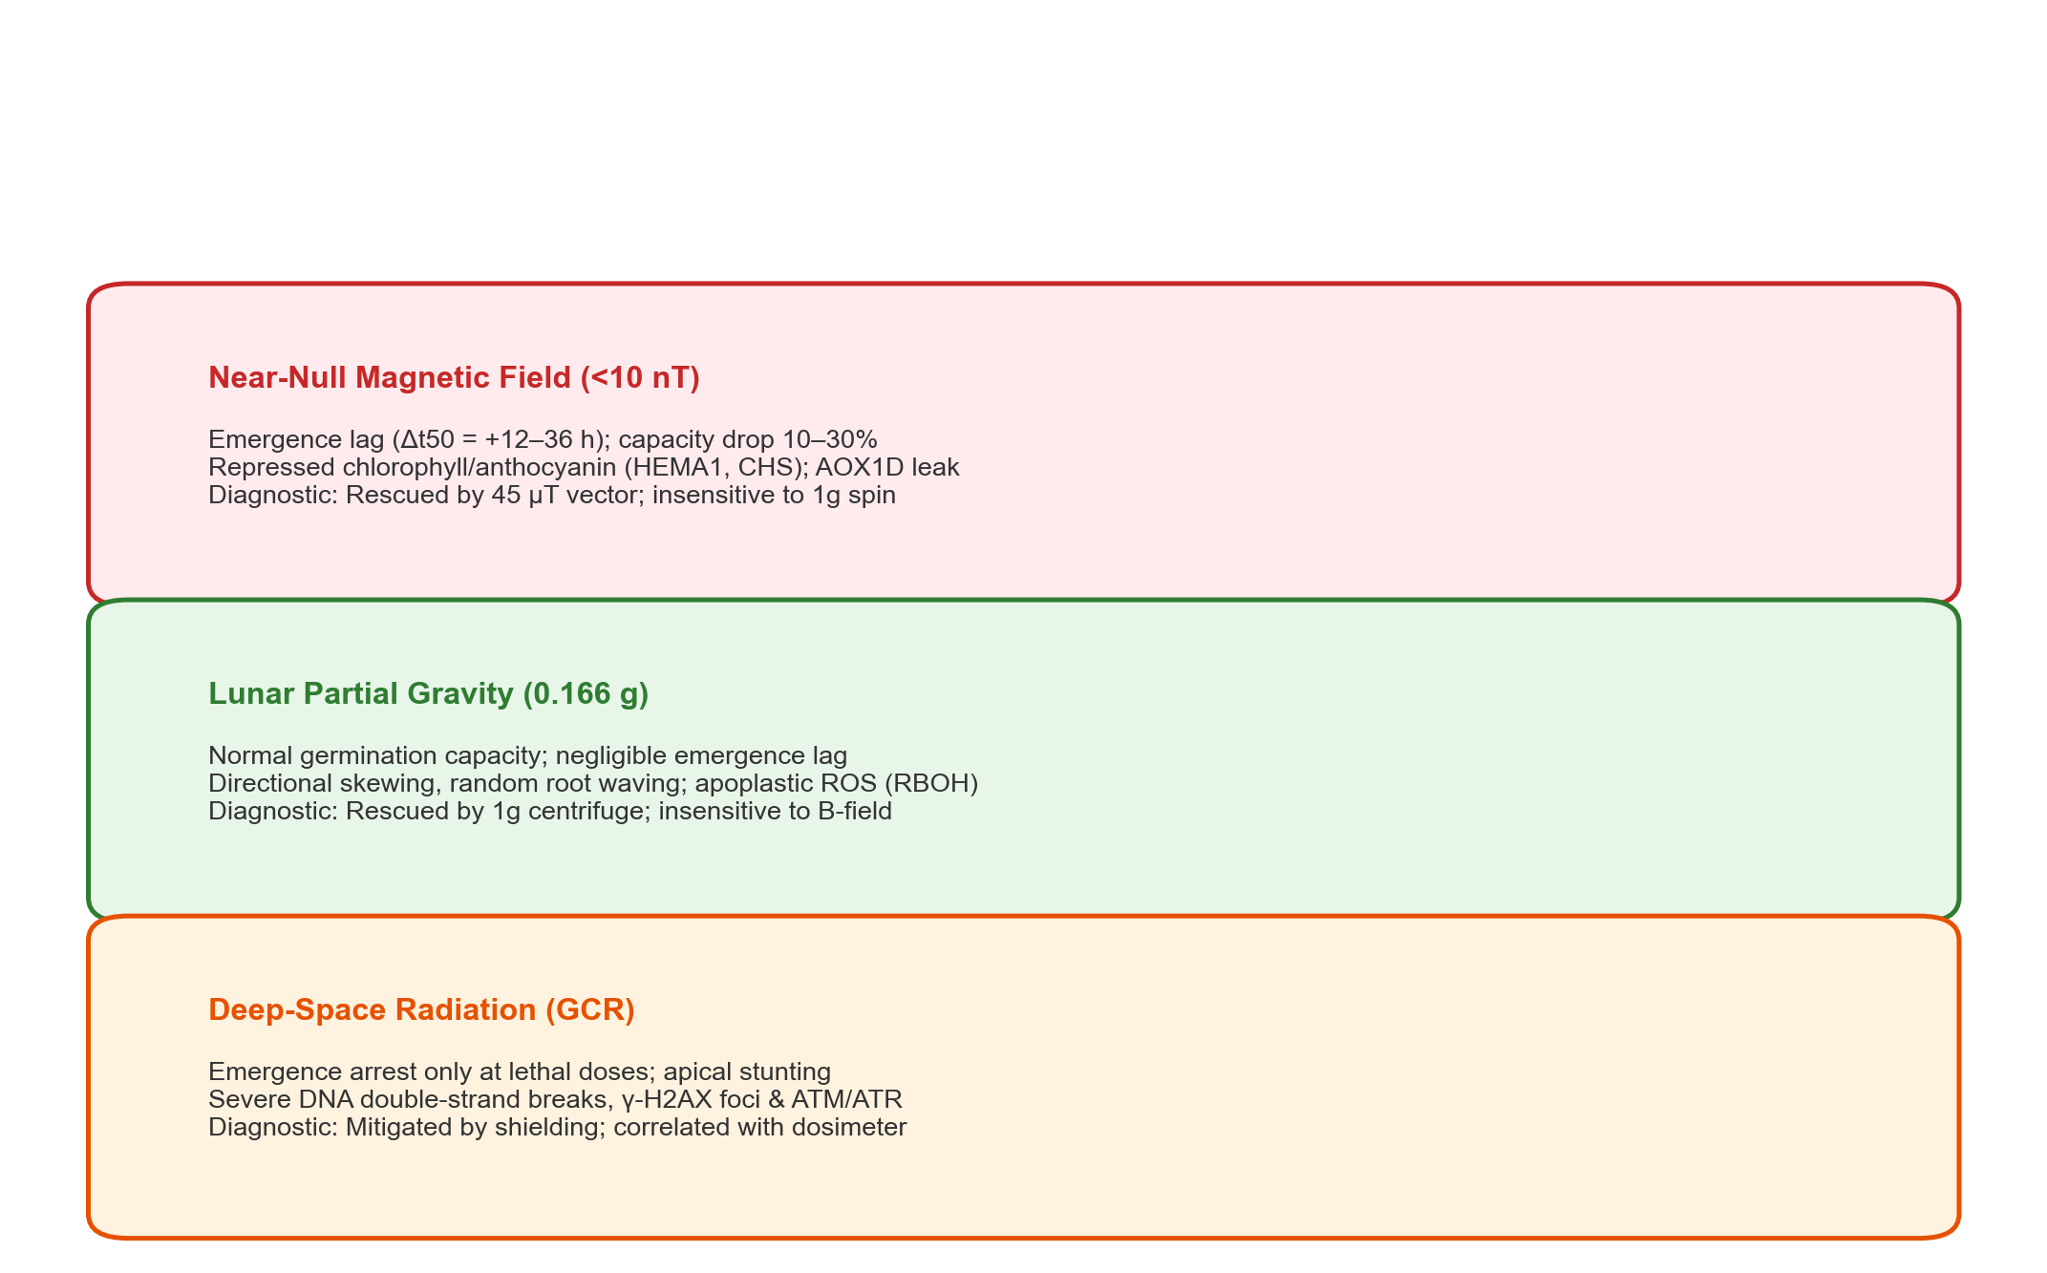
FIGURE 6 MONTAGE | EDITABLE LAYOUT
Ground Simulation Standards & Post-Flight Disambiguation
3-chamber ground controls, in situ causal rescue proof-of-concept, and post-flight phenotypic disambiguation framework
(a) Methodological Ground Simulation Standards (3-Chamber Parity)
(b) Hardware Self-Magnetic Assessment Protocol (Power-State Mapping)
(c) Post-Flight Phenotypic Risk Disambiguation Framework (Comparative Matrix)
Life Sciences in Space Research (2026) | Artemis Missions LEAF Perspective Slide 12 of 16
Notes:
TALKING POINTS (SLIDE 11 - FIGURE 5 MONTAGE):
• Figure 5 establishes our translational roadmap, focusing on rigorous ground simulation methods and post-flight disambiguation.
• Panel (a) sets the 3-chamber ground standard: Chamber 1 (GMF terrestrial control), Chamber 2 (Shielded/Cancelled NNMF lunar simulation), and Chamber 3 (Bifilar sham control matching current, heat, and vibration without magnetic fields).
• Panel (b) introduces our hardware self-magnetic assessment protocol: Characterizing induced magnetic fields across subsystem operating states (LED PAR lighting, fluidic pumps, thermal heaters, and avionics bus) to establish empirical transfer functions that subtract hardware self-fields without requiring active coils in flight.
• Panel (c) provides our post-flight phenotypic disambiguation framework: A full comparative matrix distinguishing hypomagnetic lesions from lunar partial gravity (0.166 g) and deep-space cosmic radiation (GCR) using specific cellular targets and diagnostic rescue strategies.

Slide 13
TABLE 3 DEEP DIVE
Phenotypic Risk Disambiguation Matrix for Lunar Plant Biology
Diagnostic criteria to decouple Near-Null Magnetic Fields from Lunar Partial Gravity and Deep-Space Radiation
Environmental Stressor | Primary Cellular Target | Phenotypic Diagnostic Signature (Days 0–5) | Disambiguation Strategy
Near-Null Magnetic Field (NNMF, < 10 nT) | Cryptochrome radical pairs [FAD•- ... TrpH•+]; SDP1 triacylglycerol lipase. | • Emergence lag (Δt50 = +12–36 h) • 10%–30% capacity drop; chlorosis • Downregulated HEMA1/CHLH/POR • Mitochondrial AOX1D & CAT3 leak • Minimal nuclear DNA breaks | • Reversible by in situ 45 µT vector re-application (causal rescue). • Insensitive to 1g spin centrifugation. • Correlates with 3-axis magnetometer canopy telemetry.
Lunar Partial Gravity (0.166 g) / Microgravity | Amyloplast statolith sedimentation; Mechanosensitive ion channels (MSL/MCA); PIN auxin carrier polarity. | • Normal germination capacity • Negligible emergence lag (Δt50 < 4 h) • Random root waving & directional skewing • Normal plastid greening under PAR • Localized apoplastic ROS (RBOHD/F) | • Fully rescued by onboard 1g centrifuge controls. • Completely insensitive to static magnetic field manipulation. • Quantified via camera morphometry.
Deep-Space Radiation (GCR / SPE) | Direct nuclear DNA ionization; Radiolysis of H2O producing •OH; Oxidation of Fe-S clusters. | • Emergence failure only at lethal doses • Mitotic apical cell cycle arrest • Severe chromosomal aberrations • High γ-H2AX phosphorylated foci • Marked lipid peroxidation (MDA) | • Mitigated by passive polyethylene or water-wall shielding. • Independent of magnetic coils or centrifuges. • Directly calibrated against active dosimeter telemetry (Gy).
Life Sciences in Space Research (2026) | Artemis Missions LEAF Perspective Slide 13 of 16
Notes:
TALKING POINTS (SLIDE 12 - PHENOTYPIC DISAMBIGUATION MATRIX):
• This table represents our key translational science recommendation for Artemis payloads and lunar greenhouses.
• When plants show stress on the lunar surface, how do we know if it was hypomagnetic stress, partial gravity (0.166 g), or radiation?
• This matrix provides unambiguous diagnostic markers:
1. Hypomagnetic field delays emergence velocity (Δt50 = +12–36 h), represses chlorophyll/anthocyanin synthesis via cryptochromes, and triggers mitochondrial AOX1D without nuclear DNA damage. In ground controls, it is fully rescued by a 45 µT vector.
2. Lunar partial gravity causes directional skewing and cell wall changes, but germination rate and greening are normal. It is rescued by a 1g centrifuge, but unaffected by magnetic fields.
3. Radiation causes double-strand DNA breaks and γ-H2AX foci, which are independent of magnetic fields or gravity.
• This framework replaces arbitrary mission abort criteria with a rigorous post-flight diagnostic methodology.

Slide 14
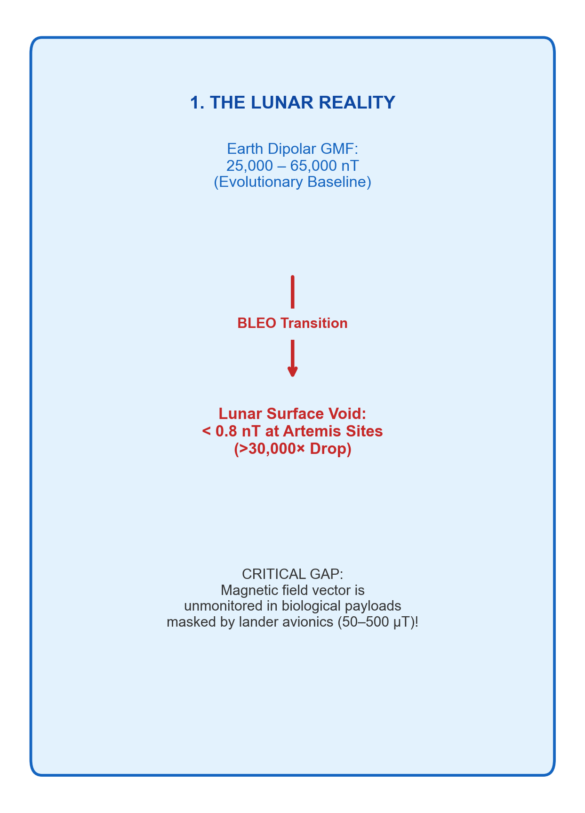
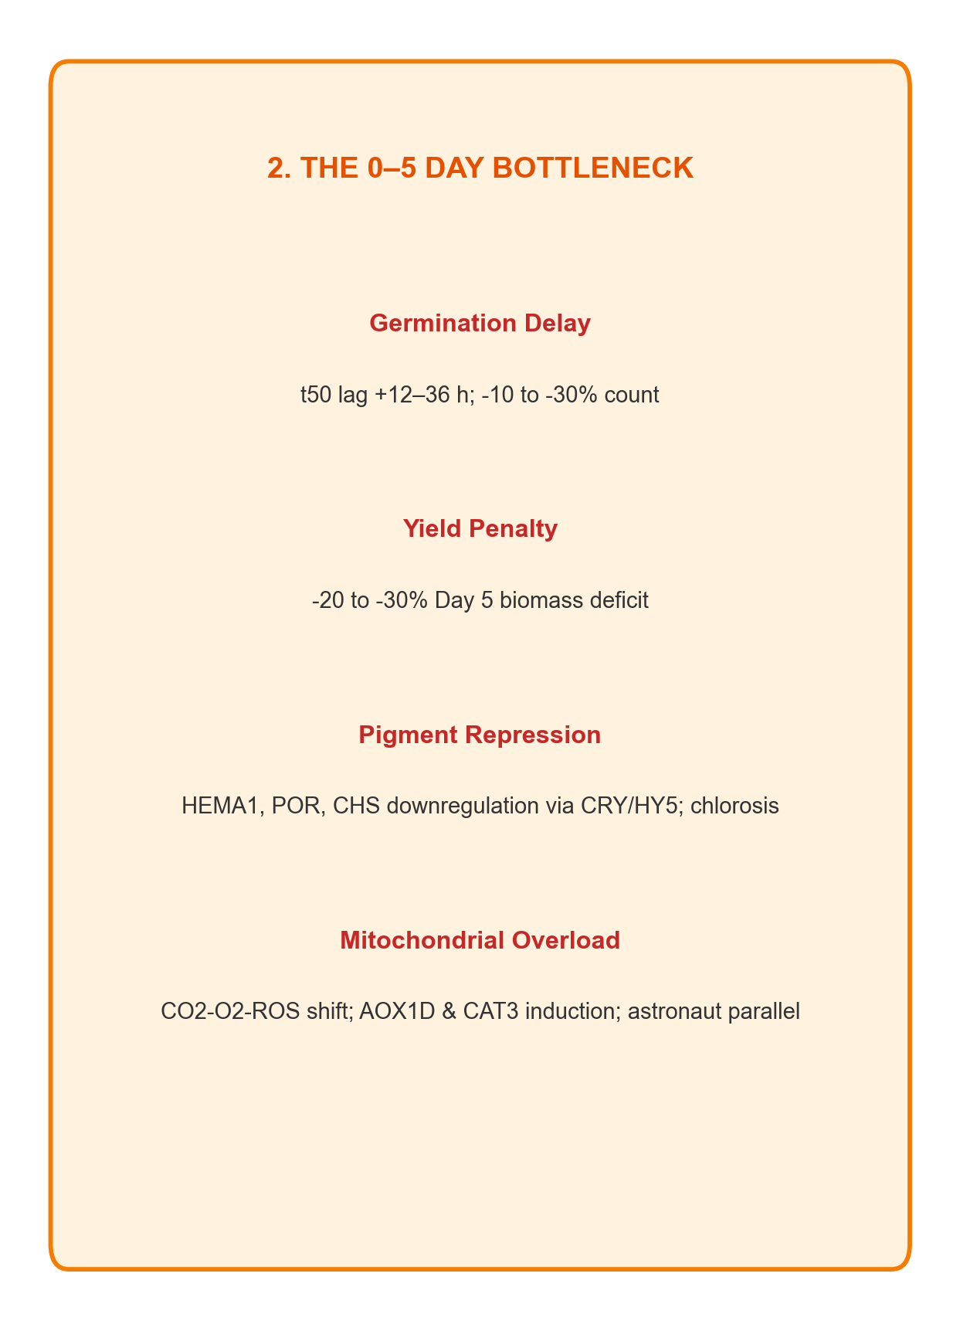
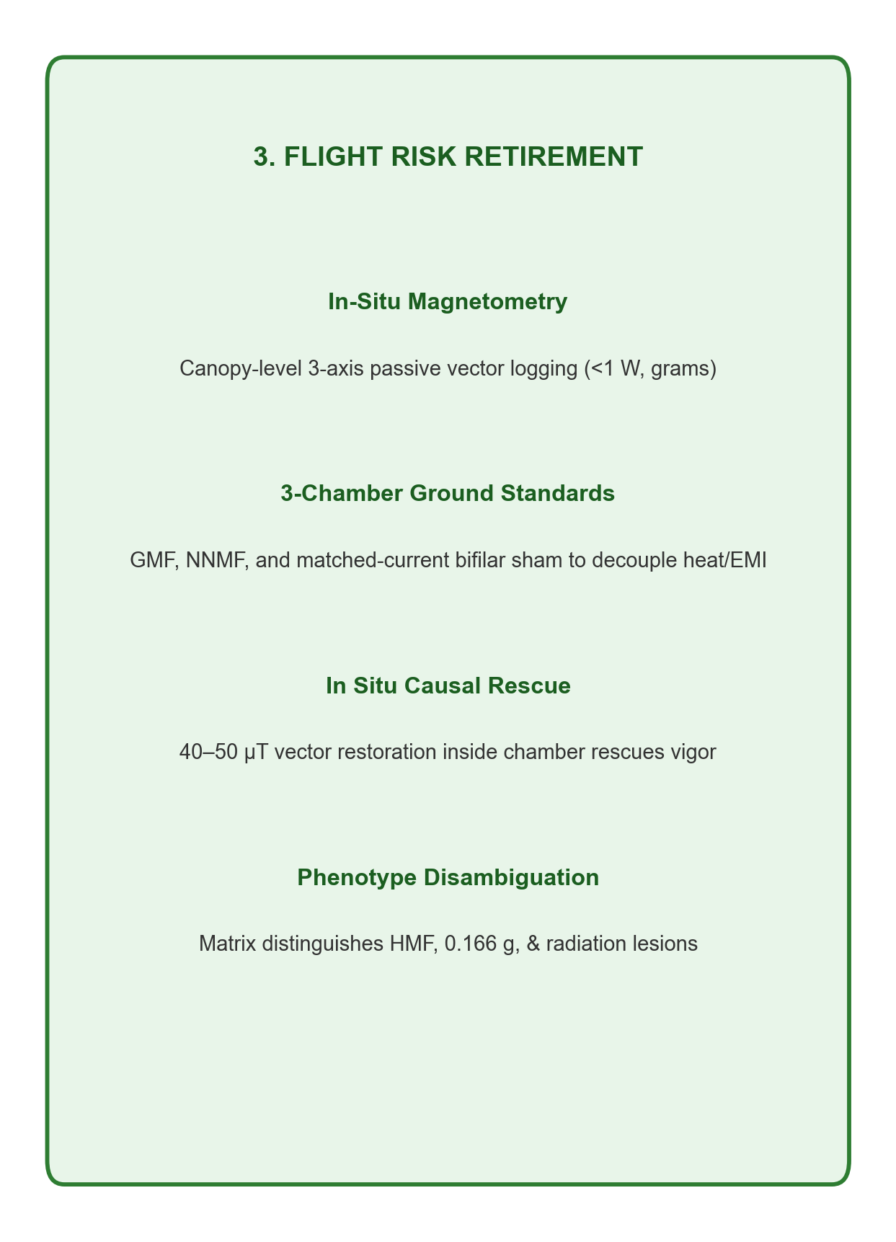
GRAPHICAL ABSTRACT | LSSR SUBMISSION SUMMARY
The Complete Narrative in a Single Glance
From lunar surface physics to 0–5 day developmental vulnerability and flight risk retirement
(1) The Lunar Reality (<0.8 nT Void)
(2) The 0–5 Day Vulnerability Bottleneck
(3) Flight Validation & Risk Retirement
Life Sciences in Space Research (2026) | Artemis Missions LEAF Perspective Slide 14 of 16
Notes:
TALKING POINTS (SLIDE 13 - GRAPHICAL ABSTRACT):
• If you have only two minutes to pitch this paper to an executive or conference audience, this slide tells the entire story.
• Panel 1 (The Lunar Reality): As missions travel beyond low Earth orbit to the Moon, ambient magnetic fields collapse from Earth's 50 µT to less than 0.8 nT at Artemis South Pole sites. This variable is currently unmonitored in flight payloads.
• Panel 2 (The 0–5 Day Vulnerability): Removal of the geomagnetic field causes delayed water uptake, a 12–36 hour emergence velocity lag, a 28% biomass yield loss, and cryptochrome-driven chlorosis.
• Panel 3 (The Solution): We establish a standard flight risk-retirement protocol: in-situ 3-axis magnetometry, 3-chamber ground controls, active causal rescue coils, and predeclared Green/Amber/Red operational decision gates.

Slide 15
RESEARCH ROADMAP & DISCUSSION
Key Questions for the Working Group
Strategic priorities for Artemis missions LEAF operations and long-duration lunar bioregenerative life support
Question 1: Flight Payload Hardware Integration
• How should Artemis LEAF and commercial lunar biological payloads integrate 3-axis fluxgate magnetometers without introducing thermal or EMI artifacts?
• Where is the optimal mounting position relative to seedling cassettes and LEDs?
• What telemetry sample rates (10 Hz vs. 1 Hz) are necessary to capture AC ripple?
Question 2: Crop Plasticity & Cultivar Selection
• Which candidate space crops (Arabidopsis, microgreens, dwarf wheat, tomato) demonstrate natural genetic tolerance to near-null magnetic fields?
• Can pre-flight seed conditioning (magnetic priming or epigenetic pre-exposure) mitigate the Day 0–5 germination and emergence lag?
• How do mutant lines (e.g. cry1/cry2, hy5, aox1a/d) perform under simulated lunar fields?
Question 3: Active Magnetic Sub-Assemblies for BLSS
• Should future lunar surface greenhouses incorporate triaxial Helmholtz coils as standard operational infrastructure?
• What are the mass, volume, and power trade-offs of delivering a continuous 45 µT vector over square meters of plant canopy?
• Does vector re-application completely restore nutritional quality and secondary metabolite profiles?
Life Sciences in Space Research (2026) | Artemis Missions LEAF Perspective Slide 15 of 16
Notes:
TALKING POINTS (SLIDE 14 - DISCUSSION & ROADMAP):
• Now I'd like to open up the floor to the group for discussion around these three strategic questions.
• First: Hardware integration. In LEAF, space is tight. Can we place miniature commercial fluxgate sensors inside the cassette volume, or should they be mounted externally with a calibrated transfer function?
• Second: Genetic tolerance and seed priming. Are there specific cultivars that don't suffer the 28% biomass deficit? Can we prime seeds on Earth with specific magnetic exposures prior to launch?
• Third: Future lunar infrastructure. If long-term lunar greenhouses are built at Shackleton Crater, should active magnetic coils be part of the baseline environmental control system alongside lighting and HVAC?
• Let's hear your thoughts.

Slide 16
APPENDIX & OPEN SCIENCE
FAIR Data Repositories, NASA OSDR Accessions & Web Portal
All manuscript drafts, figures, datasets, and analysis scripts are fully open and reproducible
Manuscript & Documents
• Master Markdown: manuscript/Hypomagnetic_Lunar_Plant_Biology_LSSR_Review.md
• Compiled Word Doc: Near_Null_Magnetic_Fields_Lunar_Plant_Biology_LSSR_Review.docx (2.96 MB)
• BibTeX Library: references_LSSR.bib (79 audited references; CrossRef-verified)
• Target Journal: Life Sciences in Space Research (COSPAR / Elsevier)
Processed Empirical Data Tables
• data/landing_sites_magnetic.csv (Field magnitudes across 23 exploration sites)
• data/lunar_mag_field_grid.csv (1° resolution Lunar Prospector / Kaguya total field)
• data/seedling_kinetics_summary.csv (Empirical Day 0–5 germination kinetics)
• data/multiomics_overlap_osd782_nnmf.csv (OSDR-782 vs. NNMF gene concordance)
NASA Open Science Data Accessions
• OSD-782: Arabidopsis thaliana response to 1 Gy ionizing radiation (rad-bio-app)
• OSD-8: Spaceflight transcriptional response in Arabidopsis seedlings
• OSD-27: Light quality and microgravity interactions in space crops
• Rad-Bio-App: https://osdr.nasa.gov/bio/repo/data/studies/OSD-782
Interactive Web Portal & Zenodo Release
• Live CoSE Showcase: https://dr-richard-barker.github.io/NMF_review/
• GitHub Repository: https://github.com/dr-richard-barker/NMF_review
• Zenodo Package: .zenodo.json, CITATION.cff, MANIFEST.tsv, CHECKSUMS.sha256
• ABAI Quality Control: 5/5 checks passed; official HEAD attestation active
Life Sciences in Space Research (2026) | Artemis Missions LEAF Perspective Slide 16 of 16
Notes:
TALKING POINTS (SLIDE 15 - APPENDIX & OPEN SCIENCE):
• Finally, this slide documents all open science assets and repository deliverables.
• Everything we've shown today is fully open, reproducible, and tracked in Git.
• The compiled Word document is ready for co-authors to edit.
• The CoSE web portal is live at dr-richard-barker.github.io/NMF_review.
• All datasets trace directly to NASA OSDR accessions and Lunar Prospector/Kaguya orbital magnetometer archives.
• Thank you to all co-authors across Purdue, NASA KSC, CU Boulder, and Space Lab Technologies. Looking forward to your feedback!

