Slide 1
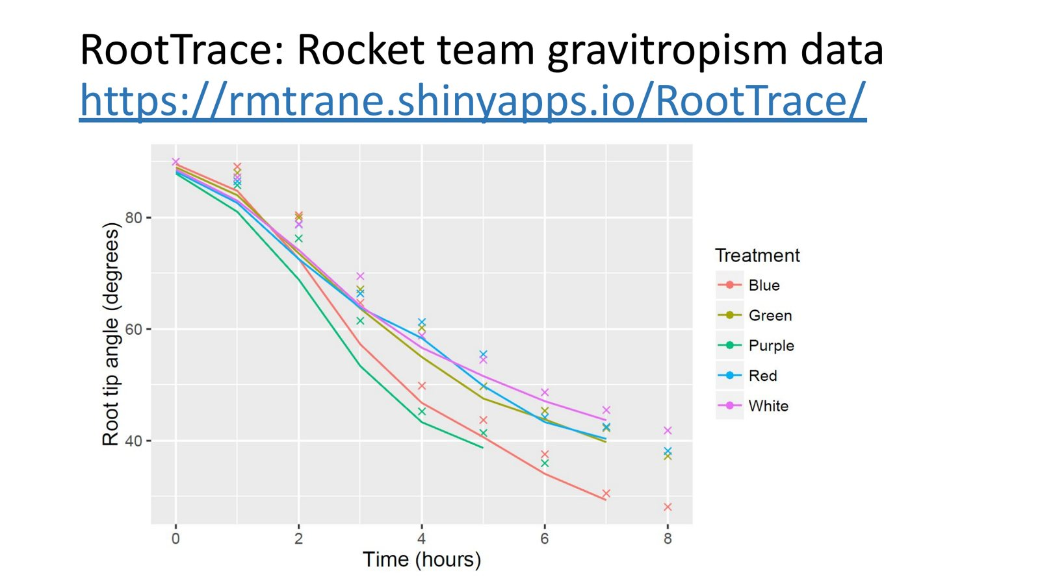
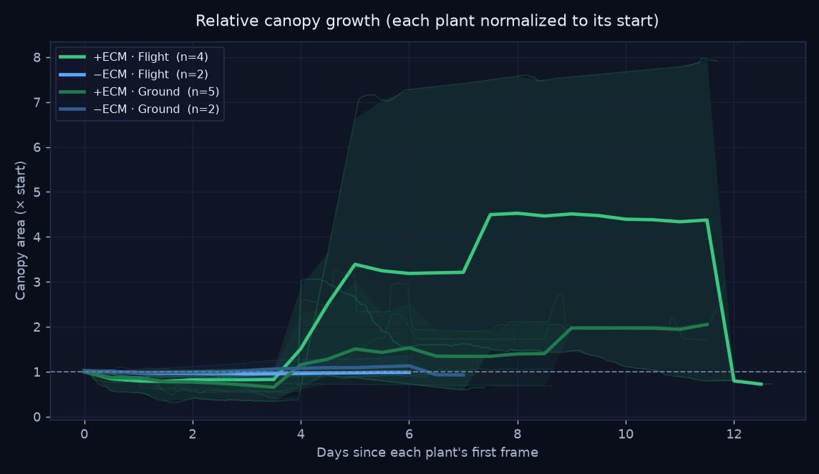
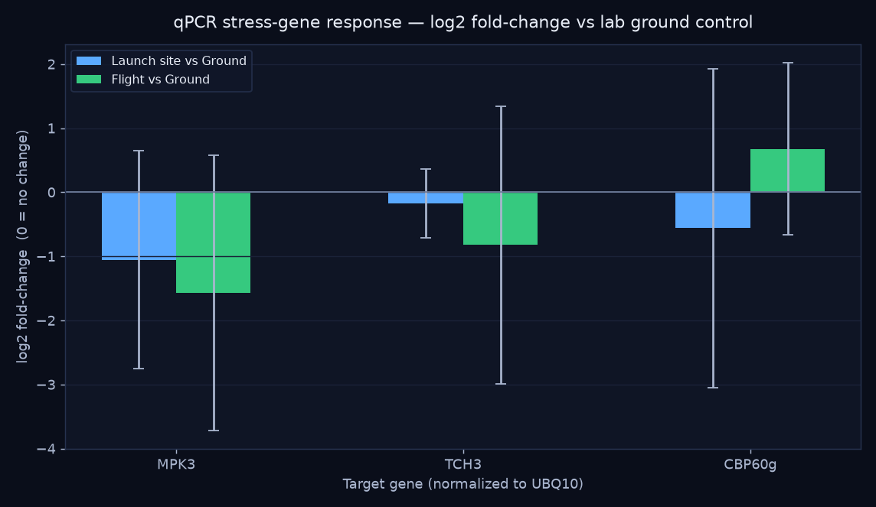
Botanical Sounding Rockets as an Accessible Space-Biology Platform
ASGSR 2026
HS / MS Category
August 2026 deadline
Arabidopsis stress-gene responses and ectomycorrhiza × Populus survival across three 2018 sounding-rocket launches
[Student Lead Author]¹, [Co-Author Student Name(s)]¹, Richard Barker², and the MadWest High School Rocket Team¹
¹MadWest High School · ²AstroBotany Laboratory, University of Wisconsin–Madison, Madison, WI, USA
Background
KEY FINDING
TREES: Mycorrhizal Seedlings Died Back
Root Gravitropism Under Spectral Light
Orbital stress signature: ISS transcriptomics (BRIC-19 / TOAST) reveal a high-light / ROS stress signature in spaceflight plants — HSP101, HSP70, and WRKY33 upregulated even in darkness (Choi et al., 2019).
Why sounding rockets?
Orbital access is scarce and expensive. Suborbital sounding rockets offer:
▸ Repeatable, student-accessible flights
▸ Brief, intense profile: high-G boost + ballistic coast
▸ Controls, post-flight assays, and open-data deposition
Question: Can repeatable suborbital launches let students probe flight-associated plant biology and contribute to the open-data record?
+ECM survived to
71–73%
of peak canopy
−ECM held at
94–96%
of peak canopy
Root-tip angle declined across all spectral treatments (blue, green, purple, red, white LEDs), confirming active gravitropic reorientation. Root length varied with spectrum. Establishes the team's capacity to quantify the gravity-sensing behavior that spaceflight perturbs.
Three-Launch Program (2018)
L1
Arabidopsis test — Launch 1
Conclusions
Flown Arabidopsis reportedly flowered earlier than controls; co-flown ECM spores remained viable post-flight. These qualitative observations motivated the subsequent experiments.
Hypothesis refuted. Mycorrhizal (+ECM) Populus tremula seedlings peaked, then died back — one individual fell to 22% of peak canopy. Non-mycorrhizal plants held near peak. The die-back was plainly visible in the timelapse; a start-to-end summary would have masked it.
⚠ Caveat: +ECM imaged ~9 d; −ECM only ~6 d (duration confound); n = 2–5/group. Trends, not controlled proof.
Platform works. Three independent assays (phenotype, qPCR, timelapse) returned interpretable plant-biology readouts from suborbital flights.
Honest negative result. ECM did not improve Populus flight survival — the die-back was only visible with peak→end trajectory analysis, not start-to-end.
Pathway remodeling, not simple stress. qPCR trends (↓MPK3, ↓TCH3, ↑CBP60g) align with the orbital high-light/ROS/HSP framework (Choi et al., 2019).
Open data. Full OSDR/ISA-formatted dataset produced — student results enter the reusable science record.
L2
Reggies' Veggies — Arabidopsis qPCR
Arabidopsis Col-0 flown alongside launch-site and lab controls, fixed in RNA•later on recovery. qPCR: MPK3, TCH3, CBP60g (UBQ10 reference). n = 4/group.
Launch 2 qPCR: Stress-Pathway Remodeling
MPK3
0.34×
↓ reduced
stress MAP kinase
TCH3
0.56×
↓ reduced
touch / mechano signal
CBP60g
1.60×
↑ elevated
defense signaling
L3
TREES — Populus × ECM survival
Future Work
Populus tremula ± ECM inoculation, flown vs. ground. ~2,600-frame timelapse (~12 d). Automated ExG canopy segmentation: start → peak → end trajectories.
HSP101/HSP70/WRKY33 targeted flight. Add ROS-marker qPCR panel; H₂O₂ + hypoxia positive controls. n≥14 for 3-fold change (α=0.05, 80% power).
TREES repeat with matched imaging windows. Remove duration confound; identify ECM species; add cm² calibration to pipeline.
Formal OSDR deposit. Confirm current NASA OSDR requirements and finalize data submission.
Methods Summary
All flights: Cesaroni K1620 motor, apogee ≈4,046 ft, dual-deployment recovery (drogue at apogee, main at ~700 ft AGL); PerfectFlite altimetry.
qPCR: ΔΔCt vs. Lab calibrator; fold-change = 2^(−ΔΔCt). n=4 bio. reps. Tissue fixed in RNA•later on recovery.
Canopy analysis: ExG index (2G−R−B), near-white glare removal, rolling-median smoothing. Per-plant start → peak → end trajectories. ~2,600 frames over ~12 days.
Open data: Code and processed data formatted to ISA model for NASA OSDR deposit (GitHub + Zenodo).
Data & References
Data: Code, processed data, and ISA package: github.com/dr-richard-barker/madwest-astrobotany · Zenodo (DOI on deposit). Raw imagery in Zenodo.
[1] Choi et al. (2019). Am. J. Bot. 106(1):123–136.
[2] Willems et al. (2016). Plant Physiol. 171(3):1720–1733.
[3] Toyota et al. (2018). Science 361:1112–1115.
[4] NASA OSDR / GeneLab: osdr.nasa.gov
Flown Arabidopsis trended: ↓ MPK3 (0.34×), ↓ TCH3 (0.56×), ↑ CBP60g (1.60×) vs. Lab control. Flight shifts which pathways engage, rather than simply amplifying stress. n=4; error bars cross zero — trends only.
Not affiliated with or endorsed by NASA · Independent educational project · ASGSR HS/MS Category · dr.richard.barker@gmail.com

