Slide 1

Istio
What is Istio?
Challenges of the Microservice Architecture
How it solves the challenges
Install & demo

Slide 2
What is Istio?
Istio uses a service mesh(huh?)
Collects telemetry, tracing, logging
A configurable open source service-mesh layer that connects, monitors and secures the containers in a Kubernetes cluster
Traffic management, control traffic

Slide 3

What is Service Mesh?
Istio is a service mesh
A service mesh defines both the control plane (to configure desired service connectivity and behavior) and the data plane (to direct traffic and enforce security rules.) Without a service mesh, all of these capabilities would need to be built directly into all the various microservices — a complex task
A dedicated infrastructure layer to facilitate service-to-service communication
Service mesh handles the communication and traffic between microservices.
Main idea is to put “all communication” in a sidecar proxy.
But, why do we need it? It is free. And, it takes care of the challenges. What are these challenges?

Slide 4
Challenges of microservice architecture
MS
Microservice C
inventory
Shopping cart Application
Microservice A
Shopping Cart
MS
MS
MS
Microservice B
Webserver
Microservice D
payment

Slide 5
Challenges
Adding endpoints, means we have to add another pod/container, more configuration
Adding more complexity to the business logic
Correctly routing traffic between services
Handle the communication inside the cluster
Security is not handled properly
Metrics & monitoring is another layer of complexity

Slide 6
Total Challenges
Pod
The pod has now become complex, and more time to configure, develop and troubleshoot.
Developers now spend time configuring instead of working on the application logic.
Business Logic
Communication config
Security
Metrics
Tracing

Slide 7
Solution: Istio
Pod
Communication config
Security
Metrics
Tracing
Side car proxy :
Communication config
Handles network logic
Security
Metrics
Tracing
Side Car Proxy
MS
Business Logic
Developers can now focus on business logic and the microservices. And more time to focus on other stuff like drink more coffee, games

Slide 8
Download
Note: before install, minikube needs to have resources: minikube start --cpus 6 --memory 6g
Repo Url: https://github.com/istio/istio/releases/tag/1.24.0
Download to a folder: istio-installation/ istio-1.24.0-linux-amd64.tar.gz
Unpack it: tar -xf istio-1.24.0-linux-amd64.tar.gz
Change to directory: @mint-vm:~/istio-installation$ cd istio-1.24.0/
Mint-vm: ~/istio-installation/istio-1.24.0$ ls
bin LICENSE manifests manifest.yaml README.md samples tools
@mint-vm:~/istio-installation/istio-1.24.0$ cd bin
@mint-vm:~/istio-installation/istio-1.24.0/bin$ ls
istioctl
Export to path: ~/istio-installation/istio-1.24.0/bin$ export PATH=$PATH:/home/user/istio-installation/istio-1.24.0/bin
Now run the command: istioctl
Will display the following:
Istio configuration command line utility for service operators to
debug and diagnose their Istio mesh.
Usage:
istioctl [command]
Note: only works in the terminal where export to path is executed.

Slide 9
istioctl install
> istioctl install
|\
| \
| \
| \
/|| \
/ || \
/ || \
/ || \
/ || \
/ || \
/______||__________\
____________________
\__ _____/
\_____/
This will install the Istio 1.24.0 profile "default" into the cluster. Proceed? (y/N) y
✔ Istio core installed ⛵️
✔ Istiod installed 🧠
✔ Ingress gateways installed 🛬
✔ Installation complete
Note: takes a few mins depending on system resources.

Slide 10
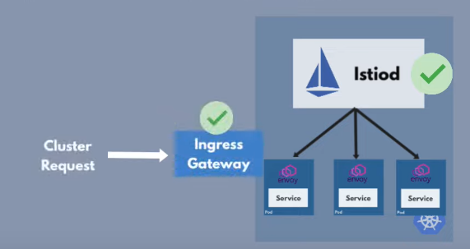
Get Pod
Run the post install command:
mint-vm:~/istio-installation/istio-1.24.0/bin$ kubectl get pod -n istio-system
NAME READY STATUS RESTARTS AGE
istio-ingressgateway-8cd544cbd-5db4c 1/1 Running 0 5m35s
istiod-6b5fb7b484-2w4pq 1/1 Running 0 6m16s
We have ingress gateway and an Istio pod.
Note: the 1/1 is only the pod and not proxy. See next steps.

Slide 11
Configure Proxy in the namespace
To inject the Istio into the pods, create the label namespace: kubectl label namespace default istio-injection=enabled
To view the label:
kubectl get ns default --show-labels
NAME STATUS AGE LABELS
default Active 24h istio-injection=enabled,kubernetes.io/metadata.name=default
This will inject the proxy into the pods.

Slide 12
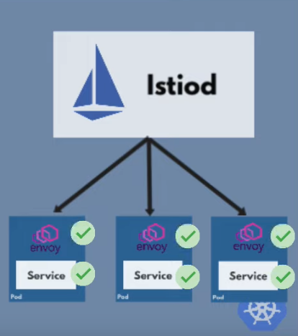
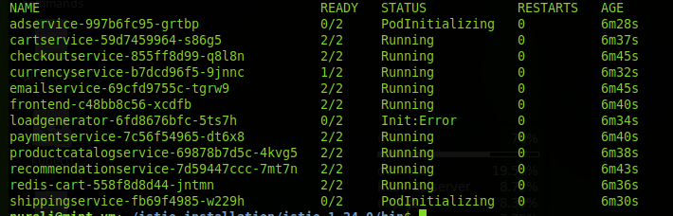
Example using Google cloud platform, microservices
Kubectl apply -f https://raw.githubusercontent.com/GoogleCloudPlatform/microservices-demo/refs/heads/main/release/kubernetes-manifests.yaml
Be warned! This example takes at least 8 mins for all pods to initialize.
Now we can see the 2 containers per pod 2 / 2 under the Ready column:
Kubectl get pod

Slide 13
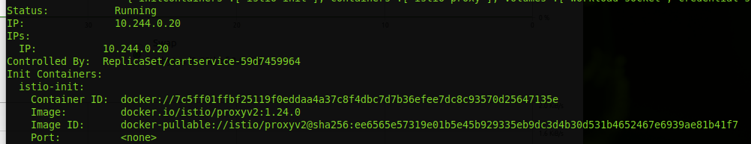
Describe pod
kubectl describe pod cartservice-59d7459964-s86g5
We can see the istio is injected into the pod:

Slide 14
Data Visualiztion?
Istio itself is Not a visualization
It only collects the telemetry data
We have to use the add ons:
https://istio.io/latest/docs/ops/integrations/

Slide 15
Install addons
The addons are included in the istio folder:
istio-1.24.0/samples/addons
Kube command:
kubectl apply -f istio-1.24.0/samples/addons/
This will install all the visual tools
Note: depending on system, may take over 10mins. (feel free to grab more coffee...)

Slide 16
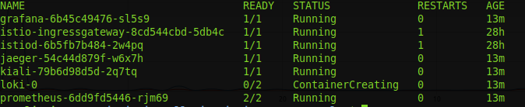
Check the status
Check the status: kubectl get pod -n istio-system

Slide 17
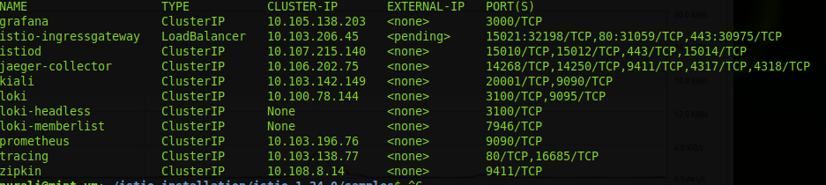
Check the services
kubectl get svc -n istio-system
We’ll use kiali as an example

Slide 18
Kiali demo
Visual tool using service mesh management for Istio
Configure port forwarding:
kubectl port-forward svc/kiali -n istio-system 20001
Then open from browser: http://127.0.0.1:20001

Slide 19
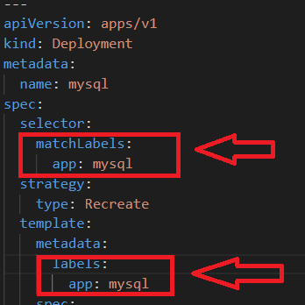
Summary
Install istio
Inject
Install visual tools add ons
No configuration in yaml files,
but need the label called app
This is used to make the
visualization work
No added code!
More time for coffee, games
There is more to Istio than this presentation.

Slide 20
Resources
https://isitobservable.io/observability/service-mesh/what-is-servicemesh-and-specially-what-is-istio
https://www.ibm.com/topics/istio
https://www.youtube.com/watch?v=voAyroDb6xk
https://www.youtube.com/watch?v=16fgzklcF7Y
https://www.solo.io/topics/istio

