Slide 1
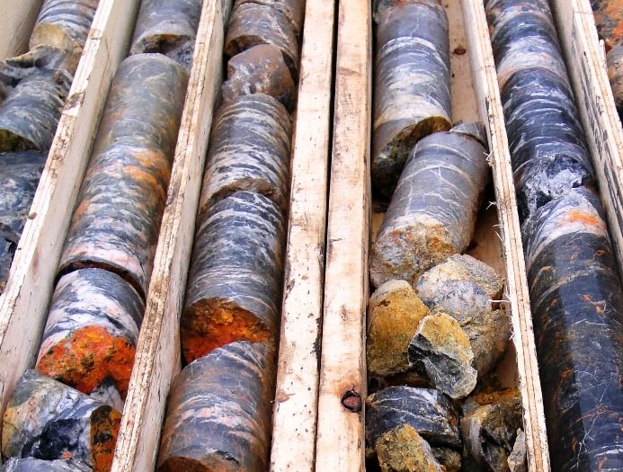
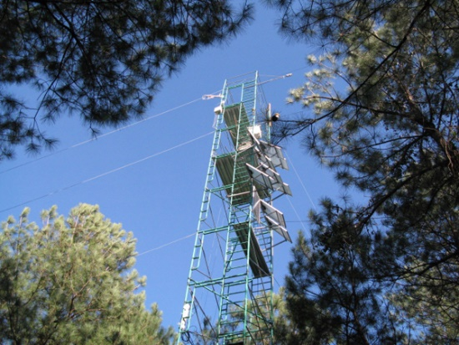
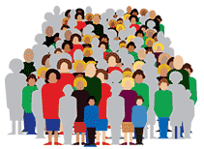
Harmonising data description across social & natural sciences
Simon J D Cox, Simon Hodson, Lesley Wyborn, Phil Archer, Joachim Wackerow, Steve McEachern
7 November 2018
Land and Water

Slide 2
Finding data for x-disciplinary applications
Use cross-domain data catalogs

Slide 3
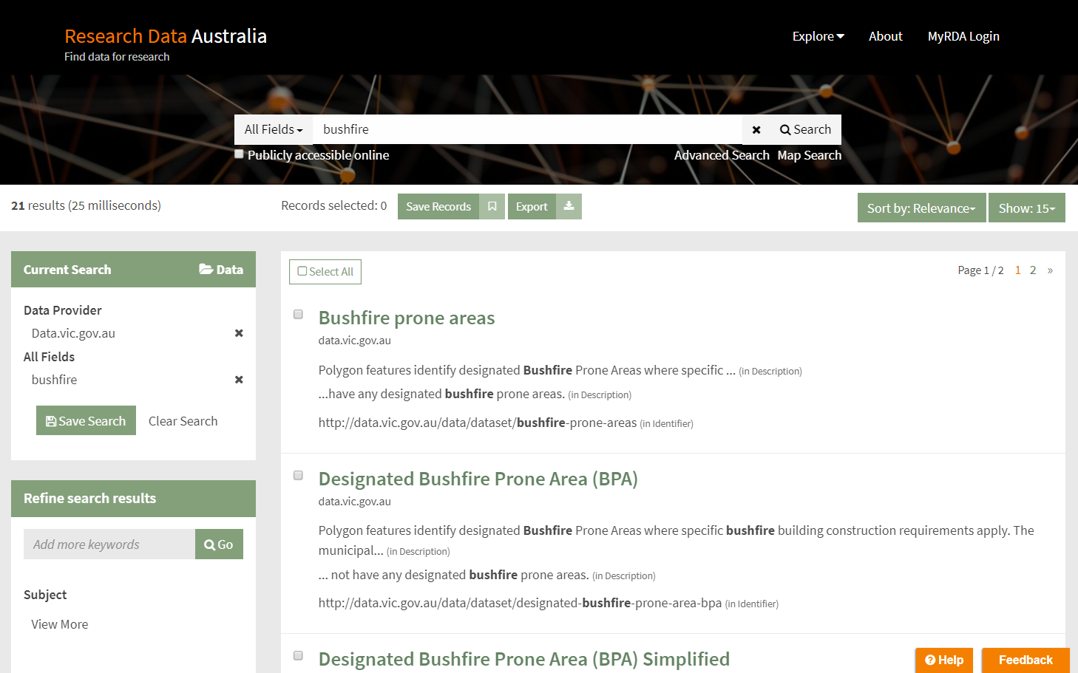

Slide 4
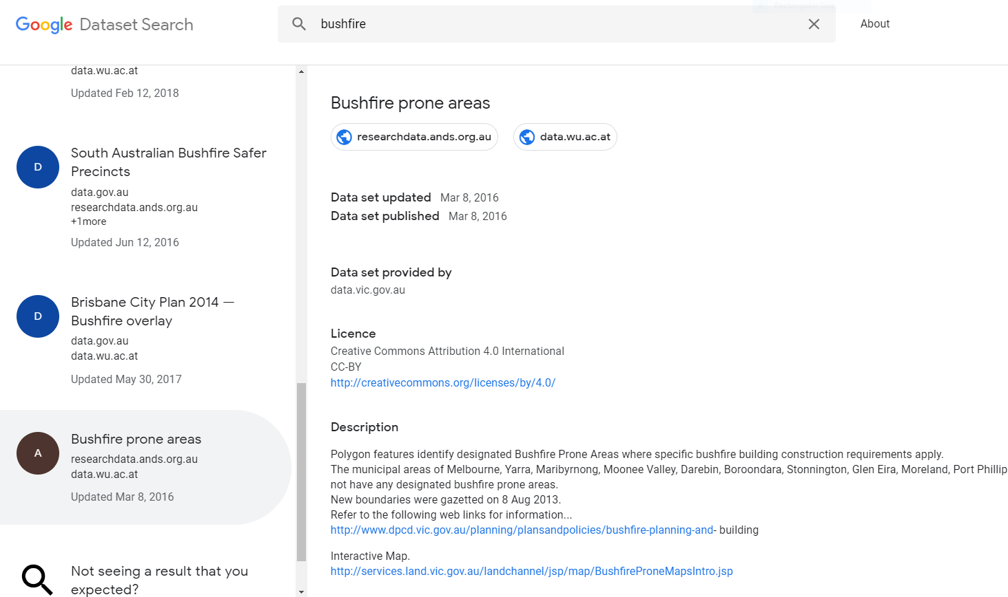
Google dataset search

Slide 5
Limitations of dataset catalogs
Weak thematic semantics
Abstract, keywords, subject/theme 
Variable, instrument, protocol 
Summary statistics missing or incomplete

Slide 6

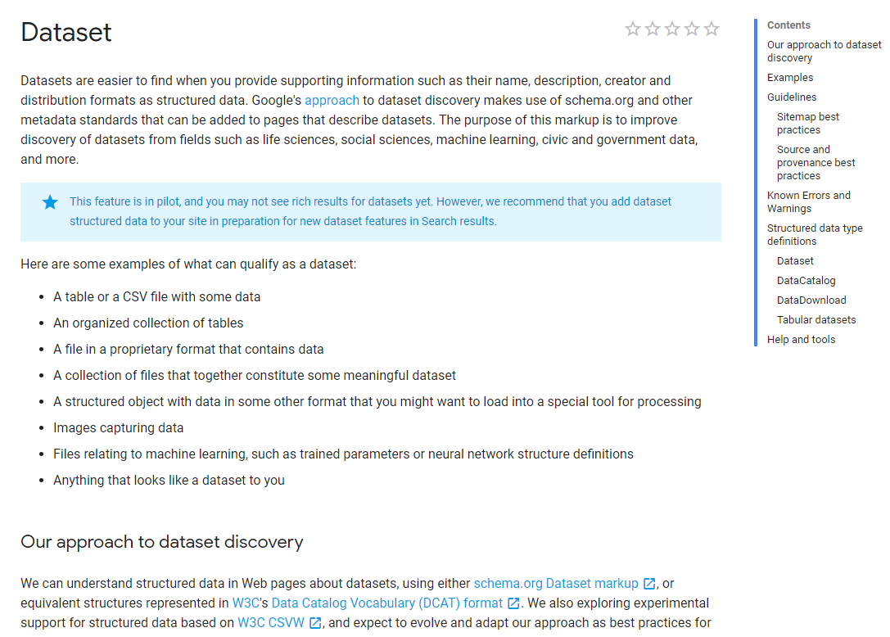

Slide 7

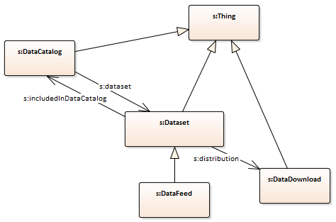
Dataset catalog – schema.org

Slide 8
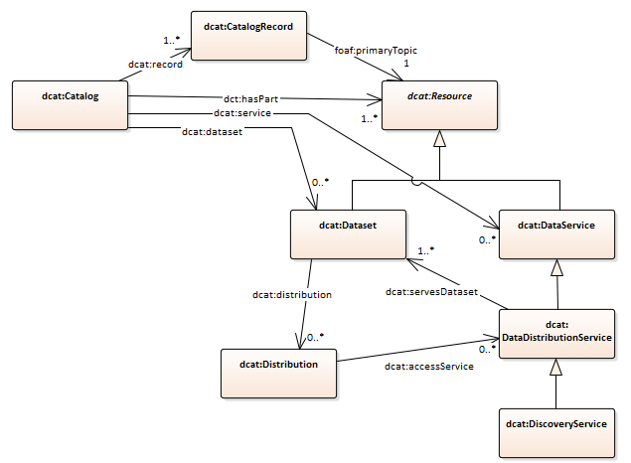

W3C Dataset catalog vocabulary - DCAT

Slide 9

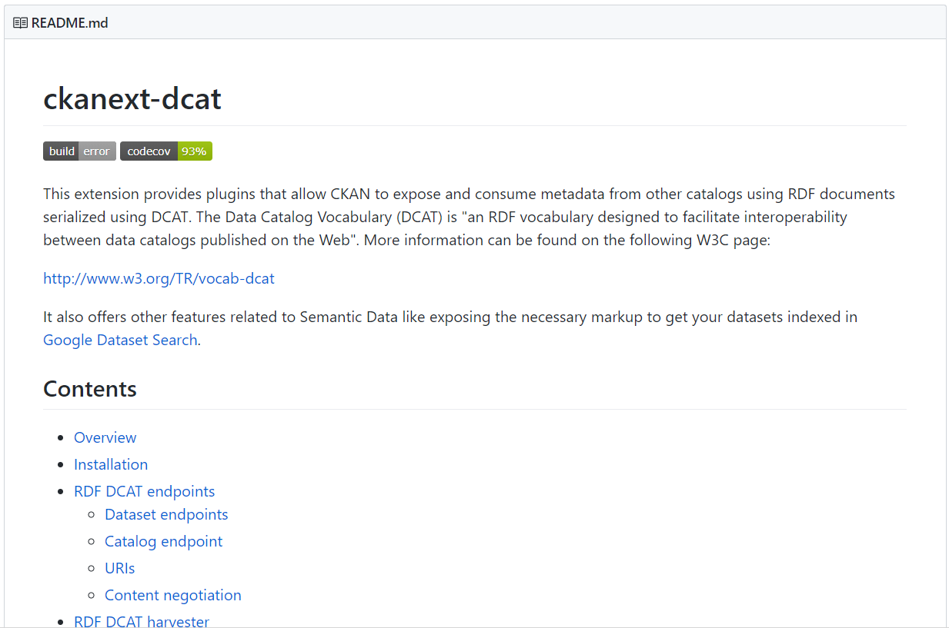
CKAN ♥ DCAT

Slide 10
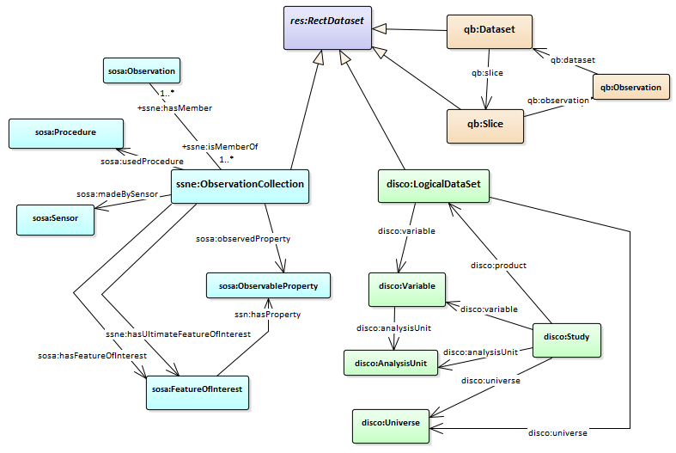




Lining up natural and social science concepts

Slide 11

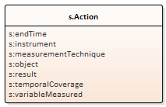
Observation metadata
SSN Observation
resultTime
madeBySensor
usedProcedure
hasFeatureOfInterest
hasResult
phenomenonTime
observedProperty

Slide 12
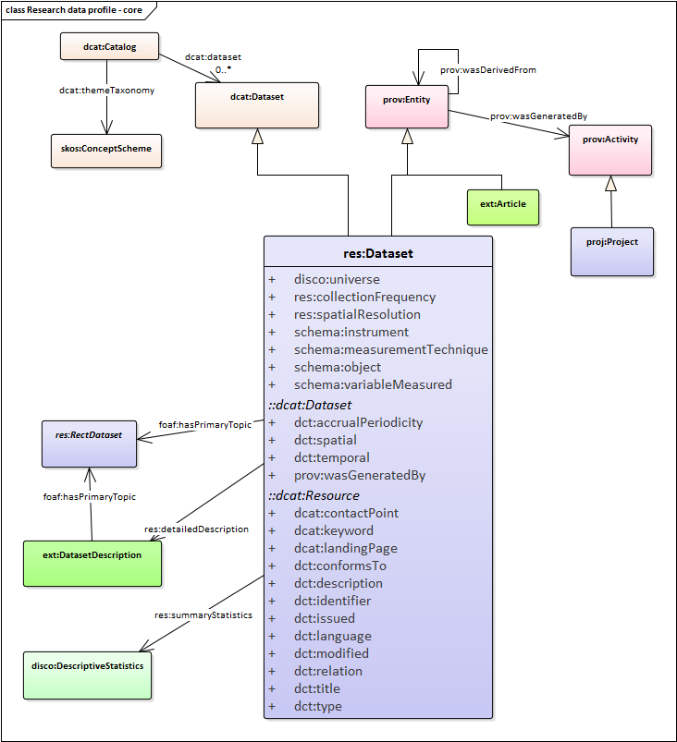
Metadata mashup
Controlled vocabularies
Provenance/context
Observation properties
Dataset statistics

Slide 13



Profile for research data discovery & assessment
Add to dataset descriptions (catalog entry):
observation semantics
summary statistics
formal provenance
Load richer metadata, get better indexes, find more datasets …

Slide 14
Thank you
Land and Water
Simon Cox Research Scientist
t +61 3 9545 2365
e simon.cox@csiro.au w www.csiro.au
Simon Hodson Lesley Wyborn Phil Archer Joachim Wackerow Steve McEachern
+ participants in CODATA initiative and workshop at Dagstuhl
Land and water

Slide 15
Individual observations
There are many conceptual- and implementation-models for individual observations

Slide 16

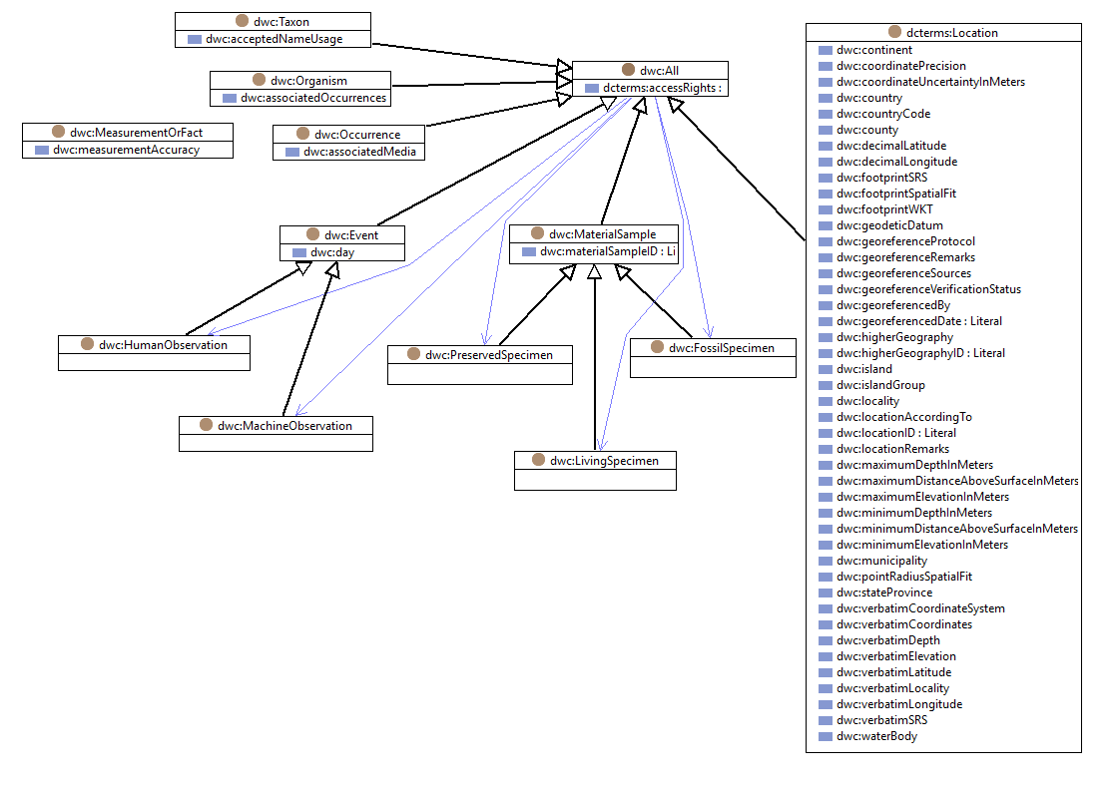
Darwin Core - biodiversity

Slide 17

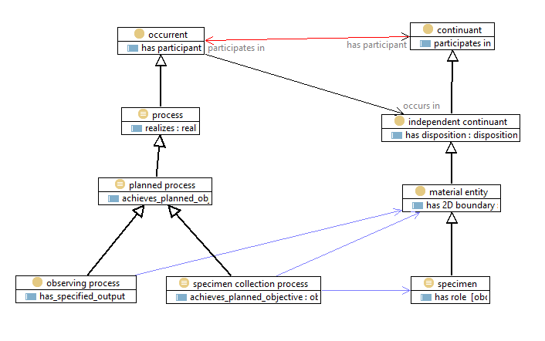
OBO - Open Biological and Biomedical Ontologies

Slide 18

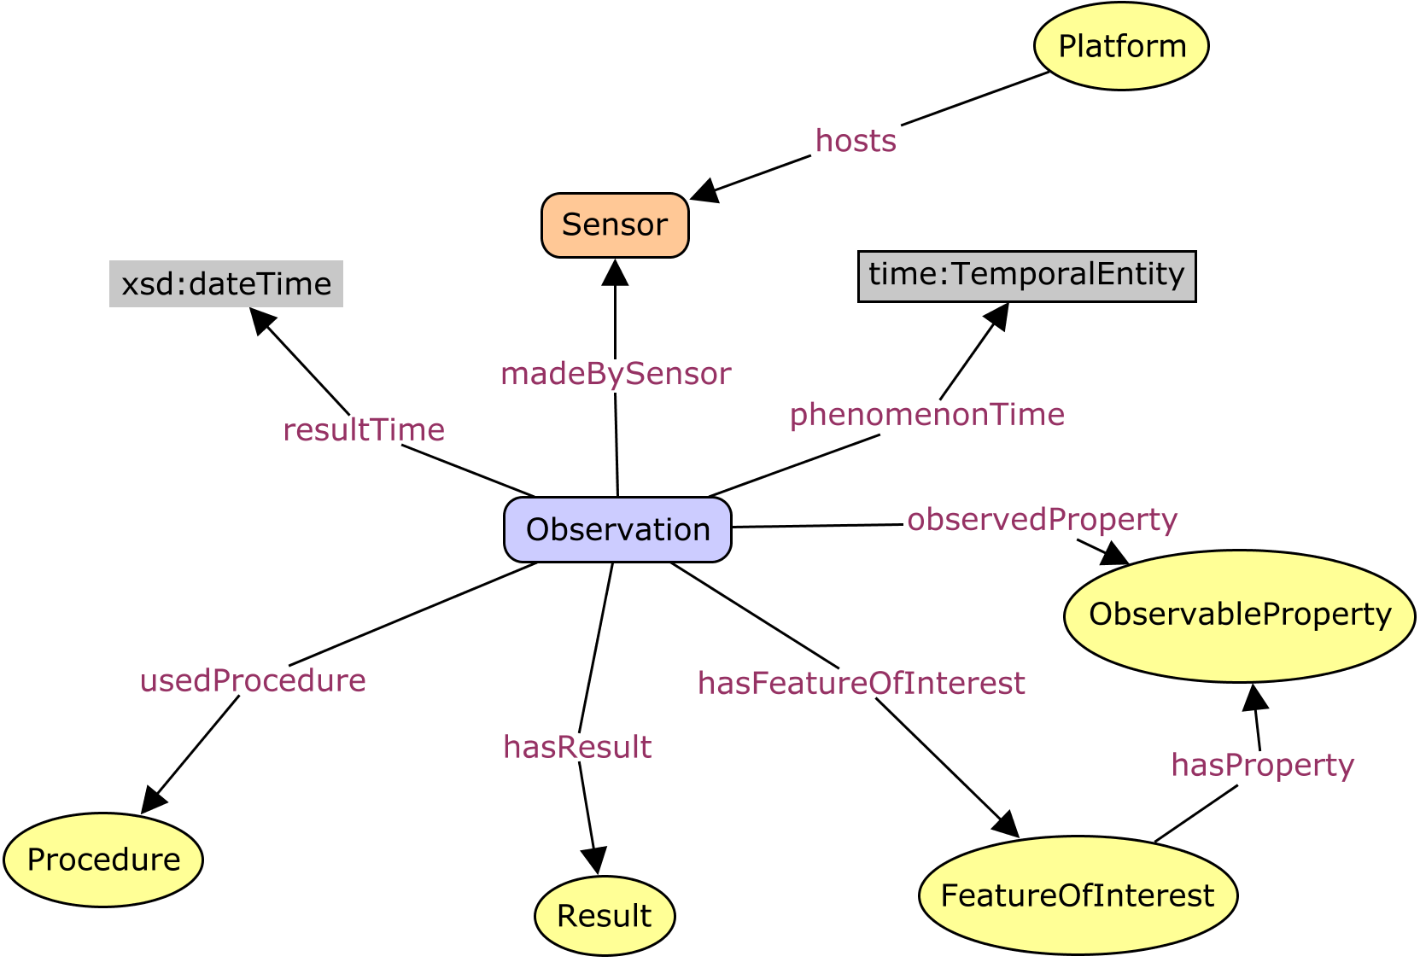
O&M / SSN – geospatial/general purpose
instruments and sensors
observable-properties
the application-domain
protocols and procedures
object types (features)
Notes:
The general model can be specialised for use in a specific domain, by defining domain specific feature types and lists

Slide 19
Datasets - collections of observations
Empirical science requires datasets, composed of collections of observations

Slide 20
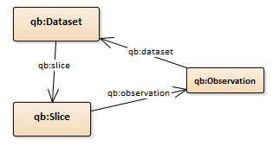
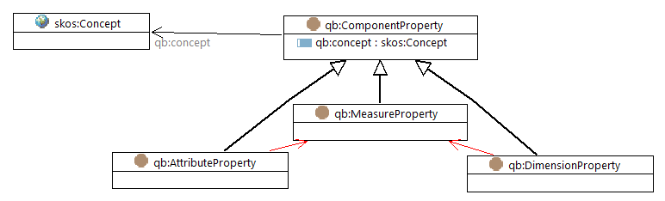
SDMX / QB – Official Statistics

Slide 21
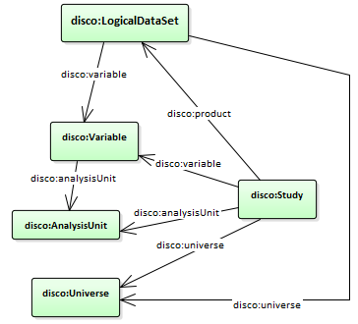
DDI / DISCO – Social sciences

Slide 22
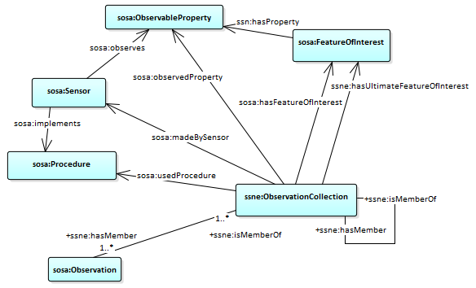
SSN Observation collection – generic?

