Slide 1
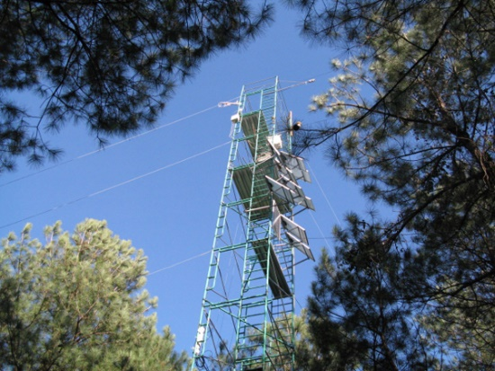


Cross-domain data discovery and integration
Simon J D Cox
CSIRO Land and Water
7 November 2018

Slide 2
Finding data for x-disciplinary applications
Use cross-domain data catalogs

Slide 3

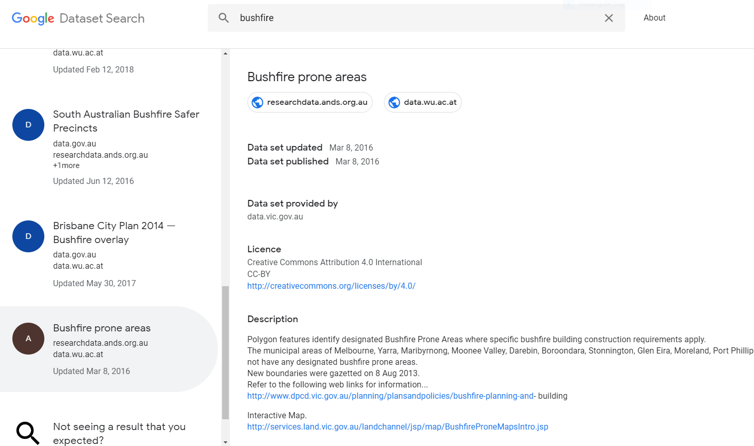

Slide 4
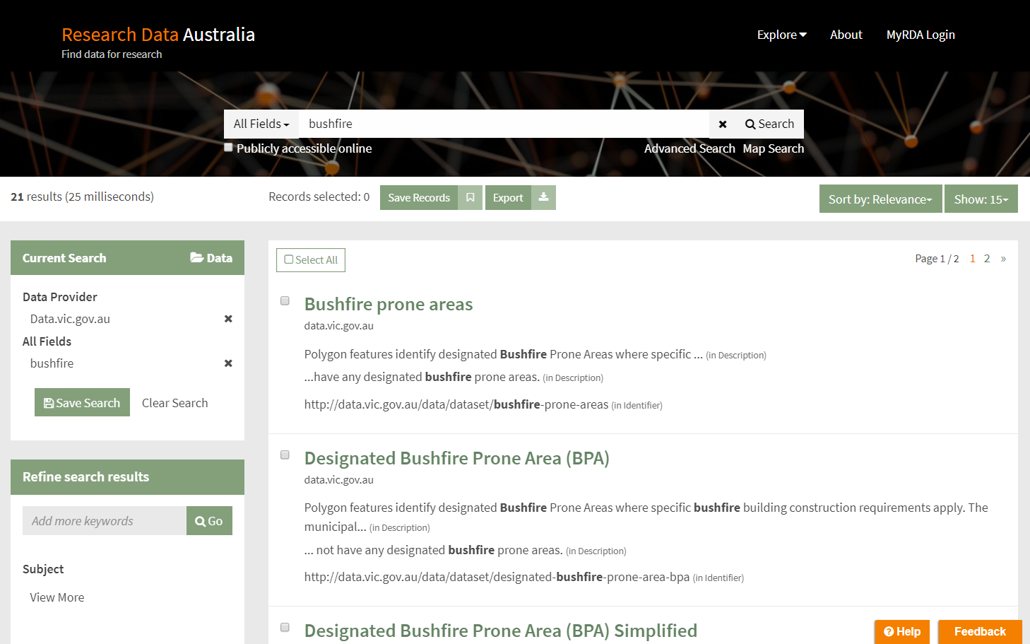

Slide 5
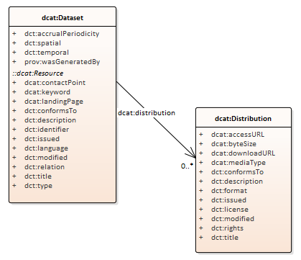
Generic dataset metadata

Slide 6


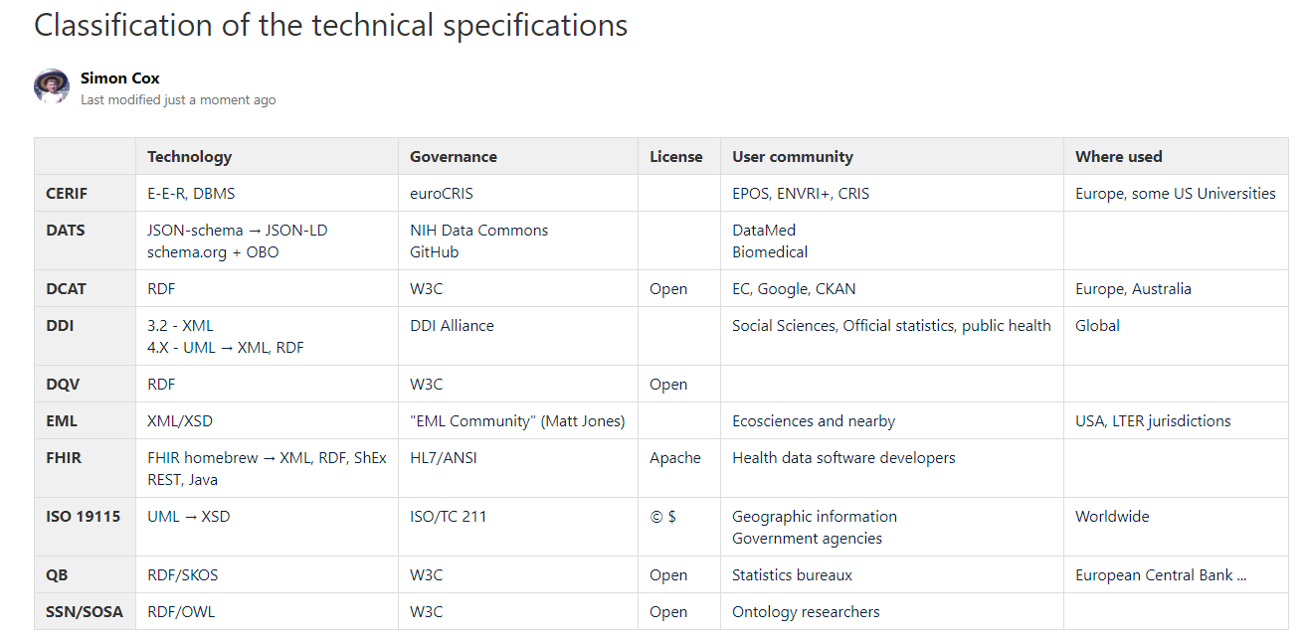
Metadata standards
Notes:
There – two dirty words in one title!

Slide 7

Study level
DCAT
DATS
EML
DDI
19115
CERIF
DQV
FHIR HL7Q
QB
SSN/SOSA
Generic applications
Primarily domain usage
Variable level

Slide 8


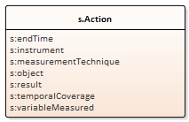
Observation metadata
SSN Observation
resultTime
madeBySensor
usedProcedure
hasFeatureOfInterest
hasResult
phenomenonTime
observedProperty

Slide 9
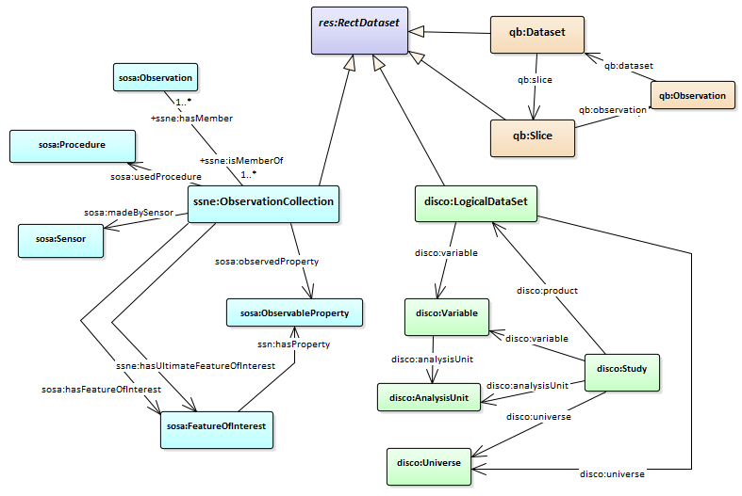



Lining up natural and social science concepts

Slide 10
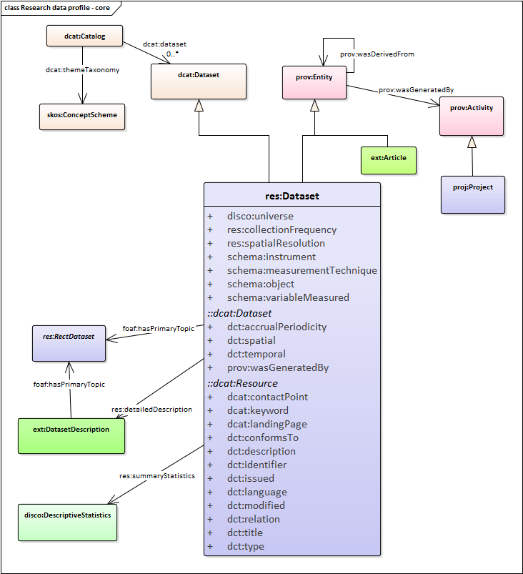
Metadata mashup
Controlled vocabularies
Provenance/context
Observation properties
Dataset statistics

Slide 11
Is ‘metadata’ the solution?
Discovery might be done other ways

Slide 12



Semantic Data Lake – Envisaged Architecture
Run-time integration?
Execution Plan
Decomposing
User Query
SPARQL query
Metadata
property -> data source (type)
SQL
?item gho:Country ?country .
?item gho:Disease ?disease .
...
MongoDB
Finding Relevant Data Sources
Queries Translation
XML
SELECT country, disease, ... FROM Observations
SQL
SQL
XPath
JSONPath
Database
XML File
MongoDB
Notes:
The Squerall project has proved initially promising results but needs further development. Performance is better than the traditional integration at ingestion time - i.e. mapping everything to a single unified data model - as you only ever query relevant data, not the whole lot, looking for things that aren’t there.

Slide 13

Thank you
Simon J D Cox
Research Scientist
CSIRO Land and Water
simon.cox@csiro.au.au

Slide 14
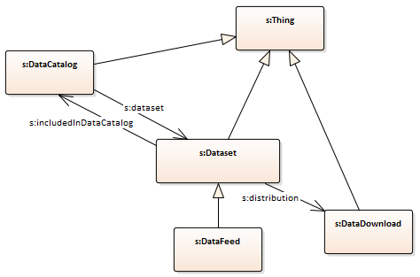
Dataset catalog – schema.org

Slide 15
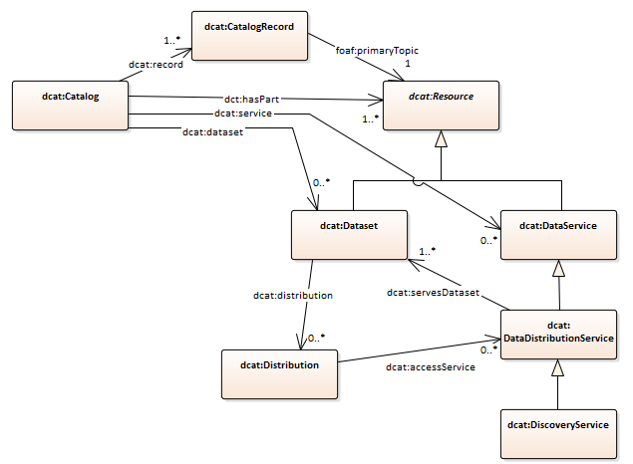

W3C Dataset catalog vocabulary - DCAT

Slide 16

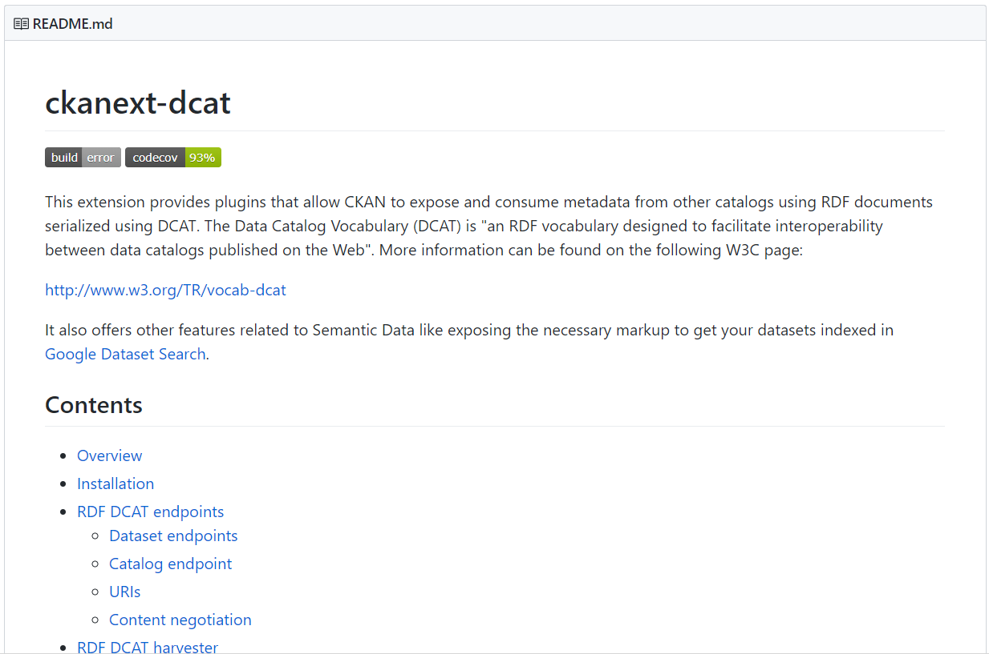
CKAN ♥ DCAT

