Slide 1

Statistics for the Social Sciences
Psychology 340
Fall 2006
Analysis of Variance (ANOVA)

Slide 2
Outline (for week)
Basics of ANOVA
Why
Computations
ANOVA in SPSS
Post-hoc and planned comparisons
Assumptions
The structural model in ANOVA

Slide 3
Outline (for week)
Basics of ANOVA
Why
Computations
ANOVA in SPSS
Post-hoc and planned comparisons
Assumptions
The structural model in ANOVA

Slide 4
Example
Effect of knowledge of prior behavior on jury decisions
  Dependent variable: rate how innocent/guilty
  Independent variable: 3 levels
    Criminal record
    Clean record
    No information (no mention of a record)

Slide 5
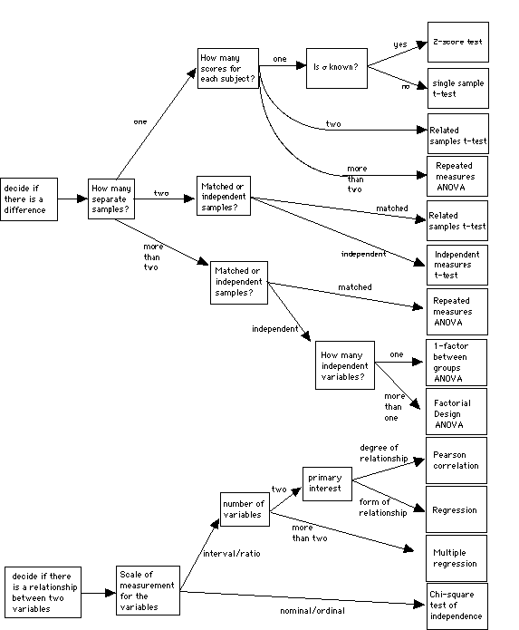
Statistical analysis follows design
The 1 factor between groups ANOVA:
  More than two
  Independent & One score per subject
  1 independent variable

Slide 6
Analysis of Variance
Generic test statistic
X_{B}
X_{C}
X_{A}
Criminal record | Clean record | No information
10 | 5 | 4
7 | 1 | 6
5 | 3 | 9
10 | 7 | 3
8 | 4 | 3
More than two groups
  Now we can’t just compute a simple difference score since there are more than one difference

Slide 7
Analysis of Variance
Test statistic
Observed variance
F-ratio =
Variance from chance
X_{B}
X_{C}
X_{A}
Criminal record | Clean record | No information
10 | 5 | 4
7 | 1 | 6
5 | 3 | 9
10 | 7 | 3
8 | 4 | 3
More than two groups
  Need a measure that describes several difference scores
  Variance
    Variance is essentially an average squared difference

Slide 8
Testing Hypotheses with ANOVA
Hypothesis testing: a five step program
  Step 1: State your hypotheses
    Null hypothesis (H₀)
      All of the populations all have same mean
    Alternative hypotheses (H_{A})
      Not all of the populations all have same mean
      There are several alternative hypotheses
      We will return to this issue later

Slide 9
Testing Hypotheses with ANOVA
Hypothesis testing: a five step program
  Step 1: State your hypotheses
  Step 2: Set your decision criteria
  Step 3: Collect your data
  Step 4: Compute your test statistics
    Compute your estimated variances
    Compute your F-ratio
    Compute your degrees of freedom (there are several)
  Step 5: Make a decision about your null hypothesis
  Additional tests
    Reconciling our multiple alternative hypotheses

Slide 10
Step 4: Computing the F-ratio
Analyzing the sources of variance
  Describe the total variance in the dependent measure
Why are these scores different?
Two sources of variability
  Within groups
  Between groups
X_{B}
X_{C}
X_{A}

Slide 11
Step 4: Computing the F-ratio
Within-groups estimate of the population variance
  Estimating population variance from variation from within each sample
    Not affected by whether the null hypothesis is true
Different people
within each group
give different ratings
X_{B}
X_{C}
X_{A}

Slide 12
Step 4: Computing the F-ratio
Between-groups estimate of the population variance
  Estimating population variance from variation between the means of the samples
    Is affected by the null hypothesis is true
There is an effect
of the IV, so the
people in different
groups give different
ratings
X_{B}
X_{C}
X_{A}

Slide 13
Partitioning the variance
Note: we will start
with SS, but will
get to variance
Total variance
Stage 1
Between groups
variance
Within groups
variance

Slide 14
Partitioning the variance
Total variance
Criminal record | Clean record | No information
10 | 5 | 4
7 | 1 | 6
5 | 3 | 9
10 | 7 | 3
8 | 4 | 3
Basically forgetting about separate groups
  Compute the Grand Mean (GM)
  Compute squared deviations from the Grand Mean

Slide 15
Partitioning the variance
Total variance
Stage 1
Between groups
variance
Within groups
variance

Slide 16
Partitioning the variance
Within groups variance
Criminal record | Clean record | No information
10 | 5 | 4
7 | 1 | 6
5 | 3 | 9
10 | 7 | 3
8 | 4 | 3
Basically the variability in each group
  Add up of the SS from all of the groups

Slide 17
Partitioning the variance
Total variance
Stage 1
Within groups
variance
Between groups
variance

Slide 18
Partitioning the variance
Between groups variance
Criminal record | Clean record | No information
10 | 5 | 4
7 | 1 | 6
5 | 3 | 9
10 | 7 | 3
8 | 4 | 3
Basically how much each group differs from the Grand Mean
  Subtract the GM from each group mean
  Square the diffs
  Weight by number of scores

Slide 19
Partitioning the variance
Total variance
Stage 1
Between groups
variance
Within groups
variance

Slide 20
Partitioning the variance
Now we return to
variance. But, we
call it
Means Square (MS)
Total variance
Recall:
Stage 1
Between groups
variance
Within groups
variance

Slide 21
Partitioning the variance
Mean Squares (Variance)
Between groups
variance
Within groups
variance

Slide 22
Step 4: Computing the F-ratio
The F ratio
  Ratio of the between-groups to the within-groups population variance estimate
Observed variance
F-ratio =
Variance from chance
The F distribution
The F table
Do we reject or fail
to reject the H₀?

Slide 23
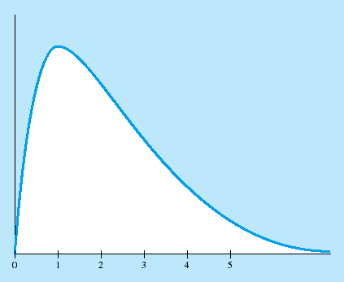
Carrying out an ANOVA
The F distribution
The F table
  Need two df’s
    df_{between} (numerator)
    df_{within} (denominator)
  Values in the table correspond to critical F’s
    Reject the H₀ if your computed value is greater than or equal to the critical F
  Separate tables for 0.05 & 0.01

Slide 24
Carrying out an ANOVA
The F table
  Need two df’s
    df_{between} (numerator)
    df_{within} (denominator)
  Values in the table correspond to critical F’s
    Reject the H₀ if your computed value is greater than or equal to the critical F
  Separate tables for 0.05 & 0.01
Do we reject or fail
to reject the H₀?
  From the table (assuming 0.05) with 2 and 12 degrees of freedom the critical F = 3.89.
  So we reject H₀ and conclude that not all groups are the same

Slide 25
Summary of Example ANOVA
Criminal record | Clean record | No information
10 | 5 | 4
7 | 1 | 6
5 | 3 | 9
10 | 7 | 3
8 | 4 | 3
F_{crit}(2,12) = 3.89, so we reject H₀

Slide 26
Next time
Basics of ANOVA
Why
Computations
ANOVA in SPSS
Post-hoc and planned comparisons
Assumptions
The structural model in ANOVA

Slide 27
Assumptions in ANOVA
Populations follow a normal curve
Populations have equal variances

Slide 28
Planned Comparisons
Reject null hypothesis
  Population means are not all the same
Planned comparisons
  Within-groups population variance estimate
  Between-groups population variance estimate
    Use the two means of interest
  Figure F in usual way

Slide 29
1 factor ANOVA
X_{A}
X_{B}
X_{C}
Null hypothesis:
  H₀: all the groups are equal
The ANOVA tests this one!!
X_{A} = X_{B} = X_{C}
Alternative hypotheses
  H_{A}: not all the groups are equal
X_{A} ≠ X_{B} ≠ X_{C}
X_{A} ≠ X_{B} = X_{C}
X_{A} = X_{B} ≠ X_{C}
X_{A} = X_{C} ≠ X_{B}

Slide 30
1 factor ANOVA
Planned contrasts and post-hoc tests:
  - Further tests used to rule out the different Alternative hypotheses
X_{A} ≠ X_{B} ≠ X_{C}
Test 1: A ≠ B
X_{A} = X_{B} ≠ X_{C}
Test 2: A ≠ C
X_{A} ≠ X_{B} = X_{C}
Test 3: B = C
X_{A} = X_{C} ≠ X_{B}

Slide 31
Planned Comparisons
Simple comparisons
Complex comparisons
Bonferroni procedure
  Use more stringent significance level for each comparison

Slide 32
Controversies and Limitations
Omnibus test versus planned comparisons
  Conduct specific planned comparisons to examine
    Theoretical questions
    Practical questions
  Controversial approach

Slide 33
ANOVA in Research Articles
F(3, 67) = 5.81, p < .01
Means given in a table or in the text
Follow-up analyses
  Planned comparisons
    Using t tests

Slide 34
1 factor ANOVA
Reporting your results
  The observed difference
  Kind of test
  Computed F-ratio
  Degrees of freedom for the test
  The “p-value” of the test
  Any post-hoc or planned comparison results
“The mean score of Group A was 12, Group B was 25, and Group C was 27. A 1-way ANOVA was conducted and the results yielded a significant difference, F(2,25) = 5.67, p < 0.05. Post hoc tests revealed that the differences between groups A and B and A and C were statistically reliable (respectively t(1) = 5.67, p < 0.05 & t(1) = 6.02, p <0.05). Groups B and C did not differ significantly from one another”

Slide 35
The structural model and ANOVA
The structural model is all about deviations
Score
(X)
Group mean
(M)
Grand mean
(GM)
Score’s deviation
from group mean
(X-M)
Group’s mean’s
deviation from
grand mean
(M-GM)
Score’s deviation from grand mean
(X-GM)

